Slide 1
Internet of things (IoT)
Dr. Naushin Nower
Professor, IIT DU

Slide 2
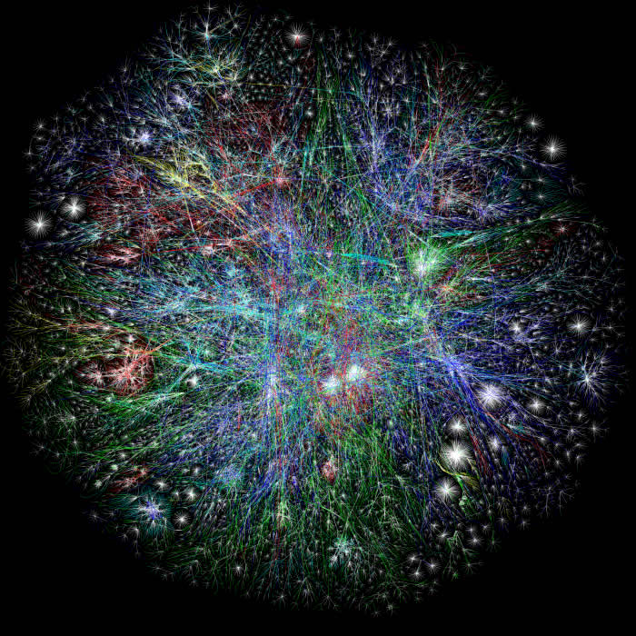

Starting from the Internet
Internet appears everywhere in the world
but it is still a connection between people and people

Slide 3
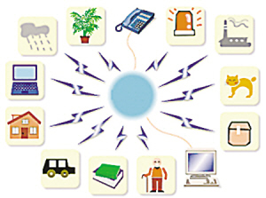
What is the Internet of Things?
Internet connects all people, so it is called “the Internet of People”
IoT connects all things, so it is called “the Internet of Things”

Slide 4
What’s the Internet of Things
Definition
(1) The Internet of Things, also called The Internet of
Objects, refers to a wireless network between objects,
usually the network will be wireless and self-configuring,
such as household appliances.
------Wikipedia
(2) By embedding short-range mobile transceivers into a wide array of additional gadgets and everyday items,
enabling new forms of communication between people
and things, and between things themselves.
------WSIS 2005

Slide 5
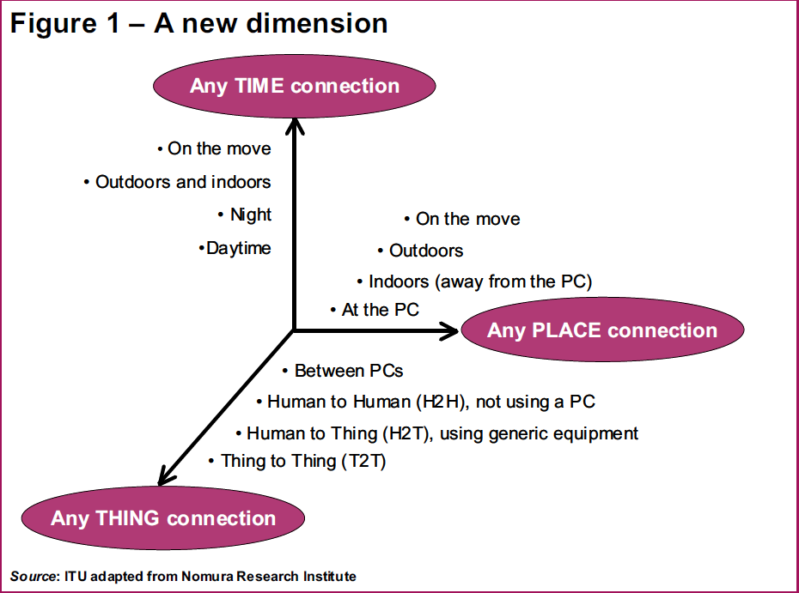
Welcome to our NEW DIMENSION

Slide 6
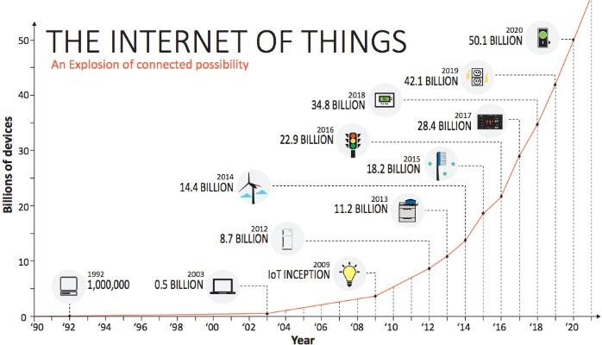
Notes:
No of end devices that are connected to internet are expected to rise above 50+ billion by 2020.
cloud computing architectures won’t be able to handle the demand of the Internet of things
So only cloud is not the optimal solution to handle this massive explosion.
Fog is needed in between to optimize – need for an interplay of cloud and fog.

Slide 7
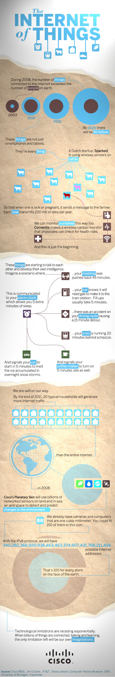
Will it affect your life?

Slide 8








Cyber-Physical Systems (CPS)
CPS are an integration of computation with physical processes. Embedded computers and networks monitor and control the physical processes, usually with feedback loops where physical processes affect computations and vice versa
Health
care
Smart grid
Aerospace
system
Smart
Transportation
CPS
Applications
Critical
Infrastructure
…
Smart
homes
Defense
system
Factory
automation
Cyber
(discrete)
Physical
(continuous)
Actuation
Feedback
loop
Sensing

Slide 9
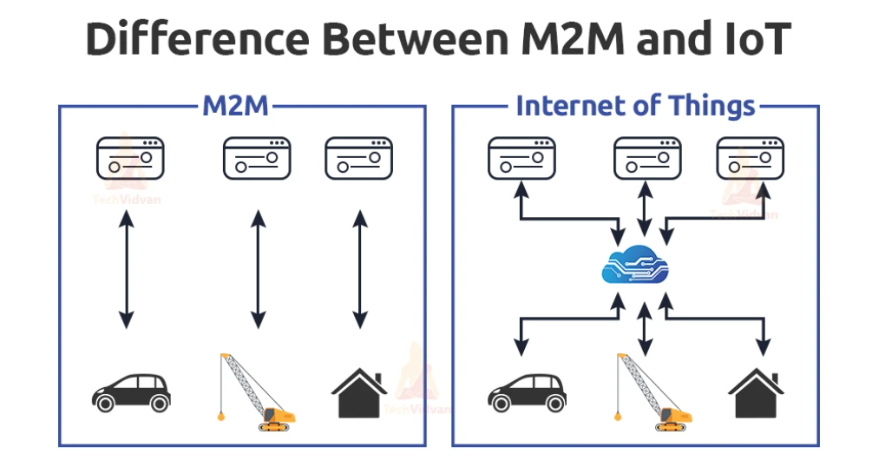
M2M (Machine-to-Machine)
concept where two or more than two machines communicate with each other without human interaction using a wired or wireless mechanism
M2M is an technology that helps the devices to connect between devices without using internet
security, tracking and tracing, manufacturing and facility management.

Slide 10
How IoT Devices Work
The IoT device collects data. That could be a temperature reading, security snapshot, an exact location. To the machine, it’s all data.
The device transmits that data over a network. Any and all network technologies can be used for IoT: WiFi, Bluetooth, satellite, cellular, even hard-wired ethernet connections
Data arrives at a storage center. An IoT data warehouse may be on a server miles away from the device, in the cloud. Or the system may centralize data on a nearby device. We call that the edge. Some devices collect, store, and even process data on the edge.

Slide 11
How IoT Devices Work..
Software processes data and may send an instruction to the device. Software in the cloud or at the edge uses data to do something. It might send an instruction to adjust an HVAC setting, for instance. It might turn on or off a light. Maybe it sends a push notification to a human user, as in predictive maintenance scenarios. Or it might simply organize data for the final step in the IoT process.
An IoT platform makes insight available to users. The true strength of IoT is its ability to collect huge data sets. That gives us the business insight we can use to make stronger decisions every time. But to put that information to use, you need an intuitive user interface within a well-designed app.

Slide 12
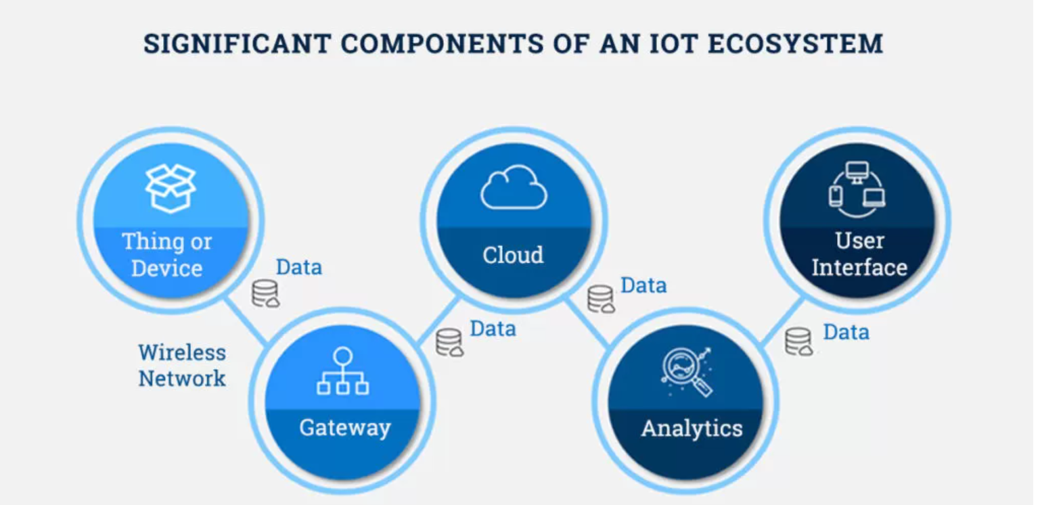
IoT Ecosystem

Slide 13
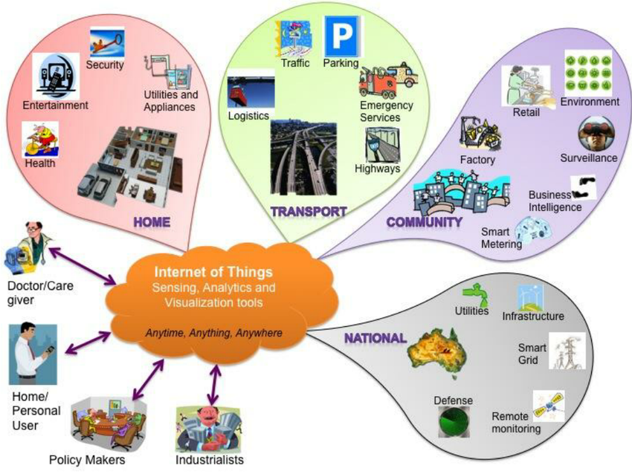

Slide 14
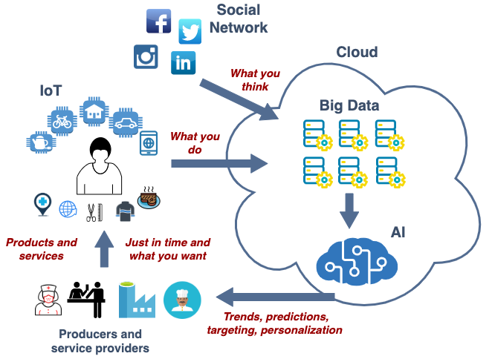
IoT, Big Data and AI

Slide 15
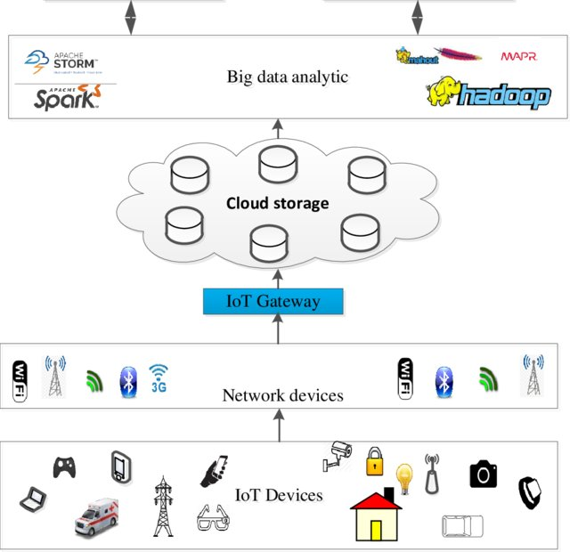
IoT Cloud and Big data

Slide 16
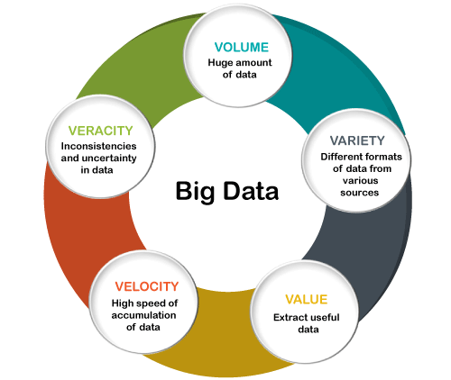
Big data

Slide 18
Why Cloud is not suitable for certain IoT Data Analytics?
Cloud is centralized, federated, consolidated, shared, automated, compartmentalized, and programmable Infrastructure
Latency and Response time is often a critical part, especially when you deal with human life or emergency procedure.
Bandwidth Cost and Capacity is very often underestimated. If you want to use N smart devices requiring each one to communicate M bytes of data then you can quickly reach huge bandwidth requirements reaching Mbit/s or even Gbit/s at a gateway level.
Security and Privacy - transmitting device data over any open and public network is risky
Power consumption - Cloud computing is energy-hungry and that it is a concern for a low-carbon economy.
Data obesity – In a traditional cloud approach, huge amount of untreated data are pumped blindly into the cloud that it is supposed to have magical algorithms written by data scientists. This vision is really not the best efficient and it is much more wise to pre-treat data at a local level and to limit the cloud processes at the strict minimum.
Offline usages versus only-online usages – Pure cloud services do not allow offline usages. It is a major shortcoming since smart cities and industry 4.0 applications require a dual offline/online paradigm.

Slide 19
Why IoT Data Analytics has to be real-time and at Edge?
Volume and Velocity – ingesting, processing and storing such huge amounts of data which is gathered in real-time.
Security – devices can be located in sensitive environments, control vital systems or send private data.
Bandwidth – if devices constantly send the sensor and video data, it will hog the internet and cost a fortune. Therefore edge analytics approaches must be deployed to achieve scale and lower response time.
Real-time Data Capture, Storage, Processing, Analytics, Knowledge Discovery, Decision-making and Actuation
Less Latency and Faster Response
Context-Awareness capability
Combining real-time data with historical state

Slide 20
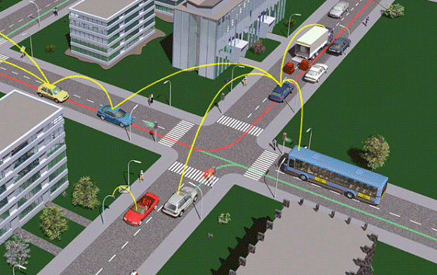
Smart Transportation: ITS
1.0 Introduction
Intelligent Transportation System (ITS) is designed to provide the real-time and reliable delivery of traffic-related information to drivers such as blind spot warnings during lane changing or notification of congestion and rerouting advise that can help to reduce traffic congestion and lost productivity
ITS involves close coupling by:
Vehicle-to-vehicle (V2V) via
wireless network
Vehicles-to-road-side
infrastructure (V2I) via
wireless network
Multiple infrastructure via
wired network
Real-time and reliable information dissemination for V2V and V2I communications are difficult problem

Slide 21
https://www.youtube.com/watch?v=hXC7vCcg2xo
https://www.youtube.com/watch?v=dDUDO3yA2Bs
https://www.youtube.com/watch?v=Ge4rG8ER_CU
https://www.youtube.com/watch?v=Br5aJa6MkBc

