Slide 1
IBM Z DATATHON 2026
Theme: Real-Time AI for Critical Decisions | Detect. Decide. Respond.
MedRelay
Catching the clinical follow-ups that fall through the cracks, as events unfold.
Evidence-aware tracking of follow-up obligations: a local LLM, a temporal evidence graph and calibrated ML, running end to end on IBM LinuxONE.
s390x big-endian
z/VM 7.3
NNPA verified
Granite on-box
Team 4ier
Imdadul Hasan Hamim (Leader) | Dibbo Chowdhury | Md Junaid Ahmmad | Siam Ahamed | Al Shahriar Alif
github.com/hamim-87/MedRelay
Prototype on synthetic data. Alerts are decision support for qualified human review.
Notes:
MedRelay finds clinical follow-up obligations in notes, tracks them against real evidence of completion, and warns early about the ones likely to be missed. It matches the 'Real-Time AI for Critical Decisions' theme: streaming events in, risk and alerts out. Everything was built and executed on an IBM LinuxONE VM.

Slide 2
THE PROBLEM
Follow-ups fall through the cracks, and “no record” is not “failed”
1
Hidden in free text
2
Chained and fragile
3
Documentation lags reality
“Repeat the CBC in 48 hours. The physician must review the result. Arrange a visit in 2 weeks.” Obligations live in notes, not in structured fields.
A result must be reviewed before the patient is told. One missed step silently blocks every task after it.
Tasks get done but are recorded late, or never. Tools that read “no record” as “failed” bury staff in false alarms.
MEASURED IN OUR SIMULATED TEST REPLAY
WHO IS AFFECTED
716 / 716
0 / 716
Patients awaiting results, referrals and repeat tests
Clinicians and care coordinators drowning in alerts they cannot trust
Patient-safety teams who need an audit trail, not a guess
done-but-undocumented tasks flagged overdue by a naive “no record = failed” rule
confirmed overdue by MedRelay (flagged unverified instead)
Why it matters: a missed result or referral can delay diagnosis, and a flood of false alarms makes real ones easier to miss. Outcomes above are simulated from explicit event timelines; no real patient data was used for follow-up outcomes.
MedRelay | IBM Z Datathon 2026 | synthetic data only, decision support for qualified human review
2 / 10
Notes:
Three facts make follow-up tracking hard: obligations are in free text, they depend on each other, and documentation lags behind what actually happened. Naive tools treat 'no record' as 'failed'. In our injected test, 716 of 716 tasks that were done but undocumented were flagged overdue by the naive rule; MedRelay confirmed none and flagged them as unverified. Simulated data.

Slide 3
OUR SOLUTION
A live, evidence-checked tracker for every follow-up
STEP 1 | EXTRACT
STEP 2 | TRACK
STEP 3 | WARN
Notes become structured obligations
Events become verified states
Forecasts become explained alerts
A local LLM plus rules propose tasks, deadlines, roles and dependencies. Every field must cite its source text, or it is rejected.
A temporal evidence graph links tasks, dependencies and events. Deterministic rules decide: pending, completed, overdue, unverified, contradictory.
Calibrated ML predicts which tasks will miss their deadline. Alerts say why, state their uncertainty, and go to a human.
WHAT MAKES IT DIFFERENT
The LLM never sets a state
No evidence is not failure
Dependency and time aware
It only proposes; rules decide.
Unverified and censored tasks stay visible, never “failed”.
A blocked review is flagged before the deadline.
Benefit for users: earlier warnings (median lead 72 h in our test), fewer false alarms, a full audit trail for every state change, and notes that never leave the server.
MedRelay | IBM Z Datathon 2026 | synthetic data only, decision support for qualified human review
3 / 10
Notes:
Extract, track, warn. The point judges should remember: the LLM only proposes evidence-grounded records; deterministic rules decide the state; absence of evidence is 'unverified', never 'failed'.

Slide 4
SYSTEM ARCHITECTURE
Everything runs inside one LinuxONE VM
IBM LinuxONE VM | s390x | z/VM 7.3 | 2 vCPU
INPUTS
OUTPUTS
Clinical notes
Extractor
Evidence graph
Risk model
Alert engine
Alert feed
synthetic discharge and visit notes
rules + Granite 4.0 350M (llama.cpp, VXE); Pydantic validator
tasks, dependencies, events; state rules R1 to R7
49 features, random forest, calibrated probability
grounded text, stated uncertainty, priority
for human review
clinical_extractor
evidence_graph
risk_predictor
alert_engine
Event stream
Event processor
SQLite (WAL)
Priority score
Audit trail
Notebook demo
results, acknowledgements, visits; late, duplicate, out-of-order
idempotent, event vs ingest time, timers, micro-batches
events, transitions, alerts; rebuild from log
risk x urgency x unresolved dependencies
every state change with rule and evidence
live storyboard
event_processor
LLM output is validated and grounded; it never sets a state.
Every box is code in the repository (src/) and was executed on the VM: clean-kernel run of the notebook, 56 code cells, 0 errors.
MedRelay | IBM Z Datathon 2026 | synthetic data only, decision support for qualified human review
4 / 10
Notes:
Left to right: notes and the event stream enter the LinuxONE VM. The extractor proposes validated obligations; the event processor ingests events idempotently and keeps SQLite as the record of truth. The evidence graph derives states with deterministic rules; the risk model forecasts failure probability; the alert engine produces grounded text. Priority combines risk, urgency and unresolved dependencies.

Slide 5
DATASET & MACHINE LEARNING
Leakage-safe by construction, honest about labels
3,284
24,296
34,441
10,002
110,521
patients
follow-up obligations
source events
action examples (weak labels)
real appointments (no-show)
Sources: Synthea, synthetic_hospital, MTS-Dialog, ACI-Bench (all synthetic or simulated) + Kaggle appointment no-shows (real, de-identified). Follow-up outcomes are simulated from event timelines.
DATA PIPELINE
Canonical tables
Scenario simulator
Event stream
Evidence graph
patients, encounters, notes, source events; SHA-256 checked
event-level timelines with documented gaps, late and missing evidence
late, duplicate and out-of-order deliveries; outcomes kept in a hidden file
103,627 nodes, 223,925 edges; dependency graph is acyclic
ML PIPELINE
49 features, 6 groups
Dense snapshots
Random forest + calibration
Validation thresholds
task, own events, workload, graph dependency, graph temporal, evidence; strict event-time cutoff
8 assessment points per task, only while the task is still open
4 model families compared on validation; split by patient; calibrated probabilities
alert threshold fixed on validation; applied once to test
No leakage
No tuning on test
Strong baselines
features see only events ingested before the assessment time
thresholds and hyper-parameters chosen on validation only
deadline-only rule, independent-task ML, patient-grouped bootstrap CIs
0 human-reviewed gold labels | outcomes simulated
Scores describe the simulator, not clinical accuracy. Real validation needs clinician-reviewed labels.
MedRelay | IBM Z Datathon 2026 | synthetic data only, decision support for qualified human review
5 / 10
Notes:
The data are synthetic or simulated, plus one real de-identified no-show dataset used as a secondary proof of concept. Key engineering decisions: strict event-time cutoffs, dense snapshot training, thresholds chosen on validation only, and patient-grouped bootstrap intervals. We state clearly that there are no human-reviewed gold labels.

Slide 6
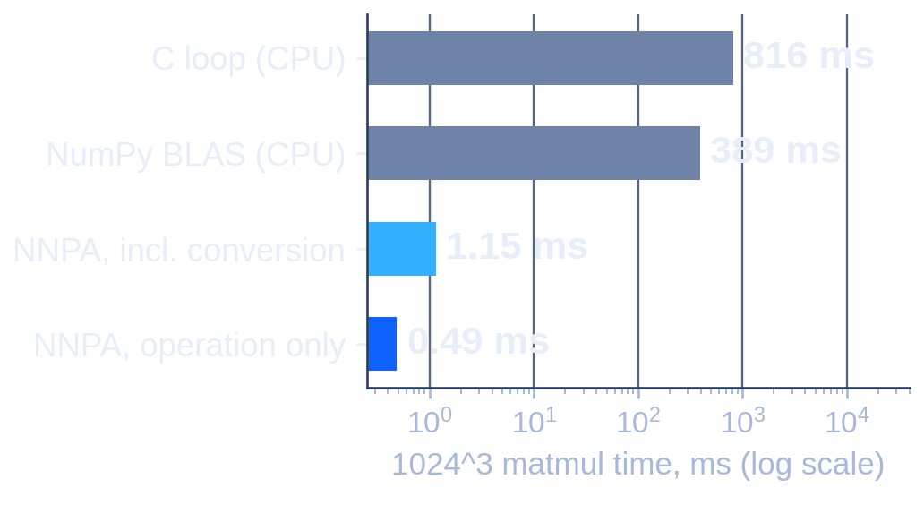
WHY IBM Z / LINUXONE
The whole stack, executed on s390x
VERIFIED ON THE VM
NNPA DEVICE TEST (zDNN 1.0.1)
Platform
s390x, big-endian, z/VM 7.3.0
Resources
2 vCPU, 4.2 GB RAM (about 2.6 GB usable)
CPU facilities
vector (VXE2) and NNPA (facility 165)
Engine memory
peak 753 MB at 100,000 events (ML run)
LLM runtime
llama.cpp (VXE) + big-endian Granite 4.0 GGUF
Local inference
granite-4.0-350m-Q8_0, 15.0 tokens/s
339x faster than NumPy BLAS on this VM incl. data conversion; max error 0.045 on values up to 13.2 (16-bit arithmetic).
20.6 k
88 to 122
2.8 s
39% / 67%
events/s
events/s
p99 queue latency
events shed
graph + state engine (12.4 k at 100,000 events)
states + alerts + ML risk (random forest), 1,000 to 100,000 events
at 2x measured capacity, backpressure, 0 events lost
bounded queue at 2x / 4x measured capacity
What we do not claim: the tree and linear risk models run on the CPU, not on the NNPA; only the zDNN microbenchmark proves NNPA execution. Throughput was measured on a small 2 vCPU VM; ML scoring speed depends on the model chosen on validation. No security, cost or availability claims are made.
Why LinuxONE fits: notes are processed by a local model on the same server that holds the data, and the event engine needs sustained, low-latency streaming.
MedRelay | IBM Z Datathon 2026 | synthetic data only, decision support for qualified human review
6 / 10
Notes:
What was actually run on LinuxONE: the full pipeline on an s390x big-endian VM under z/VM, a native Python environment, llama.cpp compiled for the z vector facility, Granite GGUF models converted to big-endian, and a direct zDNN matrix-multiply test on the NNPA. We are explicit that tree models do not use NNPA. Throughput numbers come from a 2 vCPU VM and varied between runs.

Slide 7
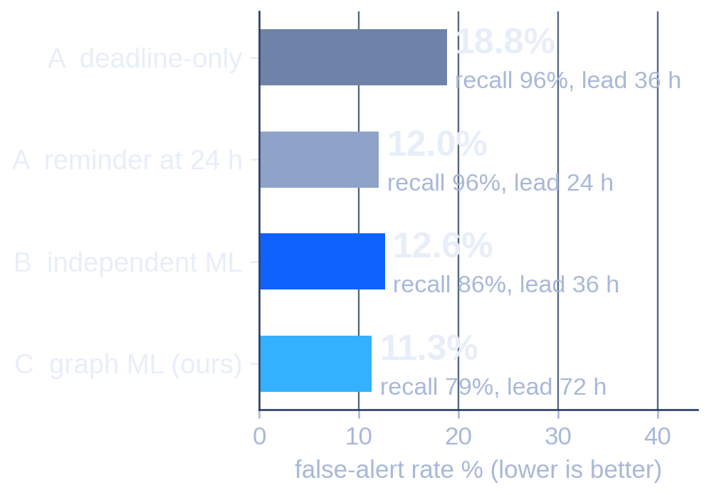
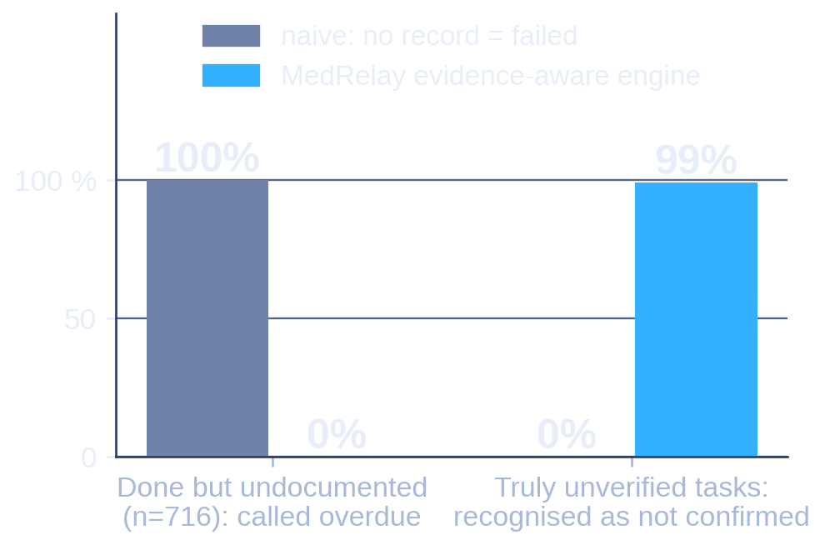
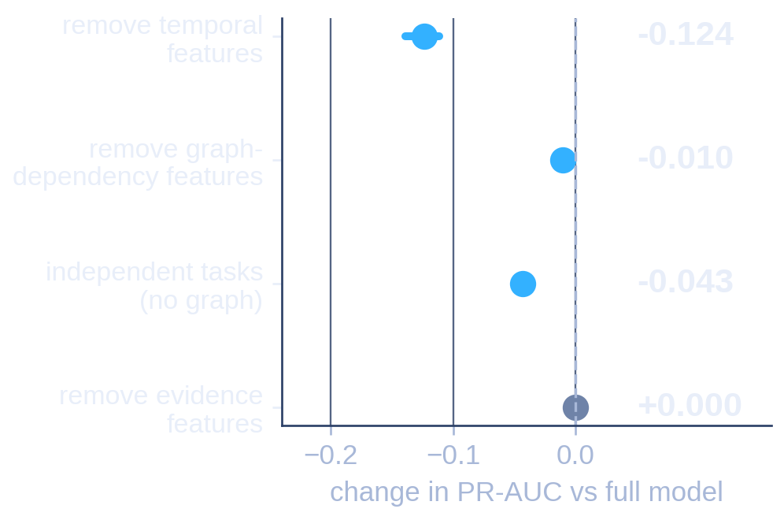
EXPERIMENTS & RESULTS
Fewer false alarms, earlier warnings, honest limits
EARLY WARNING, >= 24 h BEFORE DEADLINE
EVIDENCE-AWARE STATES vs NAIVE RULE
WHAT DRIVES THE FORECAST
Graph model C: 1,916 alerts, 82% precision, 72 h median lead. A 24 h reminder is similar on false alerts (12.0%) with only 24 h lead; deadline-only A reaches 96% recall but alerts on 2,469 of 3,967 tasks.
State accuracy at the assessment time 0.911 vs 0.853; 1.000 once late evidence reconciles. The naive rule never recognises an unverified task.
Temporal features carry most of the signal (-0.124 PR-AUC when removed). Graph features add a smaller, significant gain (+0.043 over independent tasks). Evidence features add nothing measurable.
0.893
PR-AUC, graph model
0.358
PR-AUC, real no-show data
+0.043
graph vs independent ML
0.67
failures surfaced, rules + LLM
95% CI 0.882 to 0.904; simulated outcomes
vs 0.203 base rate; secondary proof of concept
dense-test PR-AUC, 95% CI +0.039 to +0.049; at alert level not significant (-0.001)
vs 0.57 rules only; 67 failures, 120 episodes
Full-mode run on the VM (4 h 11 min): 812 test patients, 4,605 test obligations, simulated outcomes, patient-grouped bootstrap (300 resamples), thresholds chosen on validation. Over the whole window the deadline-only rule matches the ML models (max-score PR-AUC 0.963 vs 0.964); the graph model's edge is earlier: PR-AUC 0.74 vs 0.58 at 72 h ahead.
MedRelay | IBM Z Datathon 2026 | synthetic data only, decision support for qualified human review
7 / 10
Notes:
Only measured results. The strongest finding is behavioural: the evidence-aware engine does not call undocumented work failed, and the graph model warns earlier (72 h median lead) with fewer false alerts than a deadline-only rule. We also show where we are not better: a simple 24-hour reminder matches the graph model on false alerts and has higher recall, and over the whole window a deadline-only rule matches the ML models. The graph model's advantage is lead time and early-window ranking.

Slide 8
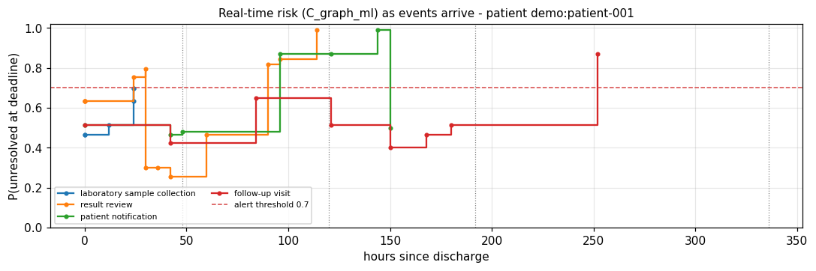
LIVE PROTOTYPE
A delayed acknowledgement, handled correctly
1 INPUT NOTE
3 AUDIT TRAIL OF THE RESULT-REVIEW TASK (VERBATIM FROM THE EXECUTED NOTEBOOK)
Patient discharged after pneumonia admission. Repeat the CBC within 48 hours. The treating physician must review the result. Contact the patient if the result is abnormal. Arrange a follow-up appointment in 2 weeks.
Mar 04 09:00
pending
R4 task created
Mar 09 09:00
censored_not_yet_assessable
R6 deadline passed, awaiting late evidence
Mar 09 10:00
overdue_without_verified_completion
R5 tracker confirms task still open
Mar 10 15:00
completed_with_evidence
R1 delayed acknowledgement arrives
2 EXTRACTED OBLIGATIONS (RULES + GRANITE 350M)
ob0
laboratory_test
4 RISK OF EACH TASK AS EVENTS ARRIVE (GRAPH ML, REAL OUTPUT)
due PT48H
ob1
followup_review
role: ordering_clinician; after ob0
ob2
patient_communication
if the result is abnormal; after ob1
ob3
appointment_referral
due P2W; after ob1
Interim “overdue” was a correct state at that time and was reconciled when the late evidence arrived (verified in the notebook: overdue_without_verified_completion to completed_with_evidence). Output of notebook section 17, executed on the LinuxONE VM; the scenario events are scripted.
MedRelay | IBM Z Datathon 2026 | synthetic data only, decision support for qualified human review
8 / 10
Notes:
Walk through the story: a discharge note produces four obligations. The review task passes its deadline, so it first becomes 'censored', then 'overdue' once the tracker confirms it is still open. When the delayed acknowledgement is documented, the engine reconciles the state to completed, with the evidence id in the audit trail. Real output of the executed notebook; the events are scripted.

Slide 9
INNOVATION, IMPACT & SCALABILITY
What is proven, and what comes next
MEASURED (FULL-MODE RUN ON LINUXONE)
ANTICIPATED (NOT YET MEASURED)
0 of 716
undocumented-but-done tasks confirmed overdue (naive rule: all)
Deployment
discharge follow-up monitoring fed by EHR event streams, with a human review queue
4,895
duplicate deliveries ignored; final states identical to a clean run (100%)
Scale-out
larger LinuxONE partitions for more patients; NNPA for neural components (current models are tree and linear)
1.000
stored states restored identically when rebuilt from the SQLite event log
Validation
de-identified real records and clinician-reviewed labels (there are 0 gold labels today)
11.3% vs 18.8%
false-alert rate, graph model vs deadline-only rule, alerts >= 24 h ahead
Privacy
on-premises inference keeps notes on the server; a formal security evaluation is future work
56 / 56
notebook code cells executed without error in a clean kernel (4 h 11 min)
vs reminder systems
vs LLM-only pipelines
vs risk scores alone
evidence-aware: absence is unverified, not failed
validated, grounded fields; deterministic states
dependency and time aware, with an audit trail
MedRelay | IBM Z Datathon 2026 | synthetic data only, decision support for qualified human review
9 / 10
Notes:
Left: what we measured. Right: what we only anticipate, clearly separated. The social value is fewer missed follow-ups with fewer false alarms; the honest next step is validation on de-identified real records with clinician-reviewed labels.

Slide 10
CONCLUSION
No follow-up left behind
0 / 716
11.3%
s390x
false failures
false-alert rate
end to end
Evidence-aware states never call undocumented work “failed”; the naive rule did, every time.
Graph forecasting warns 72 h ahead with fewer false alerts than a deadline-only rule (18.8%).
Local Granite LLM, streaming engine and ML, plus a verified NNPA device test, all on one LinuxONE VM.
WHY LINUXONE MATTERS HERE
NEXT STEPS
Sensitive notes are processed by a local model on the server that holds the data.
The same VM runs extraction, graph, ML and the stream engine, with recoverable state.
NNPA execution is verified, a path for future neural models.
Clinician-reviewed labels to replace weak and simulated ones.
Validate on de-identified real records under governance.
Add neural components that can use the NNPA, and test at larger scale.
Detect. Decide. Respond. And never mistake silence for failure.
Code and notebook: github.com/hamim-87/MedRelay
Team 4ier: Imdadul Hasan Hamim (Leader), Dibbo Chowdhury, Md Junaid Ahmmad, Siam Ahamed, Al Shahriar Alif
Prototype on synthetic data. Alerts are decision support for qualified human review.
MedRelay | IBM Z Datathon 2026 | synthetic data only, decision support for qualified human review
10 / 10
Notes:
Three achievements: no false failures from missing documentation, earlier warnings with fewer false alerts, and an end-to-end system on LinuxONE. Close on the limits: synthetic data, weak labels, simulated outcomes. The repository has the notebook, tests and instructions to reproduce everything.

