Slide 1
Chapter 22: Distributed Databases

Slide 2
Chapter 22: Distributed Databases
Heterogeneous and Homogeneous Databases
Distributed Data Storage
Distributed Transactions
Commit Protocols
Concurrency Control in Distributed Databases
Availability
Distributed Query Processing
Heterogeneous Distributed Databases
Directory Systems

Slide 3
Distributed Database System
A distributed database system consists of loosely coupled sites that share no physical component
Database systems that run on each site are independent of each other
Transactions may access data at one or more sites

Slide 4
Homogeneous Distributed Databases
In a homogeneous distributed database
  All sites have identical software
  Are aware of each other and agree to cooperate in processing user requests.
  Each site surrenders part of its autonomy in terms of right to change schemas or software
  Appears to user as a single system
In a heterogeneous distributed database
  Different sites may use different schemas and software
    Difference in schema is a major problem for query processing
    Difference in software is a major problem for transaction processing
  Sites may not be aware of each other and may provide only
  limited facilities for cooperation in transaction processing

Slide 5
Data Replication
A relation or fragment of a relation is replicated if it is stored redundantly in two or more sites.
Full replication of a relation is the case where the relation is stored at all sites.
Fully redundant databases are those in which every site contains a copy of the entire database.

Slide 6
Data Replication (Cont.)
Advantages of Replication
  Availability: failure of site containing relation r does not result in unavailability of r is replicas exist.
  Parallelism: queries on r may be processed by several nodes in parallel.
  Reduced data transfer: relation r is available locally at each site containing a replica of r.
Disadvantages of Replication
  Increased cost of updates: each replica of relation r must be updated.
  Increased complexity of concurrency control: concurrent updates to distinct replicas may lead to inconsistent data unless special concurrency control mechanisms are implemented.
    One solution: choose one copy as primary copy and apply concurrency control operations on primary copy

Slide 7
Data Fragmentation
Division of relation r into fragments r₁, r₂, …, r_{n} which contain sufficient information to reconstruct relation r.
Horizontal fragmentation: each tuple of r is assigned to one or more fragments
Vertical fragmentation: the schema for relation r is split into several smaller schemas
  All schemas must contain a common candidate key (or superkey) to ensure lossless join property.
  A special attribute, the tuple-id attribute may be added to each schema to serve as a candidate key.
Example : relation account with following schema
Account = (account_number, branch_name , balance )

Slide 8
Horizontal Fragmentation of account Relation
account_number
branch_name
balance
A-305
A-226
A-155
Hillside
Hillside
Hillside
500
336
62
account₁ = σ_{branch_name=“Hillside”} (account )
account_number
branch_name
balance
A-177
A-402
A-408
A-639
Valleyview
Valleyview
Valleyview
Valleyview
205
10000
1123
750
account₂ = σ_{branch_name=“Valleyview”} (account )

Slide 9
Vertical Fragmentation of employee_info Relation
branch_name
customer_name
tuple_id
Hillside
Hillside
Valleyview
Valleyview
Hillside
Valleyview
Valleyview
Lowman
Camp
Camp
Kahn
Kahn
Kahn
Green
1
2
3
4
5
6
7
deposit₁ = Πbranch_name, customer_name, tuple_id (employee_info )
account_number
balance
tuple_id
A-305
A-226
A-177
A-402
A-155
A-408
A-639
500
336
205
10000
62
1123
750
1
2
3
4
5
6
7
deposit₂ = Πaccount_number, balance, tuple_id (employee_info )

Slide 10
Advantages of Fragmentation
Horizontal:
  allows parallel processing on fragments of a relation
  allows a relation to be split so that tuples are located where they are most frequently accessed
Vertical:
  allows tuples to be split so that each part of the tuple is stored where it is most frequently accessed
  tuple-id attribute allows efficient joining of vertical fragments
Vertical and horizontal fragmentation can be mixed.
  Fragments may be successively fragmented to an arbitrary depth.
Replication and fragmentation can be combined
  Relation is partitioned into several fragments: system maintains several identical replicas of each such fragment.

Slide 11
Data Transparency
Data transparency: Degree to which system user may remain unaware of the details of how and where the data items are stored in a distributed system
Consider transparency issues in relation to:
  Fragmentation transparency
  Replication transparency
  Location transparency
Naming of data items: criteria
  Every data item must have a system-wide unique name.
  It should be possible to find the location of data items efficiently.
  It should be possible to change the location of data items transparently.
  Each site should be able to create new data items autonomously.

Slide 12
Centralized Scheme - Name Server
Structure:
  name server assigns all names
  each site maintains a record of local data items
  sites ask name server to locate non-local data items
Advantages:
  satisfies naming criteria 1-3
Disadvantages:
  does not satisfy naming criterion 4
  name server is a potential performance bottleneck
  name server is a single point of failure

Slide 13
Use of Aliases
Alternative to centralized scheme: each site prefixes its own site identifier to any name that it generates i.e., site 17.account.
  Fulfills having a unique identifier, and avoids problems associated with central control.
  However, fails to achieve network transparency.
Solution: Create a set of aliases for data items; Store the mapping of aliases to the real names at each site.
The user can be unaware of the physical location of a data item, and is unaffected if the data item is moved from one site to another.

Slide 14
Distributed Transactions
Transaction may access data at several sites.
Each site has a local transaction manager responsible for:
  Maintaining a log for recovery purposes
  Participating in coordinating the concurrent execution of the transactions executing at that site.
Each site has a transaction coordinator, which is responsible for:
  Starting the execution of transactions that originate at the site.
  Distributing subtransactions at appropriate sites for execution.
  Coordinating the termination of each transaction that originates at the site, which may result in the transaction being committed at all sites or aborted at all sites.

Slide 15
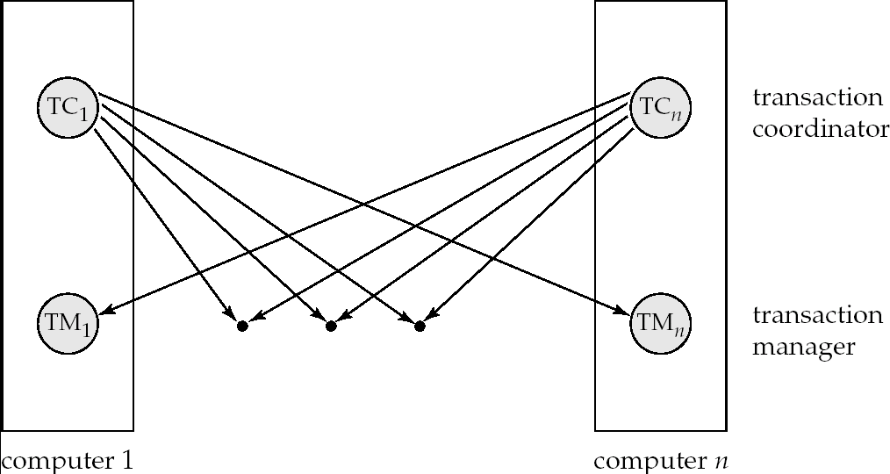
Transaction System Architecture

Slide 16
System Failure Modes
Failures unique to distributed systems:
  Failure of a site.
  Loss of massages
    Handled by network transmission control protocols such as TCP-IP
  Failure of a communication link
    Handled by network protocols, by routing messages via alternative links
  Network partition
    A network is said to be partitioned when it has been split into two or more subsystems that lack any connection between them
      Note: a subsystem may consist of a single node
Network partitioning and site failures are generally indistinguishable.

Slide 17
Commit Protocols
Commit protocols are used to ensure atomicity across sites
  a transaction which executes at multiple sites must either be committed at all the sites, or aborted at all the sites.
  not acceptable to have a transaction committed at one site and aborted at another
The two-phase commit (2PC) protocol is widely used
The three-phase commit (3PC) protocol is more complicated and more expensive, but avoids some drawbacks of two-phase commit protocol. This protocol is not used in practice.

Slide 18
Two Phase Commit Protocol (2PC)
Assumes fail-stop model – failed sites simply stop working, and do not cause any other harm, such as sending incorrect messages to other sites.
Execution of the protocol is initiated by the coordinator after the last step of the transaction has been reached.
The protocol involves all the local sites at which the transaction executed
Let T be a transaction initiated at site S_{i}, and let the transaction coordinator at S_{i} be C_{i}

Slide 19
Phase 1: Obtaining a Decision
Coordinator asks all participants to prepare to commit transaction T_{i}.
  C_{i} adds the records <prepare T> to the log and forces log to stable storage
  sends prepare T messages to all sites at which T executed
Upon receiving message, transaction manager at site determines if it can commit the transaction
  if not, add a record <no T> to the log and send abort T message to C_{i}
  if the transaction can be committed, then:
  add the record <ready T> to the log
  force all records for T to stable storage
  send ready T message to C_{i}

Slide 20
Phase 2: Recording the Decision
T can be committed of C_{i} received a ready T message from all the participating sites: otherwise T must be aborted.
Coordinator adds a decision record, <commit T> or <abort T>, to the log and forces record onto stable storage. Once the record stable storage it is irrevocable (even if failures occur)
Coordinator sends a message to each participant informing it of the decision (commit or abort)
Participants take appropriate action locally.

Slide 21
Handling of Failures - Site Failure
When site S_{i} recovers, it examines its log to determine the fate of
transactions active at the time of the failure.
Log contain <commit T> record: site executes redo (T)
Log contains <abort T> record: site executes undo (T)
Log contains <ready T> record: site must consult C_{i} to determine the fate of T.
  If T committed, redo (T)
  If T aborted, undo (T)
The log contains no control records concerning T
  implies that S_{k} failed before responding to the prepare T message from C_{i}
  S_{k} must execute undo (T)

Slide 22
Handling of Failures- Coordinator Failure
If coordinator fails while the commit protocol for T is executing then participating sites must decide on T’s fate:
  If an active site contains a <commit T> record in its log, then T must be committed.
  If an active site contains an <abort T> record in its log, then T must be aborted.
  If some active participating site does not contain a <ready T> record in its log, then the failed coordinator C_{i} cannot have decided to commit T.
    Can therefore abort T.
  If none of the above cases holds, then all active sites must have a <ready T> record in their logs, but no additional control records (such as <abort T> of <commit T>).
    In this case active sites must wait for C_{i} to recover, to find decision.
Blocking problem: active sites may have to wait for failed coordinator to recover.

Slide 23
Handling of Failures - Network Partition
If the coordinator and all its participants remain in one partition, the failure has no effect on the commit protocol.
If the coordinator and its participants belong to several partitions:
  Sites that are not in the partition containing the coordinator think the coordinator has failed, and execute the protocol to deal with failure of the coordinator.
    No harm results, but sites may still have to wait for decision from coordinator.
The coordinator and the sites are in the same partition as the coordinator think that the sites in the other partition have failed, and follow the usual commit protocol.
    Again, no harm results

Slide 24
Coordinator Selection
Backup coordinators
  site which maintains enough information locally to assume the role of coordinator if the actual coordinator fails
  executes the same algorithms and maintains the same internal state information as the actual coordinator fails executes state information as the actual coordinator
  allows fast recovery from coordinator failure but involves overhead during normal processing.
Election algorithms
  used to elect a new coordinator in case of failures
  Example: Bully Algorithm - applicable to systems where every site can send a message to every other site.

Slide 25
Bully Algorithm
If site S_{i} sends a request that is not answered by the coordinator within a time interval T, assume that the coordinator has failed S_{i} tries to elect itself as the new coordinator.
S_{i} sends an election message to every site with a higher identification number, S_{i} then waits for any of these processes to answer within T.
If no response within T, assume that all sites with number greater than i have failed, S_{i} elects itself the new coordinator.
If answer is received S_{i} begins time interval T’, waiting to receive a message that a site with a higher identification number has been elected.

Slide 26
Bully Algorithm (Cont.)
If no message is sent within T’, assume the site with a higher number has failed; S_{i} restarts the algorithm.
After a failed site recovers, it immediately begins execution of the same algorithm.
If there are no active sites with higher numbers, the recovered site forces all processes with lower numbers to let it become the coordinator site, even if there is a currently active coordinator with a lower number.

Slide 27

Semijoin Strategy
Let r₁ be a relation with schema R₁ stores at site S₁
Let r₂ be a relation with schema R₂ stores at site S₂
Evaluate the expression r₁ r₂ and obtain the result at S₁.
1. Compute temp₁ ← ∏_{R1 ∩ R2} (r1) at S1.
2. Ship temp₁ from S₁ to S₂.
3. Compute temp₂ ← r₂ temp1 at S₂
4. Ship temp₂ from S₂ to S₁.
5. Compute r₁ temp₂ at S₁. This is the same as r₁ r₂.

Slide 28
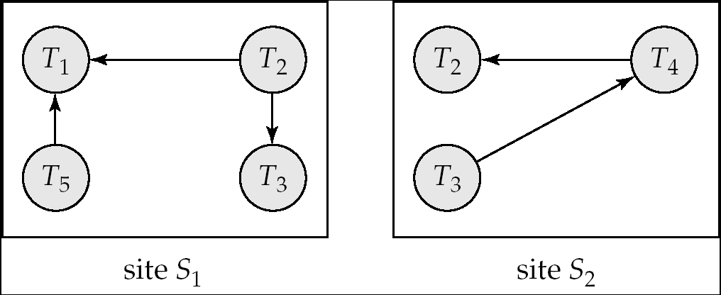
Figure 22.3

Slide 29
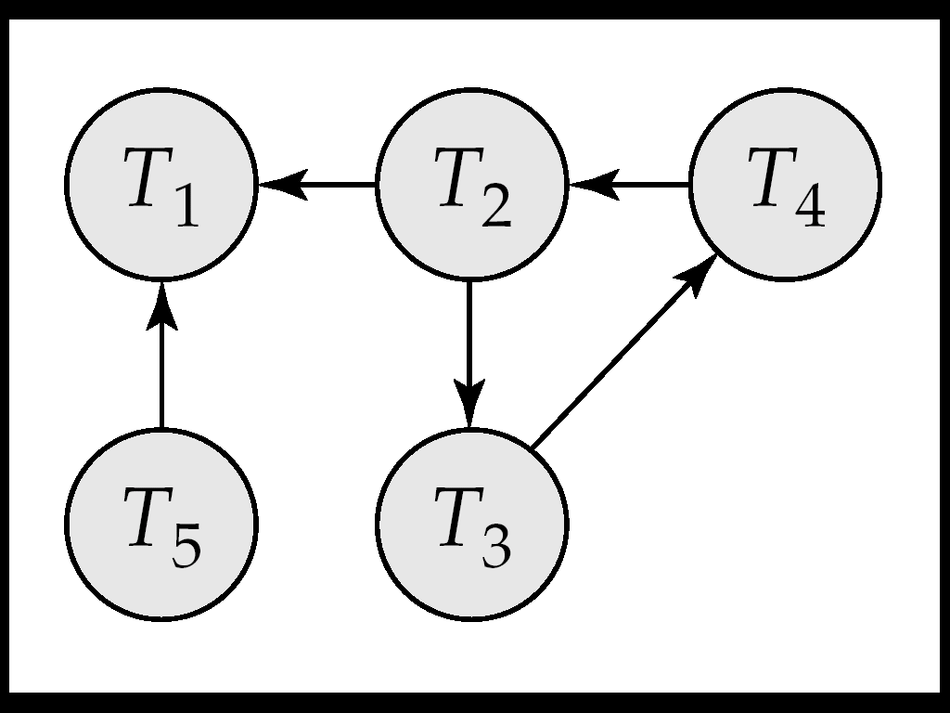
Figure 22.4

Slide 30
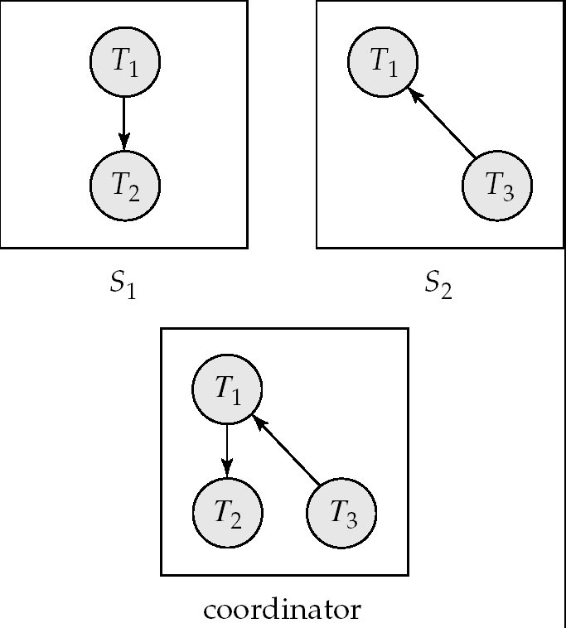
Figure 22.5

Slide 31
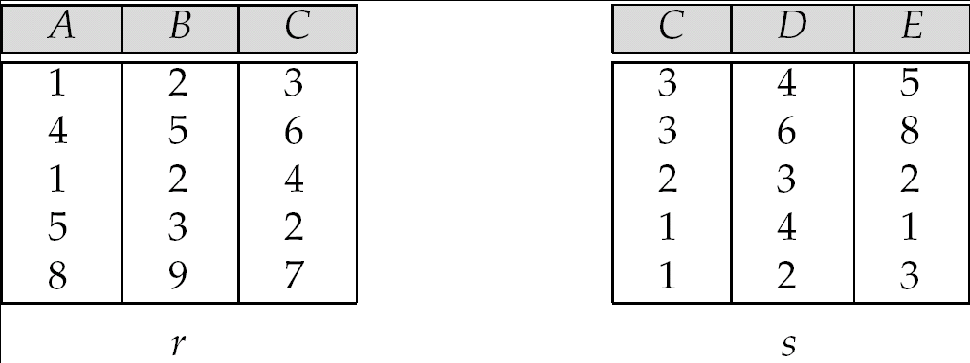
Figure 22.7

