Slide 1
Business Communication

Slide 2
Course Objectives
Understanding the importance of realistic business communication process with real life business scenarios
Adapting writing processes considering different business situations and selecting appropriate words in those scenarios through examples
Helping the students in learning the differences between formal and informal writing techniques by providing samples of formal and informal emails, letters, memos and reports.
The course deals with explanation of why communicating clearly across cultures is important to business though case studies
Helping students constructing their CV and resume through real life samples and preparing them for public speaking

Slide 3
Understanding Workplace Communication

Slide 4
Learning Outcomes
What is communication?
Importance of business communication
Current Challenges
Categories of business communication
Communication networks
The contexts for communication
The process of communication

Slide 5

What Is Communication?
The act of exchanging of information by speaking, writing, or using some other medium
Means of sending or receiving information, such as telephone lines or computers
Two parties are involved- sender and receiver

Slide 6
Communication Is Important to Business
Business Needs Good Communication
Most People DO NOT Communicate Well
Improved Communication=Better Chances for Success

Slide 7
Why Business Depends upon Communication
Business must coordinate the
activities of groups of people
Individual business units send
and receive information about all
aspects of business

Slide 8
Videos on Communication
https://www.youtube.com/watch?v=YQ3qgIMURgI
https://www.youtube.com/watch?v=ixSUBl1WNxk
https://www.youtube.com/watch?v=3FfaPhCKZew
https://www.youtube.com/watch?v=87HsUukEj4Y&index=4&list=PL058A82A702A180CF

Slide 9
Group Discussion
Group Discussion on the importance of communication
Form small groups and identify at least five advantages of effective communication in the context of a business organization

Slide 10

Current Challenges
The IMPACTS of Social Media

Slide 11
Current Challenges (Cont.)
New media are also increasing the needs for employees who have social intelligence
Social Intelligence refers to the ability to quickly assess the emotions of those around them and adapt their words, tone, and gestures accordingly
Globalization has given birth to globally integrated organizations and global social networks
Individuals need to achieve cross-cultural competency

Slide 12
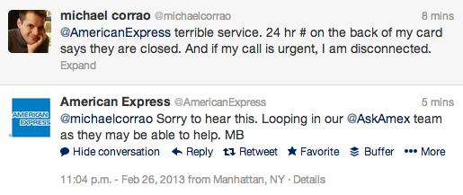
Using Social Intelligence on Social Media: Good Example
Good Example:

Slide 13
Using Social Intelligence on Social Media: Bad Example
British Airways has been under fire quite a bit for its bad customer service, and social media only promotes its problem
A customer named Hassan Syed recently paid to promote a Tweet complaining about British Airways’ customer service after the company lost his father’s suitcase

Slide 14

Here is what Hassan Syed posted on Twitter!

Slide 15
What happens next?
The tweet was seen by 76,000 users
It negatively impacted on the reputation of the organization
To make things worse, British Airways failed to respond to the promoted tweet for eight hours

Slide 16
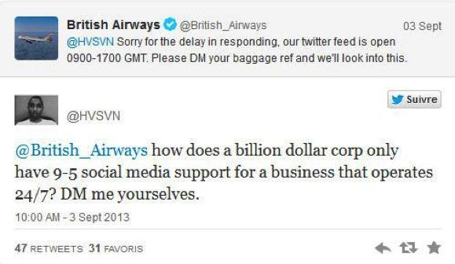
What happens next? (cont.)
Finally, BA replied to the message!

Slide 17
Group Discussion
Did you ever experience lack of social intelligence while communicating on social media?
Discuss with your neighbor and share the experience with others

Slide 18
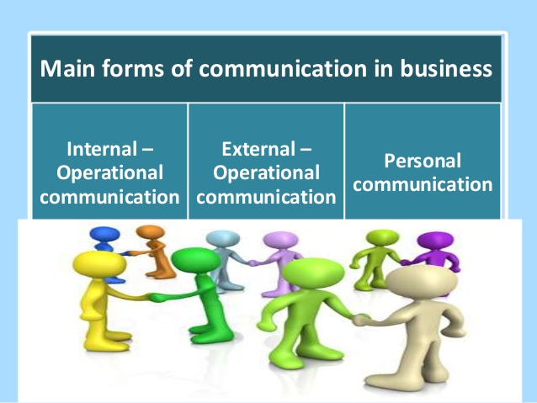
Categories of Business Communication

Slide 19
Three Categories of Business Communication
1. Internal Operational
  Communication Within a Business
    Giving Orders
    Assembling Reports
    Writing Emails

Slide 20
Three Categories of Business Communication
2. External Operational
  Communication Outside Business
    Personal Selling
    Telephoning
    Advertising
    Writing Messages
      Displays a Company’s Etiquette

Slide 21
External Audiences for Businesses
Organization
Customers
Industry Partners
Public Groups
Core Business Partners

Slide 22
Three Categories of Business Communication
3. Personal Communication
  Non-Business-Related Information/Feelings
    Affects Employee Attitude
    Attitude Affects Employee Performance

Slide 23
Group Discussion
Group discussion on the types of communication
What type of communication is most important in the context of a business organization? Give at least 3 reasons to justify your answer.

Slide 24
Communication Networks
Formal Network
Rules of communication and status hierarchy of the employees
communication flow through an organogram
The flow of information includes upward, horizontal and downward movement
Movement of information by reports, e-mail, records within organization

Slide 25
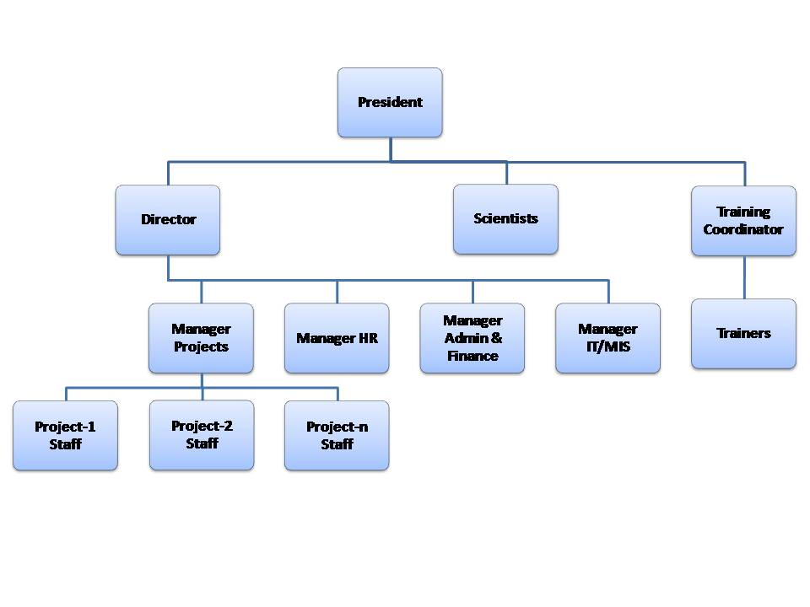
Organogram
http://saves.org.pk/site/images/stories/organogram.jpg

Slide 26
Communication Networks (Cont.)
Informal Network
Highly Complex & Continually Changing
Primarily Consists of Personal Communication
Has No Set Pattern
Links All members in Organization
……Grapevine communication

Slide 27
Communication Context
Organizational Context
-Organizational culture
- Your communication is largely shaped by the organization for whom you speak
Professional Context
-Different people possess different kinds of expertise, speak differently and have different perspectives
Personal Context
Depends on the genes you inherited, your family and upbringing, your schooling, your life experiences and culture
Your current circumstances

Slide 28
The Process of Communication
Sensing a communication need
- Why am I communicating ?
Defining the situation
- Clear sense of the situation
Consider possible communication strategies
- Analyze the contexts and relationship with the audience
Selecting a course of action
- Consider the cost and benefit of each option and choose the most optimum one

Slide 29
The Process of Communication (Cont.)
Composing the message
- Craft your presentation message or plan your conversation or presentation
Sending the message
It’s the time to send your message and you are done!

Slide 30
The Process of Communication (Cont.)
Receiving the message
- Your chosen channel has delivered the message to the intended recipient
Interpreting the message
- Recipient involves interpreting the message once has has received it
Deciding on a response
- If the message has been carefully adapted by to the recipients, it has a good chance of achieving the desired goals
Replying to the message

Slide 31
In class assignment
Think about a recent transaction you had with a business person or with a staff person at an organization or at DU. Describe the process of your communication.
if possible, describe the communication context as well
Form groups and discuss
Once you have done, send your team representative to present

Slide 32
Summary
Importance of Communication to You and to Business
Current Challenges
Three main Forms of Communication
Formal and Informal Networks
Process of Communication

