Slide 1
Class Work

Slide 2
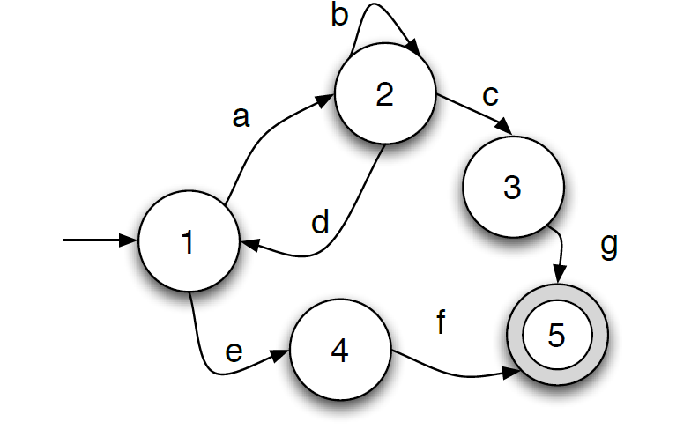
Problem 1
Convert the following NFA to a regular expression

Slide 3
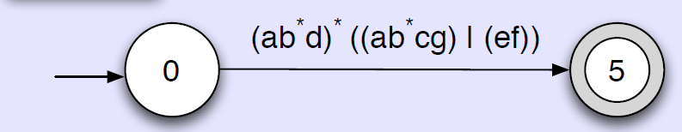

Slide 4
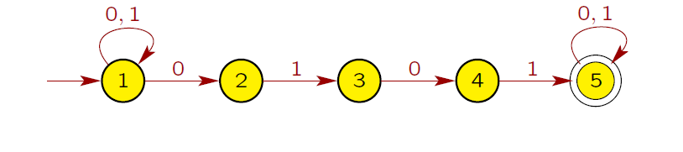
Problem 2
Give NFAs with the specified number of states recognizing each of the following languages. In all cases, the alphabet is = {0, 1}.
The language {w ∈ ∗ | w contains the substring 0101, i.e., w = x0101y for some x, y ∈ ∗ } with five states.

Slide 5
Problem 3
For the following regular expressions, write down three strings in the language generated by the expression, and give a short English description of the language. Assume P = {0, 1}.
(a) 0*10*10*10*
(Ans) 111, 0111, 01011, 010101; any string that has at least three 1’s.

Slide 6
Problem 4
For each of the following problems construct a deterministic finite automaton which describes or recognizes the language given. The underlying alphabet is P = {0, 1}. Be sure to give DFAs and not NFAs.
{ w | w has an even number of 1’s. }
{ w | w has an even number of 0’s and odd number of 1’s. }
{ w | w does not contain the substring 110. }
{ w | w has exactly one occurrence of the substring 010. }

Slide 7
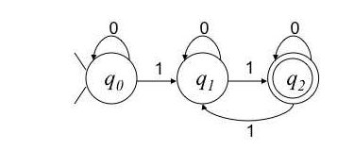
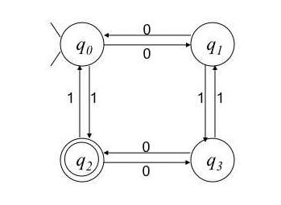
a)
B)

Slide 8
