Slide 1
Theory of Computing
SE-2112
Lecture-3
Dr. Naushin Nower

Slide 2
Regular expressions
Finite automata are machine-like descriptions of languages
Alternative: declarative description
Regular expressions are an algebraic way to describe languages.
They describe exactly the regular languages.
Notation to specify a language
  Capable of describing the same thing as a NFA
    The two are actually equivalent, so RE = NFA = DFA
  We can define an algebra for regular expressions
  Specifying a language using expressions and operations
  Example: 01* + 10* defines the language containing strings such as 01111, 100, 0, 1000000; * and + are operators in this “algebra”

Slide 3
Regular expressions..
Regular expressions denote language.
Given that R₁ and R₂ are regular expressions, regular expressions are built from the following operations
  Union: R₁+R₂
  Concatenation: R₁R₂
  Kleene Star Closure: R₁*
  Parentheses (to enforce precedence): (R₁)
Nothing else is a regular expression unless it is built from the above rules

Slide 4
0
c
a
b
1
1
(0+1)1

Slide 5
1
c
1
2
0

Slide 6
1
3
2

Slide 7
R₁₁⁰= (ep +1)
R₁₂⁰= 0
R₂₁⁰= phi ¹⁺¹ ⁼ ¹
⁰⁺⁰⁼⁰
^{0+1*0 =1*0}
R₂₂⁰ = (0+ 1 +ep)
R₁₁¹ = R₁₁⁰+ R₁₁⁰(R₁₁⁰)* R₁₁⁰
=(ep+1) + (ep+1) (ep+1)* (ep+1)

Slide 8
(01)*+ (10) *+ 1(01) *+ 0(10) *
^{01 , 010101, 0101,……}
^{10, 1010……}
¹⁰¹
⁰¹⁰

Slide 9
Examples
1 + ε
(ab)* + (ba)*
(0+1+2+3+4+5+6+7+8+9)*(0+5)
(x+y)*x(x+y)*
(01)*
0(1*)
01* equivalent to 0(1*)

Slide 10
RE’s: Definition
Basis 1: If a is any symbol, then a is a RE, and L(a) = {a}.
  Note: {a} is the language containing one string, and that string is of length 1.
Basis 2: ε is a RE, and L(ε) = {ε}.
Basis 3: ∅ is a RE, and L(∅) = ∅.

Slide 11
RE’s: Definition – (2)
Induction 1: If E₁ and E₂ are regular expressions, then E₁+E₂ is a regular expression, and L(E₁+E₂) = L(E₁)∪L(E₂).
Induction 2: If E₁ and E₂ are regular expressions, then E₁E₂ is a regular expression, and L(E₁E₂) = L(E₁)L(E₂).
Concatenation : the set of strings wx such that w
Is in L(E₁) and x is in L(E₂).

Slide 12
RE’s: Definition – (3)
Induction 3: If E is a RE, then E* is a RE, and L(E*) = (L(E))*.
Closure, or “Kleene closure” = set of strings
w₁w₂…w_{n}, for some n > 0, where each w_{i} is
in L(E).
Note: when n=0, the string is ε.

Slide 13
Precedence of Operators
Parentheses may be used wherever needed to influence the grouping of operators.
Order of precedence is * (highest), then concatenation, then + (lowest).

Slide 14
From DFA to RE
Ԑ-NFA
NFA
RE
DFA

Slide 15
Equivalence of FA and RE
Finite Automata and Regular Expressions are equivalent. To show this:
  Show we can express a DFA as an equivalent RE
  Show we can express a RE as an ε-NFA. Since the ε-NFA can be converted to a DFA and the DFA to an NFA, then RE will be equivalent to all the automata we have described.

Slide 16
DFA to Regular Expression
Theorem: If L=L(A) for some DFA A, then there is a regular expression R such that L=L(R).
Build the regular expression “bottom up” starting with simpler strings that are acceptable using a subset of states in the DFA
Define R^{k}_{i,j} as the expression for strings that have an admissible state sequence from state i to state j with no intermediate states greater than k
  Assume no states are numbered 0, but k can be 0

Slide 17
R⁰_{i,j}
Observe that R⁰_{i,j} describes strings of length 1 or 0, particularly:
  {a₁, a₂, a₃, … }, where, for each a_{x}, δ(i,a_{x}) = j
  Add ε to the set if i = j
The 0 in R⁰_{i,j} means no intermediate states are allowed, so either no transition is made (just stay in state i to accept ε if i = j) or make a single transition from state i to state j
These are the base cases in our construction

Slide 18
R^{k}_{i,j}
Recursive step: for each k, we can build R^{k}_{i,j} as follows:
R^{k}_{i,j} = R^{k-1}_{i,j} + R^{k-1}_{i,k} (R^{k-1}_{k,k})* R^{k-1}_{k,j}
Intuition: since the accepting sequence contains one or more visits to state k, break the path into pieces that
  first goes from i to its first k-visit (R^{k-1}_{i,k})
  followed by zero or more revisits to k (R^{k-1}_{k,k})
  followed by a path from k to j (R^{k-1}_{k,j} )

Slide 19
And finally…
We get the regular expression(s) that represent all strings with admissible sequences that start with the initial state (state 1) and end with a final state
Resulting regular expression built from the DFA: the union of all R^{n}_{1,f} where f is a final state
  Note: n is the number of states in the DFA meaning there are no more restrictions for intermediate states in the accepting sequence

Slide 20
DFA to RE: State Elimination
Eliminates states of the automaton and replaces the edges with regular expressions that includes the behavior of the eliminated states.
Eventually we get down to the situation with just a start and final node, and this is easy to express as a RE

Slide 21
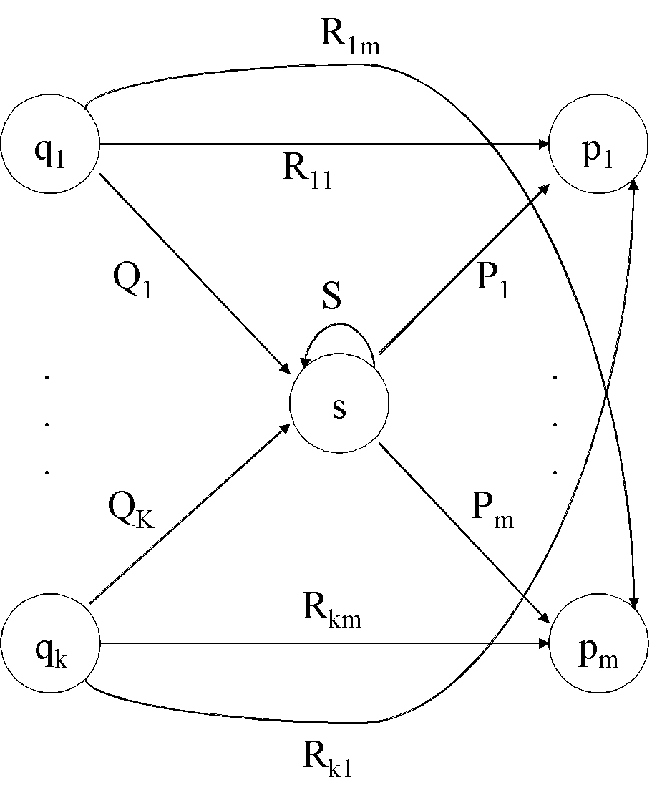
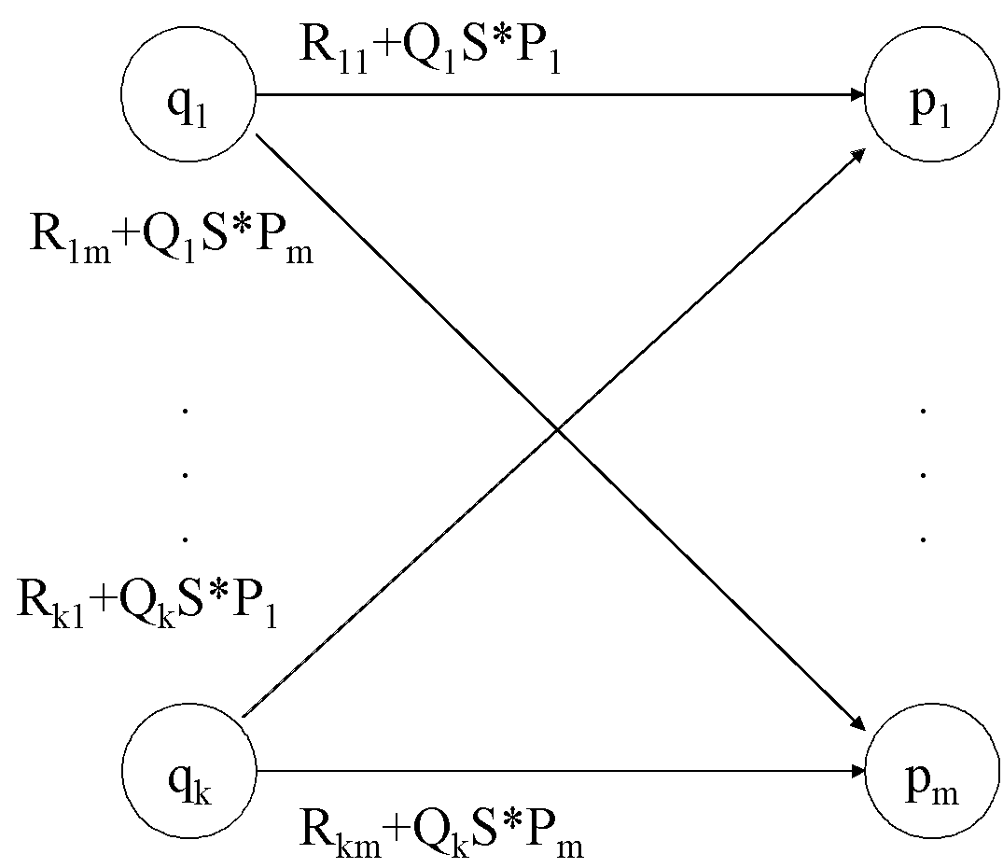
State Elimination
Consider the figure below, which shows a generic state S about to be eliminated. The labels on all edges are regular expressions.
To remove S we must make labels from each q_{i} to p₁ up to p_{m} that include the paths we could have made through S.
Note: q and p may be the same state!

Slide 22
DFA to RE via State Elimination (1)
Starting with intermediate states and then moving to accepting states, apply the state elimination process to produce an equivalent automaton with regular expression labels on the edges.
  The result will be a one or two state automaton with a start state and accepting state.

Slide 23
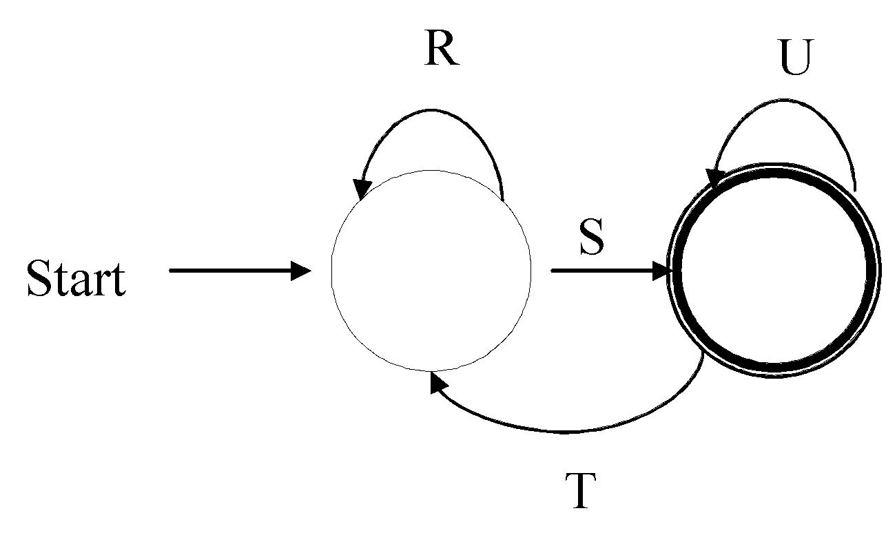
DFA to RE State Elimination (2)
If the two states are different, we will have an automaton that looks like the following:
We can describe this automaton as: (R+SU*T)*SU*

Slide 24
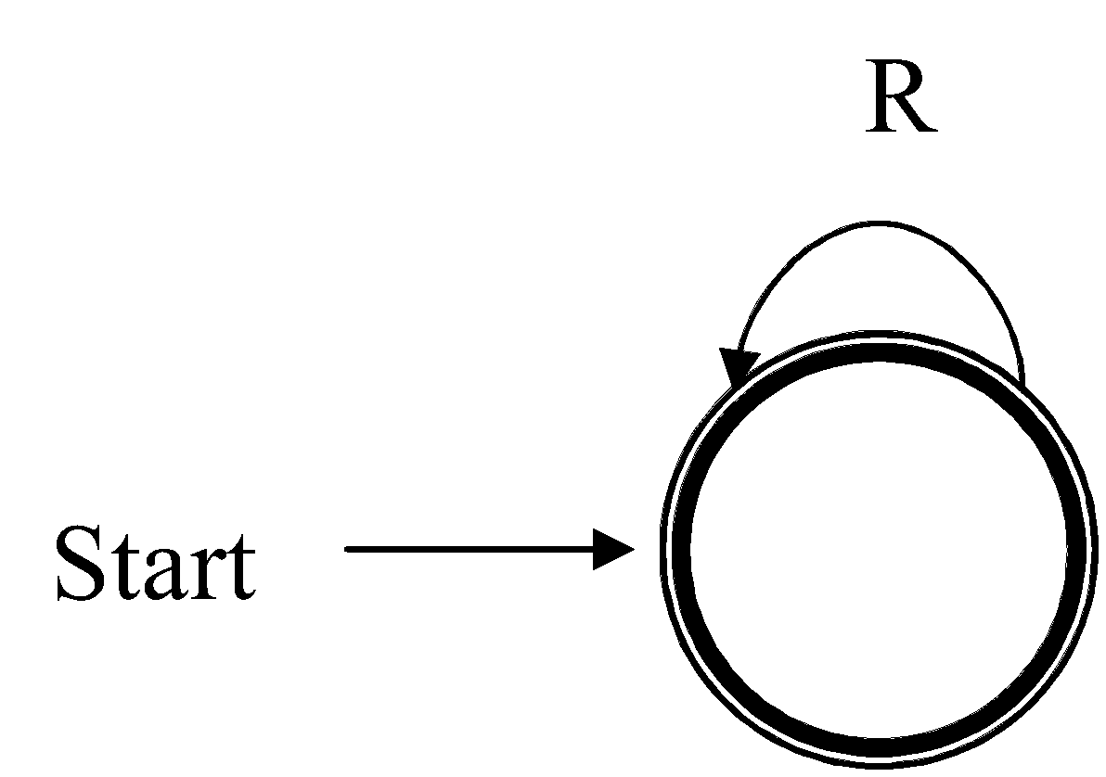
DFA to RE State Elimination (3)
If the start state is also an accepting state, then we must also perform a state elimination from the original automaton that gets rid of every state but the start state. This leaves the following:
We can describe this automaton as simply R*.

Slide 25
DFA to RE State Elimination (4)
If there are n accepting states, we must repeat the above steps for each accepting states to get n different regular expressions, R₁, R₂, … R_{n}. For each repeat we turn any other accepting state to non-accepting. The desired regular expression for the automaton is then the union of each of the n regular expressions: R₁∪ R₂… ∪ R_{N}

Slide 26
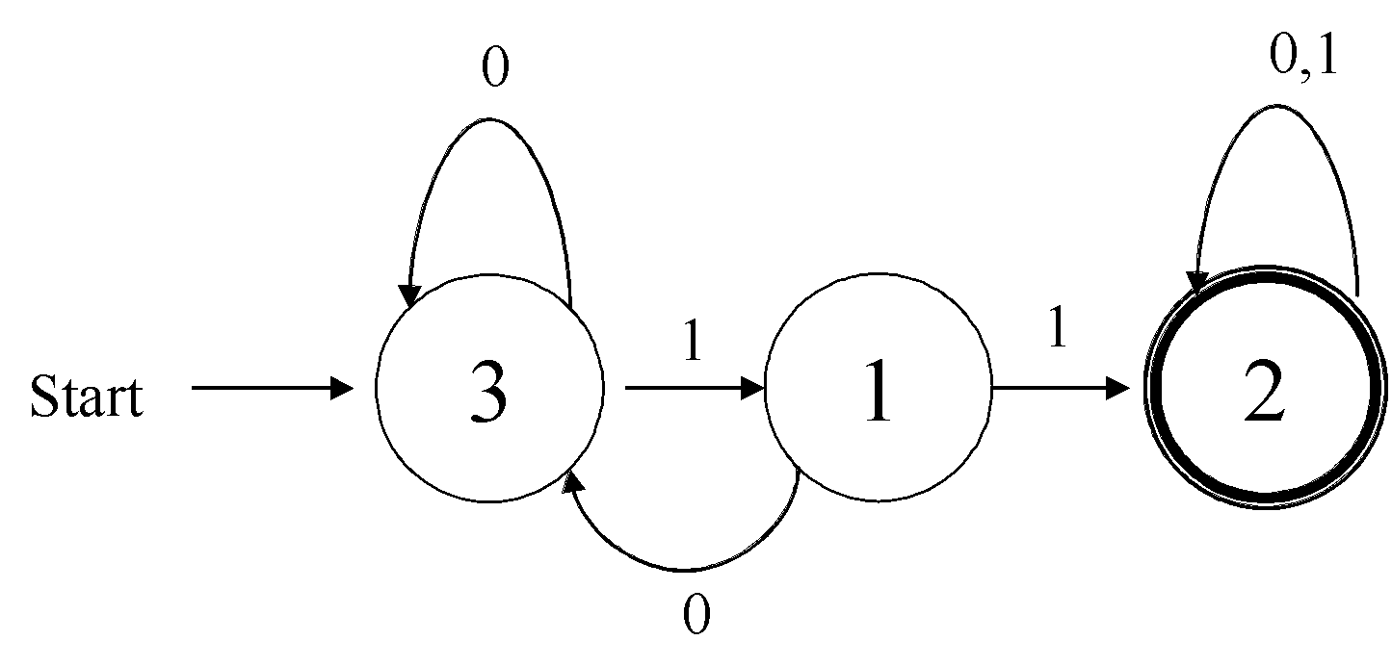
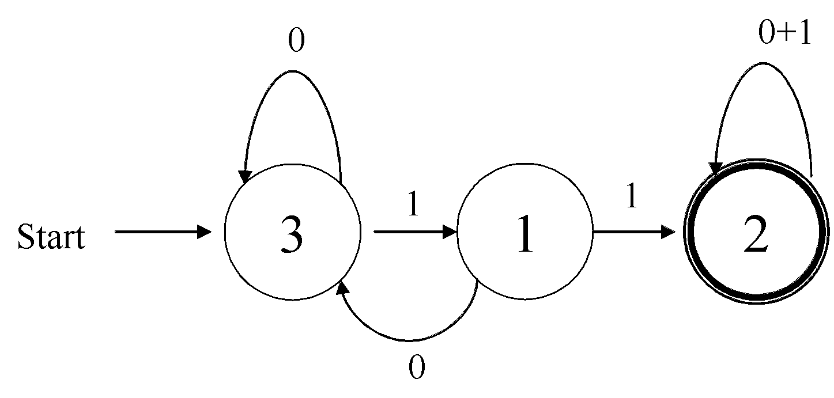
DFA🡪RE Example
Convert the following to a RE
First convert the edges to RE’s:

Slide 27
DFA 🡪 RE Example (2)
Eliminate State 1:
To:
0
0+1
3
1
1
1
2
Start
0
0+10
0+1
Note edge from 3🡪3
3
11
2
Start
Answer: (0+10)*11(0+1)*

Slide 28
Second Example
Automata that accepts even number of 1’s
Eliminate state 2:
0
0
0
1
1
2
1
3
Start
1
0
0+10*1
1
10*1
3
Start

Slide 29
Second Example (2)
0
0+10*1
1
10*1
3
Start
Two accepting states, turn off state 3 first
0
0+10*1
1
10*1
3
Start
This is just 0*; can ignore going to state 3 since we would “die”

Slide 30
Second Example (3)
0
0+10*1
1
10*1
3
Start
Turn off state 1 second:
0
0+10*1
1
10*1
3
This is just 0*10*1(0+10*1)*
Combine from previous slide to get 0* + 0*10*1(0+10*1)*
Start

Slide 31
Converting a RE to an Automata
We have shown we can convert an automata to a RE. To show equivalence we must also go the other direction, convert a RE to an automaton.
We can do this easiest by converting a RE to an ε-NFA
  Inductive construction
  Start with a simple basis, use that to build more complex parts of the NFA

Slide 32
RE to ε-NFA
Basis:
R=a
a
R=ε
ε
R=Ø
Next slide: More complex RE’s

Slide 33
S
ε
ε
R=S+T
ε
T
ε
S
ε
T
R=ST
ε
ε
S
ε
R=S*
ε

Slide 34
RE to ε-NFA Example
Convert R= (ab+a)* to an NFA
  We proceed in stages, starting from simple elements and working our way up
a
a
b
b
a
ε
b
ab

Slide 35
RE to ε-NFA Example (2)
ab+a
a
ε
b
ε
ε
ε
a
ε
ε
(ab+a)*
a
ε
b
ε
ε
ε
ε
ε
a
ε
ε

Slide 36
What have we shown?
Regular expressions and finite state automata are really two different ways of expressing the same thing.
In some cases you may find it easier to start with one and move to the other
  E.g., the language of an even number of one’s is typically easier to design as a NFA or DFA and then convert it to a RE

Slide 37
Algebraic Laws for RE’s
Just like we have an algebra for arithmetic, we also have an algebra for regular expressions.
  While there are some similarities to arithmetic algebra, it is a bit different with regular expressions.

Slide 38
Algebra for RE’s
Commutative law for union:
  L + M = M + L
Associative law for union:
  (L + M) + N = L + (M + N)
Associative law for concatenation:
  (LM)N = L(MN)
Note that there is no commutative law for concatenation, i.e. LM ≠ ML

Slide 39
Algebra for RE’s (2)
The identity for union is:
  L + Ø = Ø + L = L
The identity for concatenation is:
  Lε = εL = L
The annihilator for concatenation is:
  ØL = LØ = Ø
Left distributive law:
  L(M + N) = LM + LN
Right distributive law:
  (M + N)L = LM + LN
Idempotent law:
  L + L = L

Slide 40
Laws Involving Closure
(L*)* = L*
  i.e. closing an already closed expression does not change the language
Ø* = ε
ε* = ε
L⁺ = LL* = L*L
  more of a definition than a law
L* = L⁺ + ε
L? = ε + L
  more of a definition than a law

Slide 41
Checking a Law
Suppose we are told that the law
  (R + S)* = (R*S*)*
holds for regular expressions. How would we check that this claim is true?
1. Convert the RE’s to DFA’s and minimize the DFA’s to see if they are equivalent (we’ll cover minimization later)
2. We can use the “concretization” test:
  Think of R and S as if they were single symbols, rather than placeholders for languages, i.e., R = {0} and S = {1}.
  Test whether the law holds under the concrete symbols. If so, then this is a true law, and if not then the law is false.

Slide 42
Concretization Test
For our example
  (R + S)* = (R*S*)*
We can substitute 0 for R and 1 for S.
The left side is clearly any sequence of 0's and 1's. The right side also denotes any string of 0's and 1's, since 0 and 1 are each in L(0*1*).

Slide 43
Concretization Test
NOTE: extensions of the test beyond regular expressions may fail.
Consider the “law” L ∩ M ∩ N = L ∩ M.
This is clearly false
  Let L=M={a} and N=Ø. {a} ≠ Ø.
  But if L={a} and M = {b} and N={c} then
  L∩M does equal L ∩ M ∩ N which is empty.
  The test would say this law is true, but it is not because we are applying the test beyond regular expressions.
We’ll see soon various languages that do not have corresponding regular expressions.

Slide 44
Thank you ☺

