Slide 1
Theory of Computing
SE-312
Dr. Naushin Nower

Slide 2
Problem -1
Suppose we are told that the law
  (R + S)* = (R*S*)*
holds for regular expressions. How would we check that this claim is true?
Convert the RE’s to DFA’s and minimize the DFA’s to see if they are equivalent.
We can substitute 0 for R and 1 for S.
The left side is clearly any sequence of 0's and 1's. The right side also denotes any string of 0's and 1's, since 0 and 1 are each in L(0*1*).

Slide 3
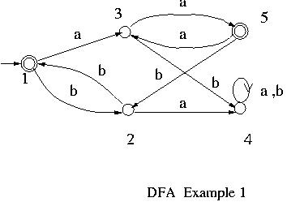
Problem-2
Let us try to minimize the number of states of the following DFA.

Slide 4
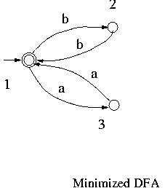
Solution -2

Slide 5
Thank you ☺

