Slide 1
The Problem of Sorting (Book: Chapter-2)
Input: sequence ⟨a₁, a₂, …, a_{n}⟩ of numbers.
Output: permutation ⟨a'₁, a'₂, …, a'_{n}⟩ such
that a'₁ ≤ a'₂ ≤ … ≤ a'_{n} .
Example:
Input: 8 2 4 9 3 6
Output: 2 3 4 6 8 9
Notes:
Reference: chapter 2 of Cormen

Slide 2
Insertion Sort Pseudocode
A[0] unused, valid elements: A[1] … A[n]
Algorithm Name with parameters (like a C function-header)
Comment
Equivalent CPP function
void insertionSort (int A[], int n)
{ //here A[0 . . n] is an int array
int i, j;
for (j = 2; j<=n; j++) {
key = A[ j];
i = j – 1;
while(i > 0 && A[i] > key){
A[i+1] = A[i];
i = i – 1;
}//while
A[i+1] = key;
}//for
}
INSERTION-SORT (A, n) ⊳ A[1 . . n]
for j ← 2 to n
do ⊳ Insert A[ j ] into the sorted subarray A[1..j -1]
⊳ in such a position that A[1..j] becomes sorted
key ← A[ j]
i ← j – 1
while i > 0 and A[i] > key
do A[i+1] ← A[i]
i ← i – 1
A[i+1] ← key
Algorithm body
For loop body
While
Loop
body
Indentation/spacing determines where
the algorithm/loop/if/else-body ends

Slide 3
Insertion Sort Simulation
i | j
1 | 2 | 3 | 4 | 5
7 | 4 | 9 | 5 | 1
INSERTION-SORT (A, n) ⊳ A[1 . . n]
for j ← 2 to n
do ⊳ Insert A[ j ] into the sorted subarray A[1..j -1]
⊳ in such a position that A[1..j] becomes sorted
key ← A[ j]
i ← j – 1
while i > 0 and A[i] > key
do A[i+1] ← A[i]
i ← i – 1
A[i+1] ← key
key
4
 | i | j
1 | 2 | 3 | 4 | 5
4 | 7 | 9 | 5 | 1
key
9
 |  | i | j
1 | 2 | 3 | 4 | 5
4 | 7 | 9 | 5 | 1
key
5
 |  |  | i | j
1 | 2 | 3 | 4 | 5
4 | 5 | 7 | 9 | 1
Loop Invariant: At the beginning of each iteration of the for loop, A[1..j-1] is already sorted
key
1
See Cormen Book (pp. 18-19) for the proof
1 | 2 | 3 | 4 | 5
1 | 4 | 5 | 7 | 9
Conclusion: when the for loop ends, j=n+1; so according to the loop invariant, A[1..(n+1-1)]=A[1..n]=A is sorted

Slide 4
Insertion Sort Algorithm Revisited
INSERTION-SORT (A, n) ⊳ A[1 . . n]
for j ← 2 to n
do key ← A[ j]
i ← j – 1
while i > 0 and A[i] > key
do A[i+1] ← A[i]
i ← i – 1
A[i+1] = key
What is the time complexity?
Depends on arrangement of numbers in the input array.
How can you arrange the input numbers so that this algorithm becomes most inefficient (worst case)?
How can you arrange the input numbers so that this algorithm becomes most efficient (best case)?

Slide 5
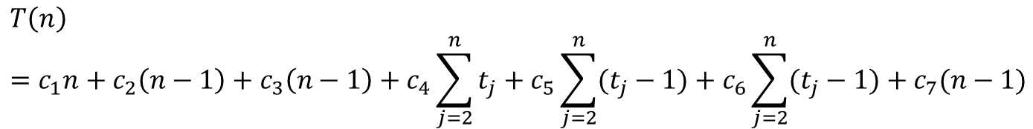
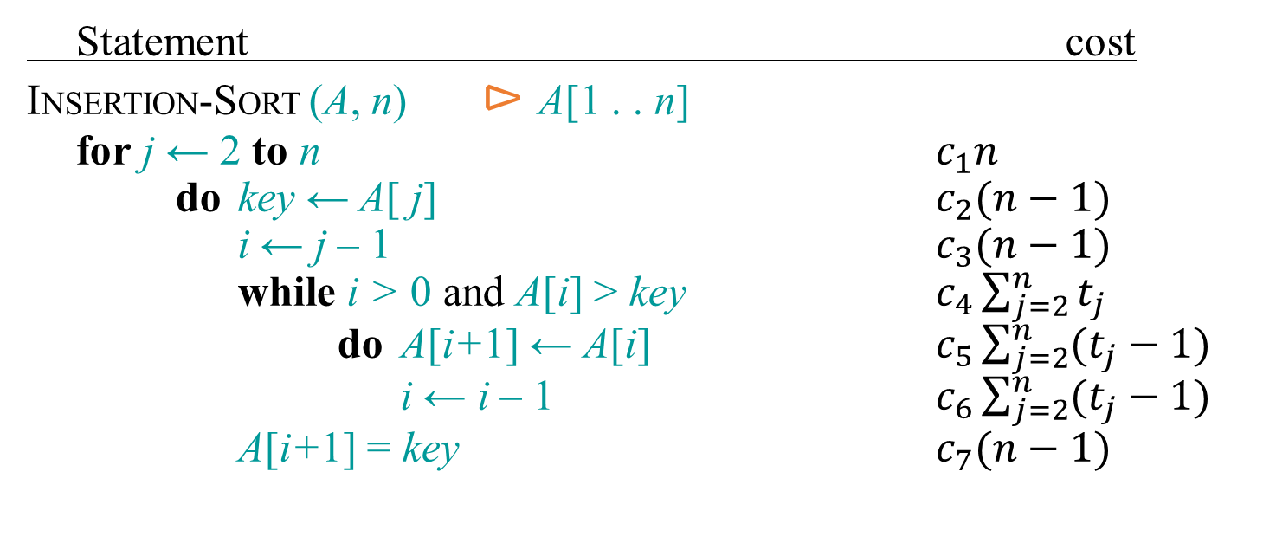
Insertion Sort: Running Time
Statement cost
INSERTION-SORT (A, n) ⊳ A[1 . . n]
for j ← 2 to n $c_{1}n$
do key ← A[ j] $c_{2}(n−1)$
i ← j – 1 $c_{3}(n−1)$
while i > 0 and A[i] > key $c_{4}\sum_{j=2}^{n}{t_{j}}$
do A[i+1] ← A[i] $c_{5}\sum_{j=2}^{n}{(t_{j}−1)}$
i ← i – 1 $c_{6}\sum_{j=2}^{n}{(t_{j}−1)}$
A[i+1] = key $c_{7}(n−1)$
$$T\left(n\right)={c_{1}n+c}_{2}\left(n−1\right)+c_{3}\left(n−1\right)+c_{4}\sum_{j=2}^{n}{t_{j}}+c_{5}\sum_{j=2}^{n}{(t_{j}−1)}+c_{6}\sum_{j=2}^{n}{(t_{j}−1)}+c_{7}(n−1)$$
Here t_{j} = no. of times the condition of while loop is tested for the current value of j.
How can we simplify T(n)? Hint: compute the value of T(n) in the best/worst case

Slide 6
Insertion Sort: Running Time
Statement cost
INSERTION-SORT (A, n) ⊳ A[1 . . n]
for j ← 2 to n $c_{1}n$
do key ← A[ j] $c_{2}(n−1)$
i ← j – 1 $c_{3}(n−1)$
while i > 0 and A[i] > key $c_{4}\sum_{j=2}^{n}{t_{j}}$
do A[i+1] ← A[i] $c_{5}\sum_{j=2}^{n}{(t_{j}−1)}$
i ← i – 1 $c_{6}\sum_{j=2}^{n}{(t_{j}−1)}$
A[i+1] = key $c_{7}(n−1)$
If you are asked to compute worst case time of Insertion-Sort, just say that the while loop runs j times for worst possible input i.e. reverse sorted array (explain why) and then compute T(n) from T(n) = Σ^{n}_{j=2} (j) = …. = n(n+1)/2 – 1 which is O(n²)
You don’t really need to show such a detailed calculation as shown here & in the book.
$$T\left(n\right)={c_{1}n+c}_{2}\left(n−1\right)+c_{3}\left(n−1\right)+c_{4}\sum_{j=2}^{n}{t_{j}}+c_{5}\sum_{j=2}^{n}{(t_{j}−1)}+c_{6}\sum_{j=2}^{n}{(t_{j}−1)}+c_{7}(n−1)$$
Here t_{j} = no. of times the condition of while loop is tested for the current value of j.
In the worst case (when input is reverse-sorted), in each iteration of the for loop, all the j-1 elements need to be right shifted, i.e., t_{j}=(j-1)+1 = j :[1 is added to represent the last test]. Putting this in the above eq., we get: T(n) = An²+Bn+C → O(n²), where A, B, C are constants.
What is T(n) in the best case (when the input numbers are already sorted)?

