Slide 1
Mergesort

Slide 2
Merge Sort
Merge sort is a comparison sorting technique.
This technique follows the divide-and-conquer approach.
It maintains the following 3 steps:
1. Divide: Divide N-element sequence to be sorted into two subsequences of
about N/2 elements each and sort the two subsequences recursively .
2. Conquer: Merge the two sorted subsequences to produce the sorted result.
Merge sort uses the “merge” step to combine two sorted sublists to create one single
sorted list.
Suppose A is a sorted list with R elements and B is another sorted list with S elements.
After merging there is only a single sorted list C with N=R+S elements.

Slide 3
Mergesort Algorithm
Mergesort(List, N)
(1) Msort (List, TempList, 0, N-1)
(2) End
Merge(List,TempList,Lpos,Rpos,RightEnd)
(1) Set LeftEnd = Rpos-1 and TmpPos = Lpos
(2) NumElement = RightEnd – Lpos + 1
(3) While Lpos<=LeftEnd && Rpos<=RightEnd
If List [Lpos] <= List [Rpos] then
TmpList[TmpPos++]=List [Lpos++]
Else
TmpList[TmpPos++]=List [Rpos++]
(8) While Lpos <= LeftEnd
TmpList[TmpPos++] = List [Lpos++]
(10) While Rpos <= RightEnd
TmpList[TmpPos++] = List [Rpos++]
For I = 0 to NumElement do step 13
List [RightEnd--]=TmpList [RightEnd--]
End
Msort(List, TempList, Left, Right)
(1) If Left < Right do steps 2 to 5
Set Center = (Left+Right)/2
Msort (List, Temp List,Left,Center)
Msort (List,TempList,Center+1,Right)
Merge(List,TempList,Left,Center+1,Right)
End

Slide 4
Example:
Suppose Array A = 5, 2, 4, 7, 1, 3, 2, 6. Sort the array using Mergesort.
5 | 2 | 4 | 1 | 7 | 3 | 2 | 6
5 | 2 | 4 | 1
7 | 3 | 2 | 6
5 | 2
4 | 1
7 | 3
2 | 6
5
2
4
1
7
3
2
6
2 | 5
1 | 4
3 | 7
2 | 6
1 | 2 | 4 | 5
2 | 3 | 6 | 7
1 | 2 | 2 | 3 | 4 | 5 | 6 | 7

Slide 5
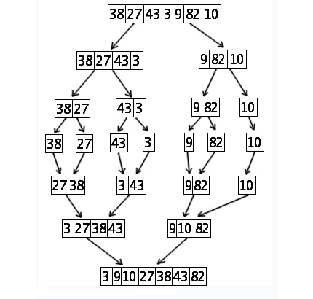
Example:
Suppose Array A = 38, 27, 43, 3, 9, 82 and 10. Sort the array using Mergesort.

Slide 6
Complexity of Merge-Sort
Let T(N) be the number of comparisons needed to sort N elements using merge sort. This algorithm requires at most logN passes. Moreover, each pass merges a total of N elements and each pass will require at most N comparisons. So, for all cases, T(N) = 0(NlogN).
Recurrence Relation for Mergesort
T(1) = 1 For N = 1
T(N) = 2T(N/2) + N Otherwise

Slide 7
# T(N) = 2T(N/2) + N is equivalent to O(Nlog₂N)
Solution:
T(N) = 2T(N/2) + N
T(N/2) = 2T(N/4) + N/2
T(N/4) = 2T(N/8) + N/4
……………………..
T(2) = 2T(1) + 2
T(N) = 2^{K}T(N/2^{K}) + K.N
By using 2^{K} = N, it is obtained as
T(N) = NT(1) + NLog₂N = N + NLog₂N = O(NLog₂N)
So, T(N) = 2T(N/2) + N is equivalent to O(Nlog₂N).

Slide 8
END

