Slide 1


Bank Management System
Presentation on
Submitted by-
John Pritom Biswas → 20215103016 Rabeya bashri Sumona → 20215103104 Hamim Sheikh → 20215103049
Azizur Rahaman Ankon → 20215103015
Zarin Akter → 20215103032
Submitted to- Md. Shahiduzzaman Lecturer Bangladesh University of Business and Technology.

Slide 2

TABLE OF CONTENTS
01
02
03
04
05
06
Project Overview
Objectives
Project Diagram
Details about Bank Management System.
Purpose behind choosing this project which motivates us.
The design of the project.
Key Features
Used Tools
Advantages
Some main features added to the project.
Programming language and apps used in the project.
Some advantages that makes our project unique.

Slide 3

01
Project Overview

Slide 4

Bank Management System project is a simple console application designed to demonstrate the practical use of Python language and its features as wells as to generate an application that can be used in any Bank companies small or big.
The main aim of the Bank Management System project is to keep a track of transactions and user information.
This program definitely has a wide scope to minimize errors in the making of bills and it also limits the delay of delivering bills to the customers.
This application also helps find the user information and transaction fast.

Slide 5

02
OBJECTIVES

Slide 6
To make a simple and cost-effective program for small and big Bank companies
To give an easy account opening experience & minimize human errors.
To prevent mistakes in transaction users.
To get easy and fast money withdraw and deposit
To ensure proper and continuous control over Bank System and error free transactions .

Slide 7

03
PROJECT DIAGRAM

Slide 8
Diagram
Start
Admin
Mode
User Mode
Exit
Fail
Login
Fail
Success
Login
Register
Exit
Admin Menu
User Menu

Slide 9

Diagram
Admin Menu
Delete
Enter Address
Insert
Logout
Exit
Enter Amount
Create a new Admin
Enter Phone
Enter Passwod
Get
Enter Name
Enter ID
Update

Slide 10
Diagram
User Menu
Update
Logout
Enter Address
Deposit
Enter Password
Enter Phone
Withdraw

Slide 11

04
KEY FEATURES

Slide 12
Creating User & Admin database.
Creating separate panels for User and Admin.
Deposit Money.
Withdraw Money.
Multiple user register Option.
Manage & Keep track of new Users & Transactions information.
Update Phone , Password, Address.
Removing human calculating error and Transaction fast.

Slide 13

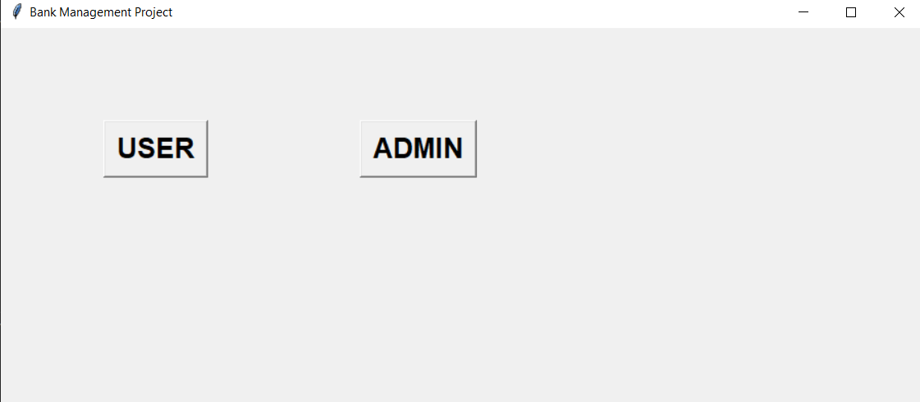
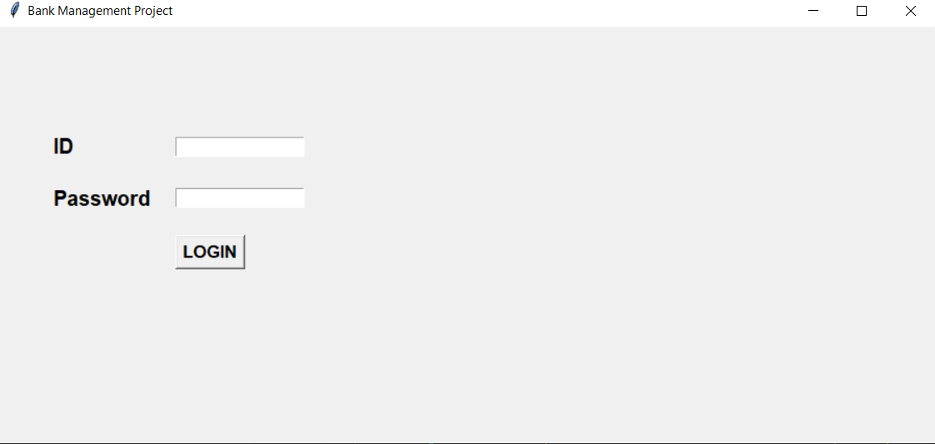
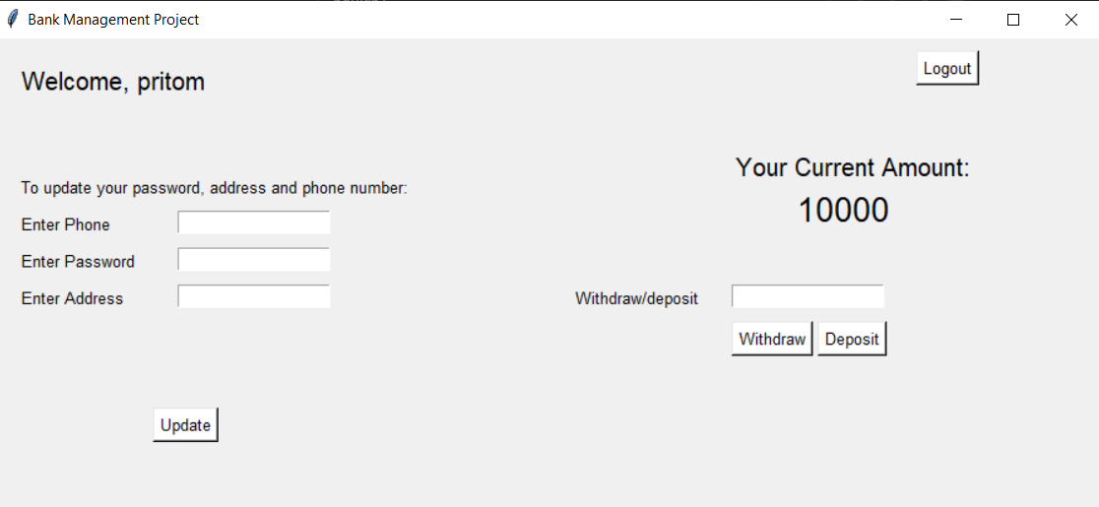
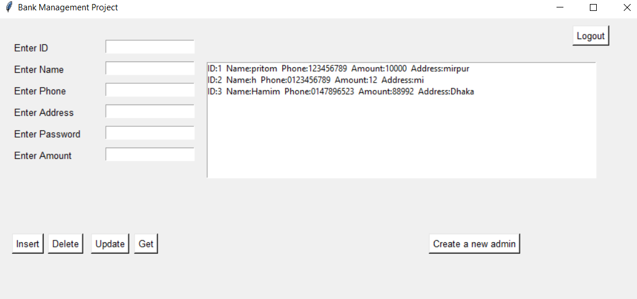
SOME SNAPS OF FEATURES

Slide 14
05
USED TOOLS

Slide 15

Hardware Tools
Personal Computer
RAM : 4gb or above.
Hard Disc : 500GB or above
Software Tools
Visual Studio : It is used to compile program files.
Operating System : Windows 10 or above.

Slide 16

06
Advantages

Slide 17

It reduces inaccuracy in the management of Bank and transaction information.
It will enhance productivity by making intelligent business decisions.
It can provide customers great service in a short time.
Bank Management system can do the manual tasks for you very easily and efficiently avoiding human errors.
Well-maintenance information about Bank , User and transactions can help you avoid so many wasted times looking for documents and help stop problems quicker.

Slide 18

THANK YOU
for your precious time.

