Slide 1

Presentation Topic:
Design a simplified circuit from a given circuit (which consists of two independent sources) which provides the same value of power to the load.
Presented To ,
Mohammad Nowshed Al Nur
Lecturer
Department of Electrical & Electronic Engineering

Slide 2
Team Members
Hamim Sheikh
ID : 20215103049
Intake :47
Sumaiya Akter Nurjahan
ID : 20215103042
Intake :47
Amzad Hossain
ID : 20215103048
Intake :47
Shad islam
ID : 20215103041
Intake :47
Ritu khatun
ID : 20215103031
Intake :47

Slide 3
Background
Load resistance is a circuit or a simply way to saying that load resistance is what through which you consume power .To calculate Thevenin's resistance and voltage we need to find the power source in the original circuit and remove them and calculating total resistance between the open connection points .Draw the Thevenin equivalent circuit, with the Thevenin voltage source in the series with the Thevenin's calculating total resistance between the open connection points. Draw the Thevenin equivalent Circuit, with the Thevenin voltage source in the series with the Thevenin's resistance. To calculate load current we need to find the total current flowing through by using the Ohm's Law, I= Vth/Rth .

Slide 4
Motivation
Thevenin’s Theorem are used where the load can be Varied . So, basically these methods reduce the big linear circuit into 1 source & 1 resistor. Later we can put any kind of load & measure the variations of current & voltages across the load. The load can be a Fan, bulb, etc.

Slide 5
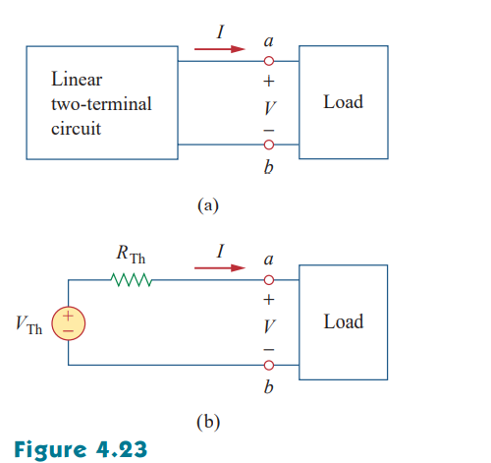
Literature review
Thevenin’s theorem provides a technique by which the fixed part of the circuit is replaced by an equivalent circuit. According to Thevenin’s theorem, the linear circuit in Fig. 4.23(a) can be replaced by that in Fig. 4.23(b). (The load in Fig. 4.23 may be a single resistor or another circuit.) The circuit to the left of the terminals in Fig. 4.23(b) is known as the Thevenin equivalent circuit; it was developed in 1883 by M. Leon Thevenin (1857–1926), a French telegraph Engineer.

Slide 6
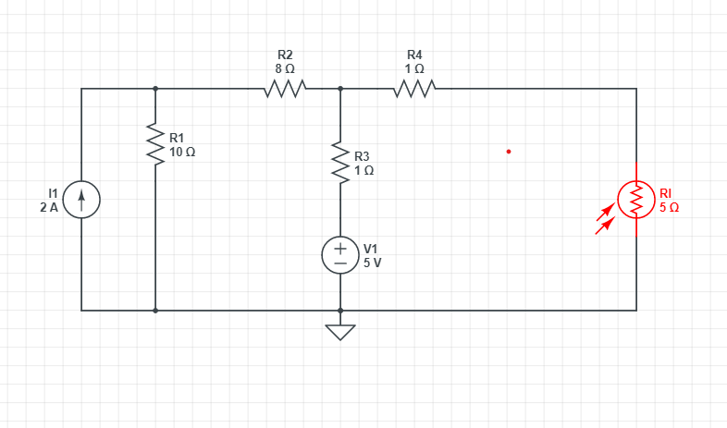
Methodology

Slide 7
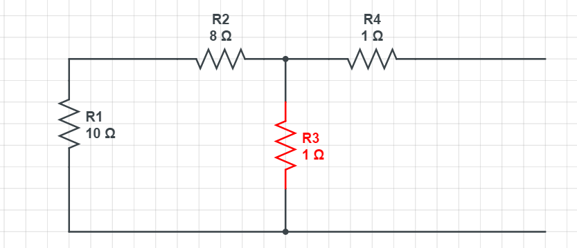
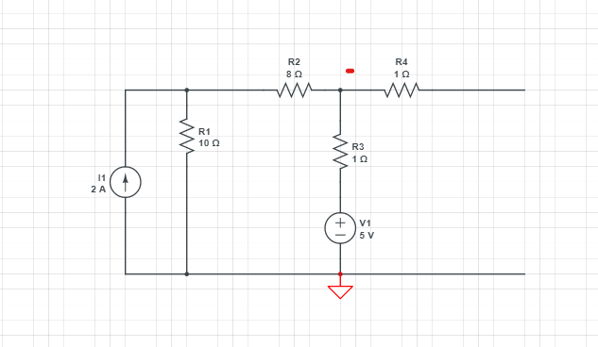
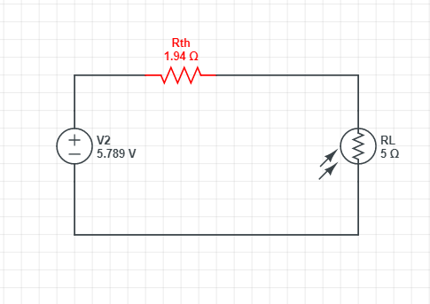
Detailed Circuit Diagram

Slide 8
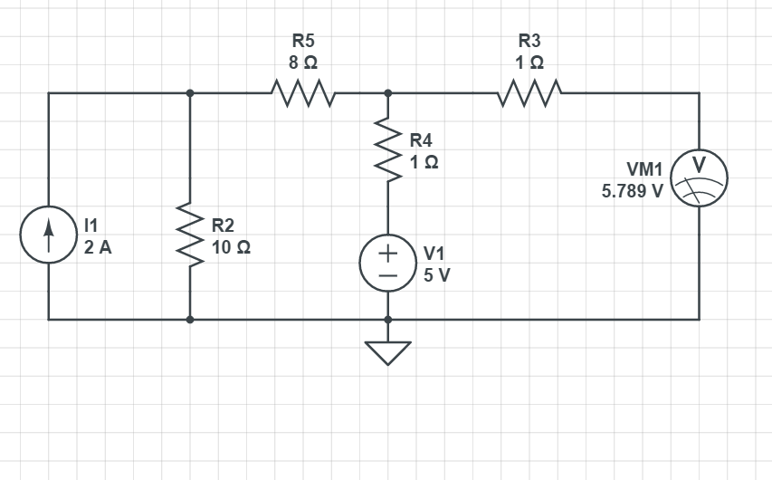
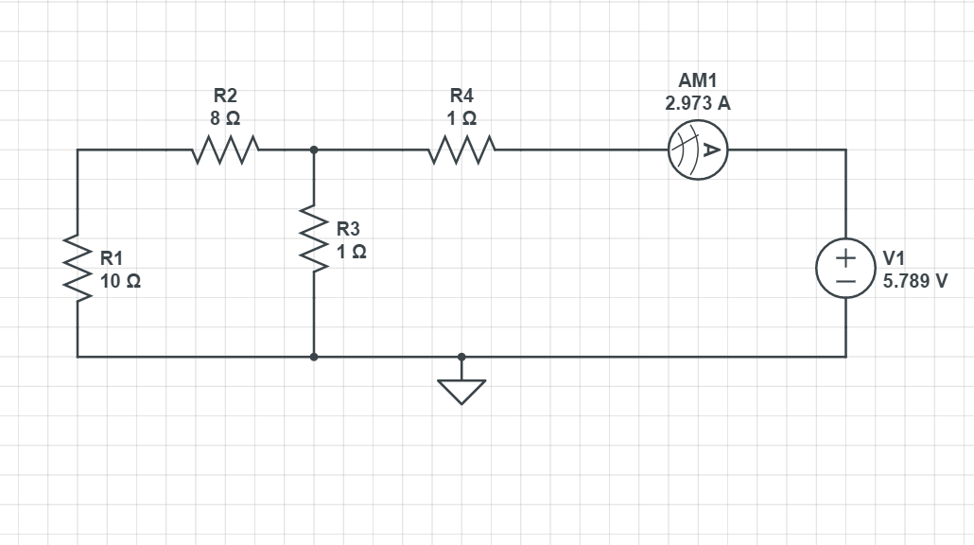
Simulation/Hardware prototype
For V_{th}
For R_{th}

Slide 9
Conclusion
Thevenin's Theorem states that it is possible to simplify any linear circuit, no matter how complex, to an equivalent circuit with just a single voltage source and series resistance connected to a load.

