Slide 1
Hack the Valley Challenge - User-generated content monetization by Team APME
A license negotiator for intellectual property on public repositories using Ethereum Smart Contracts and BlockOne ID
Members: Andreas Hauschild, Michael Hauschild, Michael Brem, Eugen Lechner
GitHub Link: https://github.com/haminacta/apme/

Slide 2
The APME Negotiator
Establishing a platform to bring consumer and content publisher together using Blockchain and Ethereum Smart Contract technology
Traceable ownership of intellectual properties rights
Providing a common web interface to the content and Ethereum network using B1^{ID}
Supports common ways of payment as well
Managing of IPFS storage for providers by securing access to the stored content using encryption
Delivers decrypted content after payment confirmation to the consumer
Advantages for Content Consumer
Never loose access to the content you already payed for
Resell your license anytime anywhere
Advantage Content Provider
Leverage of public IPFS storage to store all kind of contents
Receive instant payment for your content
Track your content usages
Fine granular managing of copy rights by different license level
Provision of license evaluation services
Revenue can easily distributed to group of people that create the content without leaving somebody out

Slide 3





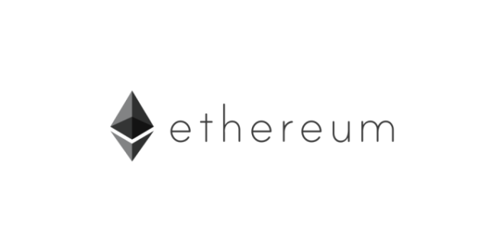


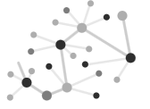

APME Negotiator - Architectural Overview
Browse Content
APME
Content / Wallet
content
price
Content
Consumer
#pay/fetch/sell
Content
Provider
Content encryption
Content decryption
verify / buy

Slide 4
Everyone get’s his share by Smart Contract ☺
Intellectual Property
Consumer
Publisher
Engineer
Artists
Authors

