Slide 1
Spring Core
Instruction: NGUYEN ANH MINH (M. Sc.)

Slide 2
Outline
Bean naming
Bean scoping
Dependency injection

Slide 3
General approach
Define and create service interfaces
Implement service interfaces
Add bean definitions
Access and use container-managed beans

Slide 4
Choosing a Bean name

Slide 5
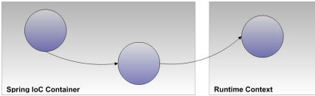
Bean name
Uses
Identify bean collaborators when defining spring beans
Identify beans to be accessed automatics from the spring IoC container using the bean factory API.
Configuration
Xml bean attribute id
W3C xml schema datatype
Accepts a single value
Xml bean attribute name
One more values delimited by comma or space
Separate xml elements alias

Slide 6
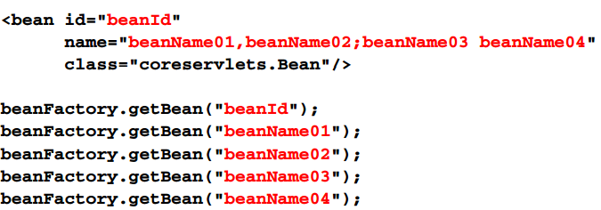
Bean definition example
Establish multiple names for clients
Single class implementing multiple interfaces

Slide 7
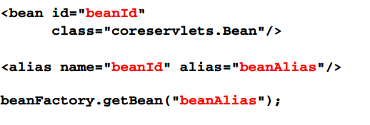
Bean definition example
Adapts names from client contexts

Slide 8
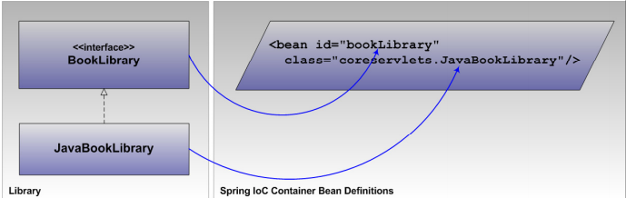
Naming convention
Establish a convention in order to predict bean names
Identify objects according to the interface
Use unqualified class names
Start name with a lower-case letter

Slide 9
Naming convention
Conventions are guidelines
When necessary , it is okay to depart from the convention
This may demonstrate the need to refactor
For example, separate or merge responsibility

Slide 10
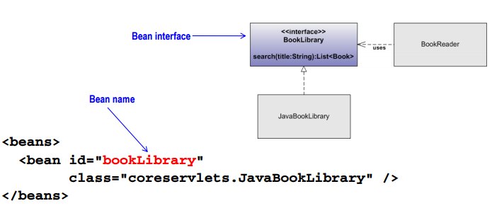
Naming convention example

Slide 11
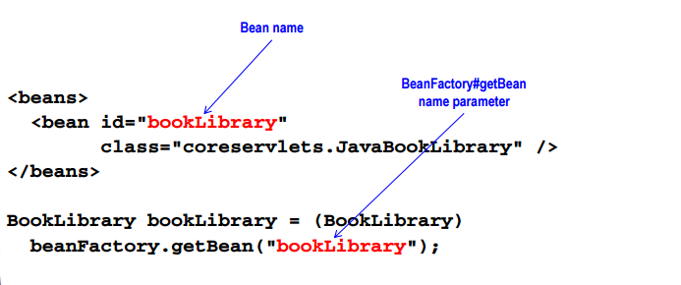
Naming example
Convention coordinates when accessing the spring container

Slide 12
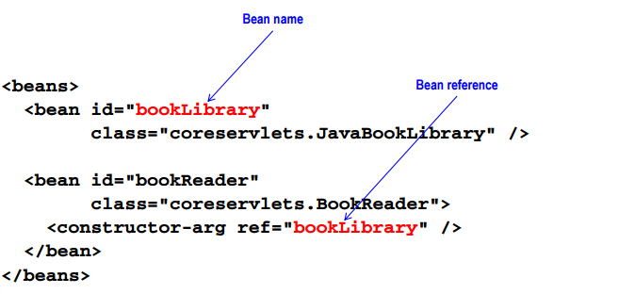
Naming convention example
Convention coordinates naming within a bean definition document

Slide 13
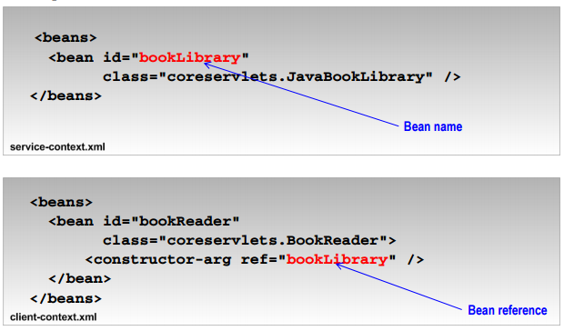
Naming convention example
Convention coordinates naming across separate bean definition files

Slide 14
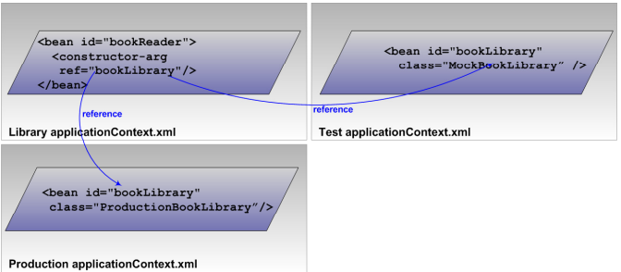
Naming convention example
Coordinating across contexts
Test
Production

Slide 15
Bean naming summary
Establish naming convention
Unqualified class name
Name starting with a lower-case letter
Name is based on the interface type
Use the convention to predict names across contexts
Use the xml bean id attribute for declaring the bean name
Rely on the same conventions for referencing other beans

Slide 16
General approach review
Define and create service interfaces
Implement services interfaces
Add the bean definitions
Establish bean identifiers using the id attribute
Alias can be established using name attribute or alias element
Develop bean names consistently using a convention
Access and use container-managed beans
The access and integration method is context -dependent

Slide 17
Bean scope

Slide 18
Bean scope
Bean scopes control bean creation and storage
The spring ioc container defines five bean scopes
Singleton (default)
Prototype
Request*
Session*
globalSesion*
Only available in web application enviroments
Bean scope configuration is exposed through the xml bean attribute scope

Slide 19
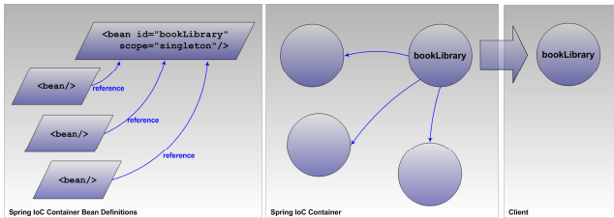
Singleton scope
The default bean scope
Explicitly specifying singleton is allowed but redundant
Caches and distributes the same bean instance
Collaborative references
Bean factory bean access requests
Replaces singleton implementations

Slide 20
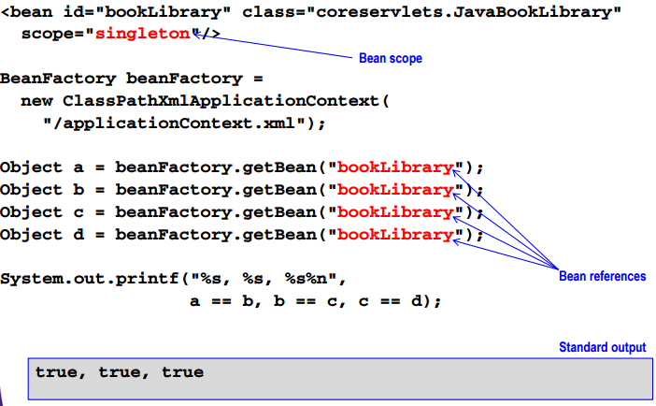
Singleton scope example

Slide 21
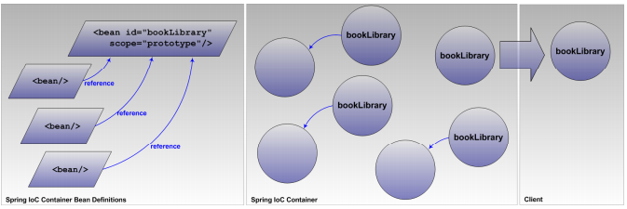
Prototype scope
Prototype scope caches and distributes a new bean instance for various types of bean requests
Collaborative references
BeanFactory bean access requests

Slide 22
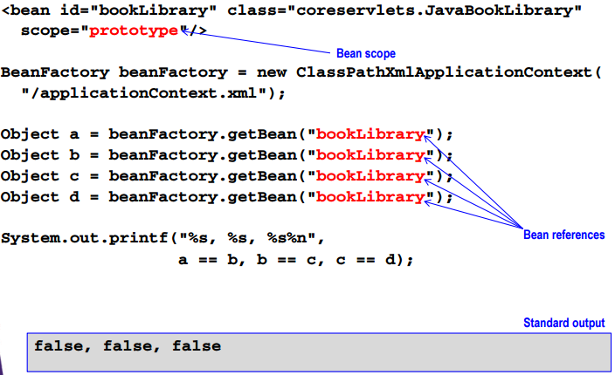
Prototype scope example

Slide 23
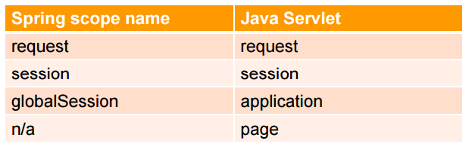
Externally-stored bean scopes
Java servlet scope support

Slide 24
General approach review
Define and create service interfaces
Implement service interfaces
Add the bean definitions
Establish identifiers using the id attribute
Alias can be established using name attribute or alias element
Develop bean names consistently using a convention
Default to singleton beans
Override bean creation and caching using scope attribute
Access and use container-managed beans
The access and integration method is contex-dependent

Slide 25
Dependency injection (DI)

Slide 26
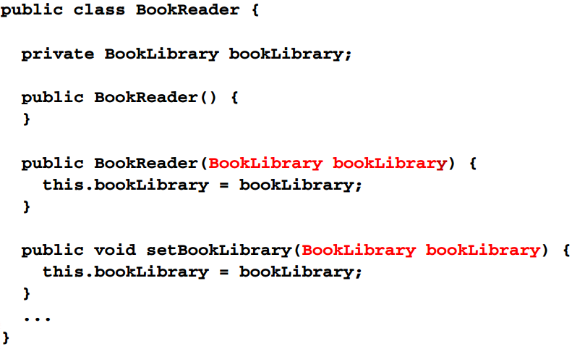
Dependency injection target

Slide 27
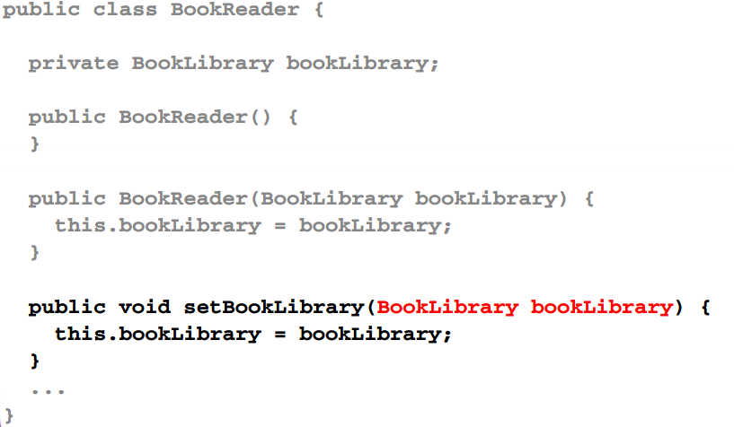
Property setter DI target

Slide 28
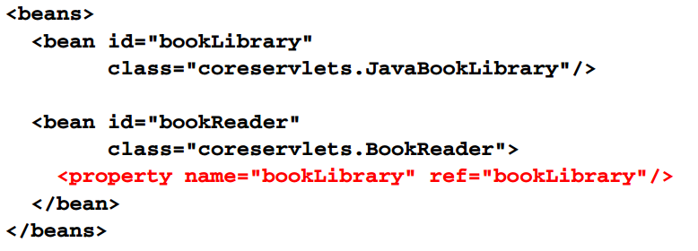
Property setter DI example

Slide 29
Property setter DI details
Match on qualified setter methods by name
Based on JavaBEan conventions
The property setter has no relationship to a class field
Must conform to the capitalized property name prefixed with set
E.g. property foo as the setter method setFoo,
Must be public
Configuration fails with private, protected , or package –private modifiers
Must specify the return type void
Imcompatible with chaining setter methods
Must accept exactly one parameter
Must be enclosed by a class the has a no-arges constructor
No requirements on access modifier

Slide 30
Property setter DI implications
Forces the class to be mutable
Includes the property name in the DI declaration
Supports inheritance

Slide 31
Property setter DI bean definition
Configuration is exposed by the xml element type property
Child to the xml element bean
Requires a value for the xml element attribute names
Support shorthand configuration
Value attribute for directly specifying a value
Ref attribute for referring to beans defined elsewhere
Support child references
Collaborators , inner bean, collections , and values

Slide 32
Property setter DI process
Verify the presence of a no-arges constructor
Verify the method signature
Public access modifier
Void return type
Bean oriented name
Map the property into the bean definition
Create the nested xml property elements
Identify the property using the name attribute
Identify the value to be passed into the setter method as a parameter value

Slide 33
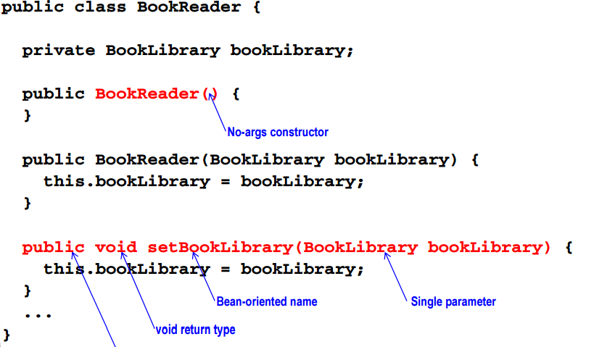
Property setter DI example
Public prototype

Slide 34
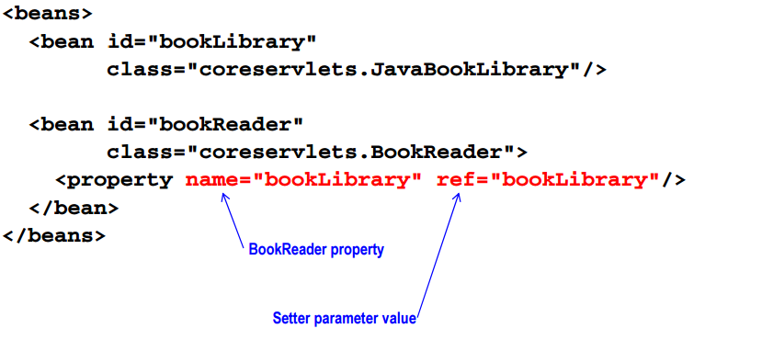
Property setter DI example

Slide 35
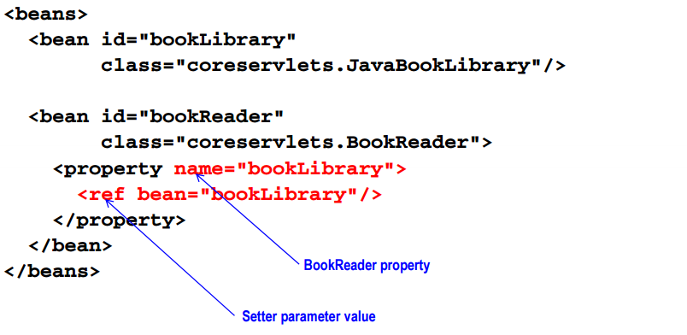
Alternative property setter DI example

Slide 36
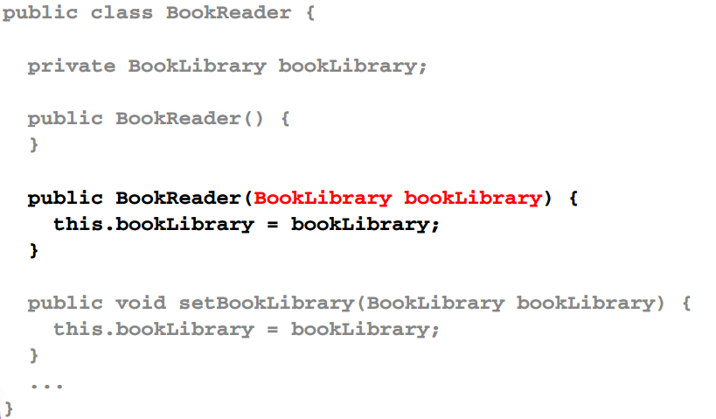
Constructor DI target

Slide 37
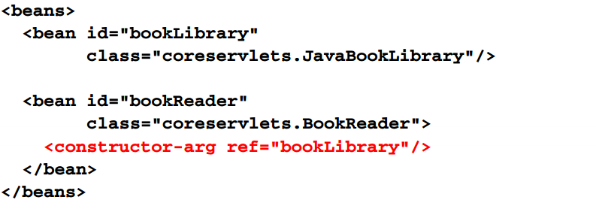
Constructor DI example

Slide 38
Constructor DI details
Matches on constructor using parameter types
Must share matching quantities
Must share matching types
Must match while preserving parameter ordering
Constructor by type matching is ambiguous
Multiple constructors may match the constructor –arg configuration

Slide 39
Constructor DI implications
Support an immutable class design
Does not support parameter naming
Requires multiple constructor for each parameter parameter parameter combination

Slide 40
Constructor bean definition
Configuration is exposed by the xml element type constructor –arg
Child the xml element bean
Support shorthand configuration
Value attribute for directly injecting a value
Ref for referring to beans defined before
Supports child references
Collaborators, inner beans, collections, and values
Offer fine-tuned constructor matching options
Index
type

Slide 41
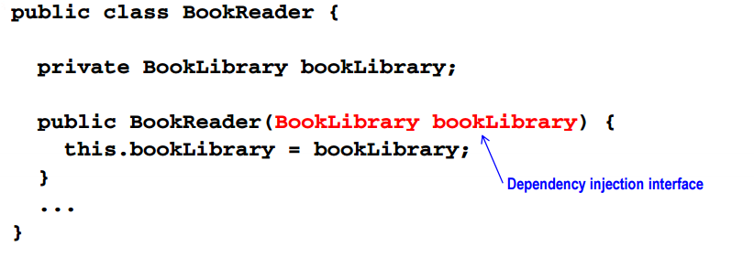
Constructor DI example

Slide 42
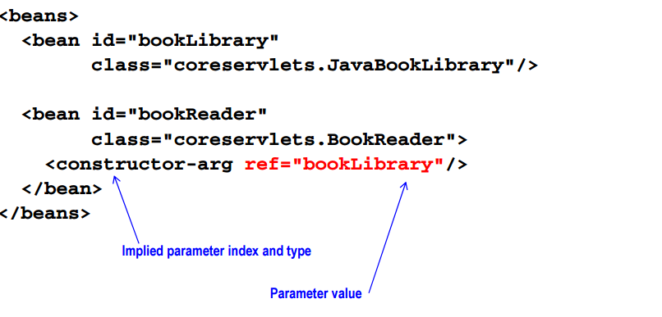
Implied constructor DI
Implied index and type

Slide 43
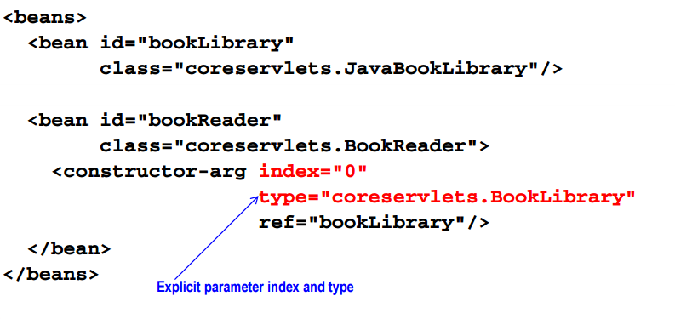
Explicit constructor DI
Explicit index and type

Slide 44
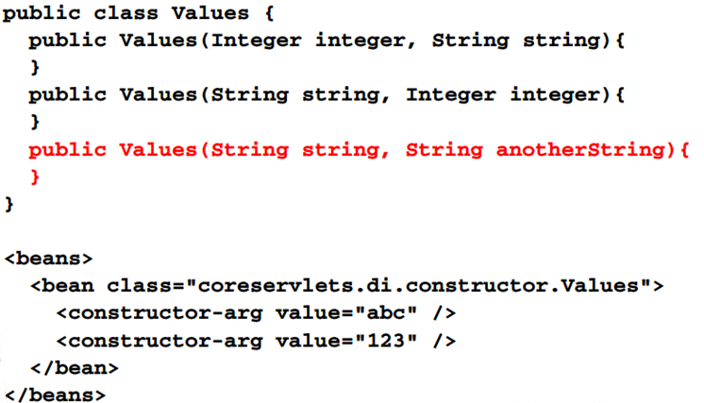
Implied constructor matching
Implied matches are ambiguous

Slide 45
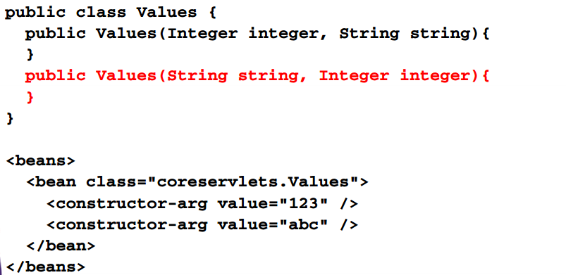
Implied constructor matching
Argument can be automatically reordered

Slide 46
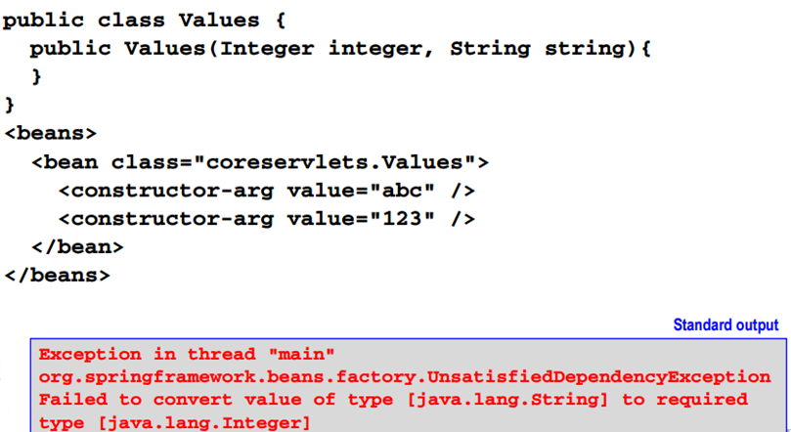
Implied constructor matching
Implied matches are unreliable

Slide 47
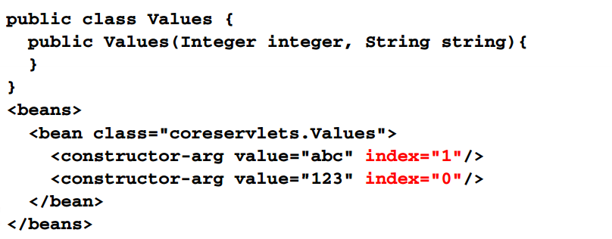
Explicit constructor matching
Implied matches can be corrected by specifying the index and or/ type

Slide 48
Constructor matching
Always specifying index and type when you have overloaded constructors

Slide 49
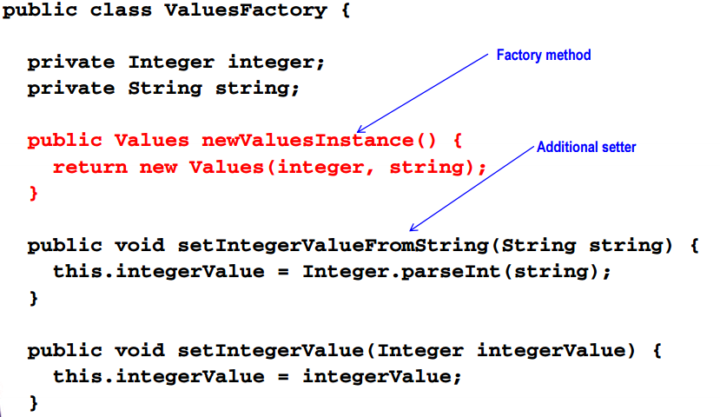
Constructor DI alternative

Slide 50
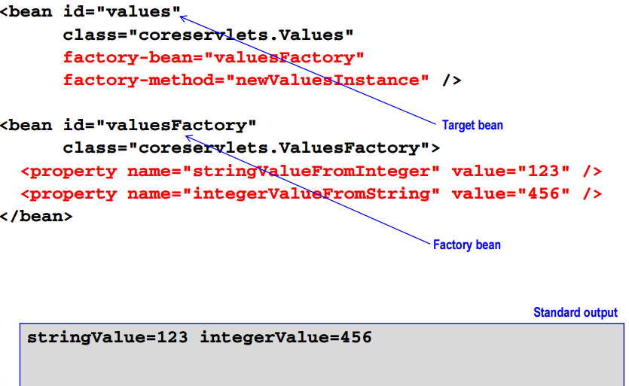
Constructor DI alternative

Slide 51
DI alternatives
Lookup method
Autowiring
Annotation-driven autowiring

Slide 52
Lookup method DI
Overrides or implements a factory method
Abstract keyword is optional
Public modifier required
Final classes are not supported
Accommodates special use cases
Scope loss between bean and collaborators if the dependency specifies a more transient scope
Version of the abstract template pattern
Requires cglib library

Slide 53
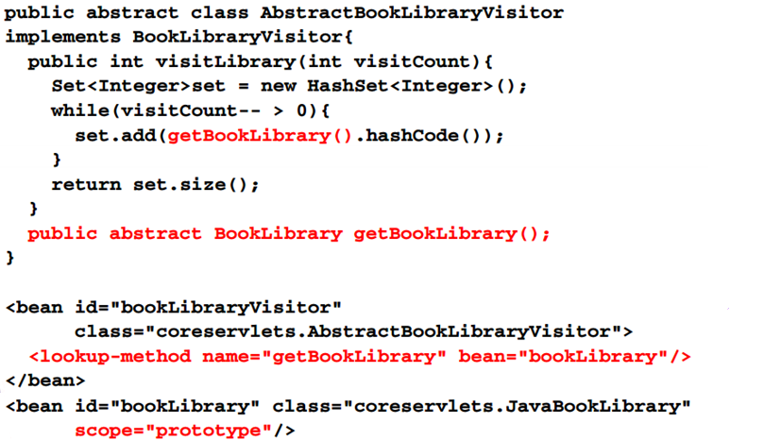
Lookup method DI

Slide 54
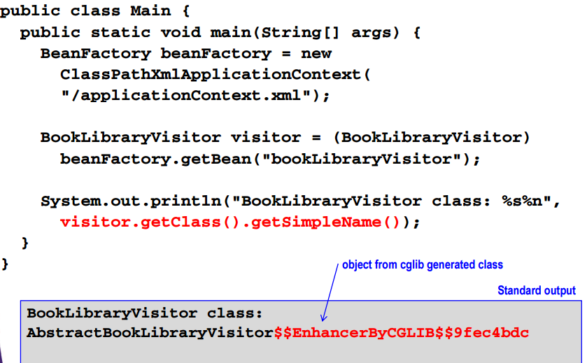
Lookup method DI

Slide 55
Autowiring DI
Enabled by specifying an autowiring strategy
Autowiring is implied
DI resolution may quietly fail
Properties setter dependency resolution

Slide 56
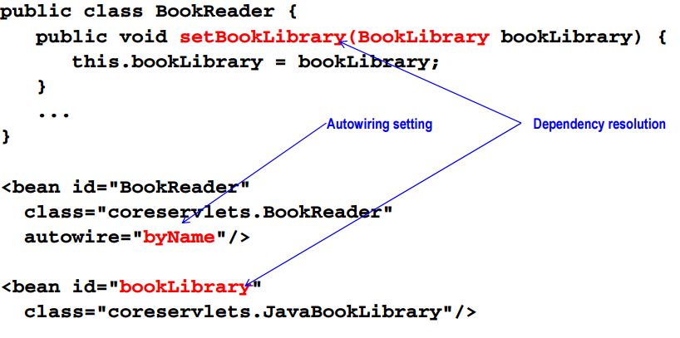
Autowiring DI

Slide 57
Annotation –driven autowiring
Uses annotations for specifying dependencies
Reduce xml configuration
Introduces spring class imports into source code
Violates POJO design principles
Decentralizes application configuration
Mitigates the benefits of a central blueprint
Implies dependencies

Slide 58
Annotation –driven autowiring process
Declare an empty xml element, context : annotation-config
Requirement depends on beanfactory implementation
Annotate dependency target
Field
Method
Constructor

Slide 59
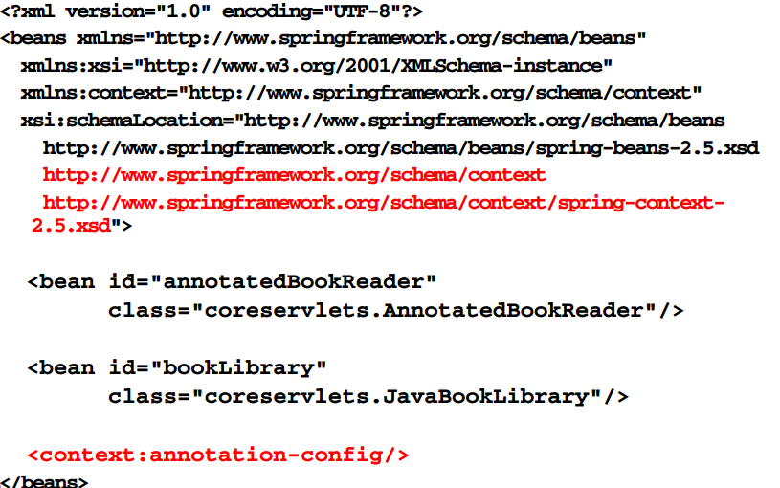
Annotation driven autowiring

Slide 60
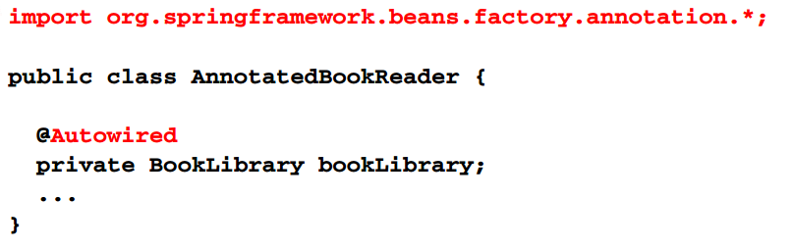
Annotation driven autowiring

Slide 61
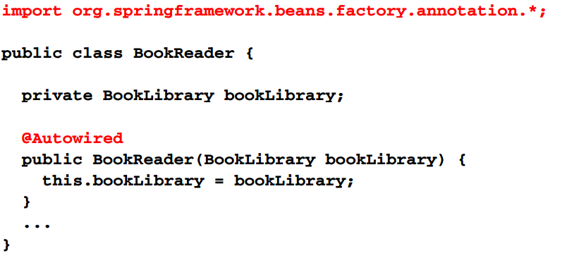
Annotation-driven autowiring constructor

Slide 62
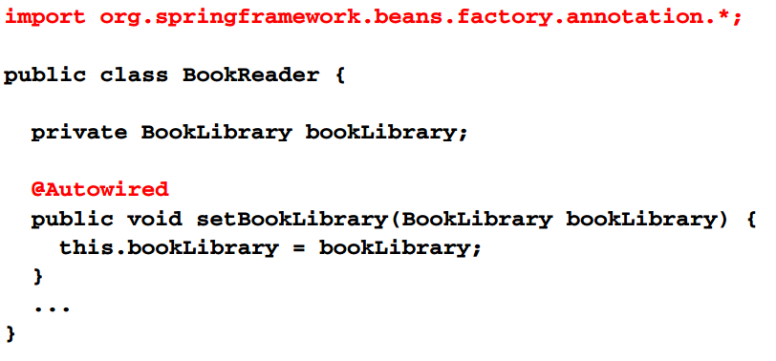
Annotation-driven autowiring property setter

Slide 63
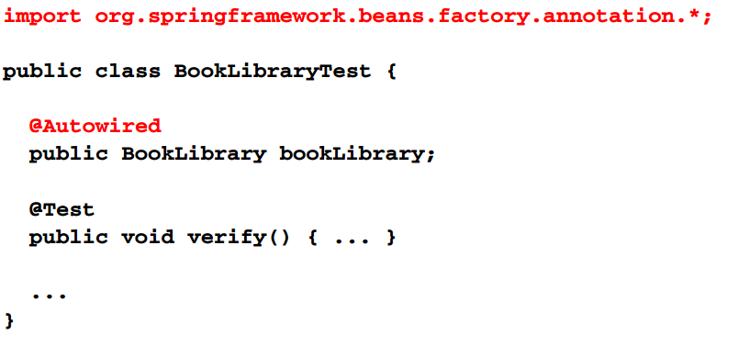
Auto wired test contexts

Slide 64
General approach review
Define and create service interfaces
Implement services interfaces
Add the bean definitions
Establish identifiers using the id attribute
Alias can be published using name attribute or alias element
Develop bean names consistently using name attribute or alias element
Develop bean names consistently using a convention
Default to singleton beans
Override bean creation and caching using scope attribute
Specify bean inter-dependencies using DI mechanism
Property setter , constructor , lookup –method , autowiring
Access and use container –managed beans
The access and integration method is context-indenpendent

Slide 65
Summary
Bean naming
Establish naming standards
Use id and/or name attributes or separate alias elements
Favor id attribute
Simple bean configuration
Use contructor-arg elements
Complex bean configuration
Use properties element
Consider using separator factory bean with property elements
Target bean : factory-bean and factory-method
Factory bean : id and class

Slide 66
Summary
Transient bean collaborator reference
Add cglib library
Use nested lookup –method element with name attribute
Autowired
May require xml context element
Annotation -config

