Slide 1
Spring jdbc
Instruction: NGUYEN ANH MINH (M. Sc.)

Slide 2
Outline
Introduction to spring jdbc api
Result transformations
Parameter mapping
Updating data tables

Slide 3
Handling JDBC query results

Slide 4
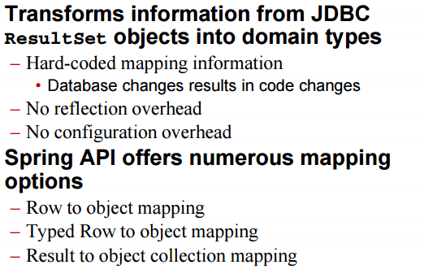
Spring JDBC resultSet

Slide 5
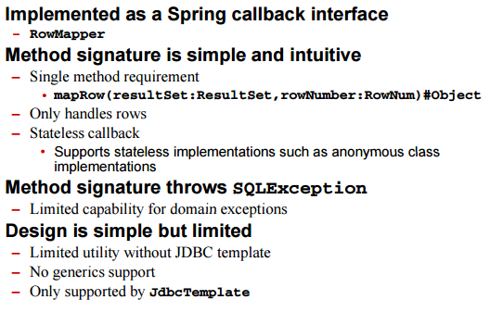
Row to Object Mapping

Slide 6
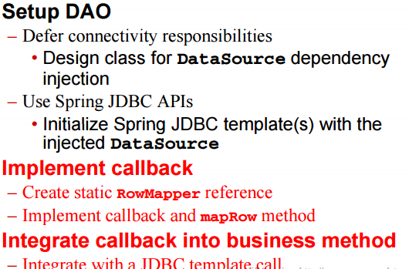
Row to Object Mapping Process

Slide 7
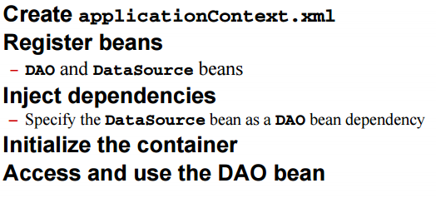
Row to object mapping process

Slide 8
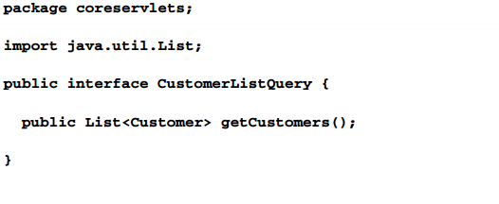
Creating DAO interface

Slide 9
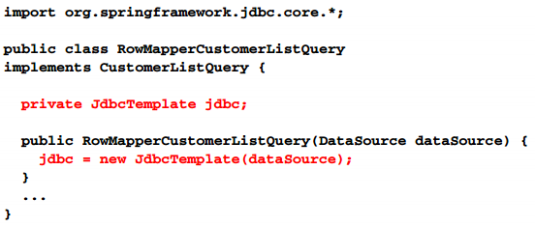
Setup DAO

Slide 10
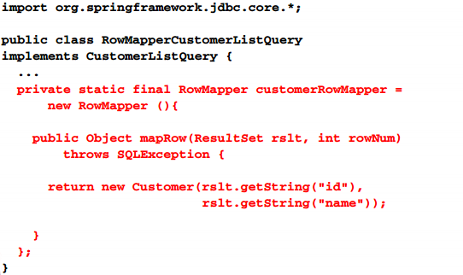
Implement callback

Slide 11
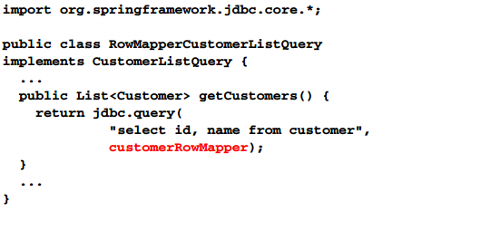
Integrate callback

Slide 12
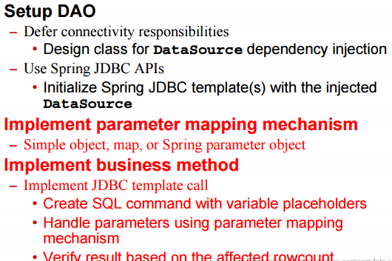
Spring JDBC table update

Slide 13
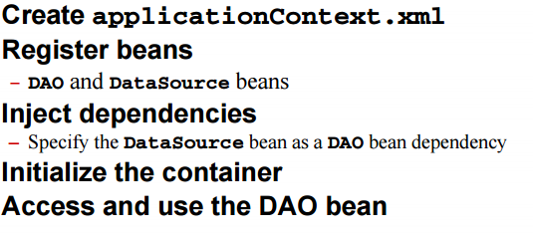
Spring JDBC table update

Slide 14
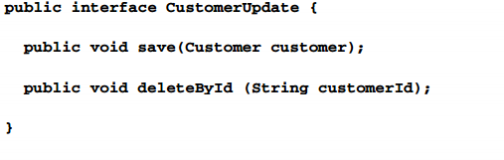
DAO interface

Slide 15
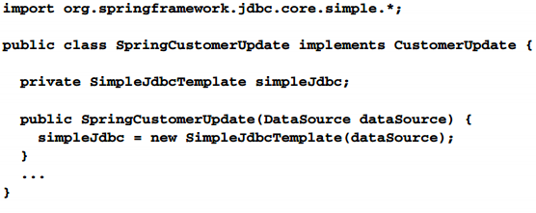
Set DAO

Slide 16
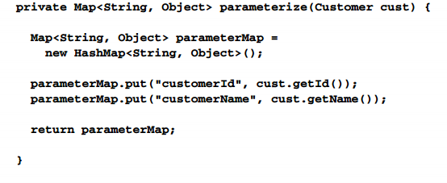
Implement parameter mapping

Slide 17
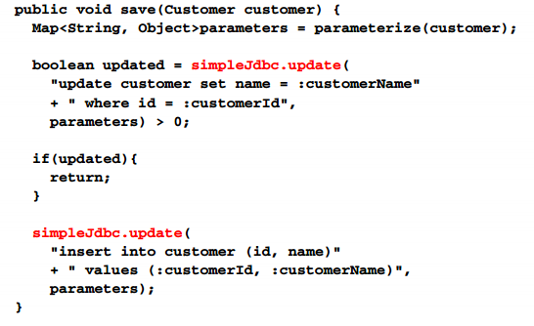
Implement save

Slide 18
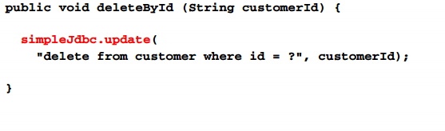
Implement delete

Slide 19
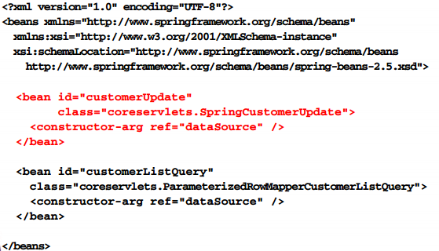
DAO Bean

Slide 20
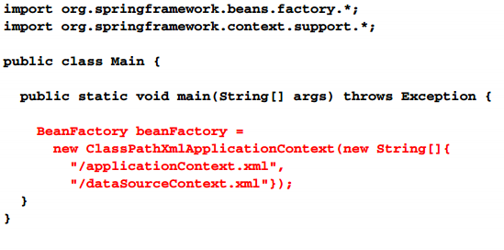
Instantiate container

Slide 21
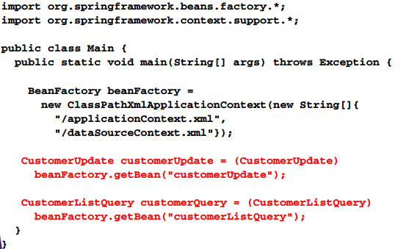
Acquire beans

Slide 22
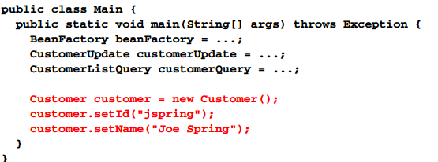
Setup customer object

Slide 23
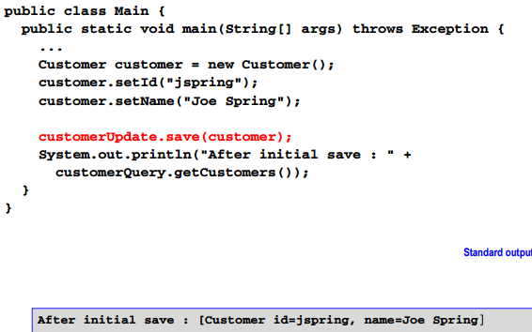
Save customer object

Slide 24
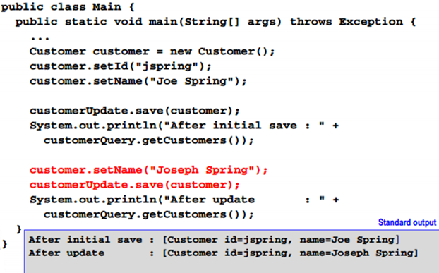
Update customer object

Slide 25
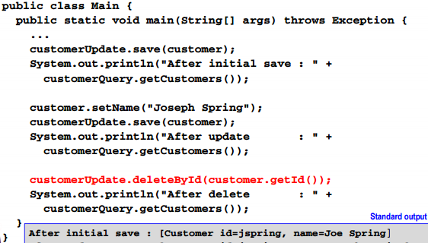
Delete customer object

Slide 26
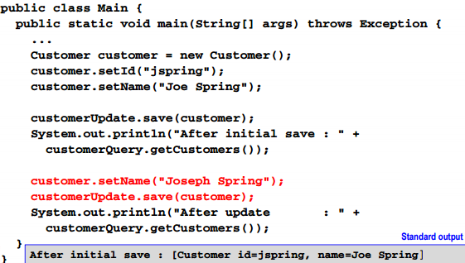
Update customer object

Slide 27
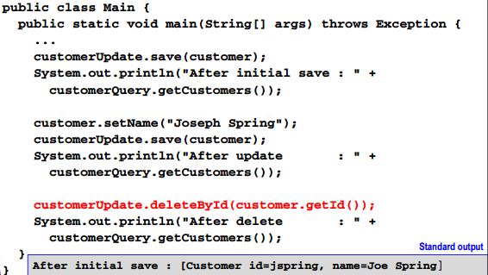
Delete customer object

Slide 28
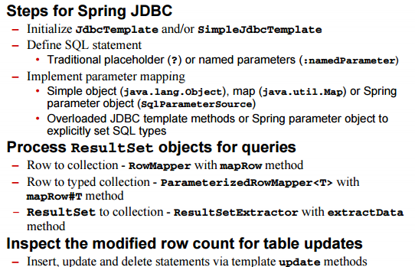
Summary

Slide 29
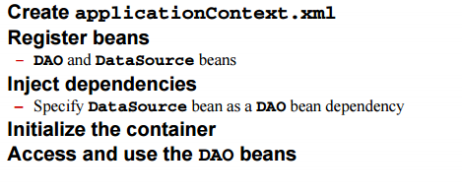
Summary

