Slide 1
Spring MVC
Instruction: NGUYEN ANH MINH (M. Sc.)

Slide 2
What is MVC
MVC stands for Model View Controller (architect)
It is design pattern used in WEB based JAVA Enterprise Applications
MVC pattern is also implemented in other WEB framework as well for separating the model layer from view layer. By doing that UI programmers and back end developers can work together
Model layer includes business specific logic
View layer is responsible for rendering (displaying) models objects inside the user interface using different view technologies (JSP, Facelets, Velocity)
Controller receives user inputs and calls model objects based on handler mappings and pass model objects to views in order to display output inside the view layer

Slide 3
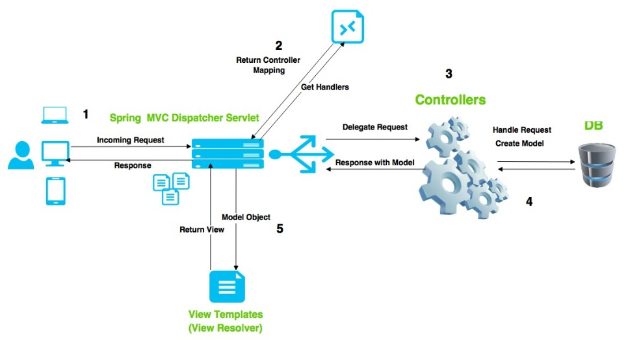
Request processing workflow in spring mvc

Slide 4
The General information about web.xml and J2EE
The web-inf/web.xml is the Web Application Deployment Descriptor of Java Enterprise Web Applications
Inside web.xml , developers can define
Servlets
Welcome file list
Filters
Context parameters
Error pages
Security rights and etc

Slide 5
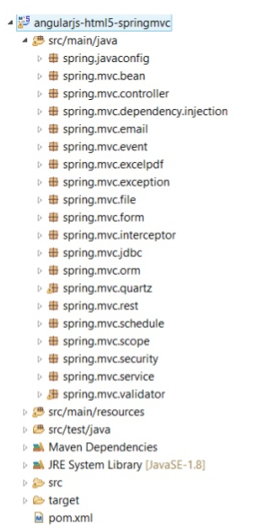
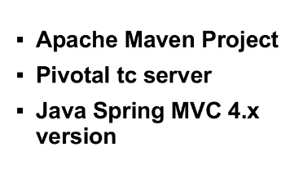
The General information about the sample application

Slide 6
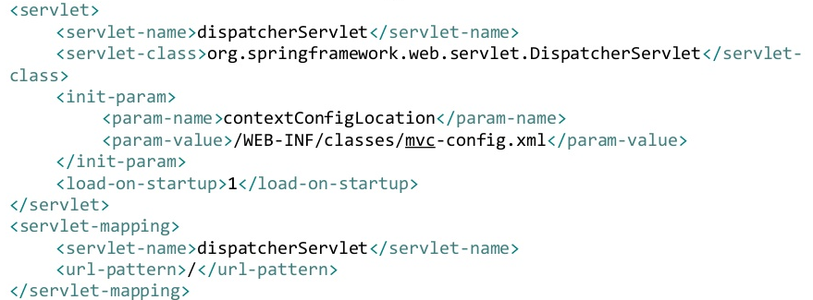
Dispatcher servlet and configuration
DispatcherServlet is configured in order to dispatch incoming HTTP request to handlers and returns response to browsers
SpringMVC is designed around DispatcherServlet
DispatcherServlet is configured in web.xml file

Slide 7
ContextLoaderlistener and configuration in spring mvc
ContextLoaderListener is responsible for caching a root application context in Java enterprise web application inside ServletContext
Developers can use different controller and view layers (for example struts, jsf, or spring mvc can be used)
Spring framework will be responsible for managing services layer or components defined ContextLoaderListner configuration files
It would be set different configuration XML files in web.xml
http://docs.spring.io/spring/docs/reference/mvc.html

Slide 8
Configure controller in spring mvc
Extending AbstractController class and implementing handleRequestInterval method
Using @Controller or @RestController annotation on class level
Controller with bean name Url mapping
Controller with class name mapping
Controller with xml config with mappings

Slide 9
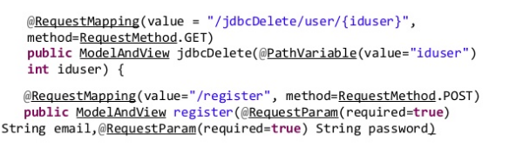
Incoming request mapped to a mapped to a method in spring mvc
@RequestMapping is used in order to map incoming request to a controller using URL matching
@RequestParam and @PathVariable is used to get parameters or available form HTTP request

Slide 10
View in spring mvc/ configure Internalresourceviewresolver
Java Spring MVC can be configured with different view technologies such as JSF, JSP, Velocity
Views are responsible for displaying the content of Model objects on browers as response output
InternalResourceViewResolver is used to resolve the correct view based on suffix and prefixes so the correct output (view) is resolved based on strings

Slide 11
Return types from controllers
You can return the followings from controllers
ModelAndView
Model
Map
View
String
Void
HttpHeaders and others

Slide 12
Scopes in Spring MVC
Default Scope in Spring MVC request
Session scope can be used in order to save the state of beans in web based applications
Each time a request send through HTTP a new bean will be created with request scope

Slide 13
Application event handling
Developers can handle application events by implementing
ApplicationListener<ApplitionEvent>
Customs events can be published by using application context and extending
ApplicationEvent class

Slide 14
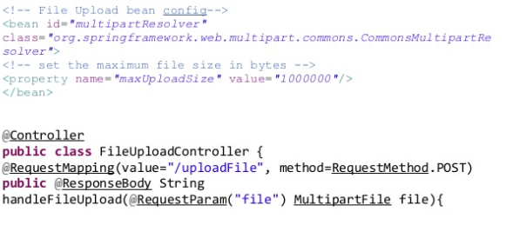
Spring MVC upload
In order to upload a file with Java Spring MVC

Slide 15
Quartz scheduling framework and spring schedules
Quartz is an alternative to spring schedules and has more functionality
In order to use Quartz ; Triggers, Jobs, Tasks, and Schedules have to defined in XML configuration
Spring Schedules can be configured using @Scheduled annotion
@Scheduled (cron=“0/30****?”) or
@Scheduled (fixedDelay = 10000) can be applied to schedules

Slide 16
Logging in Spring MVC
LOGBack framework will be used in order for logging outputs
LOGBack is a signaficantly improved version of log4j logging framework
Both log4j and logback were founded with the same developer
It is easy to switch logging technologies by using LOGBack
The configuration is done through logback.xml
By default Spring framework use commons-logging so dependencies should be excluded in pom.xml

Slide 17
Apache Maven
Apache Maven is build automation and dependency management tool
Apache Maven is configured using pom.xml file
Maven is integrated into Eclipse or STS

Slide 18
JPA and Hibernate ORM
JPA stands for Java Persistence API
Hibernate ORM is an implementation of JPA
ORM stands for Object Relational Mapping
Hibernate ORM uses @Entity annotation to manage classes in ORM framework
@Table(name=“USER”) is used to map Java Objects to Database Tables
@Id and @Column(name=“USERNAME”) annotations can be used on field levels
@PersistenceContext has to be used on EntityManager

Slide 19
JDBC and JDBC template
JDBC stands for Java Database Connectivity
It is an application programming interface API for connecting different databases
Spring MVC uses jdbcTemplate in order to run queries on databases
JDBC template simplifies database access code
JDBCTemplate handles database related exceptions and throws DataAccessException

Slide 20
PDF and Excel Documents
In order to return PDF and Excel Documents org.springframework.web.servlet.view.XmlViewResolver has to be configured in Spring MVC framework
Documents have to extend related classes named as AbstractExcelView and AbstractPdfView
Apache POI is used to generate PDFs inside sample applications
Itext library is used to generate Excel documents

Slide 21
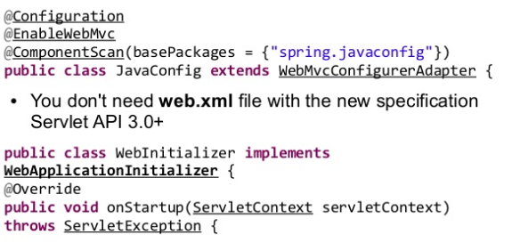
Spring MVC JAVA config
In order for configuring Spring MVC with JAVA config

Slide 22

Spring MVC email
Spring MVC can send emails to users using Java mail API
Inside the sample application Velocity Email Template is used in order for sending customized emals
Velocity is configured in configuration files and template locations should be set

Slide 23
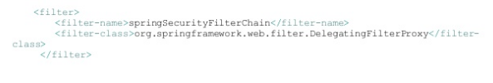
Spring security
In order for activating spring security in spring MVC applications , springSecurityFilerChain as to be configured in web.xml file with DelegatingFilterProxy
Spring security annotations and custom tages can be used in order for defining java method level security

Slide 24
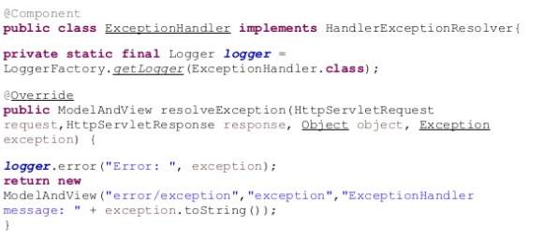
Spring exception handling
Inside spring MVC , users can be define a exception handling class by implementing

Slide 25
Spring REST with RestTemplate
@RestController will add @ResponseBody annotations to all methods inside a class
RestTemplate is used to access Rest Based Web services
@PAthVariable is used in order for getting variables from URL
ResponseEntity class is used to map response to Java objects

Slide 28
Retur

Slide 30
Return types from controllers
You can return the followings from controllers
ModelAndView
Model
Map
View
String
Void
HttpHeaders and others

