Slide 1
Spring jdbc
Instruction: NGUYEN ANH MINH (M. Sc.)

Slide 2
Outline
Introduction to spring jdbc
Spring jdbc development
Spring ioc intergration

Slide 3
Introduction

Slide 4
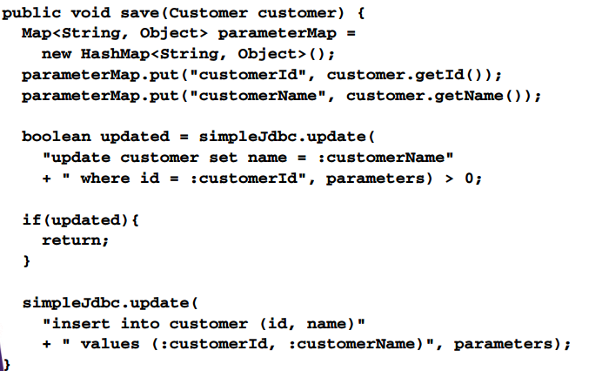
Spring jdbc solution

Slide 5
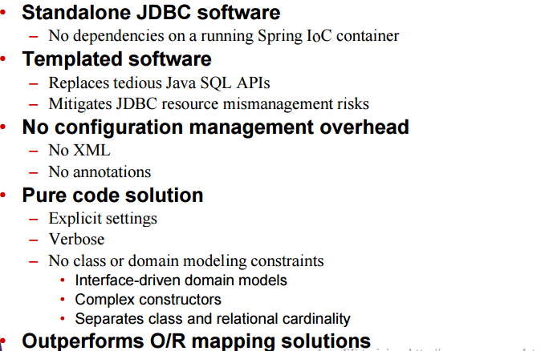
Spring JDBC

Slide 6
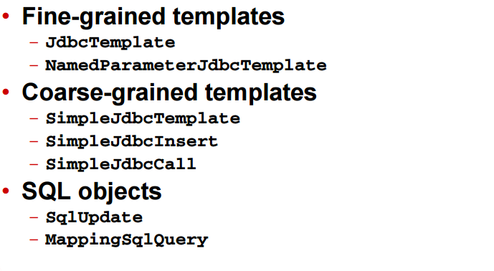
Spring JDBC templates

Slide 7
Spring IoC process review

Slide 8
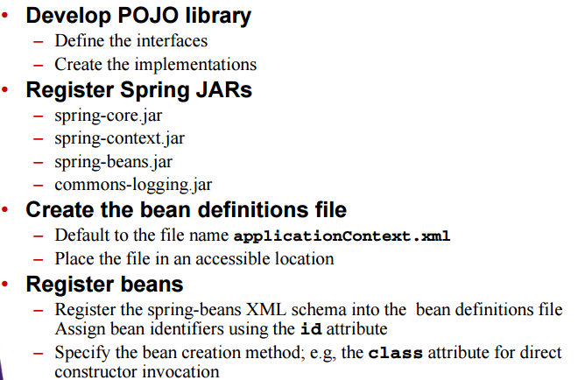
Spring IoC process

Slide 9
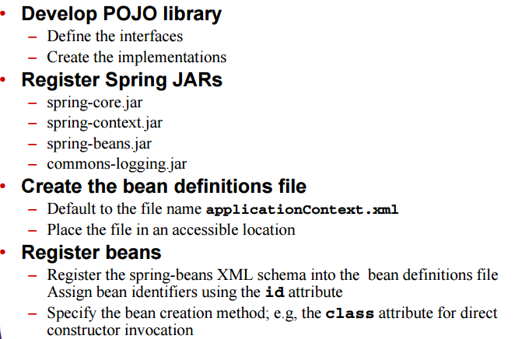
Spring IoC process

Slide 10
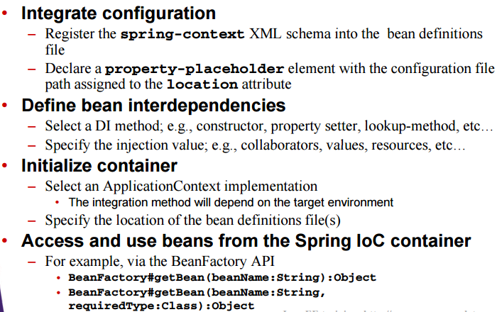
Spring IoC process

Slide 11
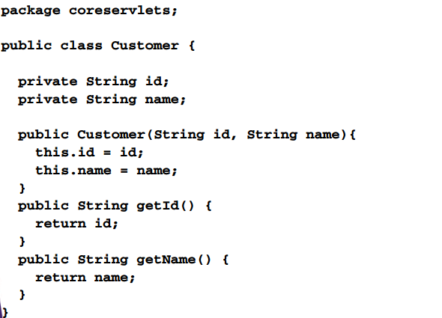
Develop pojo library

Slide 12
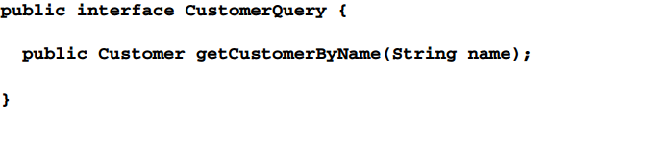
Develop pojo library

Slide 13
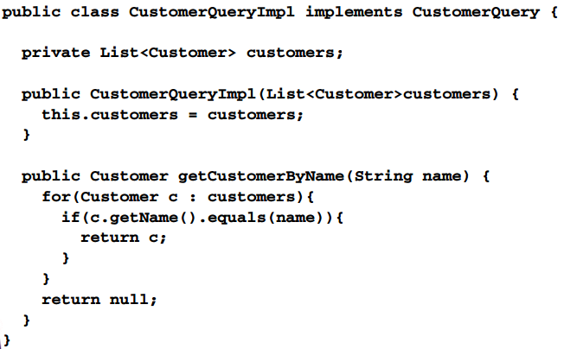
Develop pojo library

Slide 14
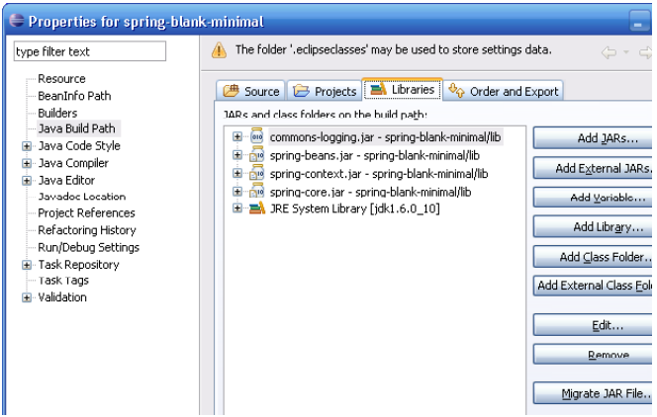
Register spring jars

Slide 15
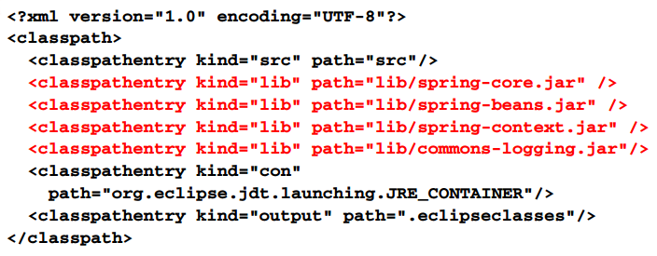
Register spring jars eclipse .classpath

Slide 16

Create the bean definition file

Slide 17
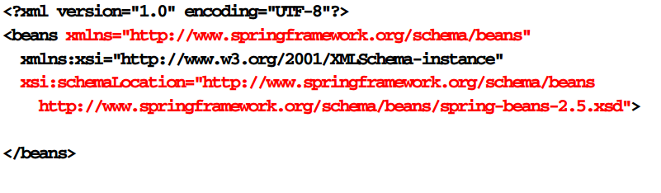
Register beans

Slide 18
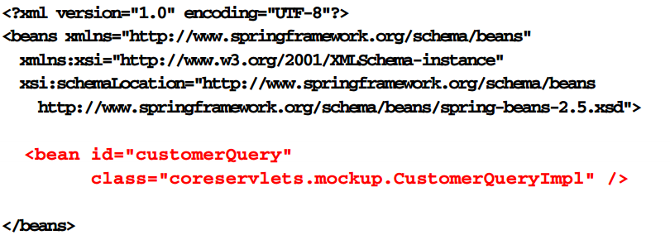
Register beans

Slide 19
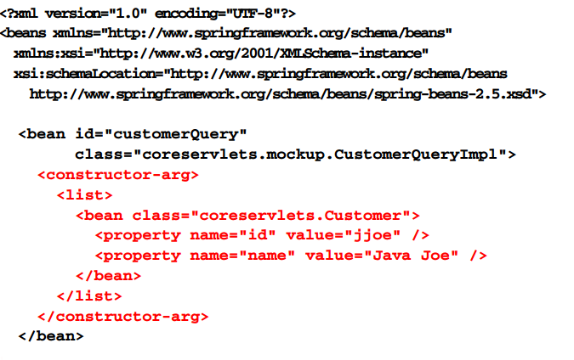
Define bean interdependencies

Slide 20
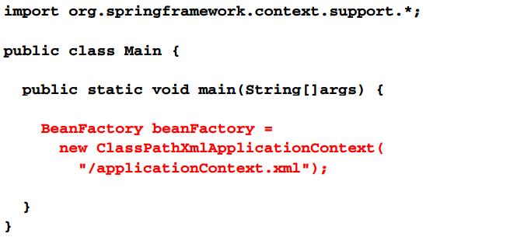
Initialize container

Slide 21
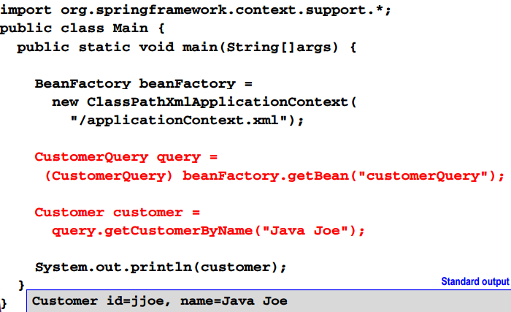
Access and use beans

Slide 22
Spring jdbc process

Slide 23
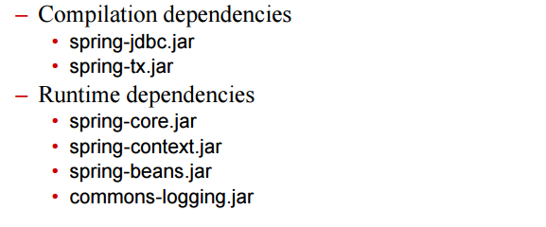
Spring jdbc process
Define persistence interfaces
Register spring jdbc jars

Slide 24
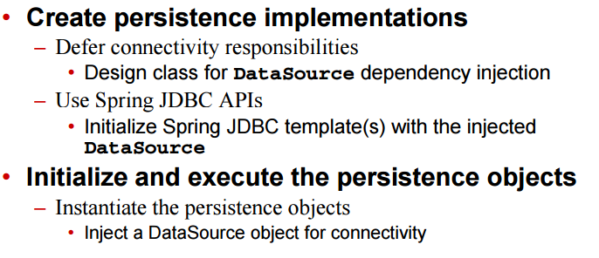
Spring jdbc process

Slide 25
Develop persistence interfaces
Public interface CustomerQuery {
Public Customer getCustomerByName(String name);
}

Slide 26
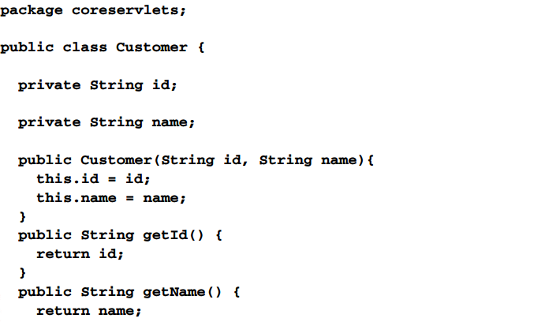
Develop persistence interfaces

Slide 27
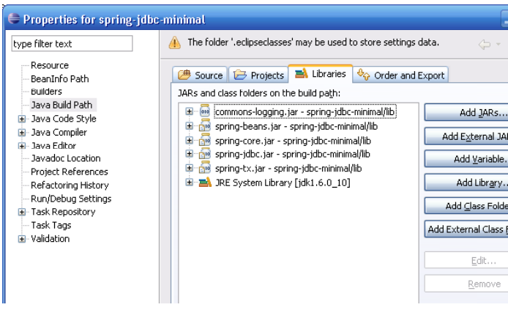
Register jdbc jars

Slide 28
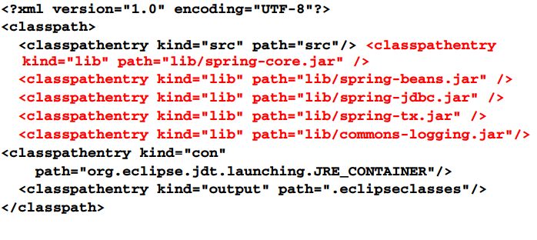
Register spring jdbc jars eclipse .classpath

Slide 29
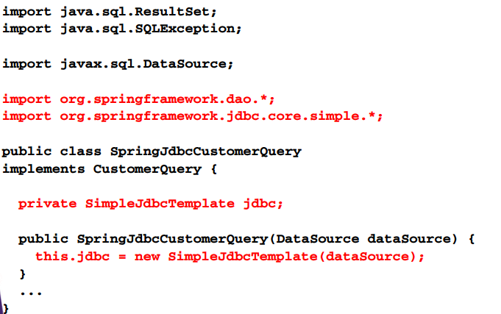
Implement persistence class

Slide 30
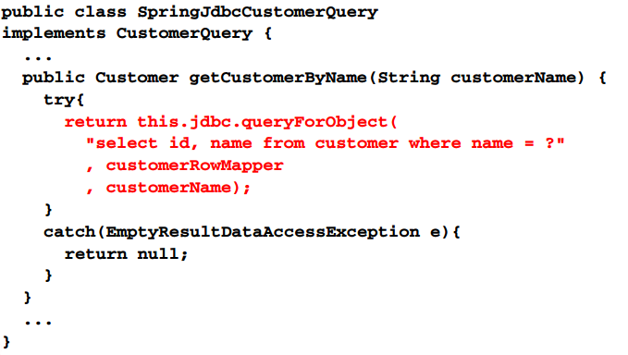
Implement persistence class

Slide 31
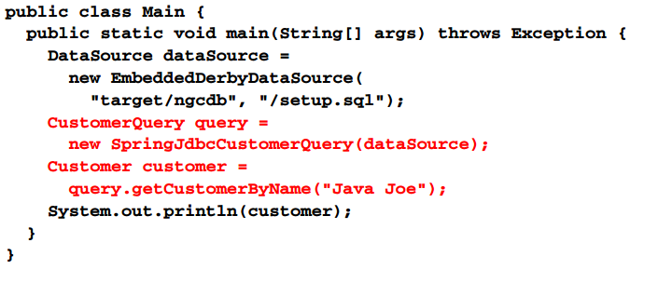
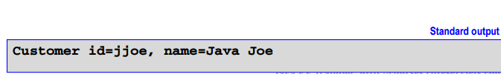
Initialize and execute persistence objects

Slide 32
Spring JDBC and spring IoC process

Slide 33
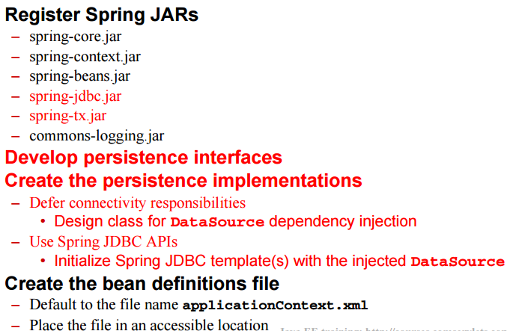
Spring JDBC and spring IoC process

Slide 34
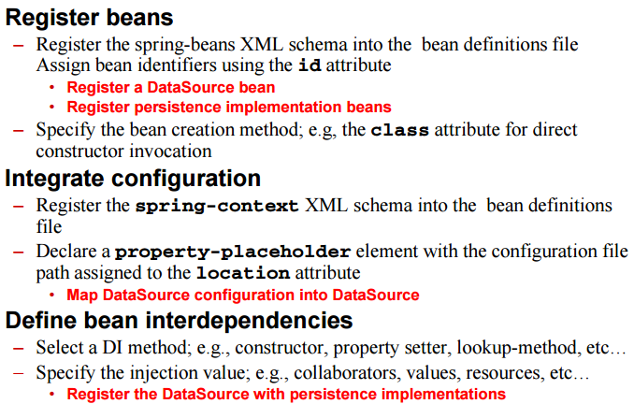
Spring JDBC and spring IoC process

Slide 35
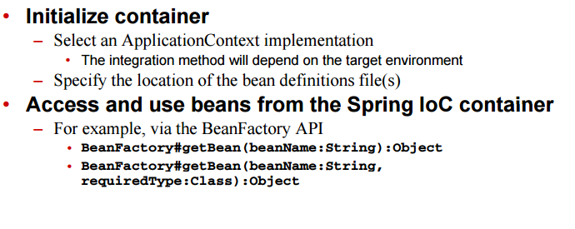
Spring JDBC and Spring IoC process

Slide 36
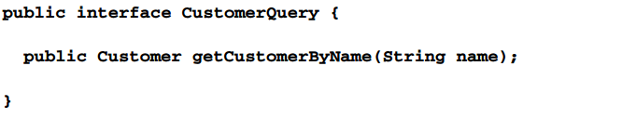
Develop persistence interfaces

Slide 37
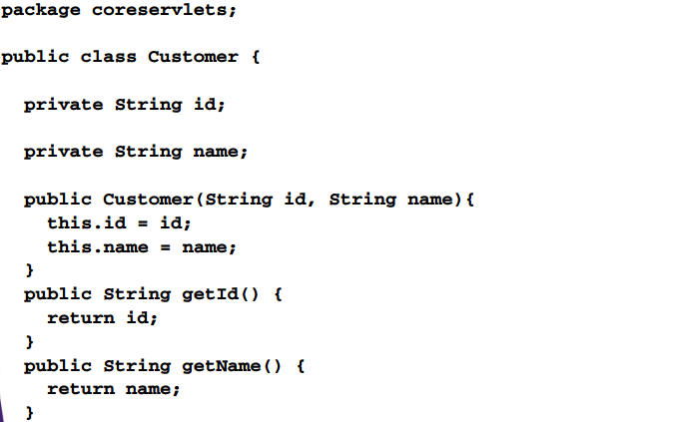
Develop persistence interfaces

Slide 38
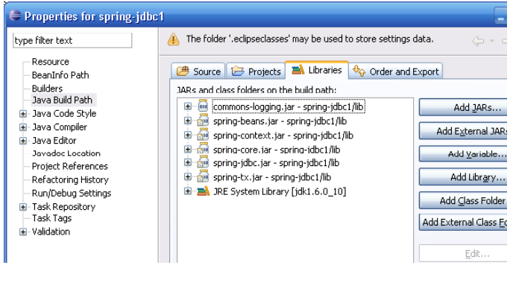
Register spring JDBC jars

Slide 39
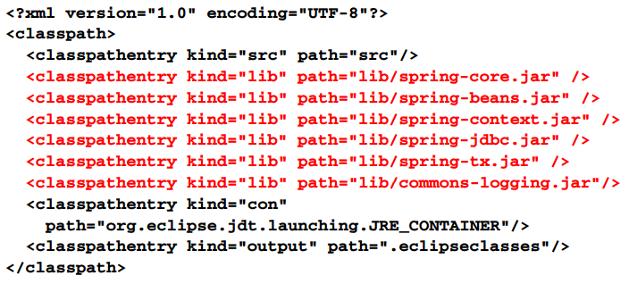
Register spring JDBC jars eclipse .classpath

Slide 40
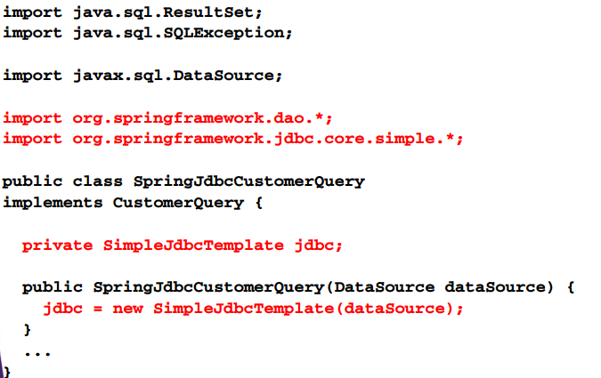
Implement persistence class

Slide 41
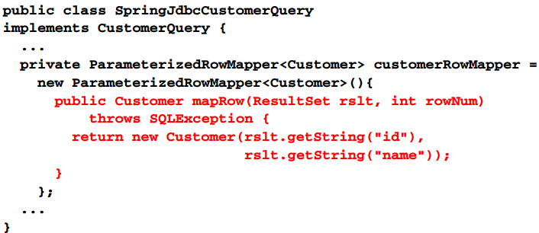
Implement persistence class

Slide 42
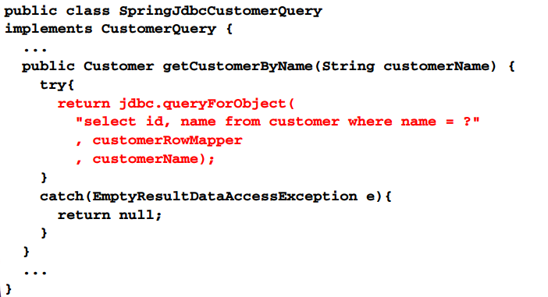
Implement persistence class

Slide 43
Create the bean definitions file
Default to applicationContext.xml
Place the file in an accessible location
Classpath, filesystem, or web module path

Slide 44
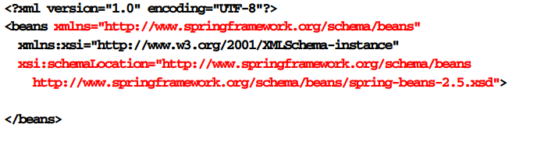
Register beans

Slide 45
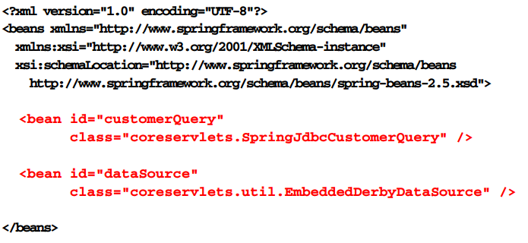
Register beans

Slide 46

Integrate configuration

Slide 47
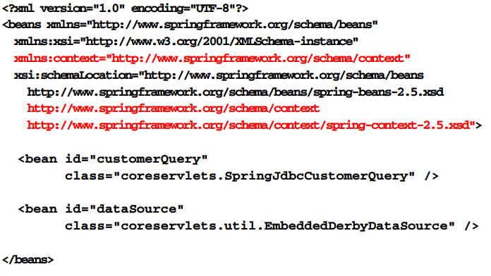
Integrate configuration

Slide 48

Integrate configuration

Slide 49
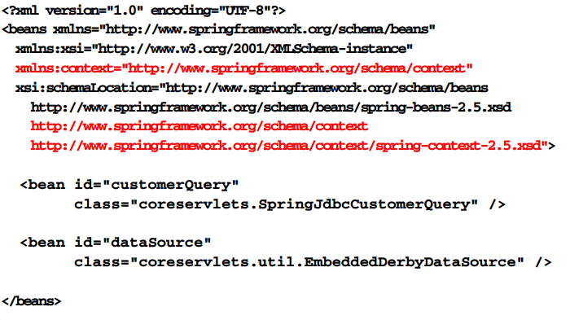
Integrate configuration

Slide 50
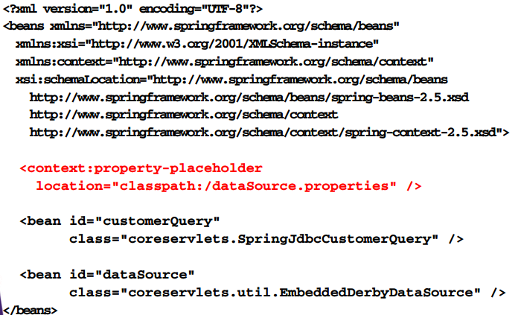
Integrate configuration

Slide 51
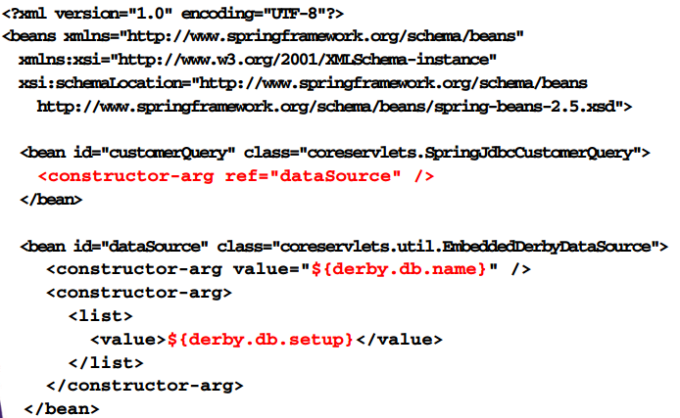
Define bean

Slide 52
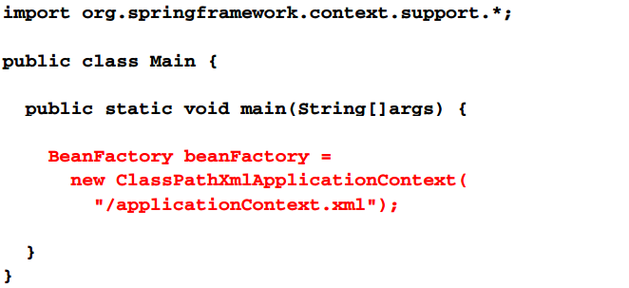
Initializer container

Slide 53
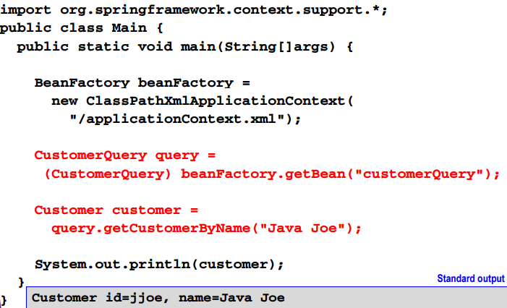
Access and use beans

Slide 54
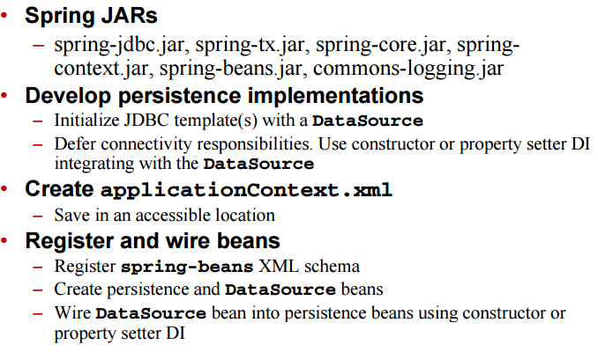
Spring JDBC and spring IoC process

Slide 55
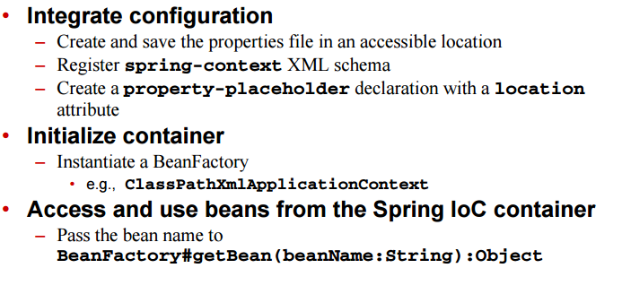
Spring JDBC and Spring IoC process

