Slide 1
Spring jdbc
Instruction: NGUYEN ANH MINH (M. Sc.)

Slide 2
Outline
Introduction to spring jdbc api
Result transformations
Parameter mapping
Updating data tables

Slide 3
Handling JDBC query results

Slide 4
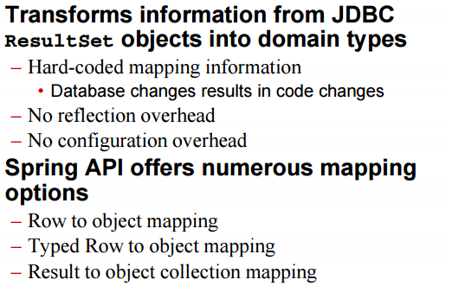
Spring JDBC resultSet

Slide 5
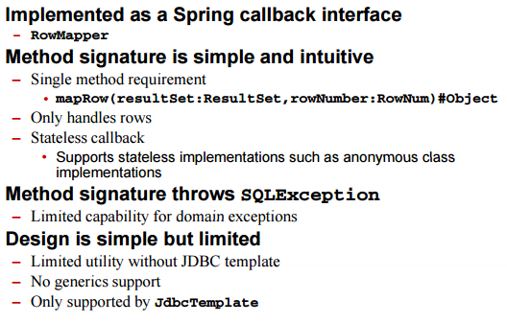
Row to Object Mapping

Slide 6
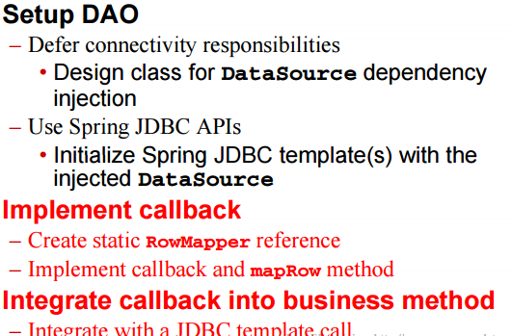
Row to Object Mapping Process

Slide 7
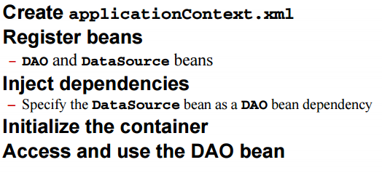
Row to object mapping process

Slide 8
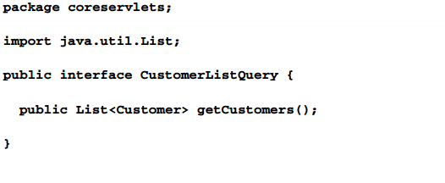
Creating DAO interface

Slide 9
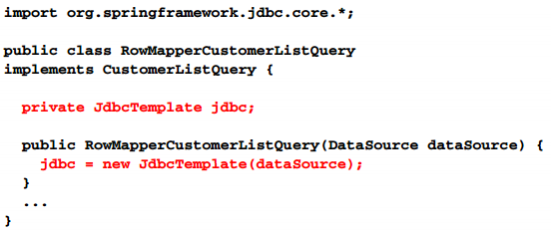
Setup DAO

Slide 10
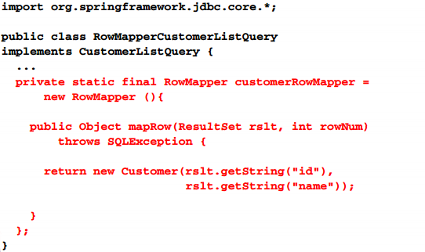
Implement callback

Slide 11
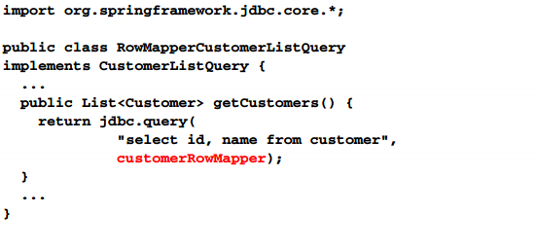
Integrate callback

Slide 12
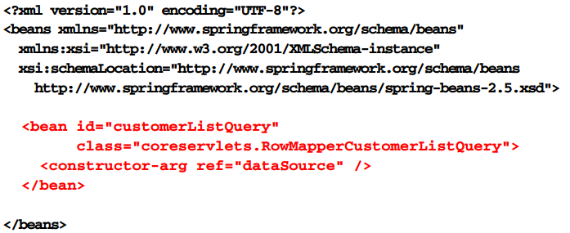
DAO Bean

Slide 13
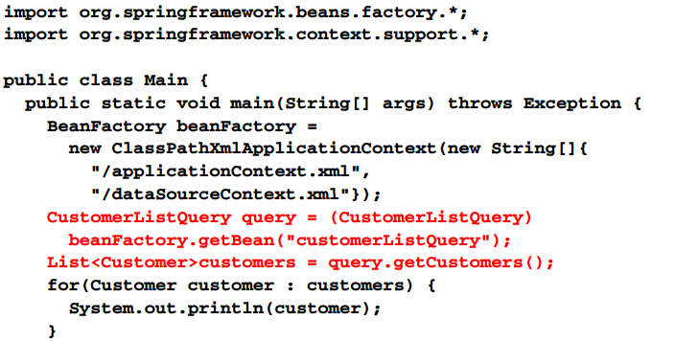
DAO Execution

Slide 14
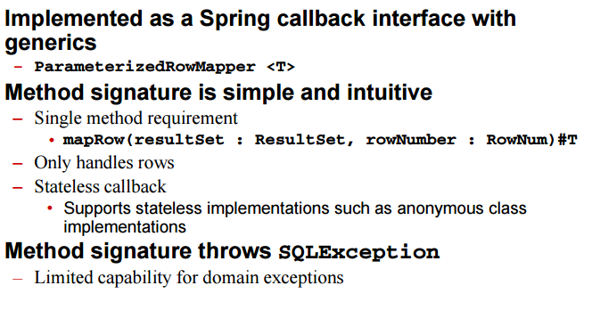
Typed row to object mapping

Slide 15
Spring query object

Slide 16
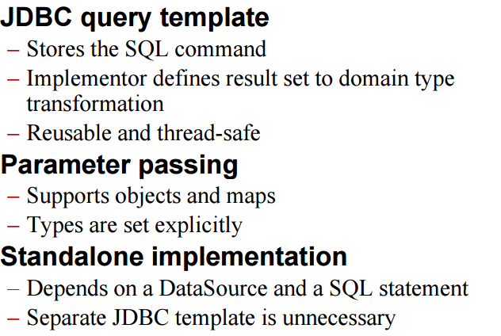
Spring query object

Slide 17
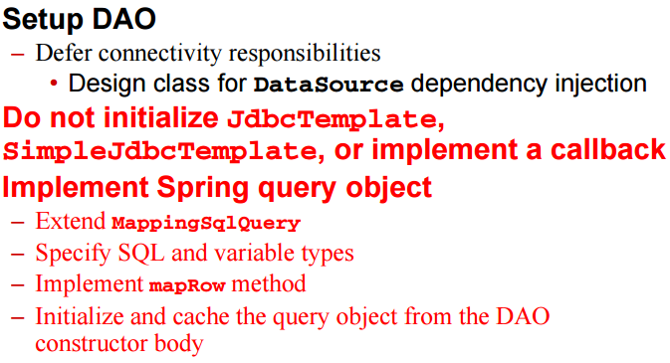
Spring query object process

Slide 18
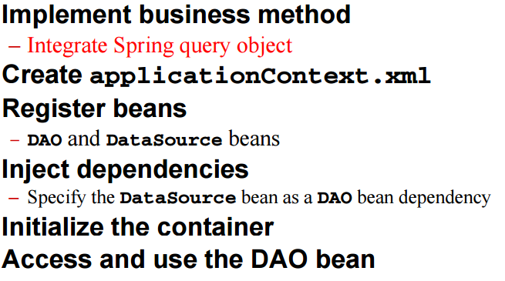
Spring query object process

Slide 19
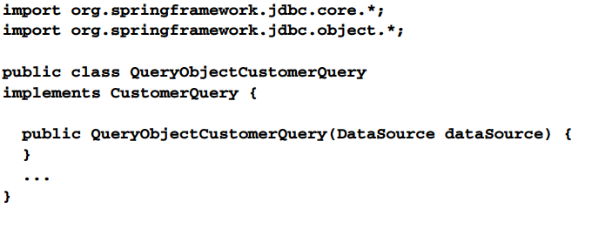
Setup DAO

Slide 20
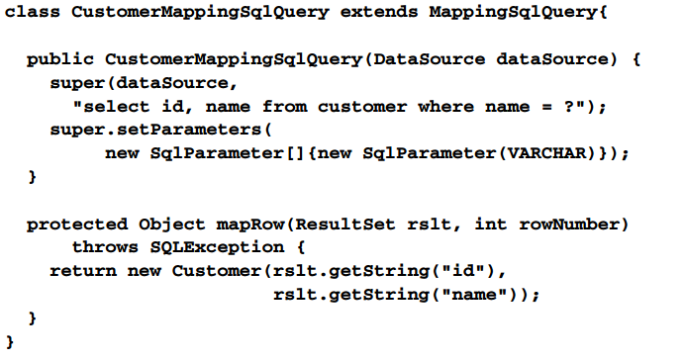
Implement spring query object

Slide 21
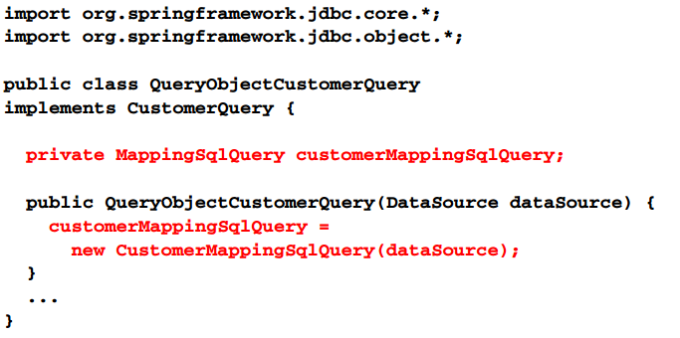
Initialize and cache spring query object

Slide 22
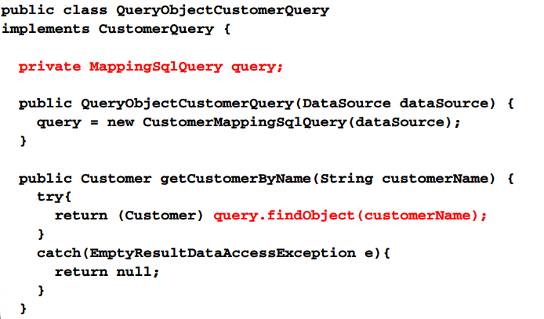
Integrate spring query object

Slide 23
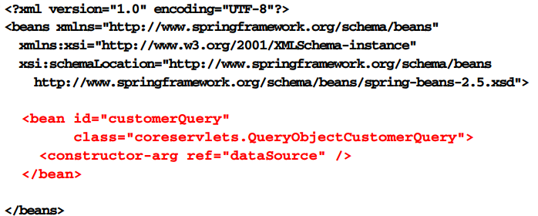
DAO Bean

Slide 24
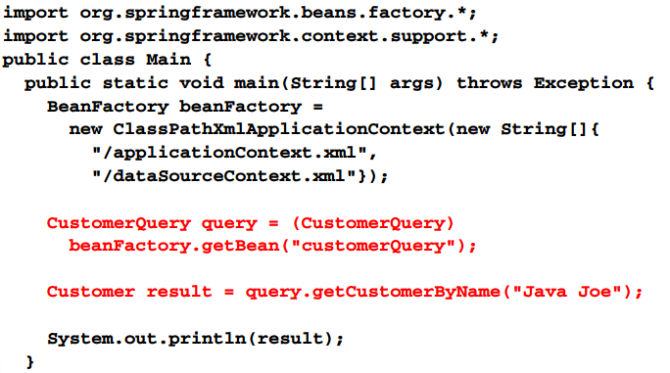
DAO Execution

Slide 25
Modifying the databases

Slide 26
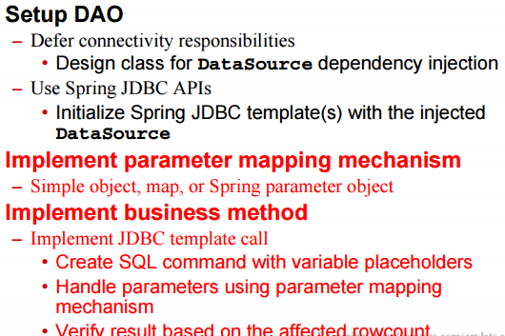
Spring JDBC table update

Slide 27
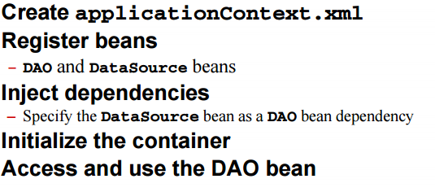
Spring JDBC table update

Slide 28
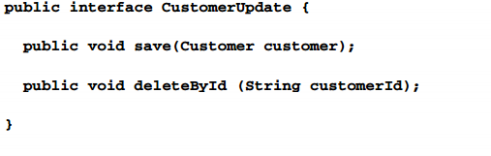
DAO interface

Slide 29
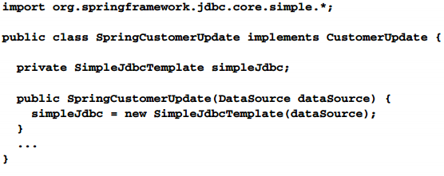
Set DAO

Slide 30
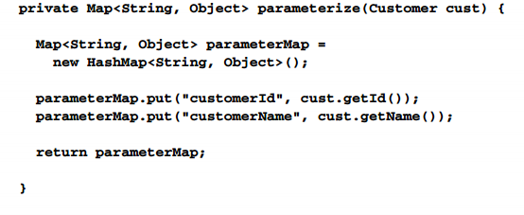
Implement parameter mapping

Slide 31
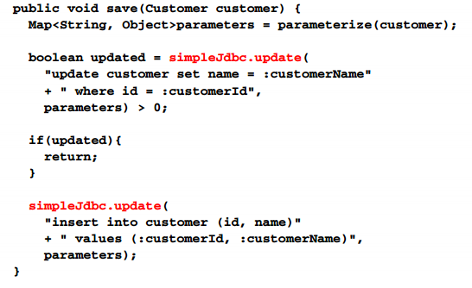
Implement save

Slide 32
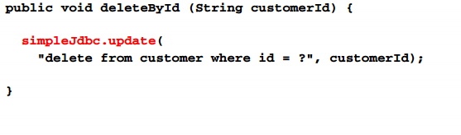
Implement delete

Slide 33
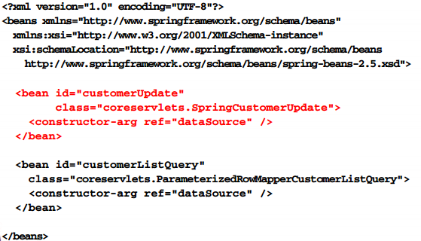
DAO Bean

Slide 34
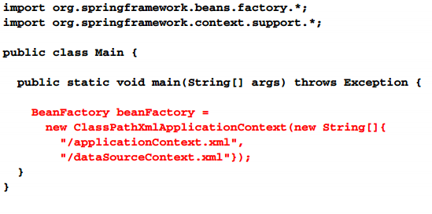
Instantiate container

Slide 35
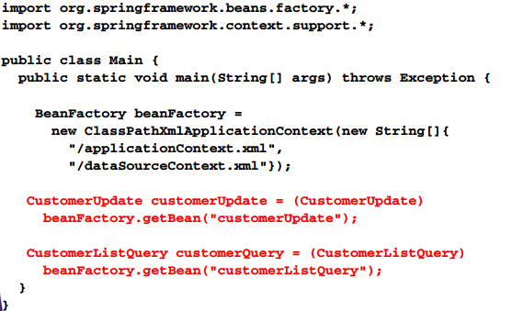
Acquire beans

Slide 36
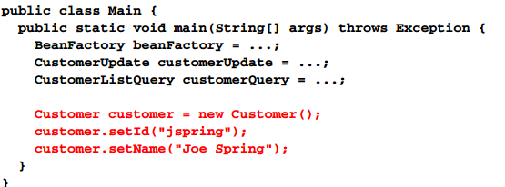
Setup customer object

Slide 37
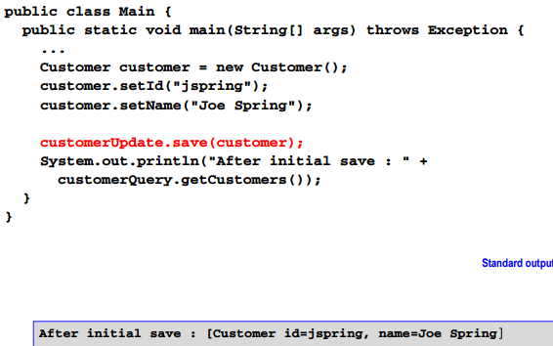
Save customer object

Slide 38
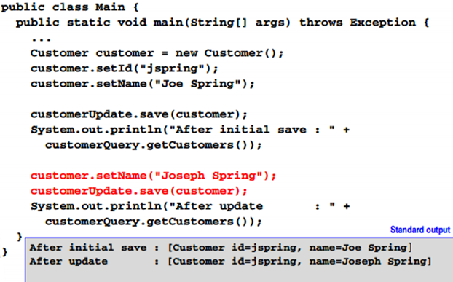
Update customer object

Slide 39
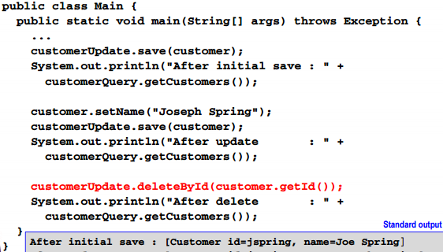
Delete customer object

Slide 40
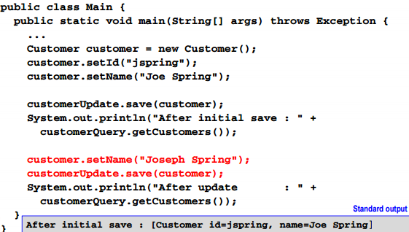
Update customer object

Slide 41
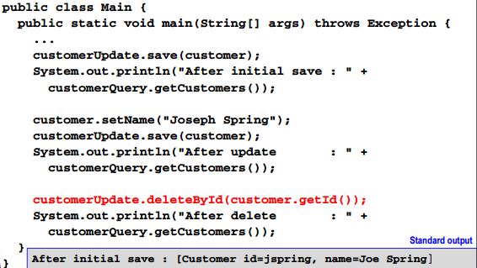
Delete customer object

Slide 42
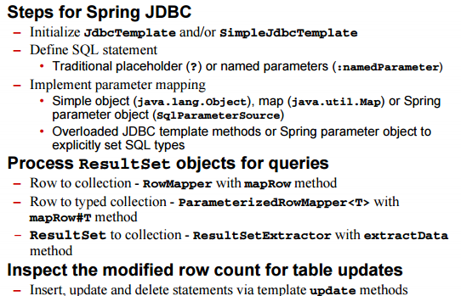
Summary

Slide 43
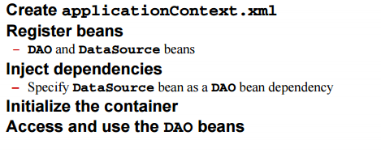
Summary

