Slide 1
Sigma sensitivity 1.5

Slide 2
Sigma sensitivity 2 deg

Slide 3
Variable re-weighting 1.5

Slide 4
Variable re-weighting 2

Slide 5
Composite weighting 1.5 all

Slide 6
Composite weighting 1.5 C1b

Slide 7
Composite weighting 1.5 C2

Slide 8
Composite weighting 2-deg

Slide 9
Composite weighting, temperature outcomes

Slide 10
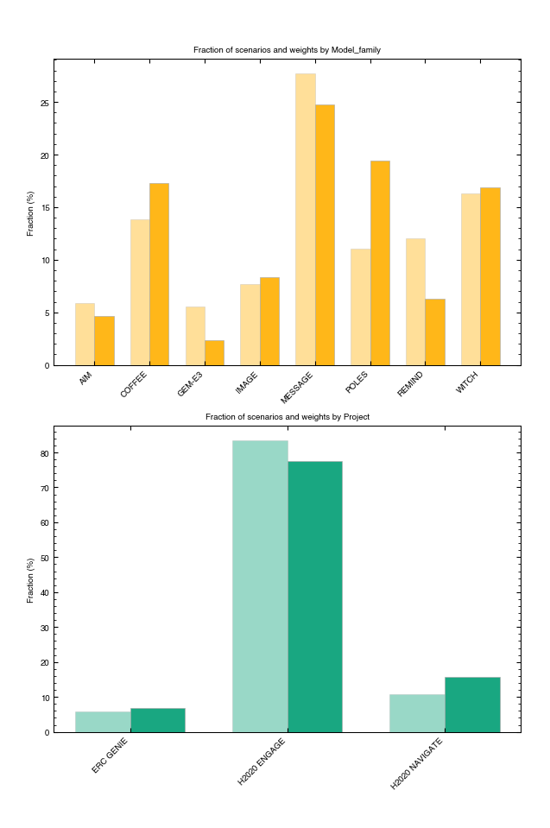
Model/Project Distribution
1.5 deg
2 deg
All-scen

