Slide 1

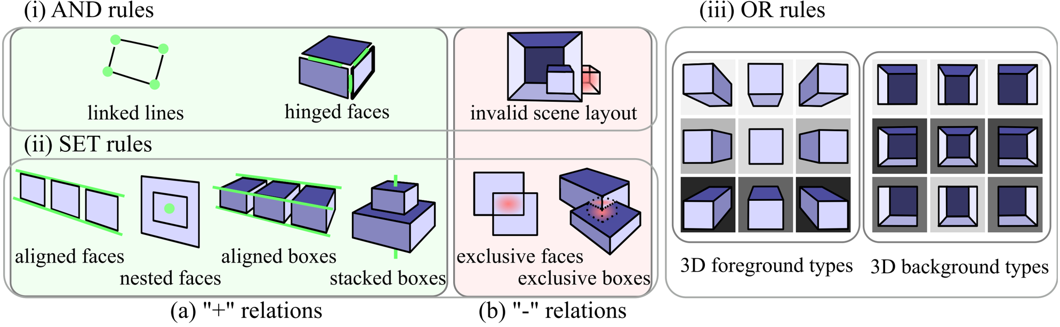
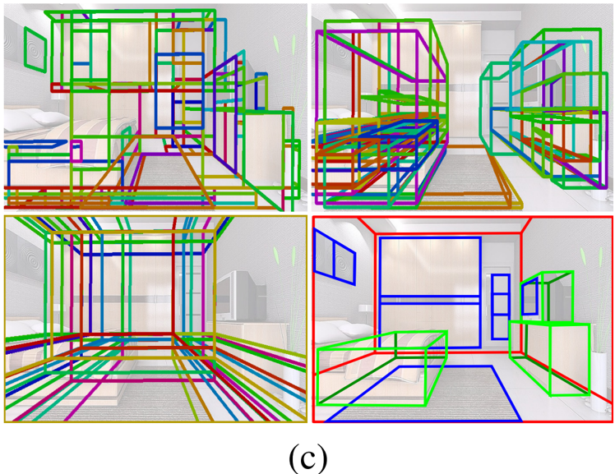
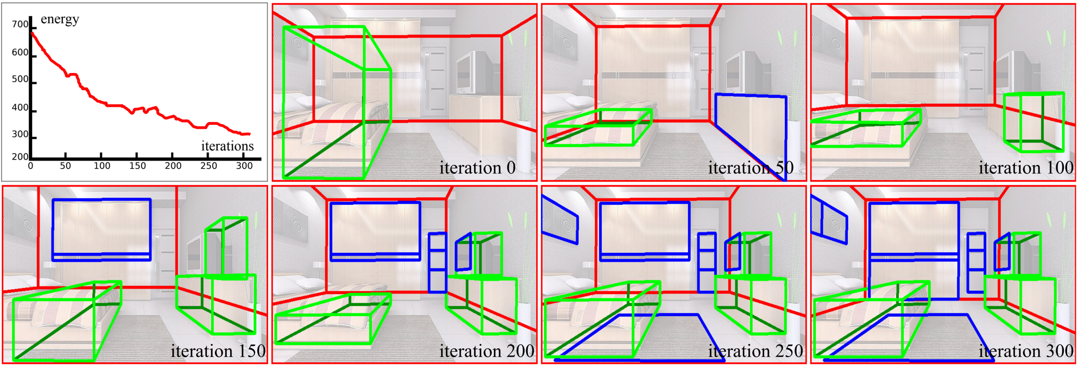
Image Parsing via Stochastic Scene Grammar
Yibiao Zhao¹, Song-Chun Zhu¹
¹Department of Statistics, University of California, Los Angeles
▶ Abstract
▶ Stochastic Scene Grammar
▶ Bayesian Formulation
•Proposes a parsing algorithm for scene understanding.
•Utilizes a generative Stochastic Scene Grammar (SSG).
•Computes 3D scene layout and detects objects.
•Features an efficient MCMC inference algorithm.
•SSG is defined as a four-tuple with production rules.
•AND rules decompose entities into components.
•OR rules allow switching between sub-types.
•Probabilistic model.
•AND/OR graph structure.
▶ Introduction
•Scene understanding uses hierarchical structures.
•Discriminative methods classify pixels.
•Generative methods use graph structures.
•SET rules are used to form ensembles.
•Cooperative '+' relations bind entities together.
•Competitive '-' relations specify exclusivity.
▶ Inference Algorithm
▶ Experiments
•Infers optimal parse trees using hierarchical sampling.
•Combines bottom-up clustering and top-down sampling.
•Tested on datasets.
•Qualitative evaluations highlight effectiveness.
•Outperforms state-of-the-art methods.
▶ Conclusion
•Proposes new parse trees with strong support.
•Refines cluster selection through sampling.
•Framework for geometric image parsing using SSG.
•Grammar model extends traditional grammars.
•Cluster sampling accelerates inference.
•Future work: add semantic labels to 3D objects.

