Slide 1

Music Genre Classification
Hamiz Siddiqui

Slide 2
Project Overview
Goal: automatically classify songs into genres using machine learning.
Motivation: similar idea used in Spotify/Apple Music for recommendations and playlist generation.
Focus: classical ML models with engineered audio features instead of deep learning.

Slide 3
Dataset: GTZAN
999 usable audio clips across 10 genres (blues, classical, country, disco, hiphop, jazz, metal, pop, reggae, rock).
Each clip is ~30 seconds, sampled at 22,050 Hz.
One corrupted file was removed; train/test split = 80% / 20% with stratification.

Slide 4
Feature Extraction (Librosa)
Extracted MFCCs, chroma vectors, spectral contrast, tonnetz, spectral centroid/bandwidth/rolloff, and RMS energy.
Computed mean and standard deviation over time for each feature type.
Final representation: 157-dimensional feature vector per track.

Slide 5
Models and Training
Supervised models: Logistic Regression, kNN, Linear SVM, RBF SVM, Decision Tree, Random Forest, AdaBoost.
Used GridSearchCV with 5-fold cross-validation to tune hyperparameters.
Also tried unsupervised clustering (K-Means, Bayesian GMM) and generative models (GaussianNB, class-conditional GMMs).

Slide 6
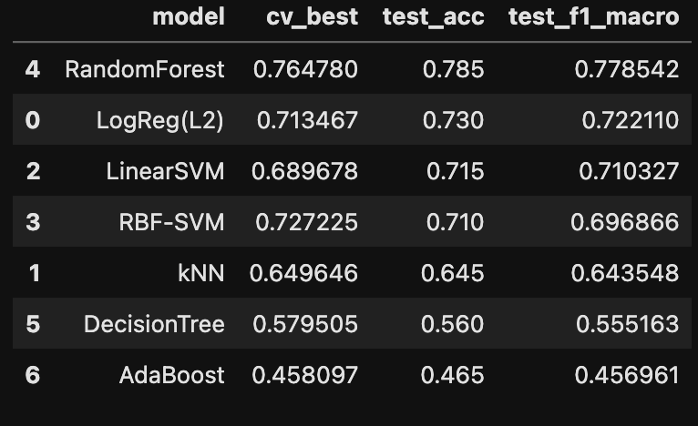
Model Performance Comparison
Random Forest achieved the best test accuracy (~78.5%) and macro F1-score (~0.78).

Slide 7
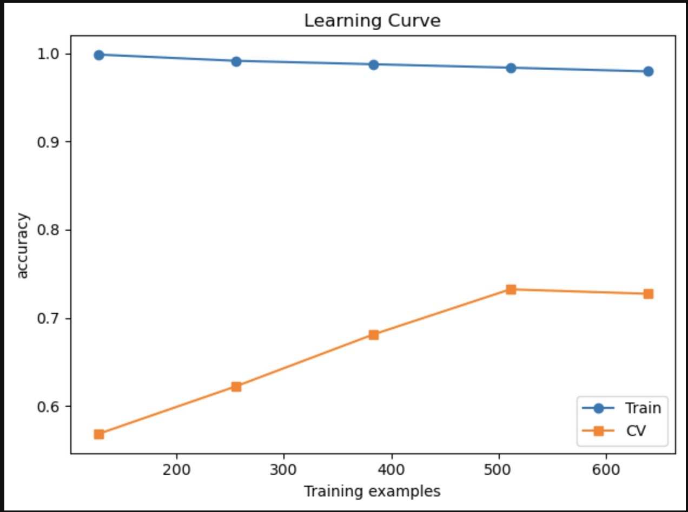
Learning Curve
Validation accuracy improves as we add more training examples; training accuracy remains very high, indicating some overfitting but room for improvement with more data.

Slide 8
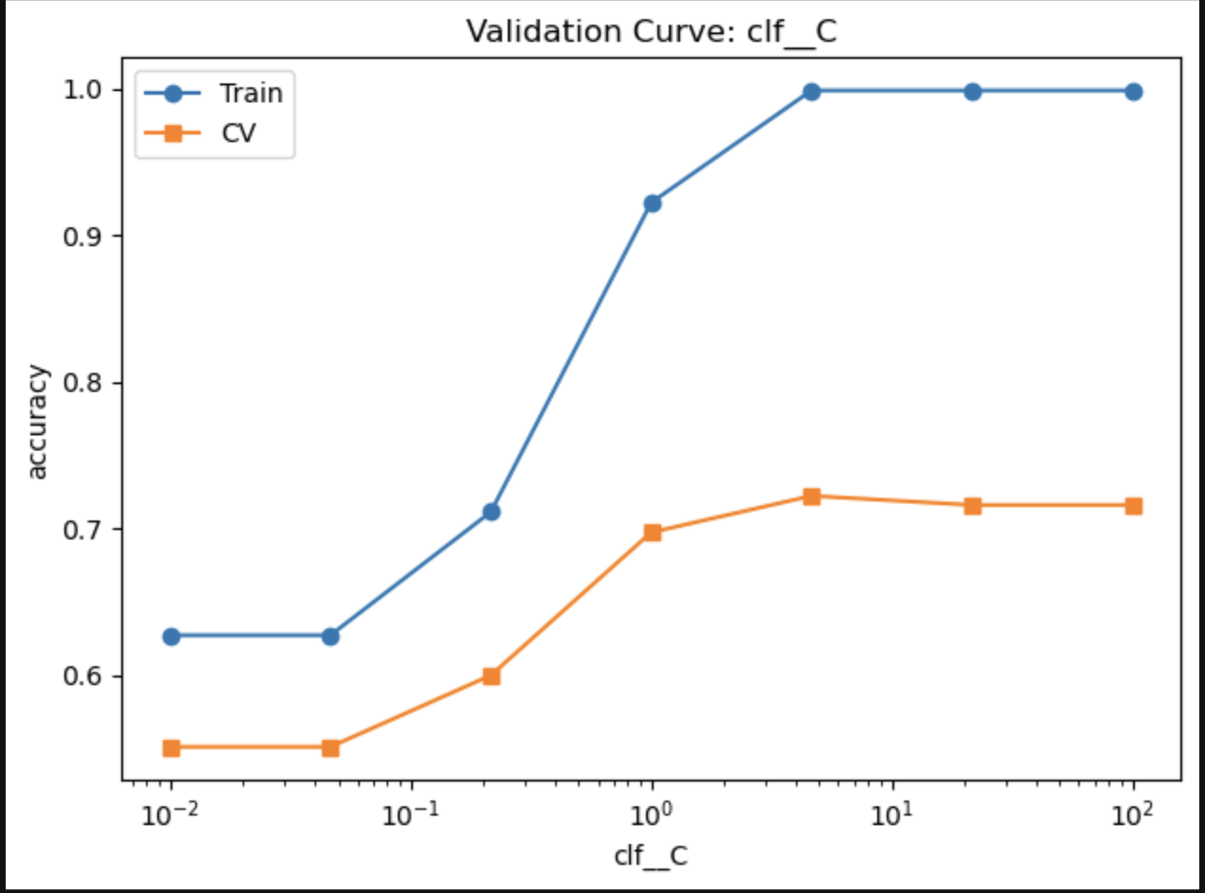
Validation Curve (SVM C parameter)
Best performance occurs around C ≈ 1–10; low C underfits, very large C starts to overfit.

Slide 9
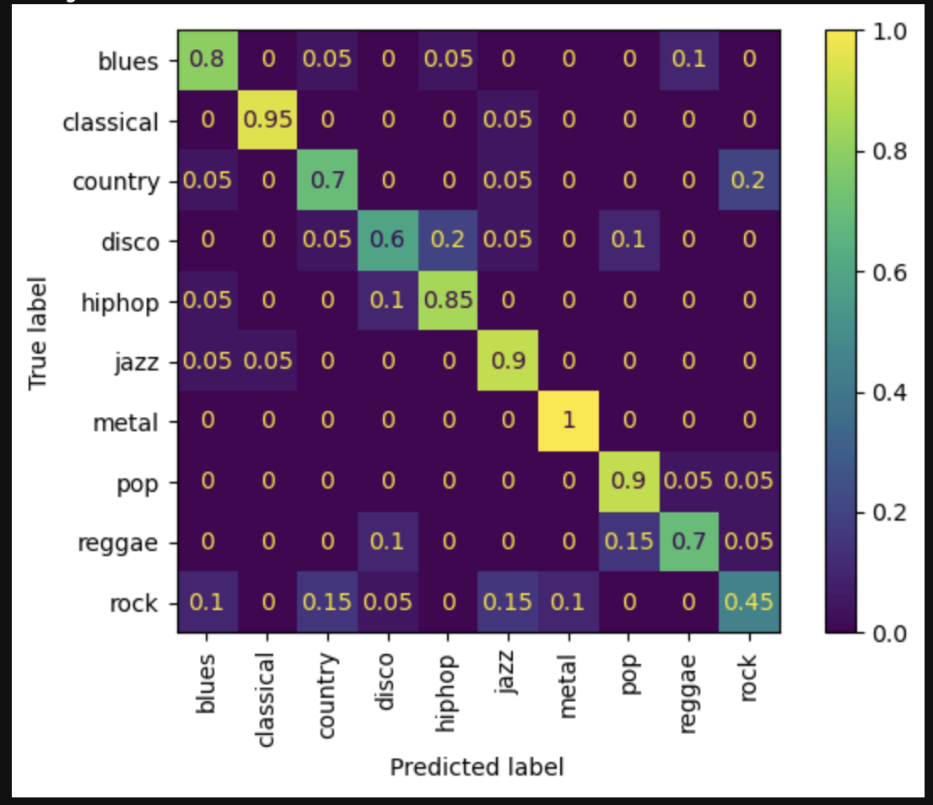
Confusion Matrix (Random Forest)
Classical, metal, and jazz are classified very accurately; country, rock, and reggae are more often confused with each other.

Slide 10
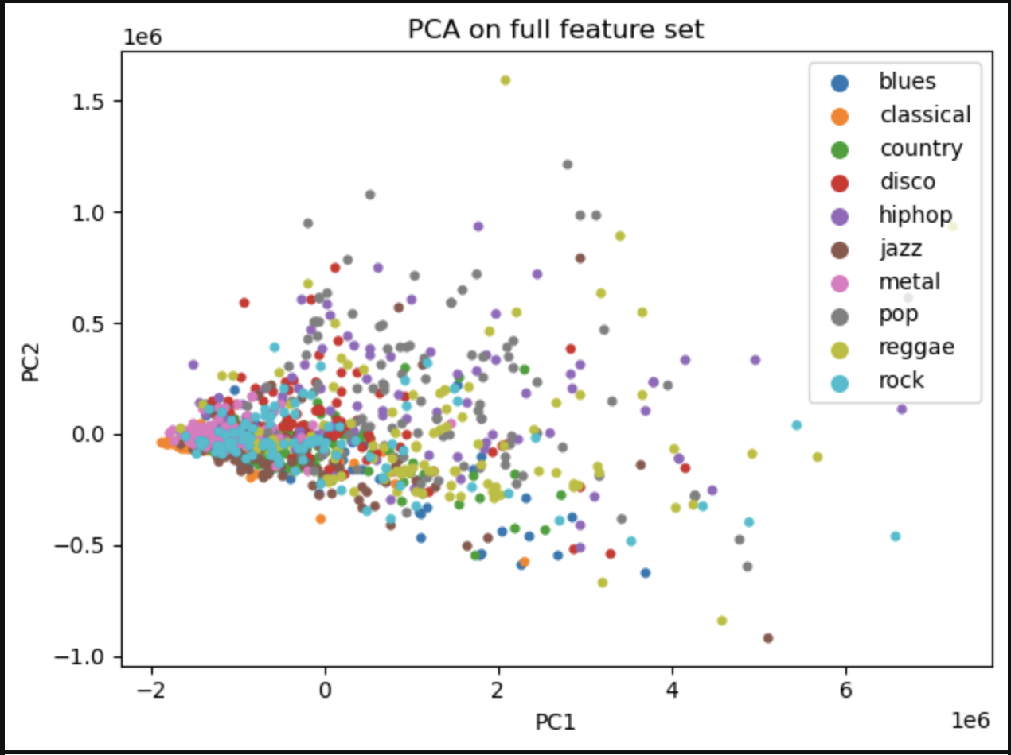
PCA Visualization
PCA projection shows heavy overlap between genres in feature space, explaining why unsupervised clustering is difficult.

Slide 11
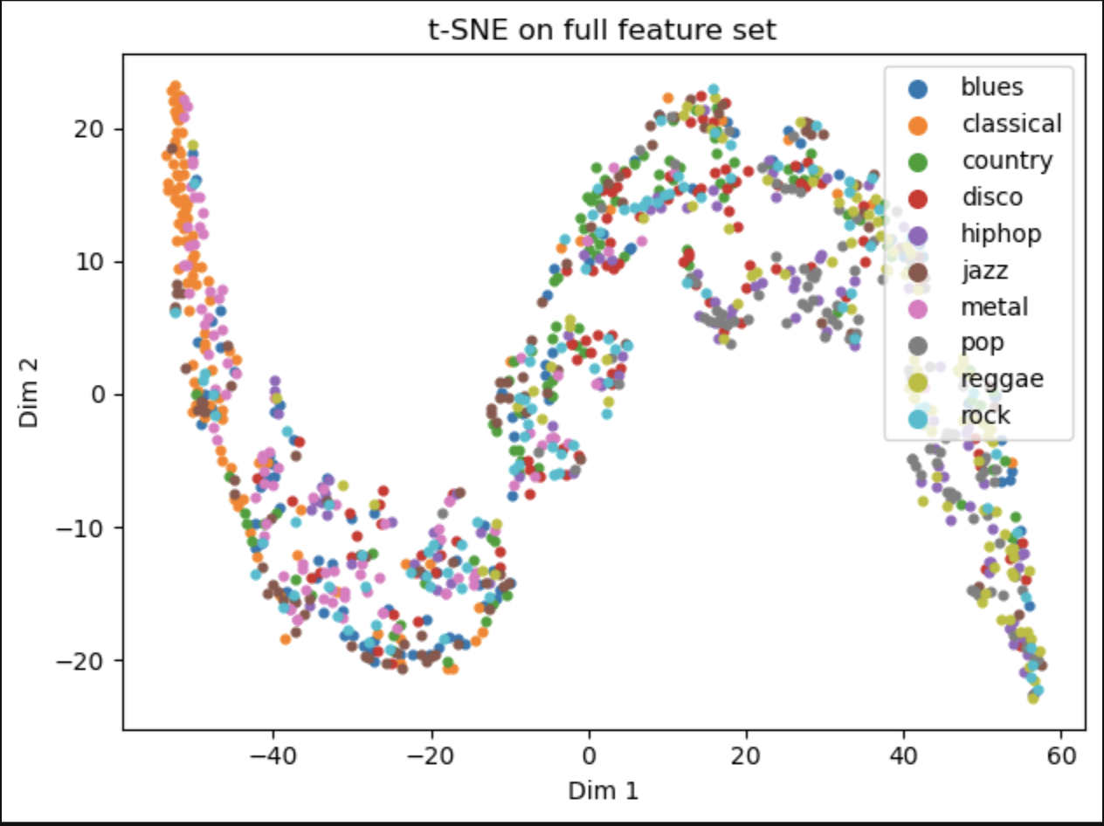
t-SNE Visualization
t-SNE reveals some curved manifold structure but genres are still mixed, confirming that labels are important for this task.

Slide 12
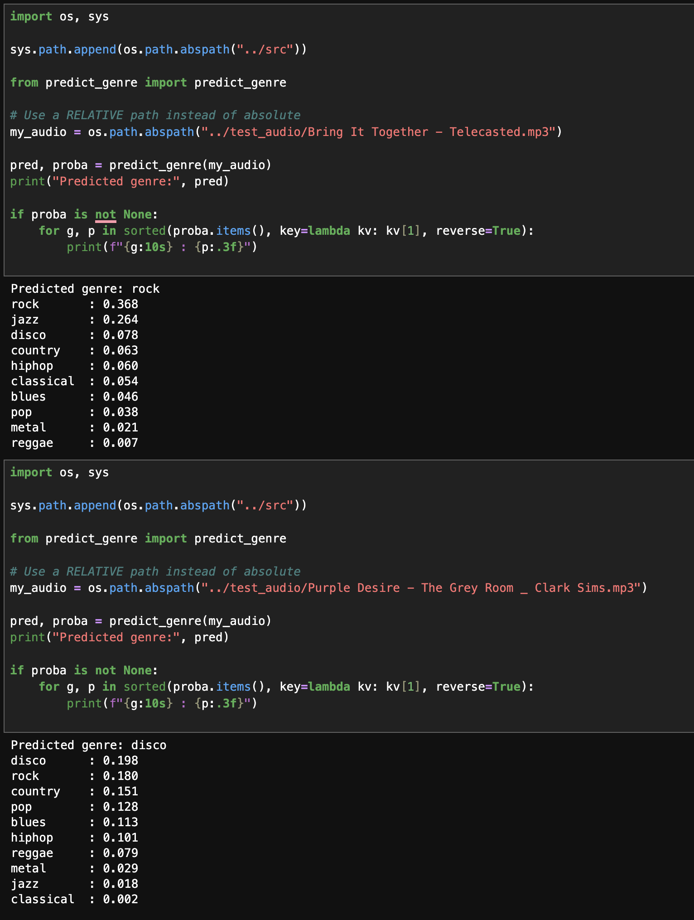
Predicting my own music
To test the model beyond the GTZAN dataset, I created a script that allows users to input any MP3 file. The script extracts the same audio features used during training and passes them through the trained Random Forest model. I tested it on one of my own songs (‘Bring It Together – Telecasted.mp3’), and the model successfully predicted a genre along with probability scores for all 10 classes, demonstrating that the system works on real-world audio outside the training set.

Slide 13

Insights and Future Work
Engineered audio features plus classical ML (especially Random Forest) can reach ~78.5% test accuracy.
Genres with distinct timbres (classical, metal, jazz) are easier; overlapping styles (rock/country/reggae) are harder.
Future work: CNNs on mel-spectrograms, data augmentation, larger datasets, and sequence models such as CRNNs or transformers.

Slide 14

Conclusion
Built a complete pipeline: feature extraction, model training, evaluation, and a script that predicts genre for a new MP3 file.
Results show classical ML is still competitive for music genre classification with good features.
Project gave hands-on experience with audio processing, model comparison, and interpreting ML results.

