Slide 1
April 2026
TimeBox Testing Lab:
A Fault Injection Framework
A Full-Stack Testing System Using FastAPI, Pytest, and Playwright
HAMIZ SIDDIQUI
MS Computer Science

Slide 2
TEXAS ENGINEERING
Problem and Project Idea
Why this project
Flaky behavior usually comes from timing, ordering, stale state, or small hidden assumptions that only show up once the app is pushed out of its clean baseline.
Project direction
Instead of copying a huge research-style proposal, I built a smaller fault-injection lab where bugs can be turned on and observed immediately.
What makes it useful
The same dashboard supports normal task actions, bug activation, scenario presets, test automation, and a visible browser demo.
Final app focus
Simple task workflow
Controlled fault profiles
Session-safe behavior
Visible demo artifacts
Readable test outcomes

Slide 3
TEXAS ENGINEERING
Tech stack at a glance
BACKEND
FastAPI
web framework + routing
SQLite
zero-config persistence
itsdangerous
signed session cookies
uvicorn
ASGI server
~450 lines in main.py
FRONTEND
Jinja2 templates
server-rendered HTML
Vanilla CSS
~600 lines, custom design
Vanilla JavaScript
~40 lines, no framework
4 templates
base, login, register, dashboard
No build step, no bundler
TESTS & TOOLING
Pytest
test runner + fixtures
Playwright
real-browser automation
FastAPI TestClient
in-process API calls
demo_browser_run.py
visible scenario walkthrough
13 automated tests in total
Deployment: render.yaml + Procfile — ready to deploy to Render's free tier.

Slide 4
TEXAS ENGINEERING
Architecture and flow
User / Presenter
Creates tasks, edits them, and turns faults on for a demo.
Dashboard UI
Task workspace, task board, controls, presets, and fault toggles.
Session Fault State
Bug profiles stored per browser session, not globally.
FastAPI + SQLite
App logic changes behavior depending on the active profile.
Tests + Demo Runner
Pytest, Playwright, visible browser runs, and full-page screenshots.

Slide 5
TEXAS ENGINEERING
Features and workflow
1. Task workspace
Create new tasks and edit existing ones from the same form.
Keeps the app realistic enough for repeatable demos.
2. Session fault control panel
Turn fault profiles on and off directly from the dashboard.
One browser session can be buggy while another stays clean.
3. Demo presets
Search, timing, and sorting presets activate grouped scenarios with one click.
Makes the presentation flow much faster.
4. Task board
Shows completion state, overdue status, due time, and quick actions.
Also gave us a clean place to validate edits and state changes.
5. Scroll restore
After clicks, the page returns to the same spot instead of jumping to the top.
Small fix, big improvement during demos.
6. Full-page screenshot capture
Demo images now show the whole page after the app settles.
That made the report and slides much more usable.

Slide 6
TEXAS ENGINEERING
Faults and demo presets
Fault profiles
Slow UI
Duplicate create bug
Unstable sort bug
Search regression
Dashboard cache bug
Midnight boundary
Preset examples
Search Demo → search regression
Timing Demo → slow UI + midnight boundary
Sorting Demo → unstable sort
Why presets mattered
They let me show a full scenario quickly instead of toggling multiple bugs manually every time.

Slide 7
TEXAS ENGINEERING
Testing strategy
API tests
Fast checks for task creation, updates, fault isolation, and preset behavior.
UI tests
Playwright confirms the real page can create, edit, search, and show bugs.
Visible demo run
Walks through scenarios in a browser with live tests.
Automated checks that passed in the final version:
• 9 API tests
session faults, updates, presets, duplicate create, search behavior, and boundary logic.
• 4 UI tests
happy path, edit flow, duplicate bug visibility, and preset-based search failure.
Shared goal
Make sure the same project works as code, as tests,

Slide 8
TEXAS ENGINEERING
Reproducibility design
01
Frozen clock
Set in the test env:
TIMEBOX_FIXED_NOW = 2026-04-17T12:00:00
Pins the app's view of "now" so due-date logic and the midnight-boundary fault produce identical results every run.
02
Reset hooks
Called in every pytest fixture:
reset_db()
reset_fault_profile()
Each test starts from a clean database and a clean fault profile, so order-of-execution never changes the outcome.
03
Session isolation
Verified by a dedicated test:
test_fault_profiles_are_
isolated_per_session
Two TestClient instances, two signed session cookies. One client's active faults never leak into the other's view.

Slide 9
TEXAS ENGINEERING
Test coverage breakdown
API tests
9 tests • tests/test_api.py
Auth
Unauthorized request to /api/tasks returns 401.
Validation
Empty task title rejected with 400.
CRUD
Create-then-read returns the task. Update via PUT changes title, description, and completion state.
Fault behavior
Duplicate create produces 2 rows. Search regression drops lowercase matches. Midnight boundary shifts status.
Session isolation
Two TestClient instances — client A's active faults stay invisible to client B.
Preset semantics
Applying a preset replaces the existing profile rather than merging with it.
UI tests
4 tests • tests/test_ui_playwright.py
Happy path end-to-end
Register → log in → reset faults → create task → search → see result.
Edit flow
Create a task, open it in edit mode, change title + description + due date, and confirm the old row is gone.
Duplicate fault visibility
Toggle duplicate_create_bug, submit one form, assert 2+ rows actually appear in the DOM.
Preset-based search failure
Apply search_demo preset, create "Alpha Task", search for "alpha", assert zero rows (case-sensitive regression).

Slide 10
TEXAS ENGINEERING
Experimental results
9
API tests passed
4
UI tests passed
Representative outcomes
Duplicate create → one submit creates two rows.
Search preset → 'alpha' does not find 'Alpha Task'.
Timing preset → UI slows down and due-date edges become easier to challenge.
Sorting preset → ordering becomes less stable and more surprising.
What improved the most
Session-based faults made behavior easier to isolate.
UI controls made the lab much easier to present.
Task editing made the app feel less fake.

Slide 11
TEXAS ENGINEERING
Issues we ran into and how we fixed them
• API-only controls felt hidden
Fix: moved fault toggles into the dashboard and kept the API mainly for automation.
• Global fault state was messy
Fix: stored the fault profile in the browser session so demos do not interfere with one another.
• The app needed a better workflow
Fix: added edit-task support instead of forcing everything through create/delete.
• Button clicks jumped back to the top
Fix: added a lightweight scroll-restore script so the page stays near the action.
• Demo screenshots looked incomplete
Fix: capture full-page images after the page settles and scrolls back to the top.
Why those fixes matter
Without them, the project technically works but feels unfinished.
With them, the app, tests, screenshots, and presentation all tell the same story.
That ended up being one of the biggest lessons of the whole project.

Slide 12
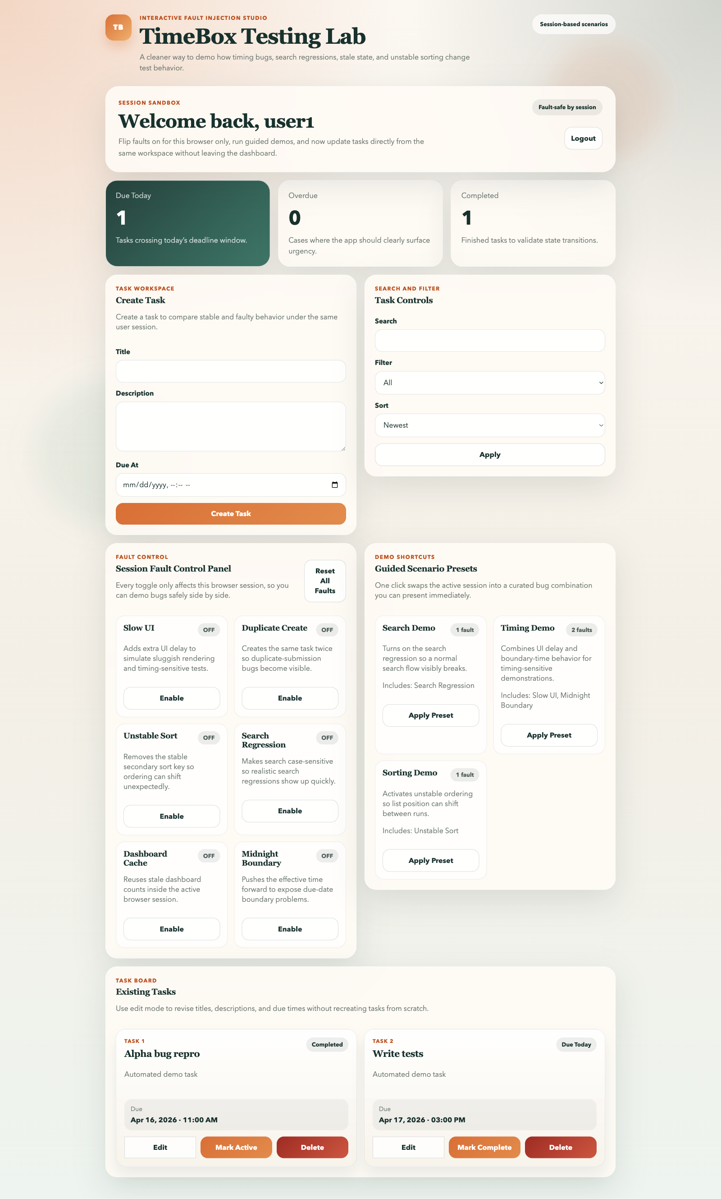
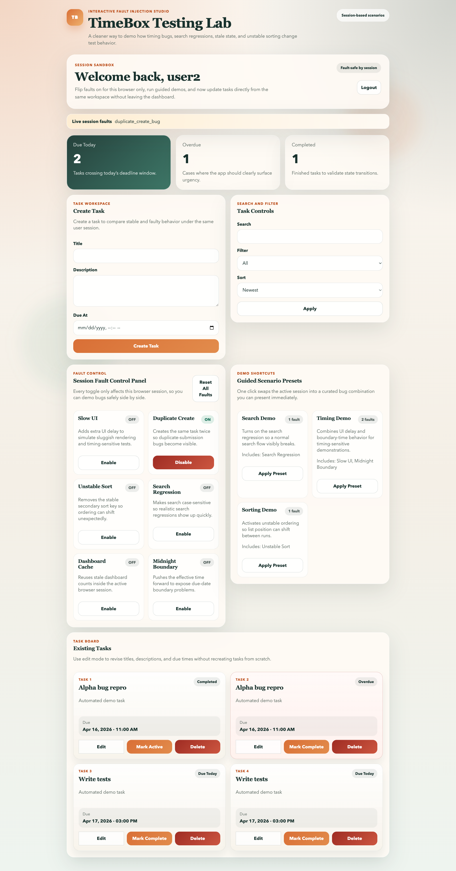
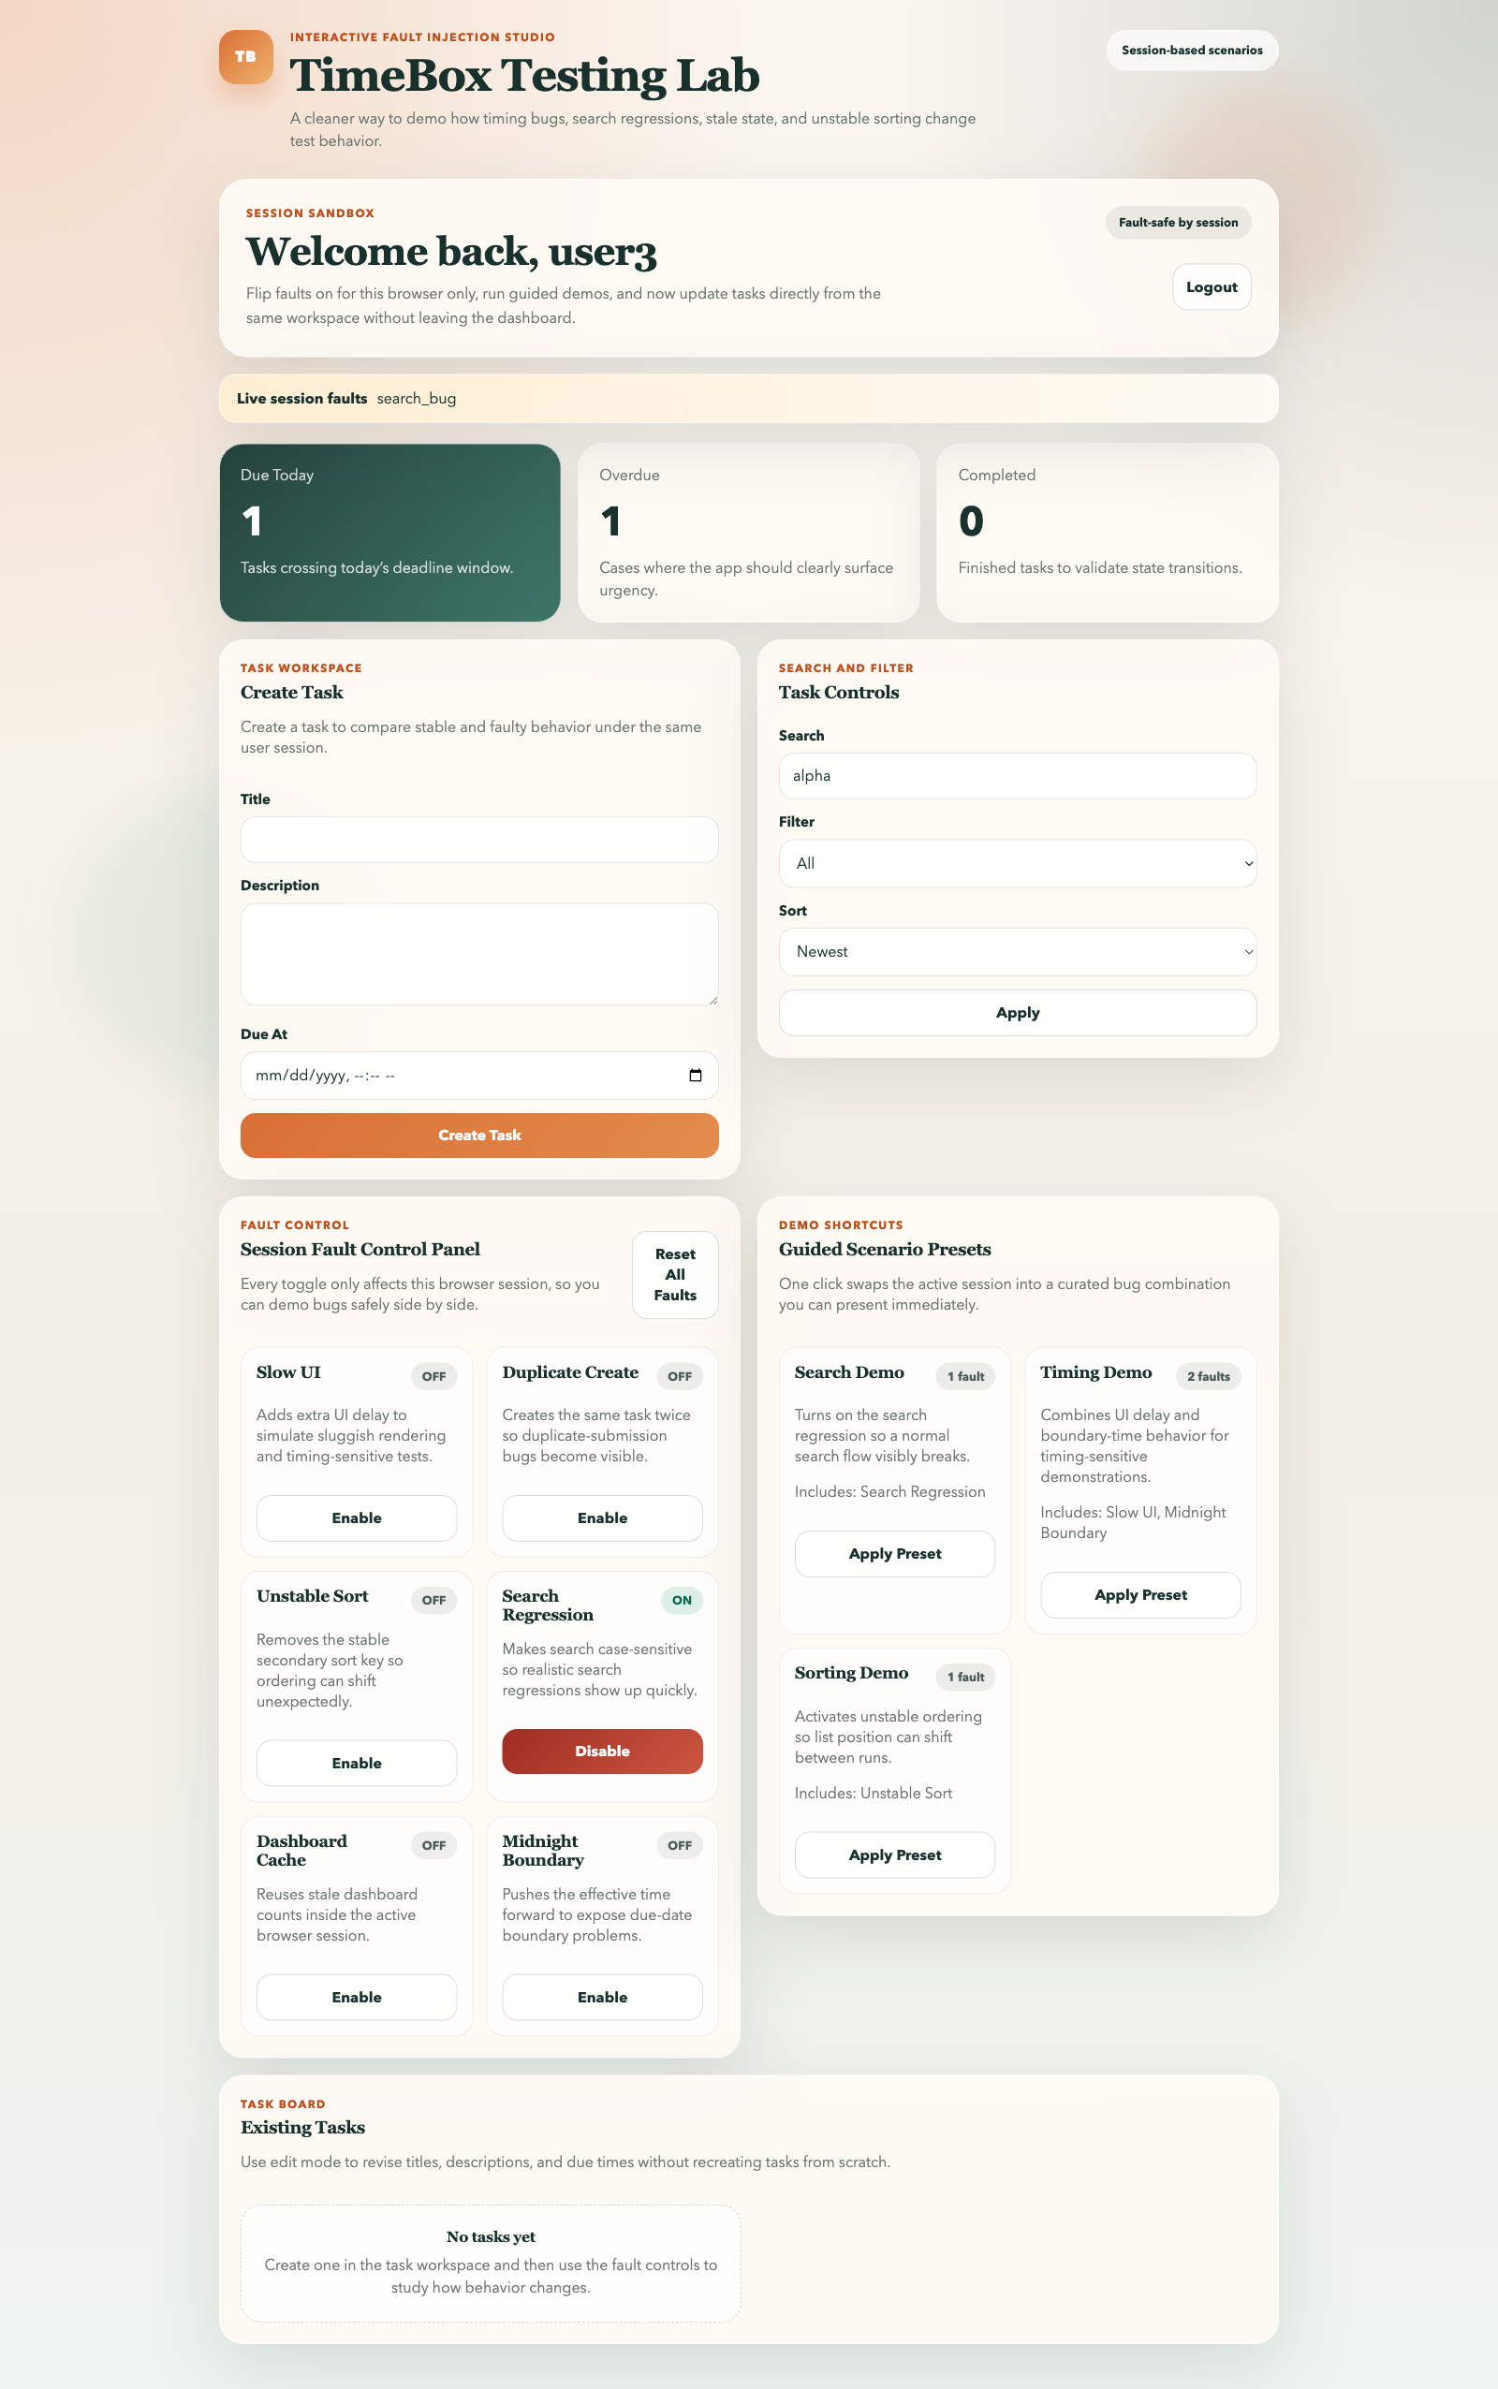
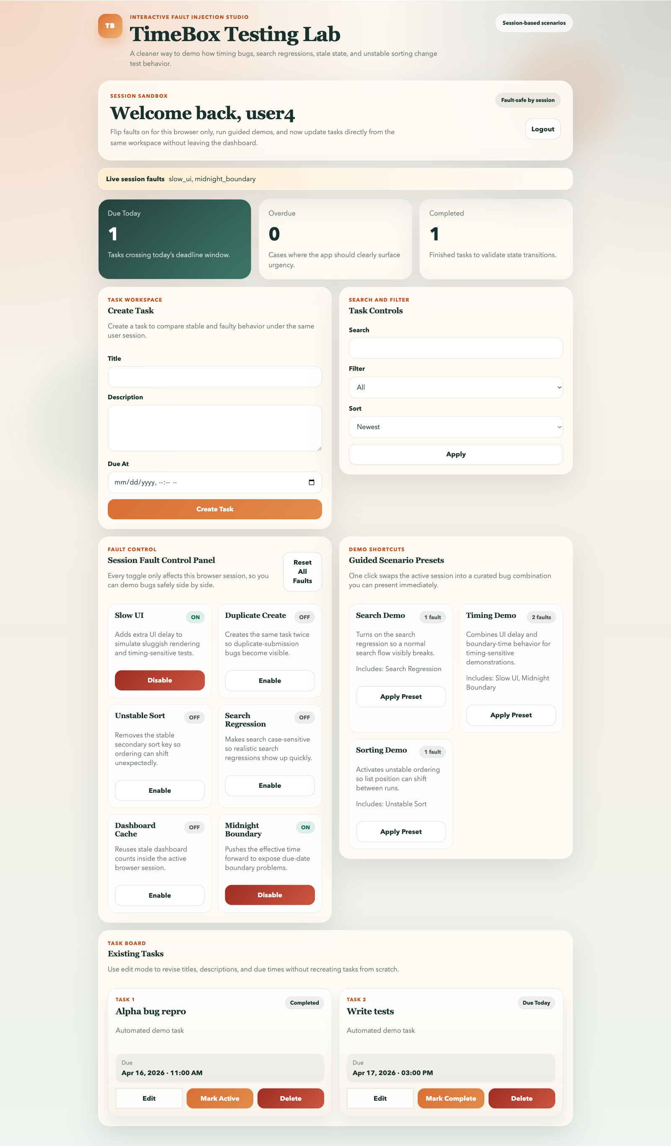
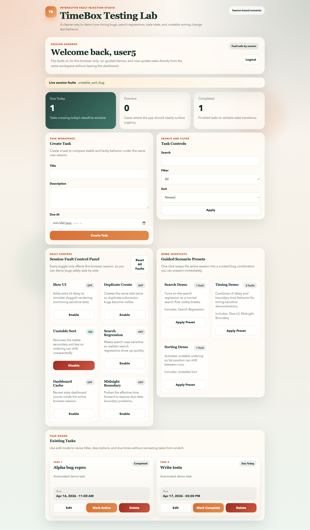
TEXAS ENGINEERING
All 5 demo scenarios
demo_browser_run.py launches a visible browser and captures a full-page screenshot of each scenario.
1. Happy path
no faults active
2. Duplicate create
duplicate_create_bug
3. Search demo
search_bug via preset
4. Timing demo
slow_ui + midnight_boundary
5. Sorting demo
unstable_sort_bug

Slide 13
TEXAS ENGINEERING
Takeaways and demo commands
Main takeaways
A small app can still show meaningful flaky behavior if the fault profiles are chosen carefully.
Session-based controls were one of the most important design improvements.
Polish matters: editing, scroll behavior, and better screenshots made the project much easier to present.
The final version connects features, tests, and demo artifacts in one place.
Future Work
CI/CD integration (GitHub Actions)
Multi-user testing scenarios
More fault types (network latency, API failure)
Metrics dashboard (failure rates, timing)

Slide 14
FastAPI + SQLite — session-scoped fault injection
Pytest + Playwright — API, UI, visible browser demo
Six fault profiles, three demo presets — repeatable bug scenarios
Hamiz Siddiqui — MS Computer Science
TimeBox Testing Lab • April 2026
THANK YOU.

