Slide 1
Converting Casual Riders to Annual Members at Capital Bikeshare
Data-Driven Station Targeting Strategy
Five high yield stations identified in the upper Northwest DC corridor. A validated pilot scales to an estimated 1,060 new annual members and an estimated $127,000 ARR systemwide
Jack Hamilton 5/26/26 https://github.com/hamjac5334/Portfolio/

Slide 2
Capital Bikeshare leaves recurring revenue on the table: around 30% of rides are casual, behave like members
The Business Question
Situation
Capital Bikeshare operates over 6 million trips per year across the DC region. Annual members generate predictable recurring revenue; casual riders pay per ride and represent around 30% of trips, a substantial pool of repeat behavior that converts only sporadically
Complication
Without user IDs in the public dataset, traditional conversion analysis is blocked. The dataset records rides, not riders, meaning the unit of observation is the trip, not the customer
Question
Which 3–5 stations represent the highest ROI targets for a casual to member conversion campaign?
Analytical Pivot
Analysis operates at the ride level via behavioral signatures, not individual user tracking. Rides with temporal and trip patterns resemble member ridership flag the conversion opportunity even without seeing the rider

Slide 3
A gradient boosting classifier learns the behavioral identity of member ridership and scores every casual ride against it
The Approach
Data: 6.2M rides, 12 months (May 2025 – Apr 2026), 500 stations
Cleaning: 2.3% rides dropped (duration outliers); systematic data quality audit
Features: 17 engineered features: temporal, trip-level, station aggregates
Modeling: chronological train/val/test split, HistGradientBoostingClassifier
Outcome: ROC AUC = 0.73 on validation; Cramér's V = 0.21 for rush-hour effect
Note: AUC of 0.73 reflects real overlap between member and casual ride patterns. Effect sizes confirm meaningful behavioral differences; sample size makes p-values uninformative.

Slide 4
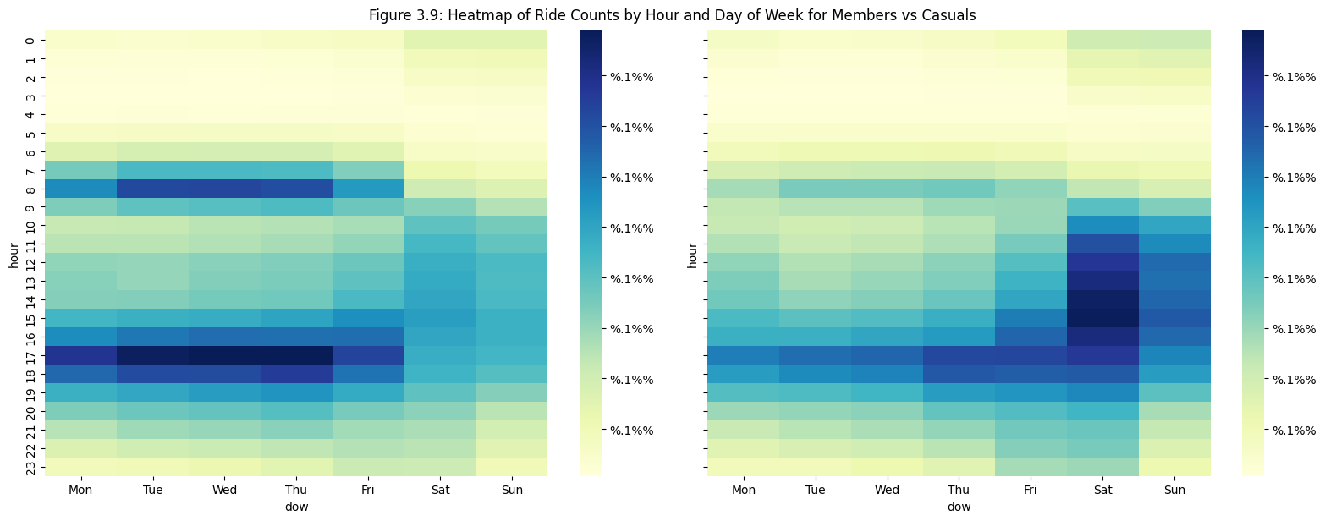
Members typically ride in commute rhythm. Casuals typically ride in leisure rhythm, but are overlapping patterns
The Central Pattern
Member panel: double-hump at 7–9am and 4–6pm, weekdays.
Casual panel: Saturday and Sunday dominant. The textbook leisure pattern with a mid day increase during the week. The visible overlap during weekday rush hours is the conversion opportunity.

Slide 5
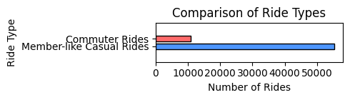
55,000 casual rides per month look like member rides, 5 times the size of a simple commuter heuristic
The Finding
55,226 (32%)
Model flagged as behaviorally member-like
5×
the model's reach vs a rule based commuter heuristic
170,968
total casual rides per month
These are riders who already behave like members. They just haven't purchased the membership.

Slide 6
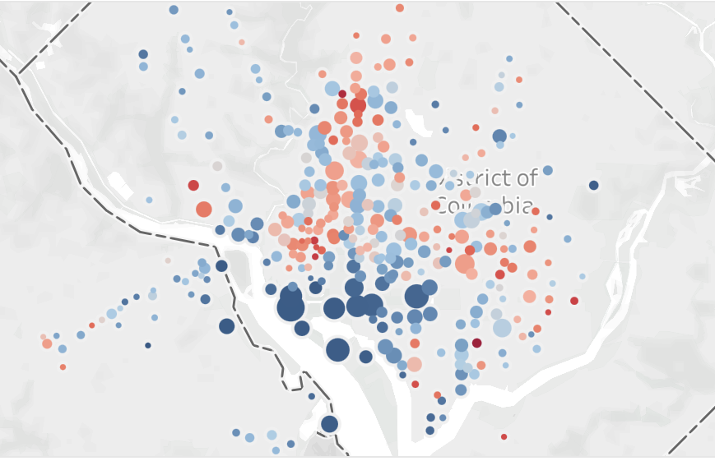
Five stations in the upper Northwest DC corridor concentrated on the conversion opportunity
The Targets and Opportunity
Station | Monthly member-like rides | Concentration | Total casual rides
Columbus Circle / Union Station | 528 | 44% | 1,206
14th & Irving St NW | 490 | 59% | 826
New Hampshire Ave & T St NW | 465 | 43% | 1,078
37th & O St NW / Georgetown | 407 | 51% | 798
14th & V St NW | 380 | 40% | 955

Slide 7
Pilot a four-tactic corridor campaign; scale once validated
The Recommendation
Interventions
On bike screen offers during weekday rush hours. Around 1,400 impressions per station per month at zero incremental cost
Permanent dock signage with QR value calculator. "Save $270/year" messaging at all five docks
Trigger based email/push to repeat single trip buyers. Operationalizes the same insight via transaction data
Adjacent employer and university partnerships. Anchor: Georgetown University, Union Station's federal cluster
Sizing
Pilot (5 stations) 43 new annual members around $5,200 ARR
Scaled systemwide 1,060 new annual members $127K ARR
Sensitivity: $48K–$318K depending on conversion rate (3%–20%).

Slide 8
A 90 day controlled pilot validates the mechanic before systemwide rollout.
Pilot Design, Limitations, Next Steps
Pilot Design
5 pilot stations vs 3 matched control stations in 90 day window
Success metric: ≥20% lift in casual to member conversion rate at p < 0.05. 25 conversions per arm required
Limitations
No user IDs available
Analysis is ride level AUC 0.73 is moderate; field validation required
Top features encode geographic base rate, not pure behavior
What I'd do next
Acquire anonymized user level data
Add weather, event, and station amenity features
Hyperparameter tuning and out of time validation
Operationalize the model in a real time targeting system
https://github.com/hamjac5334/Portfolio/tree/main/Data_Analysis/Capital_Bikeshare

