Slide 1
GIT

Slide 2
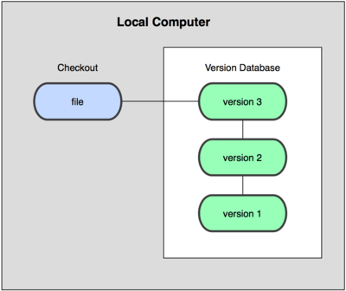
Local version control systems

Slide 3
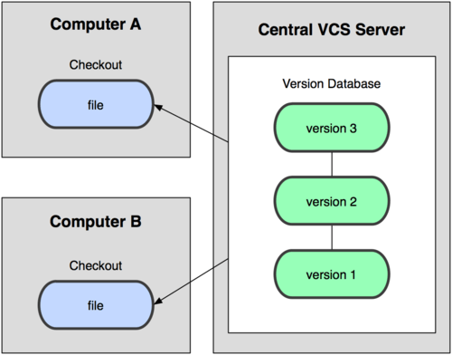
Centralized version control systems

Slide 4
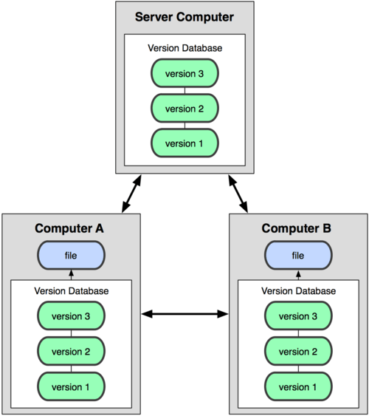
Distributed version control systems

Slide 5
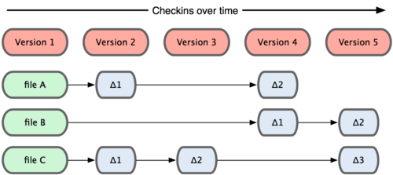
Snapshots, Not difference

Slide 6
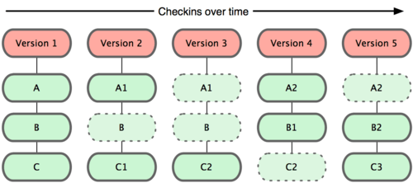

Slide 7
Most operations in Git only need local files and resources to operate.
Everything in Git is check-summed before it is stored and is then referred to by that checksum.
When you do actions in Git, nearly all of them only add data to the Git database.
Git has three main states that your files can reside in: committed, modified, and staged.

Slide 8
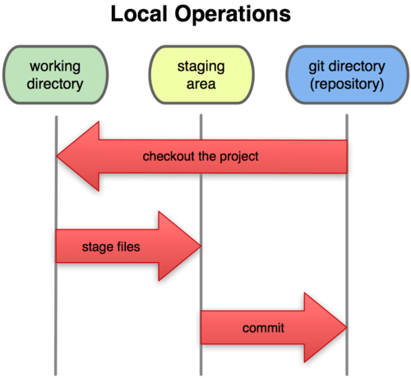
Working directory, staging area, and git directory.

Slide 9
The basic Git workflow goes something like this:
You modify files in your working directory.
You stage the files, adding snapshots of them to your staging area.
You do a commit, which takes the files as they are in the staging area and stores that snapshot permanently to your Git directory.

Slide 10
Installing Git
Installing on Windows
http://msysgit.github.com/
On Windows systems, Git looks for the .gitconfig file in the $HOME directory (%USERPROFILE% in Windows’ environment), which is C:\Documents and Settings\$USER or C:\Users\$USER for most people, depending on version ($USER is %USERNAME% in Windows’ environment).
Your identity
  $ git config --global user.name "John Doe"
  $ git config --global user.email johndoe@example.com
  If you want to override this with a different name or e-mail address for specific projects, you can run the command without the --global option when you’re in that project.

Slide 11
Editor
  $ git config --global core.editor emacs
Diff tool
  $ git config --global merge.tool vimdiff(Git accepts kdiff3, tkdiff, meld, xxdiff, emerge, vimdiff, gvimdiff, ecmerge, and opendiff as valid merge tools)
  Your settings
  $ git config –list
  Getting HELP
  $ git help <verb>
  $ git <verb> --help
  $ man git-<verb>

Slide 12
Getting a Git Repository
You can get a Git project using two main approaches.
Takes an existing project or directory and imports it into Git.
Clones an existing Git repository from another server.

Slide 13
Takes an existing project or directory and imports it into Git.
$ git init (This creates a new subdirectory named .git that contains all of your necessary repository files — a Git repository skeleton. At this point, nothing in your project is tracked yet. )
$ git add *.c
$ git add README
$ git commit -m 'initial project version'

Slide 14
Clones an existing Git repository from another server
If you want to get a copy of an existing Git repository —you need is git clone.(If you’re familiar with other VCS systems such as Subversion, you’ll notice that the command is clone and not checkout. This is an important distinction — Git receives a copy of nearly all data that the server has)
In fact, if your server disk gets corrupted, you can use any of the clones on any client to set the server back to the state it was in when it was cloned.

Slide 15
git clone [url]
$ git clone git://github.com/schacon/grit.git(That creates a directory named grit, initializes a .git directory inside it, pulls down all the data for that repository, and checks out a working copy of the latest version.)
$ git clone git://github.com/schacon/grit.git mygrit. (That command does the same thing as the previous one, but the target directory is called mygrit.)
Git has a number of different transfer protocols you can use. The previous example uses the git://protocol, but you may also see http(s):// or user@server:/path.git, which uses the SSH transfer protocol.

Slide 16
Recording Changes to the Repository
Remember that each file in your working directory can be in one of two states: tracked or untracked. Tracked files are files that were in the last snapshot; they can be unmodified, modified, or staged. Untracked files are everything else — any files in your working directory that were not in your last snapshot and are not in your staging area.

Slide 17
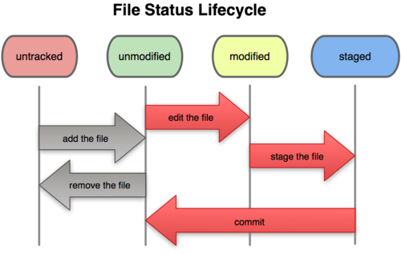
The lifecycle of the status of your files.

Slide 18
$ git status (main tool you use to determine which files are in which state)
Create README file (Untracked files: README).
$ git add README (Changes to be committed: new file: README).
Let’s change a file that was already tracked.
$ git status
Changes to be committed:
new file: README
Changes not staged for commit:
modified: benchmarks.rb

Slide 19
$ git add benchmarks.rb
$ git status
Changes to be committed:
new file: README
modified: benchmarks.rb
Change benchmarks.rb
$ git status
Changes to be committed:
new file: README
modified: benchmarks.rb
Changes not staged for commit:
modified: benchmarks.rb

Slide 20
What the heck? Now benchmarks.rb is listed as both staged and unstaged. How is that possible? It turns out that Git stages a file exactly as it is when you run the git add command. If you commit now, the version of benchmarks.rb as it was when you last ran the git add command is how it will go into the commit, not the version of the file as it looks in your working directory when you run git commit. If you modify a file after you run git add, you have to run git add again to stage the latest version of the file:
$ git add benchmarks.rb
Often, you’ll have a class of files that you don’t want Git to automatically add or even show you as being untracked.
.gitignore (*.[oa] , *~).

Slide 21
Viewing Your Staged and Unstaged Changes
If the git status command is too vague for you — you want to know exactly what you changed, not just which files were changed — you can use the git diff command.
If you want to see what you’ve staged that will go into your next commit, you can use
git diff --cached or git diff --staged
It’s important to note that git diff by itself doesn’t show all changes made since your last commit — only changes that are still unstaged. This can be confusing, because if you’ve staged all of your changes,git diff will give you no output.

Slide 22
Committing Your Changes
Now that your staging area is set up the way you want it, you can commit your changes. Remember that anything that is still unstaged — won’t go into this commit.
$ git commit (Doing so launches your editor of choice.)
$ git commit -m "Story 182: Fix benchmarks for speed“
[master]: created 463dc4f: "Fix benchmarks for speed"
2 files changed, 3 insertions(+), 0 deletions(-)
create mode 100644 README
Skipping the staging area
$ git commit -a -m 'added new benchmarks'

Slide 23
Removing files
  $ git rm grit.gemspec
  $ git rm --cached readme.txt(remove from your staging area)
  Moving files
  $ git mv README.txt README
  Viewing the commit history
  $ git log
  A huge number and variety of options to the git log command are available to show you exactly what you’re looking for.

Slide 24
Undoing Things
One of the common undos takes place when you commit too early and possibly forget to add some files, or you mess up your commit message.
Changing Your Last Commit
  $ git commit –amend
  This command takes your staging area and uses it for the commit. If you’ve made no changes since your last commit (for instance, you run this command immediately after your previous commit), then your snapshot will look exactly the same and all you’ll change is your commit message.
  $ git commit -m 'initial commit'
  $ git add forgotten_file
  $ git commit –amend
  After these three commands, you end up with a single commit — the second commit replaces the results of the first.

Slide 25
Unstaging a staged file
  $ git reset HEAD <file>...(The file is modified but once again unstaged.)
  Unmodifying a modified File
    $ git checkout -- <file> (You can see that the changes have been reverted. You should also realize that this is a dangerous command: any changes you made to that file are gone — you just copied another file over it.)

Slide 26
Working with Remotes
To be able to collaborate on any Git project, you need to know how to manage your remote repositories. Remote repositories are versions of your project that are hosted on the Internet or network somewhere. You can have several of them, each of which generally is either read-only or read/write for you. Collaborating with others involves managing these remote repositories and pushing and pulling data to and from them when you need to share work. Managing remote repositories includes knowing how to add remote repositories, remove remotes that are no longer valid, manage various remote branches and define them as being tracked or not, and more. In this section, we’ll cover these remote-management skills.

Slide 27
Showing your remotes
  $ git remote
  origin(If you’ve cloned your repository, you should at least see origin — that is the default name Git gives to the server you cloned from)
  Adding remote repositories
  $ git remote add [shortname] [url] ($ git remote add pb git://github.com/paulboone/ticgit.git)
  $ git remote -v
  origin git://github.com/schacon/ticgit.git
  pb git://github.com/paulboone/ticgit.git

Slide 28
Fetching and pulling from your remotes
  $ git fetch [remote-name]
  The command goes out to that remote project and pulls down all the data from that remote project that you don’t have yet. After you do this, you should have references to all the branches from that remote, which you can merge in or inspect at any time. It’s important to note that the fetch command pulls the data to your local repository — it doesn’t automatically merge it with any of your work or modify what you’re currently working on. You have to merge it manually into your work when you’re ready.
  $ git pull
  Pull generally fetches data from the server you originally cloned from and automatically tries to merge it into the code you’re currently working on.

Slide 29
Push
  git push [remote-name] [branch-name]
  $ git push origin master
  This command works only if you cloned from a server to which you have write access and if nobody has pushed in the meantime. If you and someone else clone at the same time and they push upstream and then you push upstream, your push will rightly be rejected. You’ll have to pull down their work first and incorporate it into yours before you’ll be allowed to push.

Slide 30
$ git remote show origin
This command shows which branch is automatically pushed when you run git push on certain branches. It also shows you which remote branches on the server you don’t yet have, which remote branches you have that have been removed from the server, and multiple branches that are automatically merged when you run git pull.

Slide 31
Tagging
Git uses two main types of tags: lightweight and annotated. A lightweight tag is very much like a branch that doesn’t change — it’s just a pointer to a specific commit. Annotated tags, however, are stored as full objects in the Git database. They’re checksummed; contain the tagger name, e-mail, and date; have a tagging message; and can be signed.
$ git tag
Listing the available tags in Git is straightforward
$ git tag -l 'v1.4.2.*‘ regexp

Slide 32
Annotated tags
  $ git tag -a v1.4 -m 'my version 1.4‘
  The -m specifies a tagging message, which is stored with the tag. If you don’t specify a message for an annotated tag, Git launches your editor so you can type it in.
  $ git show v1.4
  Lightweight tags
  $ git tag v1.4-lw
  Tagging Later
  $ git tag -a v1.2 -m 'version 1.2' 9fceb02

Slide 33
Git Branching
“killer feature”
When you commit in Git, Git stores a commit object that contains a pointer to the snapshot of the content you staged, the author and message metadata, and zero or more pointers to the commit or commits that were the direct parents of this commit: zero parents for the first commit, one parent for a normal commit, and multiple parents for a commit that results from a merge of two or more branches.
$ git add README test.rb LICENSE
$ git commit -m 'initial commit of my project'

Slide 34
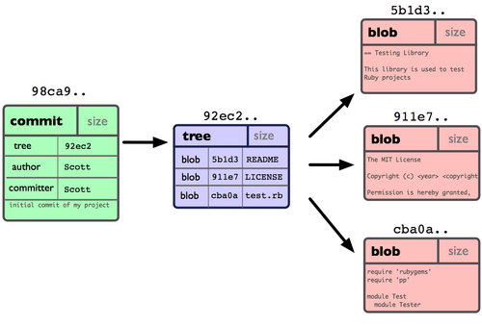

Slide 35
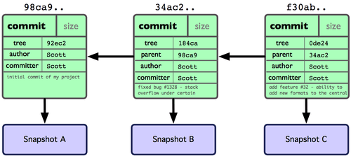

Slide 36
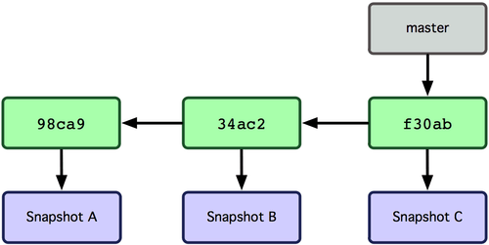
A branch in Git is simply a lightweight movable pointer to one of these commits. The default branch name in Git is master.

Slide 37
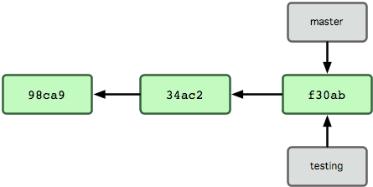
What happens if you create a new branch?
$ git branch testing

Slide 38
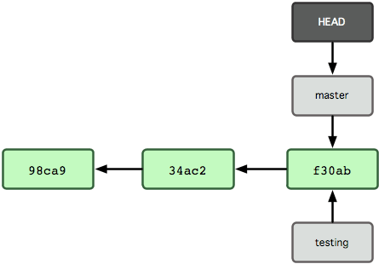
This creates a new pointer at the same commit you’re currently on.
How does Git know what branch you’re currently on? It keeps a special pointer called HEAD. In Git, this is a pointer to the local branch you’re currently on. In this case, you’re still on master. The git branch command only created a new branch — it didn’t switch to that branch.

Slide 39
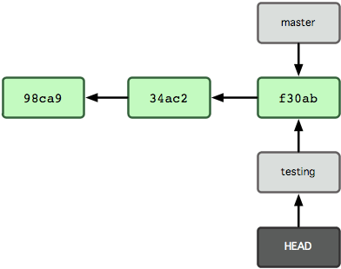
To switch to an existing branch, you run the git checkout command.
$ git checkout testing
This moves HEAD to point to the testing branch

Slide 40
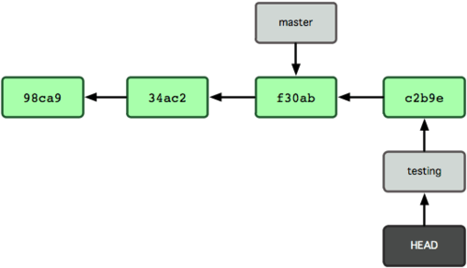
$ git commit -a -m 'made a change'

Slide 41
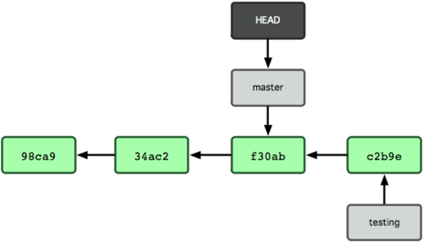
$ git checkout master
That command did two things. It moved the HEAD pointer back to point to the master branch, and it reverted the files in your working directory back to the snapshot that master points to. This also means the changes you make from this point forward will diverge from an older version of the project. It essentially rewinds the work you’ve done in your testing branch temporarily so you can go in a different direction.

Slide 42
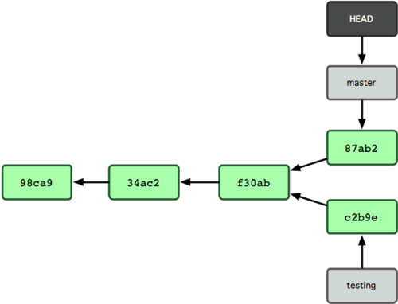
$ git commit -a -m 'made other changes'
Now your project history has diverged. You created and switched to a branch, did some work on it, and then switched back to your main branch and did other work. Both of those changes are isolated in separate branches: you can switch back and forth between the branches and merge them together when you’re ready. And you did all that with simple branch and checkout commands.

Slide 43
Because a branch in Git is in actuality a simple file that contains the 40 character SHA-1 checksum of the commit it points to, branches are cheap to create and destroy. Creating a new branch is as quick and simple as writing 41 bytes to a file (40 characters and a newline).
This is in sharp contrast to the way most VCS tools branch, which involves copying all of the project’s files into a second directory. This can take several seconds or even minutes, depending on the size of the project, whereas in Git the process is always instantaneous. Also, because we’re recording the parents when we commit, finding a proper merge base for merging is automatically done for us and is generally very easy to do. These features help encourage developers to create and use branches often.
Let’s see why you should do so.

Slide 44
Basic Branching and Merging
Let’s go through a simple example of branching and merging with a workflow that you might use in the real world. You’ll follow these steps:
Do work on a web site.
Create a branch for a new story you’re working on.
Do some work in that branch.
At this stage, you’ll receive a call that another issue is critical and you need a hotfix. You’ll do the following:
Switch back to your production branch.
Create a branch to add the hotfix.
After it’s tested, merge the hotfix branch, and push to production.
Switch back to your original story and continue working.

Slide 45
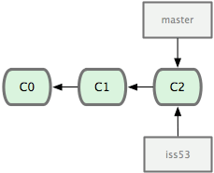
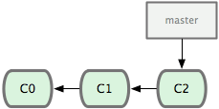
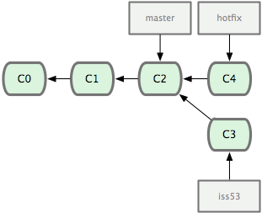
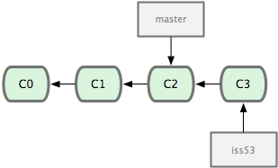

Slide 46
$ git checkout -b iss53 //Switched to a new branch "iss53“($ git branch iss53 and $ git checkout iss53)
$ git commit -a -m ‘fix issue 53‘
$ git checkout master
$ git checkout -b hotfix
$ git commit -a -m 'fixed the broken email address‘
Merge
$ git checkout master
$ git merge hotfix

Slide 47
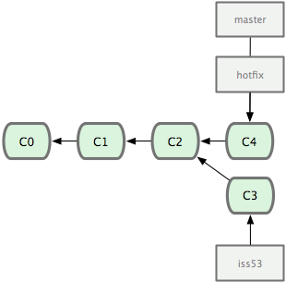
$ git branch -d hotfix //delete

Slide 48
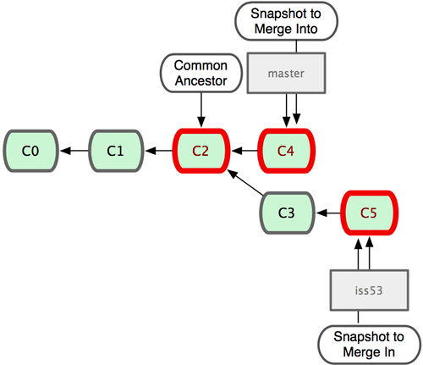

Slide 49
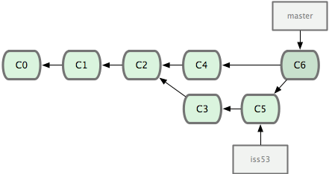

Slide 50
$ git branch( listing of your current branches. * indicates the branch that you currently have checked out)
$ git branch –v (to see the last commit on each branch)
$ git branch –merged | --no-merged

Slide 51
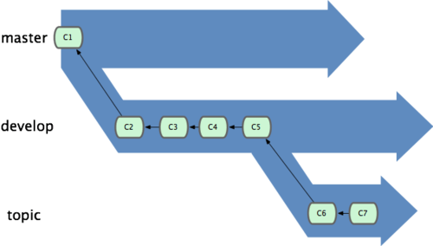

Slide 52
Git Branching - Remote Branches
Remote Branches
Remote branches are references to the state of branches on your remote repositories. They’re local branches that you can’t move; they’re moved automatically whenever you do any network communication. Remote branches act as bookmarks to remind you where the branches on your remote repositories were the last time you connected to them.

Slide 53
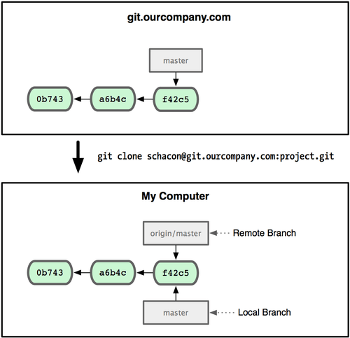

Slide 54
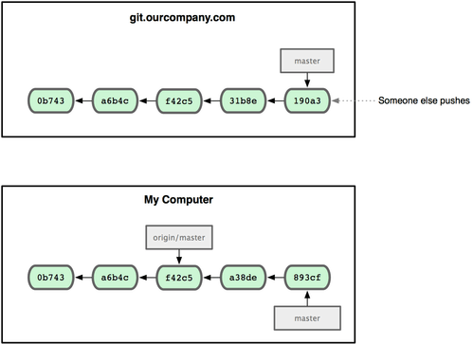

Slide 55
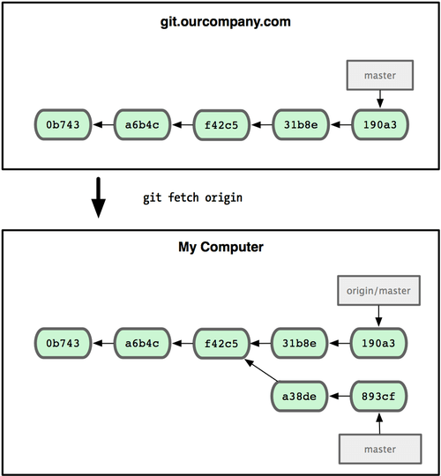
git fetch origin

Slide 56
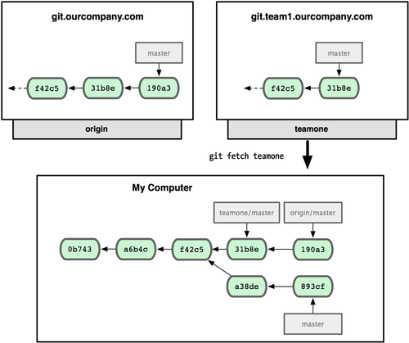

Slide 57
$ git push origin test
git push origin test:awesomebranch
If you want your own test branch that you can work on, you can base it off your remote branch:
$ git checkout -b test origin/test
//delete remoute branch
git push origin :awesomebranch

Slide 58
http://git-scm.com/book
http://try.github.io/levels/1/challenges/1
THANK YOU

