Slide 1
Project Management

Slide 2
Harvard Business School Project Management Manual
What is a Project?

Slide 3
Harvard Business School Project Management Manual
What is a Project?
A Project is defined as a unique set of activities meant to produce a defined outcome within an established time frame using specific allocation of resources.

Slide 4
Project Management Institute (PMI) Body of Knowledge www.pmi.org
What is Project Management?

Slide 5
Project Management Institute (PMI) Body of Knowledge www.pmi.org
What is Project Management?
Project Management is the application of knowledge, skills, tools, and techniques to project activities to meet or exceed stakeholders needs and expectations from the project.
What does meeting or exceeding stakeholder needs and expectations involve?

Slide 6
Project Management Institute (PMI) Body of Knowledge www.pmi.org
What is Project Management?
Project Management is the application of knowledge, skills, tools, and techniques to project activities to meet or exceed stakeholders needs and expectations from the project.
Meeting or exceeding stakeholder needs and expectations involves balancing competing demands among:
Scope, time, cost and quality
Stakeholders with differing needs and expectations
Identified requirements (needs) and unidentified requirements (expectations)

Slide 7
Project Management
Planning, organizing, motivating and controlling resources to achieve specific goals
Managing the project and its deliverables with the end goal in mind

Slide 8
Project Management Institute (PMI) Body of Knowledge www.pmi.org
What is a Project’s Life-cycle?

Slide 9
Planning and Managing Projects
Define and Organize
the Project
Plan the Project
Track & Manage
the Project
Establish the
Project Organization
Develop the Work
Breakdown Structure
Collect Status
Information
Define the
Project Parameters
Develop the
Schedule
Plan & Take
Adaptive Action
Plan the
Project Framework
Analyze Resources
Close Out
the Project
Assemble the
Project Definition
Document
Optimize Tradeoffs
Develop a Risk
Management Plan

Slide 10
Project Management Institute (PMI) Body of Knowledge
Initiating
Processes
Planning
Processes
Project Life Cycle Phases
Initiating Processes
Planning Processes
Executing Processes
Controlling Processes
Closing Processes
Controlling
Processes
Executing
Processes
Closing
Processes

Slide 11
Project Management Institute (PMI) Body of Knowledge
Project Life Cycle Phases
Initiating Processes
Planning Processes
Executing Processes
Controlling Processes
Closing Processes
Level of
Activity
Time

Slide 12
Software development Models
Waterfall
Sequential design process
Requirements
Design
Implementation
Testing
Maintenance
Pro: More effort at the beginning saves at the end
Pro: More documentation – easier to bring people on
Con: don’t always have all of the requirements up front
Con: sometimes the requirements change
“measure twice: cut once” – great when the requirements stay the same
Notes:
http://en.wikipedia.org/wiki/Software_development_process

Slide 13
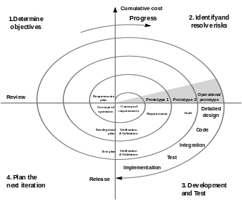
Software development Models
Spiral (risk management, waterfall + prototyping)
Adjust plan based on risk
Iterative waterfall
1-4, repeat
Notes:
http://en.wikipedia.org/wiki/Software_development_process

Slide 14
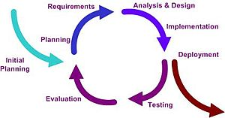
Software development Models
Iterative and incremental (vertical slices)
Important to: Modified Waterfall, Rational Unified Process, and Extreme programming and Agile
Notes:
http://en.wikipedia.org/wiki/Software_development_process

Slide 15
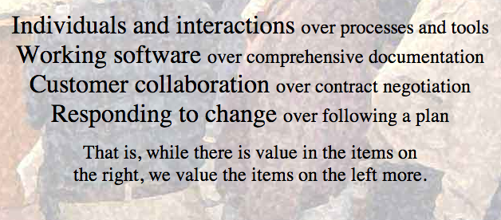
Software development Models
Agile (iterative model and change emphasis)
Based on Iterative and Incremental
Evolving requirements
It has a manifesto…
Notes:
http://en.wikipedia.org/wiki/Software_development_process
http://agilemanifesto.org/principles.html

Slide 16
Agile development
Agile software development is a group of software development methods based on iterative and incremental development, where requirements and solutions evolve through collaboration between self-organizing, cross-functional teams
Agile methodologies generally promote a project management process that encourages stakeholder involvement, feedback, objective metrics and effective controls.
Notes:
http://en.wikipedia.org/wiki/Agile_software_development

Slide 17
The Agile Manifesto
Uncovering better ways of developing software by valuing,
Individuals and interactions over processes and tools
Working software over comprehensive documentation
Customer collaboration over contract negotiation
Responding to change over following a plan
That is, while there is value in the items on the right, items on the left are valued more.
Twelve principles
Notes:
http://www.agilealliance.org/
http://www.agilealliance.org/the-alliance/the-agile-manifesto/
http://www.agilealliance.org/the-alliance/the-agile-manifesto/the-twelve-principles-of-agile-software/

Slide 18
Agile Software Development
Agile is a set of process frameworks,
Extreme programming
Lean
Scrum
http://www.youtube.com/watch?v=XU0llRltyFM
Kanban (software maintenance)
http://www.youtube.com/watch?v=R8dYLbJiTUE
http://www.youtube.com/watch?v=OJflDE6OaSc

Slide 19
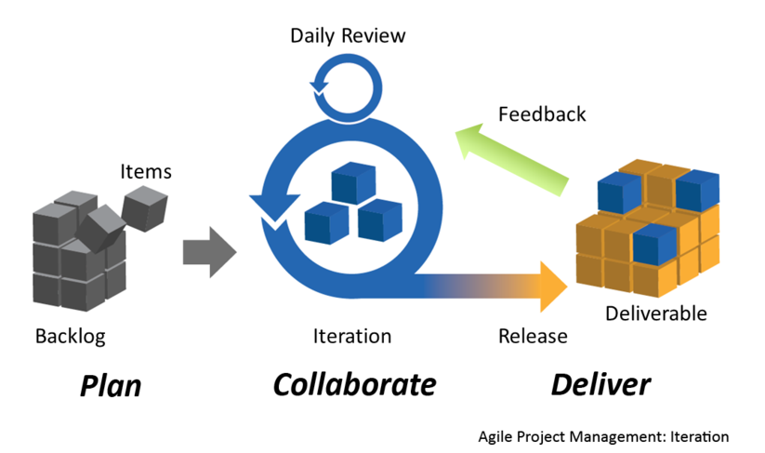
The Agile cycle
Notes:
http://en.wikipedia.org/wiki/File:Agile_Project_Management_by_Planbox.png

Slide 20

eXtreme Programming (XP)
Advocates frequent "releases" in short development cycles, which is intended to improve productivity and introduce checkpoints where new customer requirements can be adopted
Eliminates Big Design Upfront
Code most important features first
Larger overhead
Notes:
http://en.wikipedia.org/wiki/Extreme_Programming

Slide 21
XP Values
Simplicity
encourages starting with the simplest solution
Communication
favors simple designs, common metaphors, collaboration of users and programmers, frequent verbal communication, and feedback
Feedback
From the system, customer and from the team, to avoid optimism
Courage
design and code for today and not for tomorrow
Respect
respect for others as well as self-respect
Notes:
http://www.extremeprogramming.org/values.html

Slide 22
XP Rules
Planning
Managing
Designing
Coding
Testing
Notes:
http://www.extremeprogramming.org/rules.html
Planning
User stories are written. Release planning creates the release schedule. Make frequent small releases. The project is divided into iterations. Iteration planning starts each iteration.
Managing
Give the team a dedicated open work space. Set a sustainable pace. A stand up meeting starts each day. The Project Velocity is measured. Move people around. Fix XP when it breaks.
Designing
Simplicity. Choose a system metaphor. Use CRC cards for design sessions. Create spike solutions to reduce risk. No functionality is added early. Refactor whenever and wherever possible.
Coding
The customer is always available. Code must be written to agreed standards. Code the unit test first. All production code is pair programmed. Only one pair integrates code at a time. Integrate often. Set up a dedicated integration computer. Use collective ownership.
Testing
All code must have unit tests. All code must pass all unit tests before it can be released. When a bug is found tests are created. Acceptance tests are run often and the score is published.

Slide 23
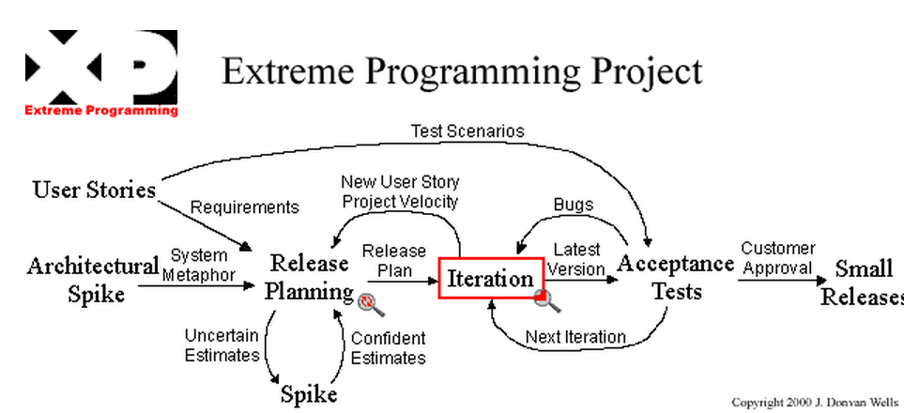
Notes:
http://www.extremeprogramming.org/map/project.html

Slide 24
XP Roles
The Customer
Sets project goals and makes business decisions
The Developer
Turn customer stories into working code
The Tracker
Keeps track of any metrics used by team
The Coach
Guides and mentors the team

Slide 25
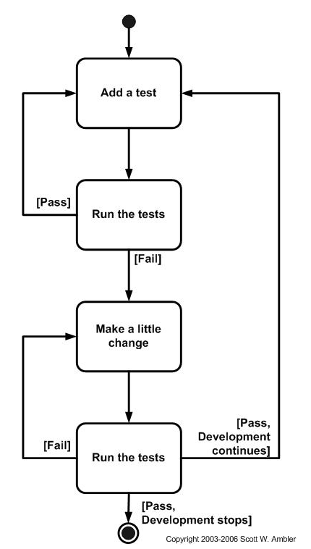
Test Driven development
Tests created before coding
Notes:
http://www.agiledata.org/essays/tdd.html

Slide 26

Scrum
Leading agile development framework
Scrum is a simple yet incredibly powerful set of principles and practices that help teams deliver products in short cycles, enabling fast feedback, continual improvement, and rapid adaptation to change.
http://www.youtube.com/watch?v=XU0llRltyFM
Notes:
http://www.scrumalliance.org/

Slide 27
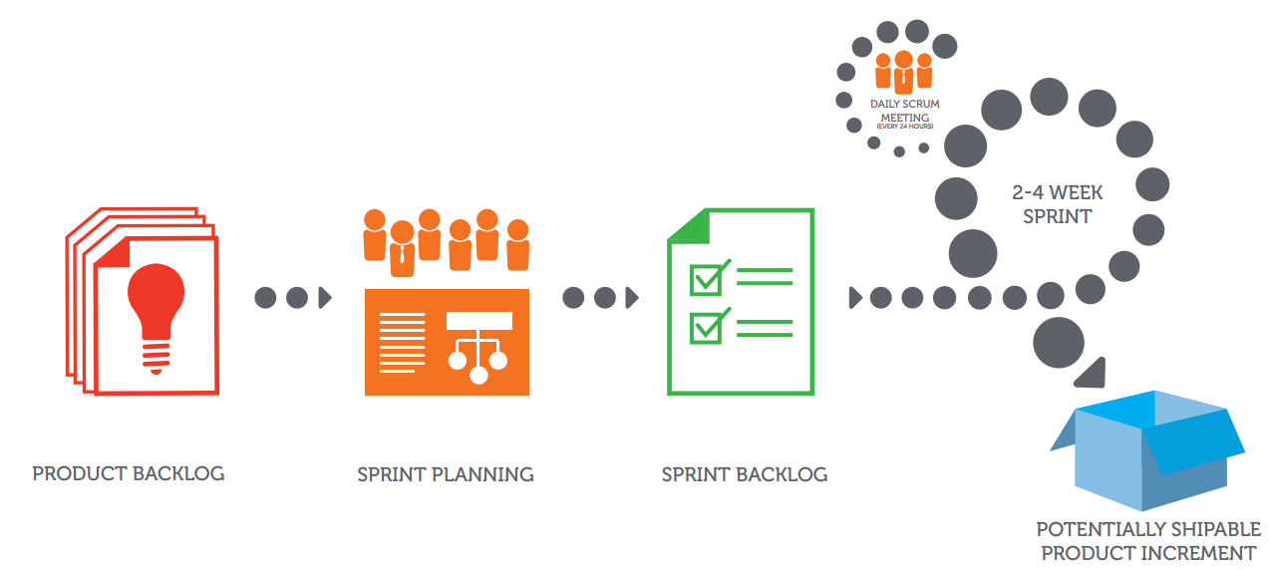

Scrum flow chart
Notes:
http://www.scrumalliance.org/scrum/media/ScrumAllianceMedia/PageGraphics/ScrumExplained-4.pdf

Slide 28
Scrum Roles
Scrum Master
Product Owner
Scrum Team
Other parties

Slide 29
Scrum Team
Team is cross-functional and consists of 5-9 people
There are no set project roles within the team
Team defines tasks and assignments
Team is self-organizing and self-managing
Maintains the Sprint Backlog
Conducts the Sprint Review

Slide 30
Scrum Master
Holds daily 15 minute team meeting (Daily Scrum)
Assures every people related to the project follow the rules
Removes obstacles
Shields the team from external interference
Maintains the Sprint Burndown Chart
Conducts Sprint Retrospective at the end of a Sprint
Is a facilitator, not a manager

Slide 31
Product Owner (PO) – fka PM
Accountable for product success
Defines all product features
Responsible for prioritizing product features
Maintains the Product Backlog
Insures team working on highest valued features

Slide 32
The Product Backlog
List of all desired product features
List can contain bugs, and non-functional items
Product Owner responsible for prioritizing
Items can be added by anyone at anytime
Each item should have a business value assigned
Maintained by the Product Owner

Slide 33
A Sprint
Time: short 2-4 weeks (or hrs, gen’l not months)
An iteration for building a piece of increment (potentially shippable) of the whole system
It’s the working time, not planning or asking what to do.
The team manages itself during a Sprint
The team commits to Product Backlog during the Sprint planning meeting
The Sprint Backlog is updated during a Sprint

Slide 34
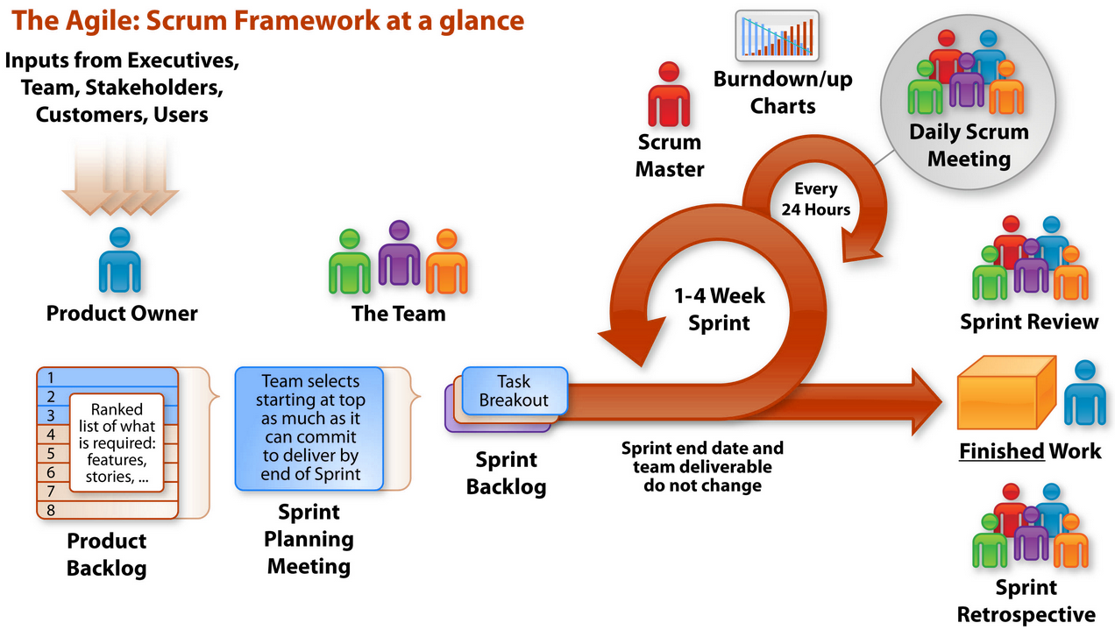
The Scrum skeleton

Slide 35
Scrum Daily Meeting
Held every day during a Sprint
Time:15 minutes
Team members report to each other not Scrum Master
Asks 3 questions during meeting
“What have you done since last daily scrum?”
“What will you do before the next daily scrum?”
“What obstacles are impeding your work?”
Opportunity for team members to synchronize their work
It helps removing burdens between members

Slide 36
Sprint Review
Time: 4 hours
Team presents “done” code to PO and stakeholders
Functionality not “done” is not shown
Feedback generated – Product Backlog maybe reprioritized
ScrumMaster sets next Sprint Review

Slide 37
Sprint Retrospective (fka post Mortem)
Time: 3 hours
Participants
Scrum Master
Scrum Team.
Product Owner is optional
Questions
What went well and what can be improved?
ScrumMaster helps the team in discovery – not provide answers

Slide 38
The Sprint Backlog
A kind of To-do list for a Sprint
Created by the Scrum Team (can be originated by one member, responsibility belongs to another)
Product Owner has defined as highest priority
Used for synchronizing works between team members

Slide 39
Potentially shippable product
Selected items are fully implemented, tested and ready for use
Small but complete
Scrum Team needs to define what does “done” mean, in what aspects and contexts.
“DONE” may be executable, passed all tests, approved by senior engineers, reviewed by peers or just nothing to do more with the item.

Slide 40
Agile Software Development
By far the more popular/well known of the frameworks
Scrum
http://www.youtube.com/watch?v=XU0llRltyFM
Kanban
http://www.youtube.com/watch?v=R8dYLbJiTUE

Slide 41
Agile Software Development
For Web development – websites, e-commerce, etc.
Very popular and effective approach
Handles dynamic requirements well
Increased overhead is easier to manage
For traditional projects – ERP, Finance, etc.
Maybe not so much
Need tighter requirements
Overhead increase is not as manageable
At the End of the day –
either we come up with a good plan first
(Waterfall, and the like)
or we don’t
(Agile and the like)

Slide 42
Agile Software Development
At the End of the day
either we come up with a good plan first
Well documented
Sequential set development plan
Waterfall, and the like
or we don’t
Iterative approach
Embrace change
Dynamic deliverables
Integrated with Client feedback
Agile and the like

