Slide 1

Learn.lk
Project Demonstration

Slide 2
Learn.lk
Submission Information
Senior Category
Gateway College Colombo
Sachintha Senanayake
0776 795 794
sachinthasenanayake180@gmail.com
Hammaad Rizwan
0774 443 366
hammaadrizwan@gmail.com
Teacher Info
Ms. Nisha Kaumadee
0773 431 861
nisha.kaumadee@gatewaycollege.lk

Slide 3
What is Learn.lk?
Learn.lk is an array of e-learning tools which helps students educate themselves on various subjects such as Chemistry, Mathematics, Computer Science, etc.
Teachers can register with our service, and they will be listed on our main website.
Students can navigate through our website to choose the suitable tutor.
In-turn we will be able to host meetings for teachers to conduct online lessons.
This system is highly beneficial during these tough times, since it enables students and teachers to seamlessly connect under one online service.

Slide 4
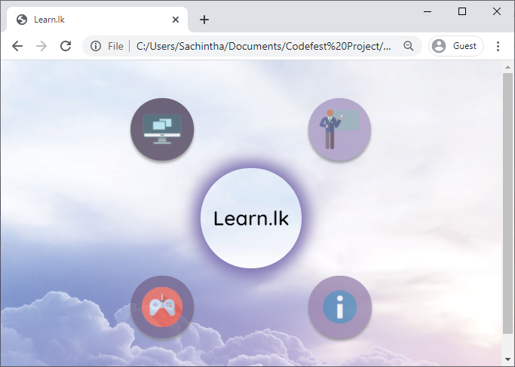
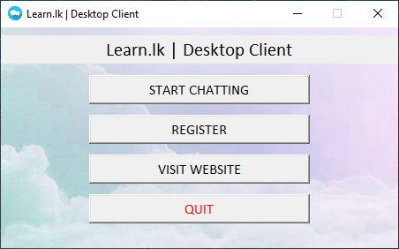



Learn.lk Web Page
Learn.lk Chat Client
+

Slide 5
What is Learn.lk?
Learn.lk System
Learn.lk Website
Learn.lk Chat Client
Register Students
Teachers
Chat Client
User Registration
About Us
Gaming Portal
User Login
User Chatting
Firebase Firestore
Learning Game

Slide 6
Learn.lk Web Page
Functionality Demo
Insert Functions Demonstration

Slide 7
Learn.lk Web Page
Code Demo
Insert Code Demonstration

Slide 8
Learn.lk Chat Client
Functionality Demo
Insert Functions Demonstration

Slide 9
Learn.lk Chat Client
Code Demo
Insert Code Demonstration

Slide 10
Learn.lk Kokis Shooter
Functionality & Code Demo
Insert Code & Function Demo

Slide 11
Effects & Benefits of Learn.lk
Helps students effectively choose their best tutor (transparent)
Offers teachers a starting point to begin online classes.
Strong student-teacher relationship; real-time chatting
User friendly & small learning curve for students / teachers
Simple & effective website management; use of Firebase Firestore
Relaxed and engaging learning methods; education games
Students can continuously learn amidst the COVID-19 outbreak
Teachers can swiftly transition online & establish a stable form of income

Slide 12
Learn.lk
Thank You!

