Slide 1

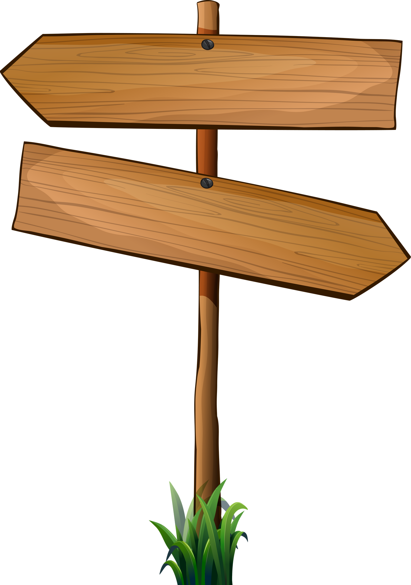

GROUP
PRESENTATION
PRESENTED BY
HAMMAD FAROOQ
WAJID ALI
ABDUL MUNAF

Slide 2
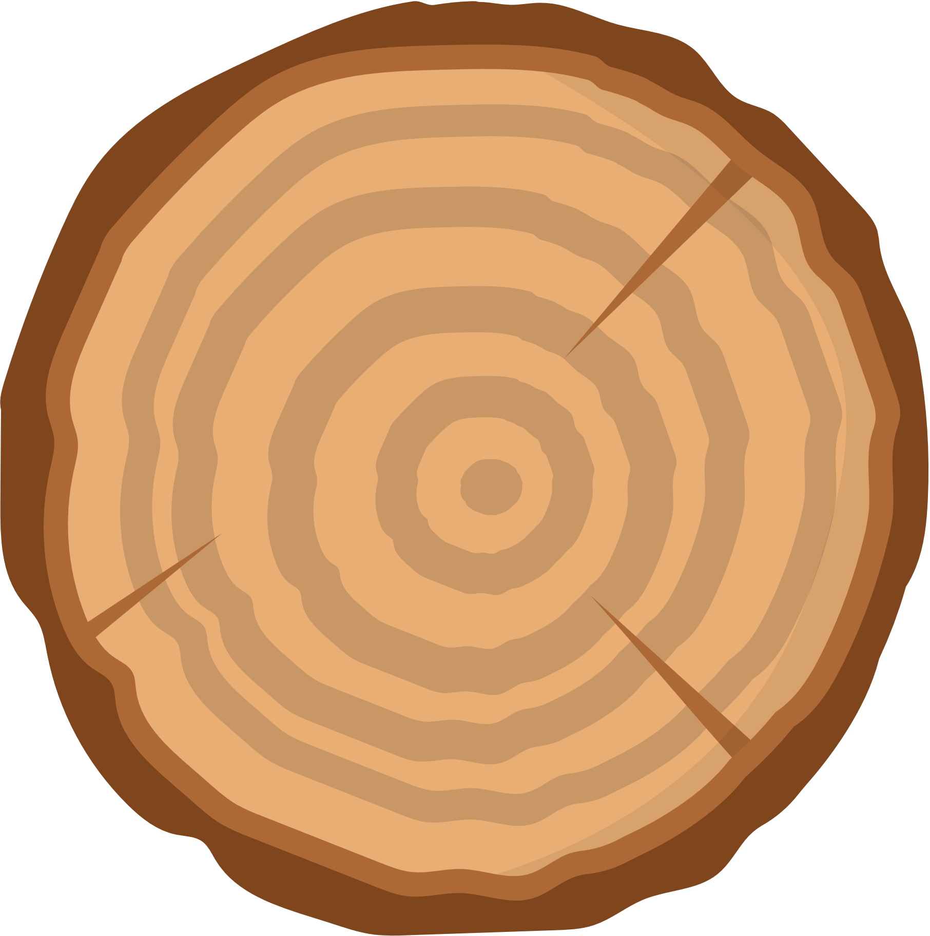

Topic:Identify common Diseases in;
Maze

Slide 3
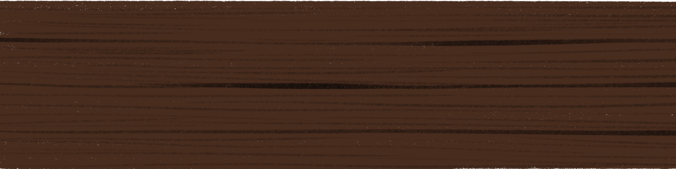
1. Dataset Overview
Data : Common_Rust has the most images (1306), Gray_Leaf_Spot the fewest (574).
Total 4,188 images across 4 categories
. Data source: [Kaggle dataset].

Slide 4
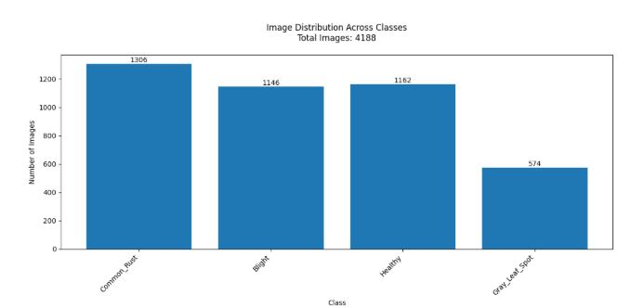
Data Set

Slide 5
Data Preprocessing and Statistics
Applied resizing, normalization, and transformations..
Calculated mean/std for effective normalization:
Mean: [0.4375, 0.4979, 0.3756] Std: [0.2129, 0.2188, 0.2125] These help speed up training and improve convergence.

Slide 6
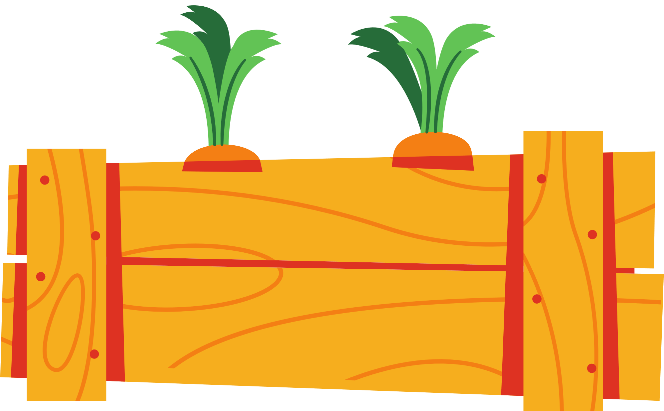
Data Augmentation
Applied techniques like random crop, flip,
rotation, color jitter.
Purpose: Improves generalization and reduces overfitting.
Sample augmented images (8-grid).
Next Slide →

Slide 7
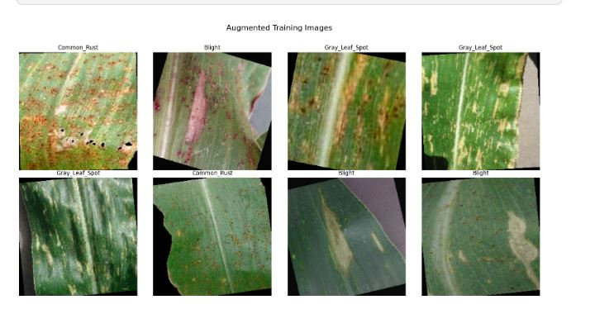
Data Augmentation

Slide 8
Model Training
Used ResNet-50 as a backbone (transfer learning)
Pretrained on ImageNet.
Batch size: 32
Optimizer: (Adam)
Loss function: CrossEntropyLoss
Training/validation split (64% train, 16% val, 20% test)
Output Classes: 4 (Blight, Common_Rust, Gray_Leaf_Spot, Healthy)

Slide 9
Why Resnet-50?
Powerful and widely used for image classification tasks.
Deep (50 layers) but stable due to residual (skip) connections.
Performs well even with a moderate-sized dataset when using transfer learning.

Slide 10
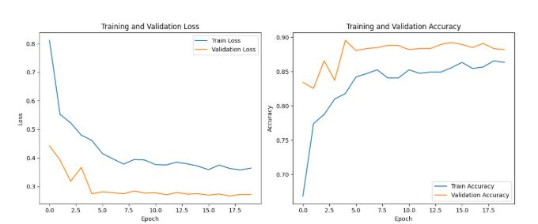
Model Training

Slide 11
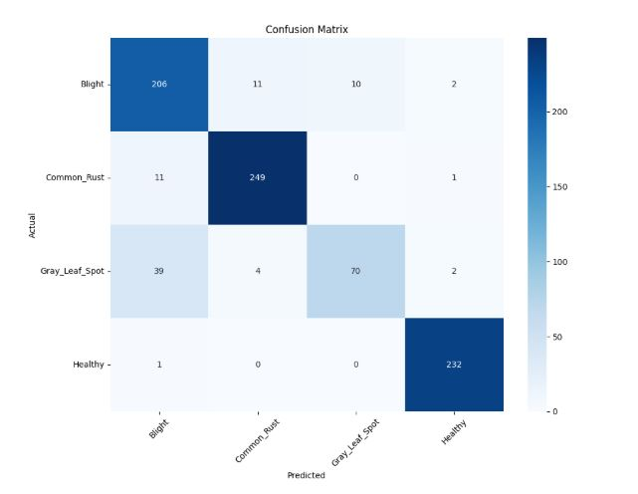
Performance Metrics

Slide 12
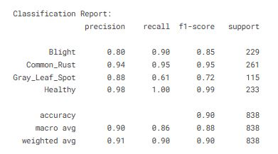

Slide 13
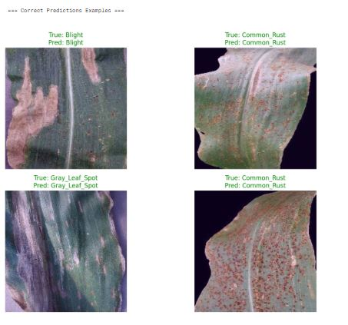
Perdictions(correct)

Slide 14
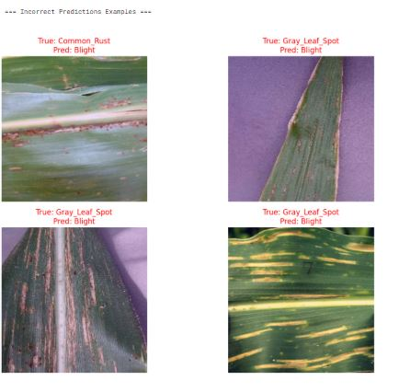
Perdictions(incorrect)

Slide 15
Perdictions:
Test Accuracy: 90.33%

Slide 16
Conclusion
Potential real-world applications:
Assist farmers in early disease detection
Reduce crop loss
Future work:
Add more data
Try other architectures like EfficientNet
Convert model to mobile app using ONNX/TF Lite

Slide 17
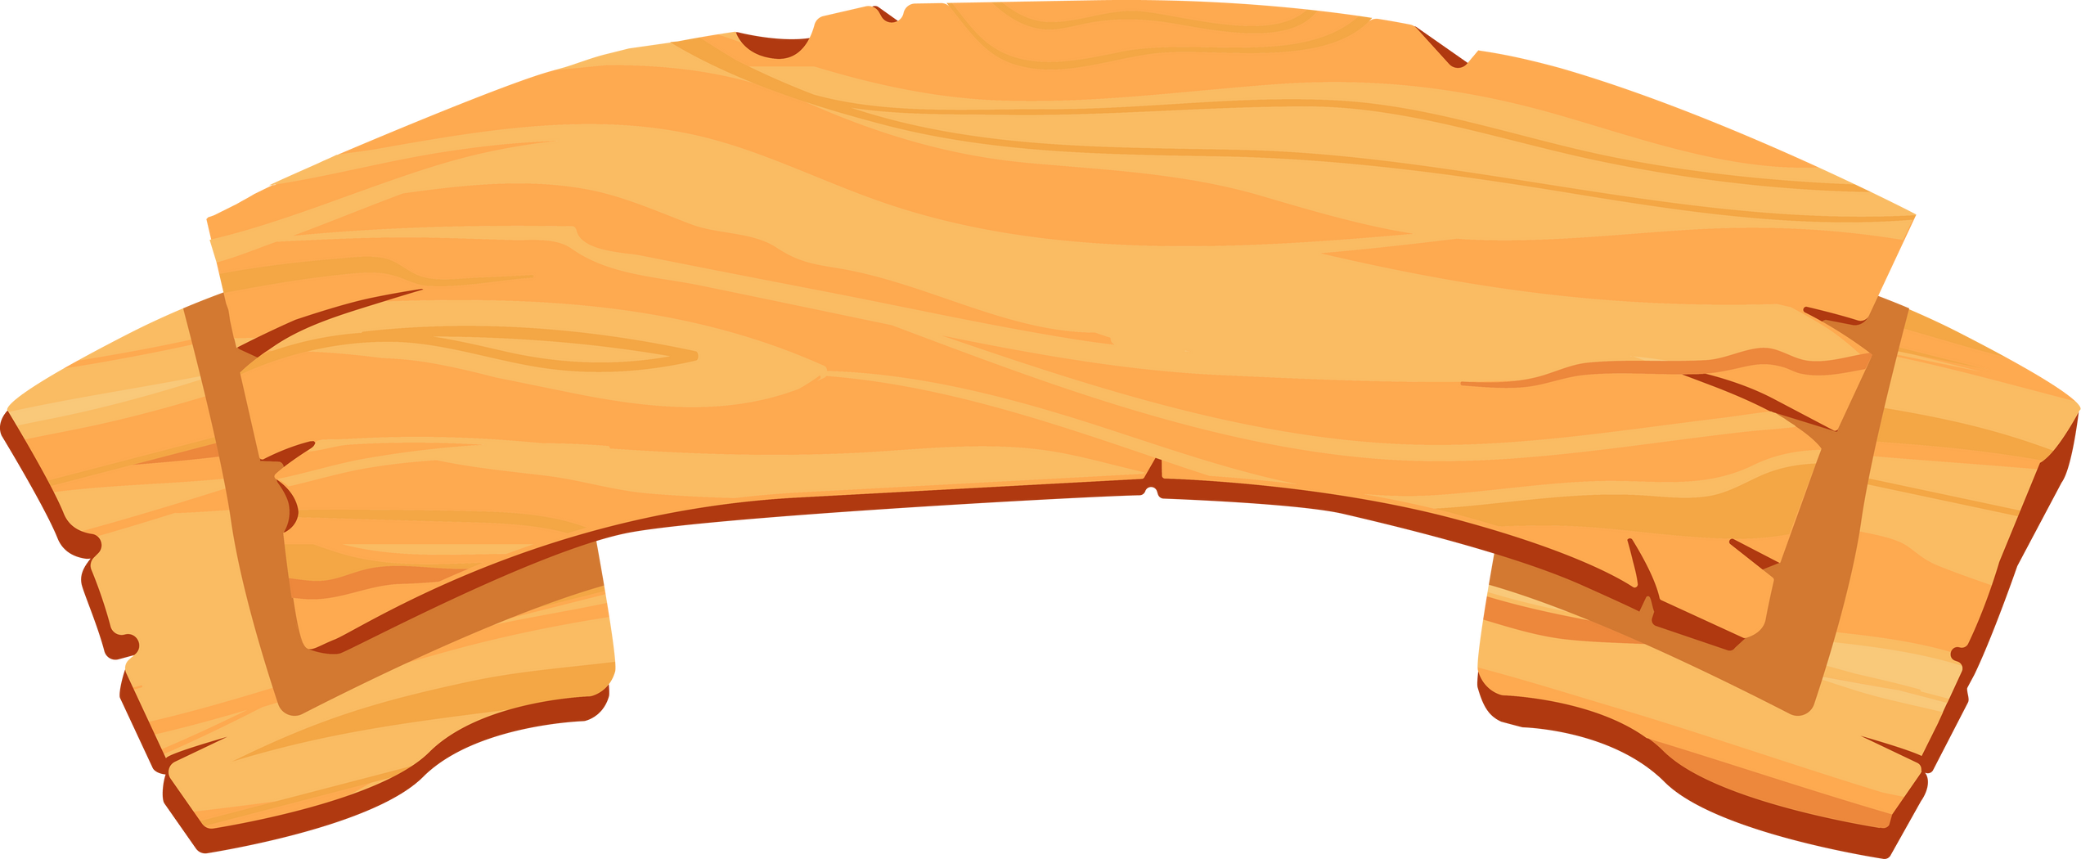
THANK YOU

