Slide 1
Accelerating Object Classification using FPGAs
Group 3
Ahanaf Rakin
Farid Chalabi
Mehdi Mousavi
Hammad Mohiuddin

Slide 2
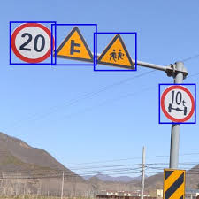
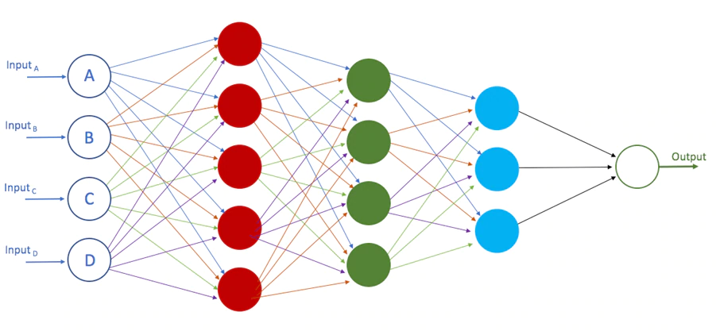
Project Overview
Cost?
Object classification models are getting better
Models getting more complex
Notes:
intro, state of the art, applications of realtime object detection

Slide 3
Project Goals
Initial plan:
Accelerate a ML model for object detection in video streams
Create bounding boxes on detected objects in video stream and display on VGA
Focus on traffic sign recognition and classification
Previous models: SSD and MobileNet
Notes:
intro, state of the art, applications of realtime object detection

Slide 4
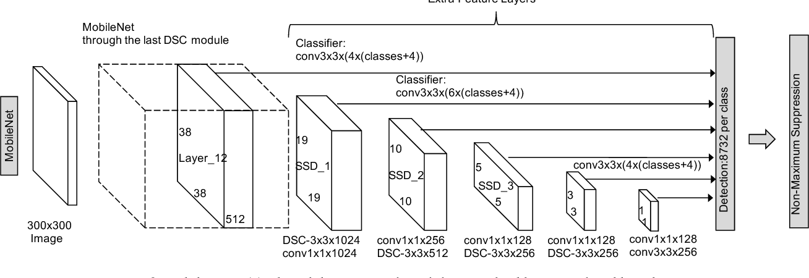
Previously Selected Models
SSD
[1]

Slide 5
Challenges with the Models
Mobilenet+SSD model too complex & resource intensive to implement in hardware
Models are difficult to split up between hardware and software
Results are calculated based on output from intermediate layers as well as the last layer
Would require storing intermediate values
Notes:
Many layers, channels and neurons
Complex to fit the whole design on a single Nexys Video board
Even more work to split over multiple boards to alleviate resource utilization issues

Slide 6
Final Project Goals
Final decision:
Perform traffic sign classification on images using a CNN
Display input image annotated with class prediction on VGA
Selected ML Architecture:
LeNet-5
Smaller model, yet sufficiently powerful for image classification
Trained ourselves in software to ensure format of weights
Notes:
intro, state of the art, applications of realtime object detection

Slide 7
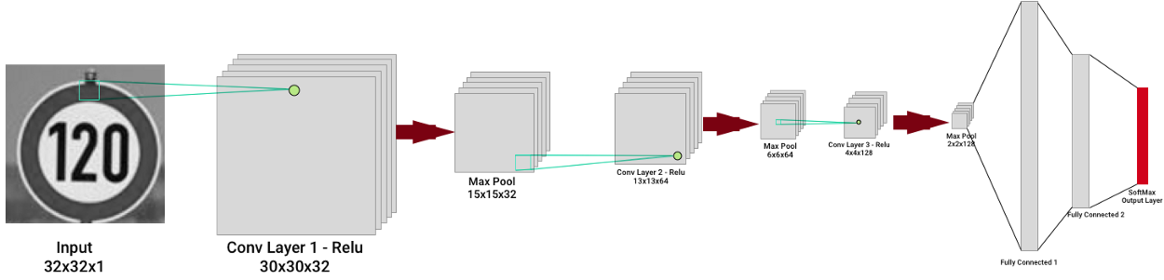
Final Model Architecture - LeNet 5
[2]

Slide 8
System Level Overview

Slide 9
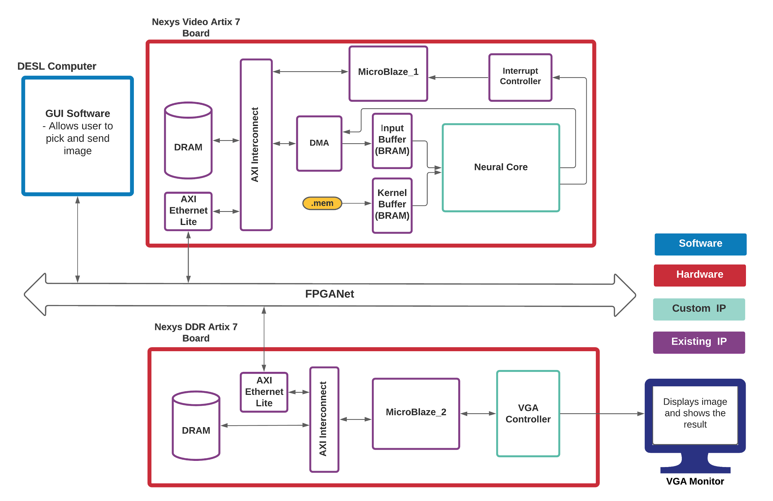

Slide 10
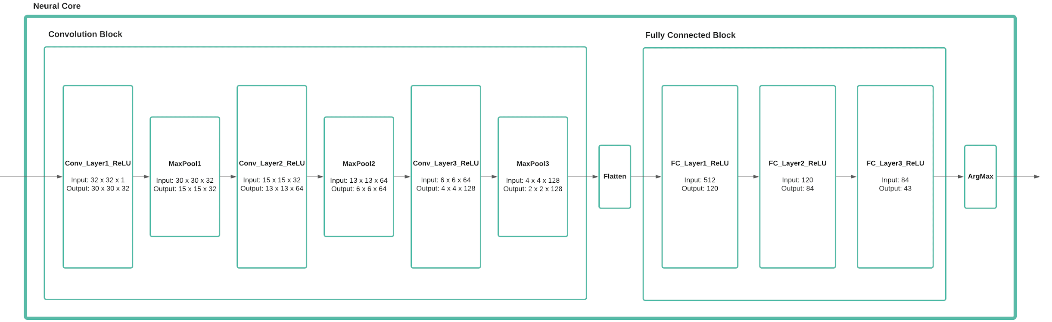
2 Main Sub-blocks
Prediction

Slide 11
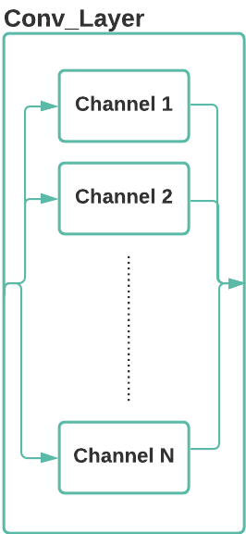
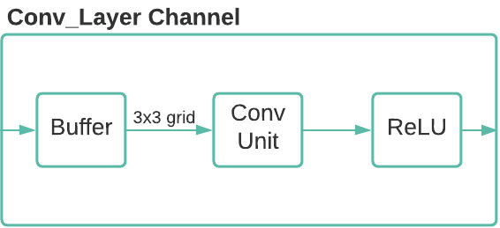
Convolution Layer

Slide 12
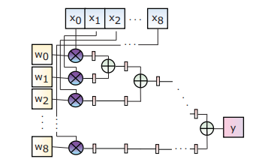
Convolution Unit
3 x 3 Convolution Unit Structure
[3]

Slide 13
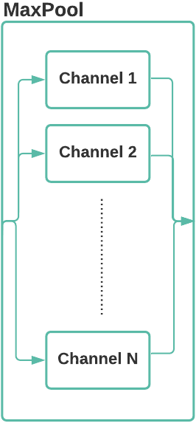
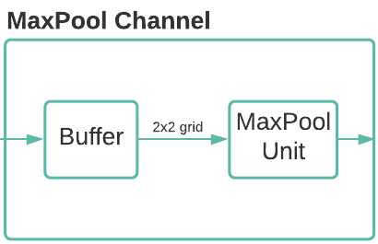
MaxPool

Slide 14
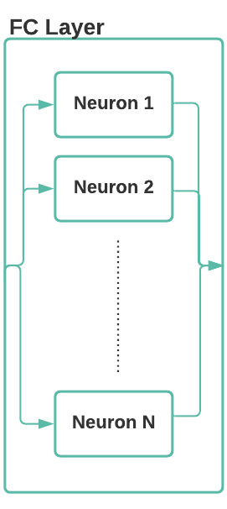
Fully Connected Layers

Slide 15
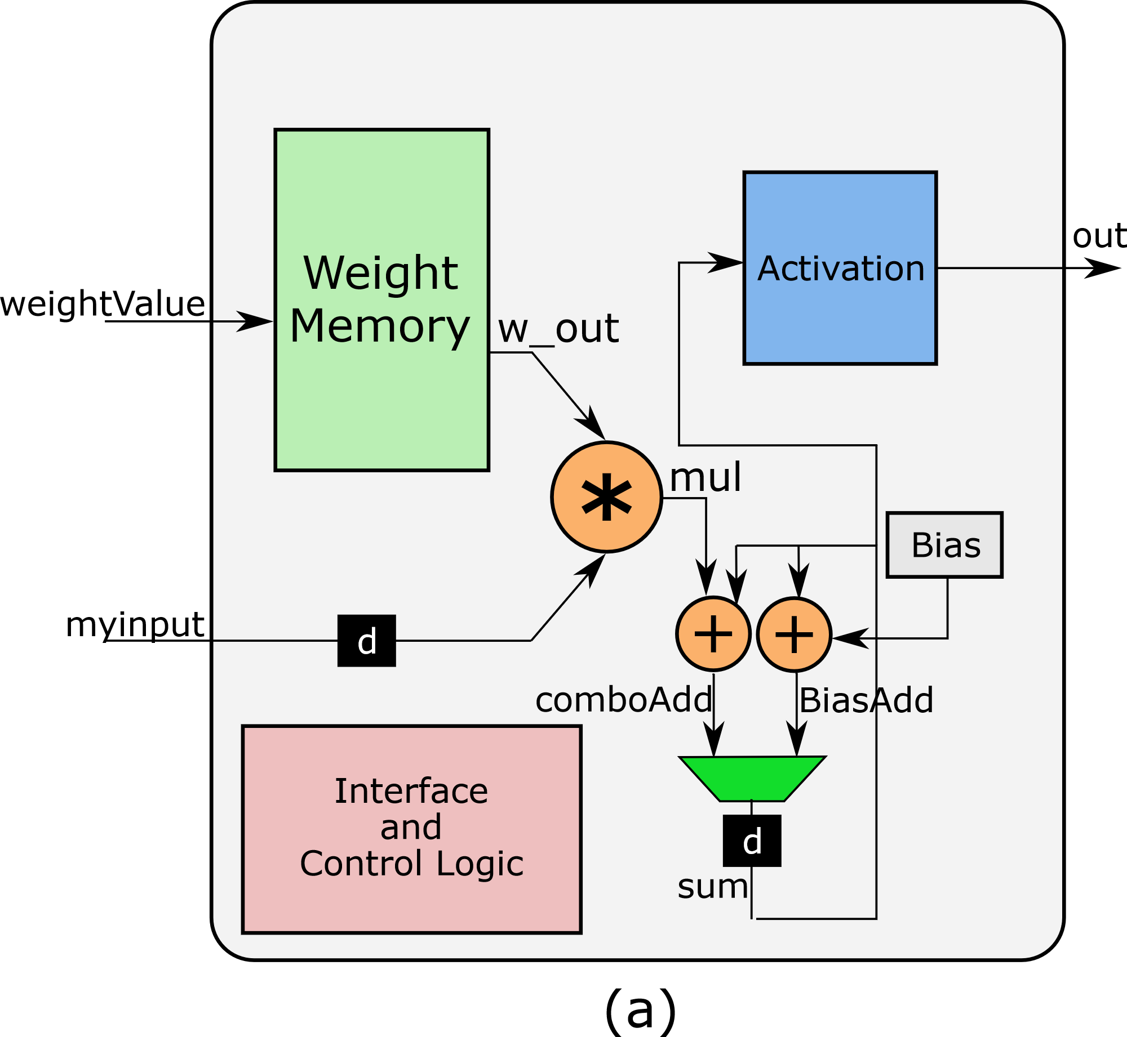
Neuron
[4]

Slide 16
Design Process

Slide 17
Bottom-Up Design Approach
Split design into major higher-level components:
Microblaze system
Data transfer and interrupt handling
Neural Core
Convolution and fully connected blocks
TCP Communication
Transferring image data and results
Machine Learning models
Training in software, quantization and weight extraction
VGA display
Displaying image with class prediction
Built components individually on separate projects and integrated at the end

Slide 18
Neural Core Implementation
Built up hardware based on the software architecture layer by layer
Parameterized all variables such as image width, input size, kernel size etc. to make code easier to modify
Started by implementing a simple Neural Core with a single 3x3 convolution layer and an image sharpening kernel as weights
Slowly built the convolution and fully connected layers and integrated them

Slide 19
Testing & Integration
There are 4 major components that needed to be tested in our design:
Neural Core
Testbenches for each sub-module to test functionality
Higher level testbenches to test the integration of sub-modules
At layer-level
At core-level
AXI interface between the integrated components
AXI VIP component used to verify streaming interface between Neural Core and DMA Controller.
Network connectivity
Simple LWIP project to test sending and receiving TCP packets
Simple python server and client to test connections
VGA
Simple C program to draw images and texts from arrays

Slide 20
Final Timing
Clock Freq. = 100 MHz
Fmax = 102 MHz
Neural Core Processing Time = 80 us

Slide 21
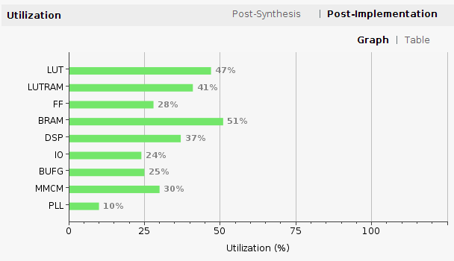
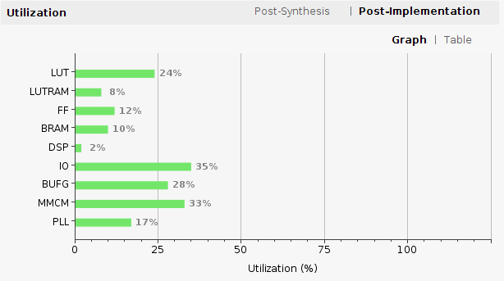
Resource Utilization
Nexys Video
Nexys DDR

Slide 22
Challenges &
Lessons Learned

Slide 23
Team Management
Google Meets
Report progress every 2-3 days and work on milestones
Debugging in pairs
Made scripts for working with redundant tasks
Easily ensure correct dependencies are installed
Managing multiple designers
2 people on software, 2 people on hardware
Well defined interfaces
Shared work through Google Drive
Milestones kept us on track
Notes:
Provided functional requirements, input/output specification and outside control logic

Slide 24

Challenges
Implementation & integration of Interrupt-based streaming from DRAM to Neural Core with DMA
Difficulty sending large packets through the network for sending images
Understanding the machine learning models and the quantization of weights
Lots of debugging for neural core IP
Notes:
Tedious reading through interrupt controller documentation and header files to use proper functions
Software model accuracy was 93% on the given classes, were not able to calculate accuracy on the hardware as the Video board needs to be reconnected to the server before sending a new image.

Slide 25
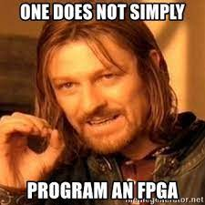
Lessons Learned
Integration is hard so start early
Incorporated skills learned in many previous courses
Networking, computer hardware/architecture, machine learning, programming
Simulating hardware using testbenches
It’s worth the time to design testbenches carefully to avoid confusion and false positives
Define interfaces in advance to avoid confusion
Learned to read through Xilinx and other documentation quickly

Slide 26
Demo

Slide 27
Questions?

Slide 28
References
[1] W. Liu et al., “SSD: Single Shot MultiBox Detector,” arXiv:1512.02325 [cs], vol. 9905, pp. 21–37, 2016, doi: 10.1007/978-3-319-46448-0_2.
[2] E. Forson, “Recognising Traffic Signs With 98% Accuracy Using Deep Learning,” Medium, 28-Aug-2017. [Online]. Available: https://towardsdatascience.com/recognizing-traffic-signs-with-over-98-accuracy-using-deep-learning-86737aedc2ab. [Accessed: 31-Mar-2021].
[3] J. Liao, L. Cai, Y. Xu and M. He, "Design of Accelerator for MobileNet Convolutional Neural Network Based on FPGA", 2019 IEEE 4th Advanced Information Technology, Electronic and Automation Control Conference (IAEAC), 2019
[4] https://github.com/vipinkmenon/neuralNetwork/blob/master/Tut-1/neuron.pdf

Slide 29
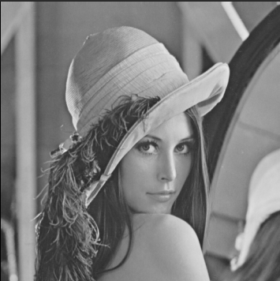

Image Sharpening Simulation Results
Input Image Output Image: Sharpened
Notes:
In summary the goal our project is to develop an efficient hardware implementation of the MobileNet-SSD model for object detection
building custom ip for neural net computations by building up (Multiply and Accumulate) MACC modules and building layer by layer
We’ll be using 1 FPGA for our model computations, 1 FPGA for video output
Our system output will be a video output on a VGA monitor to draw bounding boxes around detected objects

Slide 30
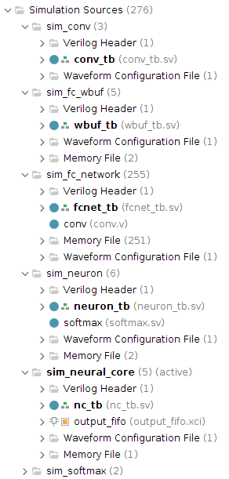
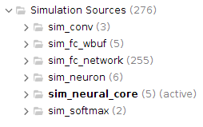
Neural Core Testbench Structure

