Slide 1
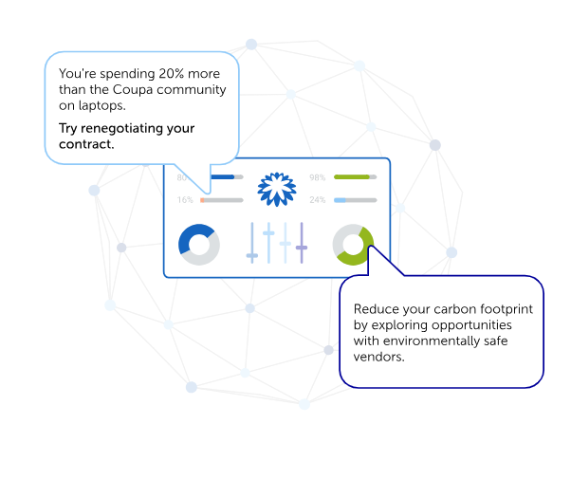
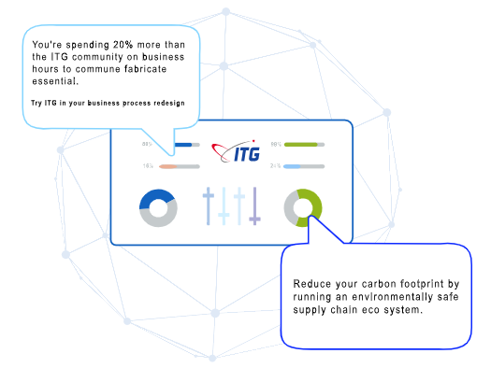
COUPA ANIMATION
ITG ANIMATION
Font is too small as compared to Coupa.
Dots are same in color
Some dots are light and some dark

Slide 2
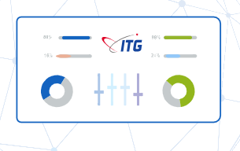
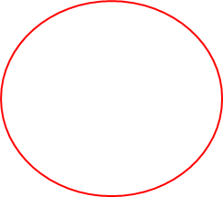
Instead of increasing and decreasing progress bar
is moving from its place
Color is going out of progress bar

