Slide 1
ABDUL HASEEB
KHAN
Front-end Back-
end developer
03420529206 haseebkhan645411@gmail.c
om
WORK EXPERIENCE
2020 – 2025 Fiverr.com
pixel animator
Working as an 2d-animator in pixel art and game assets .
working on fiverr since 2020
2023 Transcription
Translator
Worked as an translator to translate dramas,series,films in
different language .
converting audio clips into subtitles.
2024
NAVTTC
full stack developer

Slide 2
done 3-months full stack course with the company
leadership.com.
PROFILE
haseeb khan (Linkdin)
I am currently a seventh-semester student at SZABIST University
Islamabad, with a strong passion for design and development. I am
actively seeking both on-site and off-site opportunities to expand my
skill set and gain new knowledge. My goal is to refine my abilities to
align with my future aspirations, while embracing the learning process
and adapting to various environments
Bachelor in Computer
Science (UG)
Szabist University H-8/4
islamabad
2021
KIPS College G-9 Islamabad
FSC : Pre-Engineering
2018 - 2020
Fazaia Inter College E-9
Islamabad
Matric : Computer

Slide 3
Science
2016 - 2018
EDUCATION
SKILLS
English
German (Learning)
French
LANGUAGE
C++
C
html
css
CERTIFICATION
2024
GOOGLE
google ads
done 1-month google ads campaign.
running google campaign ads on e-mails,youtube
intervals,poster ads.
Bootstrap

Slide 4
React
Javascript
Java (GUI,Oop)
Node.js
Sql
swyft
Python
Kotlin
2d-pixel animation
2d-pixel game assets
haseebszabist (Github)

Slide 5
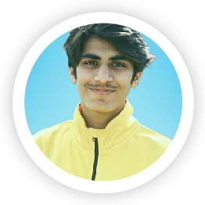

Slide 7
