Slide 1
APEXCIFY TECHNOLOGYS INTERNSHIP PROGRAM 2025
STUDENTID :AT/837/2000
CERTIFICATE OF COMPLETION
TO WHOM IT MAY CONCERN
It is to be certified that Abdul Haseeb was an active Participant at Apexcify Technologys Virtual
Internship Program in Artificial Intelligent and complete all the tasks with dedication and
hardwork. We really appreciate your efforts taken and wish you all the best for the future.
10 th August 2025 to 10 th September 2025
CEO & Founder Date of Issue
10 th September, 2025

Slide 2
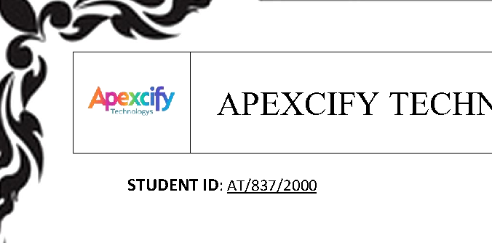

Slide 3
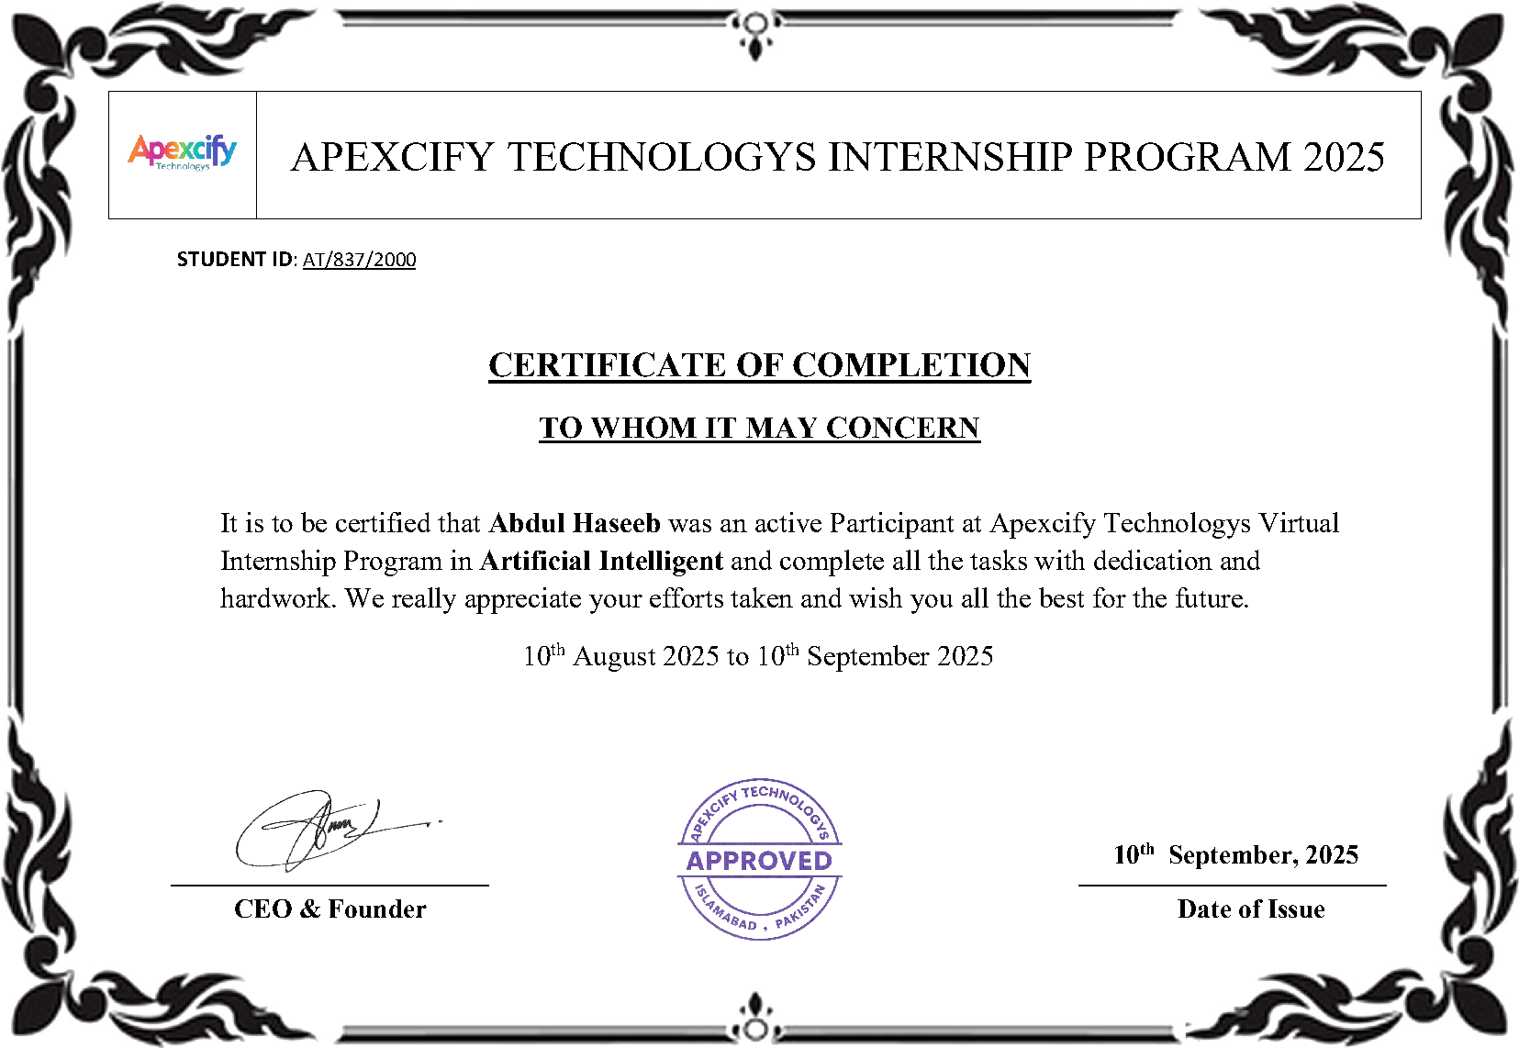

Slide 4


Slide 5


Slide 6


Slide 7
