Slide 1
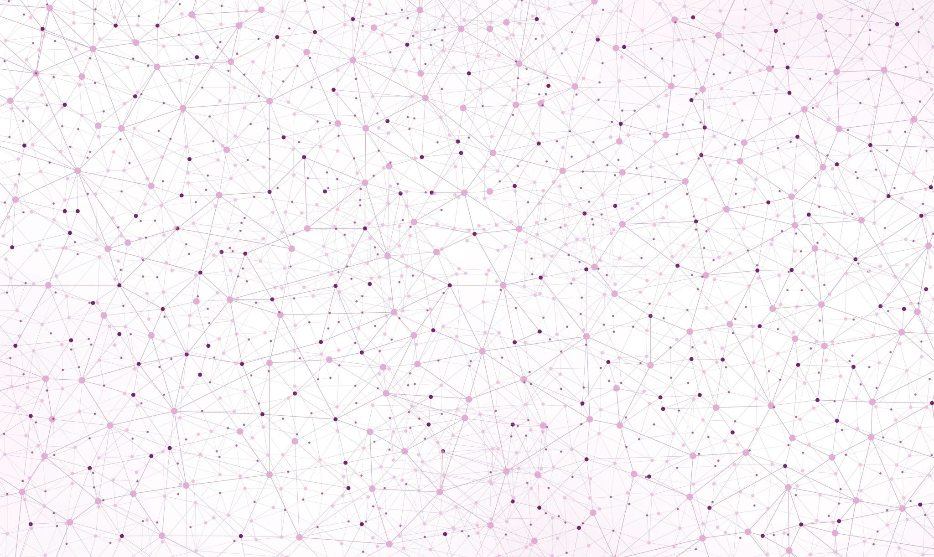
News Research Tool
AI-Powered Summarization and Analysis App By: Hammad ur Rahman

Slide 2

Project Overview
Objective:
To build an app that fetches the latest news on any topic and summarizes or analyzes it using OpenAI's GPT models.
Tools Used:
Python
LangChain
Streamlit
OpenAI API
NewsAPI

Slide 3
Key Features
🔍 Fetches real-time news based on user queries
🧠 Summarizes and analyzes news content using GPT
🌐 Clean and interactive Streamlit interface
🧩 Modular code structure (easy to maintain and scale)

Slide 4

Architecture
User Input (Query)
↓
NewsAPI → Fetch Articles
↓
LangChain + OpenAI → Analyze/Summarize
↓
Streamlit → Display Output

Slide 5
Tech Stack
Component | Technology Used
UI | Streamlit
Backend logic | Python. langchain
NewsSources | NewsAPI
AI Analysis | OpenAI GPT Models
Deployment | Streamlit Cloud

Slide 6

Code Modules
.env – Stores API keys
Langchain_configuration.py – Fetches articles using NewsAPI
app.py – Sends text to OpenAI for analysis
streamlit_ui.py – Streamlit app logic and UI

Slide 7

Challenges Faced
🔐 Environment variable and API key setup
🧠 Understanding LangChain pipelines
⌛ Deployment delays and debugging issues
💻 Illness caused temporary delay in submission

Slide 8

Conclusion
✅ Successfully built a working AI-based news analyzer
📈 Potential to expand with sentiment analysis and category filters
🚀 Learned hands-on use of APIs, LangChain, and app deployment

Slide 9

Thank You
Contact:
https://github.com/hammad941058/PROJECT-8.git

