Slide 1

GUI CALCULATOR
(USING VISUAL STUDIO CODE)

Slide 2
INTRODUCTION
A calculator is a device that performs arithmetic operations on numbers. Basic calculator can do only addition, subtraction, multiplication and division mathematical calculations.
Using Visual Studio Code (Tkinter Python)
GUI calculator is a simple calculator where one can performs basic mathematical operation by just clicking on the numbers and operation buttons and it shows the result on the screen in a blink.

Slide 3
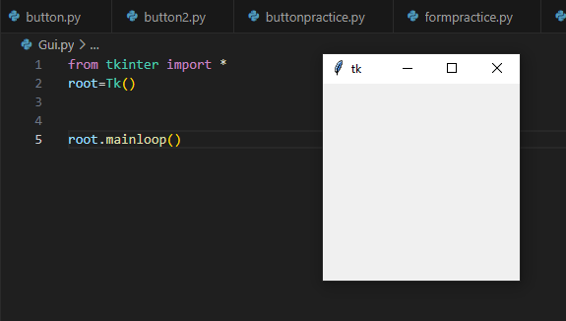
STEP 1
In order to create a GUI calculator in Visual Studio Code first we need to install VS Code and make a new file in it.
After making the file we need to install all the functions and built-in modules in the tkinter library by simple writing the following code.
from tkinter import *
After installing the above function need to make a window with the following code
root=Tk()
root.mainloop()

Slide 4
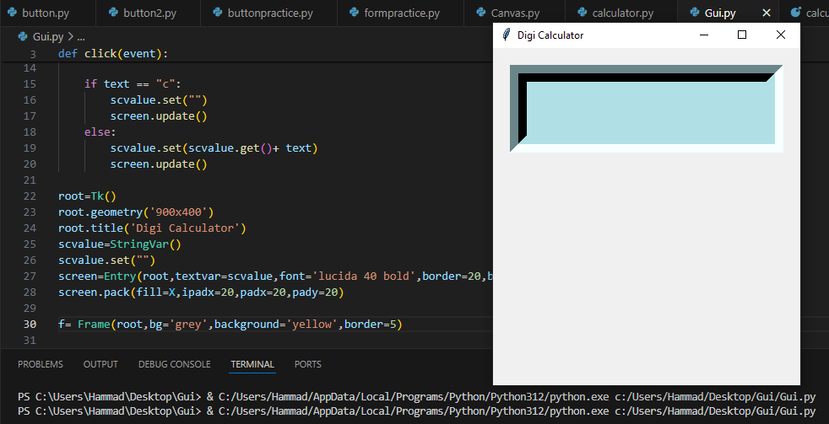
STEP 2
data=StringVar()
A variable defined using StringVar() holds a string data where we can set text value and can retrieve it. Also, we can pass this variable to a textvariable parameter for a widget like Entry. The widget will automatically get updated with the new value whenever the value of the StringVar() variable changes.
Create a frame for input field and inside we create input field to show expression.
f=frame()
f.pack()
Screen=Entry()
Screen.pack()

Slide 5
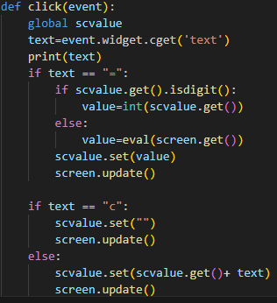
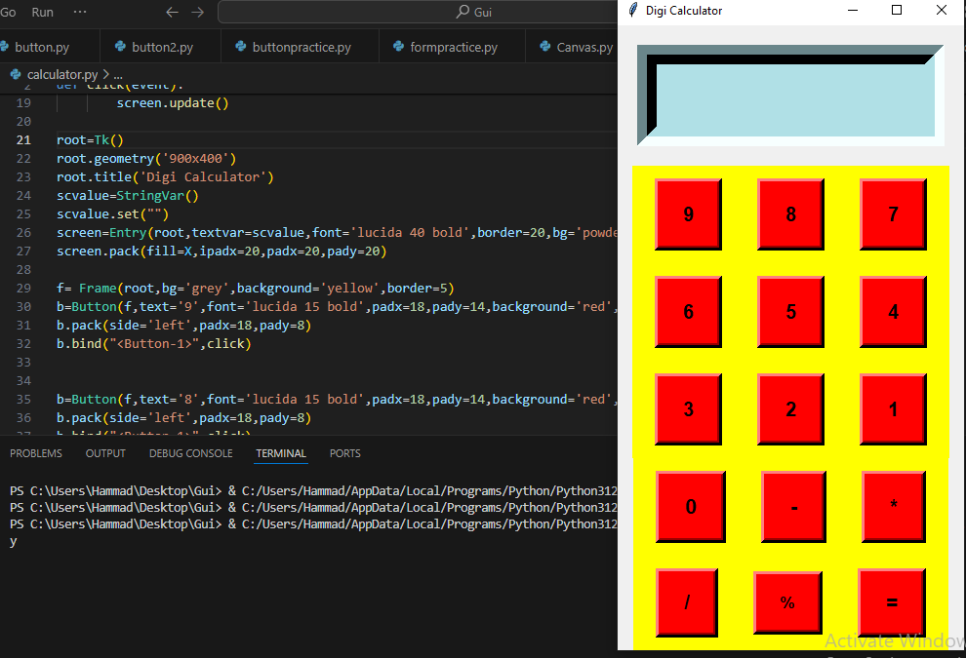
STEP 3
After creating Frame and screen i.e. Entry, created buttons with the following codes staring from 1 to 9 and add basic mathematical function like addition, subtraction, multiplication and division.
b=Button()
b.pack()
Before creating buttons a method is defined by the name “Click” which performs the mathematical operations and show the results on the screen.

Slide 6
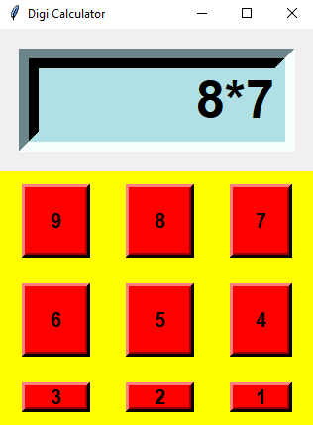
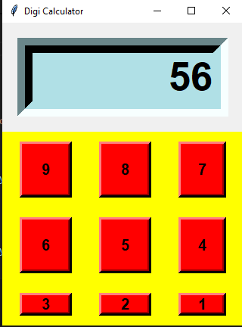
CALCULATOR IS READY

Slide 7

CONCLUSION
With the help of Tkinter python library in Visual Studio Code it is very easy to make simple calculator that performs the basic mathematical operations besides this we can also create scientific calculator by adding other operations in calculator.

