Slide 1

Telecommunication User Engagement and Device Analysis
Data-Driven Insights and Investment Recommendation
Presented by: Hammad Ur Rahman
Date: [10-11-2024]

Slide 2

Project Overview
Objective: Analyze telecommunication data to understand user engagement, experience levels, device usage patterns, and application behavior.
Tasks Completed:
Data preprocessing and feature engineering.
Calculation of engagement and experience scores.
Clustering analysis and top device/application usage insights.
Investment recommendation based on findings.

Slide 3

Dataset Overview
Data Characteristics:Total Data Usage (Bytes), Download (Bytes), Upload (Bytes).
Device Information: Handset types and manufacturers.
Application Usage Ratios: Social Media, Google, YouTube, Netflix, Gaming.
User Segmentation: Clustered by engagement and experience levels.

Slide 4
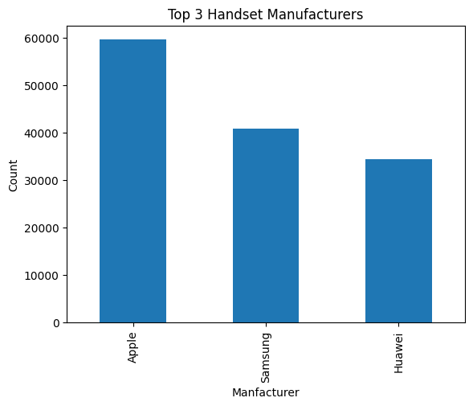
Top Handsets and Manufacturers
Top 3 Handset Manufacturers:
Apple: 59,565 users.
Samsung: 40,839 users.
Huawei: 34,423 users.
Top 10 Handsets:
Huawei B528S-23A: 19,752 users
Apple iPhone 6S (A1688): 9,419 users
Apple iPhone 6 (A1586): 9,023 users
[Additional handsets as listed above]

Slide 5
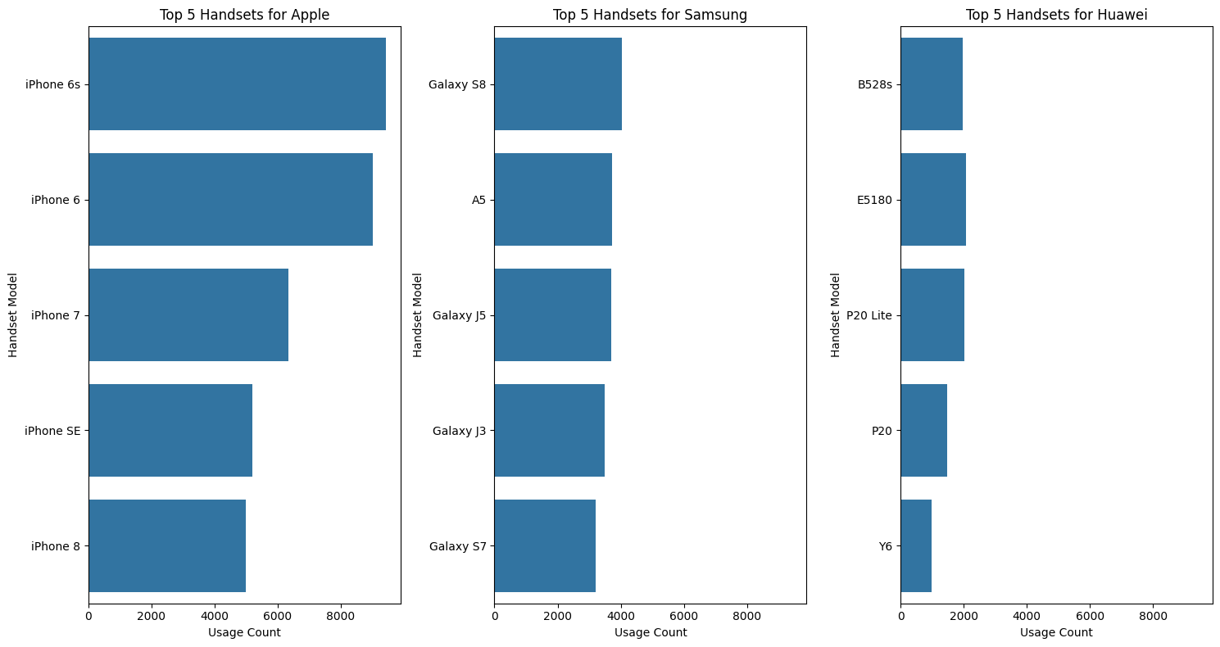
Device Usage by Manufacturer
Apple Handset Breakdown (Top 5 Models):
iPhone 6S: 15.81% of Apple devices
iPhone 6: 15.15%
iPhone 7: 10.62%
Samsung Handset Breakdown (Top 5 Models):
Galaxy S8: 11.07% of Samsung devices
Galaxy A5: 9.12%
Huawei Handset Breakdown (Top 5 Models):
B528S-23A: 57.38% of Huawei devices
E5180: 6.04%
P20 Lite: 5.87%

Slide 6
Total Data Usage by Application
Highest Data Usage Applications:
Gaming: 6.4550e+13 Bytes
Other: 6.4405e+13 Bytes
YouTube: 3.3965e+12 Bytes
Netflix: 3.3943e+12 Bytes
Insights:
Gaming and other content lead data consumption, indicating high engagement in streaming and interactive content.

Slide 7

Application Usage by User Segment
High Data Consumers:
Gaming: 3.1218e+13 Bytes
Netflix: 1.3819e+12 Bytes
Low Data Consumers:
Gaming: 4.0235e+12 Bytes
Netflix: 6.1280e+11 Bytes
Medium Data Consumers:
Balanced usage across applications, with substantial engagement in both gaming and streaming.

Slide 8

User-Level Aggregates
Top User Metrics:
Total Session Duration: Mean 146,167 ms, Maximum 18,553,750 ms.
Total Download Data: Mean 6.33e+08 Bytes, Maximum 8.15e+09 Bytes.
Application Count per User: Mean 9.76, Max 126.
Insights:
High variability in session duration and data usage, indicating diverse user engagement levels.

Slide 9
Engagement and Experience Scores
Engagement Scores:
Range: 0.07 - 0.09
Experience Scores:
Range: 0.001 - 0.022
Interpretation:
Higher scores indicate high-engagement users with potential satisfaction.
Variability suggests opportunities for improving user experience for lower-engagement users.

Slide 10

Clustering and Segmentation
User Segmentation (Clustering):
Cluster 1: High engagement and high experience - loyal users.
Cluster 2: High engagement but lower experience - engaged but possibly dissatisfied.
Cluster 3: Low engagement and low experience - opportunity for re-engagement.
Actionable Insights:
Prioritize experience improvements for Cluster 2.
Re-engage Cluster 3 with targeted incentives.

Slide 11

Key Findings and Insights
Device Usage:
Apple devices dominate the market, with the iPhone 6 series as a popular model.
Huawei’s B528S-23A is widely used among data consumers.
Application Engagement:
High consumption in gaming and streaming applications across segments.
Streaming and social media show potential for increasing engagement.
User Segmentation:
Clear distinctions in engagement levels across clusters suggest targeted user engagement strategies.

Slide 12
Investment Recommendation
Recommendation: Based on strong user engagement in high-data applications like gaming and streaming, coupled with Apple and Huawei device usage, the company shows promising growth potential in customer satisfaction and engagement.
Investment Viability:
Pros:
Strong user engagement in data-intensive applications.
Clear opportunities for targeted re-engagement and experience enhancements.
Cons:
Low experience scores in some high-engagement clusters indicate areas for improvement.
Final Verdict: Invest - The data suggests that with strategic improvements, the company can enhance user satisfaction and capitalize on existing engagement trends.

Slide 13

Thank You
Thank you for your time and attention!
We hope these insights and recommendations provide a valuable perspective on user engagement and satisfaction in the telecommunication industry.
Contact Information:
Name: Hammad Ur Rahman
Email: hammadrahman446@gmail.com
Location: Ranikhet, India

