Slide 1

Machine Learning
Lecture – 3
Logistic Regression
Muhammad Affan Alim

Slide 2
Logistic Regression - Classification
In classification, the output ‘y’ is discrete value.
In logistic regression, to develop an algorithm to determine what class a new input should fall into
Like some classification problems
Email -> spam / not spam
Online transaction -> fraudulent
Tumor -> malignant / benign

Slide 3
Logistic Regression - Classification
The problem we discuss here consist only two classification classes ‘y’ is either 0 or 1.
0 = negative class (absence of something)
1 = positive class (presence of something)
later look at multiclass classification problem, although this is just an extension of binary classification
{0,1}
{0,1,2,3,4}

Slide 4
Logistic Regression - Classification
Example
How to develop the classification algorithm
Tumor size vs malignancy (0 or 1)
We could use linear regression
Then threshold the classifier output (i.e. anything over some value is yes, else no)
In our example below linear regression with threshold seems to work

Slide 5
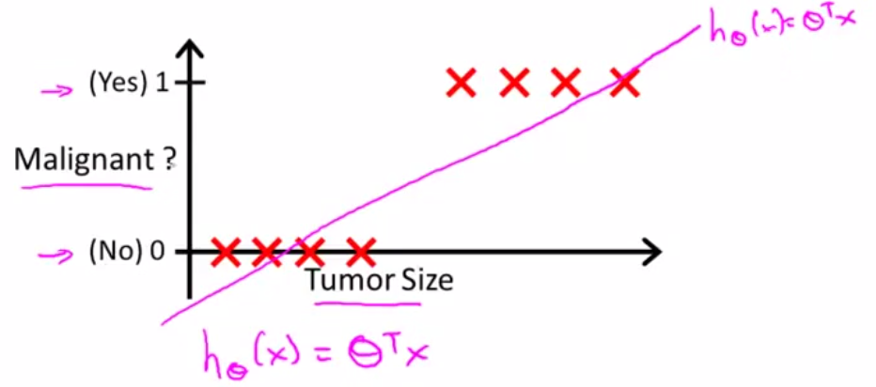
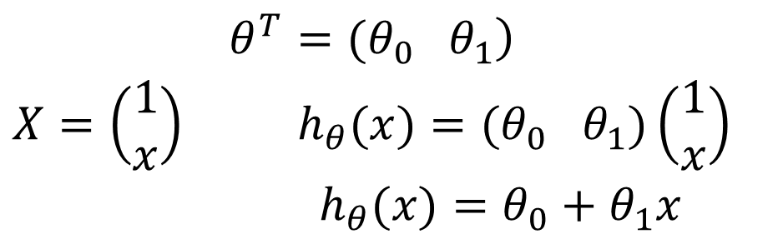
Logistic Regression – Classification (Example)
$$\begin{matrix}\left.θ^{T}=(θ_{0} θ_{1}\right) \\ X=\left(\begin{matrix}1 \\ x\end{matrix}\right) h_{θ}(x)=(θ_{0} θ_{1})\left(\begin{matrix}1 \\ x\end{matrix}\right) \\ h_{θ}(x)=θ_{0}+θ_{1}x\end{matrix}$$

Slide 6
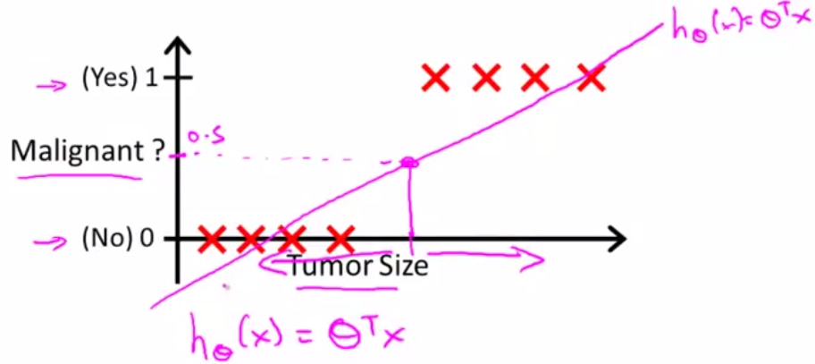
Logistic Regression – Classification (Example)
The threshold classifier output h_{θ}(x) = 0.5
If h_{θ}(x) ≥ 0.5, predict “y = 1”
If h_{θ}(x) < 0.5, predict “y = 0”

Slide 7
Logistic Regression – Classification (Example)
Problem of linear regression for classification:
We can see above diagram this does a reasonable job of satisfying the data points into one of two classes
But what if we had single yes(1) with a very small tumor (or single no(0) with a very large rumor)
This would lead to classifying all the existing yeses and nos

Slide 8
Logistic Regression – Classification
Another issues linear regression
We know y is 0 or 1
Hypothesis can give values larger than 1 or less than 0
So Logistic regression generates a value where is always either 0 or 1 such that 0 ≤ h_{θ}(x) ≤ 1
Logistic regression is a classification algorithm, don’t be confused.

Slide 9
Hypothesis Representation
What function is used to represent our hypothesis in classification
We want our classifier to output values between 0 and 1
When using linear regression we did h_{θ}(x) = (θ^{T} x)
For classification hypothesis representation we do
h_{θ}(x) = g((θ^{T} x))

Slide 10
Hypothesis Representation
Where we define g(z)
z is a real number
g(z) = 1/(1 + e^{-z})
This is the sigmoid function, or the logistic function

Slide 11

Hypothesis Representation
If we combine these equations we can write out the hypothesis as

Slide 12
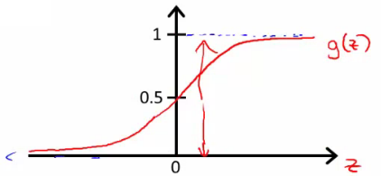
Hypothesis Representation
What does the sigmoid function look like
Crosses 0.5 at the origin, then flattens out
Asymptotes at 0 and 1
Given this we need to fit θ to our data

Slide 13
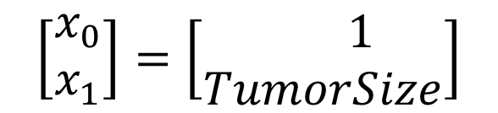
Hypothesis Representation Interpreting the hypothesis output
When our hypothesis (h_{θ}(x)) outputs a number, we treat that value as the estimated probability that y=1 on input x
Example
If X is a feature vector
with x₀ = 1 (as always) and x₁ = TumourSize
h_{θ}(x) = 0.7
Tells a patient they have a 70% chance of a tumor being malignant
$$\left[\begin{matrix}x_{0} \\ x_{1}\end{matrix}\right]=\left[\begin{matrix} 1 \\ TumorSize\end{matrix}\right]$$

Slide 14
Hypothesis Representation Interpreting the hypothesis output
We can write this using the following notation
h_{θ}(x) = P(y=1|x ; θ)
What does this mean?
Probability that y=1, given x, parameterized by θ

Slide 15
Hypothesis Representation Interpreting the hypothesis output
Since this is a binary classification task we know y = 0 or 1
So the following must be true
P(y=1|x ; θ) + P(y=0|x ; θ) = 1
P(y=0|x ; θ) = 1 - P(y=1|x ; θ)

Slide 16
Decision Boundary
Gives a better sense of what the hypothesis function is computing
Better understand of what the hypothesis function looks like
One way of using the sigmoid function is;
When the probability of y being 1 is greater than 0.5 then we can predict y = 1
Else we predict y = 0

Slide 17
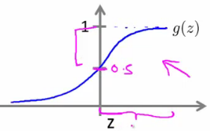
Decision Boundary
When is it exactly that h_{θ}(x) is greater than 0.5?
Look at sigmoid function
g(z) is greater than or equal to 0.5 when z is greater than or equal to 0

Slide 18
Decision Boundary
So if z is positive, g(z) is greater than 0.5
z = (θ^{T} x)
So when
θ^{T} x ≥ 0
Then h_{θ} ≥ 0.5
So what we've shown is that the hypothesis predicts y = 1 when θ^{T} x ≥ 0

Slide 19
Decision Boundary
The corollary of that when θ^{T} x ≤ 0 then the hypothesis predicts y = 0
Let's use this to better understand how the hypothesis makes its predictions

Slide 20
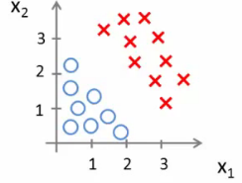
Decision Boundary - example
h_{θ}(x) = g(θ₀ + θ₁x₁ + θ₂x₂)

Slide 21
Decision Boundary
Suppose
θ₀ = -3, θ₁ = 1, and θ₂ = 1
So our parameter vector is a column vector with the above values
So, θ^{T} is a row vector = [-3,1,1]

Slide 22
Decision Boundary
What does this mean?
The z here becomes θ^{T} x
We predict "y = 1" if
-3x₀ + 1x₁ + 1x₂ ≥ 0
-3 + x₁ + x₂ ≥ 0

Slide 23
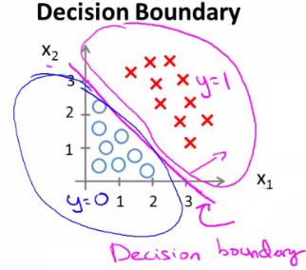
Decision Boundary
We can also re-write this as
If (x₁ + x₂ ≥ 3) then we predict y = 1
If we plot
x₁ + x₂ = 3 we graphically plot our decision boundary

Slide 24
Decision Boundary
Means we have these two regions on the graph
Blue = false,
Magenta = true and
Line = decision boundary
Concretely, the straight line is the set of points where h_{θ}(x) = 0.5 exactly

Slide 25
Decision Boundary
The decision boundary is a property of the hypothesis
Means we can create the boundary with the hypothesis and parameters without any data
Later, we use the data to determine the parameter values
i.e. y = 1 if
5 - x₁ > 0
5 > x₁

Slide 26
Decision Boundary-non-linear
Get logistic regression to fit a complex non-linear data set
Like polynomial regress add higher order terms
So say we have
h_{θ}(x) = g(θ₀ + θ₁x₁+ θ₃x₁² + θ₄x₂²)

Slide 27
Decision Boundary-non-linear
We take the transpose of the θ vector times the input vector
Say θ^{T} was [-1,0,0,1,1] then we say;
Predict that "y = 1" if
-1 + x₁² + x₂² >= 0 or
x₁² + x₂² >= 1

Slide 28
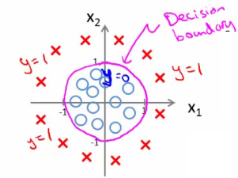
Decision Boundary-non-linear
If we plot x₁² + x₂² = 1
This gives us a circle with a radius of 1 around 0

Slide 29
Decision Boundary-non-linear
Mean we can build more complex decision boundaries by fitting complex parameters to this (relatively) simple hypothesis
More complex decision boundaries?
By using higher order polynomial terms, we can get even more complex decision boundaries

Slide 30
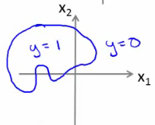
Decision Boundary-non-linear

Slide 31
Cost Function
Fit θ parameters
Define the optimization object for the cost function we use the fit the parameters
Training set of m training examples
Each example has is n+1 length column vector

Slide 32
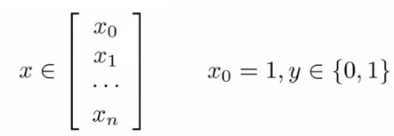

Cost Function
Training set {(x¹,y¹), (x²,y²)…(x^{m}, y^{m})}
m examples
x

Slide 33
Cost Function
This is the situation
Set of m training examples
Each example is a feature vector which is n+1 dimensional
x₀ = 1
y ∈ {0,1}
Hypothesis is based on parameters (θ)
Given the training set how to we chose/fit θ?

Slide 34

Cost Function
Linear regression uses the following function to determine θ

Slide 35
Cost Function
Instead of writing the squared error term, we can write
If we define "cost()" as;
cost(h_{θ}(x^{(i)}), y^{(i)}) = 1/2(h_{θ}(x^{(i)}) - y^{(i)})²
Which evaluates to the cost for an individual example using the same measure as used in linear regression

Slide 36


Cost Function
We can redefine J(θ) as
Which, appropriately, is the sum of all the individual costs over the training data (i.e. the same as linear regression)
To further simplify it we can get rid of the superscripts
So

Slide 37
Cost Function
What does this actually mean?
This is the cost you want the learning algorithm to pay if the outcome is h_{θ}(x) and the actual outcome is y
If we use this function for logistic regression this is a non-convex function for parameter optimization
Could work...

Slide 38
Cost Function
What do we mean by non convex?
We have some function - J(θ) - for determining the parameters
Our hypothesis function has a non-linearity (sigmoid function of h_{θ}(x) )
This is a complicated non-linear function

Slide 39
Cost Function
If you take h_{θ}(x) and plug it into the Cost() function, and them plug the Cost() function into J(θ) and plot J(θ) we find many local optimum -> non convex function
Why is this a problem
Lots of local minima mean gradient descent may not find the global optimum - may get stuck in a global minimum

Slide 40
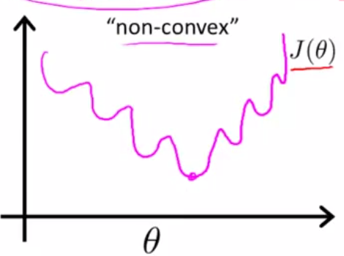
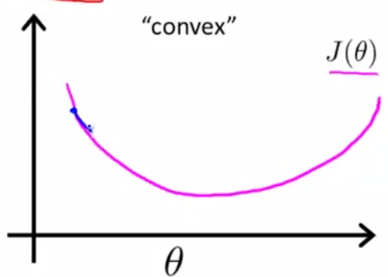
Cost Function
We would like a convex function so if you run gradient descent you converge to a global minimum

Slide 41

Cost Function
A convex logistic regression cost function
To get around this we need a different, convex Cost() function which means we can apply gradient descent

Slide 42
Cost Function
This is our logistic regression cost function
This is the penalty the algorithm pays
Plot the function
Plot y = 1
So h_{θ}(x) evaluates as -log(h_{θ}(x))

Slide 43
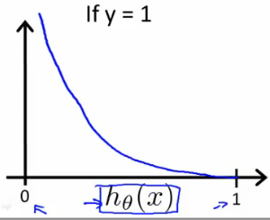
Cost Function

Slide 44
Cost Function
So when we're right, cost function is 0
Else it slowly increases cost function as we become "more" wrong
X axis is what we predict
Y axis is the cost associated with that prediction

Slide 45
Cost Function
This cost functions has some interesting properties
If y = 1 and h_{θ}(x) = 1
If hypothesis predicts exactly 1 and thats exactly correct then that corresponds to 0 (exactly, not nearly 0)

Slide 46
Cost Function
As h_{θ}(x) goes to 0
Cost goes to infinity
This captures the intuition that if h_{θ}(x) = 0 (predict P (y=1|x; θ) = 0) but y = 1 this will penalize the learning algorithm with a massive cost

Slide 47
Cost Function
What about if y = 0
then cost is evaluated as -log(1- h_{θ}( x ))
Just get inverse of the other function

Slide 48
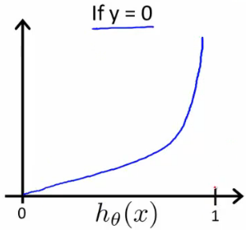
Cost Function
Now it goes to plus infinity as h_{θ}(x) goes to 1
With our particular cost functions J(θ) is going to be convex and avoid local minimum

Slide 49
Gradient Descent
Define a simpler way to write the cost function and apply gradient descent to the logistic regression
By the end should be able to implement a fully functional logistic regression function
Logistic regression cost function is as follows

Slide 50
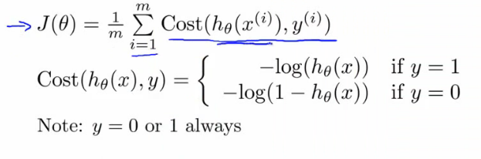
Gradient Descent

Slide 51
Gradient Descent
This is the cost for a single example
For binary classification problems y is always 0 or 1
Because of this, we can have a simpler way to write the cost function
Rather than writing cost function on two lines/two cases
Can compress them into one equation - more efficient

Slide 52
Gradient Descent
Can write cost function is
cost(h_{θ,} (x),y) = -ylog( h_{θ}(x) ) - (1-y)log( 1- h_{θ}(x) )
This equation is a more compact of the two cases above

Slide 53
Gradient Descent
We know that there are only two possible cases
y = 1
Then our equation simplifies to
-log(h_{θ}(x)) - (0)log(1 - h_{θ}(x))
-log(h_{θ}(x))
Which is what we had before when y = 1

Slide 54
Gradient Descent
y = 0
Then our equation simplifies to
-(0)log(h_{θ}(x)) - (1)log(1 - h_{θ}(x))
= -log(1- h_{θ}(x))
Which is what we had before when y = 0

Slide 55
Gradient Descent
So, in summary, our cost function for the θ parameters can be defined as

Slide 56
Gradient Descent
Why do we chose this function when other cost functions exist?
This cost function can be derived from statistics using the principle of maximum likelihood estimation
Note this does mean there's an underlying Gaussian assumption relating to the distribution of features
Also has the nice property that it's convex

Slide 57
Gradient Descent
To fit parameters θ:
Find parameters θ which minimize J(θ)
This means we have a set of parameters to use in our model for future predictions
Then, if we're given some new example with set of features x, we can take the θ which we generated, and output our prediction using

Slide 58

Gradient Descent
Then, if we're given some new example with set of features x, we can take the θ which we generated, and output our prediction using
This result is
p(y=1 | x ; θ)
Probability y = 1, given x, parameterized by θ

Slide 59
Gradient Descent
How to minimize the logistic regression cost function
Now we need to figure out how to minimize J(θ)
Use gradient descent as before
Repeatedly update each parameter using a learning rate

Slide 60
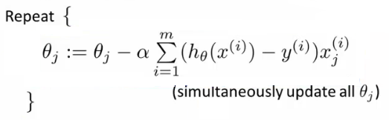
Gradient Descent
If you had n features, you would have an n+1 column vector for θ
This equation is the same as the linear regression rule
The only difference is that our definition for the hypothesis has changed

Slide 61
Gradient Descent
Previously, we spoke about how to monitor gradient descent to check it's working
Can do the same thing here for logistic regression

Slide 62
Gradient Descent
When implementing logistic regression with gradient descent, we have to update all the θ values (θ₀ to θ_{n}) simultaneously
Could use a for loop
Better would be a vectorized implementation
Feature scaling for gradient descent for logistic regression also applies here

