Slide 1
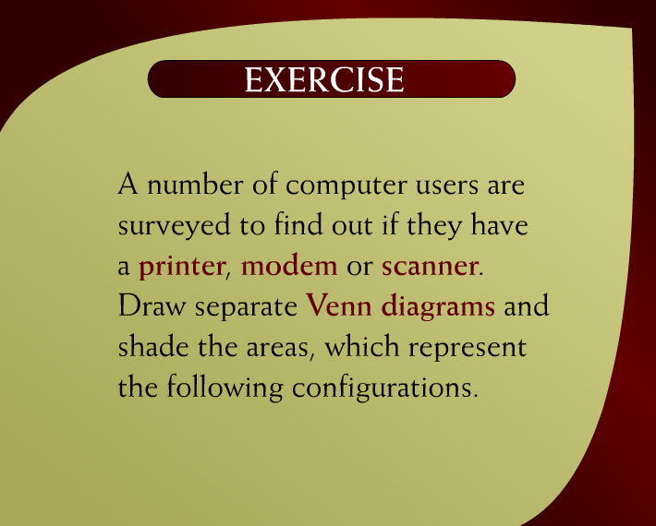
Exercise – (10 - 2)
Discrete Mathematics - BSCS

Slide 2
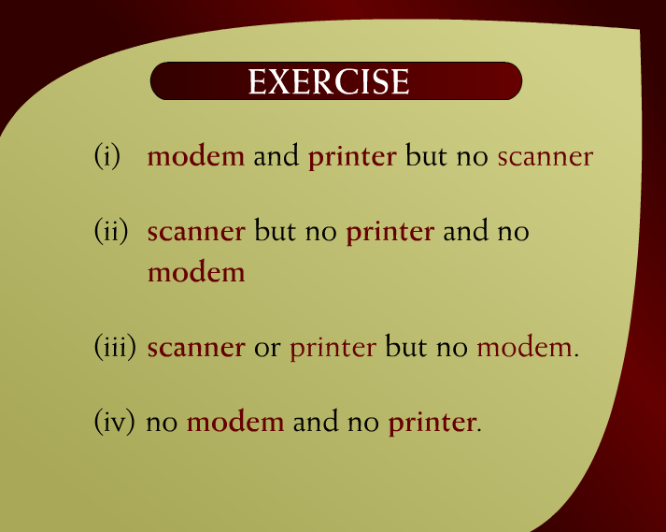
Exercise – (10 – 2b)
Discrete Mathematics - BSCS

Slide 3
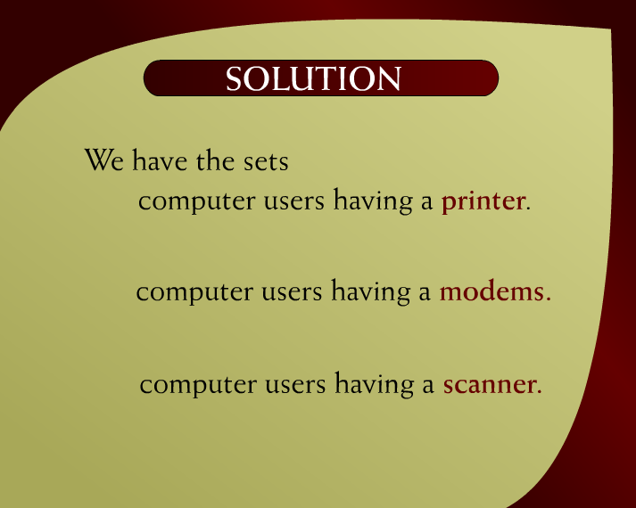
Solution – (10 – 2c)
Discrete Mathematics - BSCS

Slide 4
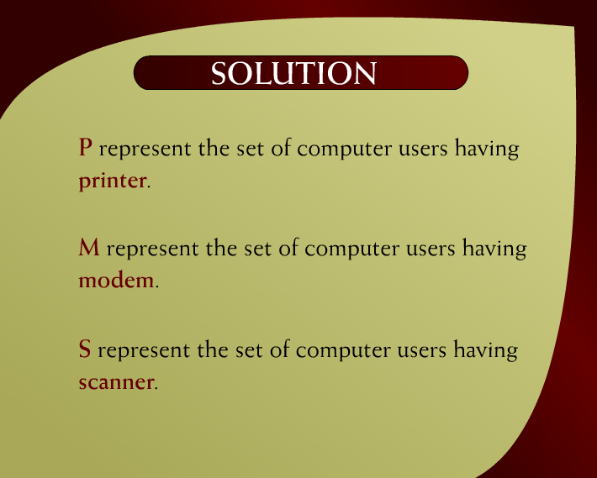
Solution – (10 – 2a)
Discrete Mathematics - BSCS

Slide 5
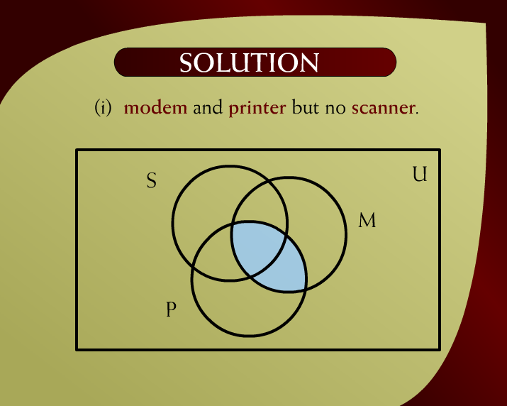
Solution – (10 - 3)
Discrete Mathematics - BSCS

Slide 6
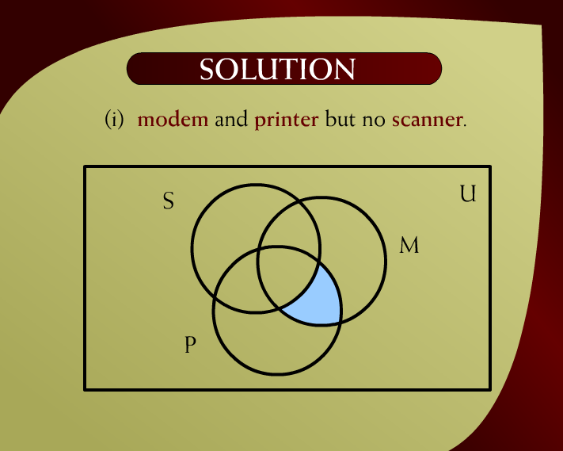
Solution – (10 - 3)
Discrete Mathematics - BSCS

Slide 7
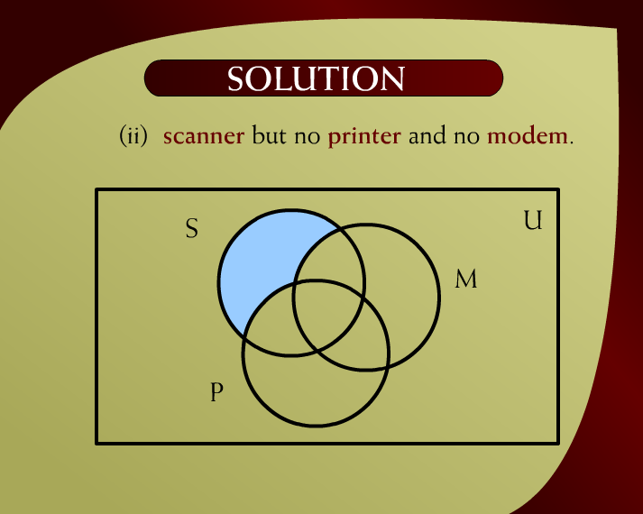
Solution – (10 – 4)
Discrete Mathematics - BSCS

Slide 8
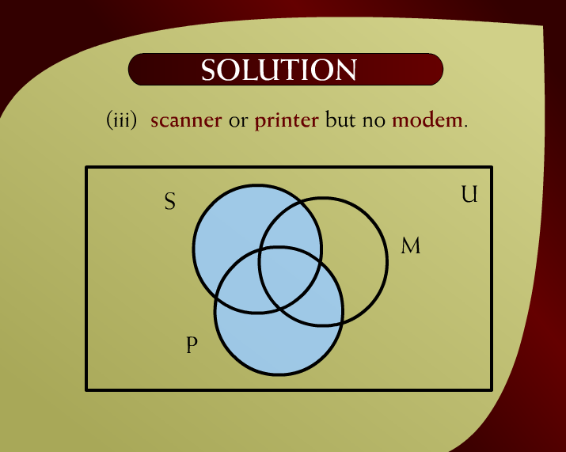
Solution – (10 - 5)
Discrete Mathematics - BSCS

Slide 9
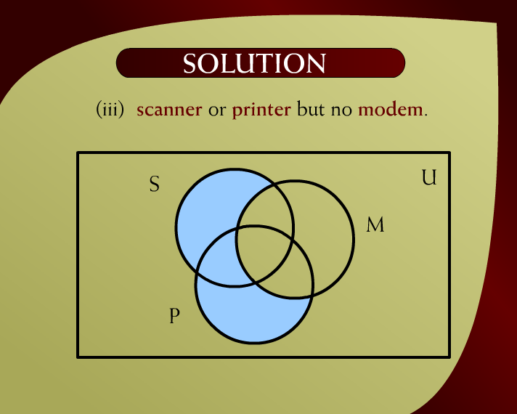
Solution – (10 - 5)
Discrete Mathematics - BSCS

Slide 10
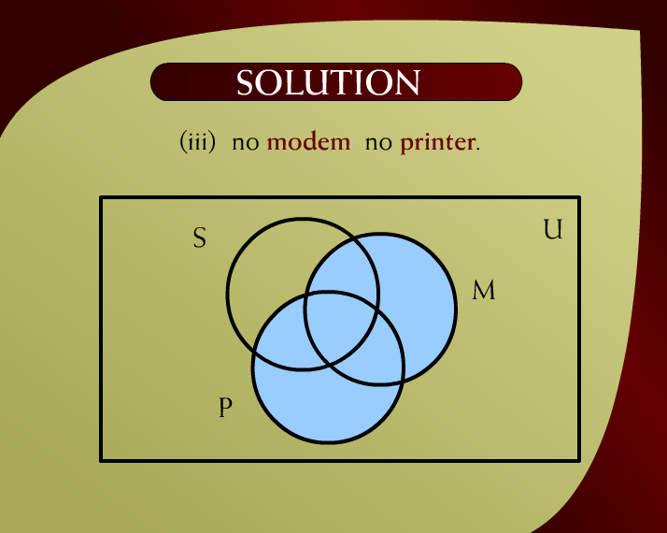
Solution – (10 - 6)
Discrete Mathematics - BSCS

Slide 11
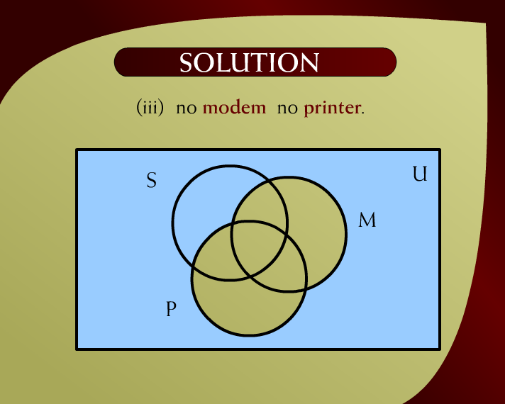
Solution – (10 - 6)
Discrete Mathematics - BSCS

Slide 12
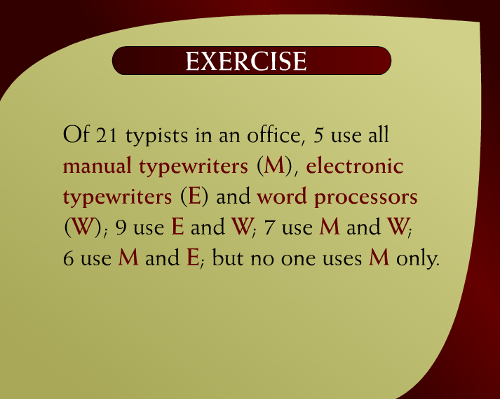
Exercise – (10 - 7)
Discrete Mathematics - BSCS

Slide 13
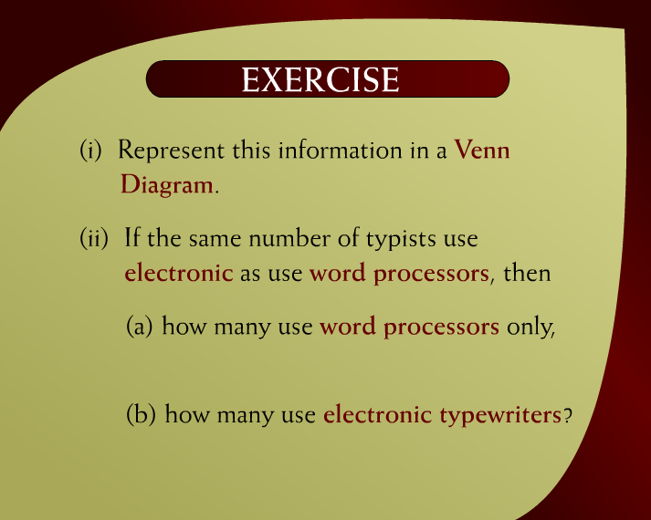
Exercise – (10 – 7a)
Discrete Mathematics - BSCS

Slide 14
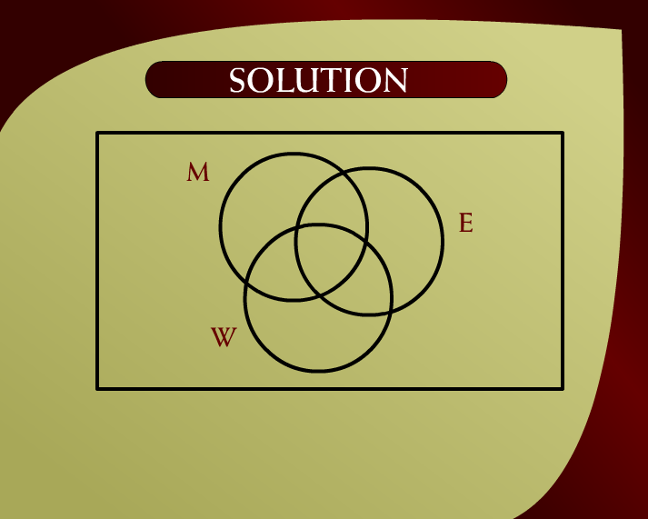
Solution – (10 – 8a)
Discrete Mathematics - BSCS

Slide 15
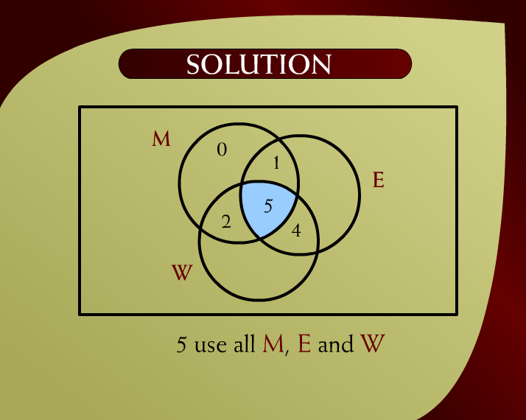
Solution – (10 - 8)
Discrete Mathematics - BSCS

Slide 16

Solution – (10 - 8)
Discrete Mathematics - BSCS

Slide 17

Solution – (10 - 8)
Discrete Mathematics - BSCS

Slide 18

Solution – (10 - 8)
Discrete Mathematics - BSCS

Slide 19
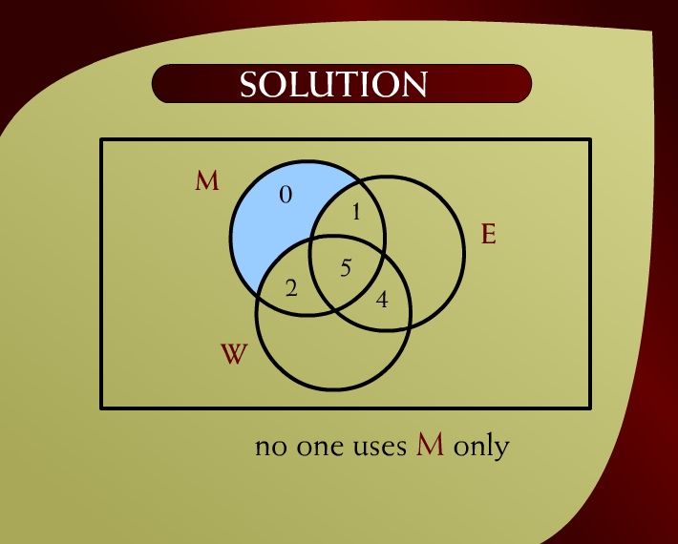
Solution – (10 - 8)
Discrete Mathematics - BSCS

Slide 20
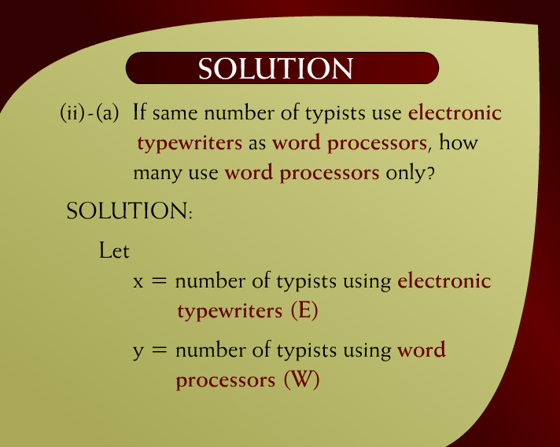
Solution – (10 - 9)
Discrete Mathematics - BSCS

Slide 21
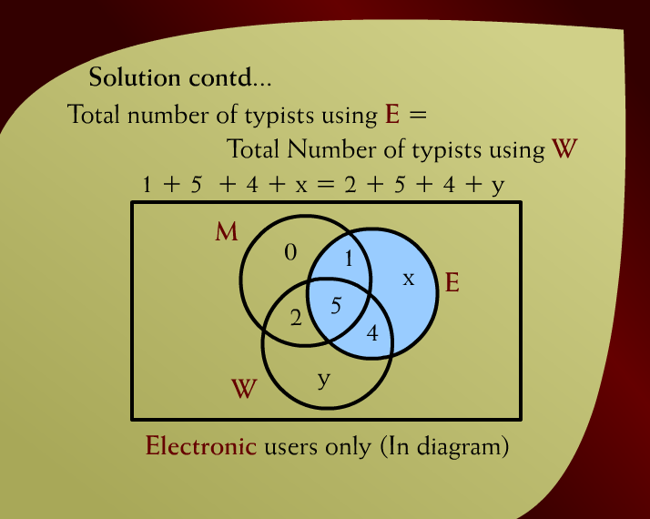
Solution Continued – (10 - 10)
Discrete Mathematics - BSCS

Slide 22
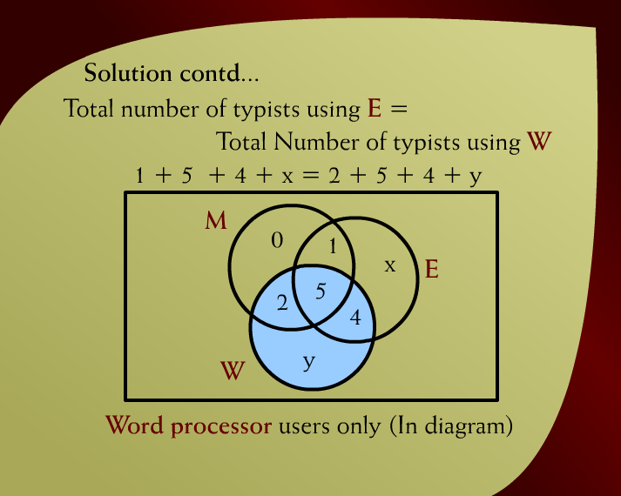
Solution Continued – (10 - 10)
Discrete Mathematics - BSCS

Slide 23
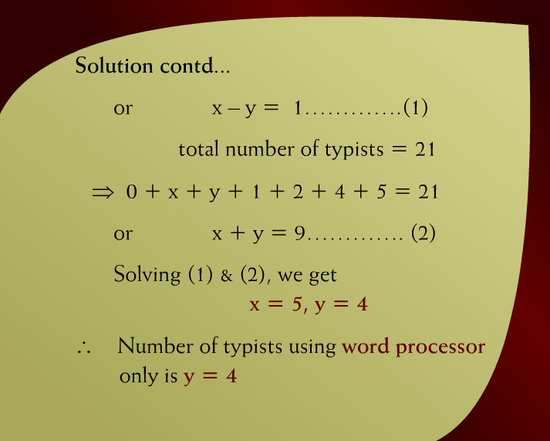
Solution Continued – (10 – 10a)
Discrete Mathematics - BSCS

Slide 24
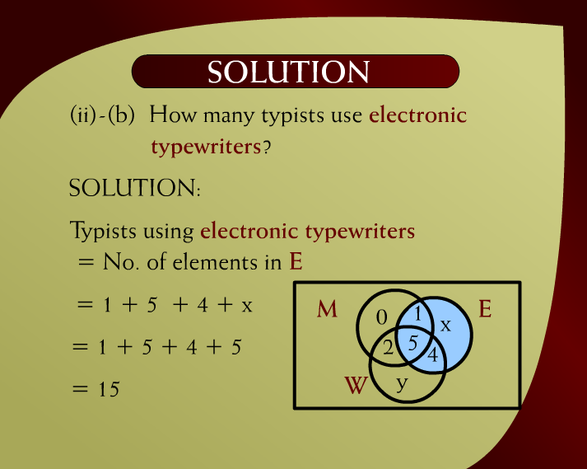
Solution – (10 - 11)
Discrete Mathematics - BSCS

Slide 25
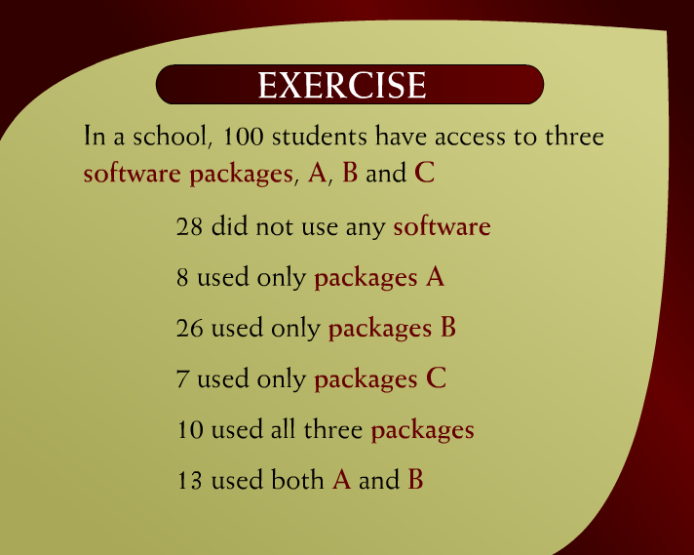
Exercise – (10 - 12)
Discrete Mathematics - BSCS

Slide 26

Exercise – (10 - 13)
Discrete Mathematics - BSCS

Slide 27
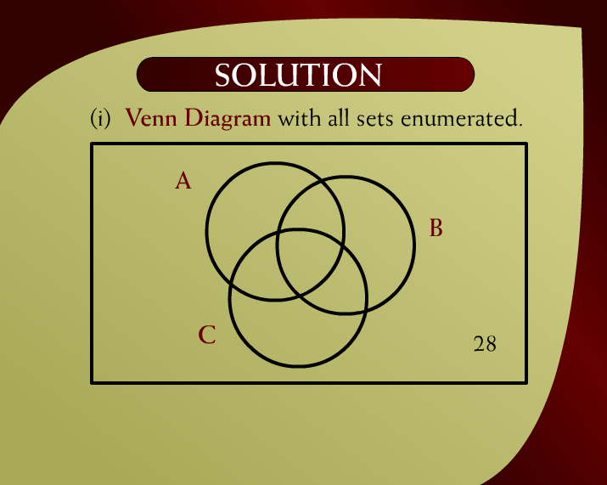
Solution – (10 - 14)
Discrete Mathematics - BSCS

Slide 28
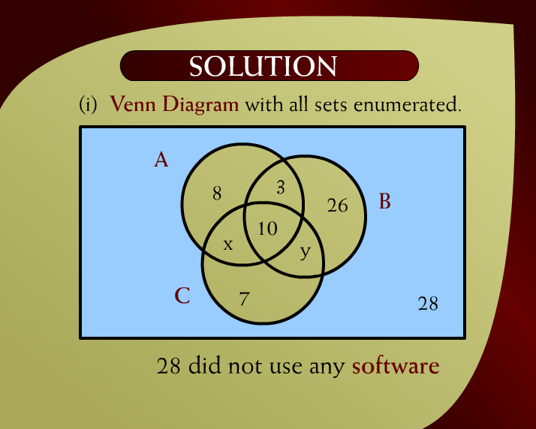
Solution – (10 - 14)
Discrete Mathematics - BSCS

Slide 29
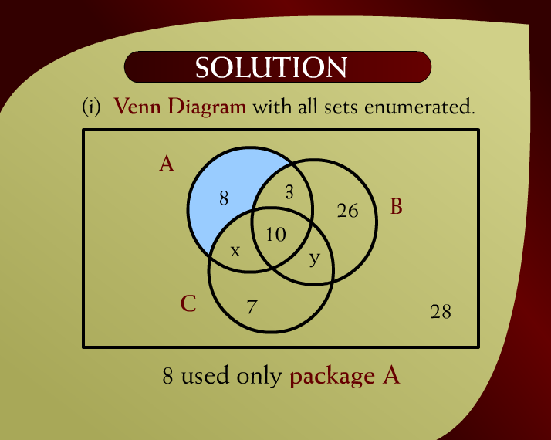
Solution – (10 - 14)
Discrete Mathematics - BSCS

Slide 30
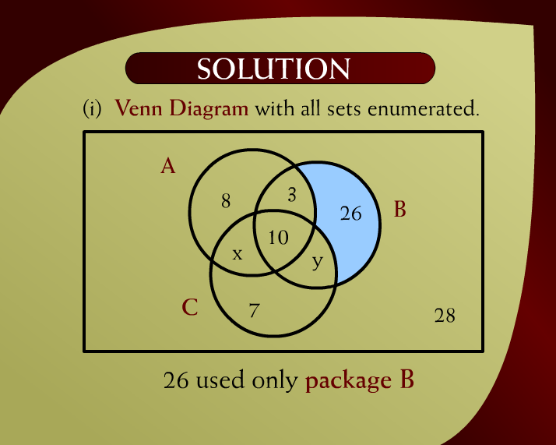
Solution – (10 - 14)
Discrete Mathematics - BSCS

Slide 31
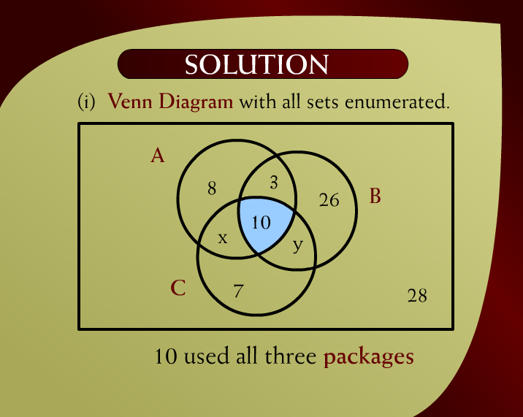
Solution – (10 - 14)
Discrete Mathematics - BSCS

Slide 32

Solution – (10 - 14)
Discrete Mathematics - BSCS

Slide 33
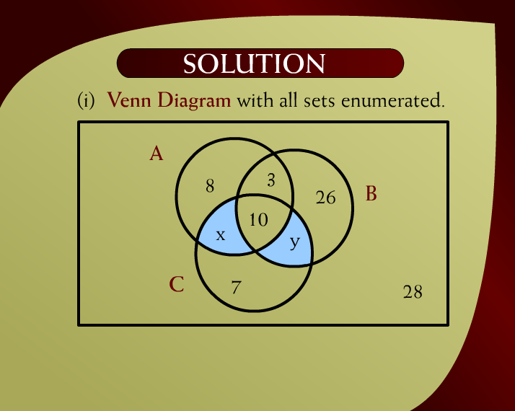
Solution – (10 - 14)
Discrete Mathematics - BSCS

Slide 34
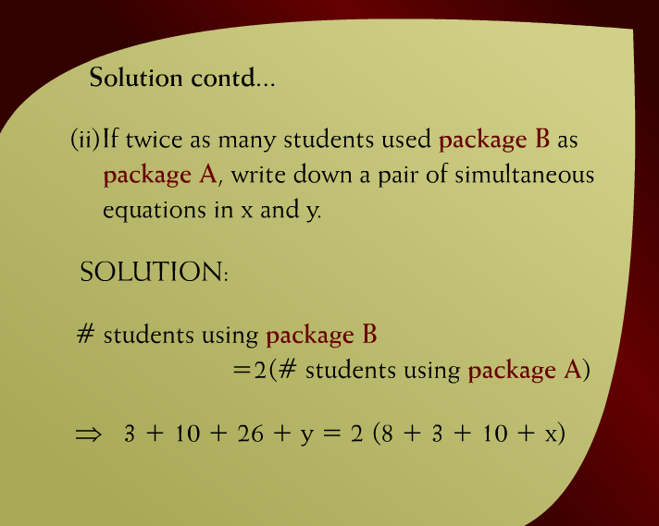
Solution Continued – (10 - 15)
Discrete Mathematics - BSCS

Slide 35
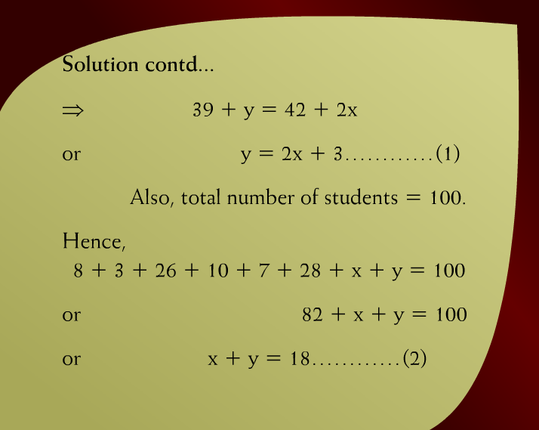
Solution Continued – (10 – 15a)
Discrete Mathematics - BSCS

Slide 36
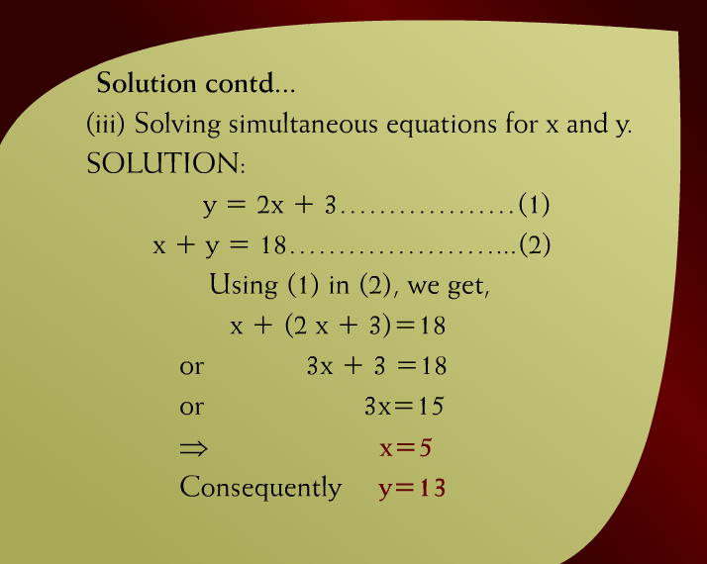
Solution Continued – (10 - 16)
Discrete Mathematics - BSCS

Slide 37
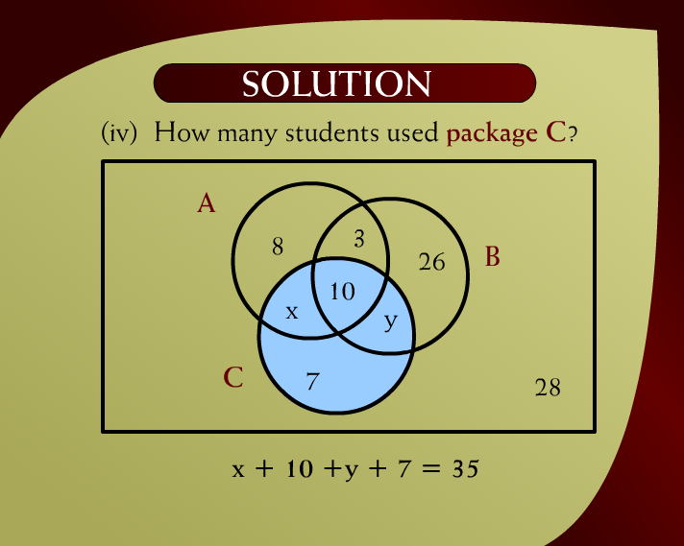
Solution – (10 - 17)
Discrete Mathematics - BSCS

