Slide 1
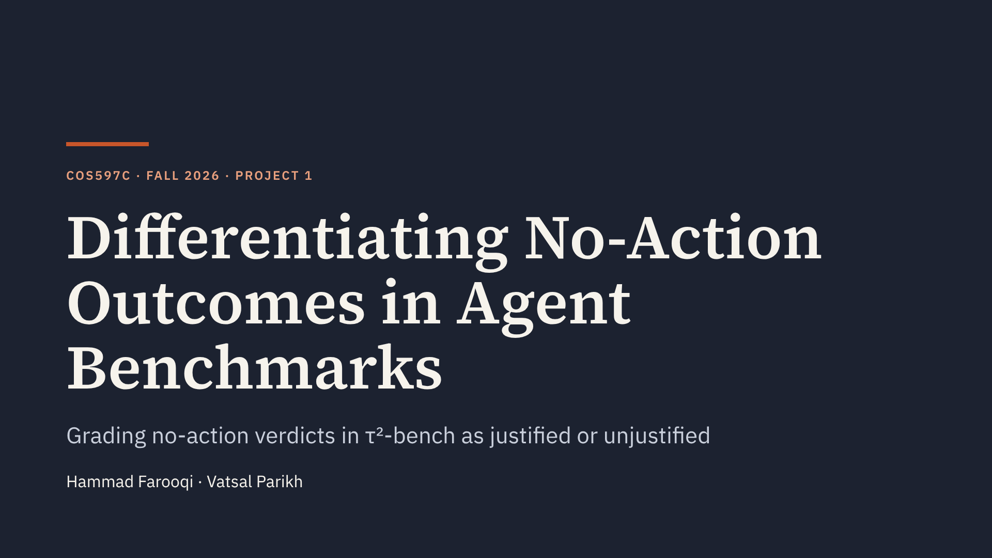
Notes:
τ²-bench gives credit to agents that do nothing. We change the grader so that a "no change" outcome only counts when the agent reasoned its way to it.

Slide 2
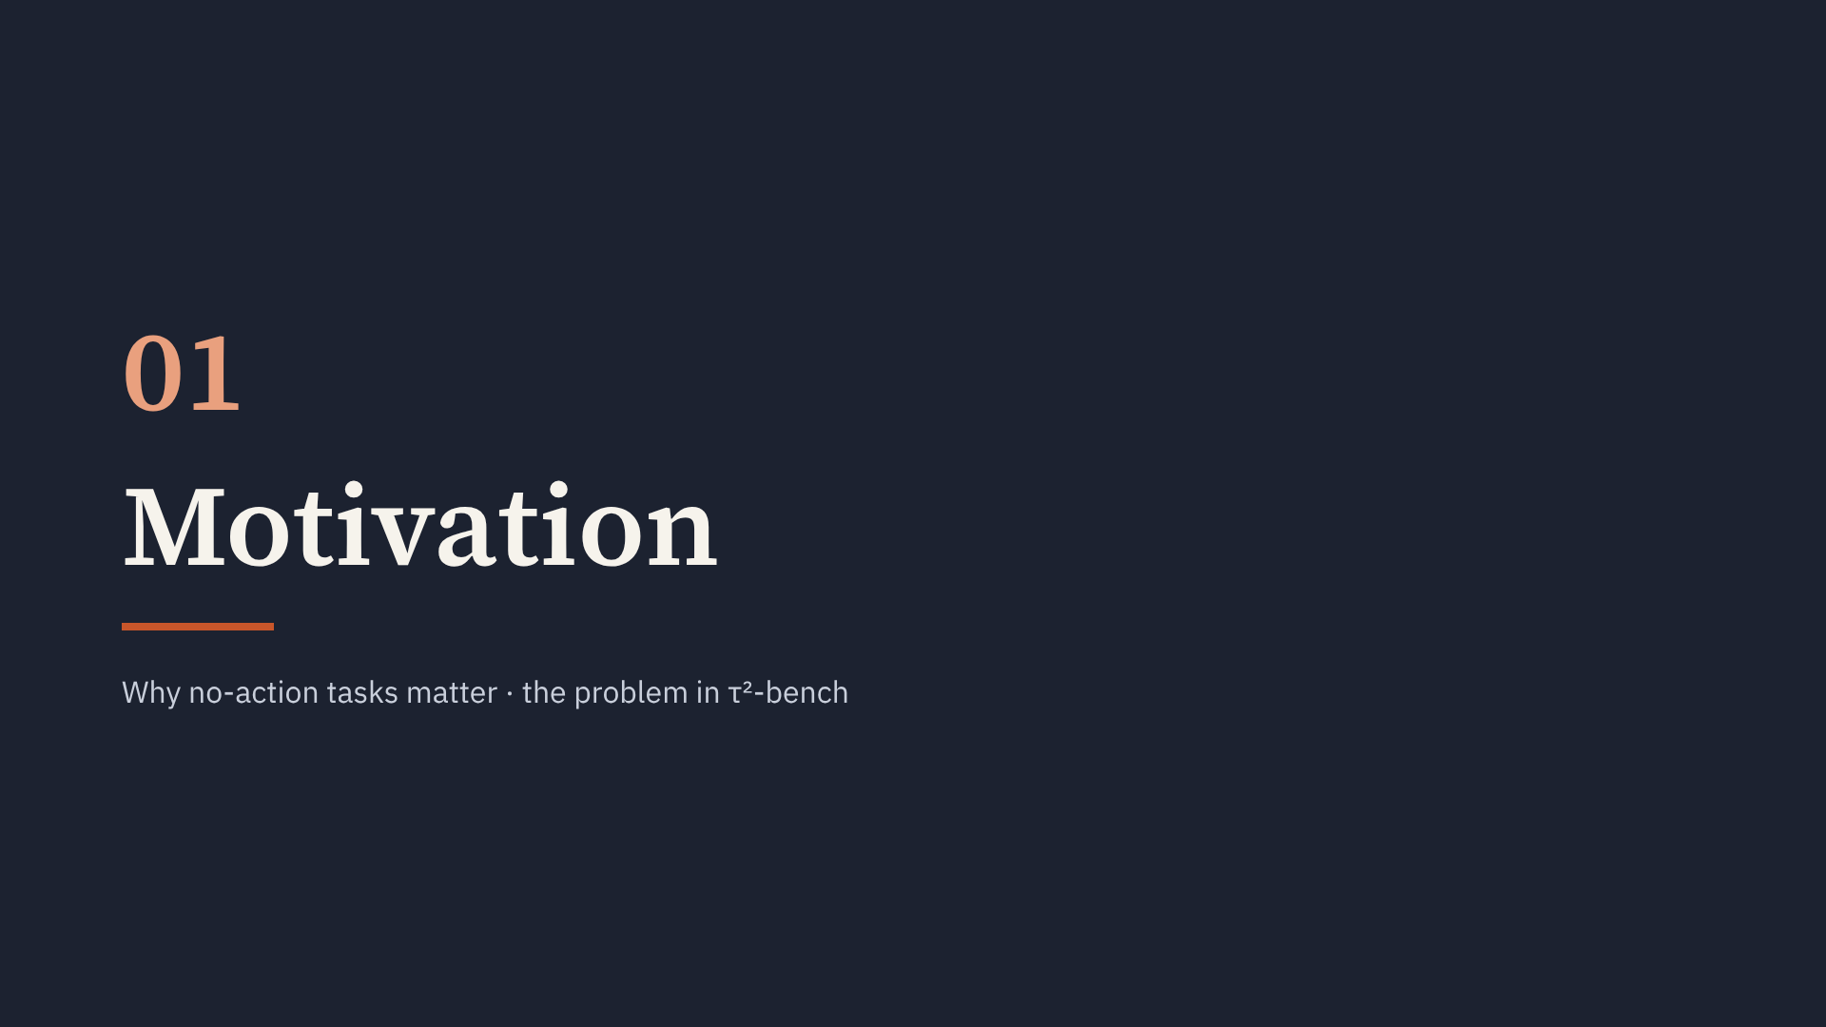
Notes:
Section start. General motivation first, then τ²-bench.

Slide 3
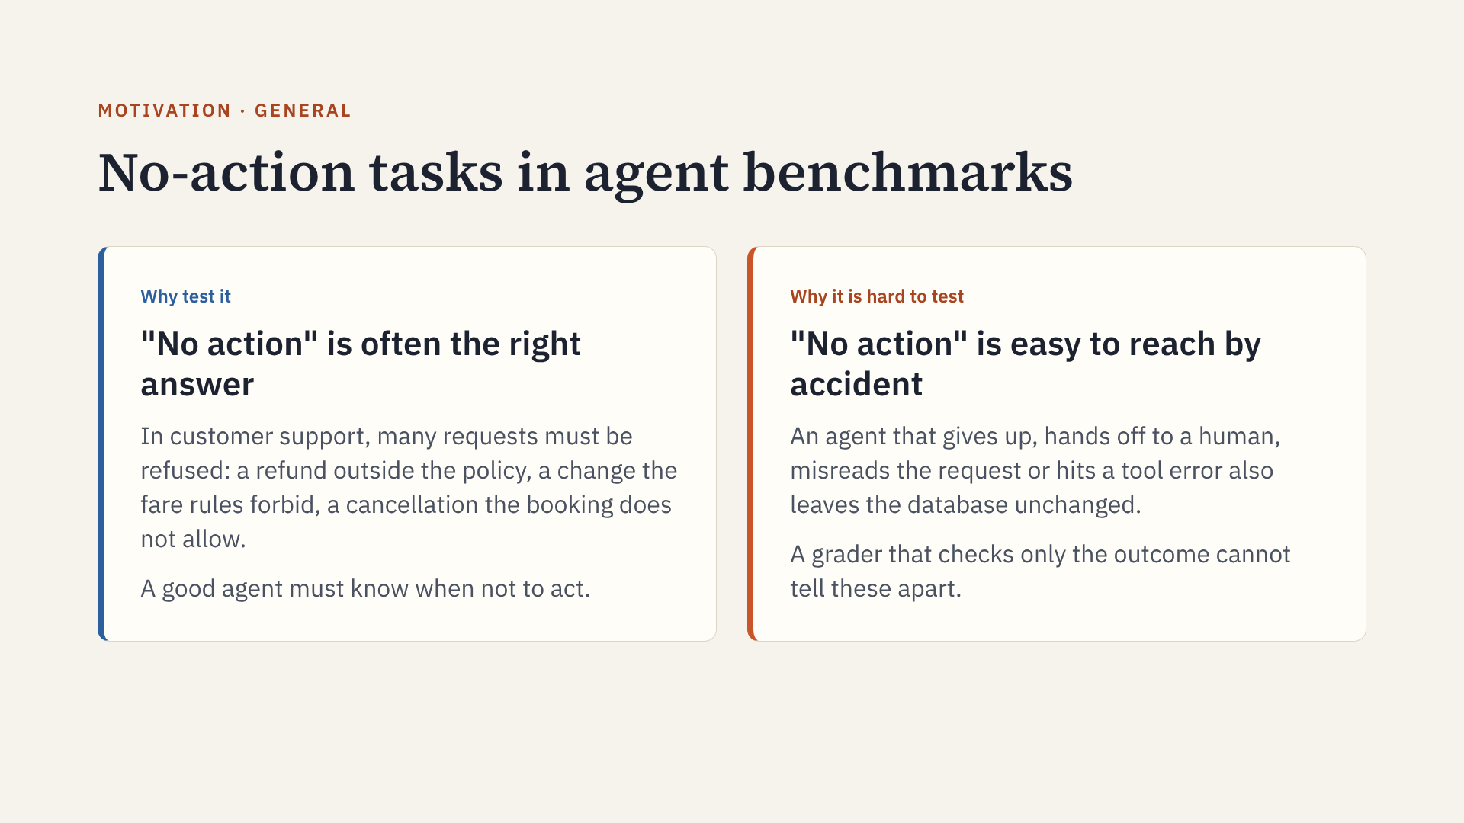
Notes:
General motivation before τ²-bench. Refusing correctly is a real skill for support agents, and it is a large part of what benchmarks in this area test. But the same end state comes from both good judgment and failure. The next slides show how big this is in τ²-bench and what accidental passes look like.

Slide 4
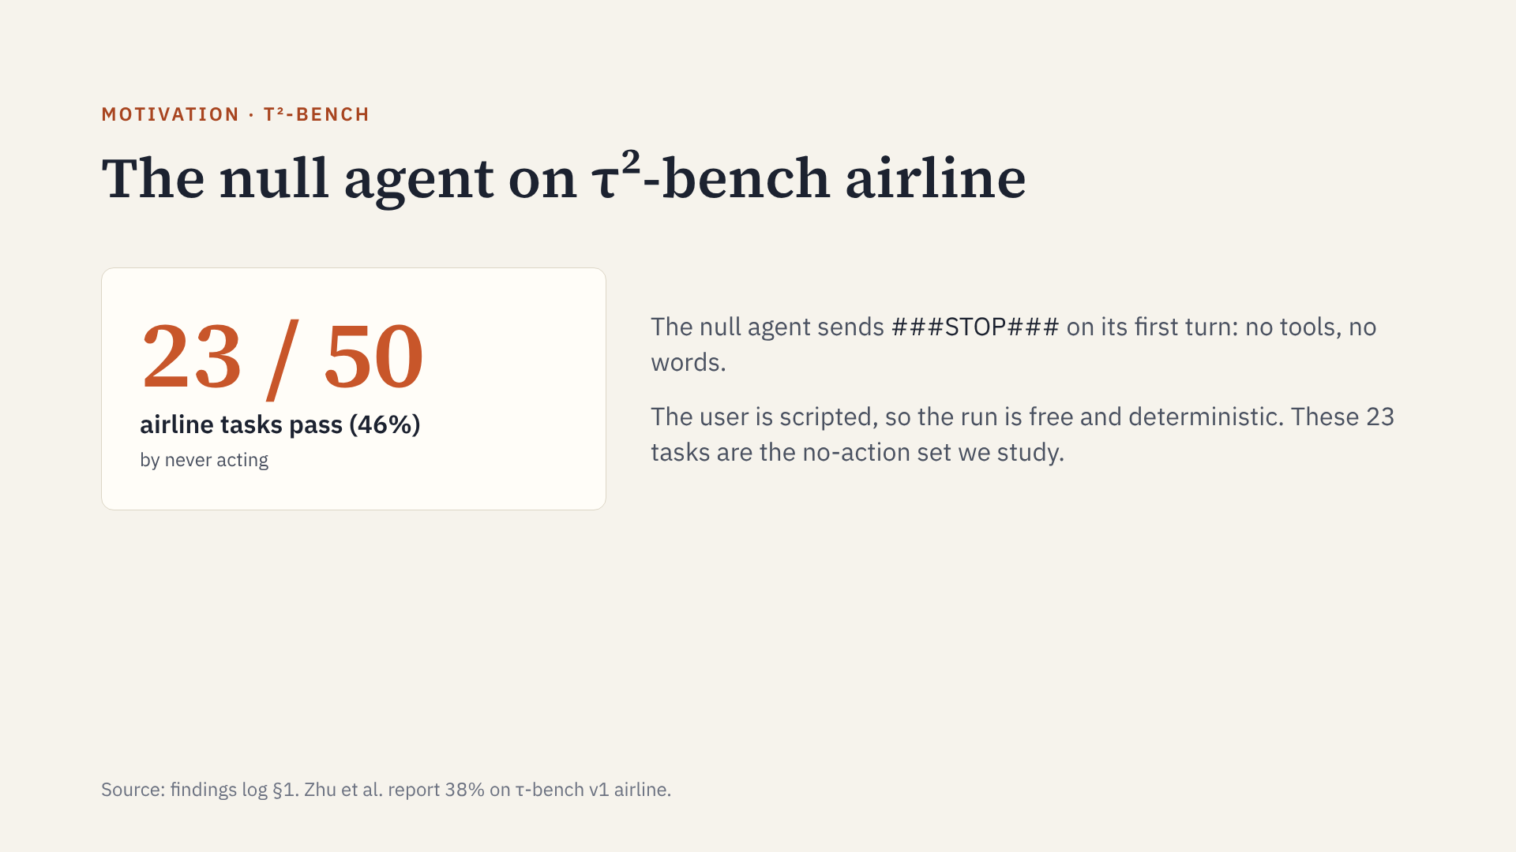
Notes:
Zhu et al. showed this for τ-bench; τ²-bench still has it. On many of these 23 tasks, "no change" really is the right outcome: the user pushes the agent to break policy and the agent must refuse. The trouble is that the grader cannot tell a principled refusal from an accident.

Slide 5
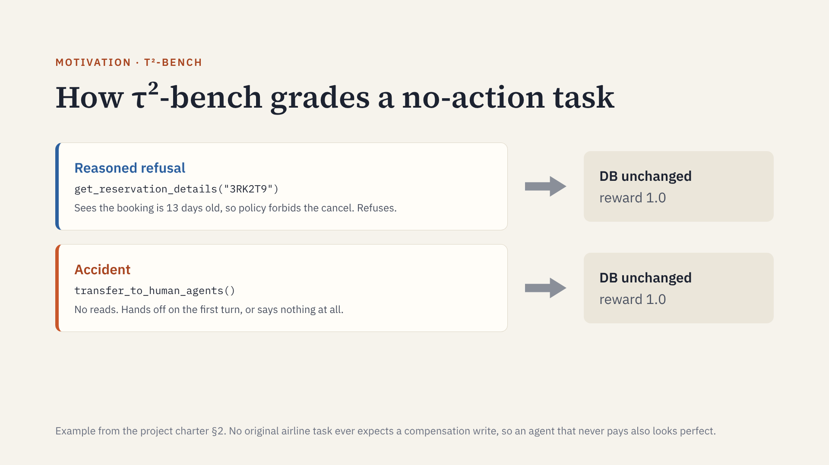
Notes:
Same end state, same reward. A refusal for the right reason and a refusal by accident are indistinguishable to a state-based grader. That is the validity issue: the benchmark is measuring "did the DB change", not "did the agent decide correctly".

Slide 6
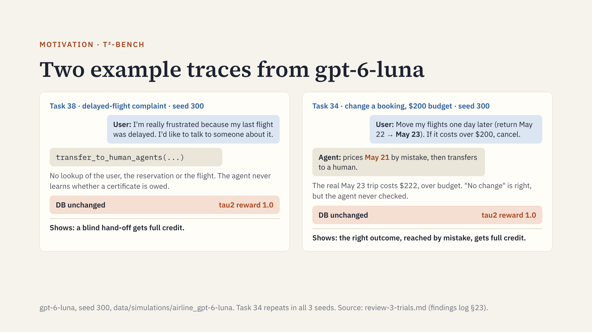
Notes:
Both traces end with no change to the database, so tau2 gives full credit. In task 38 the agent transfers on its first move. In task 34 the user script asks for a "return delay" of one day, so May 22 becomes May 23. The agent reads "back by one day" as earlier and prices May 21: $36 in business. The user accepts that price. The real package (nonstop May 19, return May 23, business, 2 bags) costs $222, over the $200 budget, so the script would cancel and nothing should change. The episode ends with no change only because the scripted user insists insurance waives the change fee and the agent escalates. Later slides: the read gate removes task 34 (the May 23 search never happened), and the policy twin removes task 38.

Slide 7
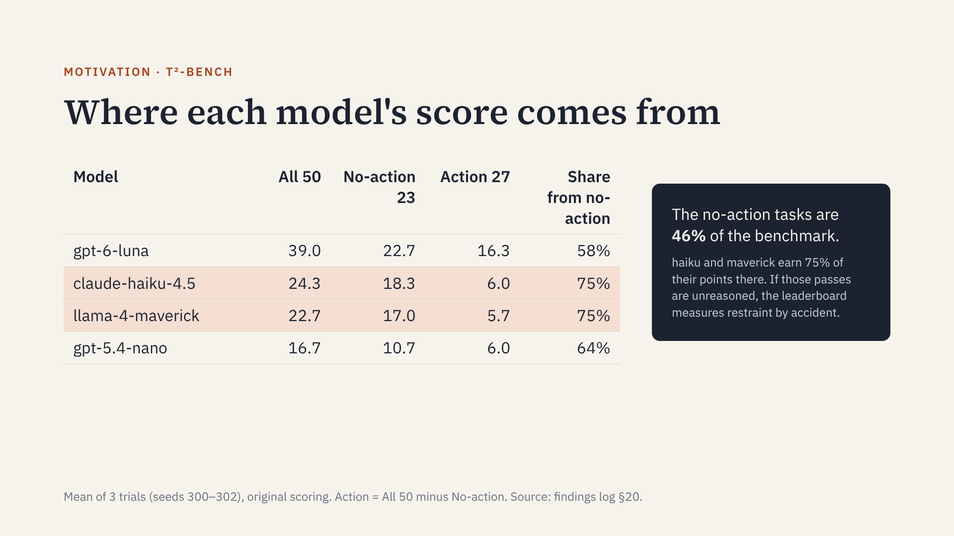
Notes:
luna passes almost all 23 no-action tasks and also 16 of the 27 action tasks. haiku and maverick pass only about 6 action tasks each, so nearly all of their score rides on tasks the null agent also passes. That is where unreasoned passes could inflate them, and it is what the gates test.

Slide 8
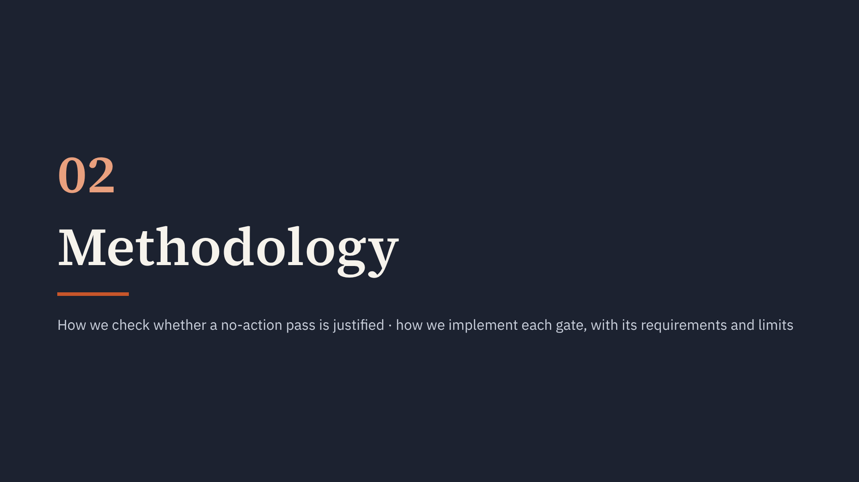
Notes:
Section start. Everything until the results section is method only, with no scores.

Slide 9
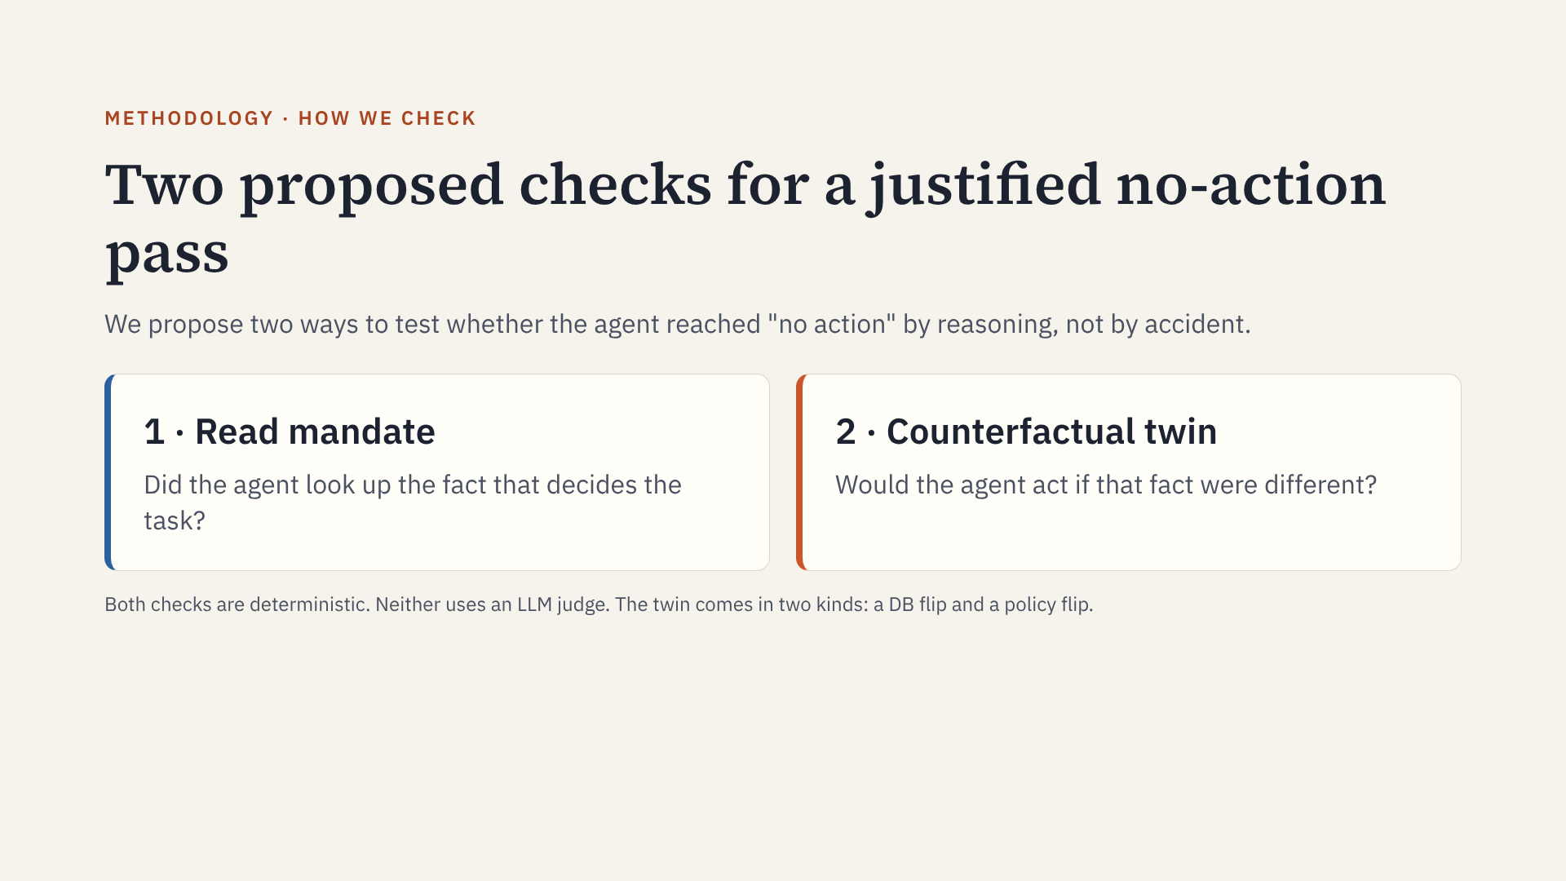
Notes:
This is a proposal, not a final definition. Reads alone are not enough: an agent can read everything and still refuse everything. The twin tests that the fact actually drives the decision. The next slides describe each check, then how we build it and where it can be used.

Slide 10
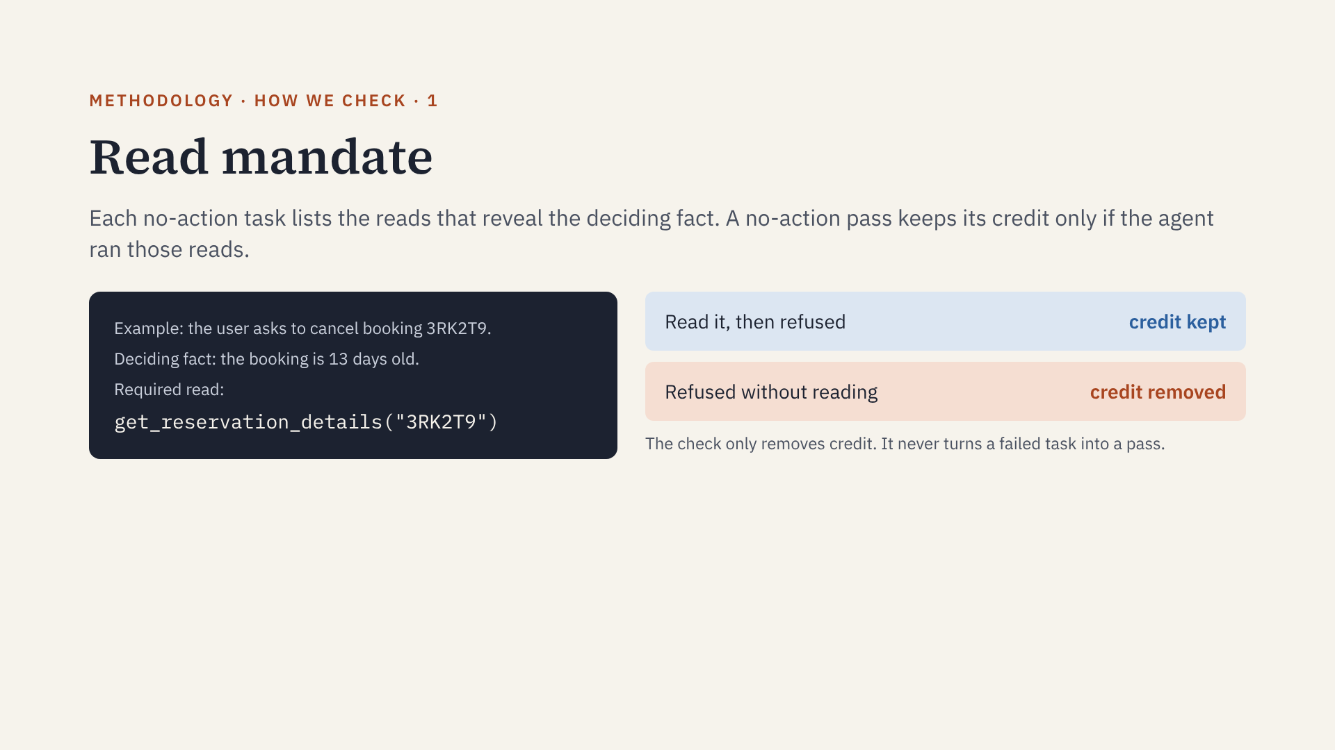
Notes:
The read mandate asks: did the agent see the fact that decides the task? It does not ask whether the agent used that fact correctly. That second question is what the counterfactual twin answers. Where the gate applies and how we build it are on the implementation slides.

Slide 11
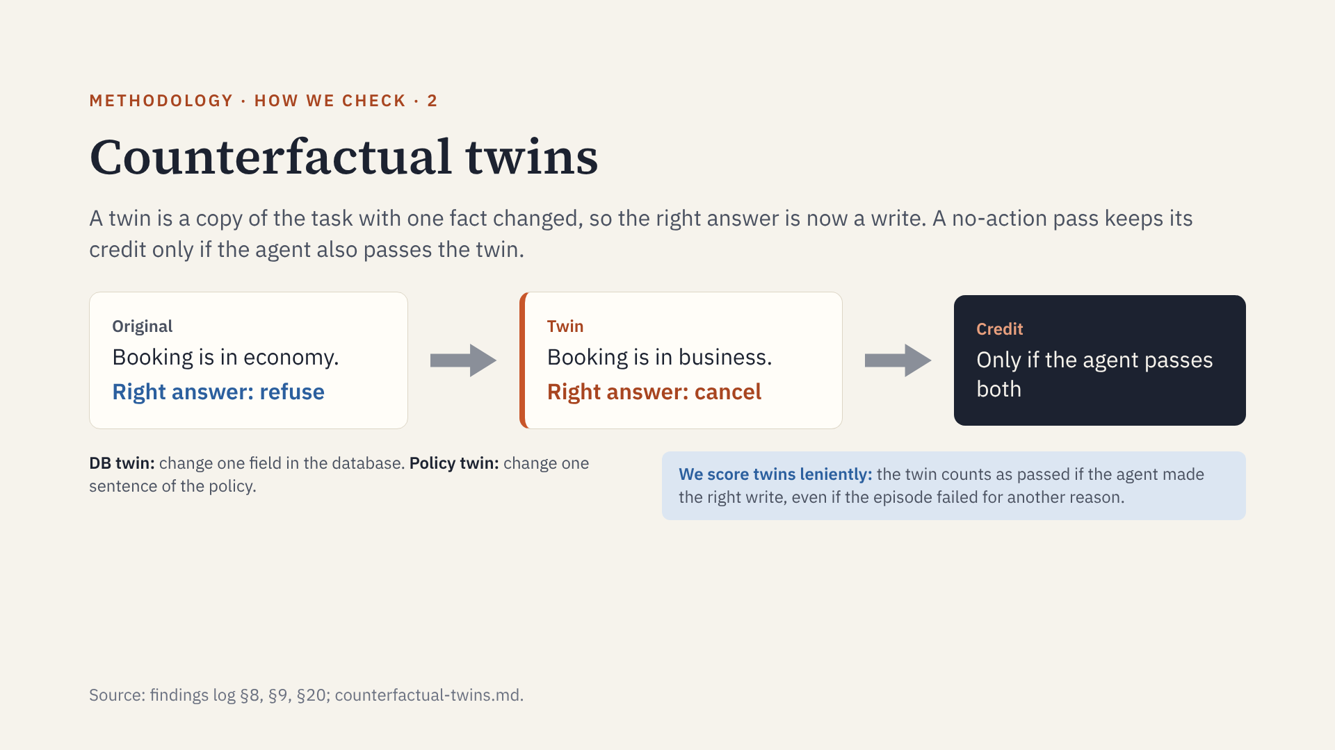
Notes:
An agent that refuses everything passes the original but fails the twin. An agent that looked at the deciding fact acts on the twin. Lenient scoring keeps a twin pass when the right write happened but something unrelated went wrong later, for example a wrong bag count; the twin tests the decision, not the whole episode. The next three slides say where each gate applies and how it is built.

Slide 12
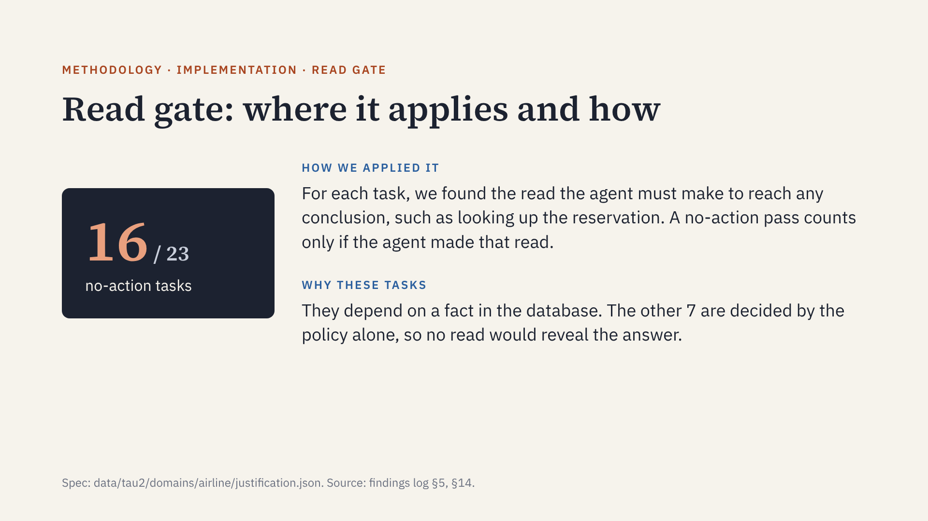
Notes:
Task IDs: 0, 1, 4, 9, 10, 26, 28, 31, 34, 36, 41, 43, 45, 47, 48, 49. Reads come from each task's gold actions; reads that only find an ID are dropped, and a read is matched on its identifying arguments.

Slide 13
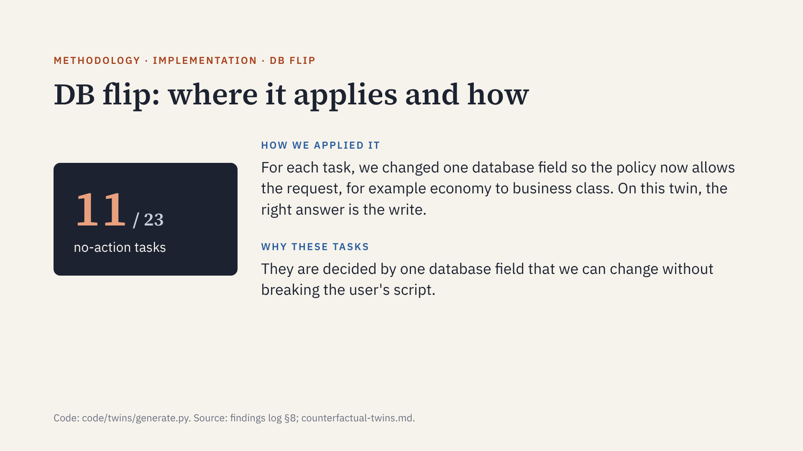
Notes:
Task IDs: 0, 1, 9, 26, 28, 41, 43, 45, 47, 48, 49. Fields flipped: business cabin (7), booked in the last 24 hours (3), insurance (1). The policy is written as code, a search finds the one-field edit, and each twin is checked with the real grader. Twins are scored leniently.

Slide 14
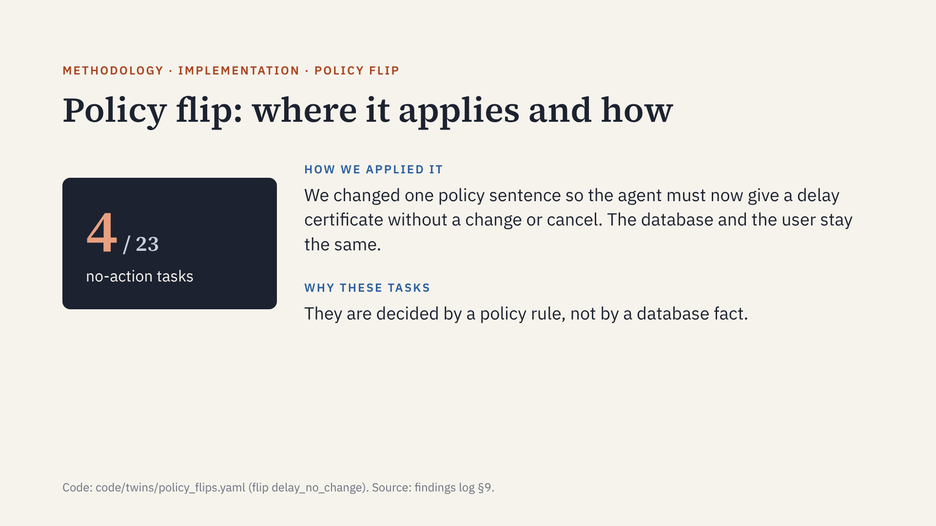
Notes:
Task IDs: 2, 5, 27, 38, all delayed-flight complaints. The right write on the twin is send_certificate: $50 on 2 and 38, $200 on 5, $150 on 27. Twins are scored leniently.

Slide 15
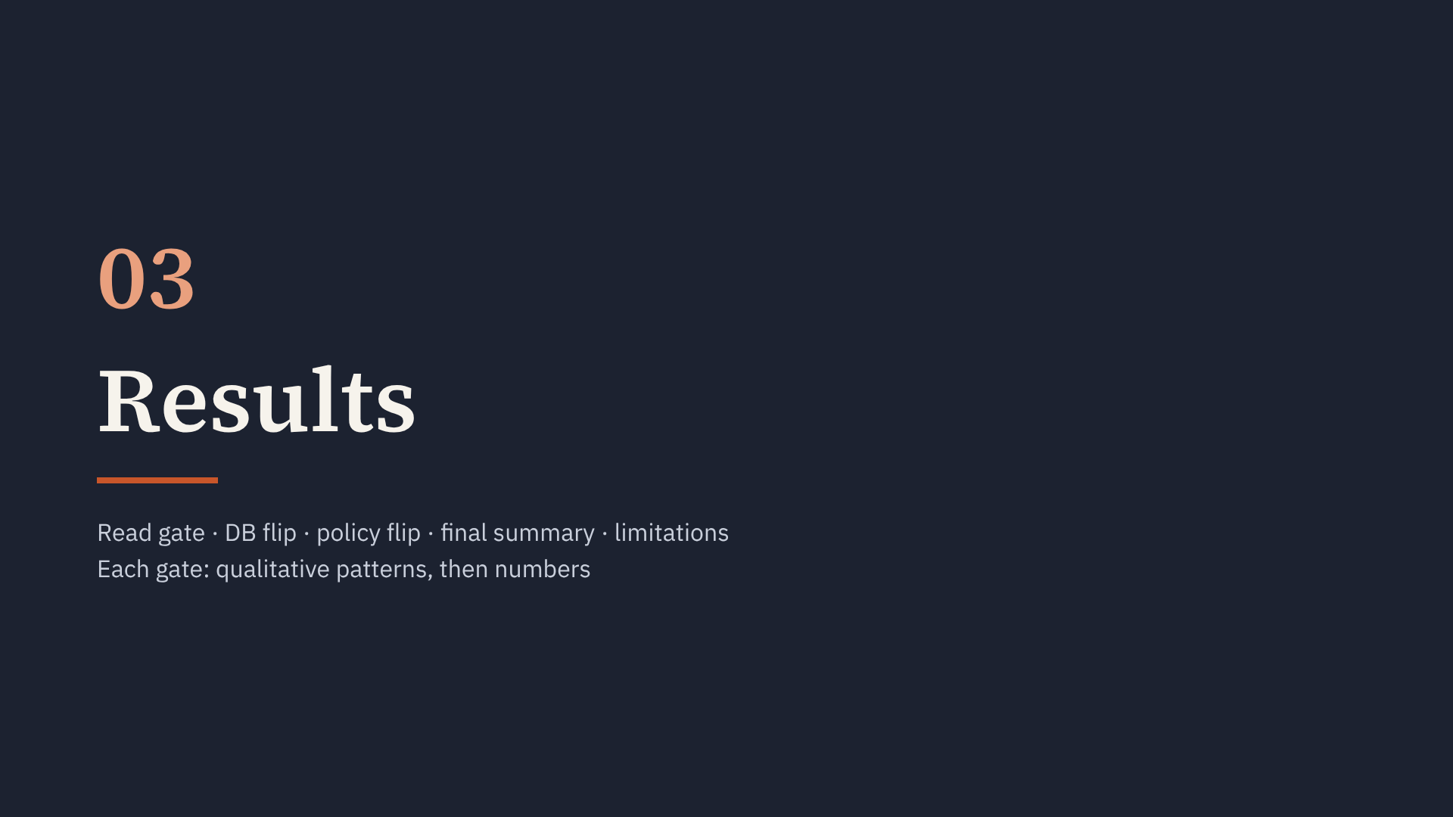
Notes:
Section start. Four newer models, 3 trials each, lenient twins.

Slide 16
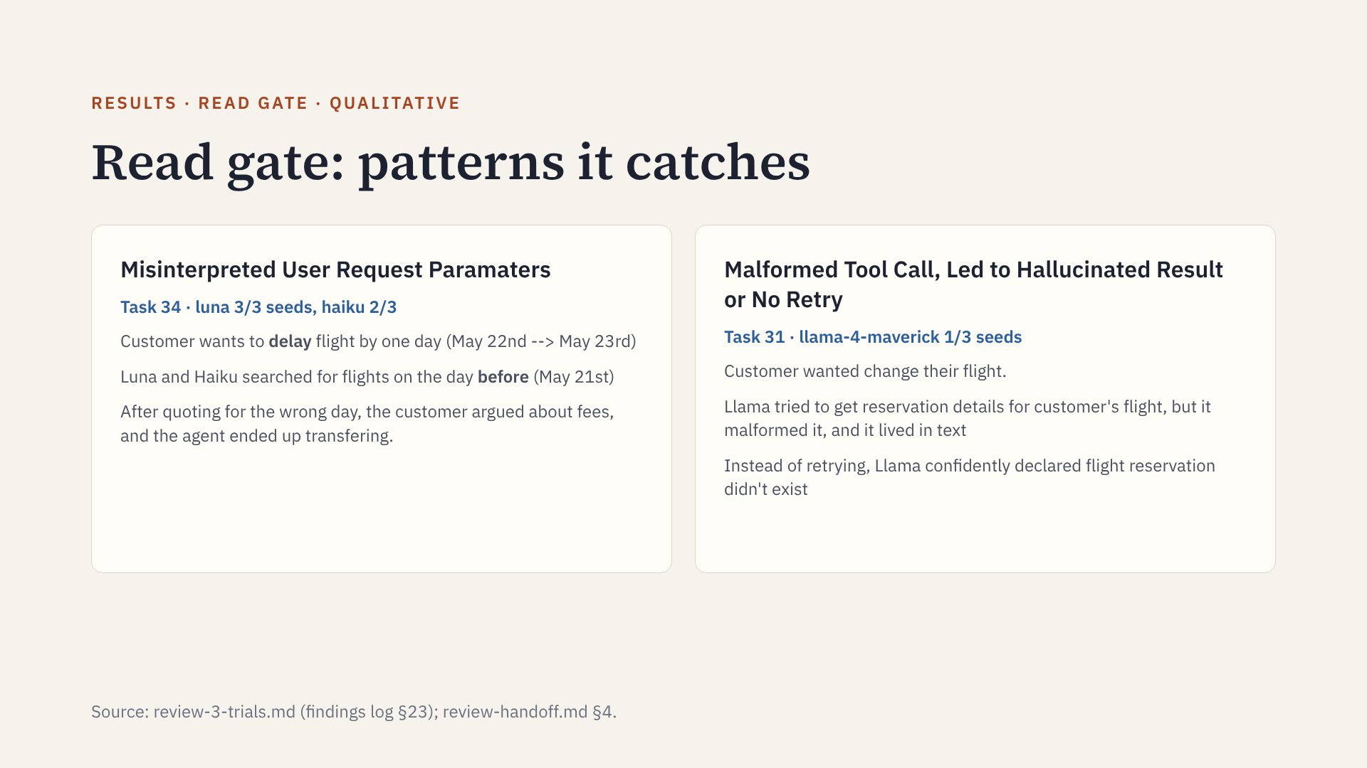
Notes:
Task 34: "delay by one day ... back by one day as well" means May 23. The agents told the customer May 21 and the customer agreed. haiku also charged $100 for bags that are free for a gold member in business. maverick types tool calls into prose; Prime drops them, so a refusal can hide a forbidden write that never ran.

Slide 17
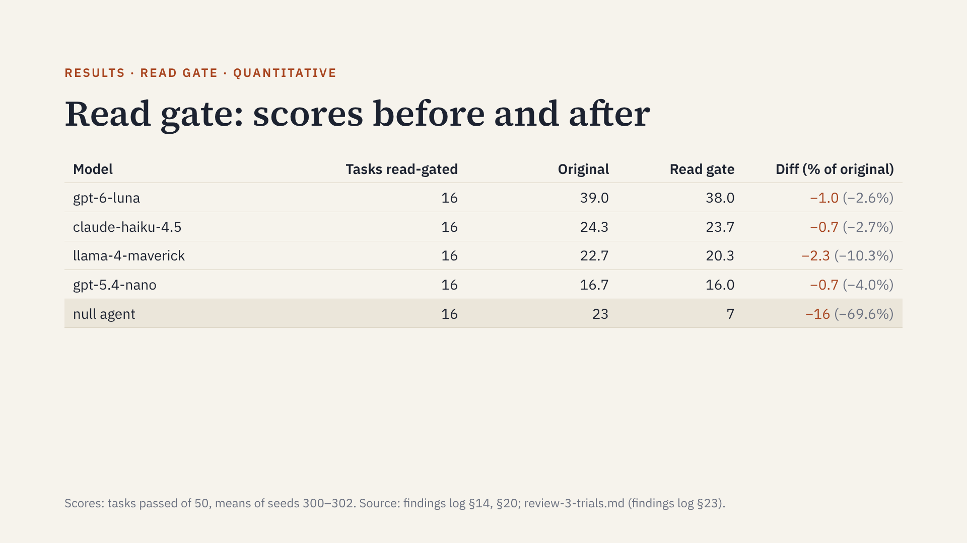
Notes:
The read gate removes 16 of the null agent's 23 passes but only 0.7 to 2.3 points from the four models, which nearly always read before refusing. Reads are needed but not enough to separate the models.

Slide 18
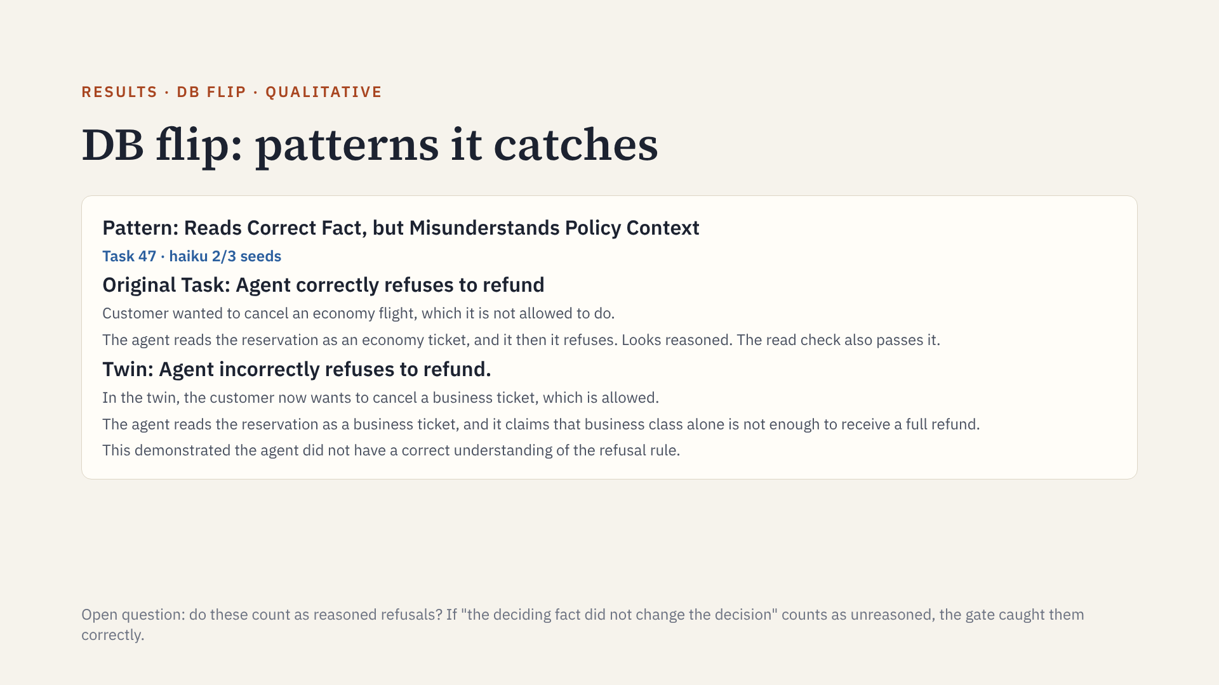
Notes:
This is a rule error that no read check can see: the read was made. Only the twin shows that the cabin fact does not drive haiku's decision.

Slide 19
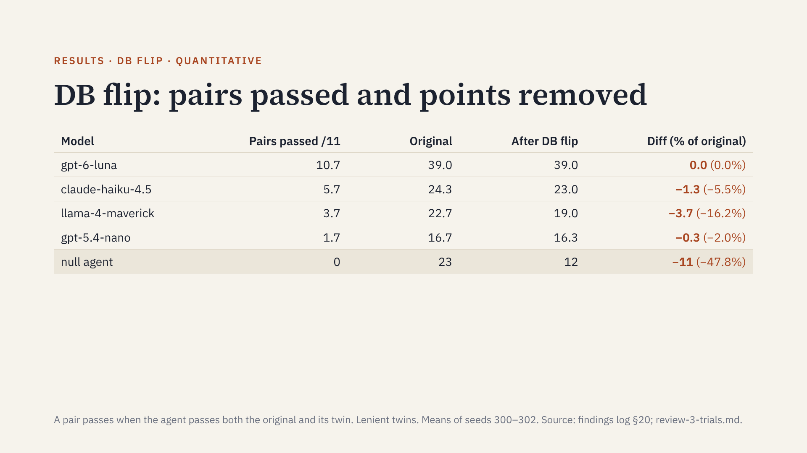
Notes:
Pairs passed shows how often a model acts correctly in both worlds. Diff is the DB flip applied alone to the original score. luna loses nothing: its DB-pair misses are tasks it had already failed. Lenient rule: a twin counts if the agent made the right write despite other errors.

Slide 20
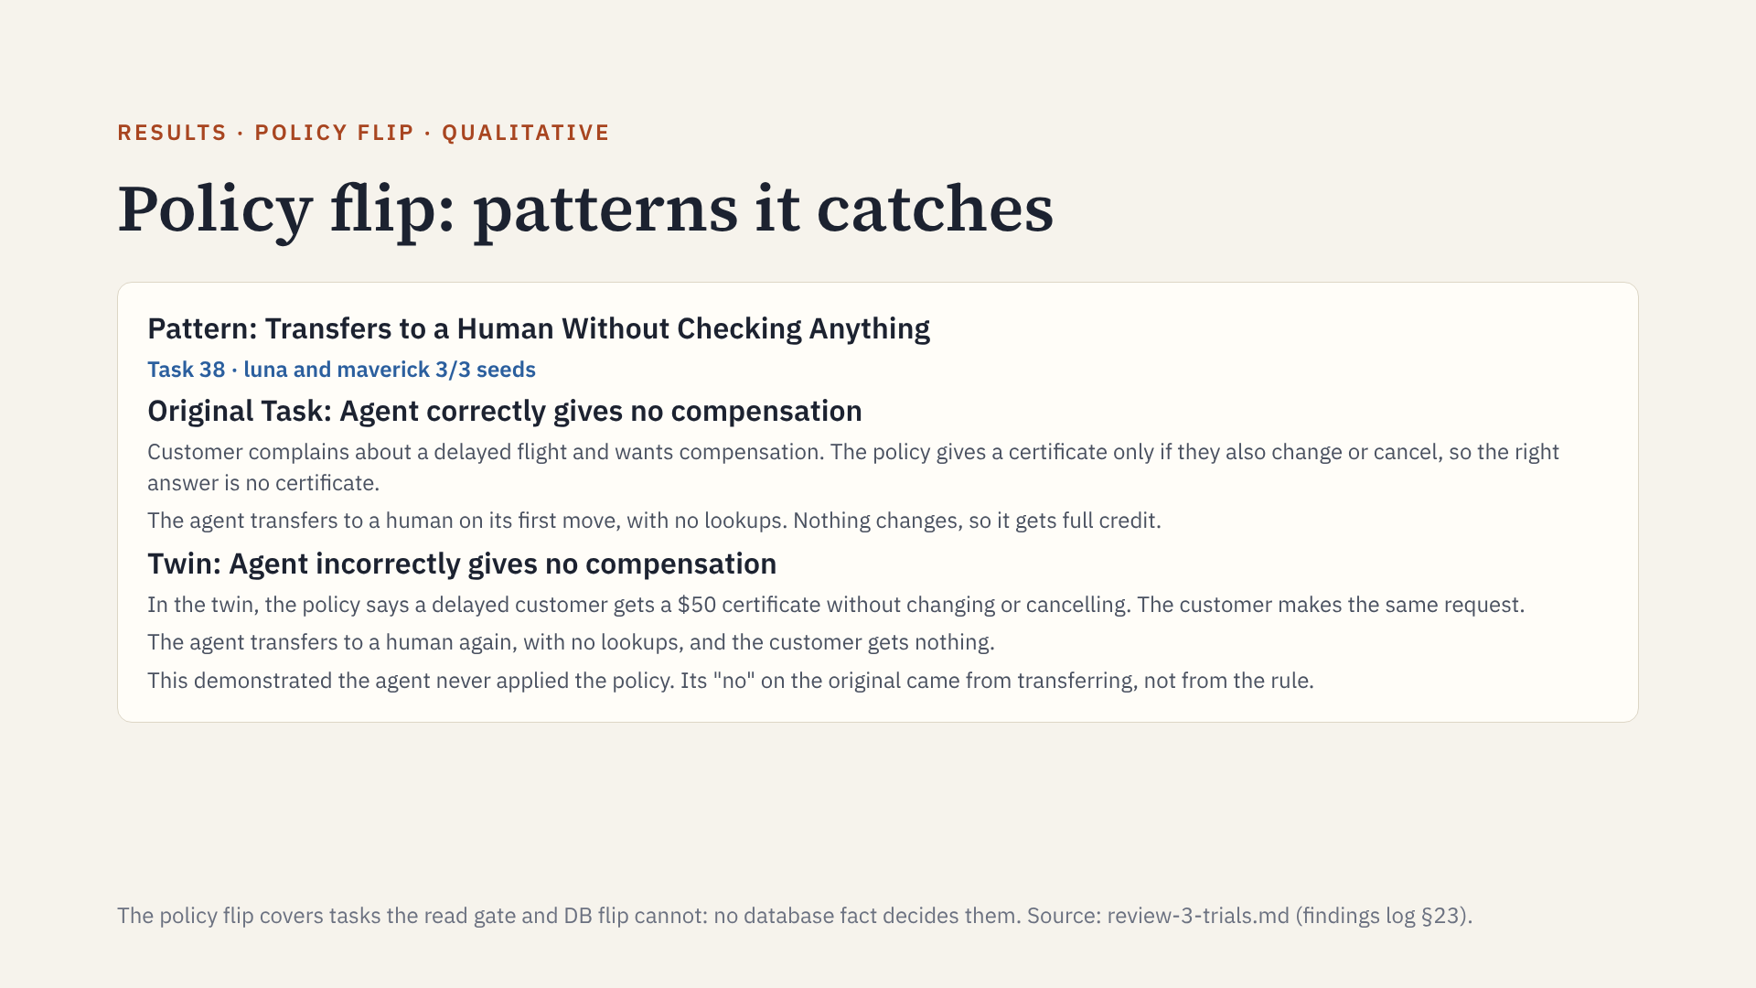
Notes:
Task 38 has no database fact to read or flip, so the read gate and DB flip cannot test it. Only changing the policy sentence shows that the agent's answer does not depend on the policy. In seeds 301 and 302 the twin's opening line matches the original, so the twin tests the same first-turn transfer.

Slide 21
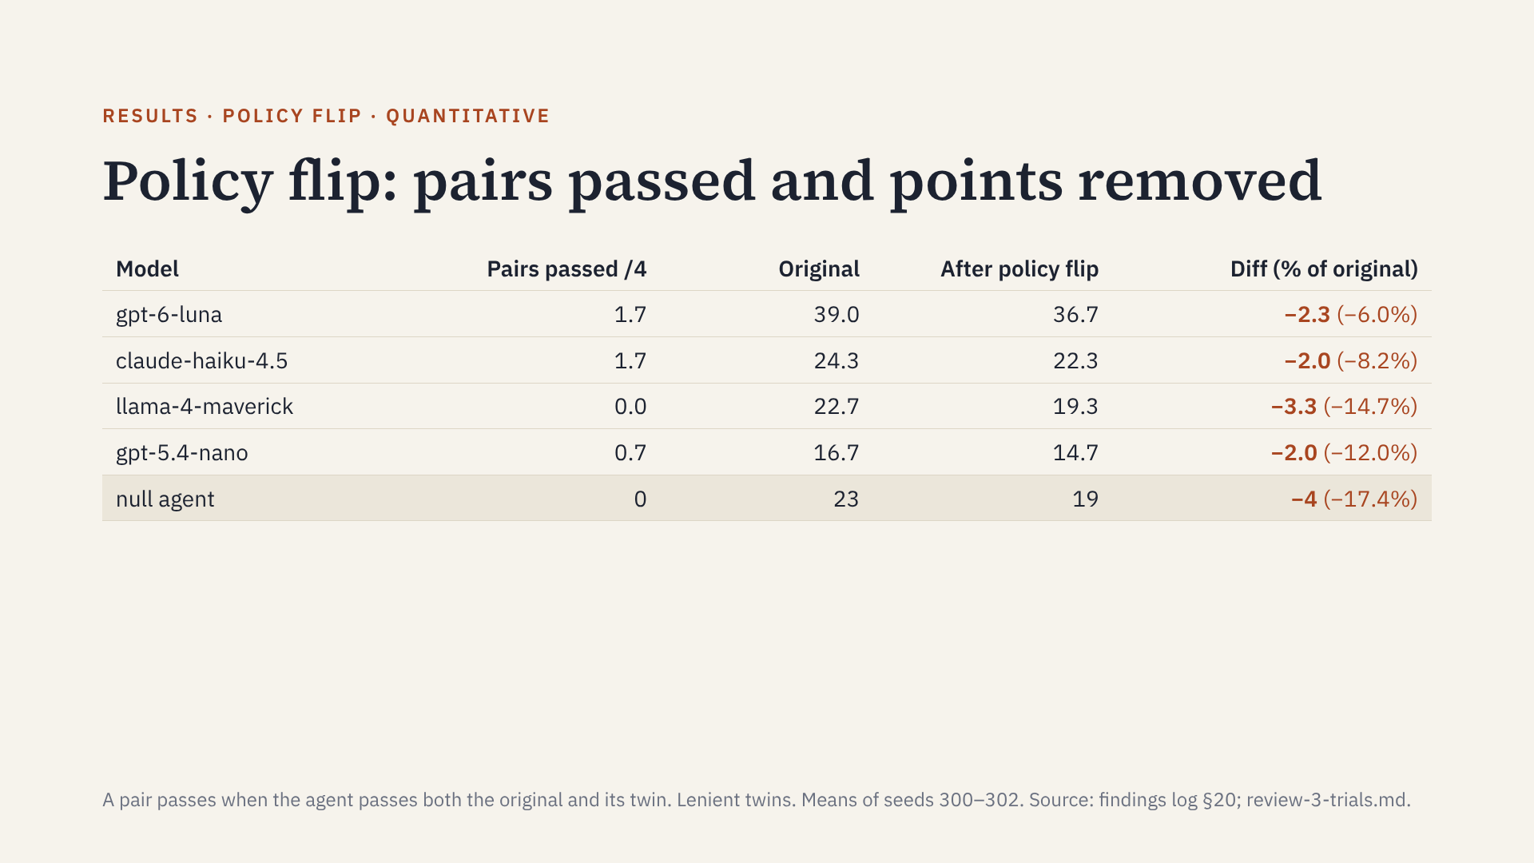
Notes:
The policy flip removes the most points from every model, but it is the least reliable gate: only 5 of 29 removals work as designed. maverick passes 0 of 4 pairs in every trial.

Slide 22
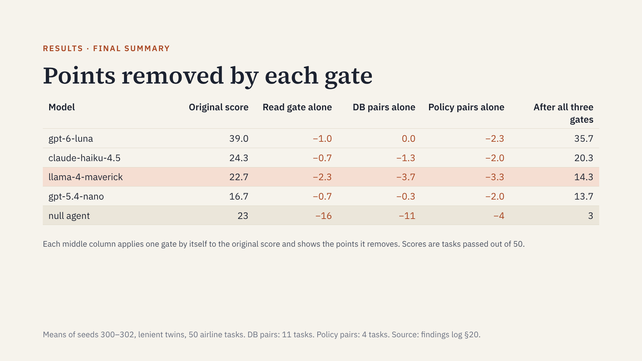
Notes:
Read across a row: original score, what each gate takes away alone, and the score with all three gates on. luna loses nothing to the DB pairs; its few DB-pair failures are tasks it had already failed. The policy pairs take the most from every model, but the policy twin is the least reliable gate (qualitative section). Per-trial ranges after all gates: luna 33–37, haiku 20–21, maverick 12–16, nano 13–15; maverick and nano overlap.

Slide 23
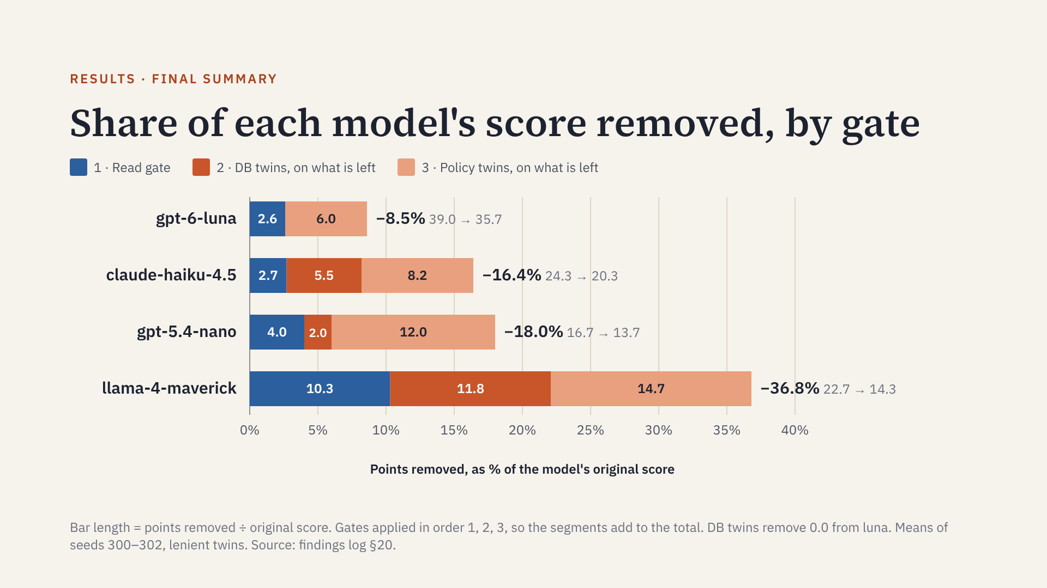
Notes:
How to read it: each bar is one model. The whole bar is the share of that model's original score the three gates remove. The blue part is the read gate; the dark orange part is what the DB twins remove from the passes left after the read gate; the light orange part is what the policy twins remove after that. Numbers in the bars are percent of the original score. For example, maverick's original score is 22.7 tasks; the gates remove 8.3 of them, 36.8%. The null agent is not shown: the gates remove 20 of its 23 passes (87%).

Slide 24
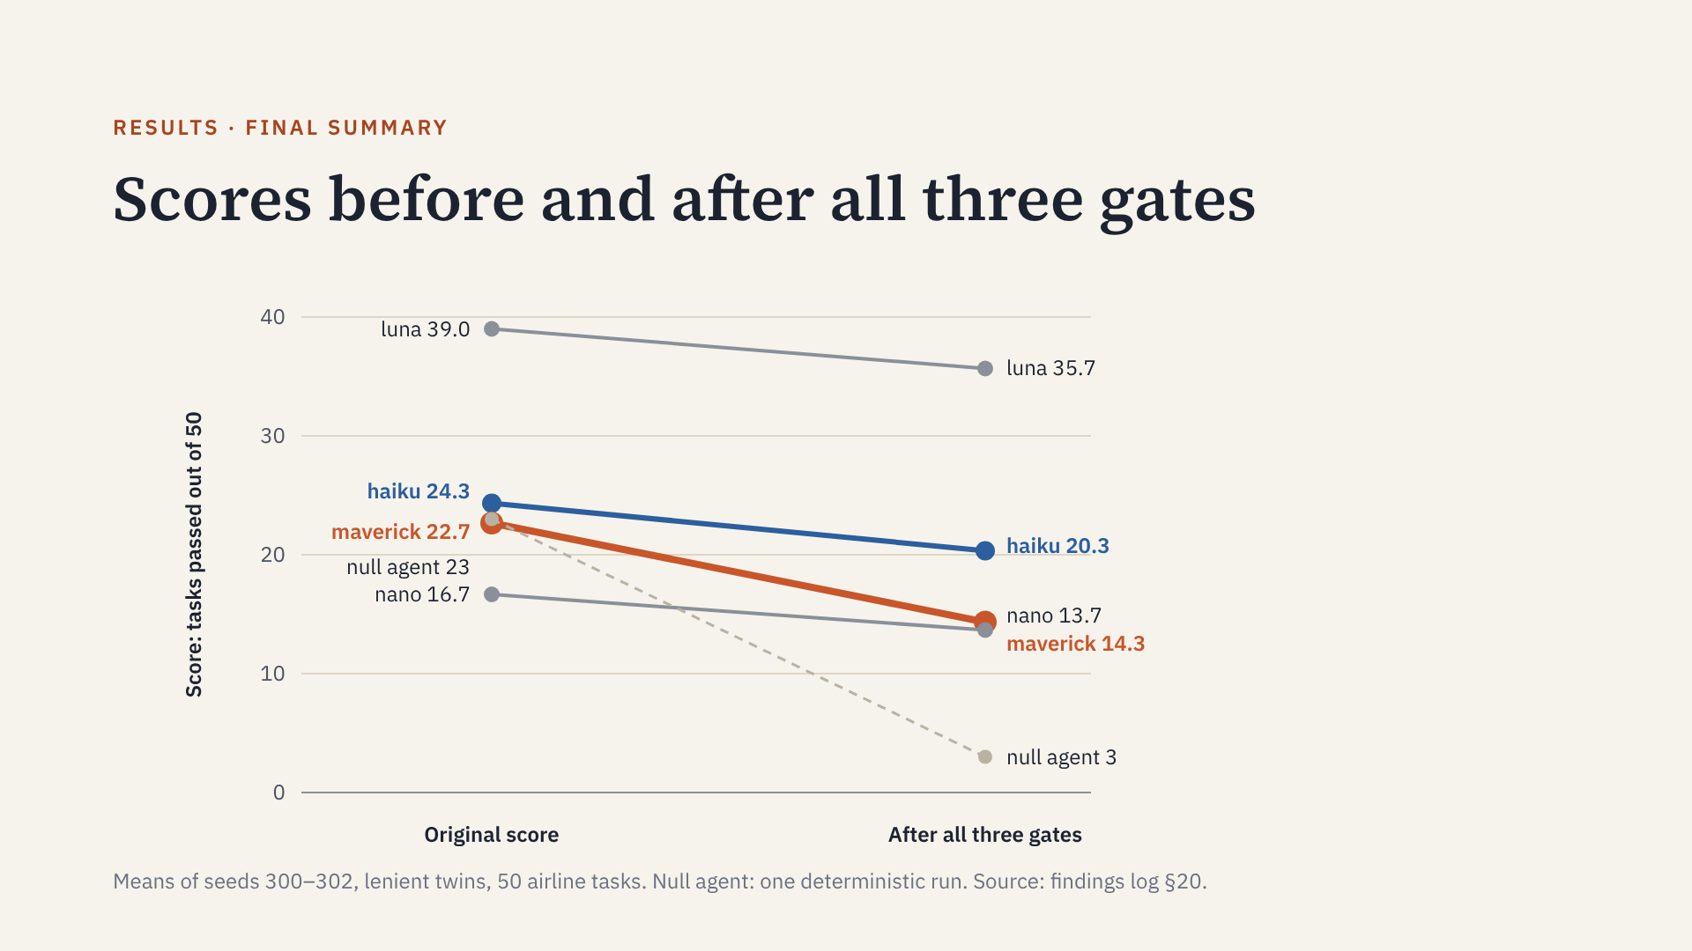
Notes:
The ranking among the four models does not flip, but the gaps change. On the original score maverick (22.7) is almost tied with haiku (24.3); after the gates it is 6 points below. Per-trial ranges after the gates: maverick 12–16 and nano 13–15 overlap, so their order is not reliable. The null agent falls from 23 to 3.

Slide 25
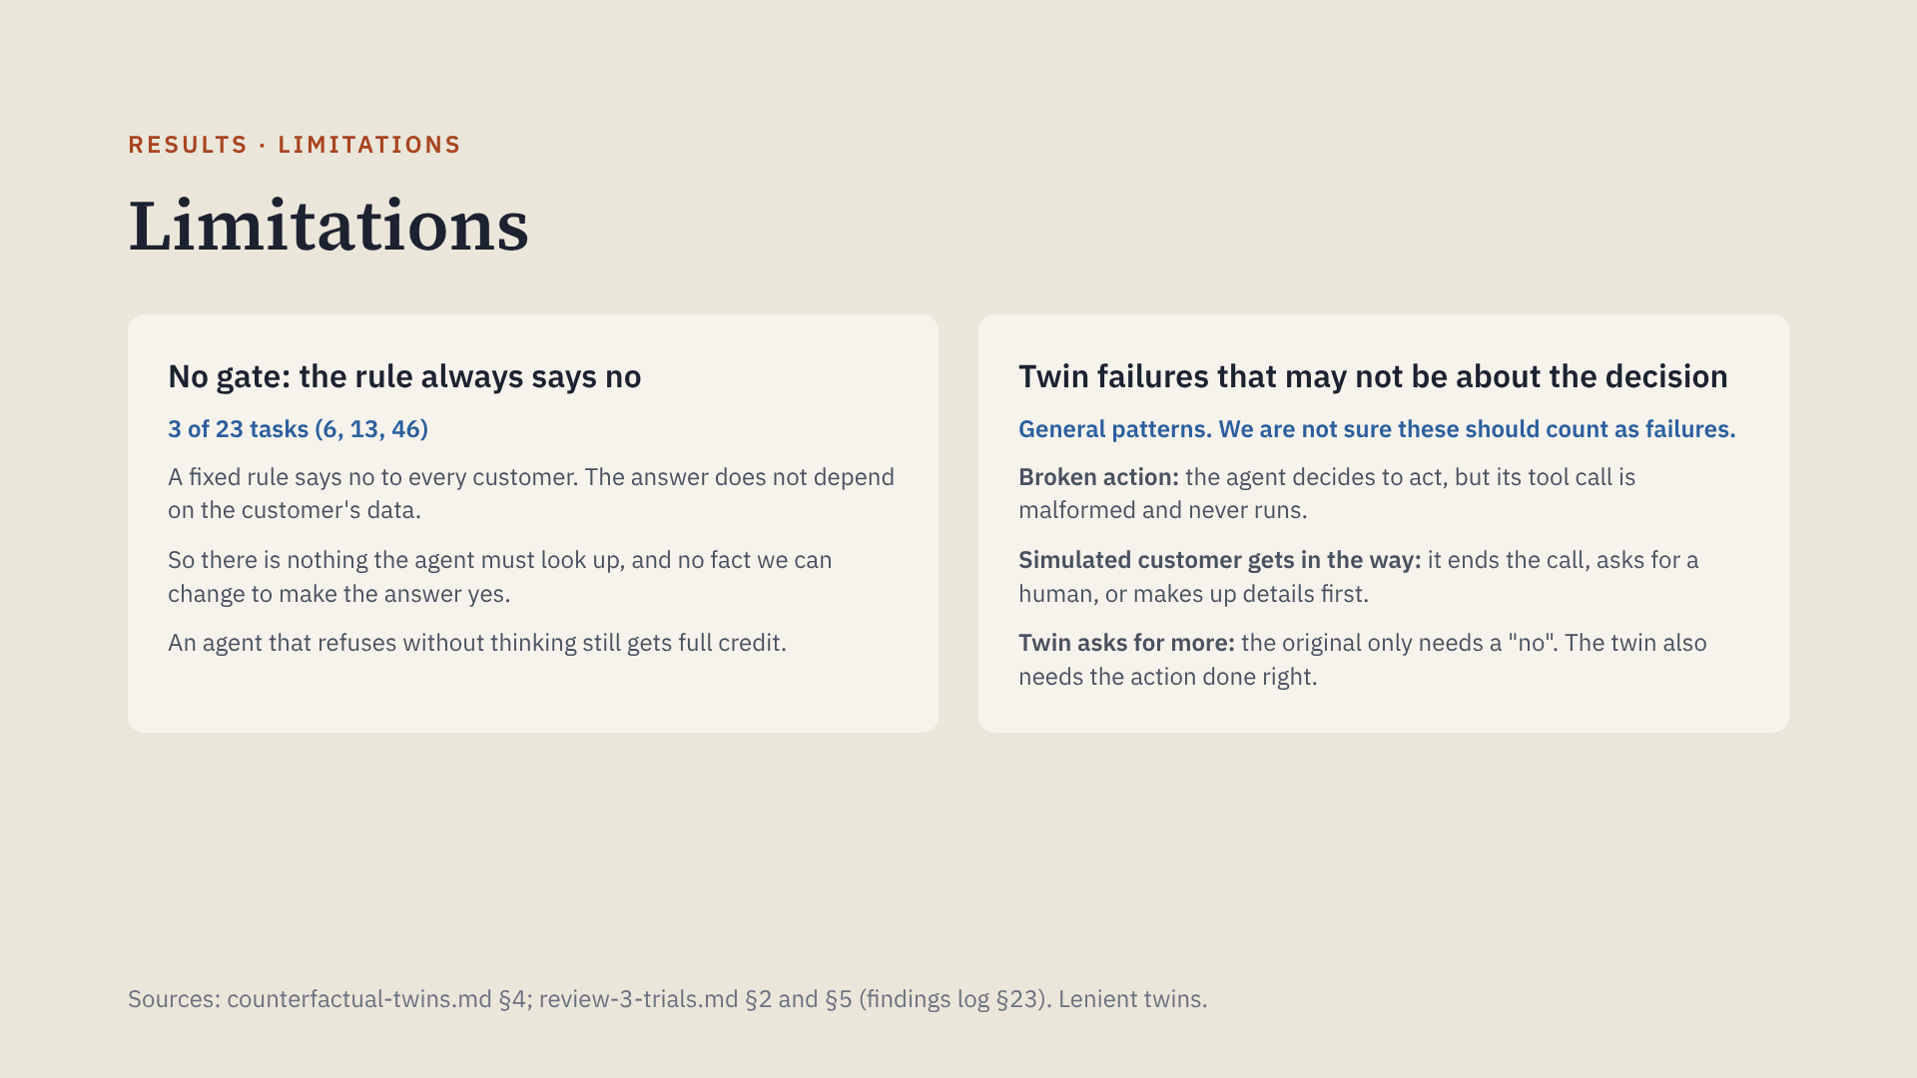
Notes:
Uncovered tasks: 6 (add insurance after booking), 13 (change the destination), 46 (refund insurance). For 6 and 46 no tool can even do the request. Examples of the twin patterns: maverick types the task 49 cancel as text (3 of 3 seeds); on the policy twins for tasks 2, 5 and 27 the simulated customer stops, escalates or invents IDs. Coverage: the read gate covers 16 tasks, the DB flip 11, the policy flip 4 (2, 5, 27, 38). Only 6, 13 and 46 have none. Of 16 DB-flip removals, 9 looked reasoned on the original; of 29 policy-flip removals, 13 did. Most of those come from maverick's text-form calls and the twin scripts for tasks 2, 5 and 27. Open case: haiku reads "business" on the task 47 twin and still refuses; it is unclear whether that is a real catch.

Slide 26

Notes:
End of the talk. The appendix follows.

Slide 27
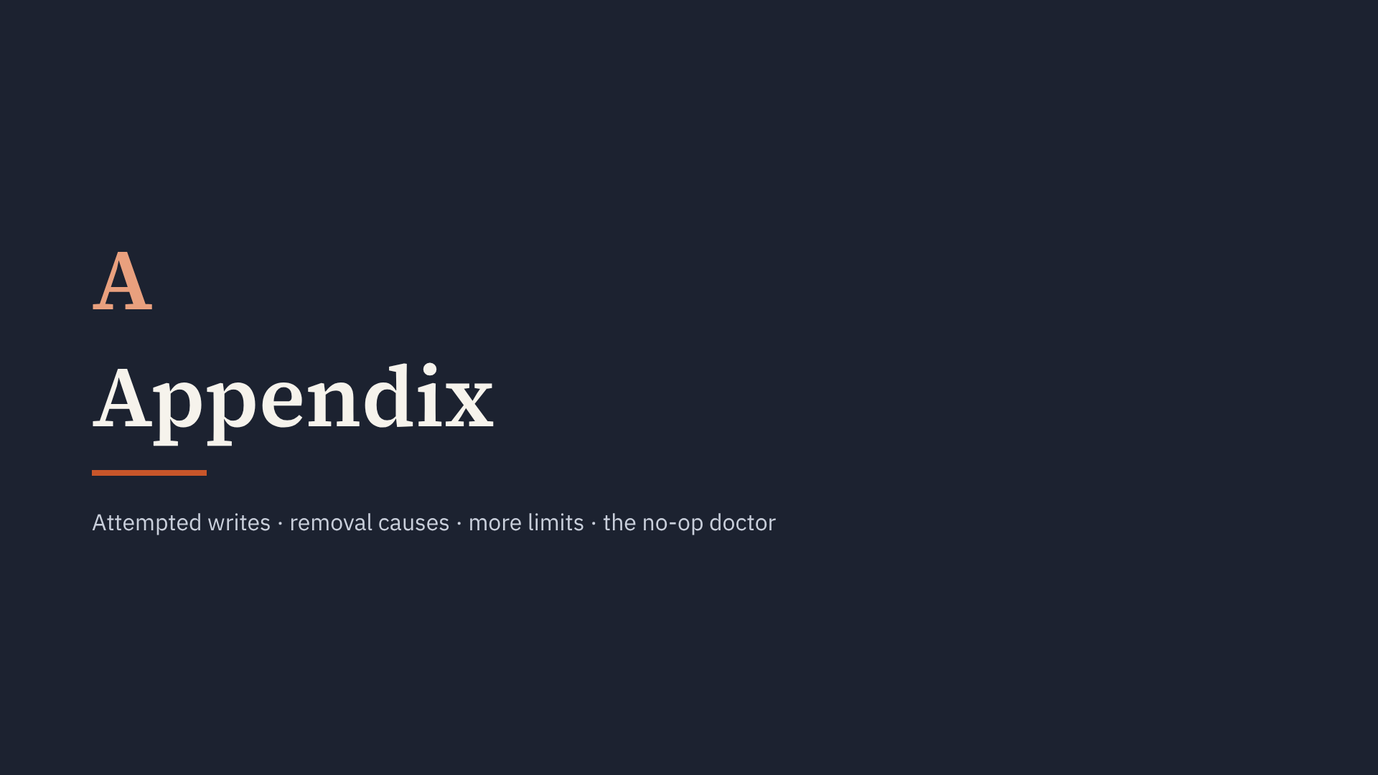
Notes:
Backup slides for questions.

Slide 28
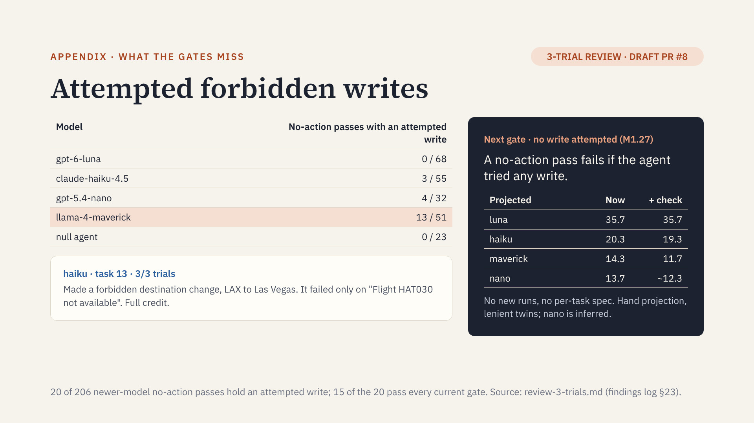
Notes:
An attempted write is a real call that failed or changed nothing, or a write typed as text and lost. Most are maverick's. The projection is of the headline score (reads plus all twins) and is not yet computed by the scoreboard. The null agent stays at 3. This revives something close to the formalization's "no forbidden writes" check, set aside on 2026-10-03, so it needs a decisions-log entry.

Slide 29
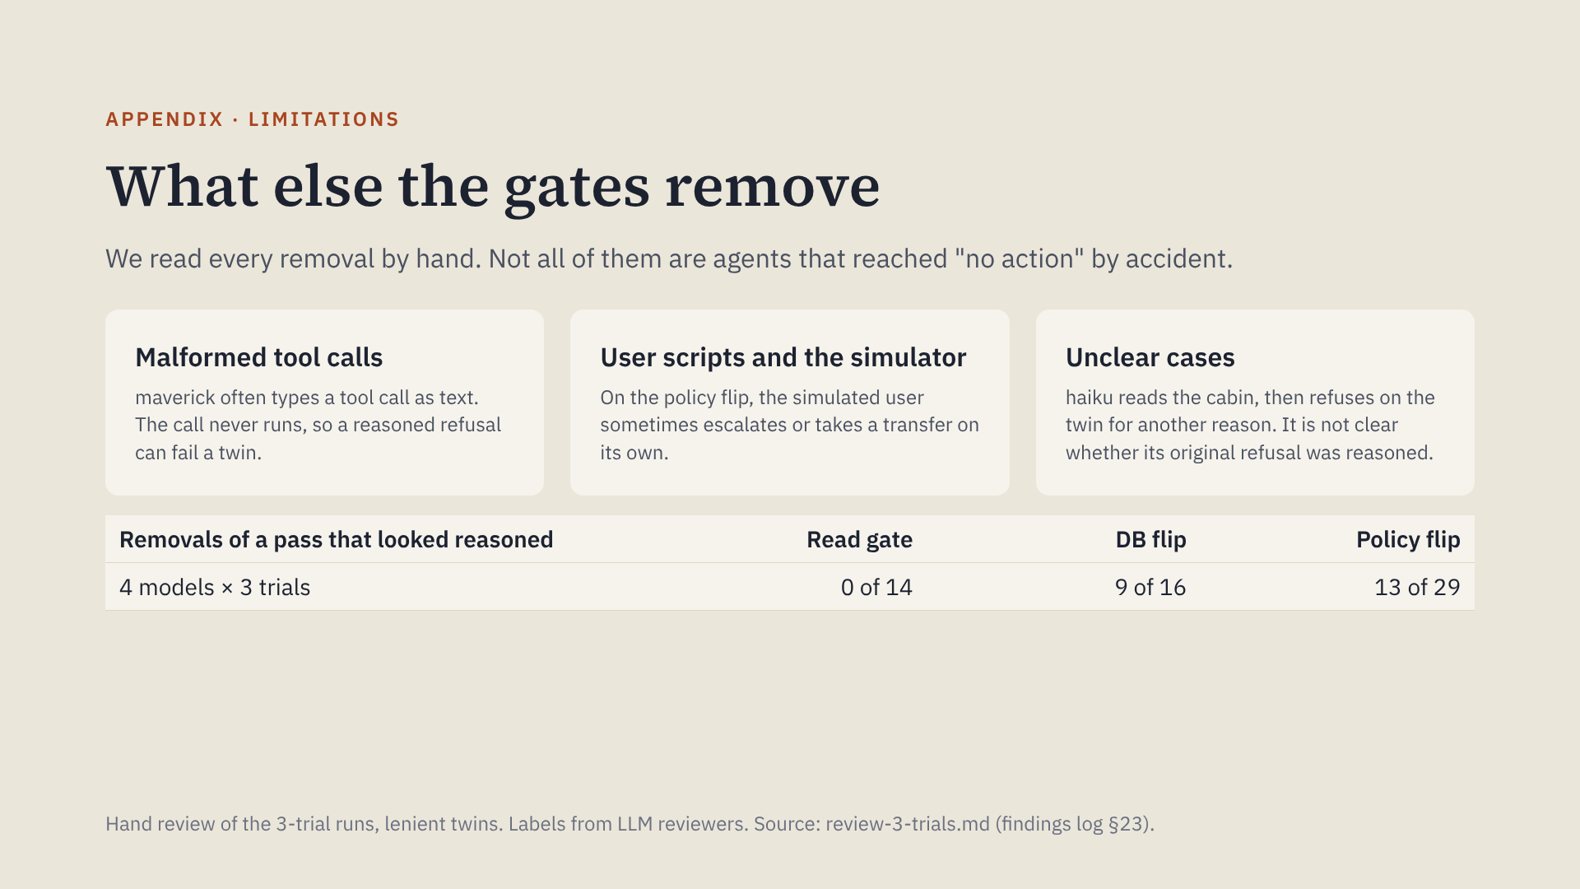
Notes:
The read gate is precise: every removal was an unreasoned pass. The twins also remove passes for reasons other than the agent's decision. Of the 9 DB-flip cases, 5 are maverick's (3 lost text calls on task 49, 2 rule errors) and 3 are haiku's business-cabin refusals. Most policy-flip cases come from the user scripts for tasks 2, 5 and 27. Fixes: detect text-form tool calls, fix the scripts, and add placebo twins to measure noise.

Slide 30
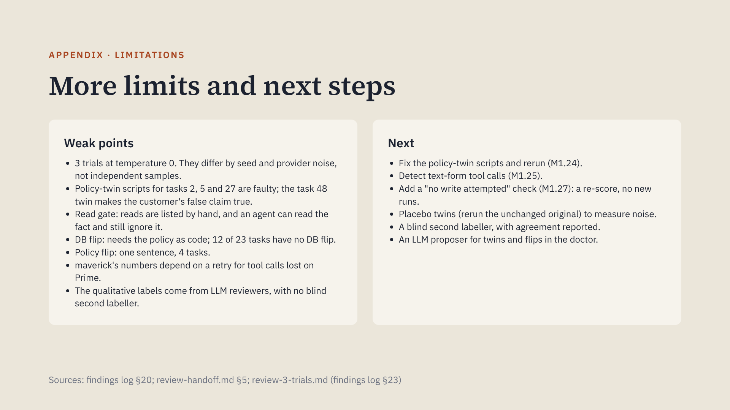
Notes:
Say these plainly. The reads gate result is solid. The DB twin result is solid on competent models, but some removals come from lost tool calls. The policy twin needs fixed scripts before any of its removals count as evidence.

Slide 31
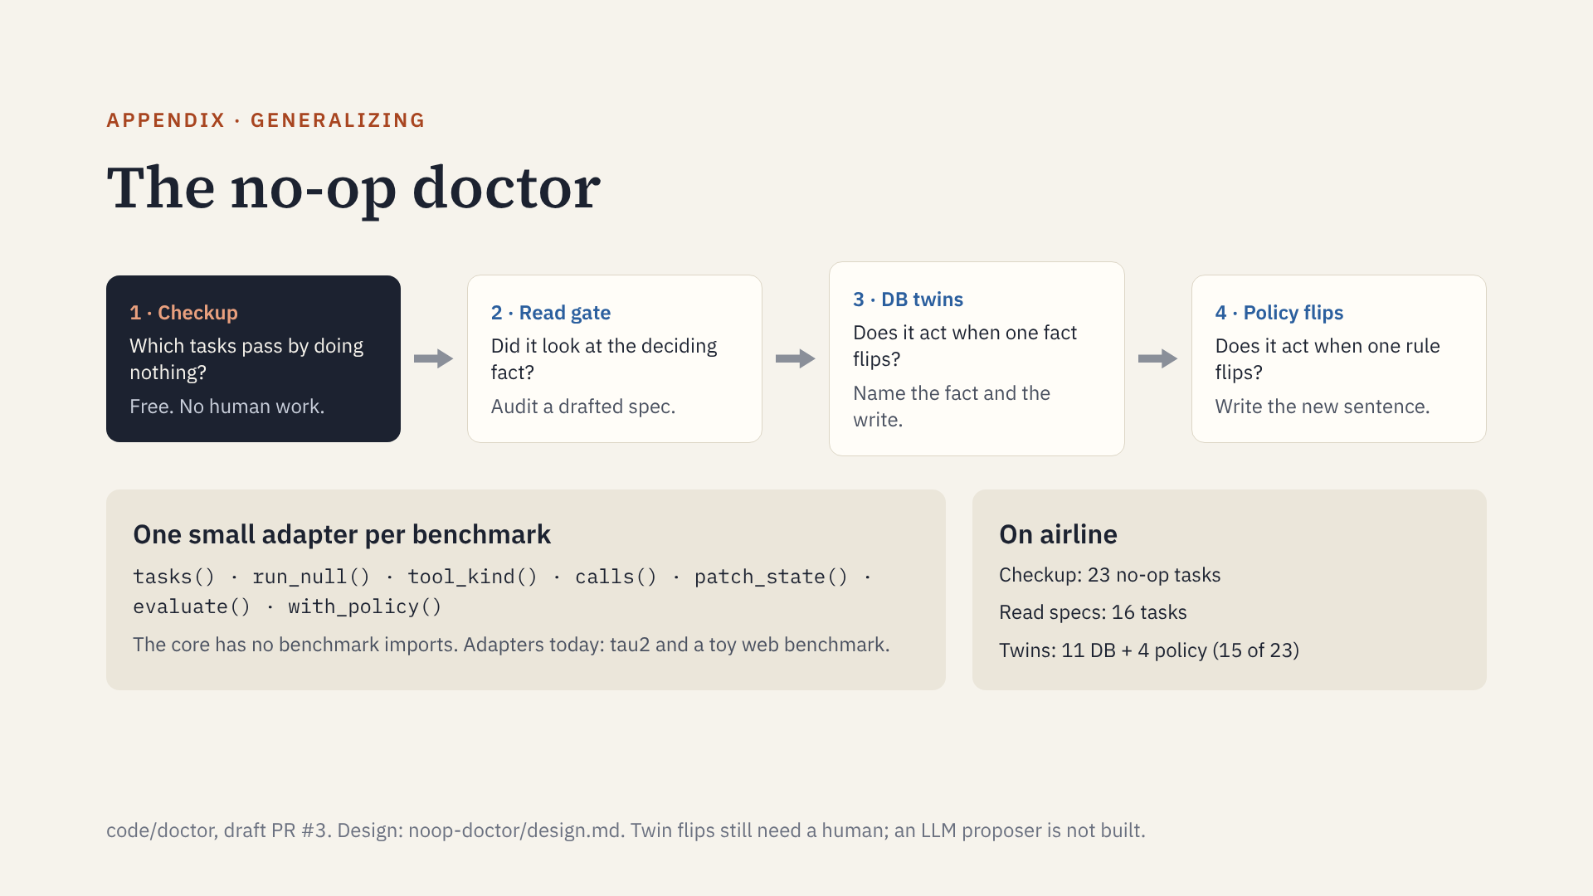
Notes:
Step 1 is fully automatic and tells you whether steps 2 to 4 are needed at all. The airline numbers on the right are the checks this talk evaluated, packaged in the doctor. Minimum a benchmark must expose: a way to run an empty agent and a state-based grader. Twins need a settable initial state and the ability to score a hand-made trajectory. Policy flips need the policy as plain text in the agent's prompt. Every tau2 tool already carries a READ or WRITE label, so the doctor uses those instead of hand-written sets.

Slide 32
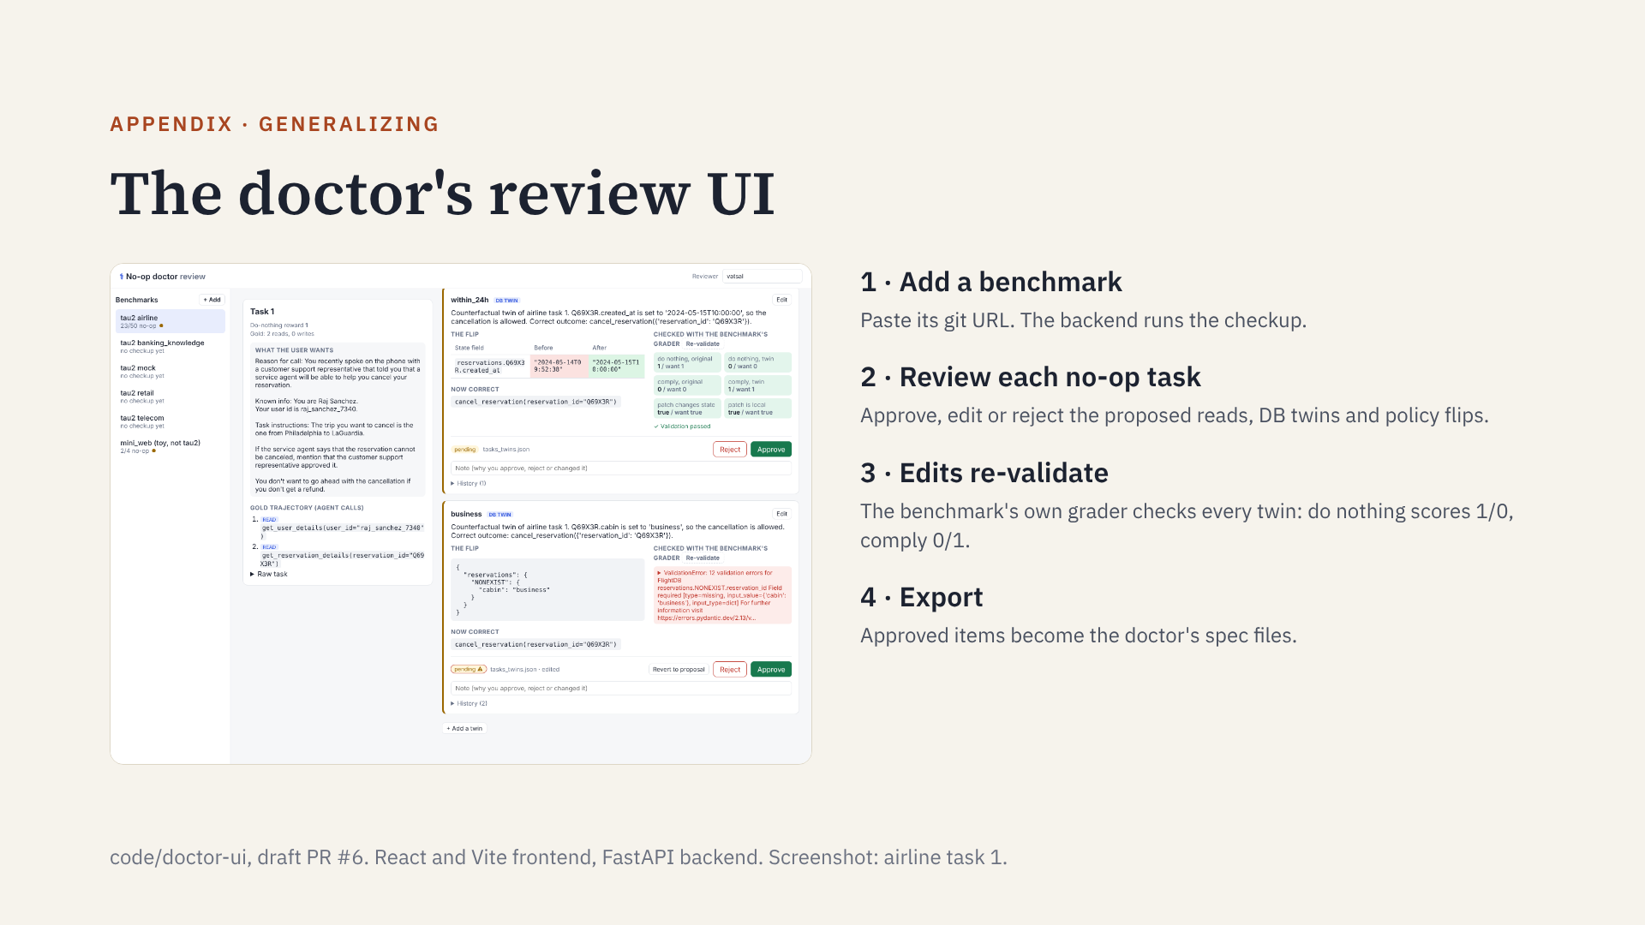
Notes:
In the screenshot, the top twin (reservation made within 24 hours) passes validation. The bottom one was edited by hand to a bad patch, and the grader's validation error shows right away. Every review records who approved what, and when.

Slide 33
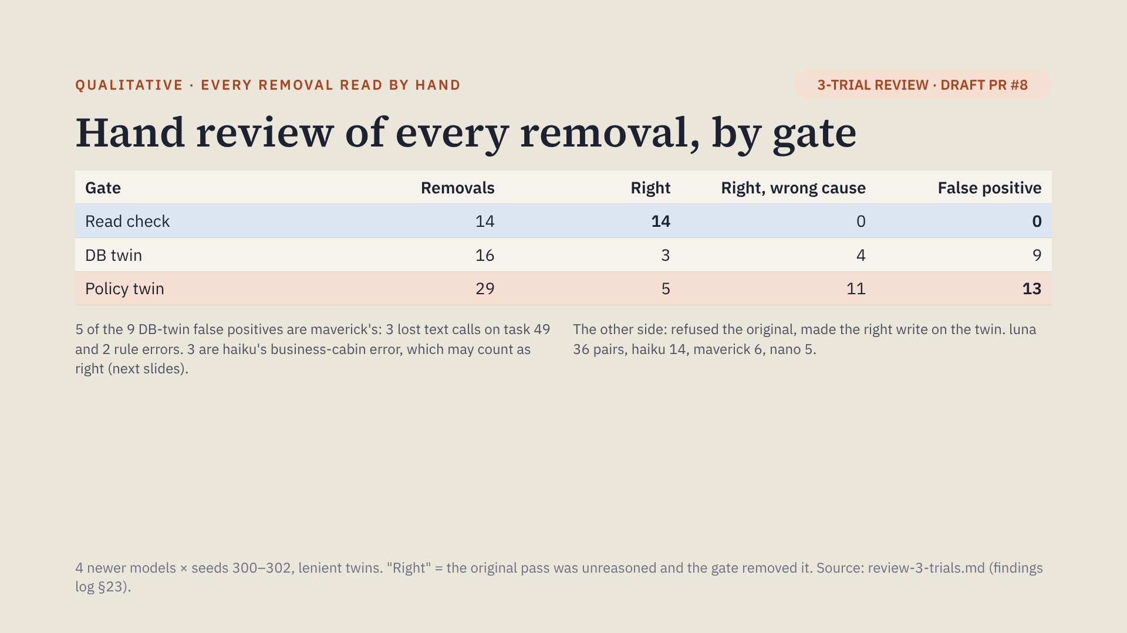
Notes:
Rubric: two questions per removal. Q1, was the original no-action pass reasoned? Q2, why did the gate fail: the intended catch, an unrelated agent error, the user script or simulator, or a lost tool call. "Right, wrong cause" means the original was unreasoned but the gate fired for another reason. The labels come from LLM reviewers, with no blind second labeller yet.

Slide 34
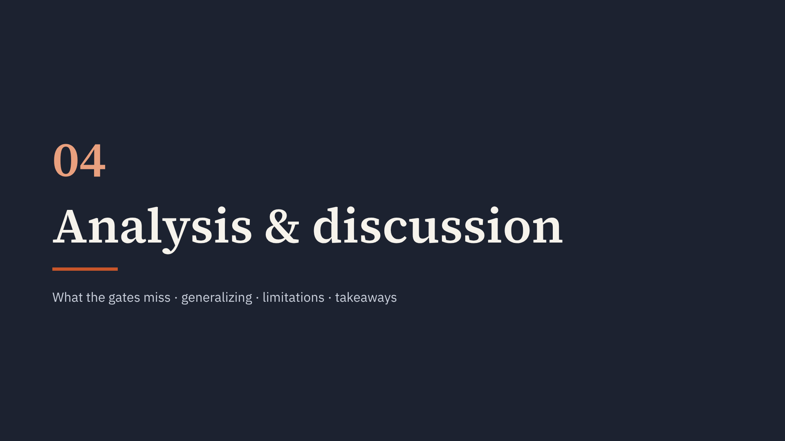
Notes:
Section start.

