Slide 1
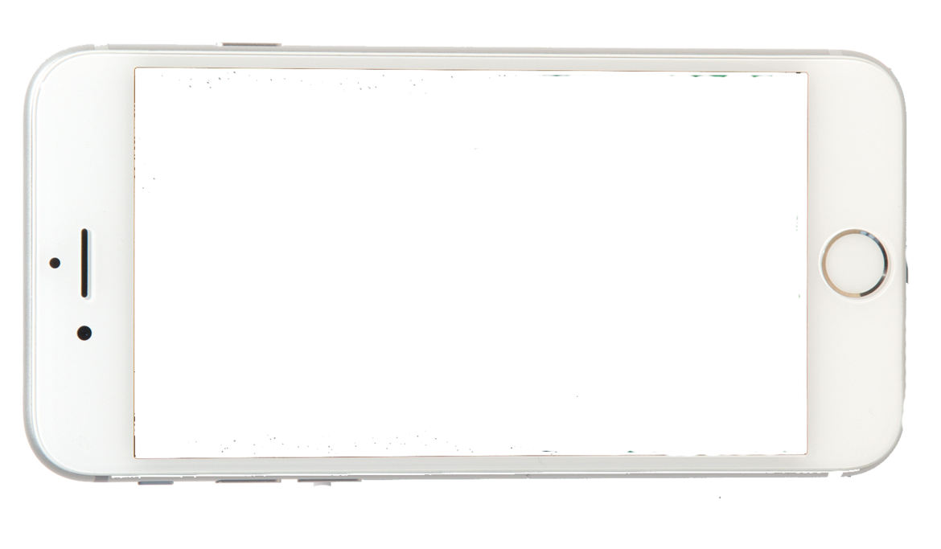

Project : Human Computer Interaction
Group Members:
Hammad Khan k142145
Sohaib Hashmi k142121
Talha Asif k142246
Presented to : Sir Behraj Khan

Slide 2
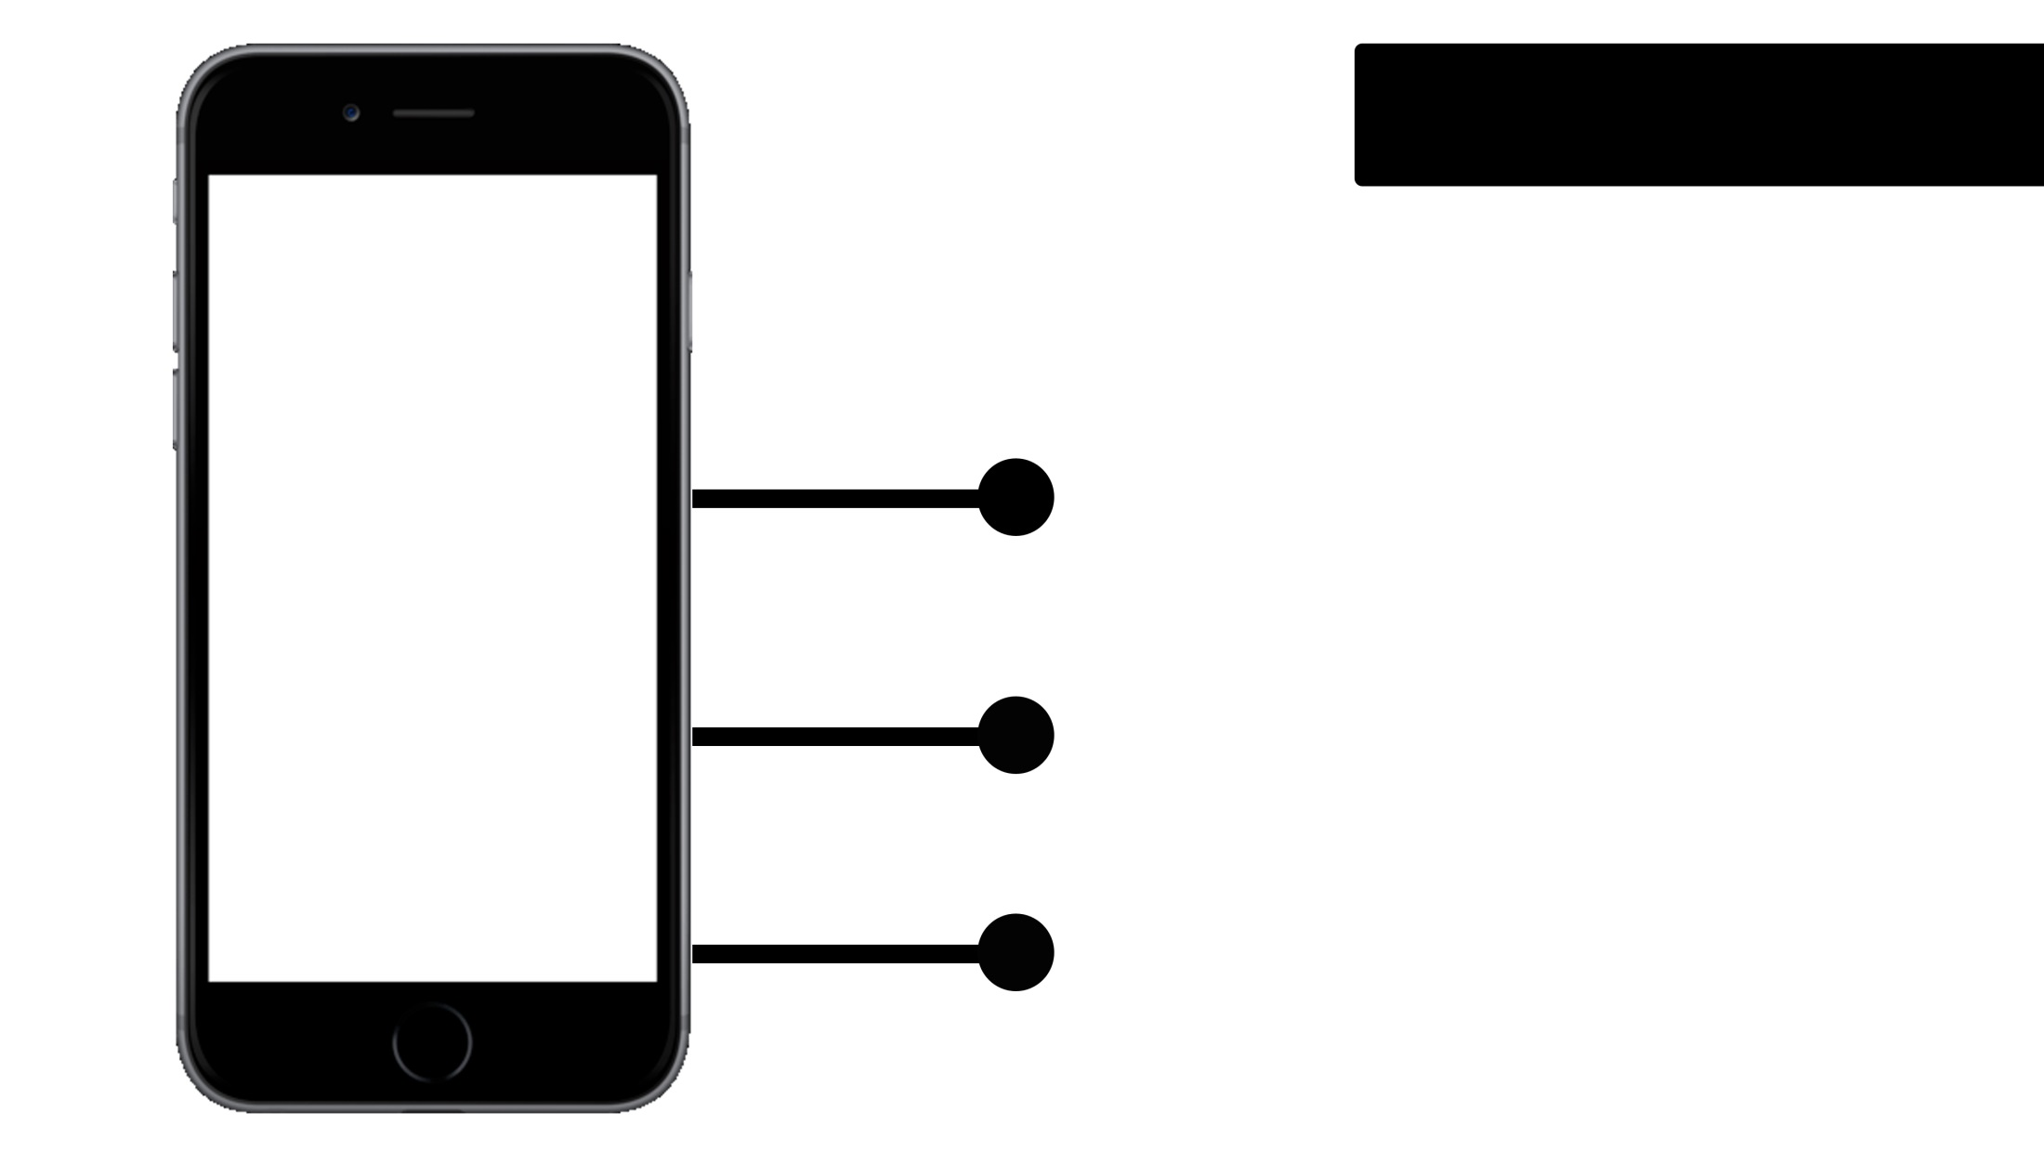

INTRODUCTION
iOS Application
Age-Limit : 5-12 years
Single Screen Application

Slide 3
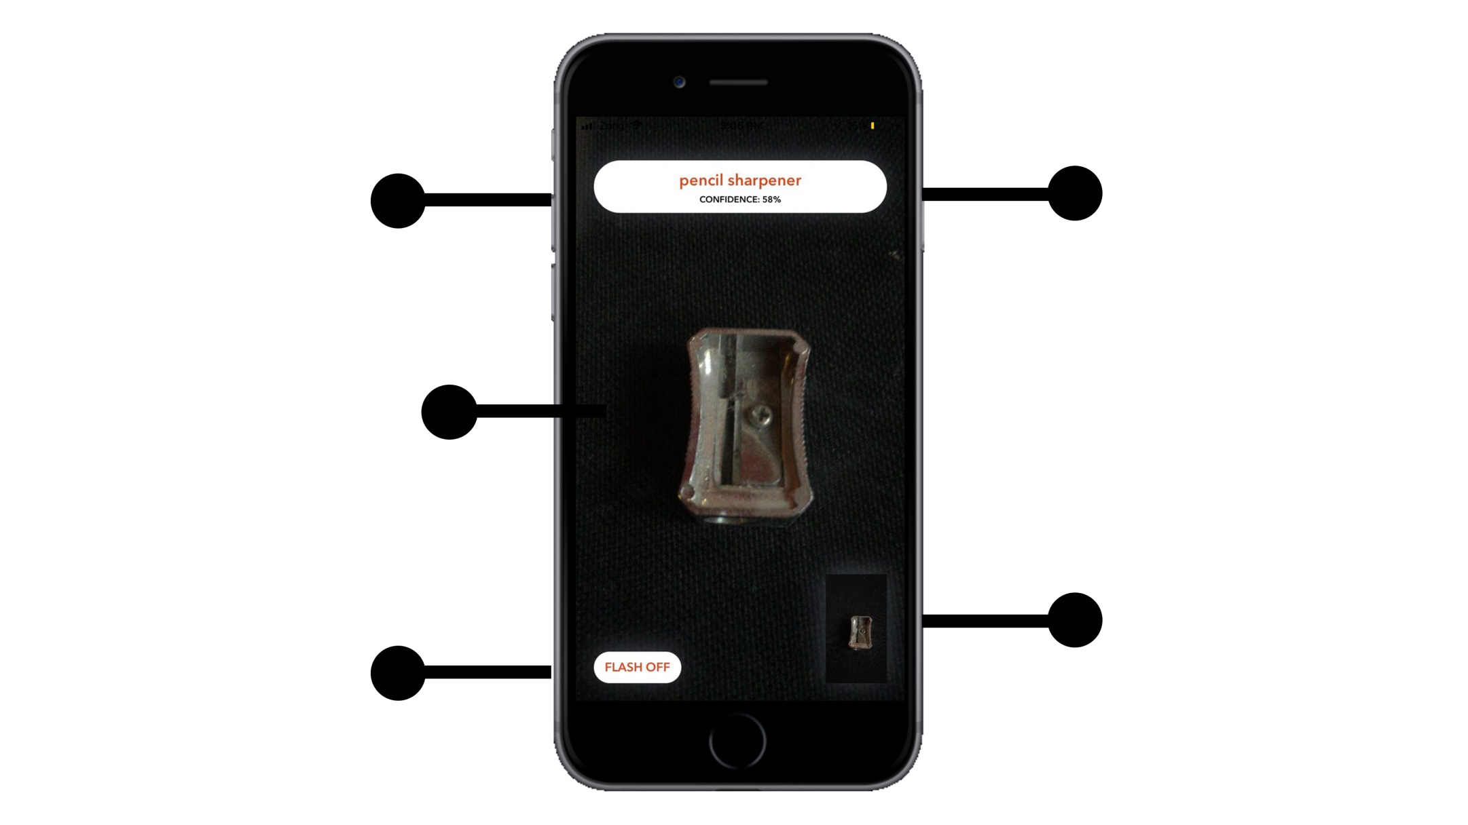
USER INTERFACE
Confidence
Percentage
Object Name
Camera
Image Clicked
Flash On/Off

Slide 4
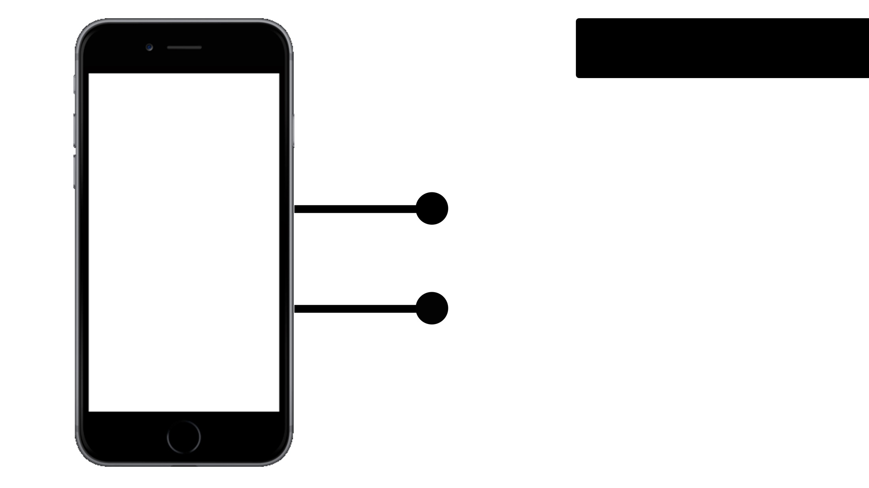
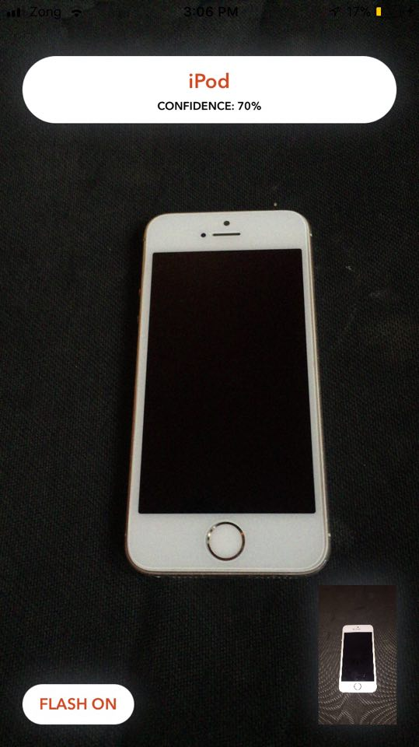
HUMAN
Output by speech and text
- Blue Acuity - Women Voice
Sensory and Short Term Memory
- Sensory for camera - STM for last image

Slide 5
COMPUTER
Interactivity
- Rapid Feedback
Positioning and Pointing

Slide 6
DONALD NORMAN MODEL
All The 7 stages of Donald Norman
Interaction Model applies here
- user establishes the goal
- formulates intention
- specifies actions at interface
- executes action
- perceives system state
- interprets system state
- evaluates system state with respect
to goal

Slide 7
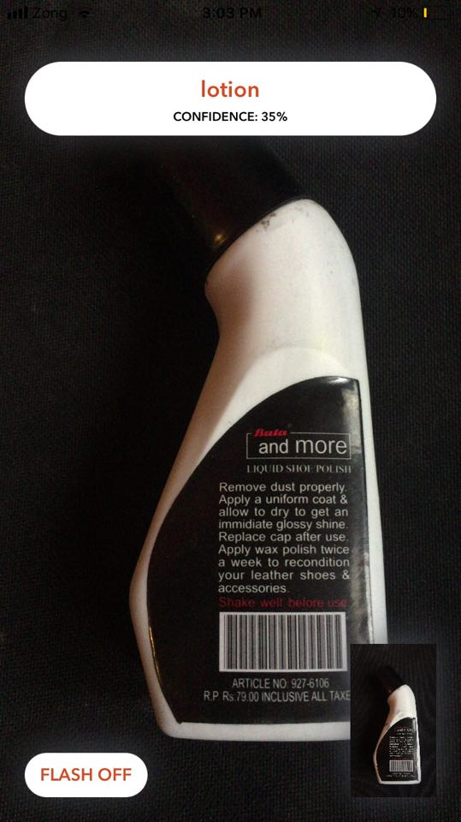
ERGONOMICS
Arrangement of Control and Display
Use of color

Slide 8
INTERACTION MODEL
Point and Click Interaction Model
Can say touch sensor, or mimimal
typing interface

Slide 9
PARADIGM
Personal Computing
Phone is a personal device and sensor will only work when application is started

Slide 10
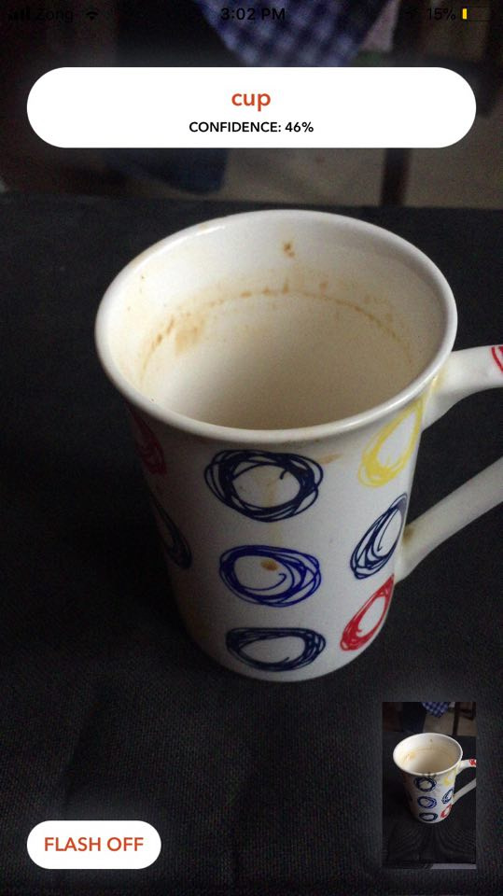
PRINCIPLE OF LEARNABILITY
Synthesizability
when the model is processing on the image
it shows a spinner on a image view which
shows that its working.
Generalizability
Same interaction as with the camera of any
smartphone.
No flexibility Principles applied here.

Slide 11
ROBUSTNESS PRINCIPLE
Responsiveness
The app is highly responsive it returns
the output in a very short time. Task conformance
The task is confirmed by text label and
Speech with confidence level of the model.

Slide 12
SCHNEIDERMAN GOLDEN
RULES :
- Strive for consistency (design is consistent)
- Offers informative feedback (feedback by speech and text)
- Internal locus of control (system is user friendly)
- Reduce short term memory(Displays are very simple
nothing to memorize)

Slide 13
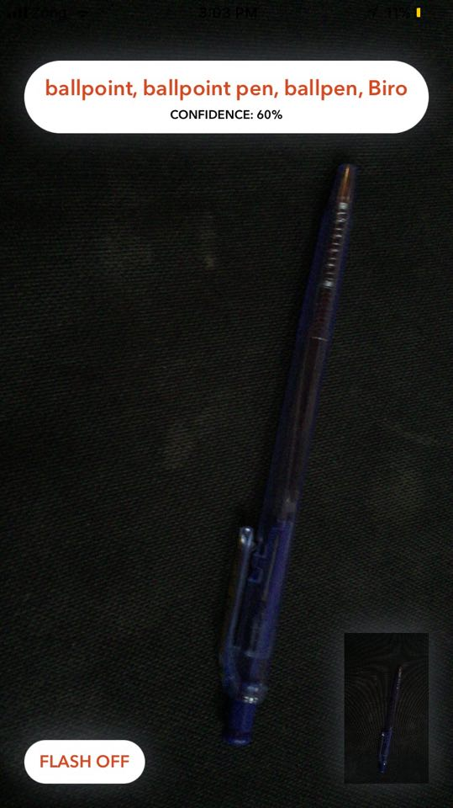
NORMANS PRINCIPLES
Use both knowledge in the world and knowledge in the head (System is speaking users language)
Simplify the structure of the tasks (performing a task is very simple) - Make things visible (everything is displayed on a single screen)
- Get the mapping right

Slide 14
Evaluation
Evaluation using Expert Analysis:
- Heuristics
Evaluation through User participation:
Field studies : Takes the designer or evaluator
out into the users work environment (App was
evaluated by the kids of age ranging from 5-12
years old in the normal home environment)

Slide 15
OBSERVATIONAL METHODS
Cooperative Evaluation: Users were
collaborated in evaluation with us which
encouraged them to criticize the system
and this method is also less constrained.

Slide 16
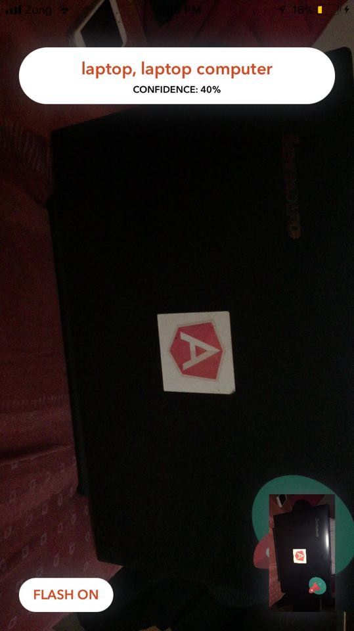
UNIVERSAL DESIGN PRINCIPLES
Principle Three: System is simple and intuitive to
use regardless of knowledge, experience, language
or level of concentration.
Principle Four: Perceptile info (Redundancy of
presentation, Information is represented in different
forms)
Principle Six: Low physical effort
Principle Seven : Size and space approach to use
(It is easy to handle a mobile phone)

Slide 17
Goal: Identifying object in an image using
a ML model
Constraints: iOS11 and onwards
3 months
pre trained model
Our users: Kids age: 5-12

Slide 18
LOCAL STRUCTURE
Self describing Flash button
text box to guide the user what action to perform,
A text field to show what object has been recognized,
Speech output

Slide 19
4 GOLDEN RULES
-No output means that you have to
take a photo
-You have to take a photo
-Output will appear of photo
-If output is there, means you have taken a
Photo.

Slide 20
-No big buttons
-There is a single mode for each button
-Screen is not congested
-Text output displayed on top emphasizing
its importance
-Voice output for kids who can't read text
-White space
-alignment
-No overuse of color
-simple design
-Communication language: English; hence
covers a good part of population.
(can include more languages in future)

Slide 21
- effectiveness: medium
- efficiency: medium
- satisfaction: high

Slide 22
verification: in class from colleagues
validation: from children at home (users)
prototyping technique: throw away
(for model)/evolutionary(for design)

Slide 23
SHUKRIYA

