Slide 1
YouTube Spam Detection
IRTM FINAL PROJECT
Hammad Khan k142145 Hafiz Muhammad Zubair Hasan k142257
Talha Asif k142246
Presented to Dr. Muhammad Rafi

Slide 2
Introduction:
As many videos of big superstar upload on YouTube on the daily basis and a handsome amount of comments posted on that videos are spam i.e people trying to promote their channel or market their product. To tackle this problem In this project we needed to identify the class of the YouTube video comments that it belongs to spam or ham.

Slide 3
Work Division:
The work divided between all group members is as following
Hammad Khan (Proposal, Ensemble experiment )
Hafiz Muhammad Zubair Hasan (Ensemble experiment)
Talha Asif (Presentation, Cross Validation, Plotting confusion matrix)

Slide 4
Dataset:
Our Dataset consist of 5 videos comment collection 1.PSY 2.LMFA 3.Shakira 4.Eminem 5.Katy Perry

Slide 5
Dataset:
Each file contains following columns of details.
-Comment ID
- Author Name
- Date
- Content
- Class (Where 1 is for SPAM and 0 for HAM)

Slide 6
Dataset:
Example :
Comment ID : LZQPQhLyRh80UYxNuaDWhIGQYNQ96IuCg-AYWqNPjpU
Date : 2013-11-07T06:20:48
Author : Julius NM
Content : Huh, anyway check out this you[tube] channel: kobyoshi02
Class : 1

Slide 7
Algorithms used:
We used ensemble approach to figure out the problem of spam detection in comments of YouTube Videos.
The Algorithms used in ensemble are 1. Logistics Regression 2. Random Forest 3. Gradient Boosting

Slide 8

Ensemble:
Ensemble methods are techniques that create multiple models and then combine them to produce improved results.
Reason to use Ensemble :
- More Accurate Results.
- Competition winners used Ensemble Netflix
Kaggle
KDD 2009
Majority Voting Classifier used

Slide 9
Logistics Regression:
Goto method for binary classifications.
Used to plot all values on the scale of 0-1 can use that as probabilties.
Work great when we remove unrelated attributes, or repeated attributes.

Slide 10
Random Forest:
Random Forest algorithm is a supervised classification algorithm
Higher the number of trees higher the results.
Randomly generated trees values are stored and one with the best possible highest value is selected as a result.

Slide 11
Gradient Boosting:
Gradient boosting is an ensembling technique, which means that prediction is done by an ensemble of simpler estimators
The aim of gradient boosting is to create (or "train") an ensemble of trees, given that we know how to train a single decision tree. This technique is called boosting because we expect an ensemble to work much better than a single estimator.

Slide 12
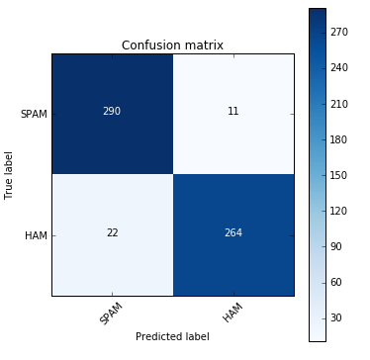
Confusion Matrix:

Slide 13
Results:
Mean Accuracy : 0.956902103907
Max Accuracy: 0.985401459854

Slide 14
Thank You

