Slide 1
Design of an Efficient Multicast Protocol for IEEE 802.11n WLANs
Ahmed Mehfooz, Amna Abid, Shanzae Nadeem Khan

Slide 2
The Future of Online Video Traffic: Predictions by Cisco
“By 2018, IP video will represent 79% percent of all internet traffic, up from 66% in 2013”
“75% of Internet traffic will be accessed via WiFi by 2018”

Slide 3
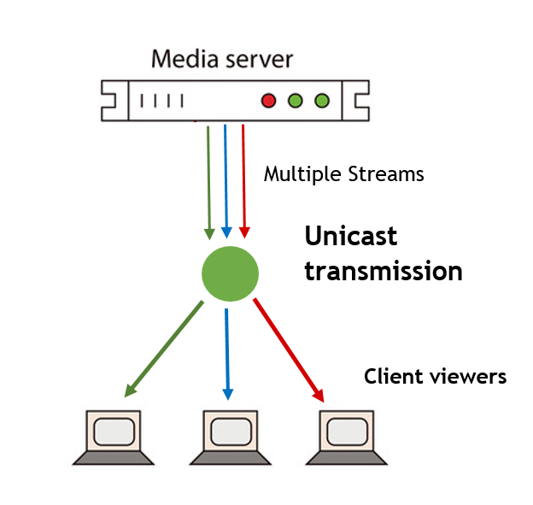
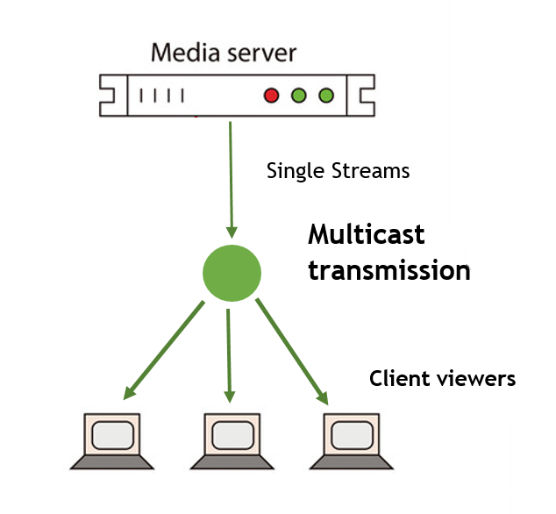
Why Multicast?
Unicast transmissions are inefficient for delivery of duplicate packets
Multicast concurrently broadcasts one packet to multiple destinations – an efficient alternative to reduce unnecessary packet duplications

Slide 4
Multicast in 802.11n
Broadcast multicast packets at the base rate
Transmits a single frame only
Receivers do not provide feedback for packets sent to them

Slide 5
What is Multicast in 802.11n missing out on?
High transmission rates
up to 300 Mbps
Reliability
due to ACKs
Frame Aggregation
multiple frames in a single aggregate frame

Slide 6
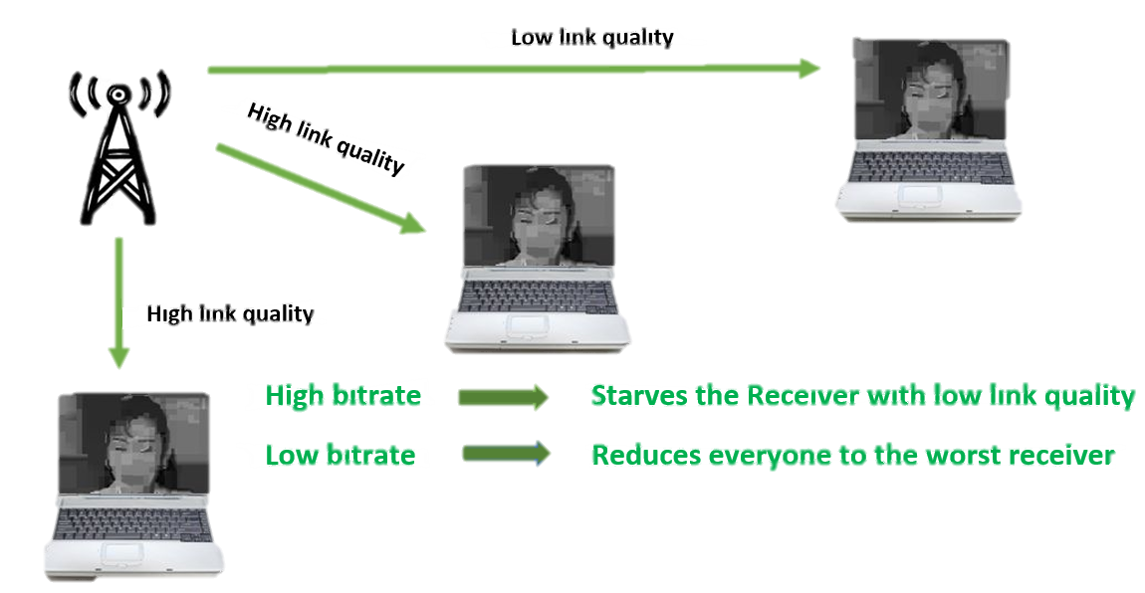
Challenges in Multicast for 802.11n
High Transmission rates make it tough for receivers with poor link quality to correctly receive packets
Feedback provides substantive overhead
may degrade system throughput
frame aggregation becomes difficult

Slide 7
Related Works
Multicast
Protocols
Leader-based
DPMM(Double Piggyback Mode Multicast)
ACK-Based
Non-leader-Based
ACK-Based
NACK-Based
NACK-Based
REMP(Reliable and efficient Multicast Protocol)
BMMM(Batch Mode Multicast MAC Protocol)
Only in Leader Based Protocols
(e.g.)
(e.g.)
(e.g.)
(e.g.)

Slide 8
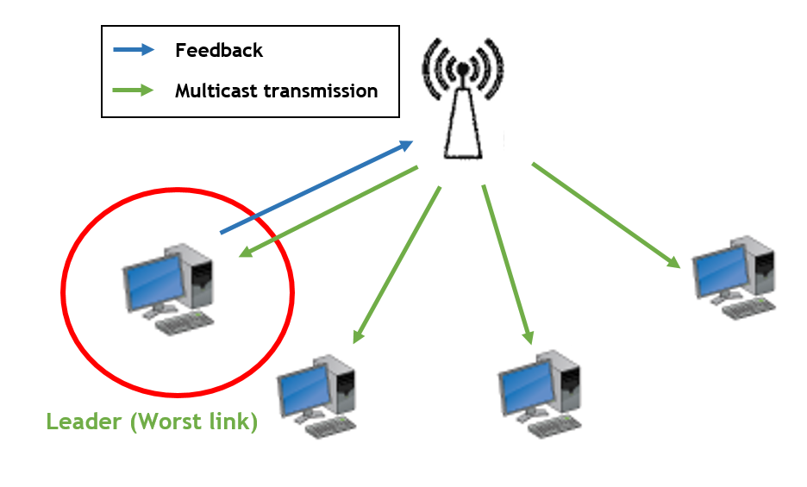
Leader-Based Multicast Protocols
Leader Selection
Usually the node with the worst link quality
Leader is responsible for sending feedback on behalf of the group

Slide 9
Advantages of Leader-Based approach
Control frame overhead is minimal
Reduced number of contention phases
Enables frame aggregation

Slide 10
Problems with Leader-Based approach
Leader Selection can add substantive overhead, a new leader is selected when:
A new node joins the group
A leader node leaves the group
A loss occurs
Leader’s feedback not always representative of the group

Slide 11
BMMM (Batch Mode Multicast MAC Protocol)
Sender uses RTS frames to sequentially instruct each intended receiver to transmit a CTS
To coordinate the ACK transmissions Request for ACK(RAK) is used.
Advantages of BMMM
Decreases multicast request completion time
Prevents ACK and CTS collisions
Reduces the number of contention phases from n to 1

Slide 12
Connectivity-Based Reliable Multicast MAC Protocol for IEEE 802.11 Wireless LANs
Improvisation of BMMM
Reduces RAK transmissions
AP finds a sequence(Q) of n recipients in u sequentially connected i.e each recipient except the first one can hear its previous recipient in the sequence
AP polls the sequence by transmitting a single RAK frame including MAC of all nodes in the sequence
In response all the recipients transmit their ACKs (on which uplink data is piggy-backed) after a SIFS interval
If the AP does not receive an ACK from some node. It sends another RAK to the node and the sequence following it.
The problem of finding the minimum number of nodes is modelled as the traveling salesman problem

Slide 13
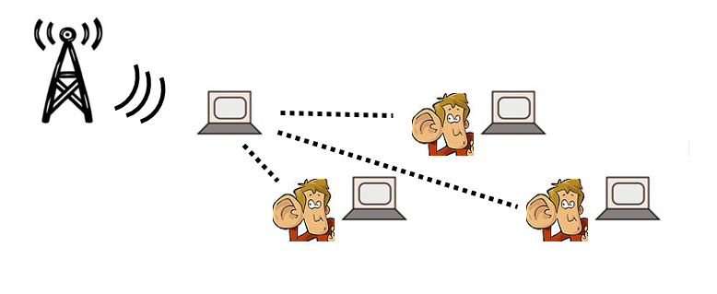
Sequence of 4 nodes , where three nodes can overhear the transmission to the first node

Slide 14
REMP (Reliable and Efficient Multicast Protocol)
Leader-Based Protocol
Node with the lowest RSSI is selected as the leader
Leader sends Block acknowledgements
In case of loss
Non-leaders send negative-ACKs
All the nodes then send block-ACKs with their respective RSSI values
Based on these RSSI values a new leader is selected
Overhead of leader Selection process

Slide 15
DPMM (Double Piggy-back Mode Multicast)
ACK frame is piggy-backed in CTS frame
ACK for the last packet is explicitly sent
Allows multicast frame aggregation by adding a bitmap to the CTS frame
Priority information is piggybacked in multicast data frames to avoid collisions with CTS frames
Cluster-Head(CH) mechanism to improve performance
Selection done at AP to reduce overhead
Control packets only sent by CHs
CH selected in case of more than 3 nodes
Several CHs are selected by AP

Slide 16
Cluster-Head Selection in DPMM
IGMP is used to generate group membership report
“group join” and “group leave” messages are sent by terminals to the AP
Link conditions are estimated by these IGMP messages
Depending on the link-conditions clusters are divided into groups
Nodes with similar link conditions are grouped into one cluster
CHs within clusters are chosen in a Round Robin fashion

Slide 17
DPMM
High overhead due to CTS frames
Higher unicast throughput
REMP
Less overhead as ACK is only sent by leader
Higher Multicast throughput
Less delay as AP retransmits to only three nodes i.e the cluster heads
Slightly higher delay as AP retransmits to all the multicast nodes
More Reliable as response is taken from all the nodes in case of lost packets
Less Fair as only the 3 CHs are responsible for NACK/ACK

Slide 18
Approaching the problem
Tradeoff between reliability and performance
Higher reliability -> Increased feedback -> Increased overhead
Higher Performance -> Decreased overhead -> Decreased reliability
Our Goal: Maximize performance while incurring minimum overhead
Obtain feedback passively
Design an efficient rate control mechanism utilizing gathered feedback

Slide 19
Passively Obtaining Feedback
Feedback always available at higher layers
We Propose specializing for Real Time Protocol
RTP Packets contain sequence number
Each video stream requires control connection
Feedback transmitted over control connection
Snooping on these packets alternative to explicit Acknowledgements

Slide 20
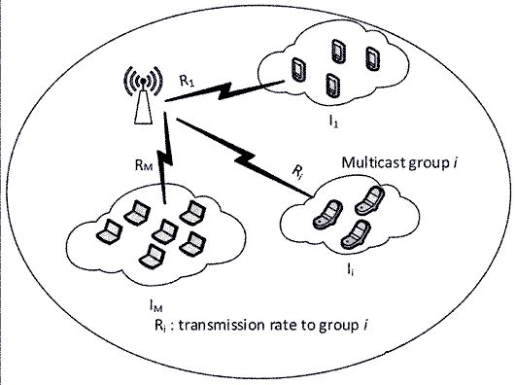
Reducing Performance Overhead
Previously illustrated problem due to receivers with different link quality
Split Receivers into separate groups according to link quality
Use different transmission rates for each group

Slide 21
Thank You

