Slide 1
Design of an Efficient Multicast Protocol for IEEE 802.11 WLANs
Ahmed Mehfooz, Amna Abid, Shanzae Nadeem Khan

Slide 2
Background Motivation
Multicast is an efficient way to broadcast a single packet to multiple receivers – unnecessary packet duplications are avoided.
Multicast has some limitations:
Packets only sent on base rate – low overall throughput
Not reliable due to the absence of a feedback mechanism
Inefficient due to lack of frame aggregation since no feedback available
Tradeoff between reliability and performance
Higher reliability -> Increased feedback -> Increased overhead
Reduced feedback -> Decreased overhead -> Improved performance
Our Goal: Maximize performance while incurring minimum overhead

Slide 3
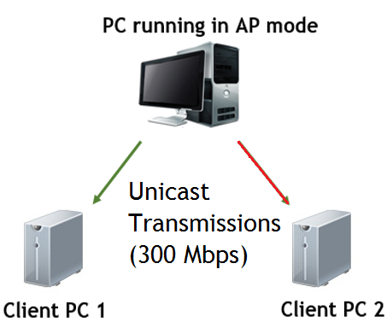
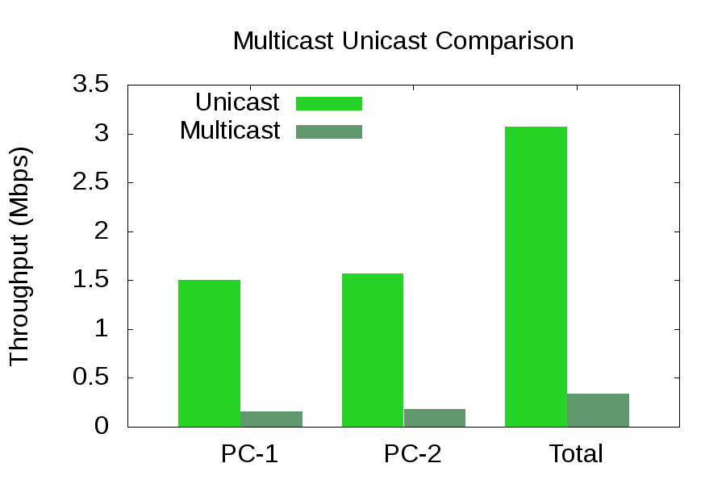
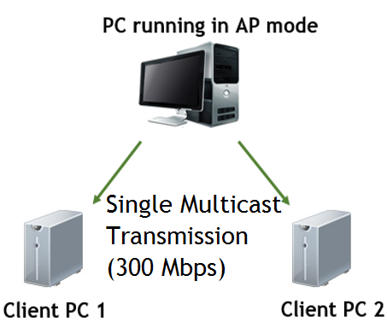
Experiments to evaluate stock 802.11 multicast performance

Slide 4
Milestones: Fall Semester
Month | Deliverable
October | Literature Review Brainstorming on possible solutions
November | Driver Code Evaluation Test-Bed Setup Experiments to Evaluate stock 802.11 Multicast Performance
December | Exploring for the most viable method to passively get feedback from receivers. Will require extensive experiments on the test-bed and driver code analysis. (Proved unsuitable – new approach needed to be adopted.)

Slide 5
Milestones: Spring Semester
Month | Deliverable
February | Developing a viable feedback mechanism to provide rate control for multicast transmissions using hooking.
March | Developing the Rate Adaptation Protocol using probing.
April | Developing the Leader Selection Protocol using the ACK overhearing method.
May | Carrying out experiments to observe the magnitude of improvement in multicast transmissions by implementing the aforementioned protocols in multicast 802.11.

Slide 6
Implementing a Viable Feedback Mechanism
Hooking – method of code injection in an active LINUX kernel
Our Hook:
Sits between the Physical Layer and Wireless Driver
Intercepts packets associated with a single multicast group
Periodic feedback response from the receivers containing PER values

Slide 7
How the kernel module works:
Craft UPD Header
Hook Registered
Add Feedback Information
Does the Dest. IP Address of the packet match the address of our multicast group?
Craft IP Header
Craft Ethernet Header
Handover Packet to Driver for Transmission Using dev_queue_xmit()
Send Feedback

Slide 8
Rate Adaptation Mechanism
A viable feedback available to choose the optimum rate for multicast transmissions
A Rate Adaptation Algorithm implemented in the Kernel Module running on the Server
Utilizes feedback from the client for every rate index
Picks best rate for next transmission based on projected throughput
Occasional backward and forward probing

Slide 9
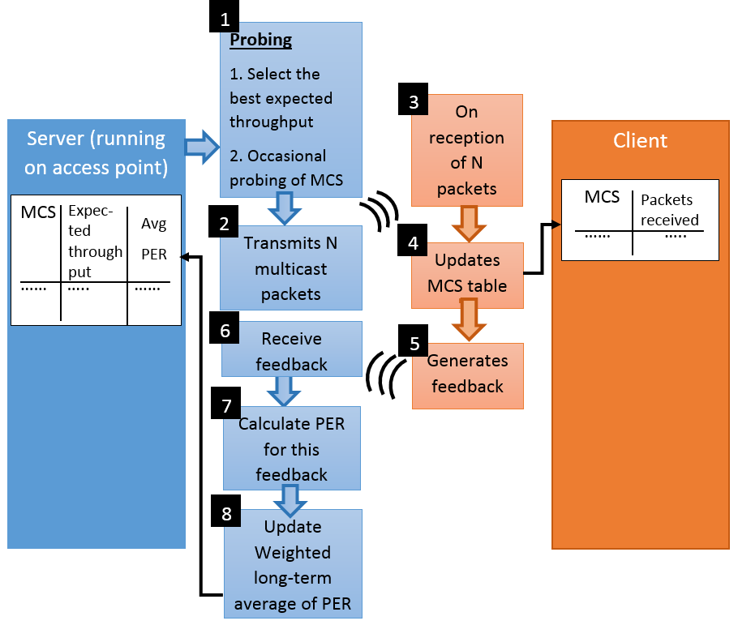
Rate Adaptation Mechanism (The Algorithm)

Slide 10
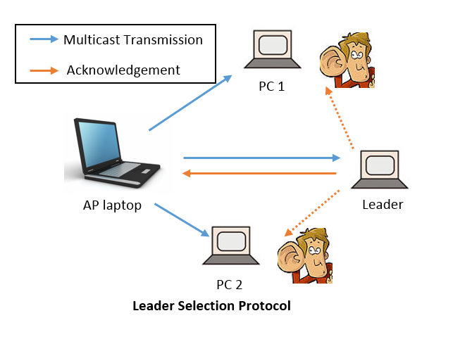
Leader Selection Protocol (The Topology)
Novelties:
Previous leader selection protocols impose a very high overhead
Our approach randomly assigns leader initially
Subsequent leader corrections in a distributed manner

Slide 11
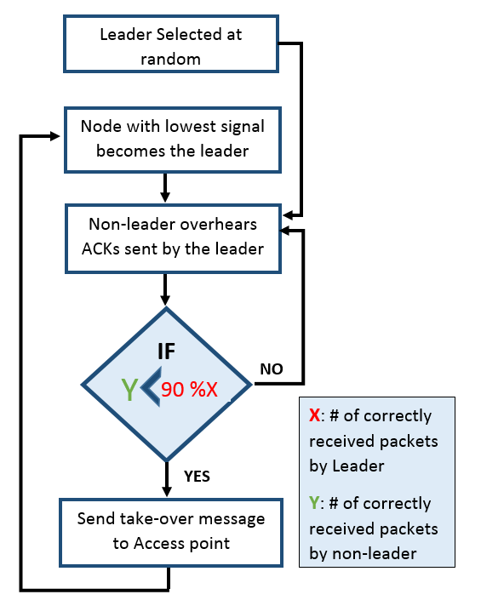
Leader Selection Protocol (The Algorithm)

Slide 12
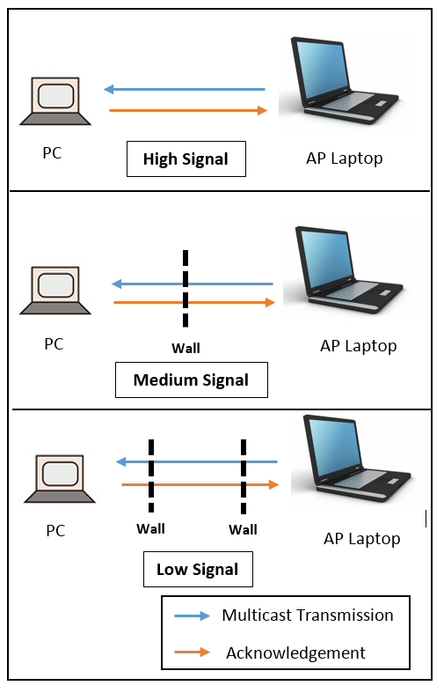
Experimental Evaluation (The Test-Bed Topologies)

Slide 13
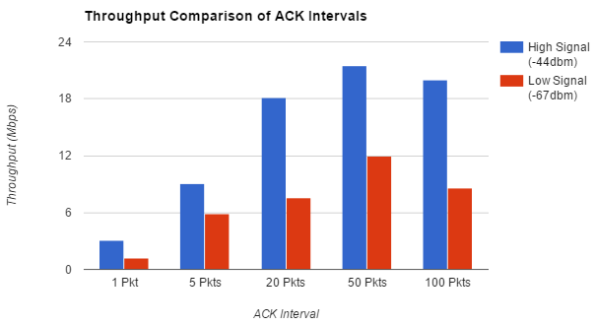
Experimental Evaluation (The Results!)

Slide 14
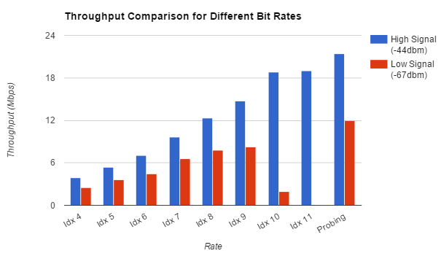
Experimental Evaluation (The Results!)

Slide 15
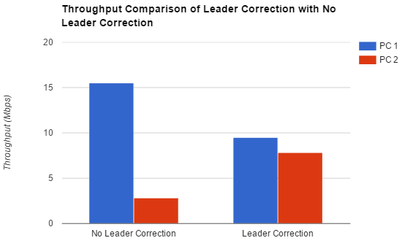
Experimental Evaluation (The Results!)

Slide 16
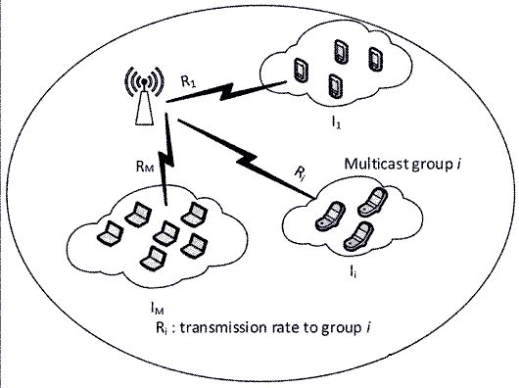
Future Venues
Split Receivers into separate groups according
to link quality
Use different transmission rates for each group
Further optimization of the Leader Selection Protocol
Increased Scalability
Dealing with the Hidden Node Problem – Implicit overhearing of the leader’s ACKs by any distant node
Further optimization of the Kernel Module
Directly utilizing MAC Layer ACKs instead of UDP sockets for sending feedback

Slide 17
Related Works
Multicast
Protocols
Leader-based
SRM(Semi Reliable Multicasting)
ACK-Based
Non-leader-Based
ACK-Based
NACK-Based
NACK-Based
REMP(Reliable and efficient Multicast Protocol)
DPMM(Double Piggyback Mode Multicast)
Adaptive Multicast Services
(e.g.)
(e.g.)
(e.g.)
(e.g.)

Slide 18
Thank You

