Slide 1
Design of an Efficient Multicast Protocol for IEEE 802.11n WLANs
Ahmed Mehfooz, Amna Abid, Shanzae Nadeem Khan

Slide 2
The Future of Online Video Traffic: Predictions by Cisco
“By 2018, IP video will represent 79% percent of all internet traffic, up from 66% in 2013”
“75% of Internet traffic will be accessed via WiFi by 2018”

Slide 3
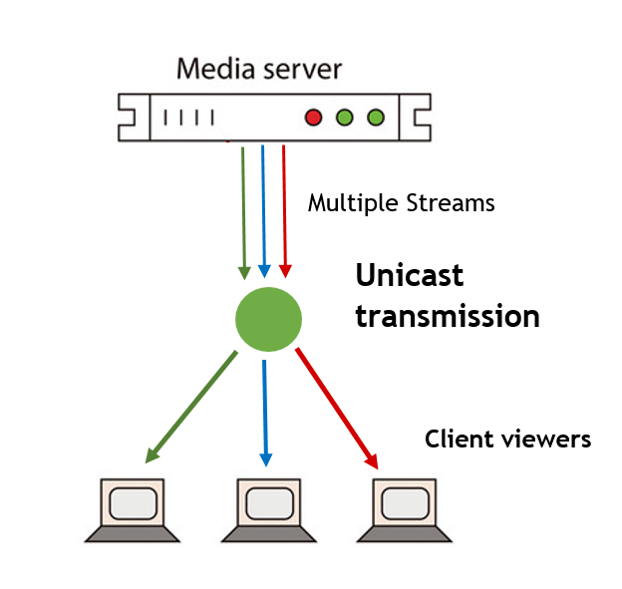
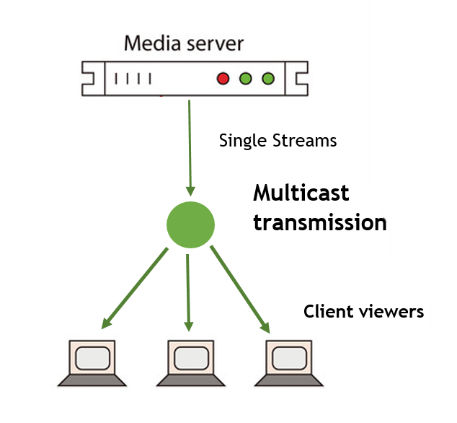
Why Multicast?
Unicast transmissions are inefficient for delivery of duplicate packets
Multicast concurrently broadcasts one packet to multiple destinations – an efficient alternative to reduce unnecessary packet duplications

Slide 4
Multicast in 802.11n
Broadcast multicast packets at the base rate
Transmits a single frame only
Receivers do not provide feedback for packets sent to them

Slide 5
What is Multicast in 802.11n missing out on?
High transmission rates
up to 300 Mbps
Reliability
due to ACKs
Frame Aggregation
multiple frames in a single aggregate frame

Slide 6
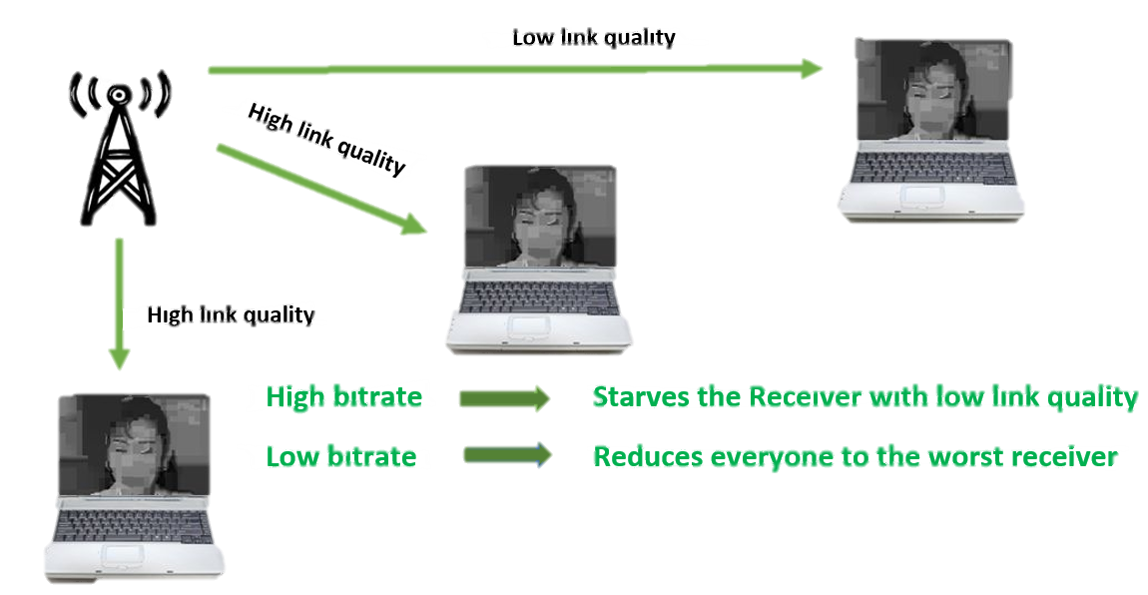
Challenges in Multicast for 802.11n
High Transmission rates make it tough for receivers with poor link quality to correctly receive packets
Feedback provides substantive overhead
may degrade system throughput
frame aggregation becomes difficult

Slide 7
Related Works
Multicast
Protocols
Leader-based
SRM(Semi Reliable Multicasting)
ACK-Based
Non-leader-Based
ACK-Based
NACK-Based
NACK-Based
REMP(Reliable and efficient Multicast Protocol)
DPMM(Double Piggyback Mode Multicast)
Adaptive Multicast Services
(e.g.)
(e.g.)
(e.g.)
(e.g.)

Slide 8
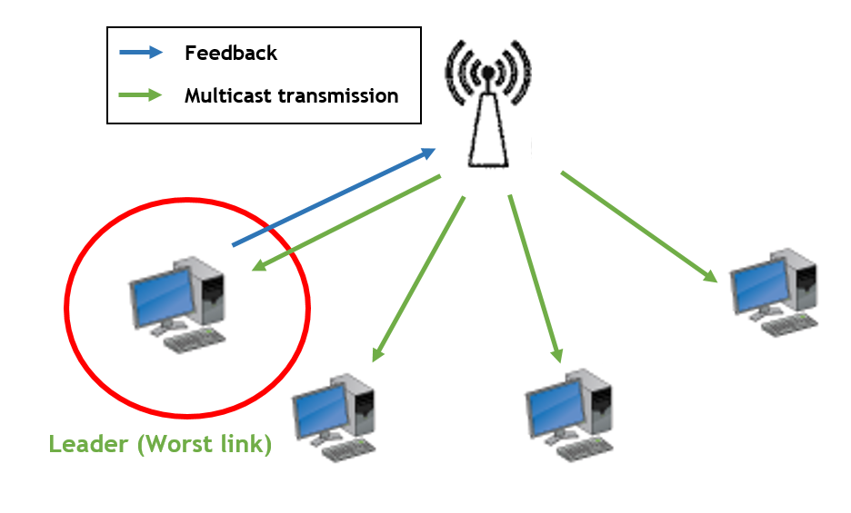
Leader-Based Multicast Protocols
Leader Selection
Usually the node with the worst link quality
Leader is responsible for sending feedback on behalf of the group

Slide 9
Problems with Leader-Based approach
Leader Selection can add substantive overhead, a new leader is selected when:
A new node joins the group
A leader node leaves the group
A loss occurs
Leader’s feedback not always representative of the group

Slide 10
Approaching the problem
Tradeoff between reliability and performance
Higher reliability -> Increased feedback -> Increased overhead
Higher Performance -> Decreased overhead -> Decreased reliability
Our Goal: Maximize performance while incurring minimum overhead
Obtain feedback passively
Design an efficient rate control mechanism utilizing gathered feedback

Slide 11
Passively Obtaining Feedback
Feedback always available at higher layers
TCP Acknowledgements
Application Layer Feedback
Snooping on these packets alternative to explicit Acknowledgements

Slide 12
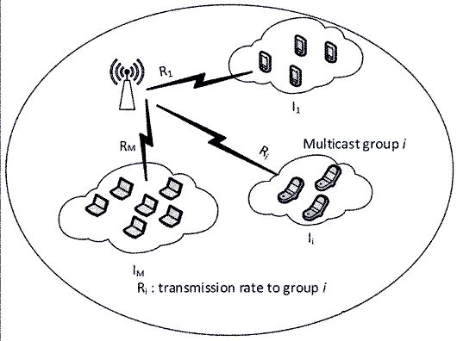
Reducing Performance Overhead
Previously illustrated problem due to receivers with different link quality
Split Receivers into separate groups according to link quality
Use different transmission rates for each group

Slide 13
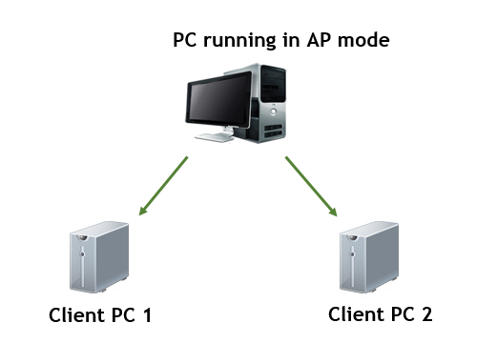
Test-bed Setup
PCs running Ubuntu 12.04 (can be added on demand)
PCs equipped with WiFi running ath9k open-source wireless drivers

Slide 14
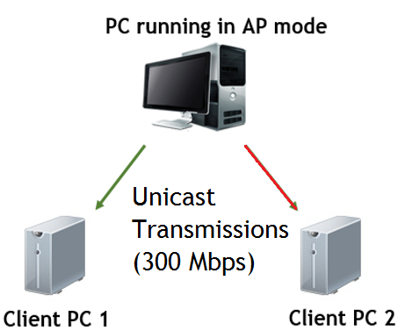
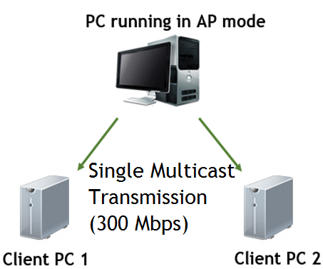
Test-bed Experiment

Slide 15
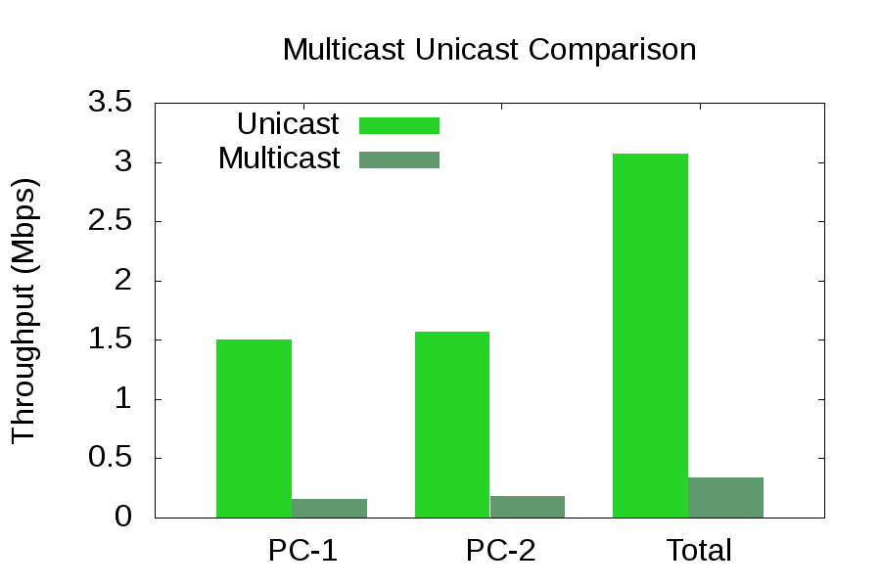
Test-bed Results

Slide 16
Milestones: Fall Semester
Month | Deliverable
October | Literature Review Brainstorming on possible solutions
November | Driver Code Evaluation Test-Bed Setup Experiments to Evaluate stock 802.11n Multicast Performance
December | Exploring for the most viable method to passively get feedback from receivers. Will require extensive experiments on the test-bed and driver code analysis

Slide 17
Milestones: Spring Semester
Month | Deliverable
February | Implementing a viable feedback mechanism to provide rate control for multicast transmissions
March | Explore the viability of electing a leader to collect better feedback and try to enable frame aggregation for multicast transmissions
April | Extensive Evaluation of our implementation under various scenarios that are possible in Wireless networks

Slide 18
Thank You

