Slide 1
Design of an Efficient Multicast Protocol for IEEE 802.11n WLANs

Slide 2
The Future of Online Video Traffic: Predictions by Cisco
“By 2018, IP video will represent 79% percent of all global traffic by 2018, up from 66% in 2013”
“75% of Internet traffic will be accessed via WiFi by 2018”

Slide 3
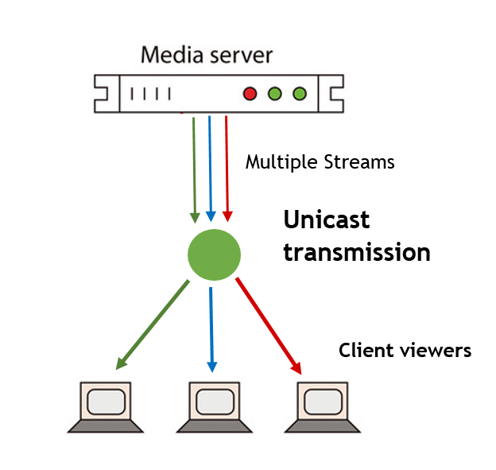
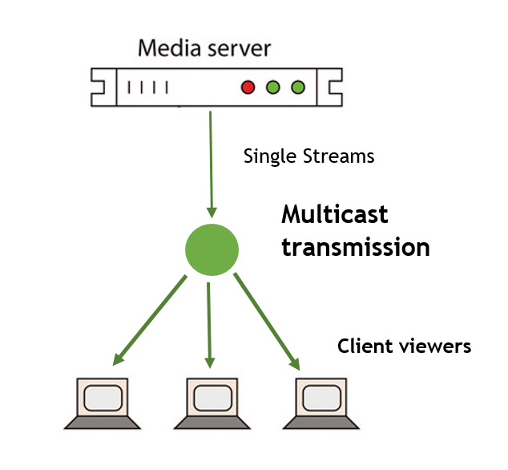
Multicast
Unicast

Slide 4
Why Multicast?
A Video may be served to multiple recipients over Wifi
Unicast transmissions are inefficient for delivery of duplicate packets
Multicast concurrently broadcasts one packet to multiple destinations – an efficient alternative to reduce unnecessary packet duplications

Slide 5
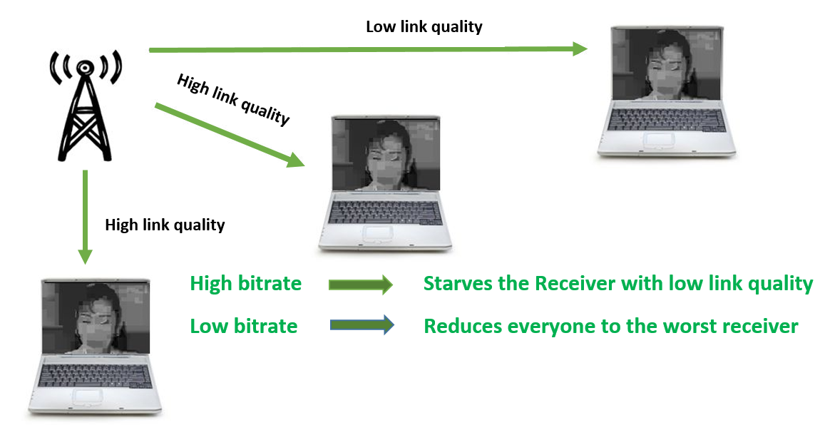
Multicast Challenges in Current Wireless Design

Slide 6
Multicast in 802.11n
Broadcast multicast packets at the base rate. (Base rate is the lowest possible transmission rate)
Transmits single MPDUs (MAC Protocol Data Unit)
Receivers do not Acknowledge received packets.

Slide 7
What is Multicast in 802.11n missing out on?
High transmission rates: 802.11n supports very high bitrates (up to 300 Mbps). Transmission rates for Unicast transmissions are dynamically determined based on channel conditions
Reliability: Unicast transmissions in 802.11n are reliable due to compulsory ACKs.
Frame Aggregation: 802.11n aggregates multiple MPDUs in a single aggregate frame, this makes channel utilization more efficient.

Slide 8
Challenges in Multicast for 802.11n
High Transmission rates make it tough for receivers with poor link quality to correctly receive packets.
Prevalent feedback based protocols do not scale well with Multicast due to the large number of receivers involved.
Frame aggregation requires block-Acknowledgments, it is not scalable to request blockAcks from every receiver in a Multicast Transmission.

Slide 9
Related Works
Multicast
Protocols
Leader-based
e.g. : SRM(Semi Reliable Multicasting)
ACK-Based
Non-leader-Based
ACK-Based
NACK-Based
NACK-Based
e.g. : REMP(Reliable and efficient Multicast Protocol)
e.g. : DPMM(Double Piggyback Mode Multicast)
e.g. : Adaptive Multicast Services

Slide 10
Leader-Based Multicast Protocols
Rate adaptation based on leaders channel conditions
Leader provides feedback
Other nodes remain silent or send NACK in case of loss.

Slide 11
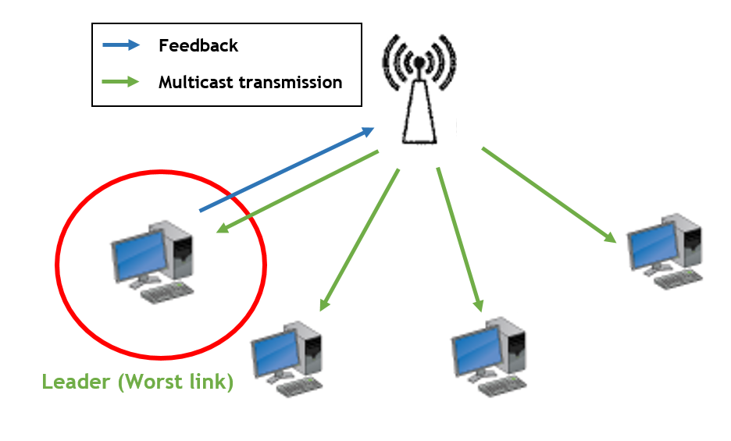

Slide 12
Problems with Leader-Based approach
A new Leader is Selected when
A new node joins the group
A leader node leaves the group
Channel conditions change
A loss occurs
Leader Selection becomes difficult in case of varying Network Conditions and has a constant overhead.

Slide 13
Milestones: Fall Semester
Month | Deliverable
October | Literature Review Brainstorming on possible solutions
November | Driver Code Evaluation Test-Bed Setup Experiments to Evaluate stock 802.11n Multicast Performance
December | Exploring for the most viable method to passively get feedback from receivers. Will require extensive experiments on the test-bed and driver code analysis. Tentative ideas: Snooping on TCP/Application Layer acknowledgements Utilizing rate table entries for receivers from previous Unicast transmissions

Slide 14
Milestones: Spring Semester
Month | Deliverable
February | Implementing a viable feedback mechanism to provide rate control for multicast transmissions
March | Explore the viability of electing a leader to collect better feedback and try to enable frame aggregation for multicast transmissions
April | Extensive Evaluation of our implementation under various scenarios that are possible in Wireless networks

Slide 15
Thank You

