Slide 1
PRESENTATION
PHISHING ATTACKS BY
SYED HAMMAD RAZA
CYBER SECURITY
INTERNSHIP
TASK #2

Slide 2
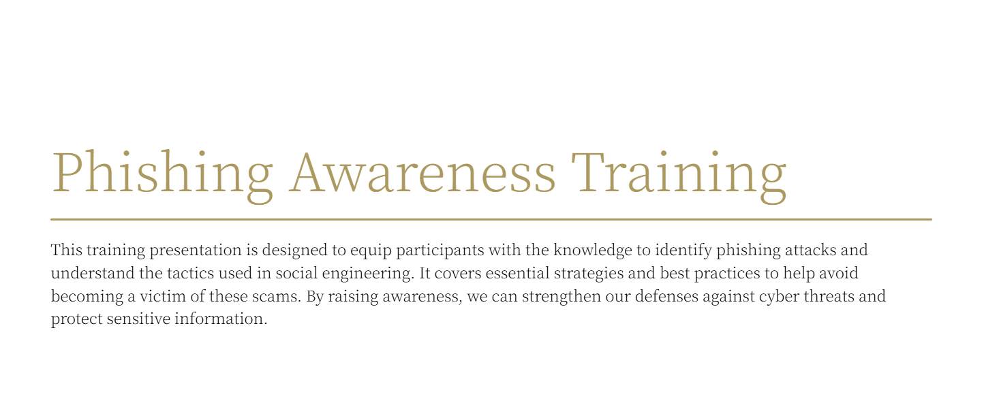

Slide 3
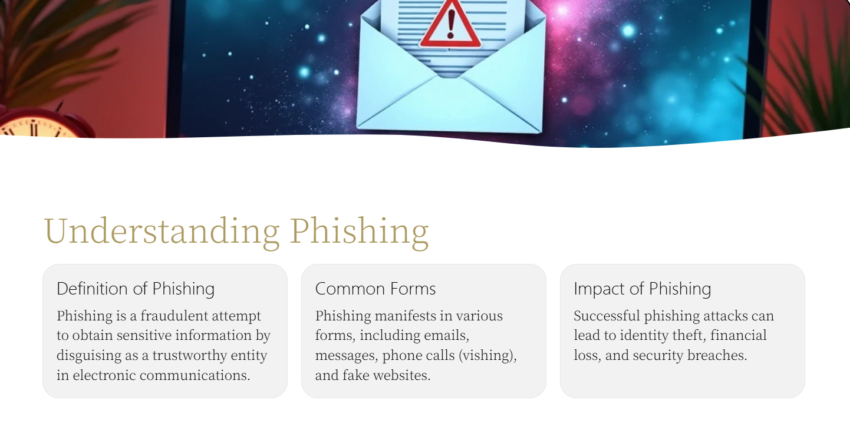

Slide 4
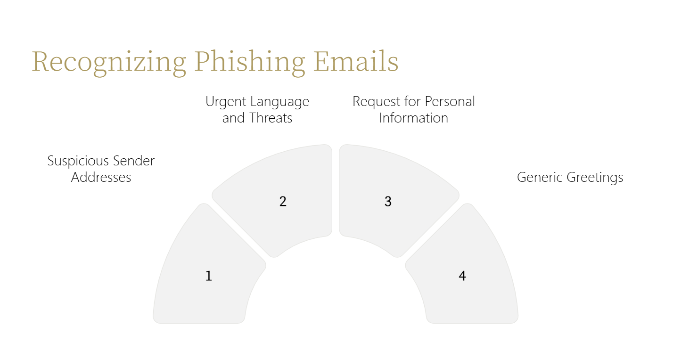

Slide 5


Slide 6
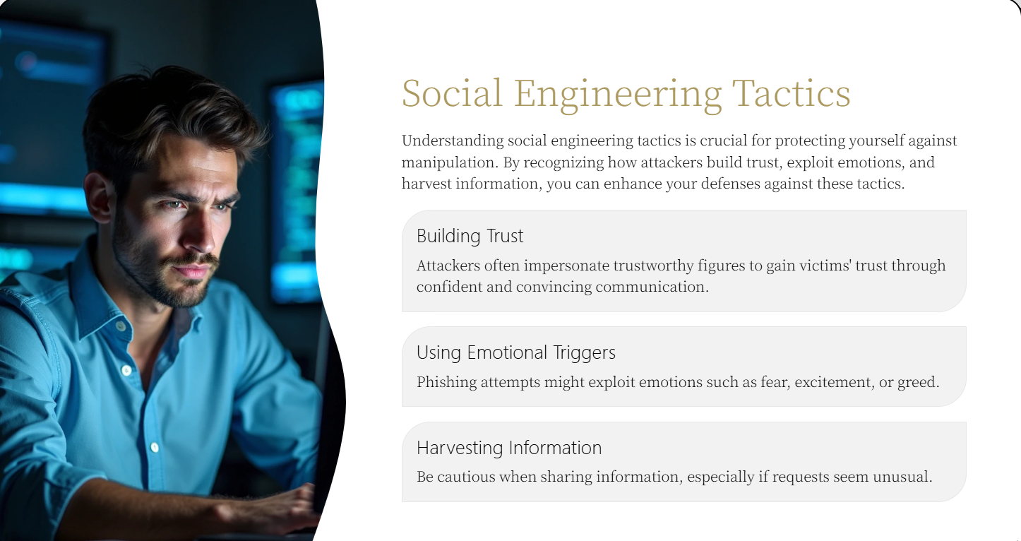

Slide 7
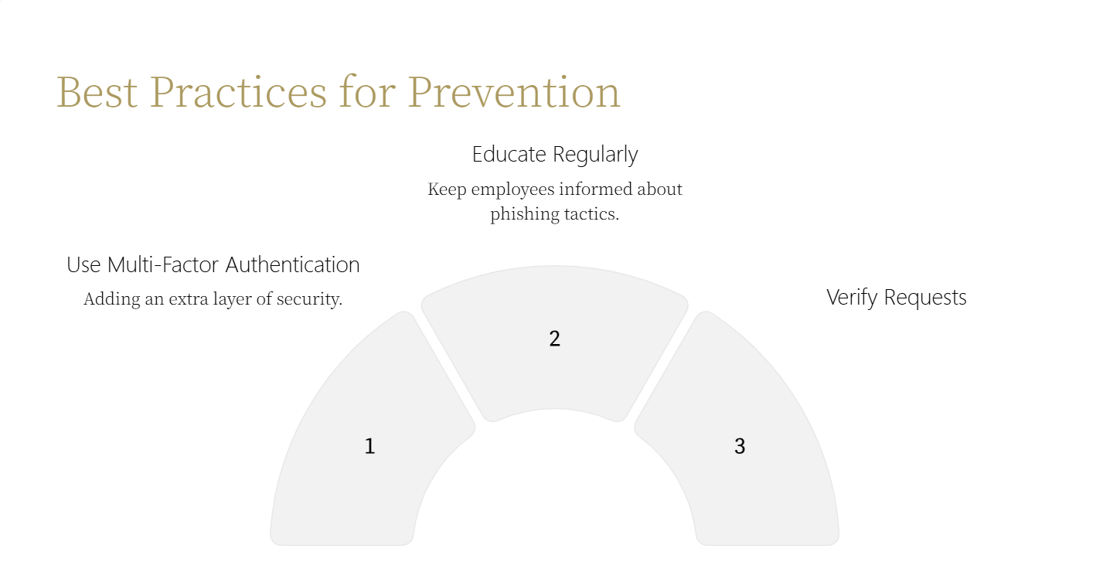

Slide 8
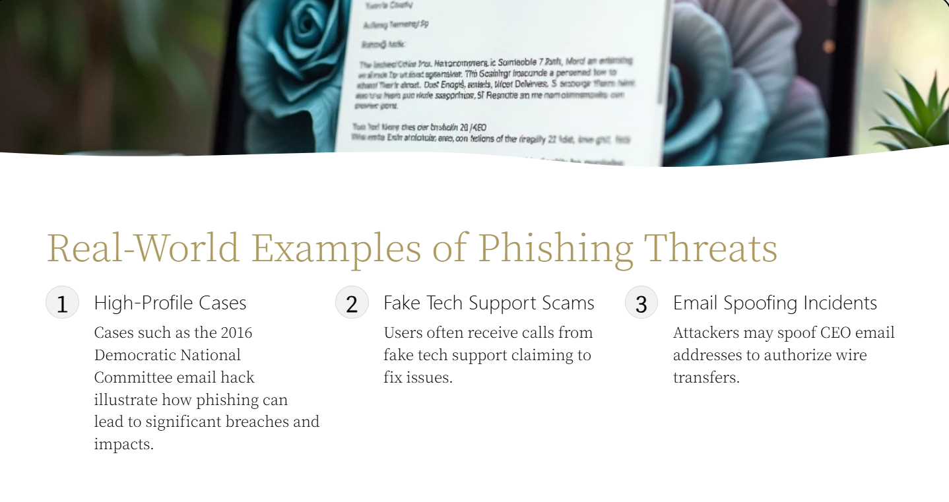

Slide 9
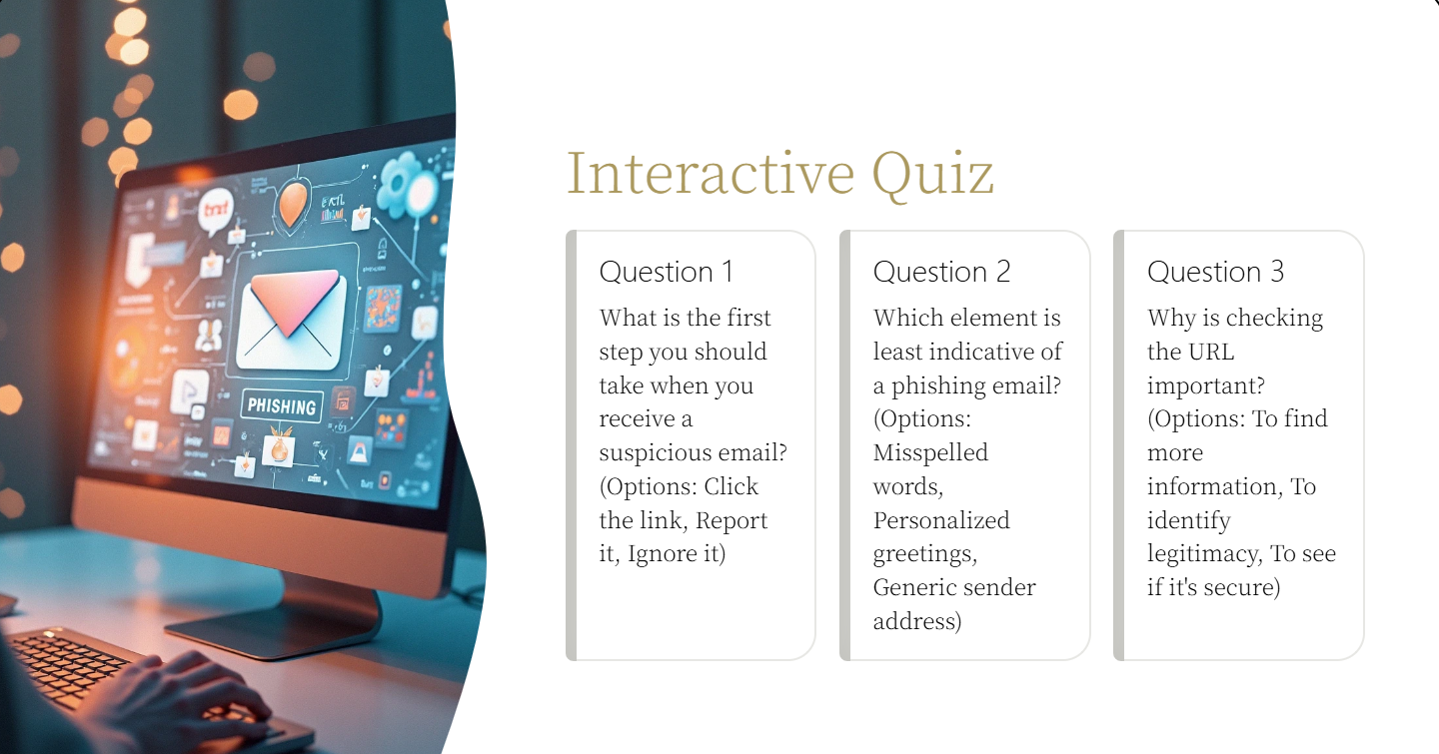

Slide 10
