Slide 1

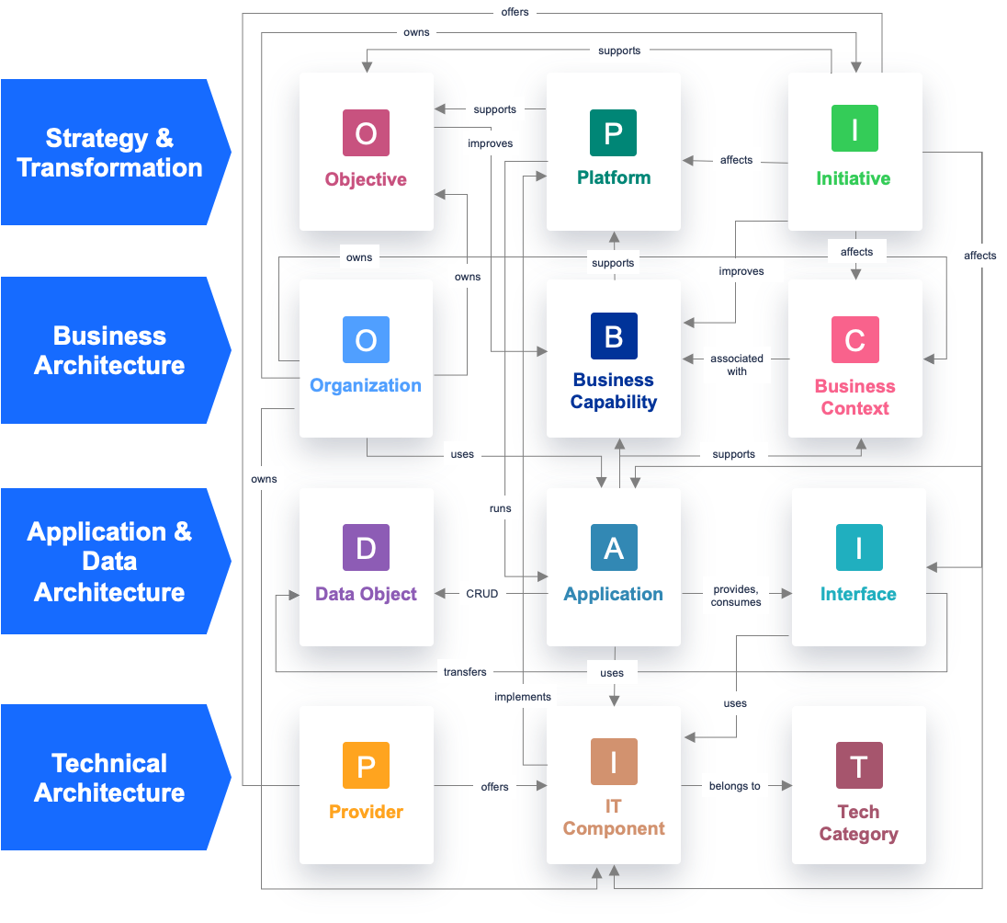



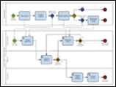

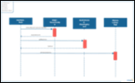


Building Blocks and the ADM
Architecture Content
Architecture Building Blocks & Solution Building Blocks - The Language
- Illustration-
Strategy & Transformation
Business
Architecture Building Block (ABB)
Cross Layers Relationship
Data
Application
Technology
Solution Building Block (SBB)
Solution

