Slide 1
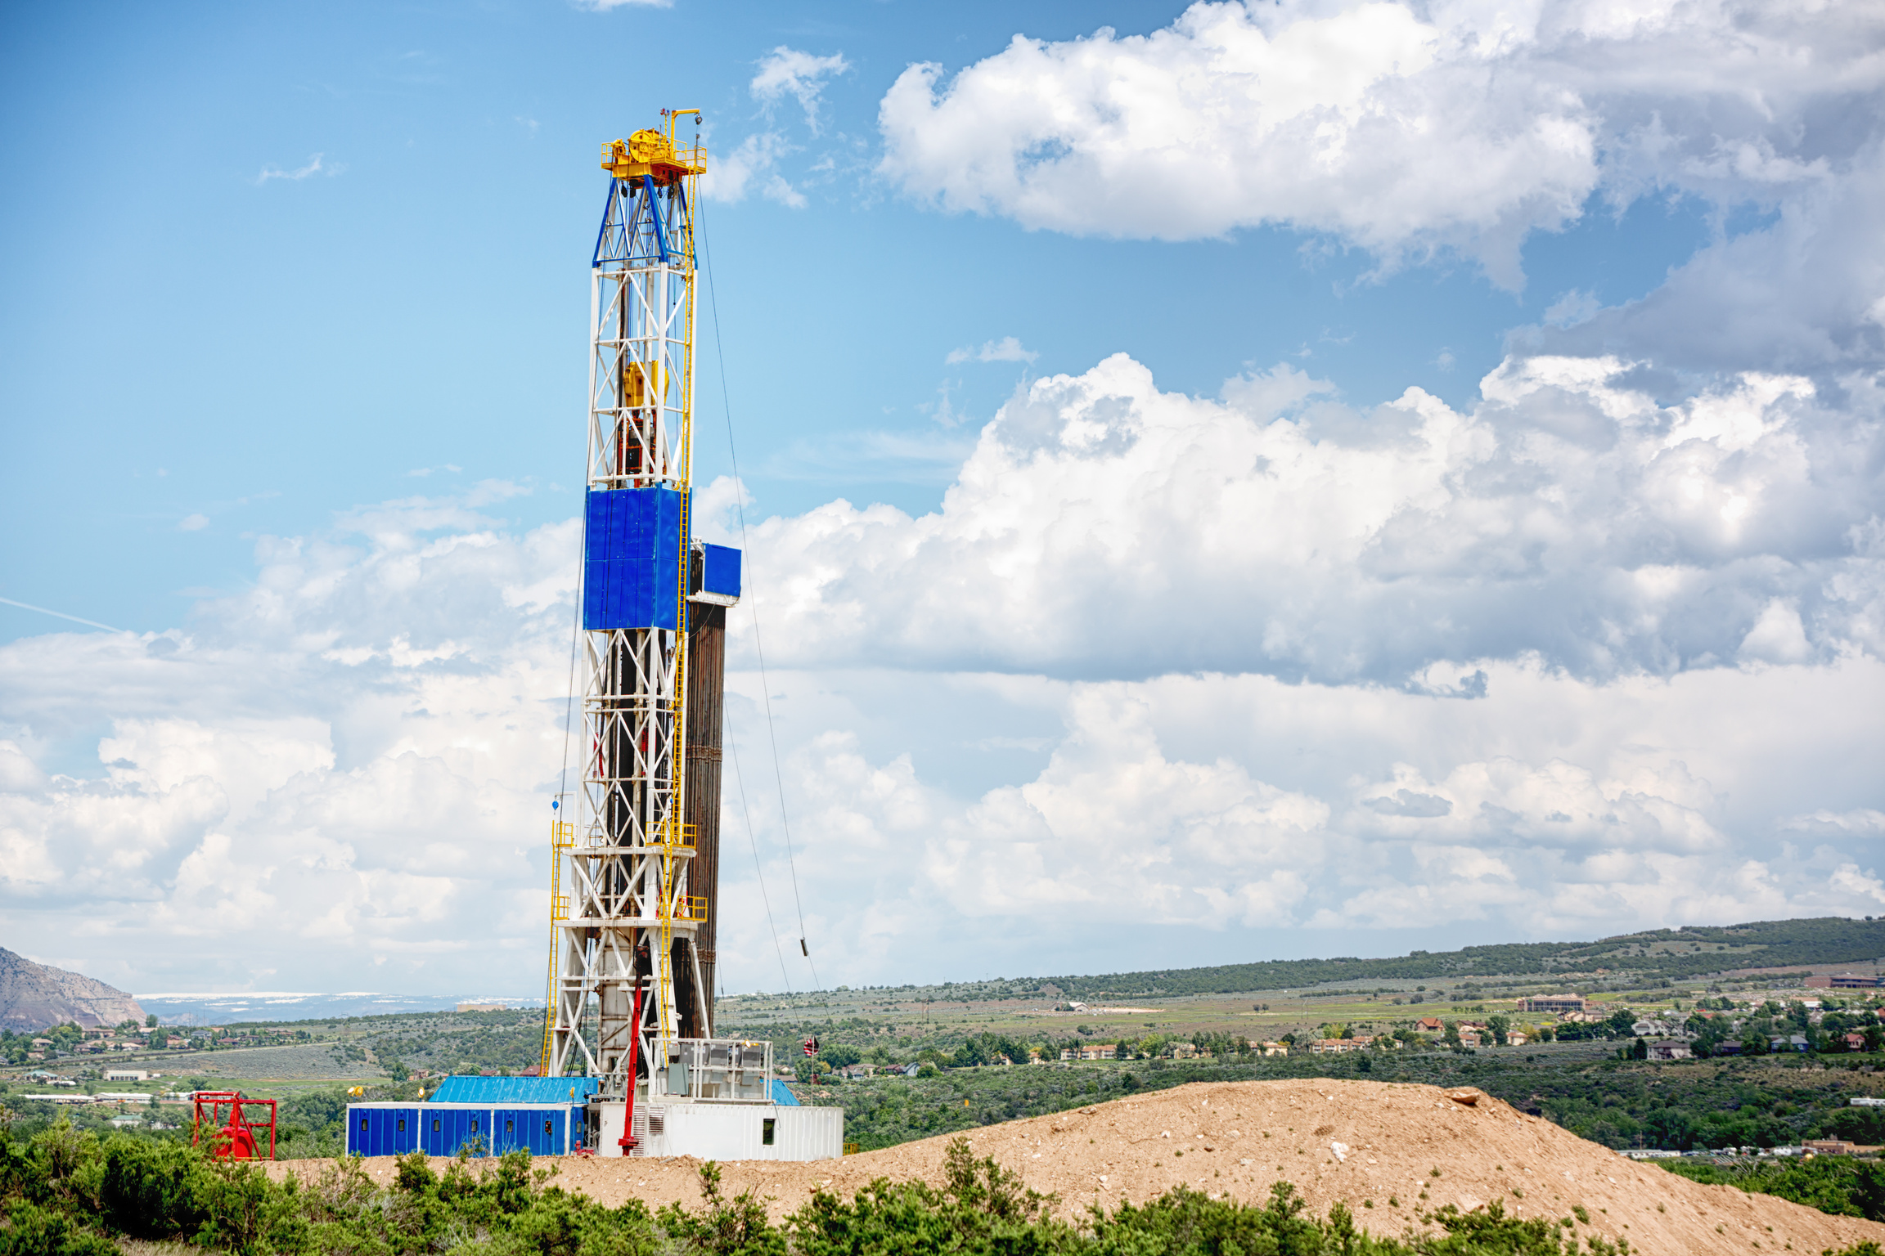
The Economic Way to Drill Geothermal Well in Indonesia
By: Yudi Hartono

Slide 2
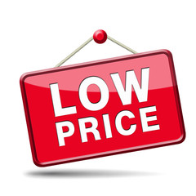



Objectives
Cost Evaluation in Drilling Geothermal Well
Sharing knowledge for cost saving initiative to provide significant well cost reduction.
Manage database all good drilling method and practice to achieve drilling cost effective

Slide 3

Introduction …book history..
Aug 2017
A non IPM Contract for Exploration Drilling in PT. SMGP, IIGCE Aug 2017
23 Dec 2020
Collaboration between JDS and Enerka to conduct online seminar with the title “The Economic Way To Drill Geothermal Well”.
July 2021
JDS and EBTKE agreement to translate this seminar to become a book.
9 Dec 2022
May 2023
Book Revision: Re-structure the book content refer to the drilling campaign flow process.
The book of “Pedoman Efisiensi Biaya Pemboran sumur panas bumi” was launched by EBTKE and ESDM.
2018-2019
ITB International Geothermal Workshop (IIGW), presented in pre-workshop session, topic: Drilling Procurement Strategy

Slide 4
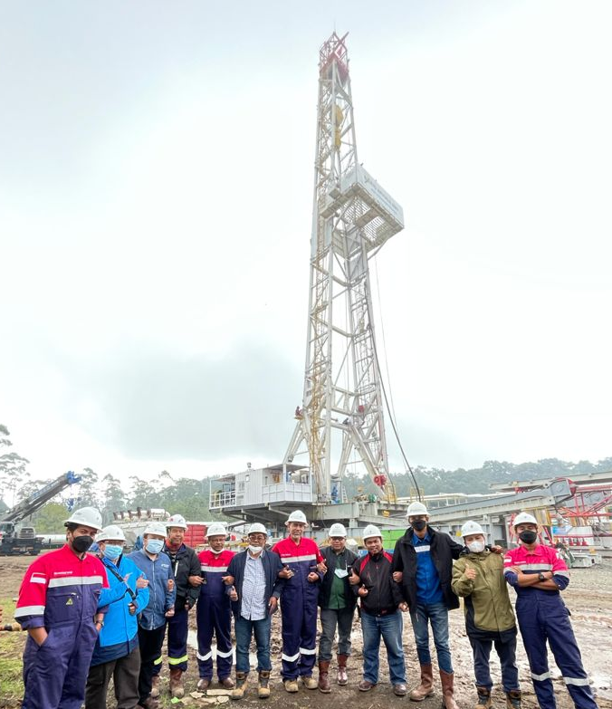
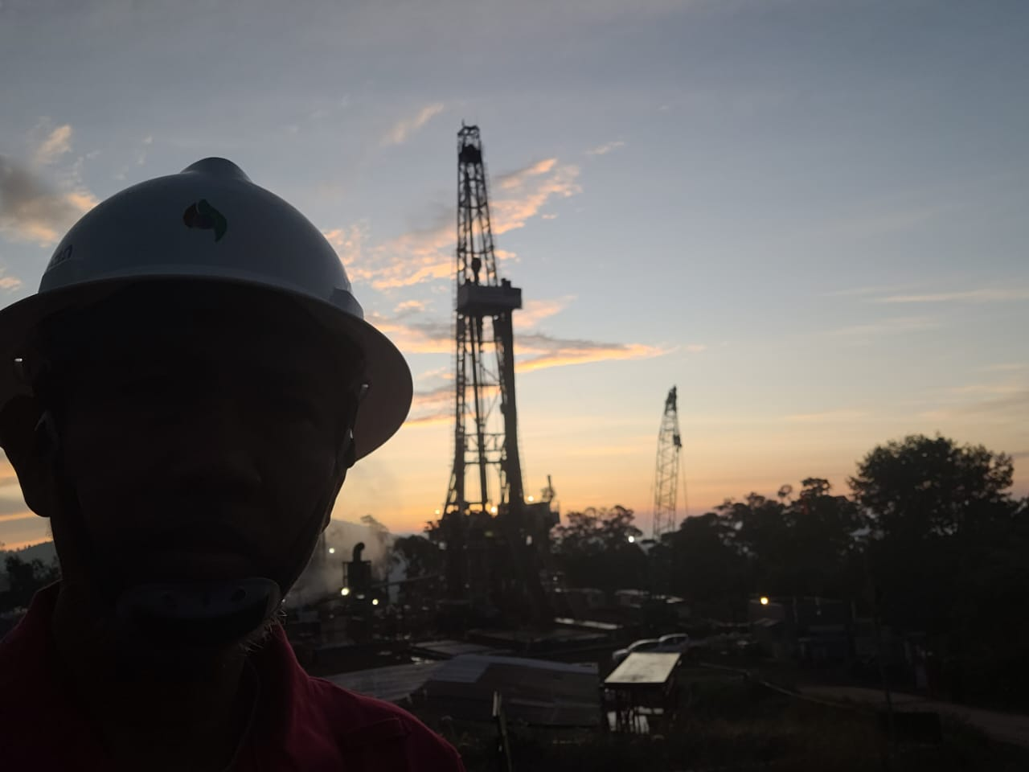
Content …
Pendahuluan
Efisiensi Biaya Pengeboran Sumur Panas Bumi
Persiapan Umum Sebelum Dimulainya Pengeboran
Optimasi Desain Sumur Pengeboran
Effesiensi Operasi Pengeboran
Strategi Pengadaan Barang dan Jasa Pemboran
Kesimpulan dan Penutup

Slide 5
Pendahuluan …
BAB-1
1.1
Kapasitas Terpasang Energi Panas Bumi dan target Pemerintah
1.2
Tipikal Desain Sumur Panas Bumi
1.3
Stastistik Biaya Pengeboran Sumur Panas Bumi di Indonesia

Slide 6
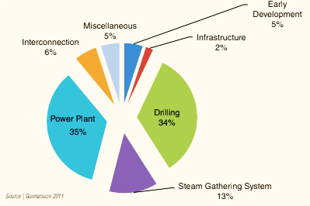

DRILLING IS CRITICAL PART, Why?.
Drilling cost from exploration to development phase: USD 3210 – 3947 per meter
Drilling Cost = 30-35% of Geothermal Project Cost.
Successfully Drilling Campaign may lead Development of the Geothermal Project.
Drilling will exist from beginning geothermal project until life of the field.
Reducing Drilling Cost → Significant improve Economic of Field Development

Slide 7


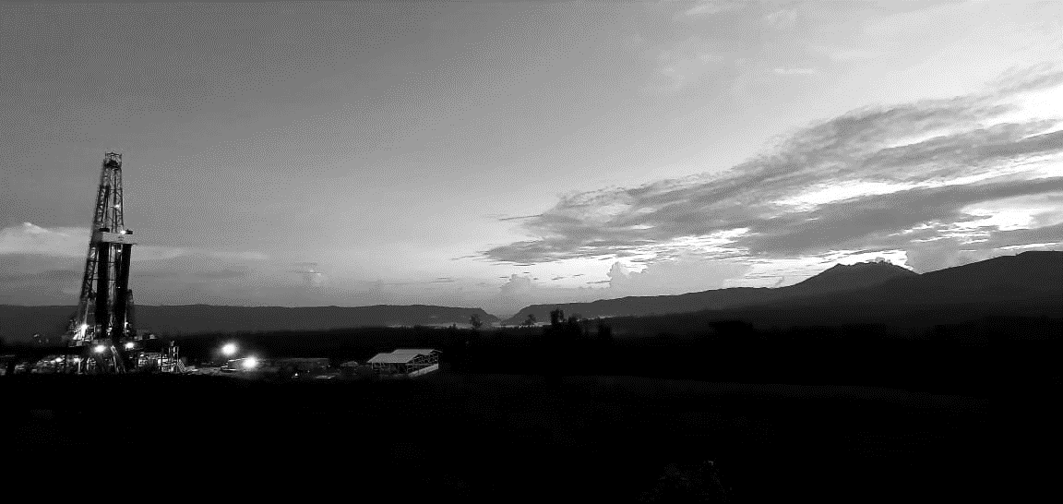
Ministry of Energy and Mineral Resources
Republic of Indonesia
Evaluasi Biaya Pengeboran Panas Bumi 2011 - 2021
DIREKTORAT PANAS BUMI
DITJEN EBTKE, KESDM
Update 11 Oktober 2021
esdm.go.id |
@kesdm
7
Ministry of Energy and Mineral Resources|

Slide 8
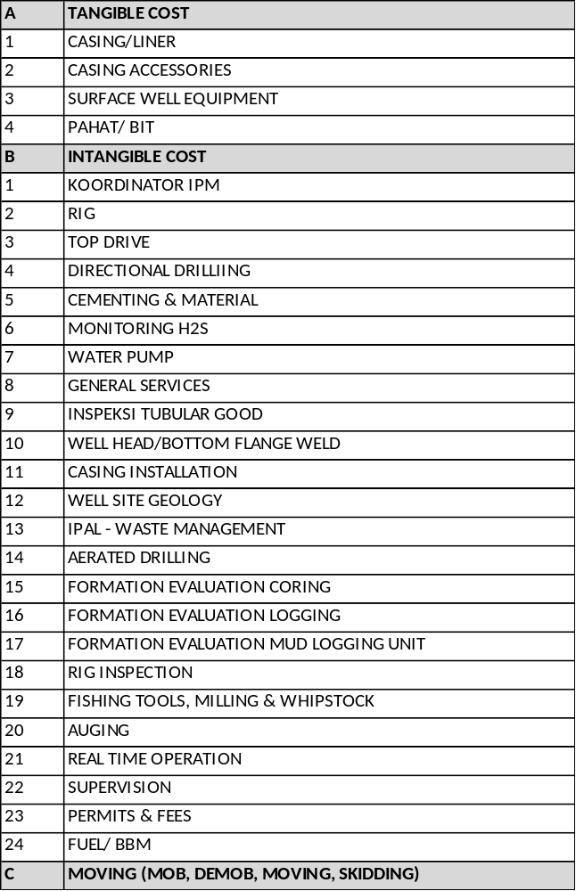
TERMINOLOGI BIAYA SUMUR DAN BIAYA PENGEBORAN
Struktur biaya sumur dan pengeboran di panas bumi
WELL COST
Drilling Cost
Infrastructure, Well pad construction, Explosive, Permit, Post Drilling, Hook up
Supporting cost (overhead)
Well test

Slide 9
STATUS BIAYA PENGEBORAN PANAS BUMI (2018-2021)
Update evaluasi biaya pengeboran panas bumi
2018
120 sumur (2011-Q2 2018)
BIAYA PENGEBORAN
Biaya pengeboran merupakan salah satu performance indikator (KPI) dalam kegiatan pengeboran a.l. drilling unit cost (USD/m), well completion (m/day), well output (MW).
Parameter yang dipertimbangkan berupa biaya pengeboran (dinormalisasi), kedalaman, tipe kontrak, jenis perusahaan, tahapan kegiatan.
Range biaya pengeboran panas bumi di Indonesia sebesar 1,3 juta USD (kedalaman 498 m) hingga 18 juta USD (kedalaman 2900 m).
Rata-rata biaya pengeboran 6,9 juta USD/sumur pada akhir 2021 dengan rincian:
  Sumur eksplorasi : 7,6 juta USD
  Sumur pengembangan : 6,6 juta USD
  Sumur operasi (M/U) : 6,5 juta USD
Data Set
2020
187 sumur (2011--2019)
2021
242 sumur (2011-Q3 2021)

Slide 10
DISTRIBUSI KEDALAMAN SUMUR DENGAN BIAYA (CORRECTED US PPI)
  Kedalaman dan Biaya Pengeboran 2011-2021
  Terdapat 242 sumur yang dilengkapi dengan realisasi biaya
  Perbandingan dilakukan dengan mempertimbangkan koreksi indeks US PPI
High
Average
Expected

Slide 11
STATUS BIAYA PENGEBORAN PANAS BUMI (Update 2021)
Update evaluasi biaya pengeboran panas bumi (unit cost)
BIAYA PENGEBORAN (unit cost USD/meter)
Rata-rata unit cost 3,258 USD/m
  Sumur eksplorasi : 3.853 USD/m
  Sumur pengembangan : 3.243 USD/m
  Sumur operasi (M/U) : 3.072 USD/m
  Biaya pengeboran tahap eksplorasi hingga ke operasi (make/up) menunjukkan trend menurun. Mengindikasikan adanya learning curve.
  Pengeboran eksplorasi relatif paling mahal mengingat Badan Usaha dalam tahap memperoleh informasi awal lapangannya.
  Pada tahap pengembangan dan operasi, pada umumnya biaya pengeboran turun, karena Badan Usaha telah memahami karakeristik lapangan, melakukan efisiensi terhadap biaya services yang tidak diperlukan.
Cost (USD/m) | Freq. | %
1000-3200 | 151 | 62
3201-5500 | 66 | 27

Slide 12
STATUS BIAYA PENGEBORAN PANAS BUMI (2018-2021)
Country comparison
Highlight pengeboran di Indonesia
  Biaya mobilisasi dari yard rig hingga ke lokasi yang remote (jarak, pengadaan alat angkat tambahan).
  Geological setting pegunungan.
  Pada umumnya menggunakan perjanjian kontraktual konvensional (daily rate).

Slide 13
STATUS BIAYA PENGEBORAN PANAS BUMI (2021)
Regional comparison
Perbandingan antar pulau/wilayah
  Tingginya biaya di Jawa diperkirakan karena jumlah sumur di Jawa yang dievaluasi jumlahnya sangat sedikit m (41 sumur) dibandingkan jumlah sumur di Sumatera (182 sumur).
  Sebanyak 52% dari sumur yang dibor selama kurun 2020-2021 di Sumatera dilakukan tanpa menyewa kontraktor rig pengeboran namun dengan rig yang dimiliki oleh Badan Usaha.
  4 sumur panas bumi di Maluku dibor dengan menggunakan skema IPM pada kedalaman maksimum 1900 m.
  10 sumur pengeboran yang dievaluasi di Sulawesi didominasi oleh sumur make-up dengan menggunakan skema semi IPM.
  5 sumur yang dievaluasi di NTT dilaksanakan hingga kedalaman 2100 m, menggunakan skema bundled.

Slide 14
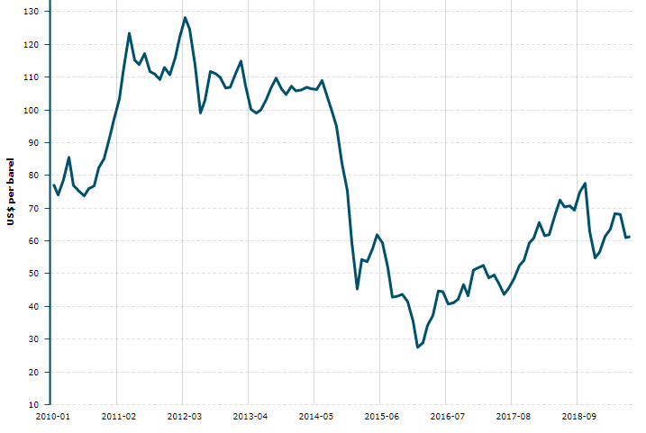
TREND BIAYA PENGEBORAN PANAS BUMI (2011-2021)
Perbandingan fluktuasi biaya pengeboran panas bumi
trend tahunan
(penurunan biaya)
Tren tahunan biaya pengeboran
  Evaluasi unit cost menunjukkan trend :
Komponen biaya rig pengeboran mengalami penurunan akibat trend penurunan komoditas harga minyak dan berkurangnya frekuensi proyek pengeboran (migas & geothermal). Trend harga minyak turun dari 90-110 USD/bbl (2011-2012) menjadi 50-70 USD/bbl (2017-2019).
Selain itu, seiring semakin banyaknya tenaga kerja di bidang panas bumi, membuat developer dapat merekrut tenaga kerja pada perusahaan masing-masing, dan beralih dari skema kontrak pengeboran Full IPM menjadi Semi-IPM, bundle dan discrete yang relatif lebih murah serta penggunaan rig sendiri.
Dengan semakin banyaknya tenaga kerja dan rig pengeboran di bidang panas bumi, proyek pengeboran panas bumi akan semakin terdorong untuk lebih cost-effective.
Kementerian ESDM mendorong biaya pengeboran panas bumi semakin murah (<2000 USD/m)
Trend Harga Minyak Indonesia
Sumber:
Lokadata.com

Slide 15
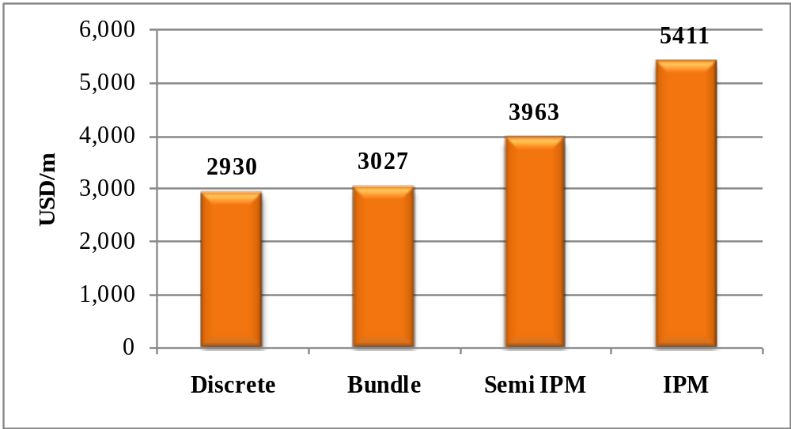
PERBANDINGAN KONTRAK PENGEBORAN PANAS BUMI (STUDI 2018)
Skema komersial/kontraktual pelaksanaan pengeboran panas bumi
  Evaluasi skema kontraktual
  Pengeboran tahun 2012-2016 mayoritas menggunakan skema semi IPM dan full IPM pada kedalaman rata-rata 2180 m.
  Pengeboran tahun 2017-2019 mayoritas menggunakan skema discrete dan bundled pada kedalaman rata-rata 2290 m.
  Kontrak discrete dan bundled relatif lebih murah pada kisaran kedalaman yang hampir sama dibandingkan kontrak Semi IPM dan IPM.
Perbandingan skema kontrak
(2018)
Tren tahunan biaya pengeboran
  Baturaden (2018), Sarulla (2014-2016) dan Jaboi dibor hingga kedalaman rata-rata 1700-1800 m dengan menggunakan skema kontrak full IPM.
  Rantau Dedap, Sokoria, Lahendong, Muaralaboh, dan Sorik Marapi dibor hingga kedalaman rata-rata 2100 – 2300 m mayoritas dengan menggunakan discrete dan bundled kontrak. Sorik Marapi tahun 2021 dibor dengan menggunakan rig sendiri, sehingga menurunkan biaya pengeboran.
  Faktor-faktor operasi seperti gangguan pelaksanaan pengeboran yang spesifik dan berbeda pada masing-masing lokasi (formasi batuan yang dijumpai, loss circulation, shallow gas, jepitan, dll).

Slide 16
PERBANDINGAN BIAYA PENGEBORAN PANAS BUMI ANTAR LAPANGAN DI INDONESIA
Perbandingan unit cost, jumlah sumur dan kontraktual
Jumlah Sumur | Tahun | Keterangan
3 | 2018 | IPM, Eksplorasi, Jawa
33 | 2014-2017 | IPM, Pengembangan, Sumatera
2 | 2017-2018 | IPM, Eksplorasi, P. Sabang
22 | 2015-2018 | Semi-IPM, Pengembangan, Sumatera
22 | 2014-2016 | Semi-IPM, Make-up, Sumatera
5 | 2015 | Semi-IPM, Make-up, Jawa
10 | 2018 | Semi IPM, Make-up, Jawa
13 | 2014-2018 | Semi-IPM, Pengembangan, Sumatera
16 | 2011-2021 | Discrete, Make-up, Jawa
4 | 2020-2021 | Full-IPM & Bundling, Eksplorasi, Jawa
3 | 2014 & 2020 | Semi-IPM & Discrete, Pengembangan, Jawa
4 | 2017-2018 | IPM, Eksplorasi (appraisal), Maluku
13 | 2017-2018 | Discrete, Pengembangan, Jawa
10 | 2015-2016 | Semi-IPM, Make-up, Sulawesi
5 | 2017-2018 | Bundled, Pengembangan, NTT
26 | 2018-2021 | Discrete, Pengembangan, Sumatera
44 | 2016-2019, 2020-2021 | Bundled, Semi IPM& IPM, Pengembangan, Sumatera. 2021 dengan rig sendiri
Wilayah | Rata-rata Biaya per Meter (USD/meter)
 | (2,888 USD/m; 10 develop; 2018)
 | (2,916 USD/m; 5 Make-up; 2018)
 | (4,289 USD/m; 6 Smr Eksplorasi; 2013)
 | (3,262 USD/m; 6 Smr Eksplorasi; 2014-2015)
 | (3,029 USD/m; 10 Smr Eksplorasi; 2016-2017
Learning Process
Penyesuaian kontrak (semi IPM → direct)
IPM (<2016) to direct (2019-2021)
Learning Process
Learning Process

Slide 17
Best Geothermal Drilling Performance by 2024
Well Name Operator | Year Drilled | Rig HP | TD, m-MD | Meter / Day | USD / Meter | Performance Category
SMT-H2 Batu Raden | 2018 |  | 3,477 |  | 2,971 | The deepest well
HLS E3 Hululais | 2017 |  | 3280 |  | 3,564 | The deepest well
Star Energy |  |  |  |  |  | Fasters Meter / day
Central Java | 2022 | 1500 | 3,009 | 93.48 | 1,146 | Fasters Meter / day and Cheapest USD / Meter
South Sumatra |  | 1000 | 2,200 | 93.66 | 1,176 | Fasters Meter / day
South Sumatra |  | 1700 | 2,715 | 93.41 | 1,148 | Cheapest USD / Meter

Slide 18

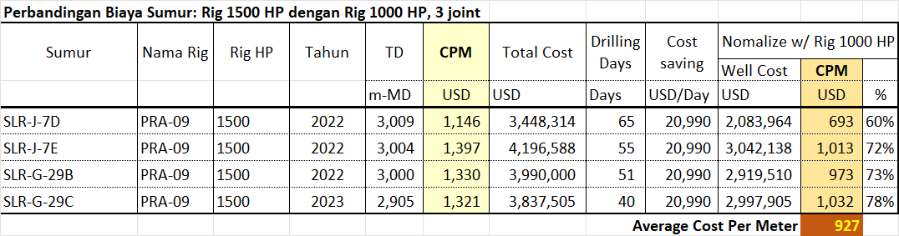
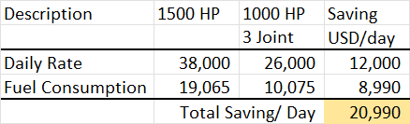
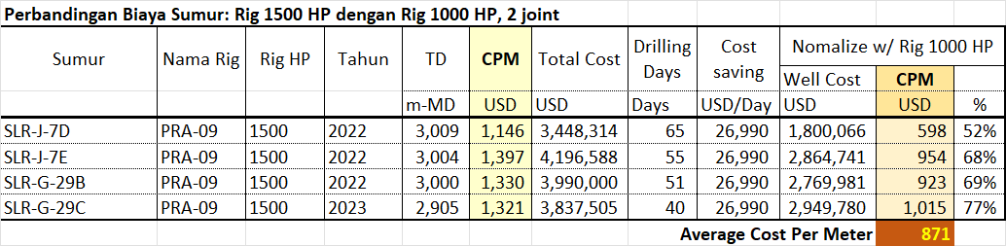
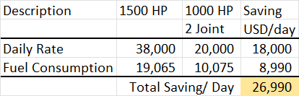
How to achieve drilling cost below USD 1000 per meter

Slide 19
Efisiensi Biaya Pengeboran Sumur Panas Bumi
BAB-2
2.1
Komponen Biaya Pengeboran Sumur Panas bumi
2.2
Proses Penghematan Biaya Pemboran. Kapan Dimulainya?

Slide 20

Drilling Geothermal Well < USD 3 Million
Cut Cost
$
Drilling Resources
Drilling Cost Saving Initiative
Drilling Optimization

Slide 21
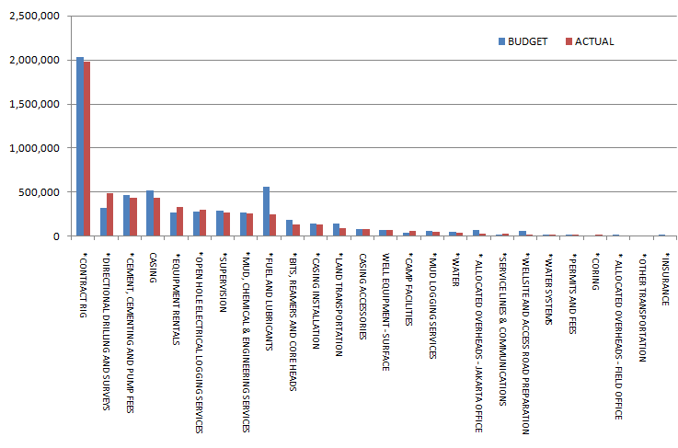
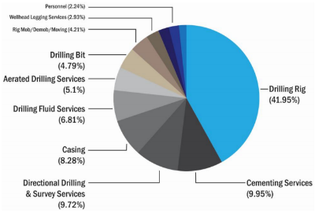
MAJOR WELL COST COMPONENT
$
More attention to the major well cost component

Slide 22
MAJOR WELL COST COMPONENT
Mud and Cementing
Drilling Bit
Fuel Consumption
Stuck Pipe
Heavy Equipment
Drilling Rig
Casing & Installation
Directional Drilling
Aerated Drilling

Slide 23

Drilling Cost Reduction Method
Low Drilling Cost
Well Design Study
Most Efficient Drilling Operation
Rig Sizing
Drilling Procurement Strategy
To get Competitive Price
To get qualified and reputable contractors: HSE, Technical and Finantial
To get high standard performance to achieve the project objective: Deliver project within timeline and cost.
To comply with internal process and local regulation.

Slide 24

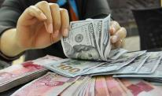
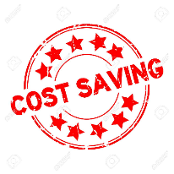
When We could cut WELL COST
Well Design & Planning
Drilling Operation
Well Cost
Procurement Process
Surface location Well TD Casing Depth Wellhead & BOP Drilling Program Drilling Risk assessment BHA failure study Bit selection study Contingency Plan HSE bridging document ERP Drilling Cost Guide DDR format Pre Spud meeting | Drilling Service and Procurement List Market survey Remuneration Table Vendor List SOW Tender priority rank General Services Identify problem on procurement process Local Hire Local Content Regulation Master List Facility | Project schedule Instruction to deliver Personnel mobilization Pre-install conductor Pre-weld wellhead Rig Mobilization Rig flat time ROP enhancement Drilling Parameters optimization Simultaneous Operation Do offline job

Slide 25


Drilling Cost Saving Initiative
Pre Drilling
Drilling Execution
Post Drilling
Optimize well TD refer to Feed Zone Procurement strategy for Drilling Material and Services Proper drilling rig selection Proper Casing Specification: Connection, sources Cement Optimization BHA Optimization for Hard Drilling New Technology Drilling Bit Wellhead connection type Well Pad location and design Optimum Water Supply design Stuck pipe recovery technic Mob/Demob strategy Purchase Rig Option
Rig inspection → reduce NPT Do offline job Faster Pipe handling Stuck pipe prevention Optimize on hire and off hire date Efficient on Drilling material usage. Tight HSE policy Prevent from damaging environment
Capture lesson learn Tight invoice checking Minimize warehouse space after drilling

Slide 26
Main Topic of Drilling Cost Saving
Drilling Organization and Personnel
Drilling Procurement Method
Rig Sizing
Conductor, Casing and Cementing Design
Wellhead – Master Valve and Cellar Design
Drilling BHA Design
Best Drilling Bit Performance

Slide 27
Persiapan Umum Sebelum Dimulainya Pengeboran
BAB-3
3.1
Membentuk Tim Pengeboran
3.2
Pemilihan dan Spesikasi Drilling Rig
3.3
Persiapan Lokasi Pengeboran
3.4
Persiapan Suplai Air Untuk Pengeboran

Slide 28
Persiapan Umum Sebelum Dimulainya Pengeboran
BAB-3
3.1
Membentuk Tim Pengeboran
Kejujuran….
Ideal Geothermal Drilling Organization Chart
Metoda Hiring Drilling Personnel
Kwalifikasi Drilling Team

Slide 29



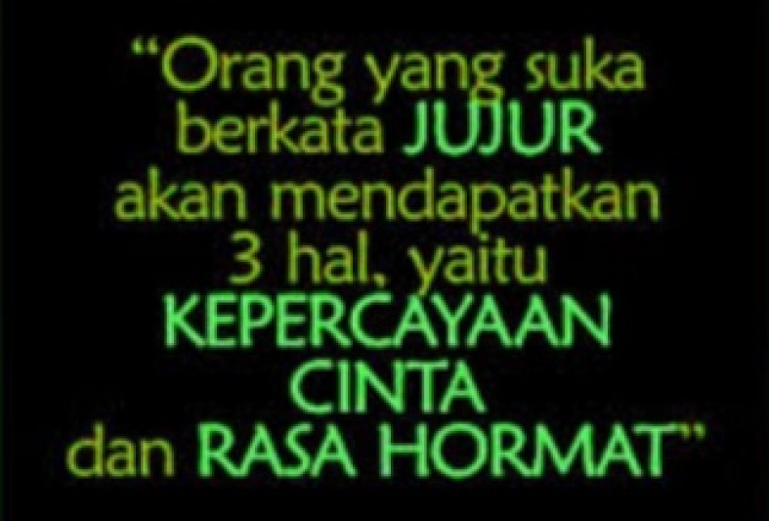


Kejujuran …
Kejujuran adalah Kunci Kesuksesan

Slide 30

Kejujuran dan Professional …!!!
High Cost
Unqualified Contractor, Project delay
Conflict of Interest
Tidak Jujur
Dalam memilih team drilling
Dalam mendesign sumur
Dalam menyusun AFE / Budget
Menentukan strategi drilling procurement
Malaksakan proses tender
Eksekusi Operasi Pemboran
Dalam review dan checking invoices
Dalam post drilling review
Dan lain-lain

Slide 31
Hiring Key Office Drilling Personnel
Drilling
Manager
Drilling Manager
+
Drilling Engineering
All Drilling Office Personnel: Engineering, Operation, Support and HSE
Level-1: Proyek pemboran jangka pendek. Misalnya tahap explorasi
Level-2: Proyek pemboran jangka menengah. Misalnya tahap exploitasi untuk marginal field
Level-3: Proyek pemboran jangka PANJANG. Misalnya tahap exploitasi dengan skala besar

Slide 32
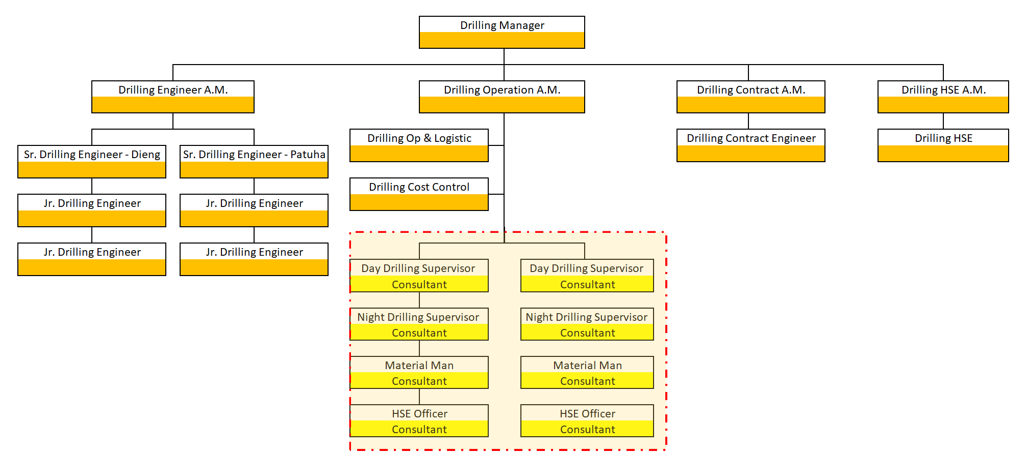
Ideal Geothermal Drilling Organization Chart
Depend on the number of rig operation

Slide 33
Drilling Personnel and Status
Drilling
Office
Permanent Employee
Consultant
Wellsite
By HRD
Labor Supply

Slide 34
Drilling Personnel Hiring Method
Drilling
Office Personnel
Consultant
Permanent
Labor Supply
Direct Contract
Direct Contract

Slide 35
Geothermal Drilling Personnel Cost → Recruitment and Hiring Method
Main Contractor Profit
Labor Supply Profit
Tax, Insurance, BPJS
Take Home Pay
5-15%
5-15%
Bidding IPM or PMC
35-40%
Bidding Labor Supply
Direct Contract Method

Slide 36
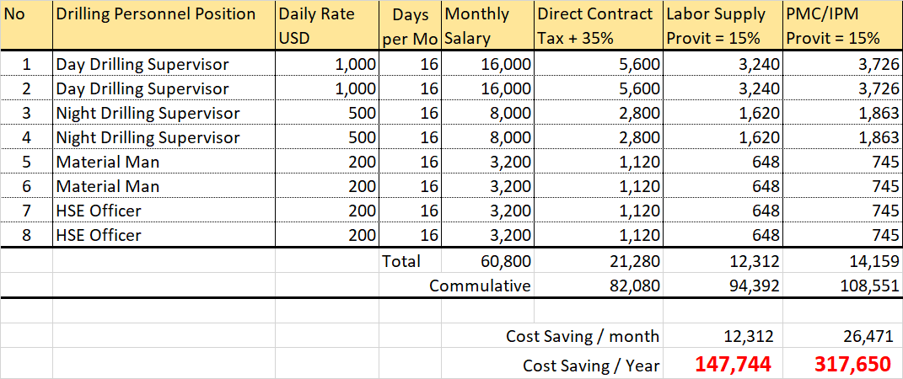
Cost Comparison vs Hiring Process Method

Slide 37
Drilling Team Qualification
At least 10 years experience and executed a lot of drilling wells (engineering, operation, support and HSE) at various places.
Have done various drilling optimization studies and cost efficiencies.
Experiences in handling various drilling procurement process, have wide networking and strong negotiation skill.
Have good relationship with other operator, service company and all level of government authorities.
Never involved in any conflict of interest and corruption.

Slide 38
Persiapan Umum Sebelum Dimulainya Pengeboran
BAB-3
3.2
Pemilihan dan Spesifikasi Drilling Rig
Rig Horsepower
Rig Equipment
Heavy Equipment
Rig moving: Skid and Walking
Rig Fuel Consumption
Own Rig

Slide 39
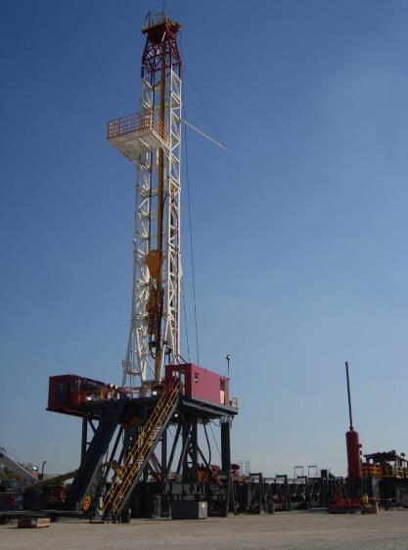
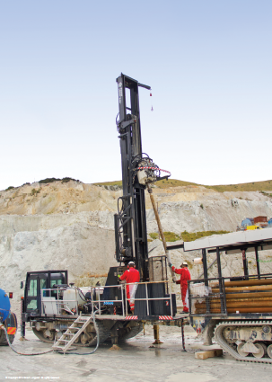
Rig Selection: Big Hole, Standards Hole and Slim Hole
Rig For Big Hole and Standard Hole:
1000 HP
1300 HP
1500 HP
2000 HP
150-220 HP For
Slim Hole

Slide 40
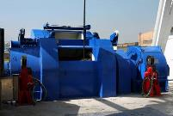
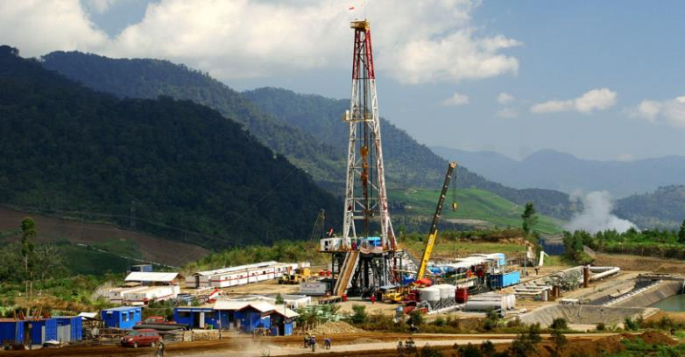
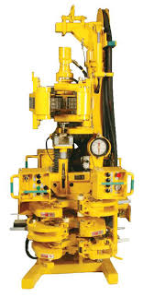
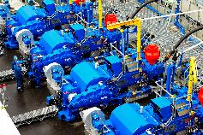
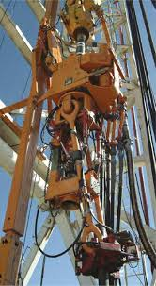
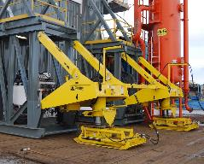
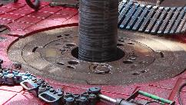
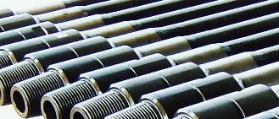
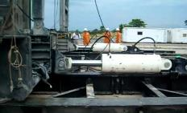
Onshore Drilling Rig Overview – Main Rig Component
Rig Mast
Drawwork
Mud Pumps
Top Drive System
Heavy Equipment
Sub Structure
Hawk Jaw
Rotary Table
Drill Pipe
Rig Skid System
Rig Walking System

Slide 41
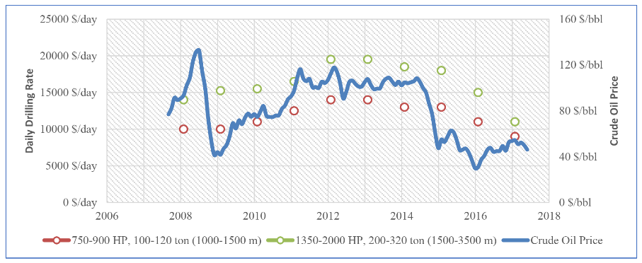
Rig Horsepower Selection
Crude Oil Prices vs Daily Rig Rated in Turkey
Rig Horsepower Utilization vs Drilling Total Depth:
750-900 HP (100-120 Ton):
1000 – 1500 m Depth
1000 (350 Ton):
1500 – 3200 m Depth
1350-1500 HP (350-500 Ton):
3200 – 5000 m Depth
2000 HP (500 Ton):
Deep well, superheated well
Daily Drilling Rig Cost in Turkey (1350 – 2000 HP):
$ 11000 - 20000
Daily Drilling Rig Cost in Indonesia (1000 – 2000 HP):
$ 19000 - 30000

Slide 42
RIG SIZING

Slide 43


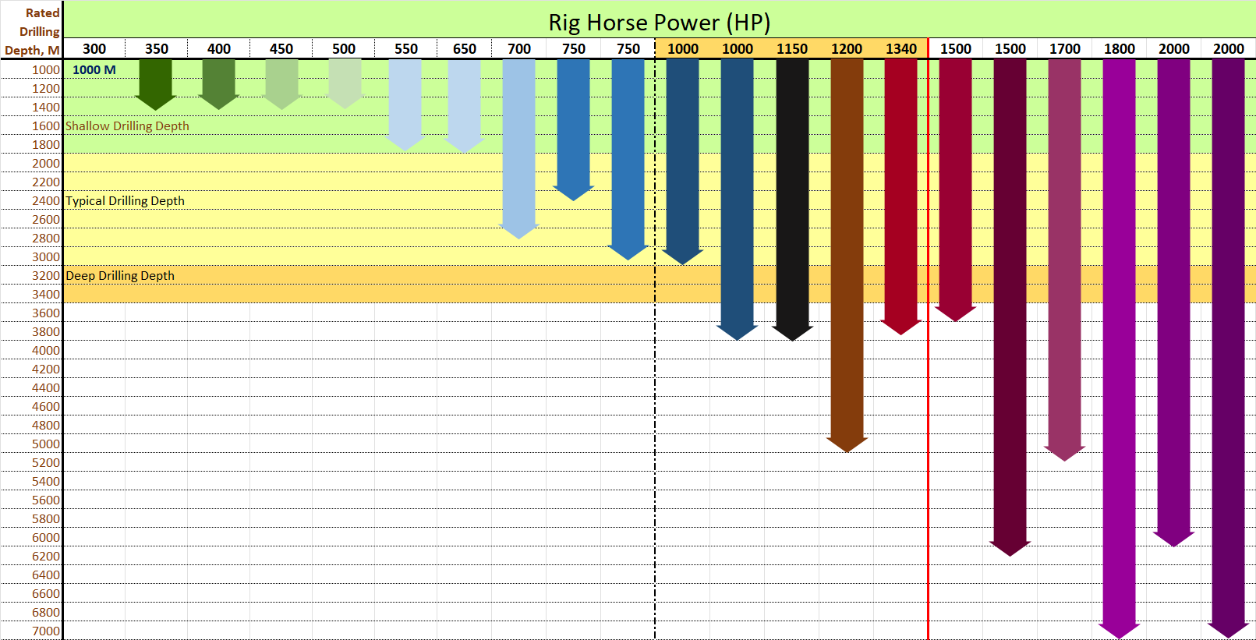
Rig Manufacturer’s Rated Drilling Depth …
Which Rig do we want to use?
Rig 750 HP
shallow well
Rig 1000 HP could be fit of propose to drill Geothermal well in Indonesia
Rig 1500-2000 HP
For superheated well
Work Over, Shallow Drilling
Typical Drilling Geothermal
Super Heated Well

Slide 44
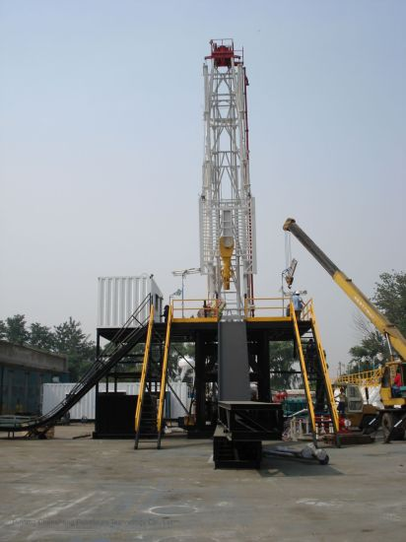
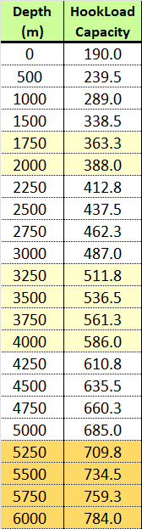
RATED DRILLING DEPTH
Capacity | 650 | 700-850 | 1000-1340 | 1500 | 1700-1800 | 2000
Rated Drilling Depth, M | 1800 | 2500 3993 | 3000 4100 | 3500 6095 | 5100 9144 | 3500 6700
Mast Capacity, Klbs | 350 400 | 400 500 | 440 650 | 675 769 | 850 1000 | 975 1250
80% Mast Cap., Klbs | 320 | 400 | 520 | 615 | 800 | 1000
Corrected Rated Drilling Depth, M | 1500 | 2100 | 3300 | 4300 | 6000 | 6700
650 HP
Rig 750 HP
Rig 1000-1340 HP
Rig 1500 HP
Rig 1700-1800 HP
Rig 2000 HP → could be capable to drill to 6700 M
1500 M
2100 m
3300 m
4300 m
6000 m

Slide 45
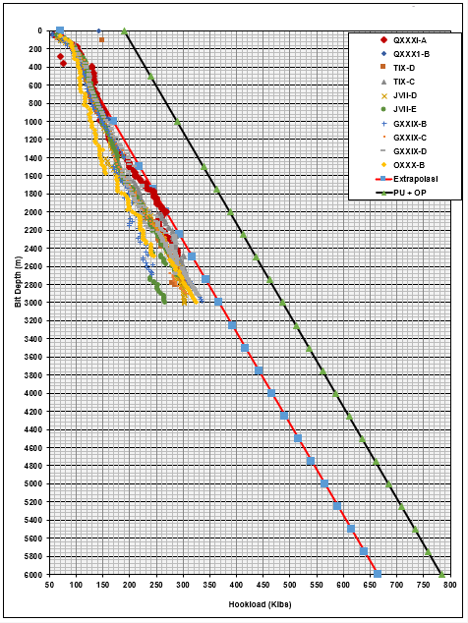
Rig 1000-1340 HP RATED DRILLING DEPTH
Capacity | 1000-1340
Rated Drilling Depth, M | 3000 4100
Mast Capacity, Klbs | 440 650
80% Mast Cap., Klbs | 440 520
Corrected Rated Drilling Depth, M | 2500 3300
Drill Pipe Specification | DP Rated Drilling Depth, M
5” DP, 19.5 ppf, Grade G-105 | 2250
5” DP, 25.6 ppf, Grade G-105 | 3500
Minimum
Maximum
Shallow TD at 2250 m-MD: Use 5” DP, 19.5 ppf, Grade G-105
Deep TD up to 3500 m-MD: Use COMBINE DP
2500 m
TDS Hoisting | TDS Horse Power | Max. Continuous Torque, lbs-Ft | Rated Drilling Depth, m-MD
350 Ton 771 Klbs | 600 | 30000 | 3000
 | 800 | 37000 | 3700
 | 1000 | 46000 | 4500
3300 m

Slide 46
Rig 1500 HP RATED DRILLING DEPTH
Capacity | 1500 HP
Rated Drilling Depth, M | 3500 6095
Mast Capacity, Klbs | 675 769
80% Mast Cap., Klbs | 540 615
Corrected Rated Drilling Depth, M | 3600 4300
Drill Pipe Specification | DP Rated Drilling Depth, M
5” DP, 19.5 ppf, Grade G-105 | 2250
5” DP, 25.6 ppf, Grade G-105 | 3500
5½” DP, 21.9 ppf, Grade G-105 | 2500
5½” DP, 24.7 ppf, Grade G-105 | 3250
5½” DP, 24.7 ppf, Grade S-135 | 4500
Minimum
Maximum
3600 m
TDS Hoisting | TDS Horse Power | Max. Continuous Torque, lbs-Ft | Rated Drilling Depth, m-MD
350 Ton 771 Klbs | 800 | 37000 | 3700
 | 1000 | 46000 | 4500
4300 m

Slide 47
Kajian Kemampuan dan Kecepatan Rig Moving
Kegiatan perpindahan rig (Rig Moving) ini dapat dikategorikan dalam 4 jenis:
  Rig Mobilisasi: perpindahan rig dari lokasi awal ke lokasi sumur pertama pemboran.
  Rig Moving didalam satu wellpad: cara perpindahan rig dalam satu wellpad bisa dengan proses skidding atau walking (berjalan) tergantung kemampuan rignya
  Rig Moving antar wellpad: Perpindahan rig ini, rig harus direbahkan dan dibongkar untuk dapat dipindahkan ke Lokasi wellpad berikutnya untuk di rig-up.
  Rig DeMobilisasi: perpindahan rig dari lokasi sumur terakhir pemboran ke lokasi yang diinginkan oleh Kontraktor rig.

Slide 48

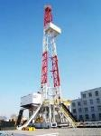


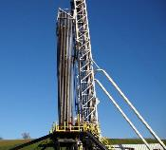
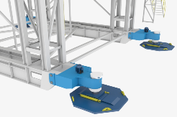
The Economic Rig Moving System
Rig Skid vs Walking System
Rig Skid and Walking System | Days to spud
 | Rig Release and ready to spud the next well: 5 days (additional rig time to LD drill pipe and Re-MU (2 day)) USD 370 K
 | Rig Release and ready to spud the next well: 3 days USD 210 K
 | Rig Release and ready to spud the next well: 0.5 days USD 35 K
If WITHOUT skid system, we have to:
LD Pipe
RD
RM
RU
MU Pipe
10 Days or USD 700 K Costly
Without Drill string stand up the rig mast
Rig Skid System
With Drill string stand up the rig mast
Rig Skid System
Rig Walking System
With Drill string stand up the rig mast

Slide 49
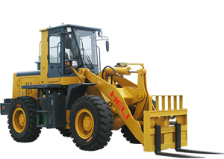
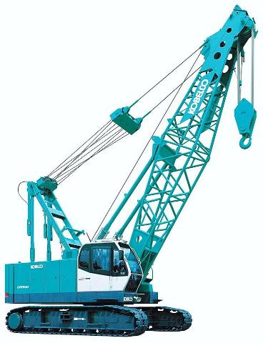
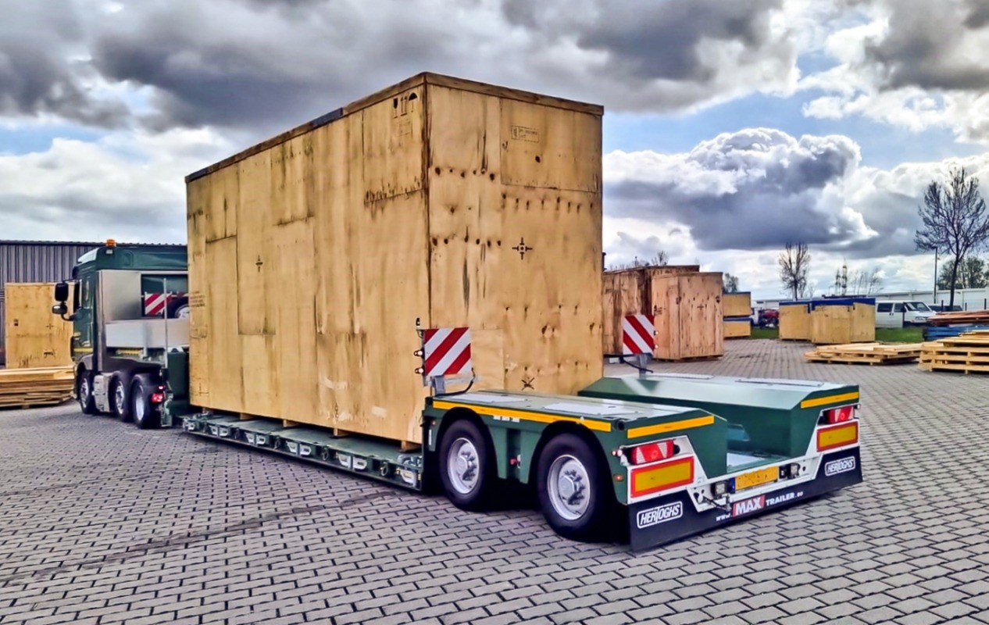
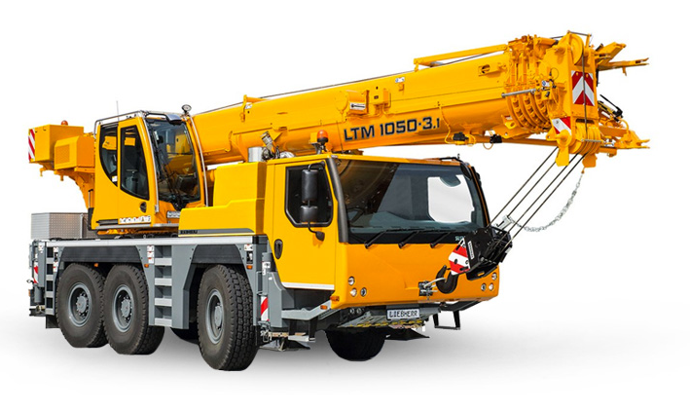
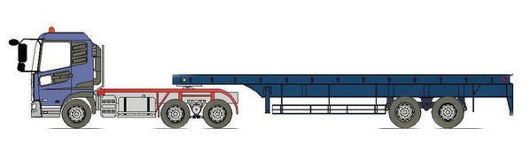
Main Heavy Equipment For Rig Moving & Daily Operation
Crawler Crane
Forklift
Low Bed
Prime Mover
Trailer
Hi Bed
Roughter / Rough Terrain /
Mobile Crane

Slide 50
Main Heavy Equipment For Rig Moving & Daily Rig Operation
Heavy Equipment |  | Capacity | Qty Rig Moving | Qty Daily Rig Operation | Remark
 | Forklift | 8-10 Ton | 2 Set | 2 Set | 10 Ton preferable. During mobilization along high slope access road, need to be standing by to help pushing the trailer.
 | Mobile Crane | 50 Ton | 2 Set | 2 Set | It is easier to move from one place to other place
 | Mobile Crane | 25-30 T Optional | 1 Set | Not Required | Smaller Tonage Crane for rigging up / setting up equipment
 | Crawler Crane | 80 Ton | 1 Set | 1 Set | Some Rig Equipment need 80 T Crane to be lifted → it will more safe and faster rather than 2 x 50 T Crane
 | Low Bed | 6 X 6 | As Required | 1Set Prime Mover + 1Set Low Bed Trailer + 1Set Hi Bed Trailer | To transport taller Rig Equipment
 | Hi Bed | 6 X 6 | As Required

Slide 51
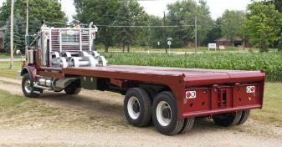
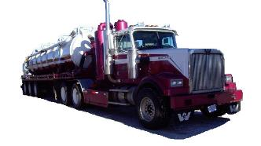
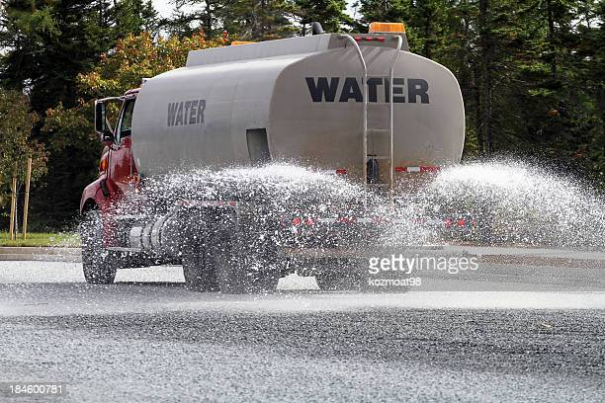
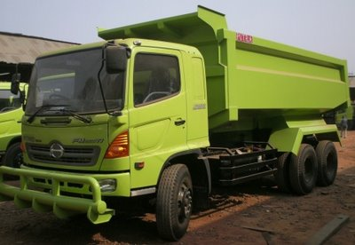
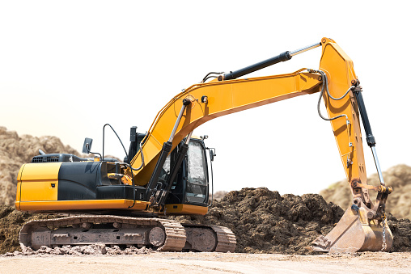
Optional Heavy Equipment For Rig Moving
Vacuum Truck
Winch Truck
Water Truck
Back Hoe
Dump Truck

Slide 52
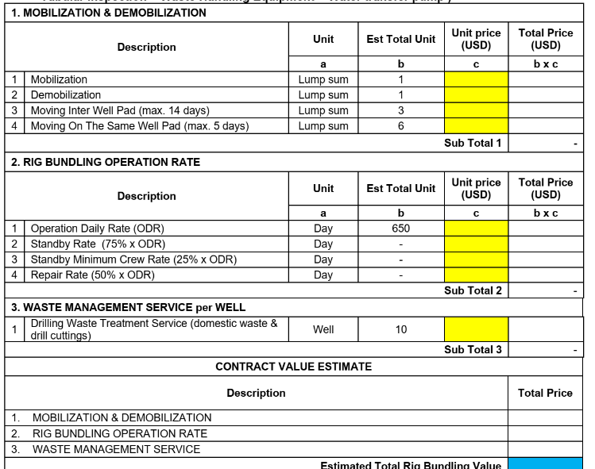
RIG RENUMERATION TABLE STRUCTURE
Rig Moving:
Each Rig type has deferent Rig Moving method and time duration for moving
To include fuel consumption to the daily rig rate.

Slide 53


RIG FUEL CONSUMPTION
1500 HP New Generation Rig: 4000 – 6000 L/day
1500 HP Old Rig: 8000-12000 L/day
To be considered into rig tender commercial evaluation
1500 HP OR 2000 HP Rig
Well design require 1500 HP Rig,
During drilling rig tender, some of Rig Contractor offer us 2000 HP Rig with Rig Price similar with 1500 HP Rig.

Slide 54
RIG FUEL CONSUMPTION
Fuel Price
Basic price + Handling
USD 0.9-1.2 per Liter
Equipment Daily Usage
Rig: 4-12 KL
Heavy Equipment: 1-2 KL
How to Reduce
Digital Measurement
Fuel Handling SOP
Water Pump: 1 KL
Vehicles: 0.3 KL
Base Camp: 0.2 KL
Air Drilling: 5-8KL
Total Consumption: 11.5 – 23.5 KL/day
Regular fuel sample check
Dedicated Fuel Truck
Always Lock fuel tank line
Daily Usage Report
Use New Generation Rig.
< 3 years age of Heavy Equipment
Proper Piping for water supply
Convert Electricity source from GenSet to PLN

Slide 55

RIG RENUMERATION TABLE STRUCTURE
Company is suggested to procure fuel itself.
The above table is added if the company policy require Rig to supply fuel.
Since every Rig type has deferent Fuel Consumption
  Option-1: To include fuel consumption to the daily rig rate
  Option-2: Rig is required to fill maximum fuel consumption per day and company only pay the actual usage of the fuel. Rig will pay any fuel consumption exceeded the sated maximum fuel/day.

Slide 56

PERTAMINA FUEL Cost Component
Basic Price (issued every 14 days period)
Basic Price
VAT
PBBKB
Transport
Do request for price discount to Pertamina → 5 – 20% Do price comparison with other fuel supplier i.e Shell, Petronas etc
Fix refer to Basic price
Fix refer to Basic price
Fix price

Slide 57

CHANCE TO GET PERTAMINA FUEL PRICE DISCOUNT
If company do direct purchase fuel, could request to Pertamina Fuel price Discount. Below are possibility % price discount:
Up to 20%: Government or BUMN direct purchase and Cash deposit in advance.
Up to 10%: Private Company direct purchase and Cash deposit in advance.
Up to 5%: Private Company direct purchase by invoice system.
Up to 10%: To Pertamina Fuel agent
Nota Kesepahaman antara SKK Migas dan PT Pertamina

Slide 58



RIG FUEL Supply – Cost Saving

Slide 59

Own 1000 – 1500 HP Used Rig
Cases: KS Orka owned DATI 231 Rig → Rig Kaisan-01
Description | Rig Rental Services | Own Rig
Rig Purchase Price | None | USD 2.5 Million
Rig Upgrade | None, included in Mob cost | USD 500 K
Mobilization | USD 1 Million | USD 1 Million
Demobilization | USD 0.5 Million | USD 100 K
Daily Rate | USD 25-30 K | USD 13 K: Rig Management: USD 5.5 K Catering: USD 3.5 K Maintenance: USD 4.0 K
Total Rig cost balance after 173 rig operating days = 5 wells Drill 6th well onward → Save Rig Cost USD 15 K daily or equivalent with cost reduction of USD 525 K per well

Slide 60

SMGP Year 2020 Drilling Statistics – Use Own Rig
SMP T-04
SMP T-09
SMP T-07

Slide 61
Persiapan Umum Sebelum Dimulainya Pengeboran
BAB-3
3.3
Persiapan Lokasi Pengeboran
Elevated Wellpad Design
Mud Pond Size and Design
Cellar Design and distance between Cellar
30” Conductor Design

Slide 62


Effective Well Pad Design
5000-8000 m3 water pond
Lower elevation for cutting and water pond
Pre design for well test pipe line layout
Proper drainage and control box
Direct Under ground drainage from Cellar to cutting Pond
Typical Rig Site Layout

Slide 63



Elevated Well-Pad Design
Mini camp area could be higher elevation than rig elevation.
Distance between Cellar → Well accessibility after being drilled
Water flow by gravity to water pond.
SIMOP: Pipeline layout not interfere with Rig Equipment layout.
Place for Mini Camps
Access for Heavy Equipment
Drainage Line from Cellar to Mud Pond
Settling Pond
Water and Mud Pond

Slide 64


Layout higher elevation for Rig Mini Camps

Slide 65
Mud Pond Size and Design
Settling Pond
Water Pond
4000 M3
Optional (due to limited area). Could be supply from other closest Wellpad Pond
Cellar
Drainage f/ Cellar
Prefer open drainage system
Mud Pond
4000 M3
Mandatory

Slide 66



Rig Picture
Rig Side View
Rig TOP View
Rig Floor Size
Post Drilling Activity
Rig Side View

Slide 67

Rig Picture: Side View for Determining Distance between Cellars
When Rig Skid forward for next sequence well, the drilled well could be access for any well intervention such as:
  Wireline operation
  Well Test Pipe Installation
Distance between Cellar (Ideal Option): 13.5 - 15.0 Meters
  Rotary Table → end Rig Floor (back side): 13.5 m
  Half of Cellar Wide: 1.5 m
15.0 m
15.0 m
15.0 m
1.5 m
13.5 m

Slide 68

Surface Anticollision
SF > 1
SF = 1
SF < 1
SF < 1
SF = Separation Factor
SF = (Ellipse Radius-1 + Ellipse Radius-2)/ Jarak lubang

Slide 69

PAD BB: Cellar Assignment
Well | Az
PTH-BB-9 | 215
PTH-BB-9A | 168
PTH-BB-9B | 245
PTH-BB-9C | 135
PTH-BB-9B
Cellar assignment refer to Well Trajectory
Avoid any Crossing as possible
Check well sequence to easy Rig Skidding
Check Wellhead Height to avoid any obstruction during Rig Skidding
PTH-BB-9C
PTH-BB-9
PTH-BB-9A

Slide 70

Cellar Assignment, Optimized ?

Slide 71


Additional Cellar to the Existing Pad. Is it safe?
Well Collision Risk - High

Slide 72

Cellars Design-2: 3m X 3m X 0.8m depth
Wellhead & BOP Stack
Drainage to Pond
3m X 3m X 1.2m depth
3m X 3m X 0.8m depth

Slide 73


Cellars Design-2: 3m X 3m X 0.8m depth
Advantage:
More simple → Less Construction Cost
Always dry cellar
No risk accumulated H2S

Slide 74
30” Conductor Specification and Installation

Slide 75
30” CASING CONDUCTOR SPECIFICATION
Manufacture | Grade | Lenght | Weight | Connection
Spiral ERW SAW Seamless | X-52 X-56 K-55 | R-3 | 310 ppf 133 ppf 129 ppf | Bevel End Quick Connector
MANUFACTURED BY ROLLING METAL PLATE:
ERW: Electric Resistance Welded
SAW: Submerge Arc Welding
LSAW: Longitudinal Submerge Arc Welding

Slide 76




30” CASING CONDUCTOR MANUFACTURE PROCESS
SAW: Submerge Arc Welding
ERW: Electric Resistance Welded
Spiral SAW
LSAW: Longitudinal Submerge Arc Welding
DSAW: LSAW with double seam weld in inside and outside

Slide 77


CASING MANUFACTURE PROCESS
ERW: Electric Resistance Welded
Manufactured by rolling metal and then welding it longitudinally across its length
SAW: Submerge Arc Welding
LSAW: Longitudinal Submerge Arc Welding,
Single seam weld on the outer surface
DSAW: LSAW with double seam weld in inside and outside
SPIRAL SAW
SEAMLESS:
Manufactured by extruding the metal to the desired length. 20-30% higher price than ERW casing

Slide 78
Ketebalan Pipa 30” Konduktor
Pemilihan ketebalan pipa 30” Konduktor harus disesuaikan dengan metoda pemasangan pipa konduktor tersebut:
  PILING, sebaiknya memakai pipa dengan ketebalan 1” untuk mencegah kolap saat pemasangan (hammer piling).
  BOR dan CEMENT, sebaiknya memakai pipa dengan ketebalan 0.75” atau 0.5”. Dengan cara ini tidak ada resiko konduktor kolap saat pemasangan.

Slide 79



30” Cost Comparison
30” Casing | Welded | USD/Jt
1” Wall Thickness | ERW
 | LSAW
 | DSAW
 | SPIRAL
 | Seamless
30” Casing | Welded | USD/Jt
0.75” Wall Thickness | ERW
 | LSAW
 | DSAW
 | SPIRAL
 | Seamless
30” Casing | Welded | USD/Jt
0.5” Wall Thickness | ERW
 | LSAW
 | DSAW
 | SPIRAL
 | Seamless
Stronger pipe, for piling installation
Thin pipe, for Auger installation
Thin pipe, for Auger installation

Slide 80
30” Conductor Setting Depth
Kedalaman Pipa Konduktor sebaiknya mempertimbangkan hal-hal berikut ini:
Kecukupan ruang kedalaman untuk merangkai BHA lubang awal, misalnya directional BHA untuk lubang permukaan 26”.
Resiko hilang lumpur dimana lumpur yang hilang bisa leakage (bocor) ke permukaan dan bisa menimbulkan pencemaran lingkungan.
Bisa menutupi/mengkover zona losses permukaan.
Kemampuan alat pemasang konduktor.

Slide 81


Conductor Depth Illustration
26” BHA Length
26” Directional BHA length = > 58 m
Option-3 and 4, we could run 26” Directional BHA without any drill out rotary BHA
Rig time saving = 20 hours
1
2
3
4

Slide 82
Conductor Depth Illustration
26” BHA Length
Option-1 & 2 | Option-3 & 4
MU Rotary BHA RIH Drill to 70 m POOH MU DD BHA RIH Drill to TD POOH | 20 hours MU DD BHA RIH Drill to TD POOH
Additional cost for Auger and Casing = | Rig time saving = 20 hours USD 58 K
Potential Cost Saving:
1
2
3
4

Slide 83
Advantages to set Deeper 30” Conductor Depth
Rig time saving since it could run directional BHA instead of initiated with Rotary BHA to provide sufficient space for Directional BHA
If any surface losses, has been cured during Augering operation which much less operating daily rate.
Note: However, it need to confirm what the maximum depth that Auger could drill.

Slide 84

WellPad Surface Location
High
Drilling Risk
Ruble area
Medium-Low
Drilling Risk
Ruble area
Ruble area

Slide 85
30” Conductor Depth
High
Drilling Risk
Ruble area
Medium-Low
Drilling Risk
Ruble area
High Risk
Broaching
Surface losses
26” Hole
Surface losses
30” Conductor
Low Risk
Broaching
Surface losses
No Risk of
Broaching
26” Hole
26” Hole

Slide 86


Cellar Off Center and Rig Alignment
Case-1: All Conductor Center Align
Case-2: Alignment Conductor Off-Center
Case-2:
Do alignment line to have Minimum Off Center of Conductor Center
Set the center of skidding rail to have Tolerable Off Center deviation up to 10 cm

Slide 87

Maximum Conductor - Rig Off Center
Refer to 30” Conductor ID and 20” Collar OD, maximum off center between Casing Conductor Center and Rig Center < 10 Cm
When running 20” casing, it will push the 20” Casing Center to alignment with Rig Center.

Slide 88
Cellar Off Center and Rig Alignment
Off center pipa konduktor ini bisa dimitigasi saat pekerjaan pemasangan pipa konduktor:
Jangan gunakan titik semua cellar dari sistem koordinat yang telah diberikan oleh baik team drilling atau dari team Sub-Surface.
Titik koordinat hanya untuk menentukan posisi 2 cellar paling ujung.
Kemudian untuk menentukan posisi beberapa cellar yang ditengah, dengan menarik garis lurus dari titik tangah dari 2 cellar paling ujung.
Kemudian titik-titik cellar bagian tengah ditentukan dari jarak antar cellar.
Setelah semua konduktor terpasang, lakukan GPS ulang untuk memberikan definitive koordinat masing-masing cellar/sumur. Definitive Koordinat ini yang akan dipakai oleh team drilling dan Sub-Surface dalam perencanaan dan drilling program.

Slide 89



Pre-Welded 2 Joints of 30” Conductors
Do not use Rig to install 30” Conductor if hard surface formation

Slide 90
Persiapan Umum Sebelum Dimulainya Pengeboran
BAB-3
3.4
Persiapan Suplai Air (Water) Untuk Pengeboran
Water Pipe Line
Steel Pipe and HDPE Water line

Slide 91

WATER SUPPLY – 1300 GPM

Slide 92

Water Supply

Slide 93


WATER SUPPLY – 1300 GPM
Water Sources:
  Water pH?
  Water Flow rate.
  Distance and elevation
  Community issue
Pipe Line Sizes:
  2 lines of 8”ODx6”ID HDPE pipe OR
  2 line of steel pipe
Water Pond Storage
  8000 – 10000 m3
  If no water source → bigger water pons → up 100.000 m3

Slide 94





WATER SUPPLY – 1400 GPM
WATER PIPE LINE: Use Galvanize or Steel Pipe Line instead of HDPE:
Less pressure drop due to friction
Higher Burst Pressure capacity → allow to utilize maximum water pump FLOW RATE and PRESSURE capacity.
  Water Pump: 600 psi
  Steel Pipe: +1000 psi
  HDPE Pipe: 300 psi.
Less water pump requirement → Less Personnel requirement → Less Community issue
Easy to repair if any pipe leak

Slide 95
Optimasi Desain Sumur Pengeboran
BAB-4
4.1
Optimasi Kedalam Akhir (TD) sumur berdasarkan data Feed Zone
4.2
Pemilihan Desain dan Ukuran Sumur Panas Bumi
4.3
Spesifikasi Casing dan Strategi Pembelian Casing
4.4
Effisiensi Pemasangan Wellhead
4.5
Pemilihan Teknologi Terbaru Drilling Bit
4.6
Optimum Desain BHA (Bottom Hole Assembly)

Slide 96

Optimasi Desain Sumur Pengeboran
BAB-4
4.1
Optimasi Kedalam Akhir (TD) sumur berdasarkan data Feed Zone
DEEPER Total Depth → COSTLY
Optimize well TD refer to Feed Zone study

Slide 97

Hence, Cost/MW increased with depth (more drilling cost with almost no increase in production gain).
Well Cost Per Megawatt
Shallow
Deep

Slide 98


Pad XX Case Study (ABC 28 & ABC 30)
Drilling shallow well at Pad XX will reduce well cost by $700k per well (13% saving) and reduce the Cost/MW to $578 k/MW (13% reduction).

Slide 99
Optimasi Desain Sumur Pengeboran
BAB-4
4.2
Pemilihan Desain dan Ukuran Sumur Panas Bumi
Big Bore Hole
Standard Hole

Slide 100


Well Design: STANDARD Hole OR BIG BORE Hole
Standard Hole | Comparison Description | Big Bore Hole
ABOVE TOR (Top Of Reservoir)
4 | Number of casing size & Wellhead | 3
4 | BOP and Wellhead installation, Cementing Job, Dumping Cement, WOC | 3
4 | Minimum BHA Size and Trip | 3
4 | No of Bit Size | 3
BELOW TOR (Top Of Reservoir)
1 up to 2 | Number of casing size | 1 up to 3
8-1/2 & 6-1/8 | Hole Size, in | 12-1/4”, 9-7/8”, 7-7/8”
5” and 3-1/2” | Drill Pipe Size | 5” only
6-1/2” & 4-3/4” | MM and MWD | 8” and 6-1/2”
Less | Production Flow | Bigger

Slide 101

Ideal Well Design: Big Bore Casing Schematic, Dual String
20” casing depth (400 – 550 m-MD) depend on 13-3/8” production casing depth.
13-3/8” production setting depth will be advised by Sub-surface team.
13-3/8” shoe depth as deep as possible to reduce long 12-1/4” hole section.

Slide 102

Well Design: INTERMEDIATE – PRODUCTION Hole Section with Contingency Plan
  INTERMEDIATE Hole: If 13-3/8” Liner is un-able set at top of reservoir → Contingency Plan:
  Drill 12-1/4” to top of reservoir and set 9-5/8” Liner and cemented.
PRODUCTION Hole: If any problem during drilling, and need set perforated liner earlier → Contingency Plan:
Drill 12-1/4” hole as deep as possible and set 10-3/4” perforated casing.
If not reach TD → Drill 9-7/8” hole as deep as possible and set 8-5/8” perforated casing.
If not reach TD → Drill 7-7/8” hole as deep as possible and set 7” perforated casing.

Slide 103
Optimasi Desain Sumur Pengeboran
BAB-4
4.3
Spesifikasi Casing dan Strategi Pembelian Casing
Seamless or Non-Seamless (Spiral, ERW, SAW)
Casing Connection Type
Comparison between Long string vs Tie Back Design
Casing Liner Adapter Design
Casing Procurement Strategy

Slide 104


CASING SPECIFICATION
Manufacture | Grade | Lenght | Weight | Connection Type
Non Seamless: Spiral ERW SAW Seamless | X-52 X-56 K-55 L-80 N-80 C-90 C-95 P110 Cr13 | R-2 R-3 | 310 ppf 133 ppf 129 ppf 72 ppf 68 ppf 53.5 ppf 47 ppf etc | Bevel End BTC, STC, LTC SCC (Special Clearance Coupling) Semi Premium Quick Connector Premium
MANUFACTURED BY ROLLING METAL PLATE (30” & 20”):
ERW: Electric Resistance Welded
SAW: Submerge Arc Welding
LSAW: Longitudinal Submerge Arc Welding
SEAMLESS (13-3/8”, 10-3/4”, 8-5/8” and 7”):
Manufactured by extruding the metal to the desired length.
20-30% higher price than ERW casing

Slide 105

SEAMLESS VS ERW CASING
Seamless Casing | Rolled Metal Plate
Advantage: Good Casing Integrity Gas Well Suitable for high pressure | Advantage: Cheaper Shorter Delivery Time
Dis-Advantage: Expensive Longer Delivery Time | Dis-Advantage: Fair Casing Integrity Not suitable for high pressure Poor CO2 and H2S resistance
13-3/8” Production Casing
10-3/4”, 8-5/8”, 7” Perforated Liner
30” Conductor
20” Surface Casing

Slide 106

Tipikal spesifikasi casing yang umum dipakai sumur Big Bore

Slide 107




CASING CONNECTION
30” Casing, ERW or Spiral SAW, 0.75” WT, R-3, Plain End
20” Casing, ERW or SAW, 133 ppf, K-55 (X-56), R-3, 3TPI CONNECTOR
13-3/8” Casing, Seamless, 68-72 ppf, L-80, R-3, PREMIUM
10-3/4” Perforated Casing, 40 ppf, K-55/L-80, R-3, SCC BTC
8-5/8” Perforated Casing, 28 ppf, K-55/L-80, R-3, SCC BTC
7” Perforated Casing, 23 ppf, K-55/L-80, R-3, SCC BTC

Slide 108



BUTRESS vs QUICK Connection Thread
Pros - Butress | Cons - Butress
Cheap price casing connection MU to tri-angle mark → no torque turn monitoring API | Not for gas well Low Temperature and pressure Limit DLS Longer time to MU (i.e. 20” casing → 20-30 minutes per joint
3 TPI (Thread Per Inch) Connection
< 5 minutes per joint
15 minutes rig time saving.
Rig Cost = USD 3000 /hrs
Cost saving per joint: USD 750.
  Additional Cost for 3 TPI connection: USD 200
  Net cost saving: USD 550 /jt
  45 joint per well: USD 24750

Slide 109

20” Casing Thread List and Comparison
Thread Name | Number of Threads | Remark
BTC, Geoconn, GPButt, TMK UP CWB | 5 TPI (Thread Per Inch) | BTC Compatible BTC Compatible BTC Compatible
GP3P | 3TPI
Big Omega, Big Omega E | 3TPI
Tenaris ER | 3TPI
Hunting Seal Lock Boss | 3TPI
TMK UP Magna | 3TPI
Geoconn

Slide 110
13-3/8” Casing Design:
Tie Back instead of Long String

Slide 111


Casing Schematic

Slide 112
Running Operation
Tie Back Design | Long String Design
Liner Run: MU and run 13-3/8” Liner (TOL – 50 m above 20” FS) MU 20” X 13-3/8” Liner Adapter Run with running string (HWDP + DP) Cementing POOH Running String Wait On Cement Run Clean Out BHA Remedial Cement if required Pressure Liner Lap | Single Run: MU and run 13-3/8” Casing to surface Run with Inner string (HWDP + DP) Cementing Remedial Cement if required POOH Inner String Wait On Cement Remedial Cement if required Lift BOP and Cut 13-3/8” Casing and Laid Down ND BOP Cut 20” casing and Final Cut 13-3/8” casing. Risk of heat expose 13-3/8” casing due to cutting torch Weld section A to 13-3/8” casing More rig Time (No pre-welded) NU Master Valve NU BOP
Tie Back Run: ND BOP Cut 20” casing MU and run 13-3/8” Tie Back Casing to surface MU Pre-Welded Wellhead and Land on C Plate Run inner string and stab into FC Cementing. NO Wait On Cement (Casing has been landed on C Plate prior cementing job). NU Master Valve NU BOP

Slide 113


Running Operation – 13-3/8” Liner & Tie Back

Slide 114

Running Operation – 13-3/8” Tie Back Casing
The 13-3/8” Tie Back Casing will be run with PRE-WELDED Wellhead for rig time saving.
PRE-WELDED Wellhead will be landed on C Plate on 20” casing before cementing → No Wait On Cement is required, we could NU BOP direct after cementing Job.
The 13-3/8” Tie Back Casing will be cemented with heavy cement slurry 16.2 ppg, almost double than water gradient.
  Heavy Cement slurry will easier to remove water in annulus comparing lighter cement used in long string cementing (13.5 ppg).
  Easier to get Free Water in 16.2 ppg Cement slurry comparing lighter cement used in long string cementing (13.5 ppg).
  Much less risk of water trap along 20” X 13-3/8” casing annulus → No well integrity issue.

Slide 115

Risk Of Losses While Cementing
Tie Back System: Hydrostatic pressure during 13-3/8” Liner Casing cementing is 278 psi (1,7 ppg) less → Less risk of loss circulation while cementing → lower probability for remedial cementing job.
Tie Back System: Single 16.2 ppg Cement Slurry: easier to get Free Water Recipe → less risk of water trap in cement when hard → less risk casing collapse when expose to hot temperature when flowing well.

Slide 116

Cement Quality in 20” X 13-3/8” Case Hole
The 13-3/8” Tie Back Casing will be cemented with heavy cement slurry 16.2 ppg, almost double than water gradient.
  Heavy Cement slurry will easier to remove water in annulus comparing lighter cement used in long string cementing (13.5 ppg).
  Easier to get Free Water in 16.2 ppg Cement slurry comparing lighter cement used in long string cementing (13.5 ppg).
  Less risk of water trap along 20” X 13-3/8” casing annulus (short Liner Lap) → No well integrity issue.
The 13-3/8” Tie Back casing will cemented after liner lap being pressure tested to 16,5 ppg EMW → to ensure no losses when pumping 16,2 ppg cement slurry. Until today, no fail on Tie back cementing job.
Good cementing quality with 16.2 ppg slurry → better anchoring for 13-3/8” production casing → less casing and wellhead expansion growth.

Slide 117

Remedial Cementing – Tie Back Design
If any losses during cementing, do remedial cementing by dropping or squeezing 50-150 bbls of 15.8 pp cement → until we could pressure test liner lap to 16.5 ppg EMW.
It is easier since shorter length for remedial cement → 30-50 m liner lap and open hole annulus.
If no injectivity rate:
  Pressure test liner lap to 16.5 ppg EMW, if leaked, squeeze cement.
  Run and cement 13-3/8” Tie Back.
Good Casing and Cementing Integrity.
If any Total Losses during remedial cement and fail cured with cement plug:
Pump Fast set cement Recipe (Econolite + Spacer + 15.8 ppg Cement

Slide 118

Remedial Cementing – Long String Design
Case-1: Losses Zone still open
Cement Top Job by pumping cement slurry thru annulus.
The heavy cement slurry will drop into long annulus section, can not control cement speed → risk of mixed with water inside annulus → Risk of free water > nil → water trap and cause well integrity issue.
If still losses: Pump Thixotropic cement ahead and follow with remedial cement slurry → risk of premature set if any stop pumping → lack of cement quality along case hole section.
All above points could initiate well integrity issue.

Slide 119
Remedial Cementing – Long String Design
Case-2: Top Of Cement Above Losses Depth causing No Injectivity:
Unable to pump remedial cement slurry.
Long Un-cemented 13-3/8” Production Casing
When flowing during well test or production phase, cause higher casing expansion and cause wellhead growth → damage on surface pipe line connection.
Again the above points could initiate well integrity issue.
Case-1 and 2 are more difficult Remedial cement job, may need longer rig time.

Slide 120

Wellhead & MV Installation Comparison
Companion Flange
12” ANSI 900, Master Valve
13-5/8” 3M Section A Wellhead
13-5/8” 3M Section A Wellhead Installation:
13-3/8” Tie Back Design:
  Pre-welded in horizontal position
  32-40 hours
  Off line job → no use Rig time
13-3/8” Long String Design
  To be welded in Vertical position, after cementing job and final cut 13-3/8” casing
  Rig Time: 32-40 hours
  Can not do Off Line → Use Rig time
  Option to expedite welding job → by pressure testing in hot condition → risk of lack on welding quality
1
2
3
Welded Connection

Slide 121

Rig Time Comparison
Rig Time Comparison – No NPT and No Remedial Cement:
Comparing SMP T-01: Long String could create 6 hours rig time Saving.
Comparing SMP T-02: Long String could be 13 hours Longer rig time.
Risk of longer rig time IF run Long string method:
Problem when weld 13-5/8” SOW Wellhead to 13-3/8” L-80 Casing.
Difficulties for Remedial Cementing Job.

Slide 122


Additional Cost Comparison
13-3/8” Tie Back System | 13-3/8” Long String System
Run 13-3/8” Casing into two section → Less weight of running casing. It is sufficient to use 150 T Single Casing Elevator. This Equipment is part in the contract, no additional cost. | Run 13-3/8” casing in single run. It is still within 150 T Single Casing Elevator without any Safety factor. It is recommend to run 13-3/8” Long String with 350 T Spider Elevator. This equipment was not in the casing handling contract. Additional cost: Equipment Rental = USD 18000 per well Mob/Demobilization = USD 6000 per call
Need 20” X 13-3/8” Liner Adapter, additional Cost: 20” X 13-3/8” Liner Adapter: USD 15000 / Set Running Tool: USD 5000 / Well 17-1/2” Hole Opener: USD 21000 for 3 well 14-3/4” Mill Tooth Bit: USD 12000 for 3 well | No 20” X 13-3/8” Liner Adapter
Total Additional Cost: USD 45,500 / Well | Total Additional Cost: USD 18000 + 6000/3 = USD 20000
Overall less risk
Much better Cement quality along case hole
Cost Different between Tie Back vs Long String:
USD 25,500
NOT Significant

Slide 123
Conclusion
Strongly NOT Recommend to run Long String Design for Geothermal Well:
Cementing 13-3/8” Casing is the most critical job to be main isolation and anchoring system. Remedial cement in Long string is more complicated and difficult comparing Tie back design.
No Rig Time saving expected from Long String Method, since we must weld 13-5/8” SOW wellhead on line (Rig Time). Risk longer rig time if any NPT during welding the wellhead.
Higher risk of longer rig time due to difficulties to do Remedial Cementing on 13-3/8” Long Production Casing string.
In 13-3/8” Tie Back System where the casing is divided into 2 section, It could make better items of casing stress distribution due to casing expansion during well flowing.
It was experienced that Long string Design contributed to the Lack of well integrity.
Most Geothermal Operators in Indonesia have abandoned to use Long string method due to well integrity concerns.

Slide 124
20” X 13-3/8” Liner Adapter and Guide Shoe Design

Slide 125


20” X 13-3/8” Liner Adapter Design – Tie Back Receptacle Lenght
3 Meters Tie Back
5 Meters Tie Back

Slide 126

20” X 13-3/8” Liner Adapter Design – Bore Receptacle Lenght
Bore Receptacle Length – 3 Meters | Bore Receptacle Length – 5 Meters
Run 13-3/8” Tie Back Liner MU 85% make torque last 2 joints Tag to bottom Space out POOH and Laid down last 2 joints MU Pre-welded Wellhead Land on C plate LD Landing Joint RIH Inner string Cementing | Run 13-3/8” Tie Back Liner MU Pre-welded Wellhead Land on C plate LD Landing Joint RIH Inner string Cementing
 | Rig Time Cost Saving = USD 11.7 K Cost for longer BR = USD 2 K Net Cost Saving = USD 9.7 K
Rig time = 4 hours

Slide 127


Tie Back Cementing Bond Improvement
During primary cementing of 13-3/8” Liner, any possibility cement exist above TOL (return during cementing or drop cement above TOL). It’s must be cleaned out before running 13-3/8” Tie Back casing.
Concerns: Clean out using 17-1/2” bit, it could be un-able to remove all cement and may remain cement layer along 20” casing ID (0.615” - 1.23” thickness).

Slide 128

Tie Back Cementing Bond Improvement
As mitigation the concerns: Clean out using 17-1/2” bit, it could be un-able to remove all cement and may remain cement layer along 20” casing ID (0.615” - 1.23” thickness):
17-1/2” ROTARY Clean Out BHA (Straight BHA) may not able to clean out hard cement.
Option-1: Run 20” casing scraper to remove the remaining cement seat, however the availability of 20” casing scraper is rare in this country. If available will be costly.
Option-2: To run 17-1/2” Clean Out BHA with 9-1/2” Mud Motor with 1.15˚ bend → hopefully could remove remaining cement seat.

Slide 129









Casing Configuration, Float Equipment and Guide Shoe Design
13-3/8” Stab In Float Collar, Cement
10-3/4” GS. Aluminum
10-3/4” GS. Cement
13-3/8” Landing Collar, Cement
Aluminum
Cement
13-3/8” Float Shoe
8-5/8” GS. Aluminum
8-5/8” GS. Cement

Slide 130

Float Equipment and Guide Shoe Design
Drill Out Cement
Drill Out Aluminum
ID = Casing ID
No Cement left
ID < Casing ID
Could not remove all Aluminum part

Slide 131

Float Equipment and Guide Shoe Design
Float Equipment and Guide Shoe Type | Advantage | Dis-Advantage
Made from Concrete Cement | Simple and Cheaper Easy to be drilled out ID after being clean out = ID casing Less risk of stuck pipe | Weaker that Aluminum Run at normal speed in open hole section Prefer not be run when bad hole condition
Made from Aluminum | Stronger Run at faster speed in open hole section (2000 – 3000 mph) Prefer to be run when bad hole condition | More Expensive Difficult to be drilled out ID after being clean out = OD of the bit, not ID casing Higher risk of stuck pipe
Reamer Shoe | Capable for rotating and reaming with casing/liner Capable to be run in bad hole condition or ruble formation. | Most Expensive Difficult to be drilled out ID after being clean out = OD of the bit, not ID casing Risk of stuck pipe

Slide 132
Float Equipment and Guide Shoe Design
Float Equipment and Guide Shoe are made from Cement and Aluminum. Refer the advantage and disadvantages, below are the recommendation:
If hole condition is in good shape, run Float Equipment and Guide Shoe made from Cement. Easy to be drilled out and no ID reduction
If hole condition is NOT in good shape, run Float Equipment and Guide Shoe made from Aluminum. We could run faster and the bottom profile of FS (GS) will self-position following the hole profile. However it has risk difficult to be drilled out and final ID will be bit size used for drilling out (ID reduction, less than casing ID). Than it will increasing risk of stuck pipe due to tight hole clearance to the BHA OD.
As mitigation, drill out with mud motor (slightly bend) and use PDC or Mill Tooth Bit. Do not ever use Insert Bit.
In case we want to rotate casing or liner due to operation dictate, we could use Reamer shoe. However reamer shoe is similar disadvantage with FS / GS made from Aluminum.

Slide 133
Casing Procurement Strategy
Casing Unit: Feet (Meter) vs Joint
Casing Size Grouping
Casing Sources
Casing Perforation

Slide 134

Casing Pricing: Joint vs Feet

Slide 135

CASING VENDOR SURVEY: Casing Size Grouping for Procurement
Partial Award refer to Casing Sizes
Group-1 | Group-2 | Group-3 | Group-4
30” Conductor | 20” Casing | 13-3/8” Casing 9-5/8” Casing | 10-3/4” Casing 8-5/8” Casing 7” Casing

Slide 136


CASING SOURCES - Casing from China
Most opinion: NO due to lack of quality of green pipe
Second Opinion: YES due to cheap price. Accepted with mitigation.
Third Opinion: Have to, If I was working in KS ORKA.

Slide 137




CASING PRICE COMPARISON (2010)
Non China
China
How to ensure the casing quality from China

Slide 138






Perforated Casing Method: At Workshop

Slide 139




Perforated Casing Method: At Rig Site

Slide 140

Perforated Casing Method: At Workshop vs At Rig Site
Perforated Casing Size | Unit | Perforation Cost at Workshop | Perforation Cost at Rig Site
10-3/4” | USD/joint |  | 128.5
8-5/8” | USD/joint |  | 109.5
7” | USD/joint |  | 109.5

Slide 141
Optimasi Desain Sumur Pengeboran
BAB-4
4.4
Effisiensi Pemasangan Wellhead
Konfigurasi Wellhead: Wellhead Housing dan Master Valve:
Wellhead Housing:
  Double wellhead housing: 21-1/4” Wellhead dan Expansion Spool
  Single wellhead housing: 13-5/8” Wellhead Housing
Master Valve:
  Single Master Valve
  Double Master Valve (Drilling MV + Production MV)

Slide 142





WELLHEAD for GEOTHERMAL WELL
Pre-weld wellhead
Slip on Weld vs Slip Lock
Casing To Casing Welded
Wellhead Installation during WOC

Slide 143


Landing Slip for 20” casing installation
Landing Slip:
Propose for hanging Casing
No WOC
Seated on Cut Off Casing
Hang casing on Casing Body
Heavy, longer installation
Landing Plate:
Hanging Pre-Welded Wellhead
No WOC
Seated on Cut Off Casing
Hang casing on Casing Collar
Lighter, easy installation
Need to ND BOP prior cementing

Slide 144


Landing Slip for 20” casing installation
Landing Slip:
Drill 26” hole
Run 20” casing
Run Inner string
Primary cementing
Cut 30” casing, hang out 29” Diverter → Well control risk: Low
Install Landing Slip and land 20” casing
Cut 20” casing and ND 29” Diverter
Final cut 20” and NU Wellhead & BOP
Landing Plate:
Drill 26” hole
Cut 30” casing, ND 29” Diverter → Well control risk: High
Run 20” casing and Pre-welded wellhead
Install Landing Plate and land 20” casing
Run Inner string
Primary cementing
NU BOP

Slide 145





STARTING HEAD: 21-1/4” Housing
Slip on Weld vs Slip Lock System
Slip Lock Wellhead:
Final Cut casing
Slip wellhead on casing
Tighten the bolt
Loose the bolt to Nipple Down wellhead
Slip on Weld (SOW) Wellhead:
Final Cut casing
Slip wellhead on casing
Do weld ID and OD
Cut Casing to Nipple Down wellhead
3-6 Rig Hours

Slide 146


Pre-Welded 13-5/8” Wellhead Housing
Pemasangan 13-5/8” Wellhead Housing ada 2 cara:
Online Wellhead Installation (Pemasangan langsung) → Pengelasan Vertikal
Run Pre-Welded Wellhead Installation → Pengelasan Horizontal

Slide 147


Non Pre-Welded vs Pre-Welded 13-5/8” Wellhead Housing
Without Pre-Welded Operation
ND BOP Run Casing Tie back Run Inner string with casing stick up → 3 hrs Cementing WOC → 8 hrs Cut casing → Install Wellhead → 35 hrs
Pre-Welded Operation
ND BOP Run casing Tie back Run Pre-welded wellhead → 1 hrs Run Inner string on Rotary Table Cementing No WOC

Slide 148


Non Pre-Welded vs Pre-Welded 13-5/8” Wellhead Housing

Slide 149
Pre-Welded 13-5/8” Wellhead Housing
Without Pre-Welded | Pre-Welded
ND BOP Run Casing Tie back Run Inner string with casing stick up → 3 hrs Cementing WOC → 8 hrs ND BOP Cut casing → Install Wellhead → 35 hrs NU BOP | ND BOP Run casing Tie back Run Pre-welded wellhead No WOC NU BOP
3 + 8 + 35 hrs longer | Rig time saving: 46 hours
 | Cost saving: USD 134 K

Slide 150



PRE-WELDED WELLHEAD
13-3/8” Casing + 13-5/8” 3M Section A Wellhead
RT opening 37.5”
Split type RT bushing is preferable.
Pre-welded wellhead in horizontal position.
Pre-welded 13-5/8” Flange housing and 13-3/8” casing Landing Joint.
Save One-Two days Rig time

Slide 151
Optimasi Desain Sumur Pengeboran
BAB-4
4.5
Pemilihan Teknologi Terbaru Drilling Bit
Rate Of Penetration (ROP)
Footage, one hole section one bit
Cost per Meter

Slide 152



DRILLING BIT SELECTION – CASE STUDY
BIT IADC: ........

Slide 153


ROCK BIT KREV:
Single vs Double Bearing (premium)
Drilling Bit Comparison: Same IADC but different Bearing Type:
80% Reliability: 305 KRev versus 950-1200 Krev (3.1-4 times)
Two Bit vs Half Bit per section
Two vs One BHA trip per section

Slide 154




New Enhance Bit Type: Faster and Longer Run
Sting Blade PDC Bit
Kymera Hybrid Bit

Slide 155

FuseTek Bit Series for Geothermal Drilling

Slide 156


ReedHycalog – FuseTek Bit Series
Drill 1000 m with one run
Save 2 bit run if using Insert Bit
Bit Dull: 1-1-BT-A-X-3-PN-BHA → Re-run able
Bit condition after being pulled to surface

Slide 157


SMGP: Drilling time Saving – New technology Bit
  12.25” NOV Fusetek bit
  Saved USD 142,109 by drilling 1,000 mMD with 11.12 mph ROP
  17.5” Baker Hughes Kymera Hybrid bit
  Saved USD 129,834 by drilling 876 mMD with 10.68 mph ROP

Slide 158
Optimasi Desain Sumur Pengeboran
BAB-4
4.6
Optimum Desain BHA (Bottom Hole Assembly)
Best BHA Configuration
Hard Facing For Geothermal Drilling
Drill Pipe Selection for Deep drilling
Drill String Inspection Level
Competitive Renumeration Table (Procurement)

Slide 159
Mud Motor and MWD Size Selection
BHA Configuration | Parameters | 26” Hole | 17-1/2” Hole | 12-1/4” Hole
9-½ MM + 9-½ EM-MWD | Max GPM | 1200 | 1200 | 1200
 | MU Time | Longer | Longer | Longer
 | Directional Control | Good | Good | Fair (*)
9-½ MM + 8-½ EM-MWD | Max GPM | 1200 | 1200 | 1200
 | MU Time | Fair | Fair | Fair
 | Directional Control | Poor: too limber for nudging. | Good but Risk of Twist off | Good, MM 6-5/8” Reg
8-½ MM + 8-½ MWD | Max GPM | 900 | 900 | 900
 | MU Time | Faster | Faster | Faster
 | Directional Control | Not Applicable, Bit: 7-5/8” Reg Connection, GPM too low |  | Good

Slide 160
Mud Motor and MWD Size Selection
BHA Configuration | Parameters | 26” Hole | 17-1/2” Hole | 12-1/4” Hole
9-½ MM + 9-½ EM-MWD | Max GPM | 1200 | 1200 | 1200
 | MU Time | Longer | Longer | Longer
 | Directional Control | Good | Good | Good
9-½ MM + 8-½ EM-MWD | Max GPM | 1200 | 1200 | 1200
 | MU Time | Fair | Fair | Fair
 | Directional Control | Poor | Good | Good
26” BHA:
9-½ MM + 9-½ EM-MWD → easy to control surface kick off and easy to fight if any surface formation Deeping
9-½ MM + 8-½ EM-MWD → less rig time to make BHA and could be use for next 17-1/2” hole section, however it was experienced un-able to control directional AZ due to surface formation Deeping. Finally need longer for making directional correction → 1 – 2 BHA Trip in and out = 24 hours = 1 day additional rig time → USD 70 K

Slide 161
Directional BHA for 12-1/4” Production Hole Section – Typical Slant Section
BHA Configuration | Parameters | 12-1/4” Hole
9-½ MM + 8-½ EM-MWD | Max GPM | 1200
 | MU Time | Longer
 | Weakness | 9-½ MM usually had 7-5/8” Reg Box Down. Need X/O or special design with 6-5/8” REG Box down to meet with 12-¼ Bit Connection
8-½ MM + 8-½ EM-MWD Motor Bend: 0˚ – 0.78˚ VS Motor Bend: 1.15˚ | Max GPM | 900
 | MU Time | Faster
 | Directional Control | Recommend to use Motor Bend: 1.15˚: Less sliding length if any correction Enlarge the 12-¼ → easier to run 10-¾” casing with Special Clearance Coupling
Potential NPT:
Run Push BHA, drillout shoe and push Liner to bottom, POOH
Estimated NPT = 1 day = USD 70K
Hole: 12-¼
SCC Coupling: 11-¼
Hole vs SCC Coupling Clearance: ½”

Slide 162


Hole Size vs Mud Motor and MWD Size Selection
Longer MM + MWD → Longer tight clearance interval
→ risk of stuck pipe

Slide 163
Mud Motor and MWD Size Selection
BHA Configuration | Parameters | 9-7/8” Hole | 7-7/8” Hole
8-½ MM + 8-½ EM-MWD | Max GPM | 900 | Not Applicable
 | MU Time | Longer
 | Directional Control | Good
8-½ MM + 6-½ EM-MWD | Max GPM | 900 | Not Applicable
 | MU Time | Fair
 | Directional Control | Poor
6-½ MM + 6-½ EM-MWD | Max GPM | Not Applicable | 700
 | MU Time |  | Fair
 | Directional Control |  | Fair

Slide 164
Mud Motor and MWD Size Selection: 9-7/8” & 7-7/8” Hole
Lubang 9-7/8”: 8-1/2” Mud Motor dan 8-1/2” MWD → menambah panjang section annulus dengan tight clearance (0.6875”). Hal ini akan menimbulkan resiko stuck pipe.
Lubang 9-7/8”: 8-1/2” Mud Motor dan 6-1/2” MWD → memperpendek panjang section annulus dengan tight clearance (0.6875”). Sehingga hal ini akan menurunkan resiko stuck pipe.
Lubang 7-7/8”: karena sifatnya untuk kotingency saja, kami menyarankan untuk run rotary BHA saja tanpa MWD.

Slide 165


Hard Facing and Drill String Hard Banding
Stabilizer Blade with Hard Facing
Drill String with Hard Banding

Slide 166



HARDFACING FOR BLADES STABILIZER
HardFacing Type | Picture
HF 4000 Tungsten carbide inserts (button type). The inserts have been developed to allow cold insertion and maintain close fit. A greater concentration of inserts on the bottom third of the blade and leading edge will increase surface contact to reduce wear in highly abrasive formations
HF 5000 This oxy-acetylene process applies tough molten carbide particles of varying sizes held in a nickel chrome matrix which provides excellent bonding properties and greater surface wear characteristics. Surface hardness levels over 40HRC. Ideal for GEO-THERMAL applications over 350°C.
HF 6000 HF6000 is a specially developed hardfacing deposit that is applied to Stabilizers and other Oilfield Industry products by the Plasma Transfer Arc (PTA) process. The process is fully automated. The movement of the hardfacing torch and simultaneous movement of the work-piece is controlled by a 6 axis Robot and an additional synchronised axis.

Slide 167

Hard Banding Durability vs. Casing Wear
Use 200XT – 300XT

Slide 168
Deep Geothermal Well
Drilling Engineering for Deep Geothermal Well:
Simulate drilling hydraulic → mud pump sizing, pump liner size.
Torque and Drag Simulation → DP torque and tension limit → DP selection.
  Surface Torque to be kept less than Drill Pipe Make Up Torque
  Surface tension to capable hanging simulated Pick Up Load + Over Pulled to activate Drilling Jars (if any un-expected stuck pipe event)

Slide 169
Drill Pipe Selection
Drill pipe function:
To hang all drill string tension load (Pick up and slack off)
To rotate the drill string and transfer drilling torque
To be line for circulation drilling fluid, allow drilling fluid to be pumped down the hole through the bit and back up the annulus

Slide 170

Drilling Torque On Bottom
Drilling Torque simulation:
Using Friction Factor 0.7, the surface torque was less than 20 Klbs ft
Accepted range to use 5” 19 ppf, G-105, 4-1/2” IF

Slide 171

Drill Pipe Tensile Load
Pick Up Load:
80% Drill Pipe Capacity, 5”, 19 ppf, G-105, Premium Class = 349 Klbs
Using Friction Factor 0.7, the pick up load 326 klbs (at 3000 m-MD) and 356 klbs (at 3300 m-MD).
If any pipe stuck and need to activated the drilling Jars with 120 klbs over pulled.
Need to pick up the drill string 446 – 476 klbs → exceeded DP tension capacity.
Need to combine the DP with higher tensile capacity

Slide 172

Drill Pipe Selection
Drill pipe commonly used (TD < + 2500 m-MD):
5” 19 ppf, G-105, 4-1/2” IF
Drill pipe commonly combine used for Deep well:
5” 19 ppf, G-105, 4-1/2” IF
5” 19 ppf, S-135, 4-1/2” IF
5” 24 ppf, G-105, 4-1/2” IF
5.5” 19 ppf, G-105, 5-1/2” IF
To be selected for the most economic

Slide 173

OVER PULLED – at 3000 m-MD
Description | Off Bottom | On Bottom
Travelling Block | 30 Klbs | 30 Klbs
TDS | 25 Klbs | 25 Klbs
BHA Weight | 326 Klbs | 326 Klbs
Over Pulled | None | 120 Klbs
Weight Indicator | 381 Klbs | 501 Klbs
Axial Load at DP Wt below TDS | 326 Klbs | 446 Klbs
+
+
+
+
Pipe Stuck
Attempt to free the pipe with 120 Klbs Overpulled

Slide 174

OVER PULLED – 3200 m-MD
Description | Off Bottom | On Bottom
Travelling Block | 30 Klbs | 30 Klbs
TDS | 25 Klbs | 25 Klbs
BHA Weight | 356 Klbs | 356 Klbs
Over Pulled | None | 120 Klbs
Weight Indicator | 411 Klbs | 531 Klbs
Axial Load at DP Wt below TDS | 356 Klbs | 436 Klbs
+
+
+
+
Need to higher grade Drill Pipe
Pipe Stuck, Attempt to free the pipe with 120 Klbs Overpulled

Slide 175

Drill Pipe Tension Yield
80% Pipe Capacity, Klbs
349
386
438
448
464
597
90% Pipe Capacity, Klbs
393
434
493
504
522
671

Slide 176

Drill Pipe Selection
5” Drill pipe S-135 → Not H2S Resistance → Cracking
  Need to change Saver Sub at TDS
Drill pipe G-105 → H2S Resistance → recommended for drilling Geothermal well
  Combine 5” DP 19.5 ppf and 5.5”, 21.9 and 24.7 ppf:
    Different size and Thread→ different handling tool and saver sub → much longer rig time to make up pipe.
  Combine 5” DP 19.5 ppf and 5”, 25.6 ppf:
    Same size and same thread→ one handling tool and saver sub → no additional rig time to make up.

Slide 177

Downhole Inspection Level
Cat. | Remark
1
2 | Well Depth < 5000 feet Mud Weight < 9.0 ppg
3 | Well Depth 5000 – 10000 feet Mud Weight 9.1 – 11.0 ppg
4 | Well Depth 10000 – 16000 feet Mud Weight 11.1 – 14.5 ppg Offshore, Inland water and remote location
5 | Well Depth > 16000 feet Mud Weight > 14.5 ppg Formation H2S concetration > 0.05 psia
API Inspection has no real universally understood meaning. DS-1 Inspection can vary from Category-1 to 5. DS-1 Inspection has a precise meaning, a category must be stated

Slide 178

Directional – MWD Pricing System: Conventional Renumeration Table
Not Optimum Equipment Inventory
Company Man, Material Man to manage own logistic → less time for drilling operation control.
Difficulty in checking invoices → more man hours
More risk for audit findings.

Slide 179

Directional – MWD Pricing System: Lumpsum Per Day for Each Hole Section
Vendor will do optimization and manage for their tool inventory to meet their best LS Unit price
Simple timesheet and invoicing, less man hours.

Slide 180

Directional – MWD Pricing System: Lumpsum Per Day for Each Hole Section
To include LIH price and estimate LIH probability in commercial evaluation
Vendor to provide best LIH price to win this bid.
Otherwise Vendor will give un-reasonable unit price → and potential contract dispute if any LIH event.

Slide 181
Effesiensi Operasi Pengeboran
BAB-5
5.1
Penanganan Loss di Section 26”
5.2
Pencegahan Stuck Pipe
5.3
Metode Pipe Recovery
5.4
Evaluasi Teknis Paska Pemboran

Slide 182
26” and 17-1/2” Curing Losses

Slide 183




Surface Losses
Losses
Spot LCM
Keep drilling with losses to bottom losses depth
Keep low concentration LCM in the system
If losses cured by drilled cutting → continue drilling
If still severe losses, stop drilling → do cement plug as per option-1.
Advantage:
cement plug could be easier since drilled cutting has plugged the loss zone.
Losses
Stop drilling, POOH
RIH OEDP
Cement Plug, POOH
WOC
Repeated if still losses
If losses cured, continue drilling
If any losses again, repeat process to set cement plug
Do option-1 if hole un-stable

Slide 184

Surface Losses – Cost Comparison
Cost saving: USD 140 K

Slide 185

Stuck Pipe Prevention
18

Slide 186
Stuck Pipe Prevention
Non Production Hole (26” & 17-1/2”) | Production Hole (12-1/4”)
Enhance hole cleaning: High flow rate (900 – 1200 gpm) Sweep with fiber Hi-Vis Pump Tandem Hi-Vis if required Use asphaltic mud chemical if any un-stable formation (ruble zone). PLC-TLC: Pump 3 X LCM (50 -100 ppb) and drill blind to let drill cutting cure losses. Closely monitor Off Bottom Torque Only Use 1 or 2 string stabilizers Use strong Hydro Mechanical Drilling Jars (8” Jars Yield Torque > 100000 ft.lbs | Enhance hole cleaning: High flow rate (900 – 1000 gpm) Pump Tandem Hi-Vis Drill with losses: PLC up to 200 bph: Keep drilling with mud PLC > 200 blh: Drill with aerated mud TLC: Drill blind with aerated mud or hi-rate technic. Closely monitor Off Bottom Torque Only Use 1 or 2 string stabilizers Use strong Hydro Mechanical Drilling Jars Monitor pick up weight to keep less pipe pulling capacity with 100-150 klbs over pulled to activated Drilling Jars up.

Slide 187


Why Drilling Jars fail..?
BHA STUDY
Jars position at maximum torsional displacement
Wellplan 2000, Critical Speed Module

Slide 188



BHA STUDY: Jars Construction
Not solid part, but consist of mandrel and housing
Flex section, OD reduction
Weak Points (T Drilling Dynamics Study):
ACME or non-API thread with sharper root radii than API RSC thread root
Mid body connection have smaller cross-section areas
Notch or hole in jars housing will accelerate fatigue
Various internal component age traceability
Jars Placement
Most of the jars were placed at distance from bit where torque displacement is maximum

Slide 189

Drilling Jars Specification Comparison
Jars yang kuat: Drilling Jars ukuran 8”, sebaiknya mempunyai Torsional Yield lebih dari 100 ft-Klbs.

Slide 190
Pipe Recovery Method
19

Slide 191
Pipe Recovery Type
Explosive
Pipe Cutter
Could cut all type of BHA Component as long Explosive OD could pass drift ID of BHA component Need various Permits | Only could cut 5” Drill Pipe or Smaller. Un-able to cut 5” HWDP and all DC type and sizes

Slide 192
Pipe Recovery Type: Cost Impact
Explosive
Pipe Cutter
Less BHA component left in hole More chance to recover BHA left in hole Less LIH Prices Deeper top of fish (TOF) → deeper sidetrack point More chance TOF still in open hole → easier to side track in open hole | More (longer) BHA component left in hole Less chance to recover BHA left in hole Expensive LIH Prices Shallower top of fish (TOF) → Shallow sidetrack point → costly Risk of TOF in CASE hole → Need Whipstock to side track → costly

Slide 193

Pipe Recovery Type: Cost Impact

Slide 194

Workflow For Explosive Handling
P3 → Pemilikan Penguasaan dan Penyimpanan
P2 → Pembelian dan Penggunaan
P1 → Pengunaan Sisa Bahan Peledak

Slide 195
Strategi Pengadaan Barang dan Jasa Pemboran
BAB-6
6.1
Daftar Pengadaan Peralatan dan Jasa Pemboran
6.2
Kajian Metoda Pengadaan Peralatan dan Jasa Pemboran
6.3
Strategi Metoda Pengadaan IPM/Turnkey
6.4
Strategi Metoda Pengadaan Discrete atau Bundle
6.5
Ringkasan Kontrak Drilling dan Pedoman Biaya Pemboran

Slide 196
Procurement strategy for Drilling Material and Services
Drilling
Rig
DD/MWD
Cementing
Mud Logging
Casing Handling
Mud
Purchase | Services | Support
Casing Wellhead Liner Adapter Drilling Bits Casing Accessories DSA and X/O | Drilling Rig Cement and Mud Directional Drilling Air Drilling Mud Coller Wellhead Installation Drilling Personnel Heavy Equipment Drilling Waste Handling VSAT Drilling Report Casing Handling H2S Service Mud Logging Drill String Inspection Hard Bending Solid Control Services Fishing Tool Services Coring Services E-Line & Explosive | Drilling Site Construction Diesel Fuel Water Pump Services UKL / UPL Security Services Road Survey Tubular Inspection Explosive Handling Permits Perforated Liner Logistic Services General Services

Slide 197

COMPETITIVE BIDDING PROCESS
12 – 25 weeks:
Pra Qualification
CSMS Qualification
Legal (Terms and Condition) Clarification
Protest Clarification
Technical Evaluation
Commercial Evaluation
Contract Award
Delivery time
Rig Up or Installation time
Internal Approval
Avoid any Conflict of interest

Slide 198
Common Type of Drilling Procurement Method in Indonesia
Individual or Discrete Contract
  Company has drilling team to do tender process to select each drilling services.
Bundled Contract → Semi IPM
  Simplified Discrete Contract type by bundling 2 or more drilling services.
Integrated Project Management (IPM)
  One Contractor do all drilling services with drilling risk at Company.
Turnkey Project Contract
  Contractor do all drilling project (including drilling risk) with Lumpsum price / well.

Slide 199


TYPE OF CONTRACT for Procuring Drilling Services
Discrete
Bundled
IPM / Turnkey
COM
COM
COM
IPM
CON
CON
CON
CON
IDS
CON
CON
CON
CON
COM: Company
CON: Contractor
IDS: Integrated Drilling Services
CON
CON
CON

Slide 200




Common in our mindset of Non DRILLER
Discrete
Bundle
Semi IPM
IPM, TurnKey
No risk, less risk
Take longer time
More experiences
More man hours, resources
Less man hours, less of paper work
Lot of paper works
Old procurement method
Trend of procurement method
Manage Own Risk
Faster in completion time

Slide 201


Why Drilling Procurement Method is critical?.
Drilling Contract Scheme Evaluation indicate the following trend:
2012-2016: Majority use Semi-IPM and Full IPM (Avg. 2180 m Depth)
2017-2019: Majority use Discrete and Bundled (Avg. 2290 m Depth)
Discrete and Bundled Contract scheme provide cheaper drilling cost.
Bundle vs IPM → Cost/m Different: USD 2384 /m
Bundle vs Semi IPM → Cost/m Different: USD 936 /m
Potential Cost Reduction: USD 5.4 – 2.1 Million per Well

Slide 202

Why Drilling Procurement Method is critical?.
South Sumatra IPM in 2019:
The IPM pricing was Lump Sum refer to TD range and capped with maximum drilling days.
If exceeding maximum drilling days, Contractor will apply daily rate.
Cost Saving using Discrete for drilling in South Sumatra:
USD 682 per meter OR 1.5 Million per Well

Slide 203



Drilling IPM
(Integrated Project Management)

Slide 204

Drilling Integrated Project Management
What are they offer
Pros and Cons
IPM Pricing & Risk Sharing
IPM Selection & Control

Slide 205
IDS / IPM ADVANTAGES
COMPANY are fucusing on their core business and managing fewer CONTRACTORS
CONTRACTORS are becoming more flexible in adapting to COMPANY requirement
Experienced team members to provide best design and services
None of the above IPM promises mentioned the competitive drilling well cost ???
Refer to SLB IPM brochures

Slide 206

IPM Contractors Market Survey
A major overspent for IPM providers comes from services that are not their core business and outsourced.
Those include, drilling rigs, casing, wellheads, logistics, vessels, civil works and a like. On some projects, the degree of outsourcing can reach as much as 40-90% of IPM scope.
Ownership of Drilling Services:
IPM Vendors: 9%
Sub Contractor: 91%

Slide 207

Review of Drilling Contract Types
Description Discrete Bundle IPM Turnkey Project

Slide 208

Drilling Project Time Table
DISCRETE Versus IPM Services
Longer project delay → more overhead cost

Slide 209


Company Expectation from IPM contracts Scheme
IPM
Resources
Sharing Risk
Optimum Price

Slide 210
Commercial Elements of IPM contracts
Pain-share & Gain-share,
IPM Contractor: Sedikit
IPM
Turnkey → Lumpsum
Lumpsum
+ Unit Price
Unit Price
Risk at Contractor,
IPM Contractor: None
Reimbursable price list
Minimum risk to Contractor
Major Risk to Company
IPM Contractor: All

Slide 211
How IPM Contractor to build best Pricing ?
Best Unit Price
Risk Basket
Total Cost
Profit
Best Market Price:
Own services
Outsource
5%-15%
Un-certain cost
Un-plan cost
Community cost
15%-35% Higher
10%-20%

Slide 212
Typical problem – IPM Drilling (Lumpsum)
Dispute – additional cost → un-predictable drilling events
Less Flexibility to change → Tight IPM contract
Low quality of drilling services → Sister company of IPM, cheap sub-contract price
Book Price utilization → in-complete pricing system
Delay on payment to Sub Contractor
Lack of HSE awareness
Exceed maximum working days → less control from Company
High price on LIH → not be evaluated in bidding
Community issue → not part of IPM business
Conflict of interest → Big Contract Value
Logistic issue → Weak of financial capability
Timesheet manipulation → less control from Company
In complete responsible matrix → to big scope of work
Commencement date dispute
Excess Rig equipment problem → limited drilling area
Use unnecessary services, material or chemicals → less control from Company.
Longer decision in handling drilling problem which cost related.

Slide 213


Strong Legal Expert – IPM Contract
Drilling Manager
Legal
Drilling Engineer
Procurement & Logistic
Cost Control

Slide 214


Slide 215
Strategi Metoda Pengadaan Discrete atau Bundle

Slide 216



6. CONTRACT PRIORITY RANK - Delivery Time

Slide 217
6.a. CONTRACT PRIORITY RANK
FIRST | SECOND | NEXT
Casing Wellhead Liner Adapter Drilling Rig Drilling Personnel E-Line & Explosive Explosive Handling UKL / UPL Civil work Permits Road Survey | Drilling Bits Cement and Mud Directional Drilling Heavy Equipment Drill String Inspection Perforated Liner Diesel Fuel Air Drilling Mud Coller Wellhead Installation | Water General Services Tubular Inspection Drilling Waste Handling VSAT Drilling Report Casing Handling H2S Service Mud Logging Hard Bending Solid Control Services Fishing Tool Services Coring Services

Slide 218


Bundling and Discrete Contract Selection
A Non IPM Contract Type
Discrete – Drilling Services
Discrete – Purchase Material
Bundling

Slide 219
MANAGING DRILLING CONTRACT
Contract Coordinator
DE
HSE
Procurement
HRD
Logistic
Facility
G&G
Contract Owner Assignment:

Slide 220
CONTRACT OWNER Responsibilities:
Prepare SOW
Prequalification Evaluation
Pre-bid meeting and clarification
Provide Justification (DA/DS)
Tender technical evaluation
Mobilization note
Contract Summary
Contract Monitoring
Contract Amendmend
Check invoice

Slide 221
CONTRACT OWNER
PIC | Drilling Contract
DE 3-4 | Casing Wellhead Liner Adapter Drilling Rig Drilling Bits Cement and Mud Directional Drilling Perforated Liner Air Drilling Mud Coller Wellhead Installation VSAT Drilling Report Casing Handling Hard Bending Solid Control Services Fishing Tool Services Coring Services Drill String Inspection
PIC | Drilling Contract
Logistic & Procurement | Permits Heavy Equipment Diesel Fuel General Services
Facility/ Civil | Permits Road Survey Water Pump Services
HSE | UKL / UPL Drilling Waste Handling H2S Service
G & G | E-Line & Explosive Mud Logging
HRD | Drilling Personnel

Slide 222
COMPETITIVE RENUMERATION TABLE

Slide 223
Competitive Renumeration Table - Drilling Services
No | Drilling Services | Cost Saving Initiative
1 | Directional Drilling | LS Cost per day for each hole section LIH include in contract price
2 | Cementing Drilling Fluid | Itemize unit price for each mud chemical Consignment basis
4 | Wire Line | Stand rate for Unit and personnel Tool: Call Out, no stand by rental cost LS cost for only successful run job Consignment Explosive material LIH include in contract price
5 | Aerated Drilling | Stand by and Operating Monthly Rate
6 | Fishing Services | Monthly rate for dedicated fishing equipment Call out daily rate for secondary fishing equipment
7 | Water Supply | Use Vitolic or steel pipe (1000 psi working pressure) instead of HDPE Pipe (300 psi working pressure) → reduce no of water pumps → less price.
8 | Drilling Rig | LS Rig Mob/Demob, Skidding, Move interpad Include Fuel consumption LIH include in contract price

Slide 224
Competitive Renumeration Table - Drilling Services
No | Drilling Services | Cost Saving Initiative
9 | Drilling Bit | Consignment basis
10 | Explosive | Cost per run for back off and severing Re-export remaining explosive
11 | Cutting Disposal | Lump Sum price per well
12
13 | Mud Logging, H2S, Casing Handling, | Include in rig daily rate
14 | Rig Inspection | Lum sump per rig inspection
15 | Tubular Inspection | Daily Rate USD per joint
16 | Aerated Drilling | LS Mob/Demob, Skidding, Move interpad Use Synpol and Injection pump

Slide 225
Ringkasan Kontrak Drilling dan Pedoman Biaya Pemboran
Mengkompile semua kontrak drilling dalam betuk soft copy.
Membuat resume masing kontrak drilling yang meliputi: point on/off hire, klausal pinalti, table harga, scope pekerjaan, matrik tanggung jawab, definisi, nomenklatur, ketentuan hilang dalam lubang, barang konsumable dan lain-lain
Buatkan pedoman biaya pemboran (Drilling Cost Guide) yang isinya semua table biaya jasa pemboran dan harga satuan material pemboran.
Sosialisasikan poin-poin diatas kepada seluruh tim drilling, kususnya kepada tim drilling operation yang ada di lapangan. Dengan sosialisasi ini akan meningkatkan awareness dan kepedulian semua tim pemboran atas besaran biaya yang akan timbul dan tentunya hal ini akan mempengaruhi cara memanage operasi pemboran secara lebih effisien.
Membuat rangkuman pedoman tentang cara dan syarat-syarat pengajuan penagihan (invoicing) dan proses pembayaran.
Membuat template untuk pengontrolan spending setiap kontrak pemboran.
Melakukan rapat bulanan untuk monitor progress setiap kontrak pemboran termasuk penyelesaian semua tagihan bulanan.
Melakukan SQM (Service Quality Meeting) untuk meningkatkan kinerja setiap kontrak pemboran. Termasuk mendiskusikan langkah-langkah efisiensi biaya pemboran kedepan.

Slide 226
Kesimpulan dan Penutup
BAB-7
1
Membangun Departemen Drilling adalah suatu keharusan
2
Pengembangan Program penghematan biaya pemboran secara berkelanjutan
3
Efisiensi Biaya Pemboran merupakan dokumen hidup yang akan selalu terupdate oleh ide-ide baru.
4
Biaya sumur murah, proyek lebih ekonomis, menarik investor, lebih banyak sumur yang dibor
5
Ucapan terima kasih kepada EBTKE yang sangat mensupport program Efisiensi Biaya Pemboran

Slide 227

DISCUSSION

Slide 228


+62-813 988 66556
yhartono.67@gmail.com

