Slide 1
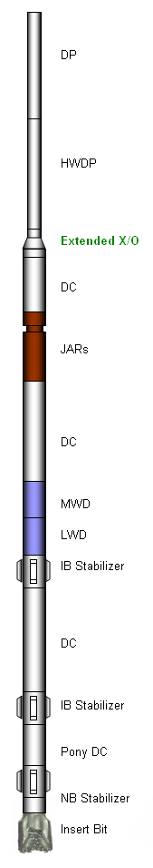
12-1/4” AND 8-1/2” BHA
CASE STUDY
Yudi Hartono 14 December 2006
@
D
A
B
C

Slide 2

Study Objectives
  Identify the factors that cause BHA failures in the past and how they interact with drill string vibration.
  Understanding how the BHA’s components influence the magnitude of drill string vibration and the relationship between BHA failure and bit penetration rate.
  Present conseptional design for optimized BHA during execution stage.
  Discuss the application of downhole vibration tools and services in the management of drill string vibration.

Slide 3

Agenda
  Introduction of Vibration
  History of BHA failure study
  Drilling Problems overview
  Offset wells overview
  Conclusion & Recommendation
  BHA Design Review

Slide 4
Introduction to Vibration
BHI Animation
Schlumberger Movie
See Basic DS Vibration.ppt

Slide 5




History of BHA Failure Study
Detail BHA Design
Drilling Dynamics
Analysis
Drill String Vibration
Guidelines
Downhole Vibration
Tools
Confirm Contractor
Acceptance
Etc…
Drilling Dynamic Study
BHI Drilling Optimization
Next...
Review Downhole Detected Vibration
Review Surface Detected Vibration
Drilling Dynamic Monitoring
Drilling Dynamic Rig Crew Training
Drillstring Integrity
  Fatigue Discussion
  Connection Selection
  Identify weak BHA component
  Traceability
  HWDP utilization other than DC
  Proper X/O
  QA/QC
  Proper MUT
  Backreaming Consideration
Other Recommendation
  Advance Washout Detection System
  Advance Rig Equipment
BHA Failure Study
Review BHA Type
Review Bit Performance
Review Downhole Detected Vibration
DS Vibration Simulation
Proper BHA Type
BHA Stabilization Model
Proper Sizes of DC
Drilling Jars
HWDP Utilization
Shock Tool Utilization
BHA Configuration
Execution
1999
2005 - 2006
2007

Slide 6
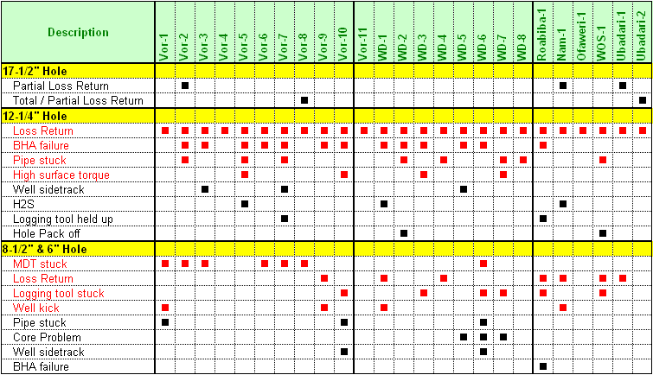
Drilling Problem Overview
Well
V1 – V11
Well
W1 – W8
Other
Wells
$...

Slide 7

13 of 25 offset wells faced BHA failure, equivalent NPT = 122 hrs / well.
Total loss rig time
1,587 hrs (66 days)
Equivalent with $ 6.6 Million if Spread rig cost $100 K/day
Normalized into current spread rig cost of $284 K/day, equivalent with
$ 18.7 Million.
Hidden cost $?? Million

Slide 8
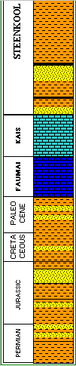
12-1/4” Hole – Offset Wells Summary
Kais and Fumai Limestone
Insert bits: 4XX and 5XX IADC.
High level of BHA vibration
Major NPT: BHA failure
BHA type: Slick, Packed, Pendulum, Motor BHA
DC size series: 9-1/2”, 8-1/2” and 6-1/2”
Vertical wells
Total mud losses, drilled blind and fill annulus with sea water

Slide 9
12-1/4” Hole – BHA study conclusion
DO:
Use packed BHA type with 3 stabilizers as basis of BHA model
Distance between stabilizers: 15/20/30 ft x 30 ft OR 30ft x 60 ft
Use 9-1/2” Mud Motor equipped with top stabilizer.
Use 8-1/2” DC series.
Use 8-1/2” drilling jars which preferable has the torsional yield not less than 100 ft-Klbs.
Use shock sub on packed BHA for ROP enhancement.
DON’T:
Do not use BHA stabilization of 15/20 ft x 60 ft
Do not use 9-1/2” DC series
Do not use 6-1/2” DC series and 6-1/2” drilling jars.
Do not placed any weaker BHA components (ie Jars, X/O etc) in where the torsional displacement is maximum.
Do not use shock tool on motor BHA.

Slide 10
12-1/4” BHA TYPE

Slide 11

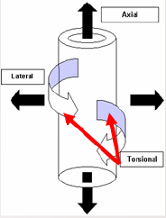
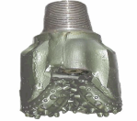
Conceptual 12-1/4” BHA Design
Shorter center of mass
8-1/2” DC
8-1/2” DC
9-1/2” DC

Slide 12

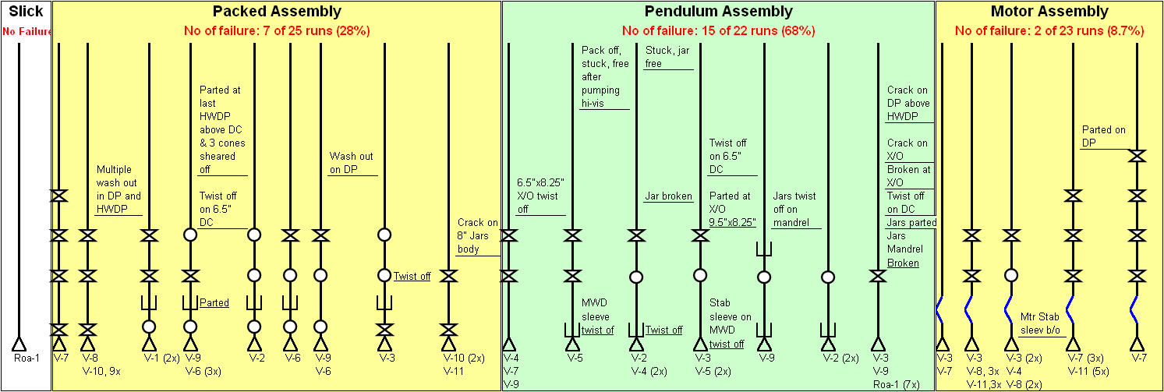
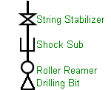
12-1/4” Offset BHA: The Fact ……..
Note:

Slide 13
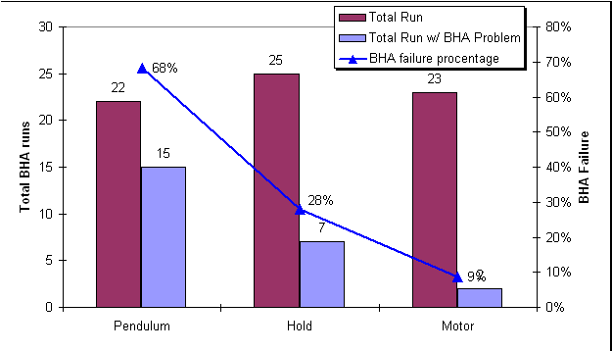
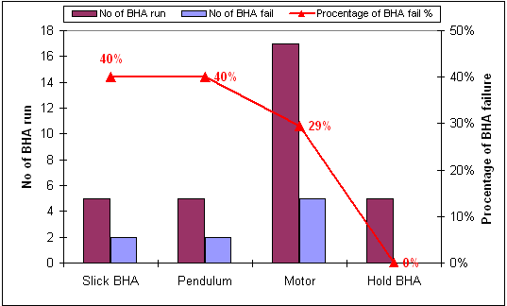
12-1/4” Offset BHA – BHA Type vs. BHA Failure
V wells W Deep Wells
Motor BHA is the smallest risk of BHA failure
No NPT when BHA failure on Motor BHA (motor stab sleeve backed off, hung above bit, not caused fishing operation)
No Packed BHA failure at Wiriagar Deep and less failure at Vorwata
Pendulum BHA is the highest risk of BHA failure (40%-68%)

Slide 14
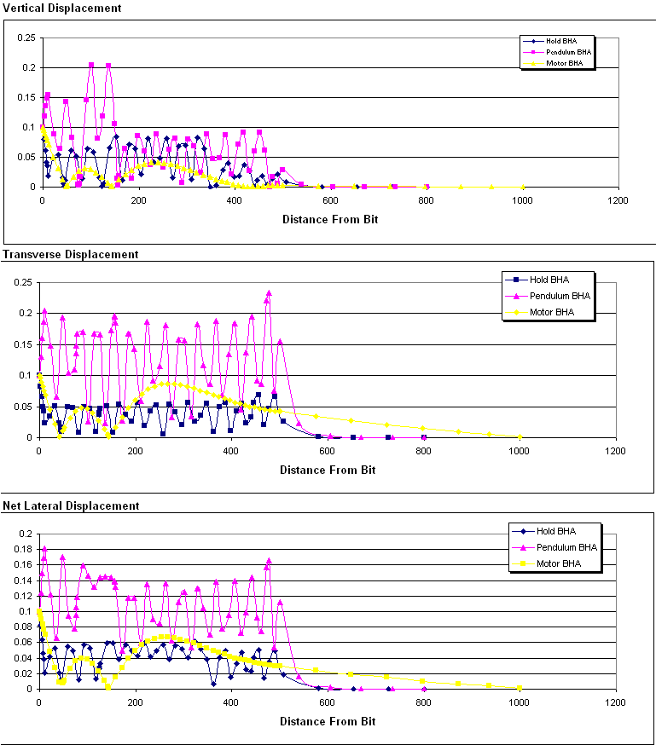
12-1/4” BHA – Lateral Displacement and BHA type
Wellplan 2000, Critical Speed Module

Slide 15
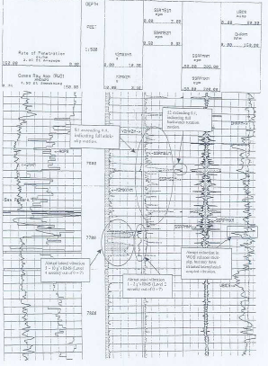
Downhole Vibration Record - sample
GR & ROP
Lateral
Axial
Vibration
Min
Max
DHRPM
Realize that in stick-slip event, the downhole BHA component always face critical speed rotation although we maintain surface rotation in safest RPM range.
Real Time Downhole Detected Vibration is useful for observing actual vibration on Drill String and immediate mitigation.
S1
S2
V Well (7,600’ – 7,730’)
Notes:
g-RMS:
g is the natural Earth Gravity Acceleration (=9.91 m/s2 or 32.17 ft/s2). VSS and CoPilot tool express the acceleration level in g-RMS. The RMS value gives an indication of both the mean and dsipersion of a sample of values and is a much more indicative way of classifying the amount of detrimental energy occurring during a certain period of vibration.
s1 = (max_RPM – min_RPM) / (2 x Avg_RPM) , over a 7.5 sec time interval
s2 is the percentage of time in which the downhole tool rotates backward as a result of the stick-slip movement of the string.

Slide 16
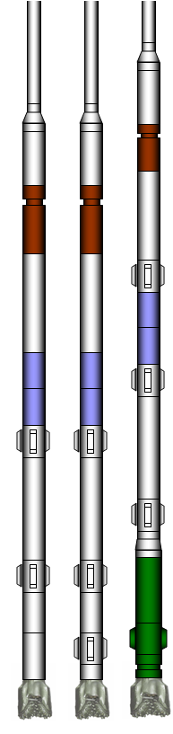
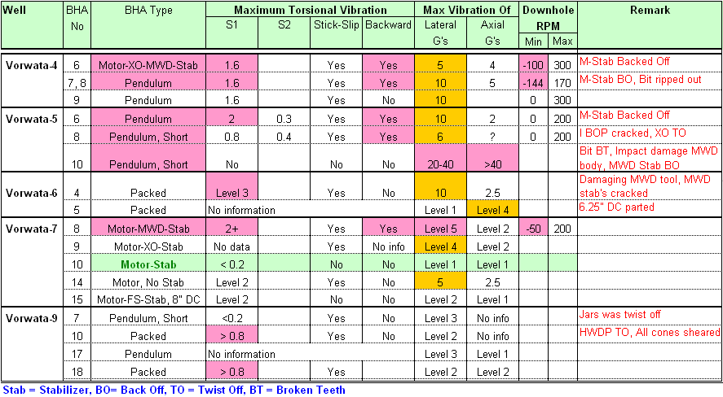
12-1/4” BHA – Vibration Record Summary of Offset Wells
V-4
V-5
V-6
V-7
V-9
Reference:
BHA Offset & T Drilling Dynamic Study
No backward motion was reported on Packed BHA
Pendulum BHA has more lateral and axial vibration
Stabilizer distance on motor may effect on vibration magnitude
The lowest vibration was reported when placed stabilizer just above the motor

Slide 17
12-1/4” BHA: JARS AND DC SIZES

Slide 18
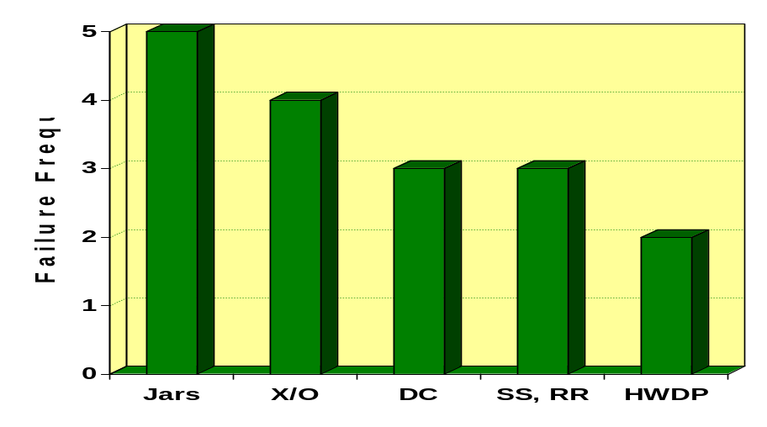
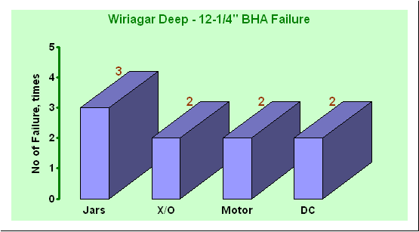
12-1/4” BHA – Failure record on BHA component
Vorwata
V Wells 12-1/4” BHA failure:
No major failure on mud motor BHA.
The most frequent failure of BHA component is Jars
2 of 3 DC failures were 6.5” DC size
BHA failure at W wells had similarity with V wells
Why Jars…?

Slide 19
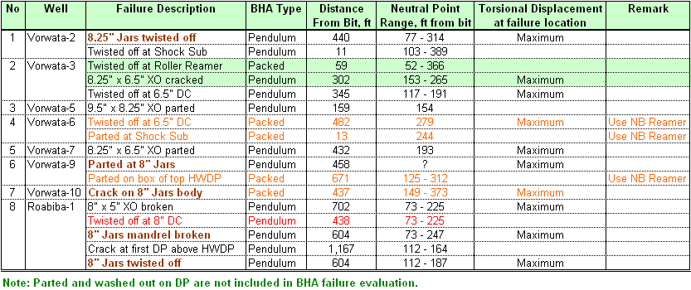
12-1/4” BHA – Failure Evaluation on BHA component
V1 – V10
Rbb
V wells 12-1/4” BHA failure:
10 of 17 failures (DC, Jars and X/O) are located at maximum Torsional Displacement
2 of 17 failures are located near of neutral point
2 of 3 failures on DC (6.5” DC size)

Slide 20
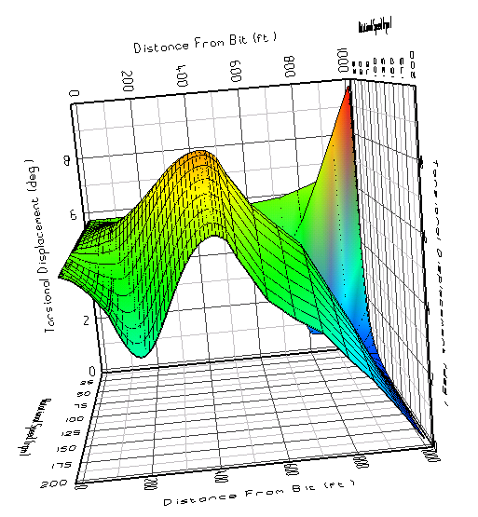
Why Drilling Jars fail..?
Jars position at maximum torsional displacement
Wellplan 2000, Critical Speed Module

Slide 21

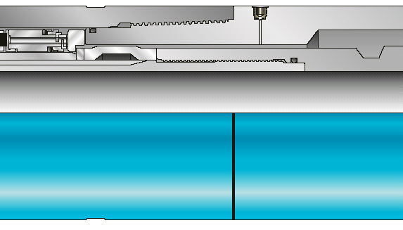
Why Drilling Jars fail..?
Not solid part, but consist of mandrel and housing
Flex section, OD reduction
Weak Points (T Drilling Dynamics Study):
ACME or non-API thread with sharper root radii than API RSC thread root
Mid body connection have smaller cross-section areas
Notch or hole in jars housing will accelerate fatigue
Various internal component age traceability
Jars Placement
Most of the jars were placed at distance from bit where torque displacement is maximum

Slide 22

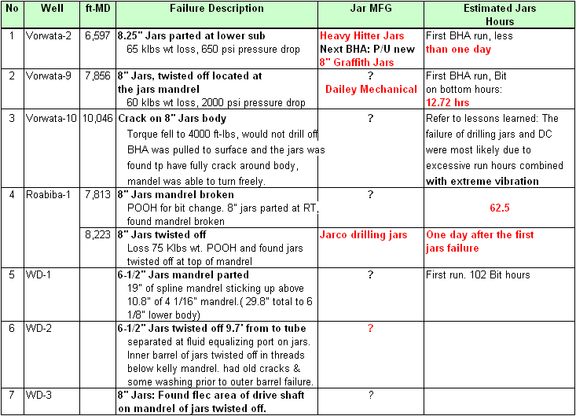

12-1/4” BHA – Jars Failure Summary
3x
V2, V9, V10
Rbb 1
WD 1 - 3
Summarized from DIMS & Final Well Report

Slide 23
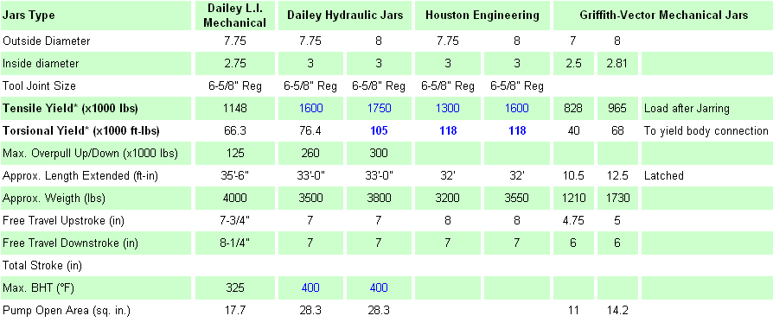

12-1/4” BHA – Drilling Jars Technical Comparison
Source: Jars Technical Specification from Manufacturer
Less Torsional Yield strength in its class
Run high strength drilling Jars, torsional yield not less than 100 ft-klbs
Will run 6-1/2” drilling Jars for drilling 12-1/4” hole?
Griffith has double acting jars that has bigger Torsional Yield.

Slide 24
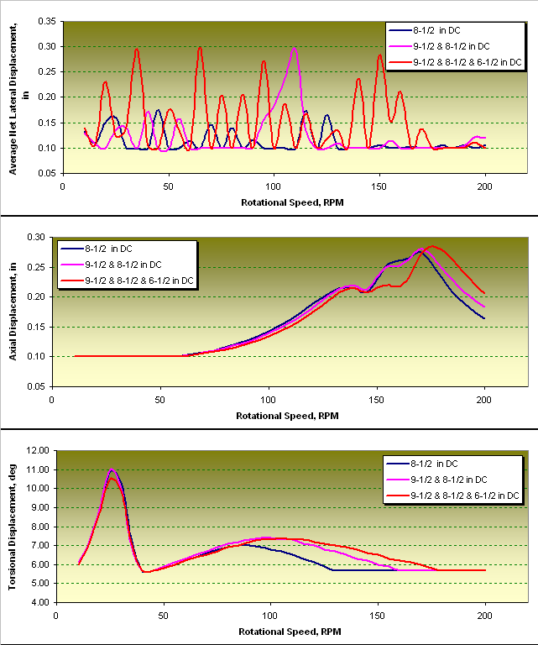

12-1/4” BHA – Vibration analysis on various DC Sizes
Do not use combination 9-1/2”x8-1/2”x6-1/2” DC or 9-1/2”x8-1/2” DC due to causing higher average net lateral displacement.
BHA with 9.5” DC will use X/O to 8.5” DC that could be as additional weak component on BHA
Use single size of 8.5” DC series: Less average net lateral displacement which will improve the bit ROP.
If use 9-1/2” motor for drilling performance reason, crossed directly above it to 8-1/2” DCs series or 8-1/2” downhole tools.
9-1/2
8-1/2
8-1/2
Wellplan 2000, Critical Speed Module

Slide 25
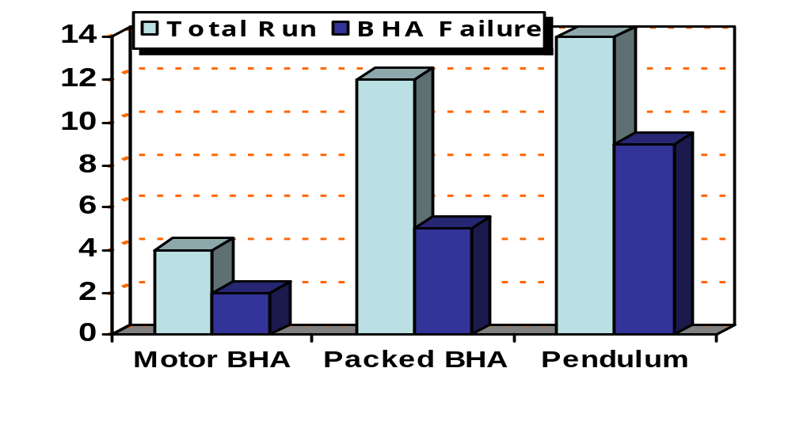
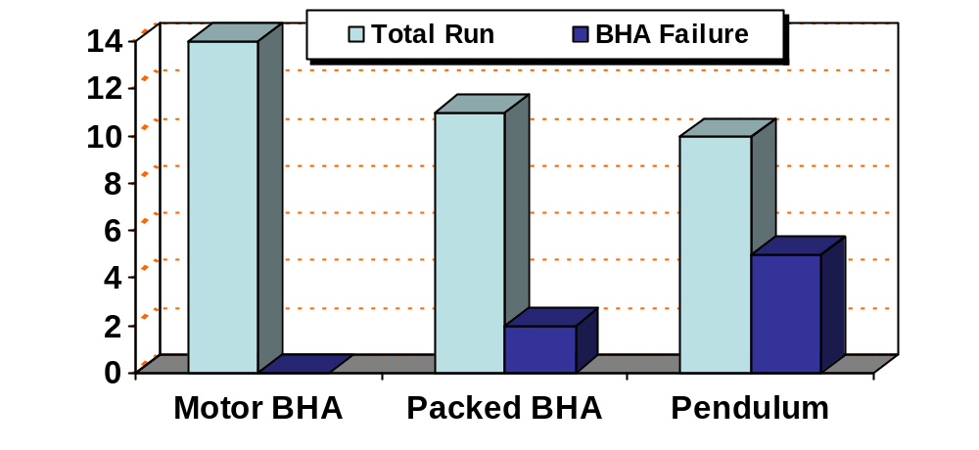
12-1/4” BHA – The Fact …….!
BHA with 9-1/2” DC Series
Motor BHA: 2 failures of 4 run
Packed BHA: 5 failures of 12 run
Pendulum BHA: 9 failures of 14 run
!
53% BHA failures
BHA with 8-1/2” DC Series
Motor BHA: No failure of 14 run
Packed BHA: 2 failure of 11 run
Pendulum BHA: 5 failures of 10 run
0%
18%
20% BHA failures

Slide 26
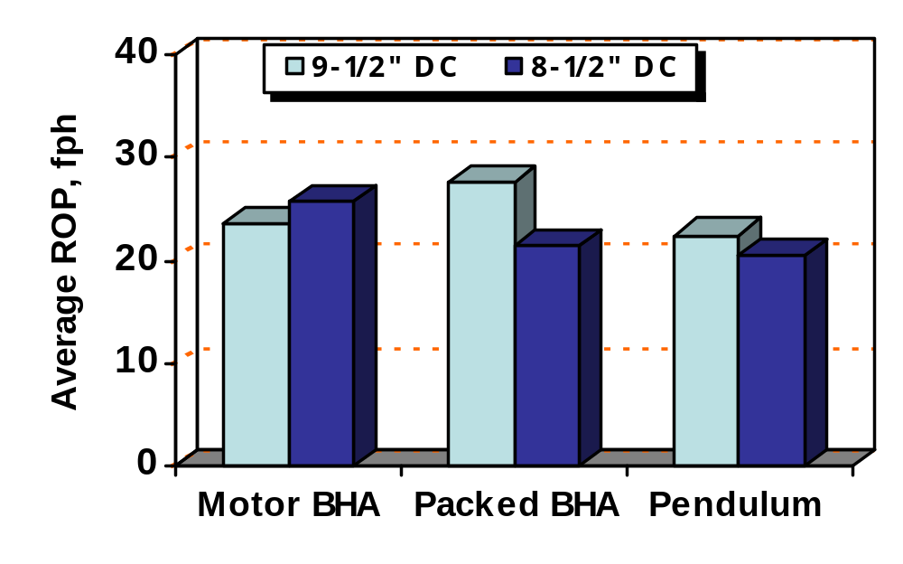
12-1/4” BHA – The Fact …….!
Faster ROP for Packed & pendulum BHA that used 9-1/2” DC Series
Faster ROP for Motor BHA that used 8-1/2” DC Series

Slide 27

Bit ROP Enhancement:
1. Shock Tool
2. Optimize BHA Stabilization
3. Downhole Vibration Tool (optional)

Slide 28
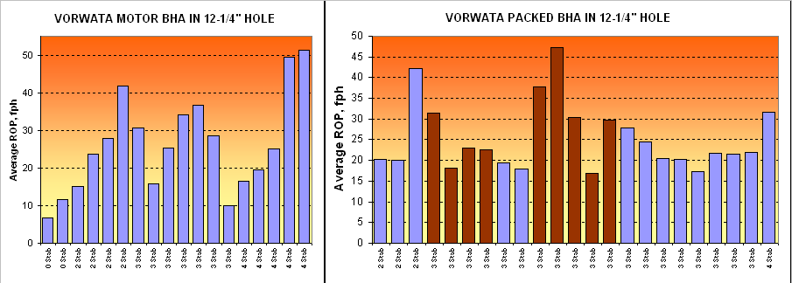
12-1/4” Bit ROP verses Number of stabilizers
Using Shock Sub
Shock Sub (SS) vs Average bit ROP on Packed BHA:
W/O SS : 21.2 fph
With SS : 28.6 fph
ROP is minimum on motor BHA when without stabilizer.
Maximum ROP of motor BHA were achieved when utilized 4 stabilizers
Maximum ROP of packed BHA were achieved when utilized 3 stabilizers & shock sub

Slide 29
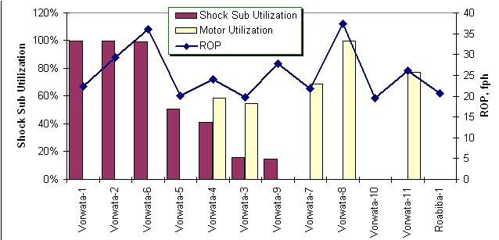

12-1/4” Offset BHA – Shock Tool vs ROP
Motor w/ Top Stab
Well
V1 – V11
Rbb-1
Use Shock Sub on packed BHA to improve bit ROP performance (V-1, 2 & 6)
Motor with top stabilizer (without Shock Sub) perform best ROP (V-8 & 11).

Slide 30
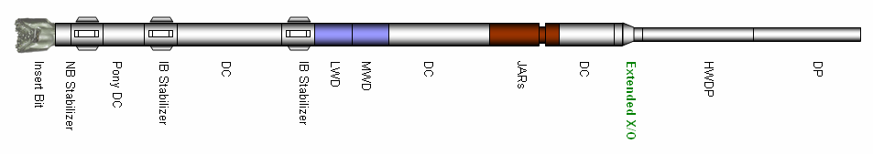
12-1/4” Packed BHA Stabilization
Vibration evaluation of various packed BHA stabilization model
B, ft | C, ft
15 | 30
20 | 30
30 | 30
15 | 60
20 | 60
30 | 60
Stabilizer Distance
F
A
B
C
D
E

Slide 31
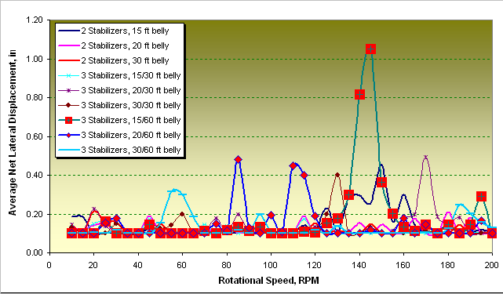
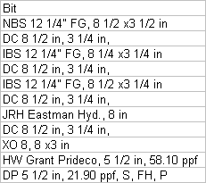
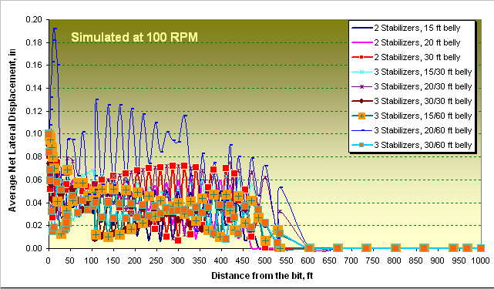
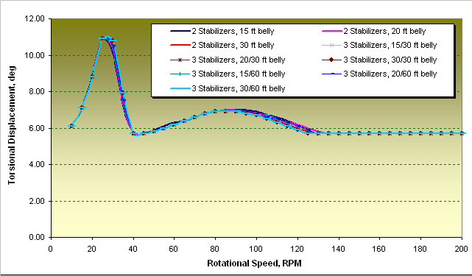
12-1/4” Packed BHA vs. Various Stabilization
BHA Component
Packed BHA Stabilization:
Do not apply 15 / 60 ft and 20 / 60 ft BHA stabilization. The net lateral displacement is higher.
Various stabilization model are no significant impact on torsional displacement.
Wellplan 2000, Critical Speed Module

Slide 32
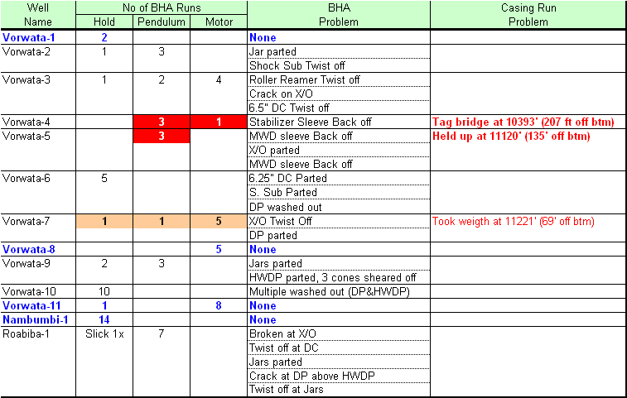
12-1/4” Hole – BHA Type vs Run Casing problem
Note: SPE/IADC 52820 – Consequences and Relevance of Drillstring Vibration on Wellbore Stability. Petrobras @1999

Slide 33
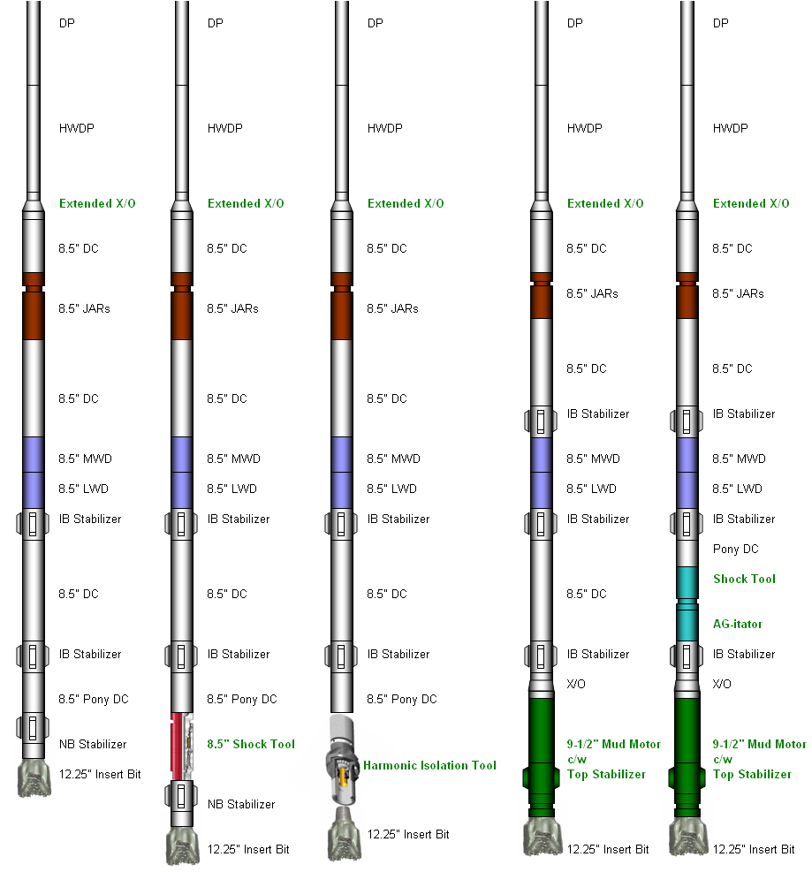
Develop 12-1/4” Packed and Motor BHA Configuration
Packed or Motor BHA Design:
Use 3 or 4 stabilizers
Not required Shock Tool on Motor BHA
Recommended distance between stabilizers:
15/20/30 - 30 ft Or 30 - 60 ft
Do not to use BHA Stabilization of 15 - 60 ft or 20 - 60 ft belly.
Benefit to use downhole vibration tool (i.e HIS, AG-itator) must be discussed further.

Slide 34
8-1/2” Hole Section

Slide 35
8-1/2” BHA – Offset well
No BHA failure except in Roabiba-1 wells
Low ROP (overbalance & vibration?)
Some of wells had mud losses (28%)
BHA type: Pendulum, Pack, Motor
Various combination number of joints 6.5” DC and 5” HWDP
PDC or insert bits
WOB of the bit 15 – 40 klbs.
Drilled into overpressure Paleocene, Roabiba, Permian formation.

Slide 36
8-1/2” Hole – BHA study conclusion
DO:
BHA type: mud motor with top stabilizers. Stabilize BHA with 2 or 3 stabilizer above the mud motor.
Use minimum 6-1/2” DC series. Utilize HWDP for providing bit WOB. This configuration will minimize vibration of net lateral displacement to enhance bit ROP and also have less risk of differential sticking.
DON’T:
Do not utilize 6-1/2” DC for providing bit WOB.

Slide 37
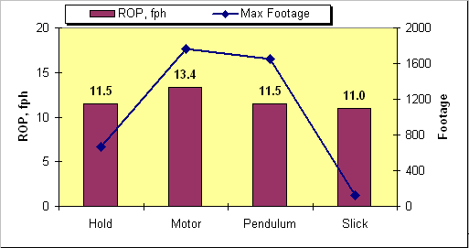
8-1/2” BHA – BHA Type vs. Bit ROP (V wells)
Use Motor assembly
  Better ROP
  Better bit footage

Slide 38

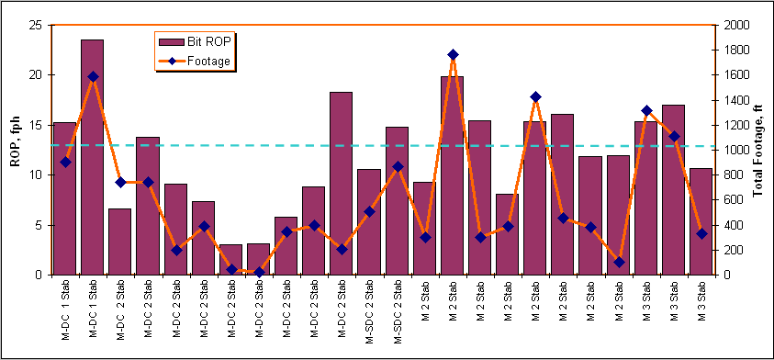
8-1/2” BHA – Motor Assembly Stabilization vs. Bit ROP
V wells
Average
Longer pendulum length (distance first stabilizer to the bit) performed less ROP.
Better ROP on motor BHA with 2 or 3 stabilizers

Slide 39
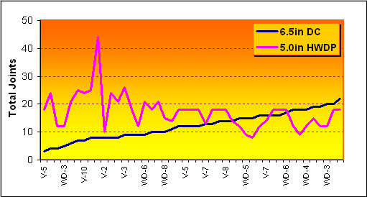
8-1/2” Offset BHA – DC and HWDP review
?
DC and HWDP Utilization on BHA
WOB
Which’s better to utilize Drill Collars or Heavy Drill Pipes for providing bit WOB?
HWDP for WOB
35 Klbs
50 Klbs

Slide 40
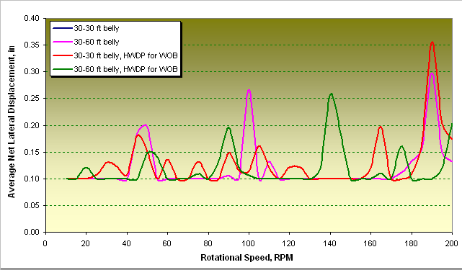
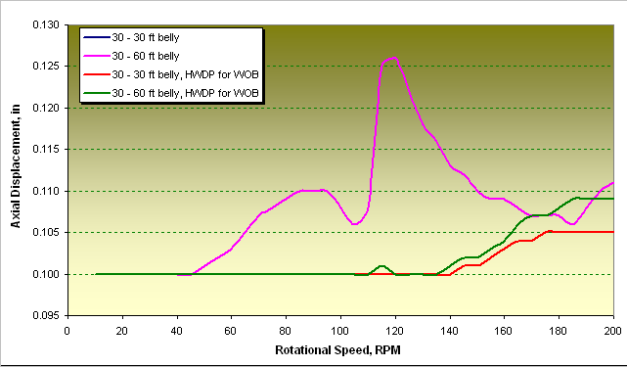
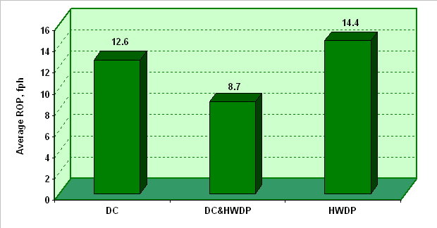
8-1/2” BHA Model – Optimum DC & HWDP configuration
Replacing DC with HWDP to provide bit WOB will have less lateral displacement (RPM<180), which could enhance bit ROP.
Use HWDP could minimize risk of differential sticking while drilling into high mud overbalance environment.
Utilize HWDP will have less axial displacement which could prolong bit life.
HWDP does not have stress concentrated internal upsets, its ID is constant (*).
HWDP: tube stiffness more closely approximates the connection stiffness, making it the most balance component (*).
Note: 30-30 ft belly & 30-60 belly have similar value
Note: 30-30 ft belly & 30-60 belly have similar value
Reff: - Wellplan 2000, Critical Speed Module
(*) T Drilling Dynamics Study

Slide 41
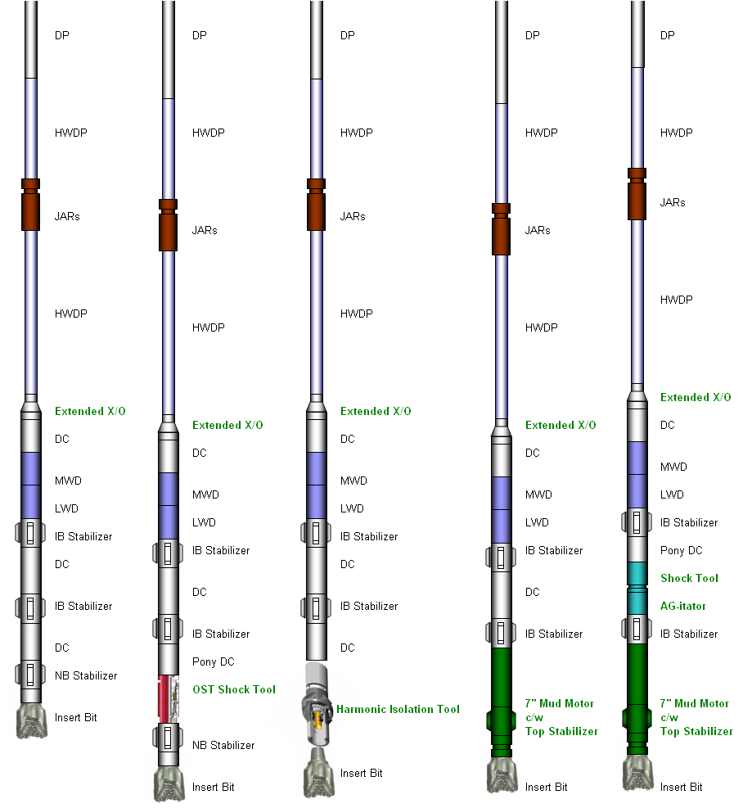
8-1/2” BHA Model Schematic
BHA stabilization: 30-30 ft or 30-60 ft belly
Use HWDP to provide bit WOB
On execution, run vibration analysis using actual each BHA component weight to determine safe drilling RPM range.
Benefit to use downhole vibration tool (i.e HIS, AG-itator) must be discussed further.

Slide 42
Further Discussion
Mud motor or Rotary Steerable System
String Stabilizer type
Downhole vibration tool, ie. Harmonic isolation tool, AG-itator etc.
Real time drill string vibration monitoring
Drillstring vibration software
Fatigue analysis / sotfware

Slide 43

String Stabilizer Type
1
2
3
Replace Straight Blades Stabilizers with Spiraled Blades Stabilizers
Straight Blades Stabilizers generate Lateral and Torsional Shocks to the drillstring in Inclined Wellbores
Reference: T Drilling Dynamic Study for Arco Berau & Wiriagar

Slide 44
Further Discussion
Drillstring vibration software animation

Slide 45
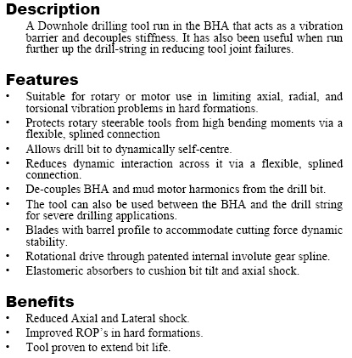
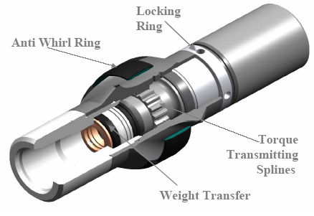
Harmonic Isolation Tool

Slide 46
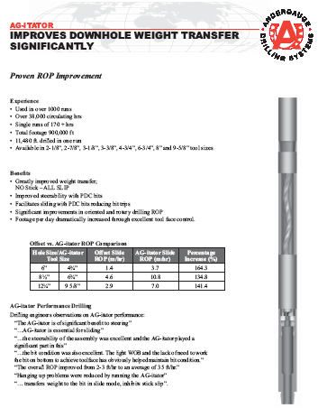
AG-itator

Slide 47
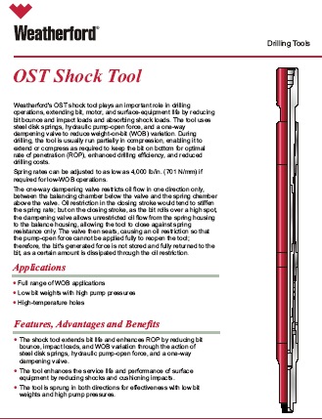
Shock Tool

Slide 48
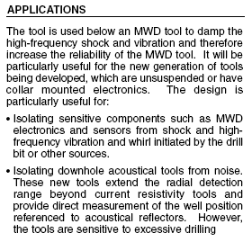
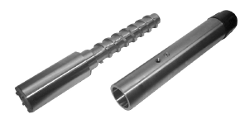
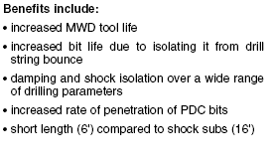

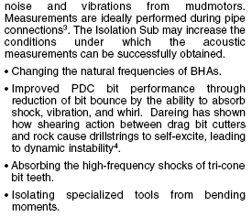
Isolator For Controlling BHA Vibration

Slide 49
The End

Slide 50
How To Measure Drill String Vibration
Surface Detection
Proximity Sensor
Rotary Torque Sensor
Pressure Sensor
Downhole Detection
Accelerometer (Lateral & Axial Vibration)
Magnetometers (Torsional Vibration)
Strain Gauge
Accelerometer:
BHI, SperySun most commonly use Mean, RMS (Root Mean Square) and actual g force value for describing the magnitude of the vibration type.
Anadrill, on other hand, is known for monitoring “shock” counts
Axial / Lateral Vibration Severity | Level RMS G’s
0 | 0 – 0.6
1 | 0.6 – 1.25
2 | 1.25 – 2.5
3 | 2.5 – 5.0
4 | 5.0 – 10.0
5 | 10.0 – 20.0
6 | 20.0 – 40.0
7 | > 40.0

Slide 51
How To Measure Drill String Vibration
Magnetometers :
Measure RPM fluctuation in the X and Y axes
The X and Y axis magnetometers are sampled at 20 Hz collected over a 7.5 second time interval. The RPM is then calculated and smoothed to 30 samples. Record Min, Max and Average to obtain two variables:
  S1 = (RPM_Max-RPM_Min)/2 X RPM_Avg.
  → If S1 > 0.2 Torsional Oscillation is occurring, If S1 > 0.8, Stick-Slip is occurring
  S2 = (# of samples < 0) / 30
  → If S2 > 0.1 then backwards rotation has occurred

