Slide 1

RIG HORSE POWER FOR DRILLING NIL WELLS
Revision 00
1. Land Drilling Rig Overview 2. Drawwork Horse Power of Offset Wells 3. Rated Drilling Depth by Rig Manufacturer 4. Rig Sizing Study 5. Rig Procurement Method

Slide 2

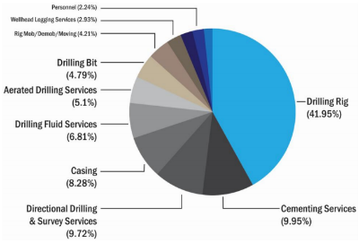
  1. Rig Cost vs Well Cost
Rig Services cost is the highest drilling cost component (+42%)

Slide 3
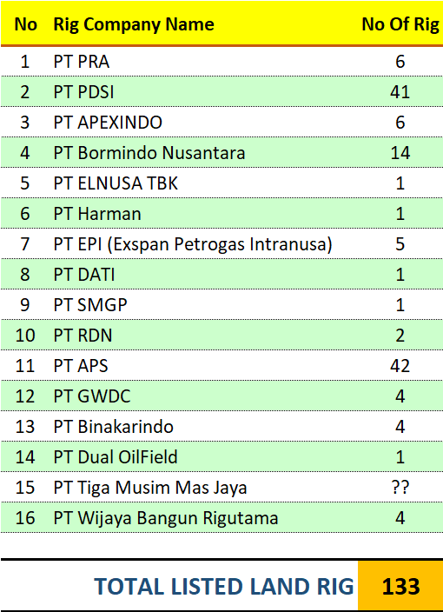
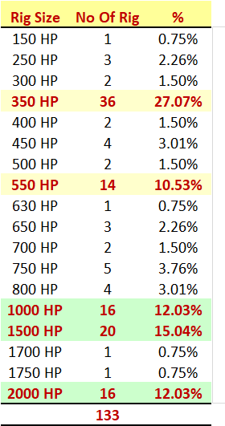
  1. Rig Inventory

Slide 4
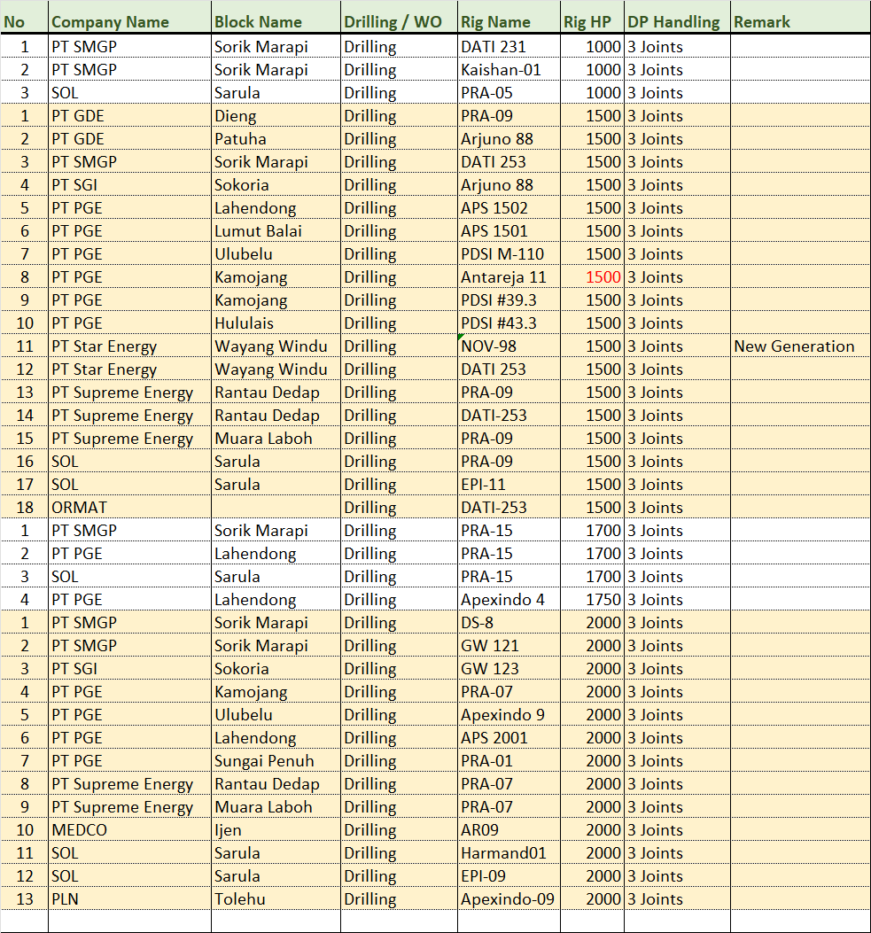
  1. Geothermal Drilling Rig in Indonesia
There two companies have been using Drilling Rig 1000 HP to drill Geothermal Wells:
SMGP
SOL

Slide 5
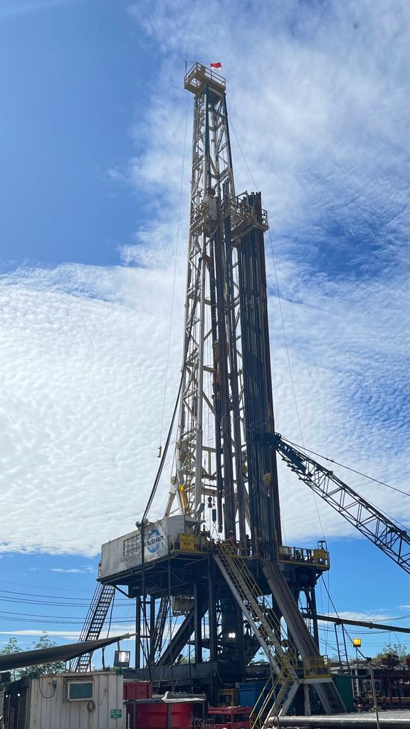
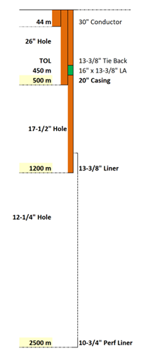
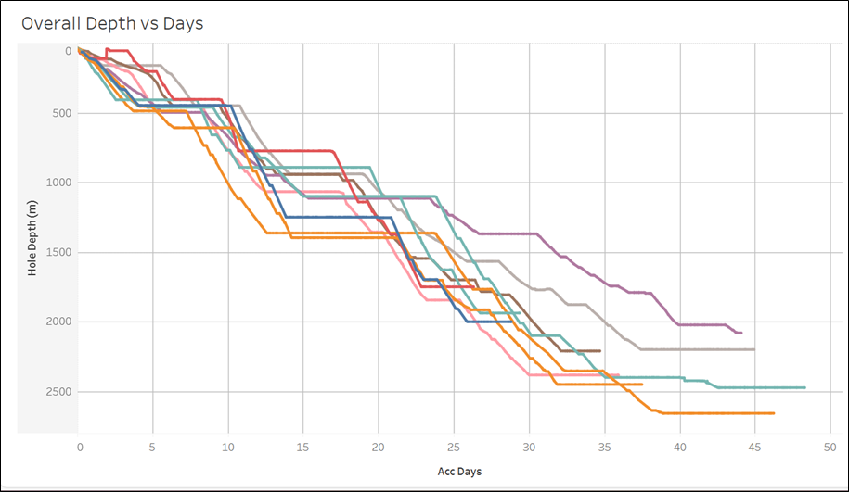
  1. Drilling Rig 1000 HP, SMGP
Deepest TD 2700 m-MD
TDS 350 T, 800 HP
5” DP, 19.5 ppf, G-105, 4½ IF, R2
4 Mud Pumps, 1000 HP
KS ORKA was successful to use 1000 HP Kaishan-1 Rig which the deepest TD of 2700 m-MD

Slide 6
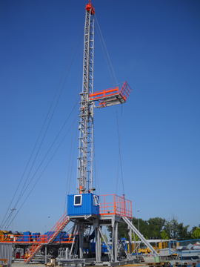
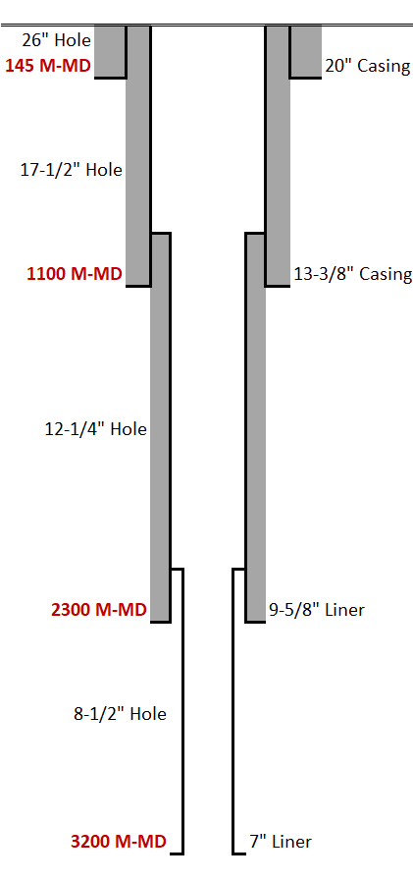
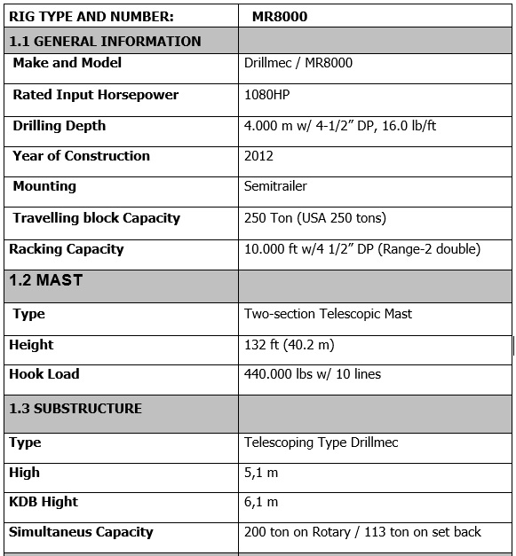
  1. Drilling Rig 1000 HP, Turkey Geothermal
2 Joints Rig Mast
Drilling Geothermal in Turkey
TD at 3200 m-MD
4 ½ 16.6 lb/ft G105 DP , 4’’ IF
Rig Daily rate: + USD 11.500

Slide 7
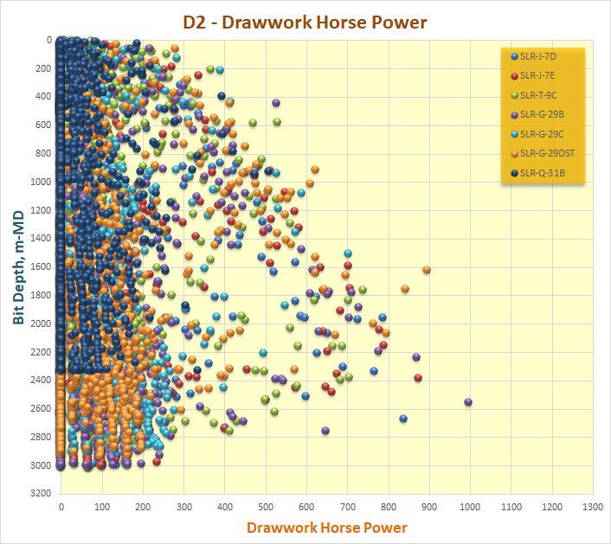

  2. Drawwork Horse Power – Offset Wells
W = Actual Hook load, lbs
Vh = Actual Pick Up speed, fpm
η = Drawwork Efficiency, use 0.8
Dieng-2 Drilling Campaign use PRA-09, 1500 HP rig.
The deepest TD at 3009 m-MD
Most likely, the rig drawwork was utilized less than 900 HP

Slide 8
  2. WJR1-2 and NIL2N-2ST Drawwork Horse Power
W = Actual Hook load, lbs
Vh = Actual Pick Up speed, fpm
η = Drawwork Efficiency, use 0.8
Max power used to pick up at WJR1-2 is 514 HP (with a
2000 HP rig)
Max power used to pick up at NIL2N-2 ST is 715 HP (with a 1000 HP rig – PRA-05)

Slide 9
  3. Drilling Rig Specification Summary – Rig Manufacturer
Capacity (Min-Max) | Unit | 650 HP | 700-850 HP | 1000-1150 HP | 1200-1340 HP | 1500 HP | 1700-1800 HP | 2000 HP
Rated Drilling Depth | Meter | 1800 | 2500 3993 | 3000 3800 | 3700 5000 | 3500 6095 | 5100 9144 | 3500 6700
Mast Capacity (Hook Load) | K-Lbs | 350 400 | 400 500 | 440 650 | 441 672 | 675 1000 | 850 1000 | 975 1250
Rotary Table Opening | Inch | 17.5 27.5 | 20.5 27.5 | 27.5 | 27.5 37.5 | 27.5 37.5 | 37.5 | 37.5
Rotary Table Height | Meter | 4.9 5.5 | 4.9 7.6 | 5.7 10.25 | 7.71 | 6.1 9.1 | 8.2 9.4 | 8.2 9.1
Mud Pumps | HP | 1000 1300 | 900 1300 | 1000 1600 | 1000 1300 | 1300 1600 | 1300 1600 | 1300 1700
Mud Tanks | Bbls | 500 1000 | 750 1230 | 1050 1547 | 1383 2100 | 1000 2400 | 1080 1960 | 1476 1812

Slide 10
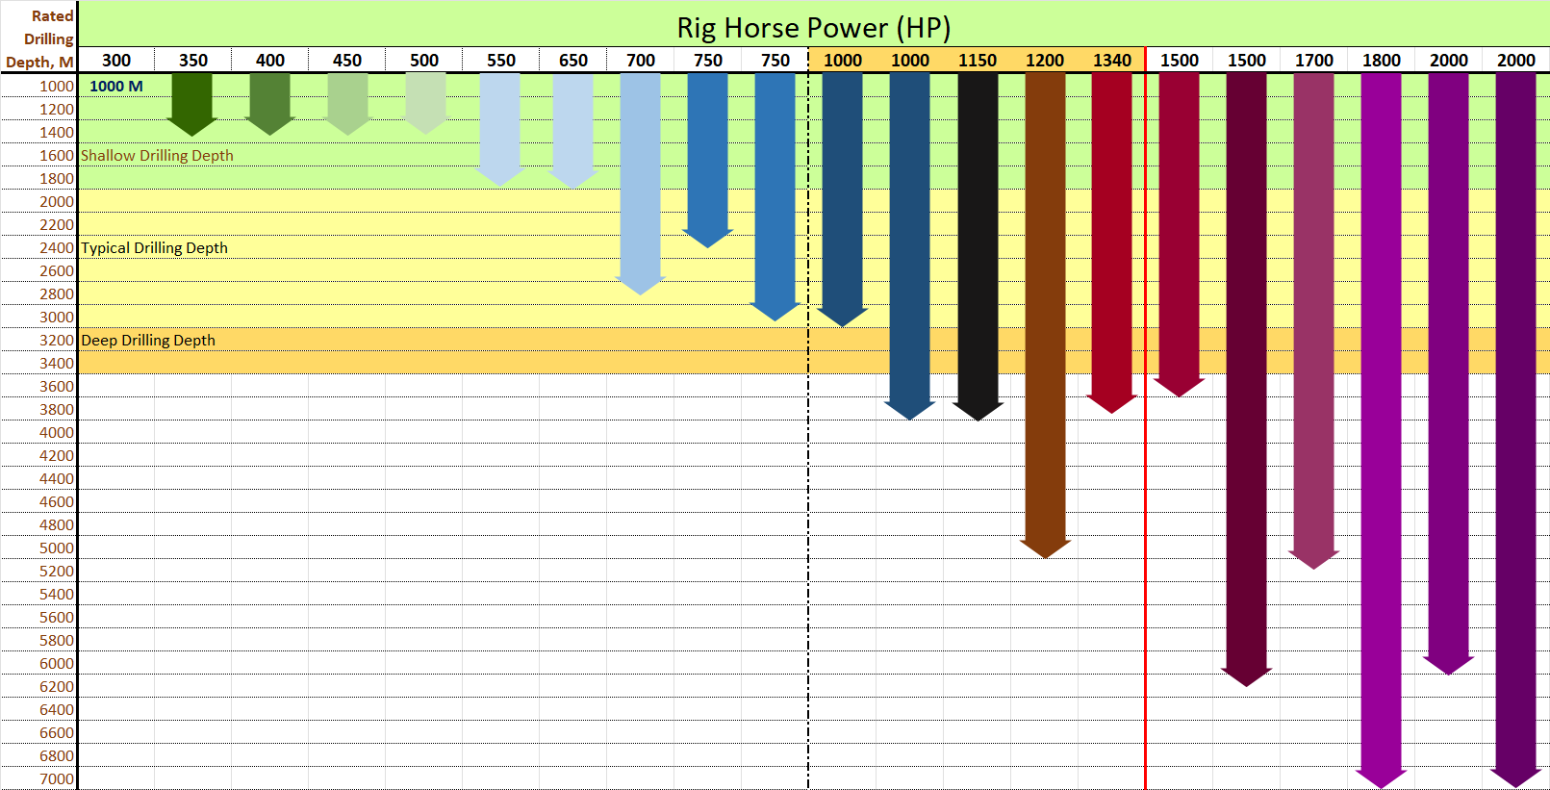
  3. Land Rig Rated Drilling Depth by Rig Manufacturer
Work Over, Shallow Drilling
Typical Drilling Geothermal
Super Heated Well

Slide 11
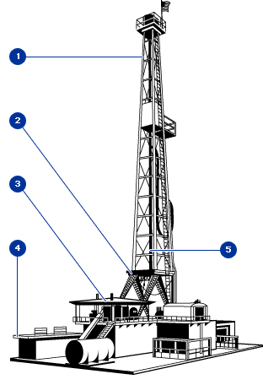
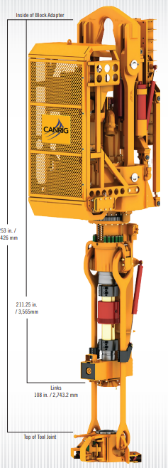
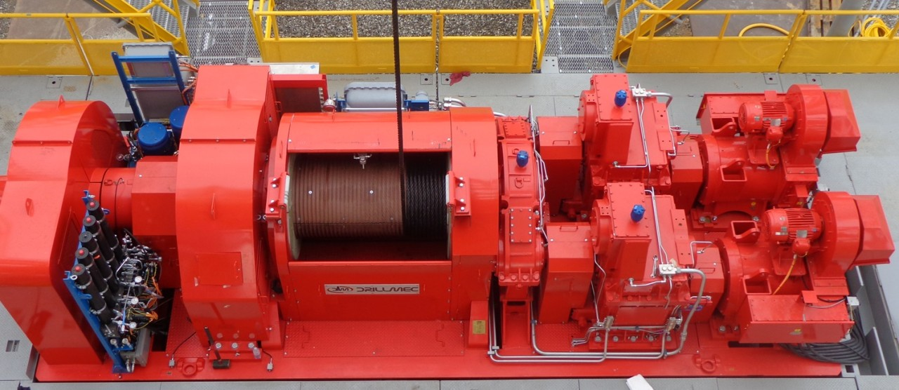
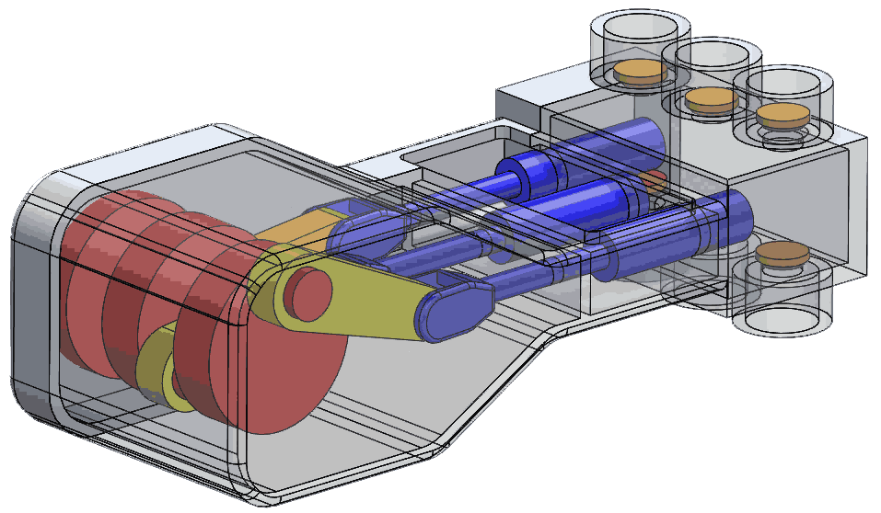
  4. Drilling Load Analysis Methodology
Rig Equipment | Specification Required | Drilling Loads To Be Analysis
Derrick Mast | Hoisting Capacity | Hook Load
Drawwork | Horse Power | Hook Load Pick Up Speed
Top Drive System | Hoisting Capacity Horse Power | Hook Load Surface Torque
Mud Pump | Flow Rate – GPM Pump Pressure | Maximum Flow Rate Maximum Pump Pressure
Drill Pipe | Tensile Make Up Torque | Hook Load Surface Torque

Slide 12
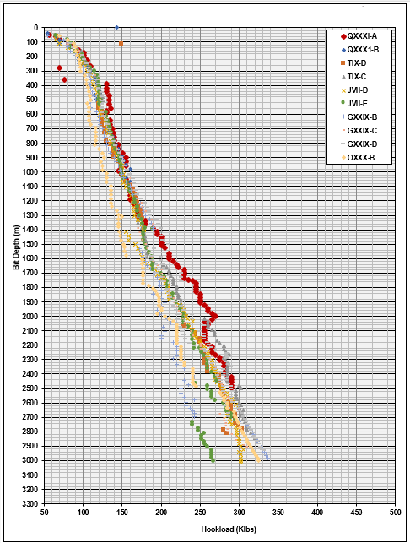
  4. Pick Load Dieng-2 vs WJR1-2 Offset Well
Dieng-2
WJR1-2
At WJR1-2, the actual maximum Pick up weight is 318 klbs. Assuming 100 klbs margin for jarring, a 1000 HP Drilling rig with 440+ klbs capacity Is sufficient

Slide 13
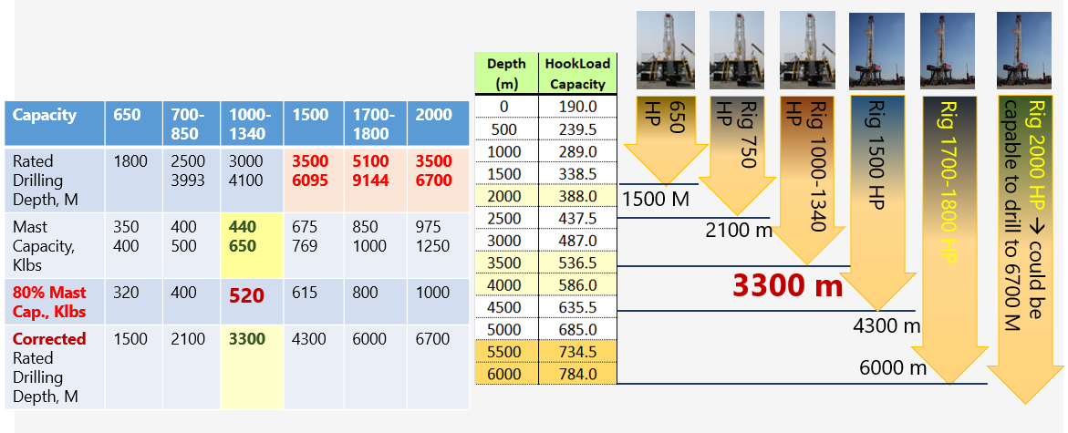
  4. Rated Drilling Depth vs Biggest Actual Pick Up Load

Slide 14
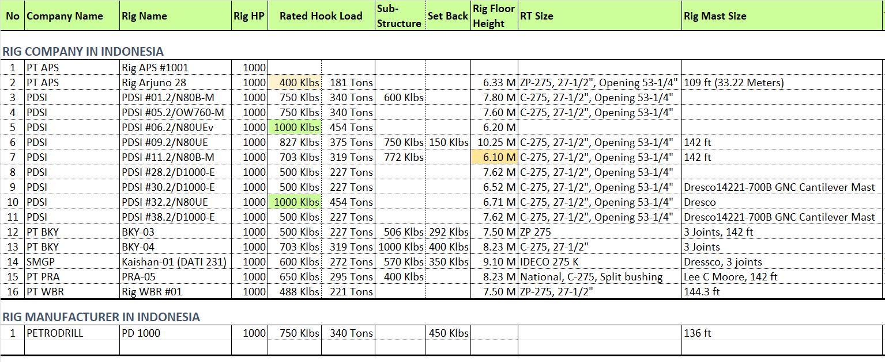
  4. Drilling Rig 1000 HP Technical Specification
Drilling Rig 1000 HP Hook Load and Rated Drilling Depth:
Minimum: 400 Klbs → Rated drilling depth: 2200 m
Average: 664 Klbs → Rated drilling depth: 4800 m
Maximum: 1000 Klbs → Rated drilling depth: Deep TD

Slide 15
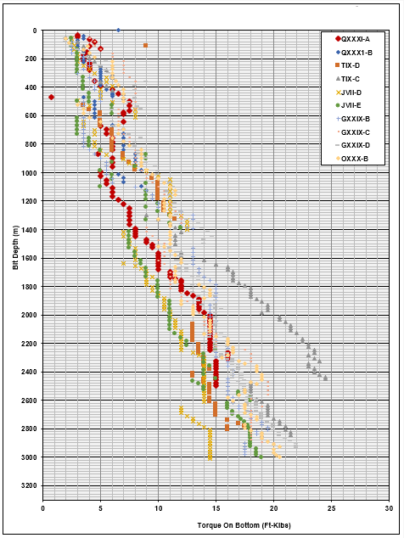
  4. ROB Surface Torque Dieng-2 vs WJR1-2 Offset Well
Dieng-2
WJR1-2
At WJR1-2, the max actual
Surface torque is 16 klbft at 7200 ft (2194 m).

Slide 16
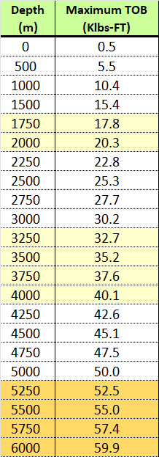
  4. Top Drive Selection
TDS Hoisting | TDS Horse Power | Maximum Continuous Torque, Lbs-Ft | Rated Drilling Depth
250 Ton 551 Klbs | 400 | 21000 | 2000 m
 | 600 | 24000 | 2300 m
350 Ton 771 Klbs | 600 | 30000 | 3000 m
 | 800 | 37000 | 3700 m
 | 1000 | 46000 | 4500 m
500 Ton 1100 Klbs | 800 | 37000 | 3700 m
 | 1000 | 52000 | 5250 m
 | 1100 | 52000 | 5250 m
 | 1200 | 58000 | 5750 m
 | 1300 | 70000 | > 6000 m
WJR1-2 maximum surface toque: 16 Klbs.ft
TDS 250 Ton OR 350 Ton, with minimum 600 HP

Slide 17
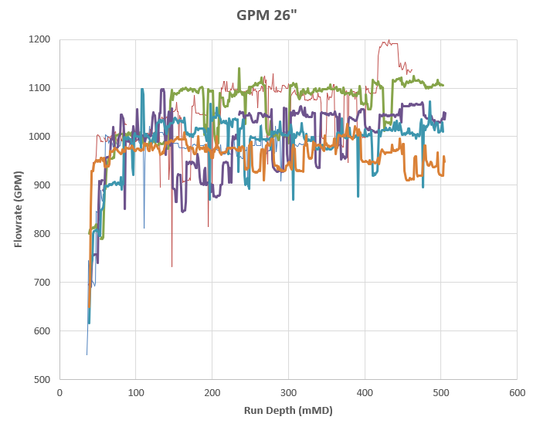
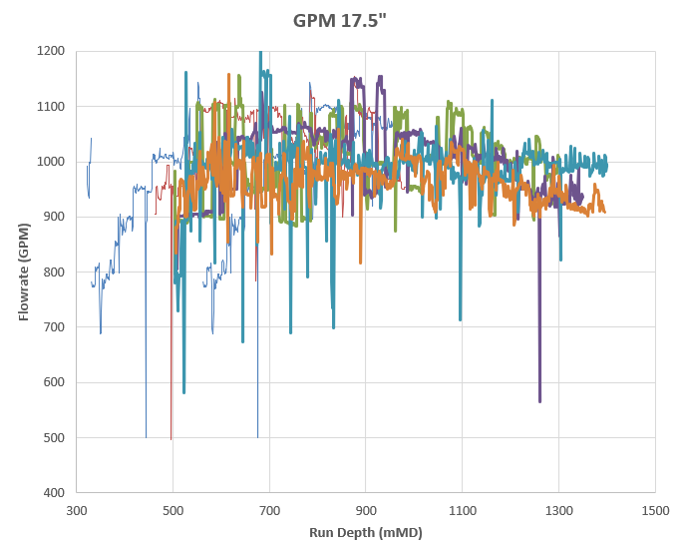
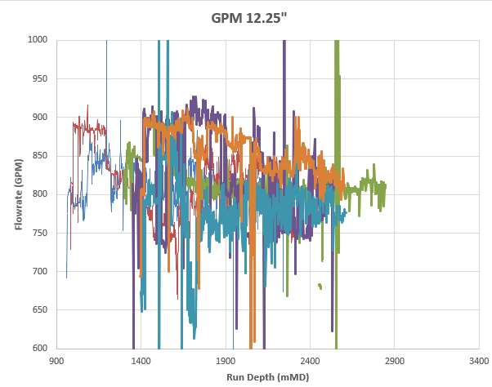
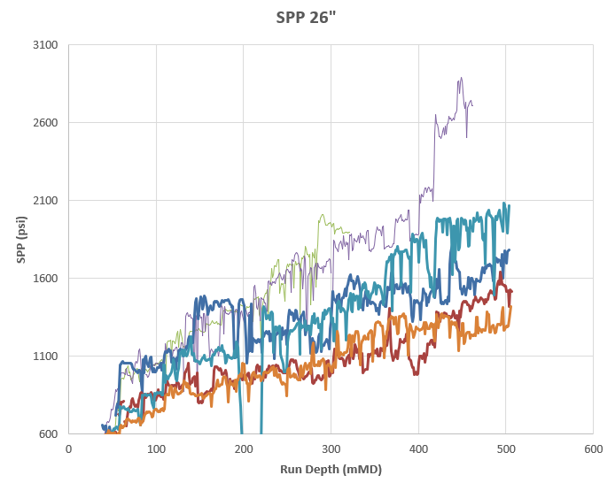
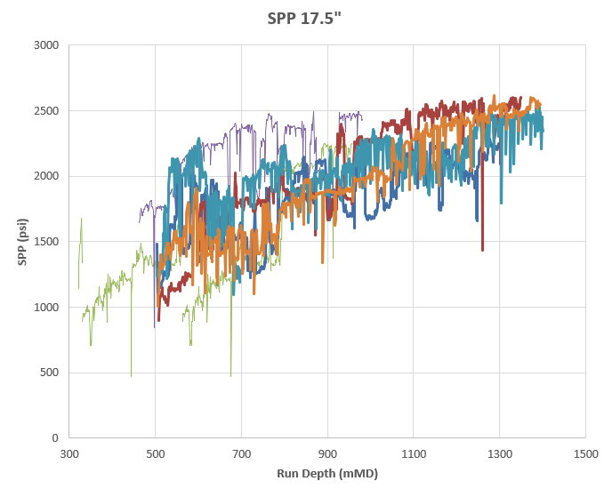
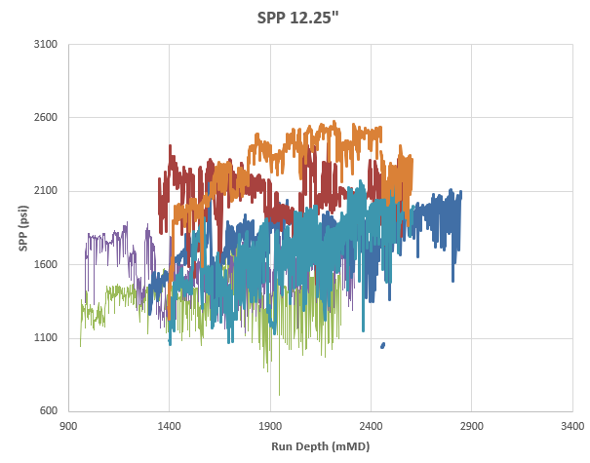
  4. Flow Rate and Surface Pressure
DG-2
GPM 26” Hole
GPM 17.5”
GPM 12.25”
1200 GPM, 2600 PSI
SPP 26” Hole
SPP 17.5”
SPP 12.25”

Slide 18
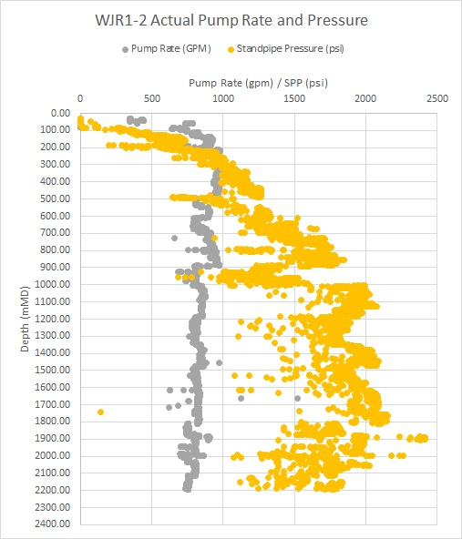
  4. WJR1-2 Actual Flow Rate and Surface Pump Pressure
Maximum Flow Rate: 1000 GPM
Maximum SPP: 2500 Psi

Slide 19
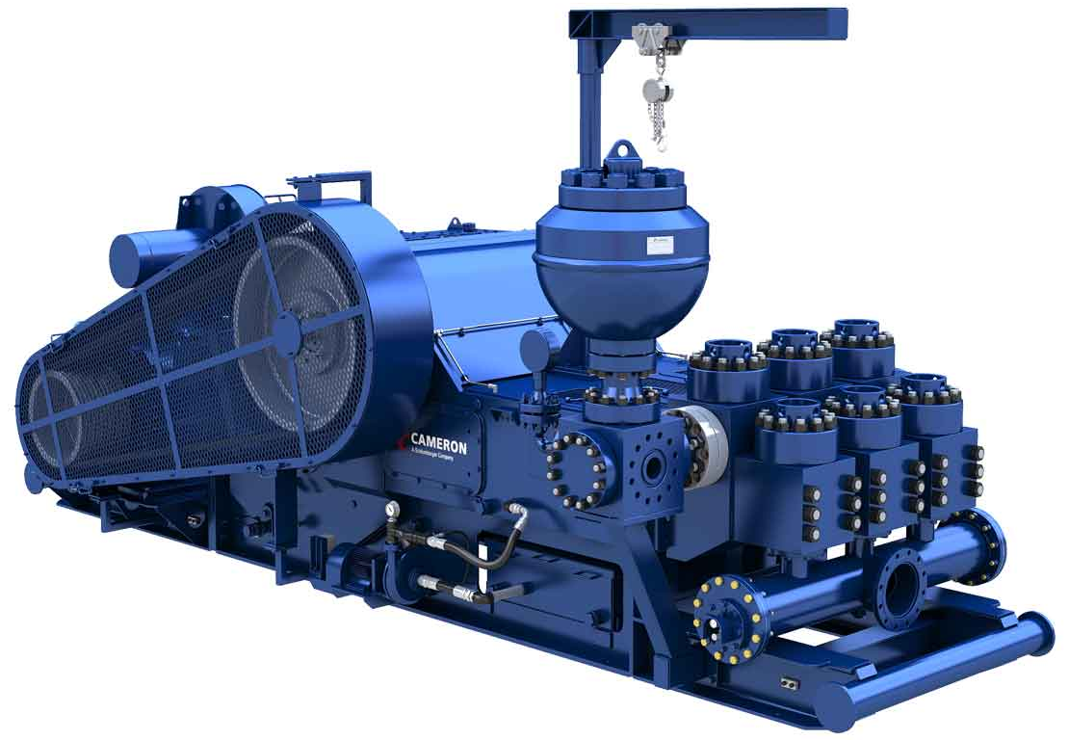
  4. Mud Pump Sizing
Hole Section | Max. Flow Rate, GPM | Max. SPP PSI
26” | 1200 | 2600
17½ | 1100 | 2600
12¼ | 925 | 2600
9⅞ | 850 | 2200
Mud Pump Rated | 1200 | 2600
It is recommended to determine the number of mud pumps:
The number of mud pump used
1 Spare
1 dedicated for Annulus
Mud Pump Rated | Liner Size | GPM @100 Spm | No Of Mud Pump | Max. SPP PSI
800 HP Mud Pump | 5½” | 306 | 4 | 2915
1000 HP Mud Pump | 6½” 6” | 430 307 | 3 | 2550 3000
1300 HP Mud Pump | 7” 6¾” | 603 561 | 2 | 2741 2957
1600 HP Mud Pump | 7” | 599 | 2 | 3434

Slide 20
  4. Drill Pipe Specification
Drill Pipe Specification | Tensile Strength, Klbs |  |  | Max Hook Load, Klbs | Hook Load Drilling Depth, M | Make Up Torque Klbs-Ft | MU Torque vs Drilling Depth, M | DP Rated Drilling Depth, M
 | New | Premium 80% New | Premium 85% SF
5” DP, 19.5 ppf, Grade G-105 | 554 | 443 | 376 | 415 | 2250 | 30.7 | 3000 | 2250
5” DP, 25.6 ppf, Grade G-105 | 742 | 594 | 505 | 544 | 3500 | 38.0 | 3750 | 3500
5” DP, 19.5 ppf, Grade S-135 | 712 | 570 | 484 | 523 | 3250 | 38.0 | 3750 | 3250
5” DP, 25.6 ppf, Grade S-135 | 954 | 763 | 649 | 688 | 5000 | 38.0 | 3750 | 3750
5½” DP, 21.9 ppf, Grade G-105 | 612 | 490 | 416 | 455 | 2500 | 43.3 | 4250 | 2500
5½” DP, 24.7 ppf, Grade G-105 | 696 | 557 | 473 | 512 | 3250 | 43.3 | 4250 | 3250
5½” DP, 21.9 ppf, Grade S-135 | 787 | 630 | 535 | 574 | 3750 | 52.1 | 5200 | 3750
5½” DP, 24.7 ppf, Grade S-135 | 895 | 716 | 609 | 648 | 4500 | 52.1 | 5200 | 4500

Slide 21
  4. Rig Sizing Summary
Capacity | 750 HP | 1000-1340 | 1500 HP | 1700-1800 | 2000
Rated Drilling Depth, M | 2500 3993 | 3000 4100 | 3500 6095 | 5100 9144 | 3500 6700
Mast Capacity, Klbs | 400 500 | 440 650 | 675 769 | 850 1000 | 975 1250
80% Mast Cap., Klbs | 320 400 | 440 520 | 540 615 | 680 800 | 780 1000
Adjust Rated Drilling Depth, M | 1400 2100 | 2500 3300 | 3600 4300 | 5000 6000 | 6000 6700
TDS Sizing | 250 Ton 600 HP | 350 Ton 800 HP | 350 Ton 800 -1000 HP | 500 Ton 1000 – 1200 HP | 500 Ton 1000 – 1200 HP
Drill Pipe Sizing | 5” DP, 19.5 ppf, Grade G-105 | 5” DP, 19.5 ppf, Grade G-105 5” DP, 25.6 ppf, Grade G-105 | Need to select hi grade drill pipe and connection | Need to select hi grade drill pipe and connection | Need to select hi grade drill pipe and connection

Slide 22
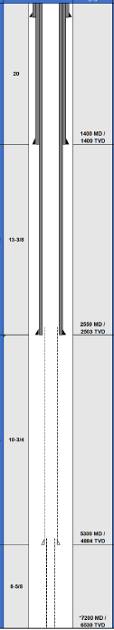
  4. Rig Sizing Summary for WJR1-3 and WJR1-4
Description | Estimated Value | Rig Specification
Well Type | Directional, Big Bore, Dual string
Total Depth | 7200 ft-MD | Rig 1000 HP Minimum
Drawwork HP | 720 HP | Rig 1000 HP Minimum
Max PU, include TDS and Traveling Block Weight | WJR1-2 offset well: 318 Klbs (normal drilling) 418 Klbs (with 100 Klbs Over Pull margin) | Rig Mast w/ 500 Klbs Min HL DP 5”, 19.5#, G-105, 4-1/2” IF TDS 350 Ton
Surface Torque | 15-23 Klbs.Ft | TDS 350 T, 800 HP DP 5”, 19.5#, G-105, 4-1/2” IF
Max GPM | Plan to apply hi-rate, 1400 GPM String Max: 1000 GPM Backside Max: 400 GPM | 1000-1300 HP Mud Pump Quantity: 4 set: 2 set being used 1 set spare 1 set tie into Backside
Max SPP | 2600 psi

Slide 23
  5. Drilling Rig Procurement Strategy
  5.1 Optimizing Rig Specification
Rig Bundling 1000 – 1500 HP:
Rig mast for 3 joints stand, with minimum 500 Klbs Hoisting Capacity
Drawwork is driven by electric motors with 120% total HP
TDS, hydraulic or Electric, 350 Ton, 800 HP minimum. Preferable TDS has own power units
Rig Floor Equipment equipped with Senior Type Hawk Jaw or equivalent.
4 Mud Pumps, Triplex, 1000 HP – 1300 HP
5” Drill Pipe, 19.5 ppf, G-105, 4-1/2” IF Connection. Hardbanding 200-300 ARNCO
Heavy Equipment:
  1 set 80 Ton Crawler Crane, 1 set 50 Ton Rougher Crane
  2 set 10 Ton Forklift
  1 set Low Bed Trailer, 1 set Hi Bed Trailer, 1 set Prime Mover 6x6
  1 set Mini Excavator
  1 set Dump Truck
Light Vehicles: Double cabin, crew bus
Skidding OR Walking System

Slide 24
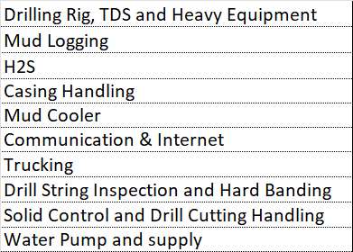
  5. Drilling Rig Procurement Strategy
  5.2 Optimizing Rig Bundling Remuneration Table
Rig will be bundled with 9 drilling services
Lump Sum Rig Mobilization & Demobilization, Rig Moving inter well and wellpad
Diesel Fuel will be included into Commercial Evaluation
LIH (25% probability) will be included into Commercial Evaluation
Include meals for 35 person (SOL and Service Company personnel)
Wellsite Reclamation
Wellsite Maintenance
Rig Bundling list of services:

Slide 25


Slide 26
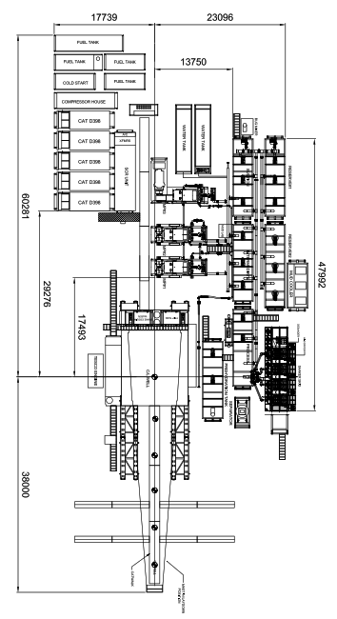
  1. Drill Rig Layout Area
C
D
Rig Size | Length, m A + B | Width, m C + D | Area, m2 Only Rig Eq.
750 HP | 52.2 | 35.5 | 1853.1
750 HP | 56.3 | 17.3 | 974.0
1000 HP, 1 joint | 53.2 | 47.1 | 2505.7
1000 HP, 2 joints | 62.4 | 37.0 | 2308.8
1000 HP, 3 joints | 91.0 | 41.8 | 3803.8
1200 HP, Ideal Rig, 2 Joints | 82.9 | 18.9 | 1566.8
1500 HP | 98.2 102.7 | 40.8 35.0 | 4006.6 3594.5
1800 HP | 82.0 | 47.7 | 3911.4
2000 HP | 89.0 | 37.0 | 3293.0
3000 HP | 62.2 | 57.8 | 3595.2
B
similar
A
All rig with 3 joints rig mast → need more 3300 m2
Rig with 2 joints Rig mast → need only 2300 m2 or 30% smaller area

