Slide 1
TEE BOX VS FLOW TEE
TECHNICAL EVALUATION
Drilling, 24 October 2025

Slide 2
Objectives
Understanding in datail comparison between Flange type versus Studded type wellhead joint connection.

Slide 3
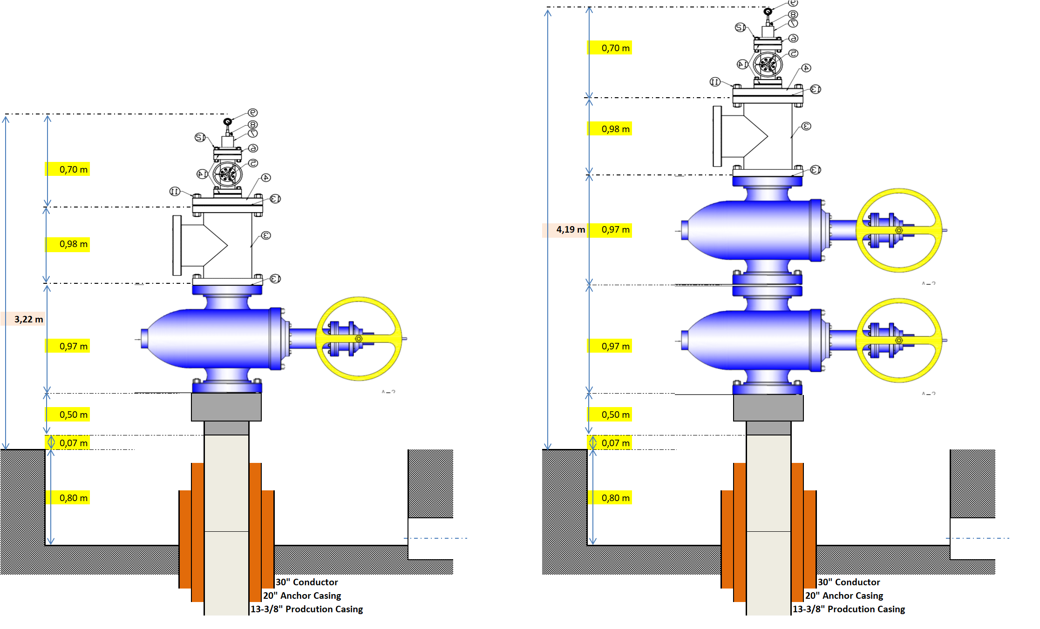
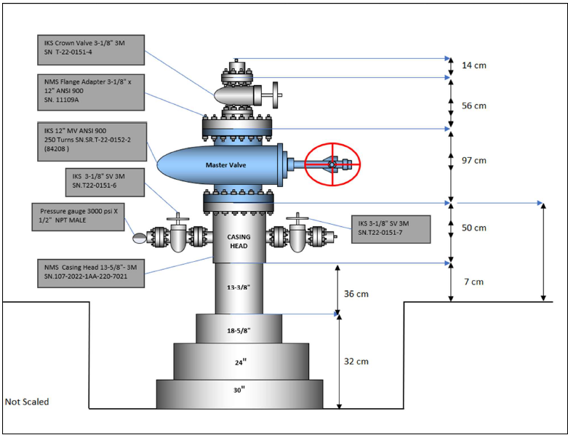
Existing WJR1-2 Wellhead Stack Up Drawing
224 Cm
57 Cm
WJR1-2 Wellhead Stack up – before tie in
WJR1-2 Wellhead Stack up with 1 MV
WJR1-2 Wellhead Stack up with 2 MVs

Slide 4
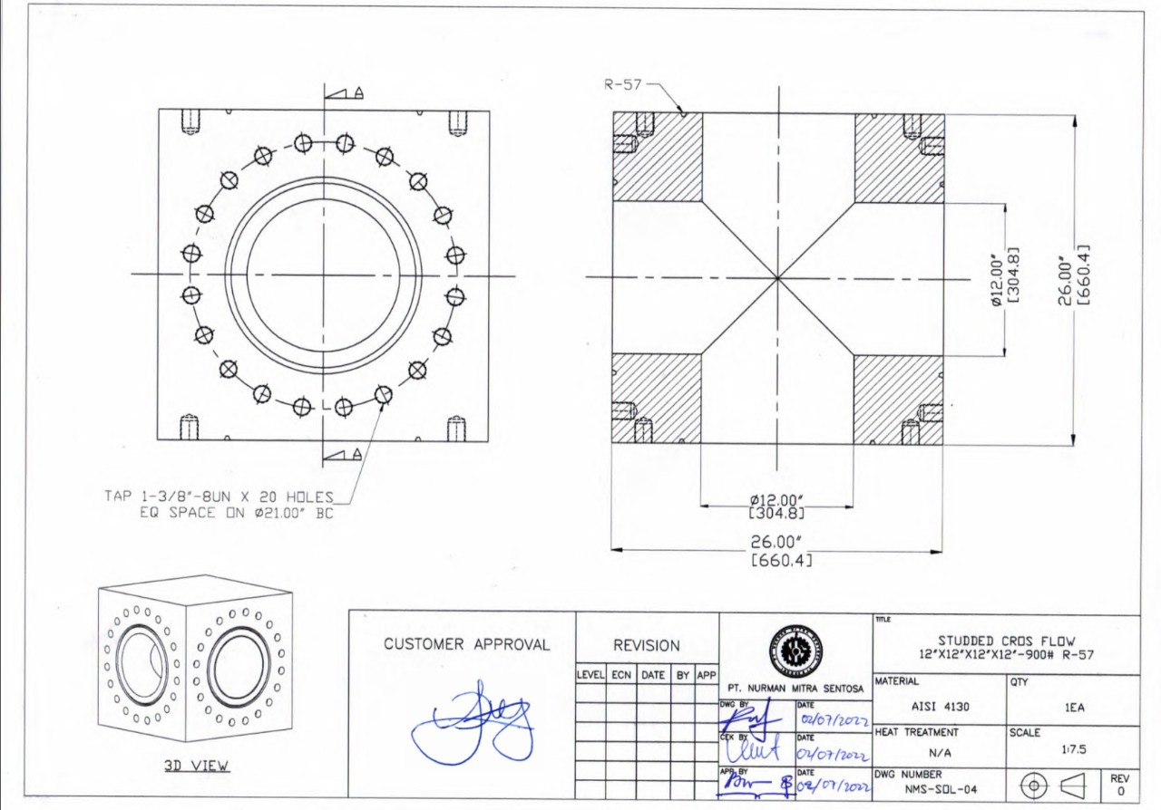
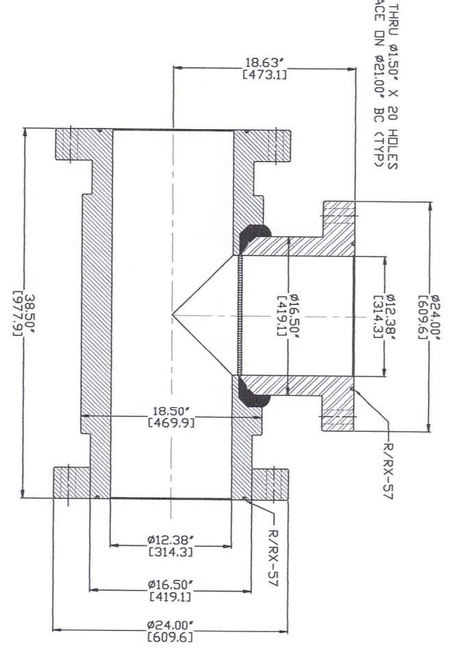
TEE Box versus Flow TEE
Description | T Box | Flow T
ID, in | 12 12.25” bit not pass, Chocking from MV ID (12.38”) | 12.38 12.25” Bit pass and full-bore ID with MV
Height, in | 26 | 38.50
Installation Replacement Maintenance | Difficult to replace bolt and nuts Risk of bolt parted and left in the T Box body | Easier
Prices
T Box (Existing)
Note:
It is recommended to use Flow T
Flow TEE

Slide 5
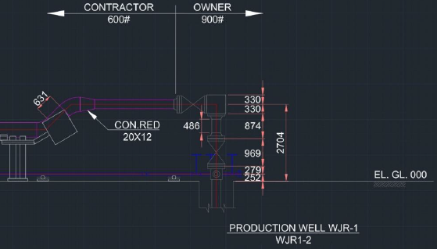
Wellhead – MV and TEE Box

Slide 6
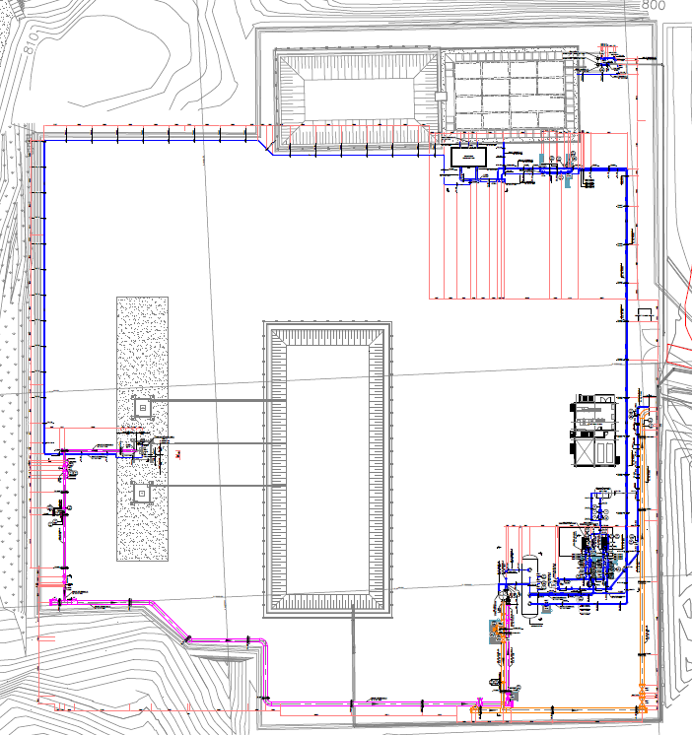
WellPad WJR1
With Production Line tied in to WJR1-2
Prior to drill WJR1-3 and WJR1-4 well
WJR1-3 (new)
Cellar-1
WJR1-2 (existing)
WJR1-1 (P&A)
Cellar-3
?
WJR1-4 (new)

Slide 7
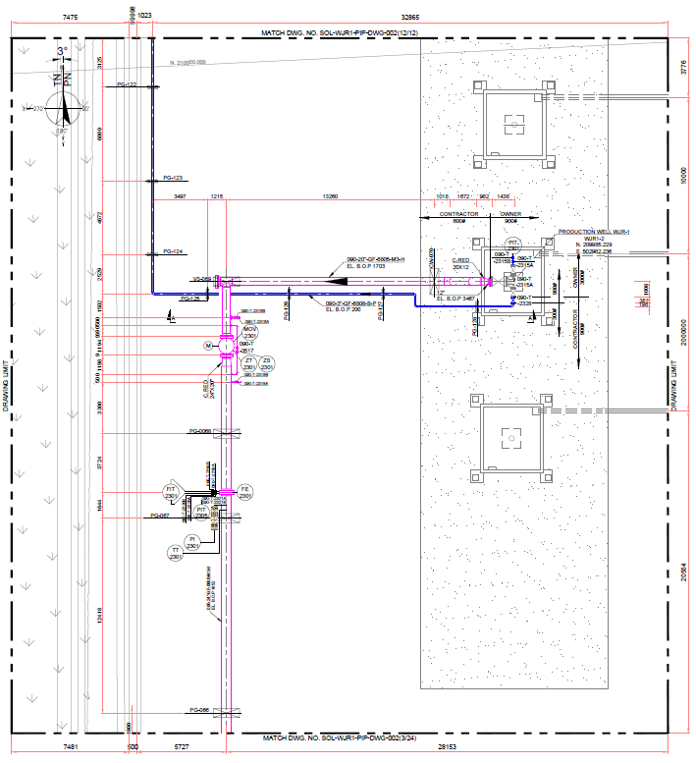
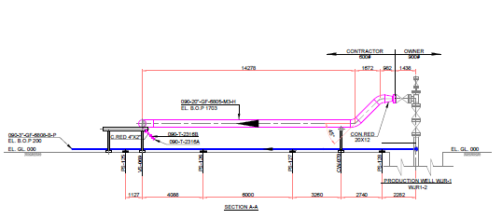
WJR1-2 Wellhead + Production Line
4.19 m
18,37 m
WJR1-2 Wellhead Stack up with 2 MVs

Slide 8

WJR1-2 Wellhead + Production Line
Design-1: 20” Pipe → 20” x 12” Reducer → 12” Pipe → 12” ANSI 900 Master Valve → 12”x12”x12” Flow TEE
Design-2: 20” Pipe → 20” x 14” Reducer → 14” Pipe → 12” ANSI 900 Master Valve → 12”x12”x12” Flow TEE

Slide 9



Wellhead Integrity

Slide 10
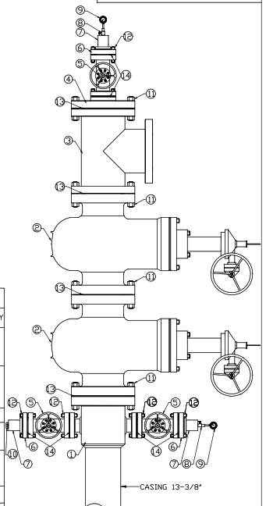
Geothermal Wellhead in Vulcanic Area
API SPEC 6D valves & ASME B 16.5 flanges Pressure rating
API 6D
7 pressure rating classes
ASME B 16.5, 2013 gives pressure derating tables for different materials
Some API Type 6B flanges are compatible with ASME B16.5 flanges. Examples:
API 6A
ASME B16.5 flanges | API type 6B flanges
3" CLASS 600 | 3-1/8” 2M
3" CLASS 900 | 3-1/8” 3M
3" CLASS 1500 | 3-1/8” 5M
12" CLASS 600 | 13-5/8” 2M
12" CLASS 900 | 13-5/8” 3M
API 6D
API 6D
API 6D
API 6A

Slide 11
API-6A versus ASME/ANSI
The Differences | ASME/ANSI B16.5 | API 6A Pressure Class Rating (Psi)
Dimension | 12” - 900 | 13-/8” – 3M
Pressure Rating | 2250 psi | 3000 psi
Pressure Test | 3375 psi (150% Pressure Rating) | 6000 psi (200% Pressure Rating)
Sample Material | WCC | AISI 4130
Prices | Lower | Higher
Grade WCC is covered by ASTM A216 standard, which specification covers carbon steel castings for valves, fittings, flanges and other pressure-containing parts for high temperature service and the quality required for assembly with other castings or wrought steel parts by fusion welding.
Flange 12"-900 is interchangeable with 13-5/8"-3M

Slide 12
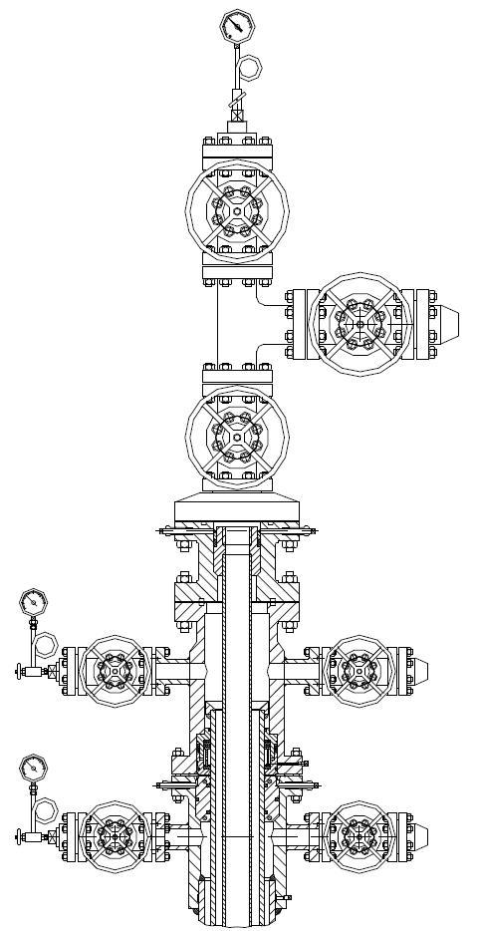
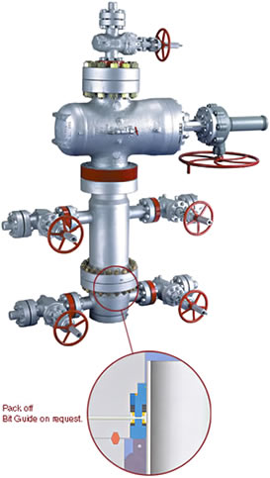
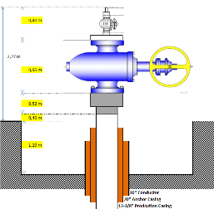
Wellhead Configuration

Slide 13
Wellhead Specification Design
13-3/8” SOW x 13-5/8” 3K x Master Valve.
13-3/8” SOW x 13-5/8” 3K: should have port for pressure test using N2.
Running Tool to run pre-welded wellhead.
Easy to operate Master Valve (close and open with steam pressure under the valve)
Flushing port to clean up any debris on valve’s gate
Provide manual guide for installation, close and open, maintenance, etc.
No threaded connection
Flange type instead of studded
Expandable Gate type

Slide 14
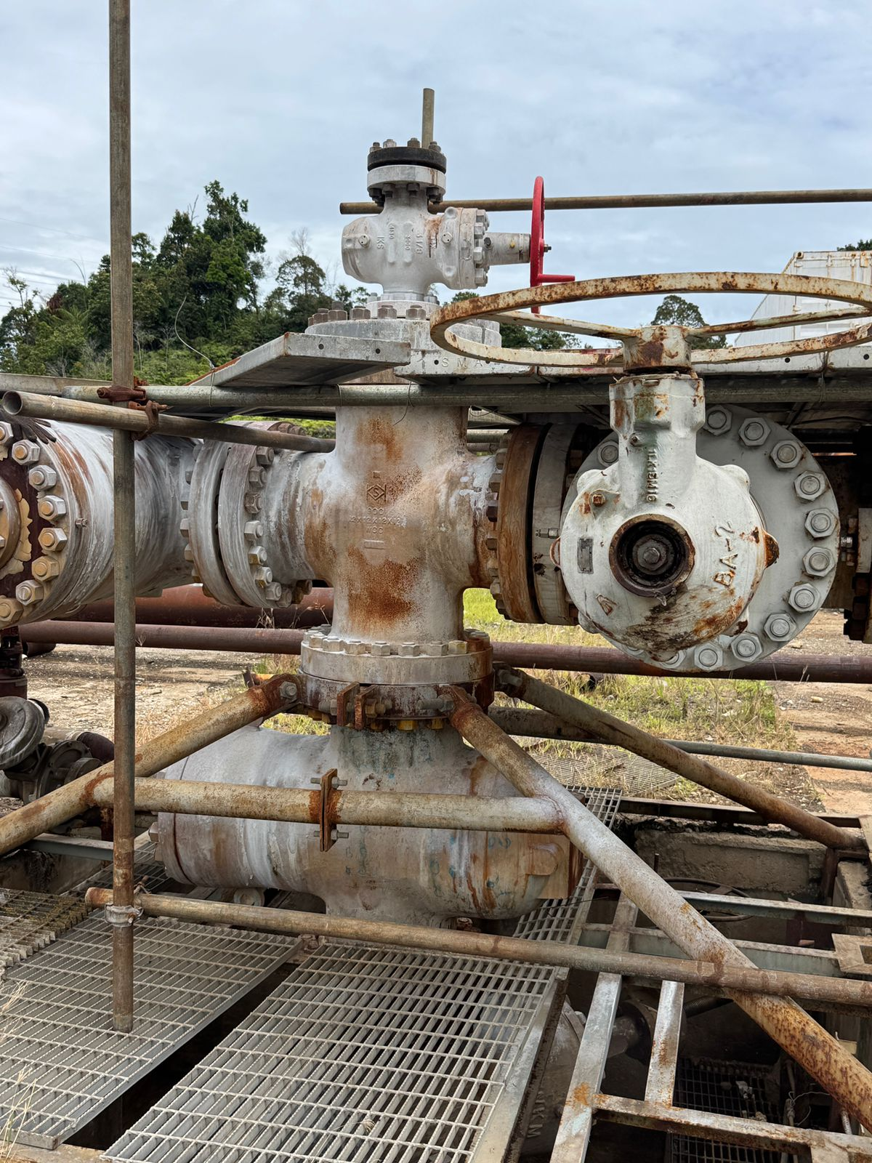
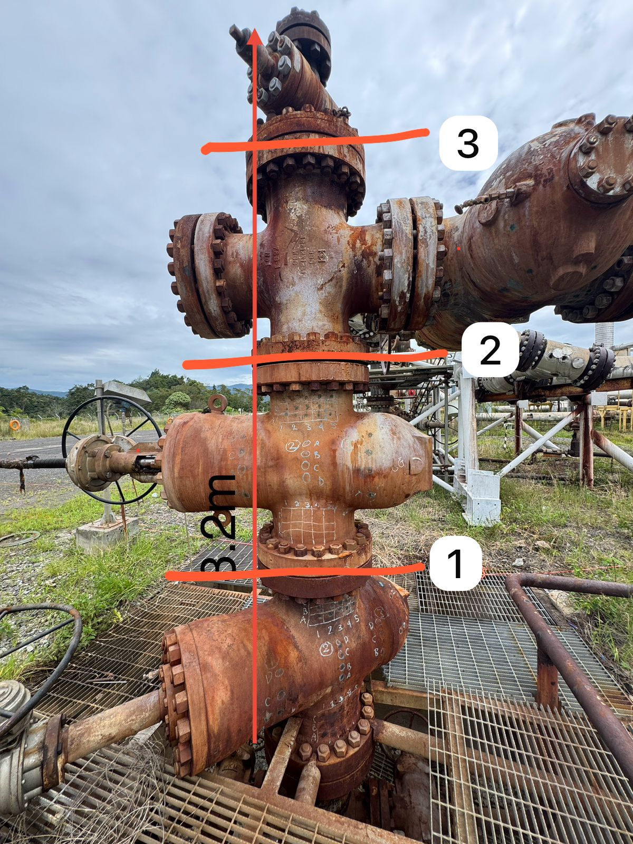
SOL Wellhead Configuration ?

Slide 15
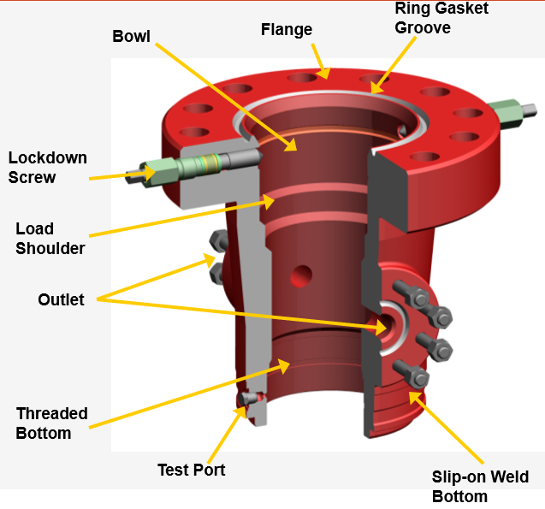
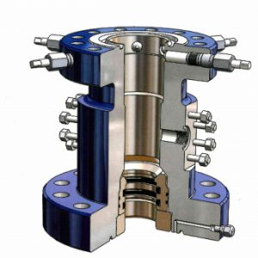
Flange vs Studded
Studded
All Flange Connection

Slide 16
Flange vs Studded
Description | Flange Type | Studded Type
Advantage | Cheaper due to simple raw material shape and easier to fabricate Easier to replace bolt and nuts | More bending moment resistance of wing valve flange No welded, no risk of crack on welding section.
Disadvantage | Less bending moment resistance of wing valve flange If wings valve flange is welded, risk of crack on welding section. | Expensive due to more complicated raw material shape and more difficult to fabricate Risk of stud stuck due to corrosion (acid environment or two different metal contact). It will difficult to be replaced.

Slide 17
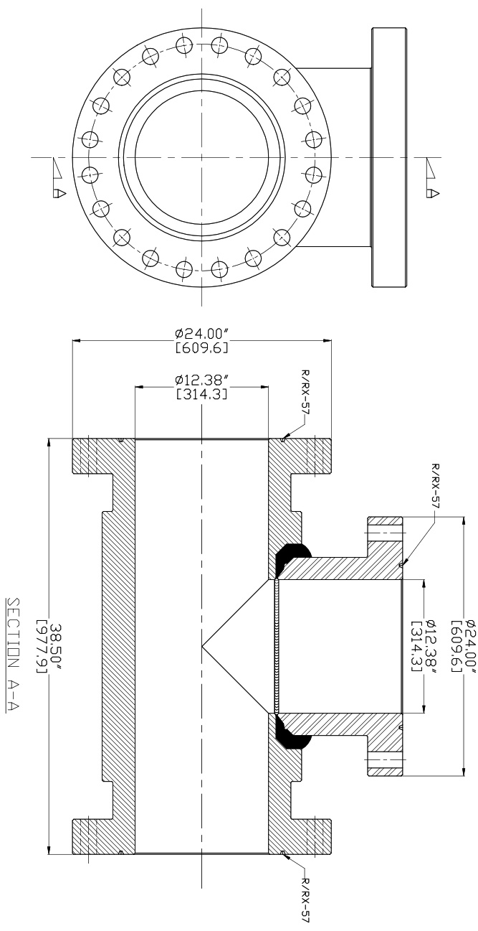
Flow TEE Design
Welded Flange Type Flow Tee
12”X12”X12”-ANSI 900, R-57 / RX-57
Full Bore 12-⅜ inch.
Flange type connection
Advantage:
Competitive price
Local product
Lighter weight
Easy for installation and maintenance
Easy to replace bolts and nuts

Slide 18
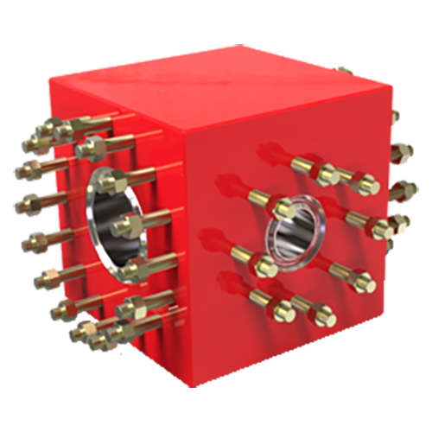
TEE Box vs Flow TEE Design
Solid Block Flow Tee Design
12”X12”X12”-ANSI 900, R-57 / RX-57
Full Bore 12-⅜ inch.
Studded Bolt type connection
Advantage:
Thicker wall.
Disadvantage:
Higher prices.
Heavier, more difficult for installation and maintenance.
Risk of stuck on stud due to corrosion (acid environment or two different metal contact), un-able to be replaced.
Studded
Flange

Slide 19
Section A Welded Design
Pre-welded Section A wellhead is preferable:
  welded in workshop, safe area (not expose to well hazardous)
  no time constraint, fabricated off line without disturbing rig time
  30-40 hours rig time saving and
  proper welded result where if any defect, welder could re-do it without any hurry.
  Cheaper welding cost, one call welder could do more than one welding job.
  Only for dual string production string design instead of long string design.
Proper welding procedure refer to Boiler and Pressure Vessel (ASME Sec. VIII & Sec. IX). 13-5/8" Casing Head is API 6A Product, and stated in API 6A 7.3.4 Welding Procedure Qualifications, 7.3.4.1 Written Procedure.

Slide 20
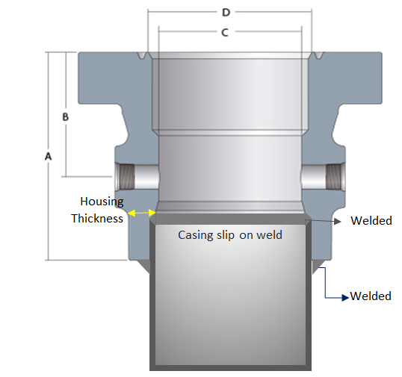
Section A Welded Design
WELDING PROCEDURE: 13-5/8" CASING HEAD (AISI 4130 Low Alloy Steel) TO 13-3/8" CASING L-80 (Carbon Steel)
13-5/8" CASING HEAD (AISI 4130 Low Alloy Steel)
13-3/8" CASING L-80 (Carbon Steel)

Slide 21
Permanent 13-5/8” Wellhead Housing Installation
13-5/8” Wellhead Housing Installation, 2 method:
Online Wellhead Installation (Pemasangan langsung) → Vertical Welding at Cellar
Run Pre-Welded Wellhead Installation: Pre-Welded Wellhead Housing with Casing → Horizontal Welding at Workshop

Slide 22
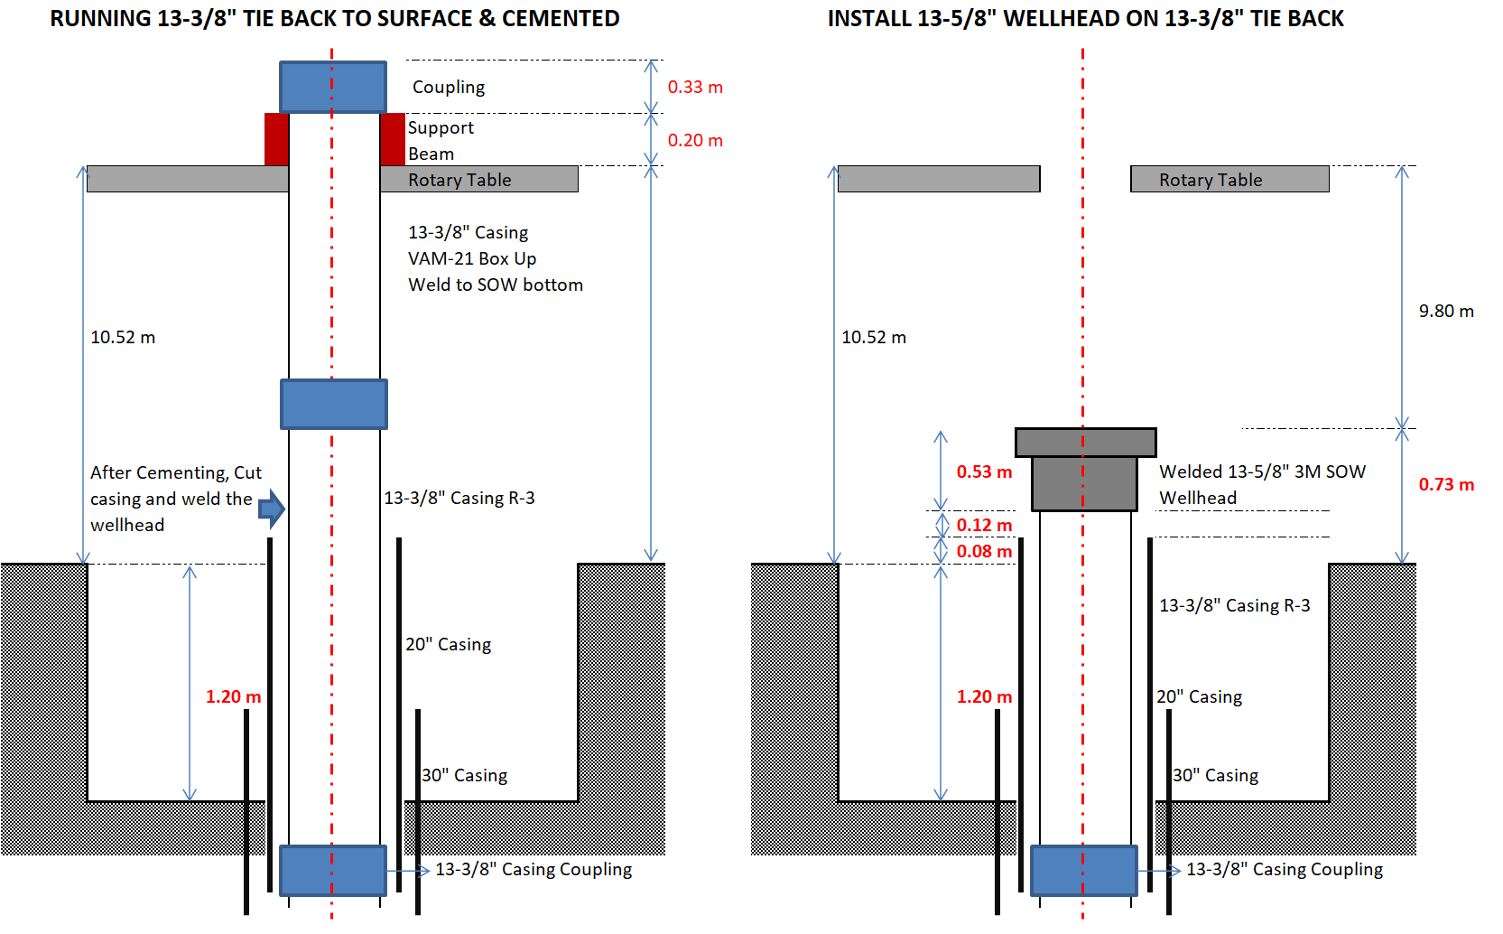
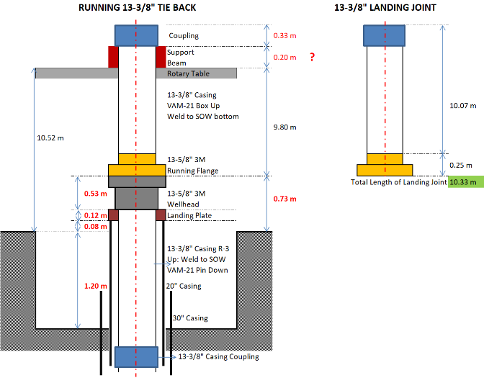
Non Pre-Welded vs Pre-Welded 13-5/8” Wellhead Housing
Without Pre-Welded Operation
ND BOP Run Casing Tie back Run Inner string with casing stick up → 3 hrs Cementing WOC → 8 hrs Cut casing → Install Wellhead → 35 hrs
Pre-Welded Operation
ND BOP Run casing Tie back Run Pre-welded wellhead → 1 hrs Run Inner string on Rotary Table Cementing No WOC

Slide 23
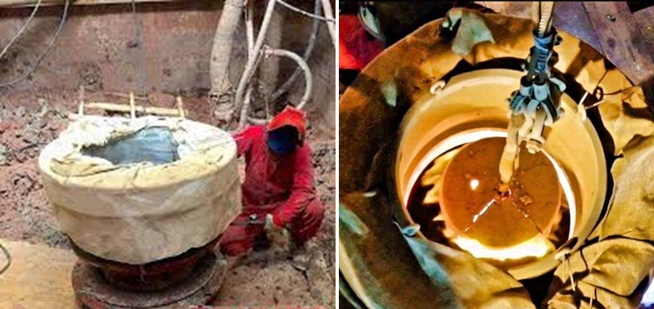
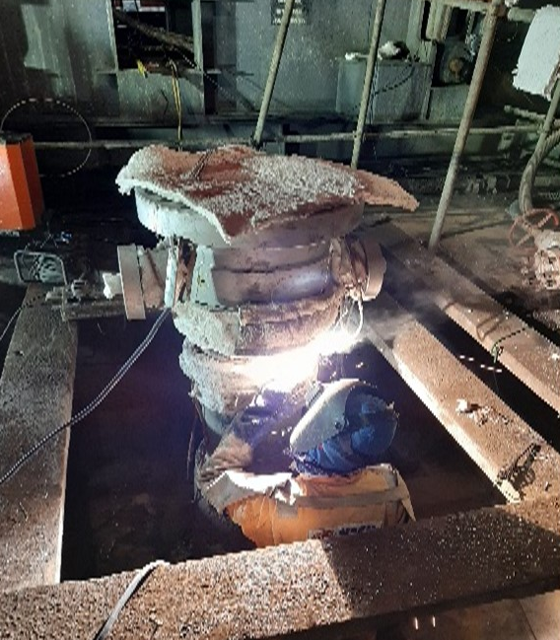
Non Pre-Welded vs Pre-Welded 13-5/8” Wellhead Housing

Slide 24
Pre-Welded 13-5/8” Wellhead Housing
Without Pre-Welded | Pre-Welded
ND BOP Run Casing Tie back Run Inner string with casing stick up → 3 hrs Cementing WOC → 8 hrs ND BOP Cut casing → Install Wellhead → 35 hrs NU BOP | ND BOP Run casing Tie back Run Pre-welded wellhead No WOC NU BOP
3 + 8 + 35 hrs longer | Rig time saving: 46 hours
 | Cost saving: USD 134 K

Slide 25
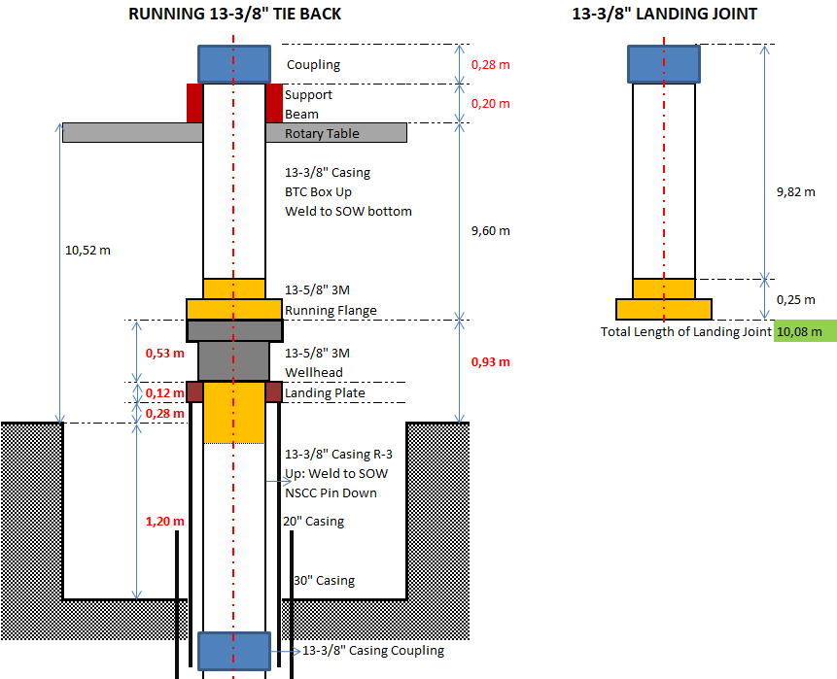
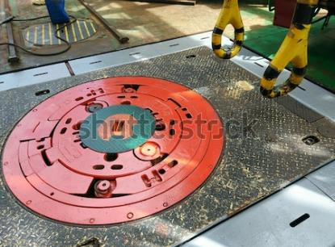

PRE-WELDED WELLHEAD
13-3/8” Casing + 13-5/8” 3M Section A Wellhead
RT opening 37.5”
Split type RT bushing is preferable.
Pre-welded wellhead in horizontal position.
Pre-welded 13-5/8” Flange housing and 13-3/8” casing Landing Joint.
Save One-Two days Rig time

Slide 26
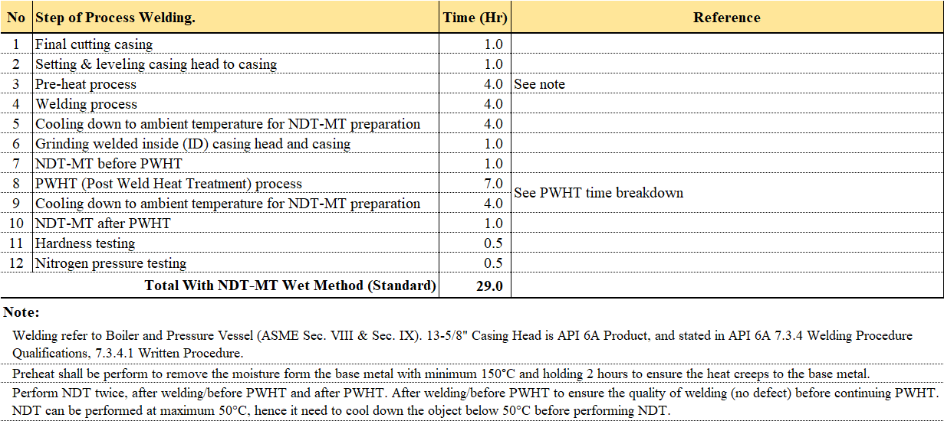
Section A Welded Design
WELDING PROCEDURE: 13-5/8" CASING HEAD (AISI 4130 Low Alloy Steel) TO 13-3/8" CASING L-80 (Carbon Steel)

Slide 27
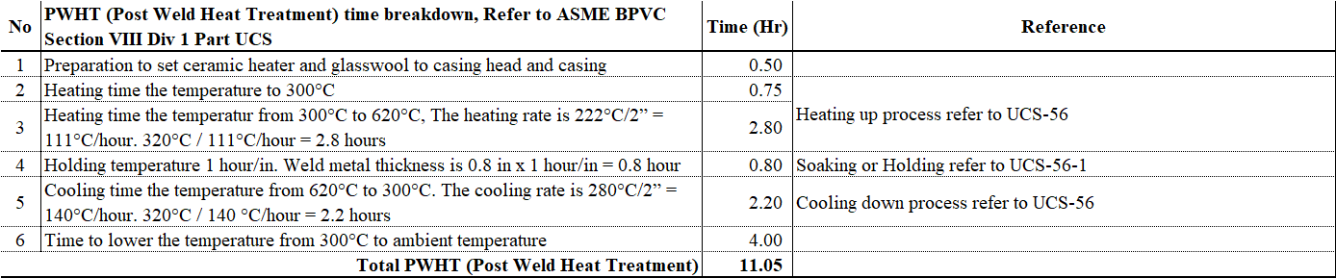
Section A Welded Design
WELDING PROCEDURE: 13-5/8" CASING HEAD (AISI 4130 Low Alloy Steel) TO 13-3/8" CASING L-80 (Carbon Steel)
Case-1: Leaking on wellhead welding during well testing due to improper welding procedure. (North Sumatra)

Slide 28
Wellhead Design for Acid Well
On progress

Slide 29
Wellhead Function and Loads
On progress

Slide 30
Wellhead Material
Material Class |  | Body, Bonnect, End and outlet connectors | Mandrel hanger, Valve sealing mechanism, Choke, Trim and Stems
AA | General Service | Carbon or low-alloy steel, or Stainless steel, or CRA | Carbon or low-alloy steel, or Stainless steel, or CRA
BB | General Service | Carbon or low-alloy steel, or Stainless steel, or CRA | Stainless steel, or CRA
CC | General Service | Stainless steel, or CRA | Stainless steel, or CRA
DD | Sour Service | Carbon or low-alloy steel, or CRA | Carbon or low-alloy steel, or CRA
EE | Sour Service | Carbon or low-alloy steel, or CRA | Stainless steel, or CRA
FF | Sour Service | Stainless steel, or CRA | Stainless steel, or CRA
HH | Sour Service | CRA | CRA
General service
Sour service
CRA: Corrosion Resistant Alloy

Slide 31
Wellhead Material
Example of Material selection chart
pCO₂ (psi) | CL⁻ (ppm) | pH₂S (psi)
 |  | <0,05 | 0,05 – 1,5 | 1,5 - 10 | >10
<7 | <50.000 | AA | DD | DD | DD
<7 | 50.000 - 100000 | BB-MOD | EE-MOD | EE-MOD | EE-MOD
<7 | >100000 | HH | HH | HH | HH
7-30 | <50.000 | BB | EE | EE-MOD | EE-MOD
7-30 | 50.000 - 100000 | BB-MOD | EE-MOD | EE-MOD | EE-MOD
7-30 | >100000 | HH | HH | HH | HH
>30 | <50.000 | CC | FF | FF | HH
>30 | 50.000 - 100000 | CC | FF | FF-MOD | HH
>30 | >100000 | HH | HH | HH | HH
MOD = 625 weld clad inlay on all seal surface

Slide 32
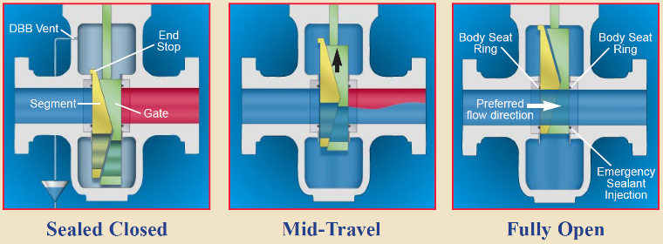
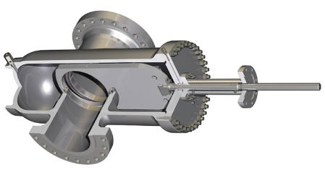
Wellhead Structure Design
MASTER VALVE:
Expanding Gate,
Metal to metal seal on seat to body and seat to gate upstream & downstream
EXPANDABLE GATE
SLAB GATE

Slide 33
Wellhead Sealing Element
On progress

Slide 34
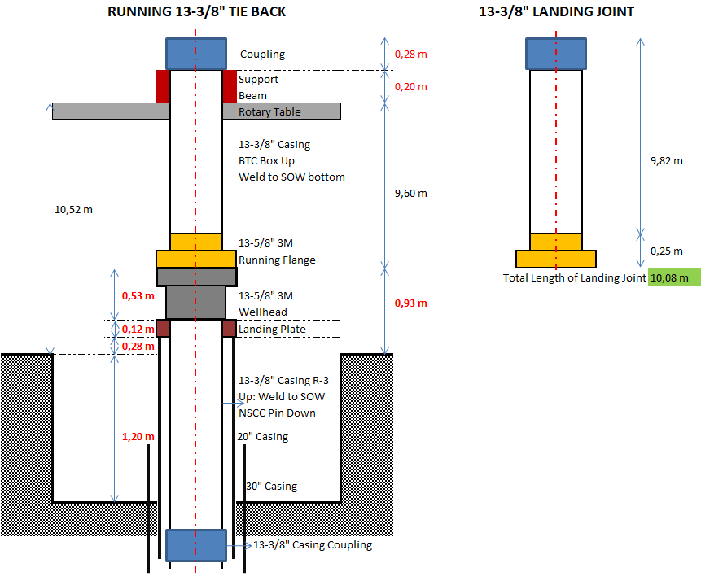
Wellhead Height and Maintenance
To be above Cellar GL or below GL?
Wellhead monitoring ?
Rain water in cellar ?
Wellhead and gate valve replacement?.
Rig workover lay out?
etc

Slide 35
Wellhead Maintenance
To be discussed

Slide 36
Wellhead Integrity Monitoring
To be discussed

Slide 37
Wellhead Allowable Minimum Thickness
To be discussed

Slide 38
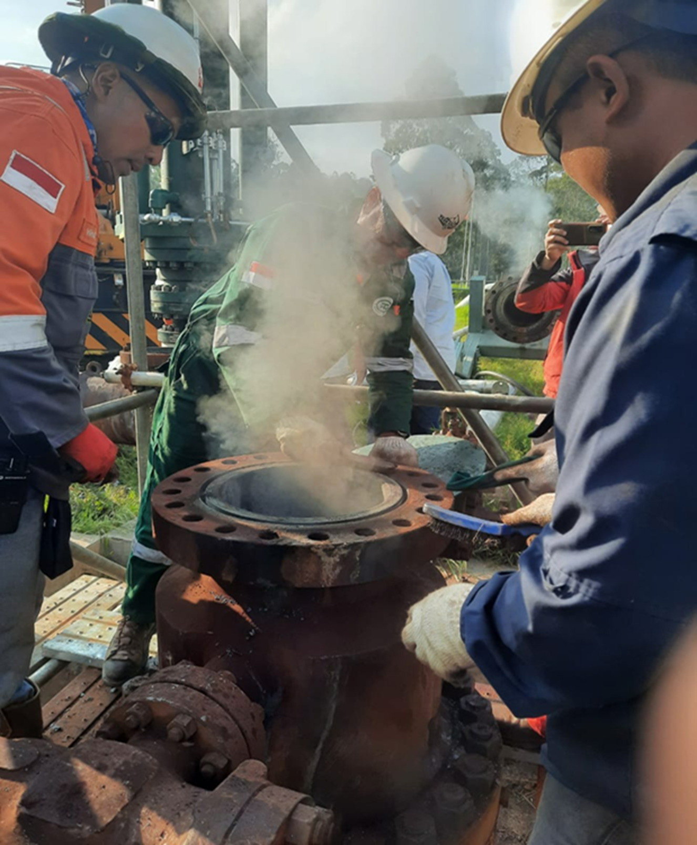
Wellhead Replacement Method
Using Geothermal Hot Packer
  Master valve replacement
  Casing Head cutoff and replacement
OBJECTIVE : To Packoff Geothermal Well in order to provide a safe condition for all geothermal wellhead repairs
Once the Packer is Set, safe to proceed to repair the wellhead

Slide 39
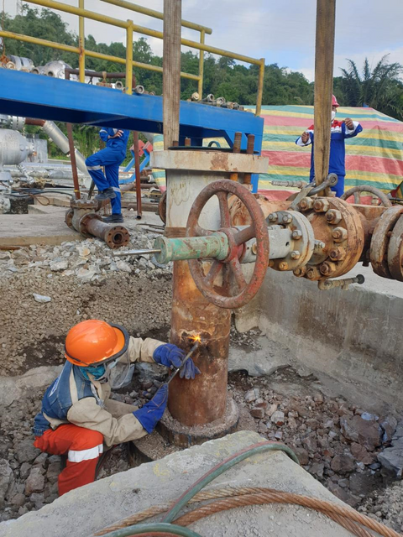
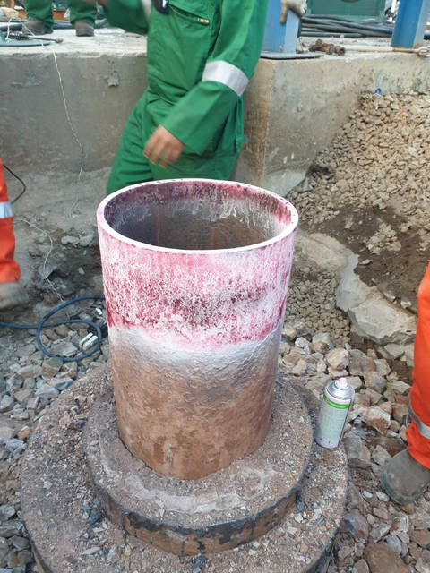
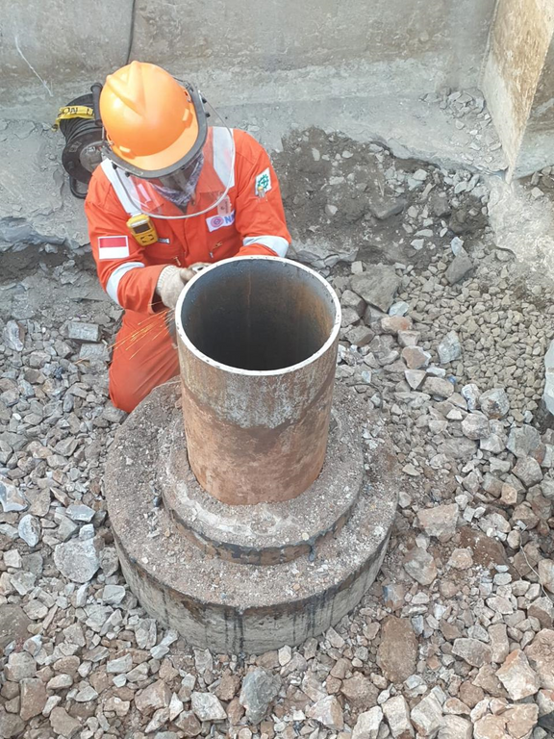
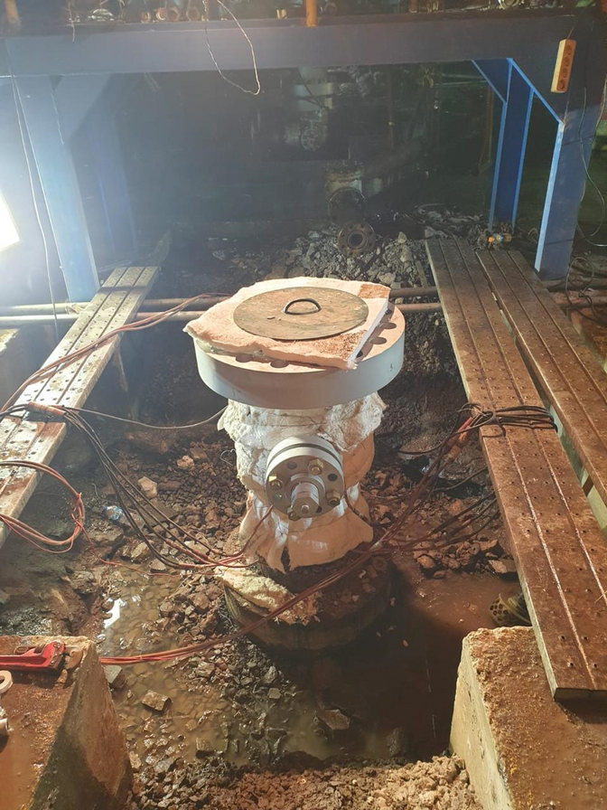
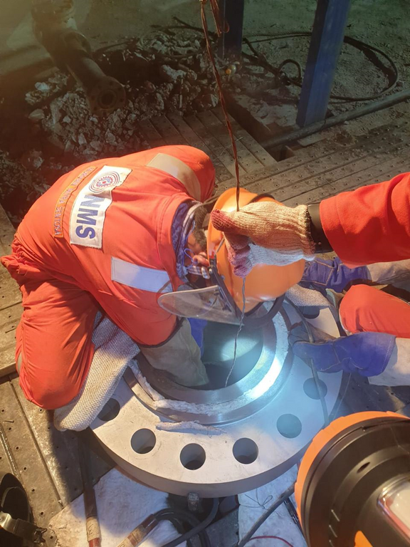
Wellhead Replacement Method
Cut Existing Casing Head
NDT of casing before welding
Grinding and leveling casing
Welding New Casing Head
PWHT Process after finish welding

Slide 40
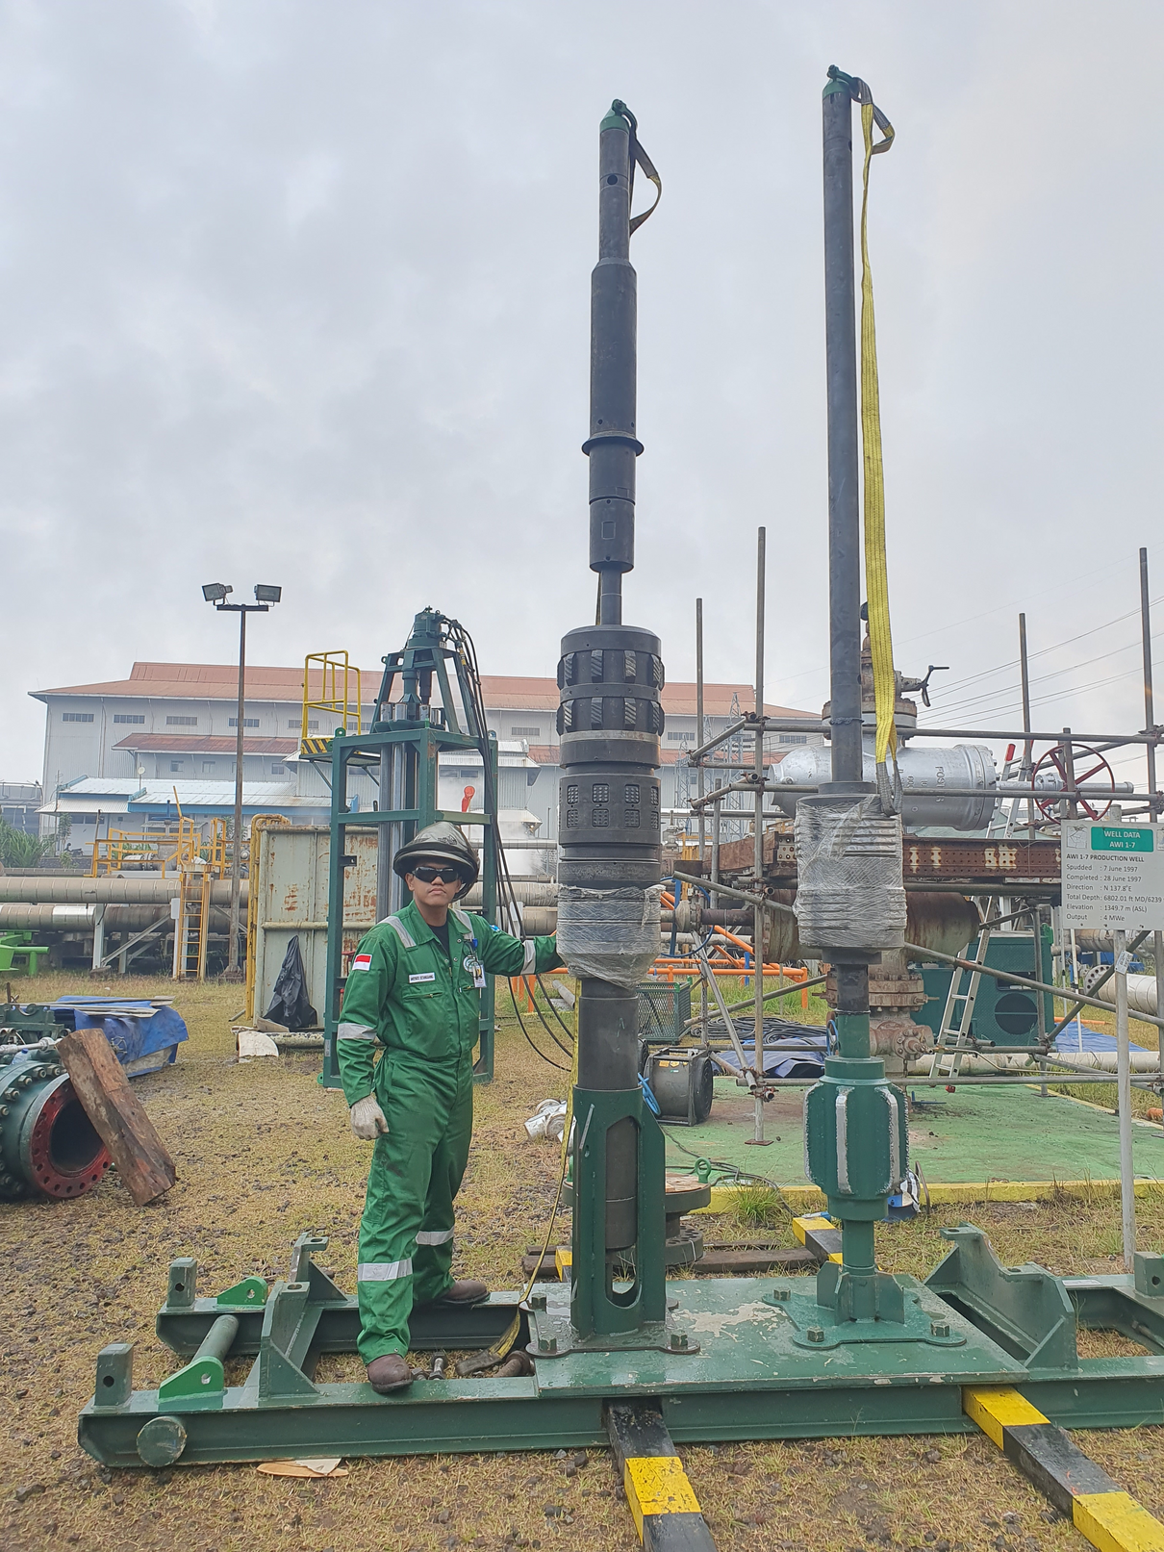
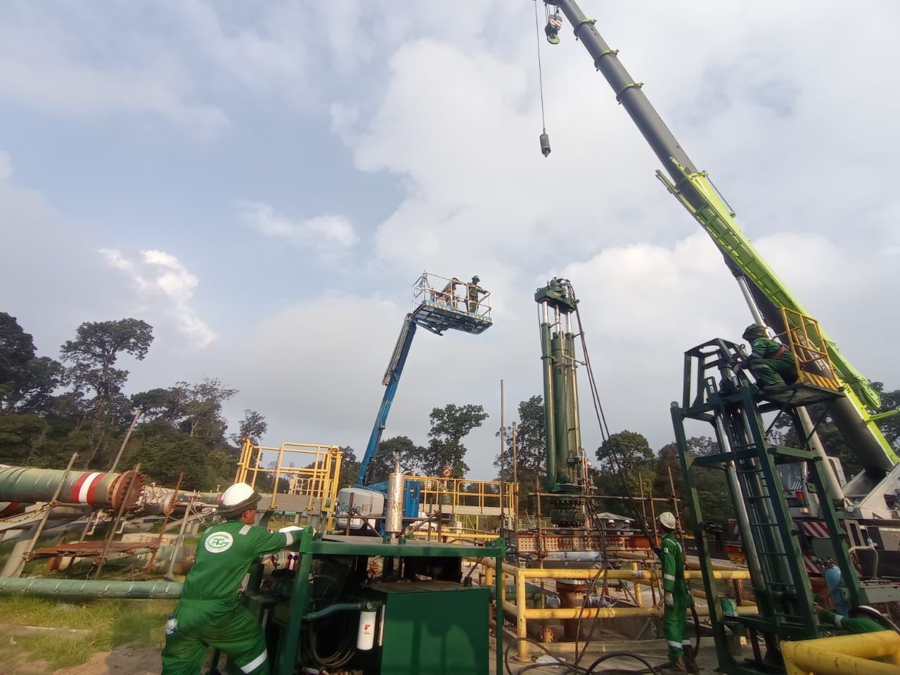
Wellhead Replacement Method
Geothermal Hot Packer Equipment
Lubricator, 1500 PSI, 650°F
Casing Scrapper: 7“ ; 9-5/8” ; 10-3/4” ; 13-3/8” ; 16" casing size
Hot Packer: 1000Psi, 550°F = 287°C
Power Unit & Hydraulic Motor
Rod Rack
Running Tool using 6 EA rods with AISI 4140 material and surface chrome. Able to reach depth of 20m from surface
Crane 50 Tons and Manlift 200kgs
Working Master Valve
Scaffolding and MTC team
SCBA and H2S Detector
Gate Cutter Mill, Hot Tapping Equipment

Slide 41
Wellhead Repair
Geothermal Hot Packer Running procedure

Slide 42
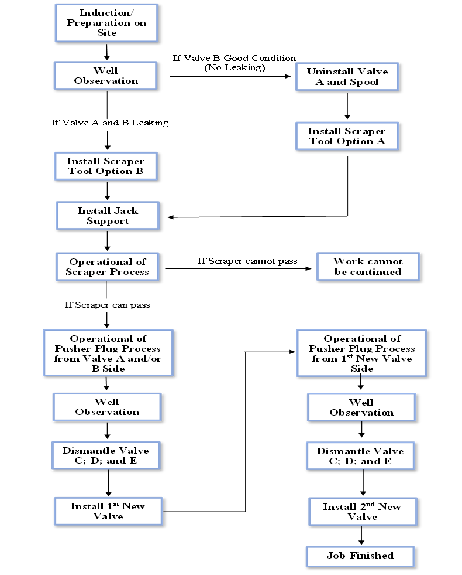
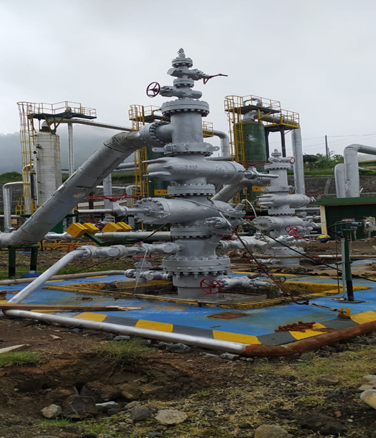
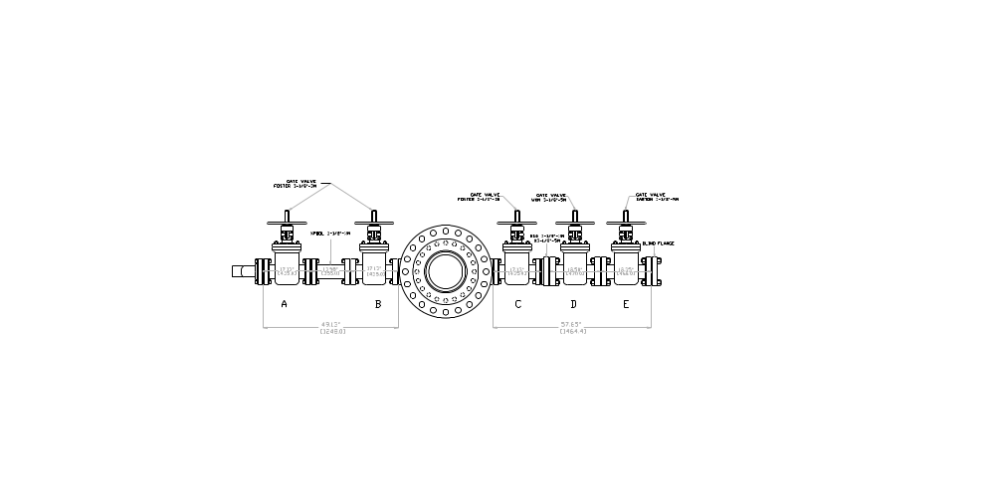
Wellhead Wing Valve Repair

Slide 43
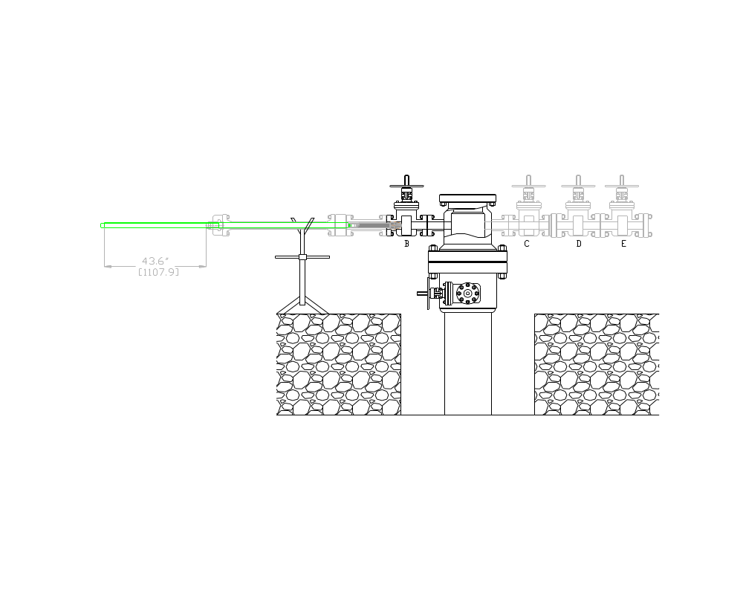
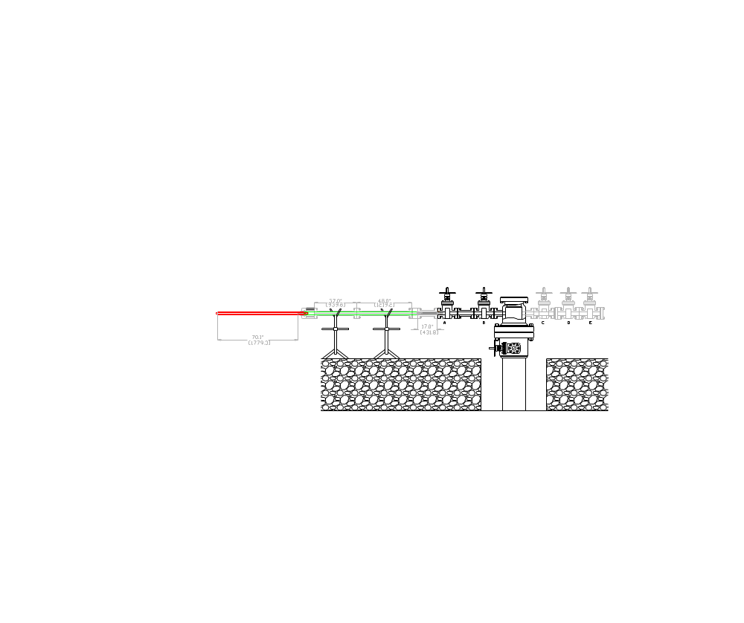
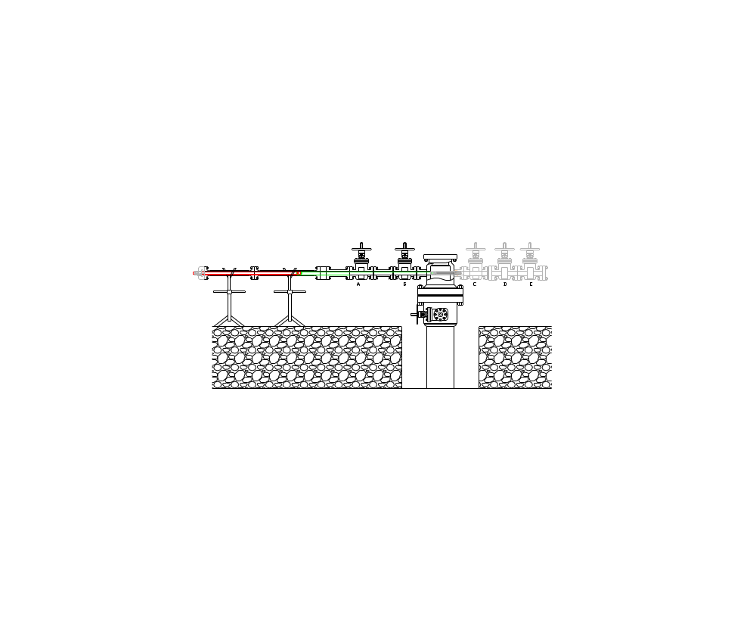
Wellhead Wing Valve Repair – Position and Run Scrapper Tool
Position before gate valve tool Option A
position before gate valve tool Option B
Running Scrapper Tool to inside the outlet

Slide 44
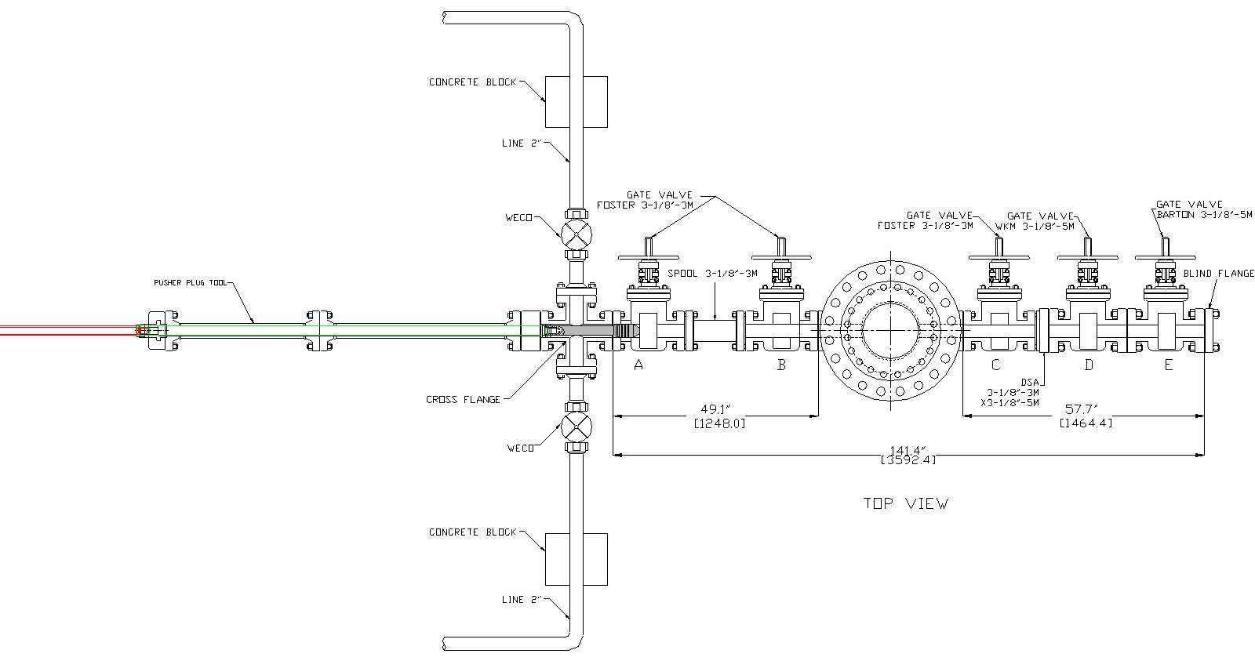
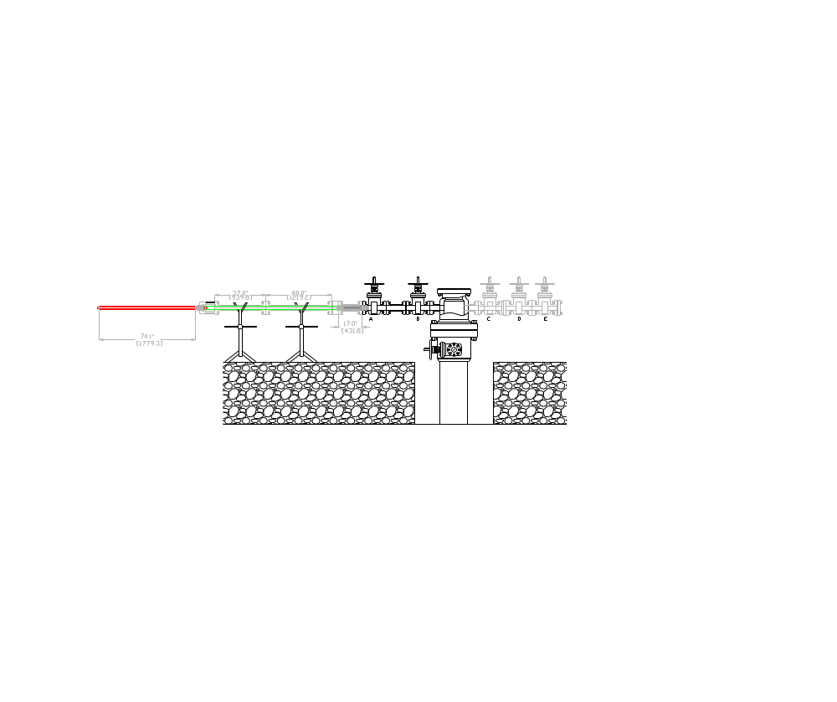
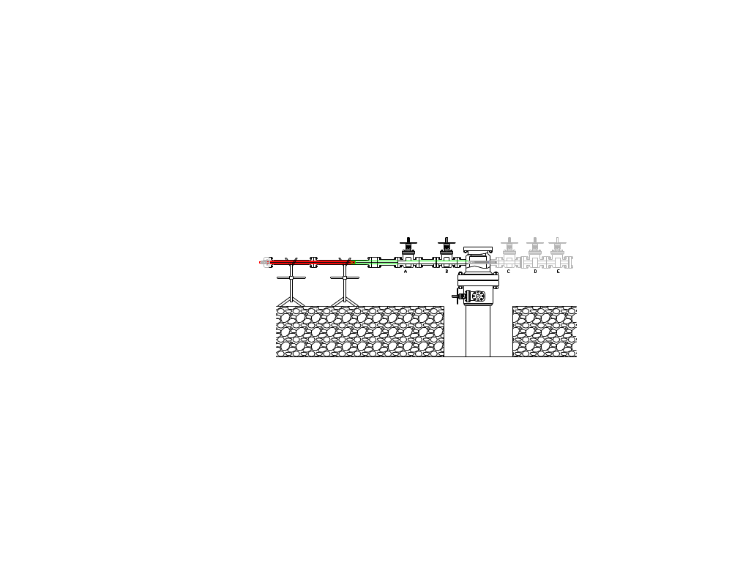
Wellhead Wing Valve Repair – Set Plug
Top View
Pusher Outlet Plug before Gate Valve
Running Pusher Outlet Plug to inside the outlet

Slide 45
Wellhead design concerns related with Wellhead Repair
Wellhead stack up: set bottom of 13-5/8” wellhead housing above top of cellar or GL (preferable 40-50 cm above GL):
  Provide casing stick up to be spared for wellhead replacement.
  The stick-up production casing above GL will not expose with water in case cellar full with water. As addition, it will easier to do UG during wall thickness monitoring.
  Placed wing valves above GL (ground level) for easy wing valve replacement using Pusher Outlet Plug otherwise using more expensive Geothermal hot packer.
Keep DRY cellar: to prevent any corrosion to surface equipment below GL.
Prefer to have thicker 13-3/8” casing (72 ppf) for upper section joints.

Slide 46
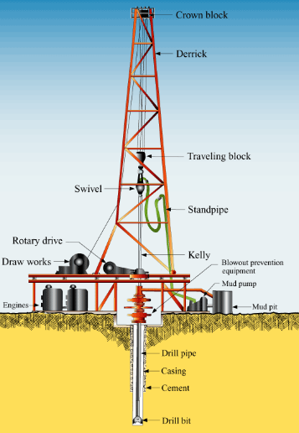
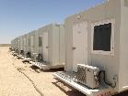
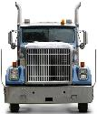
Ideal Elevated Wellpad Design
Drainage Line from Cellar to Mud Pond
Settling Pond
Water and Mud Pond

Slide 47


Ideal Cellar Design – 80 cm depth
Advantage:
More simple → Less Construction Cost
Always dry cellar
No risk accumulated H2S

Slide 48

Ideal Distance Between Well – 13.5 meters
SF > 1
SF = 1
SF < 1
SF < 1
SF = Separation Factor
SF = (Ellipse Radius-1 + Ellipse Radius-2)/ Jarak lubang

Slide 49



Rig Sub-Structure
Clear distance between Sub Base:
1000-2000 HP Drilling Rig: 4-6 m
550-750 HP Work Over Rig: 2.5 – 3.0 m

Slide 50
3 x 3 meter Cellar Sizes ?
Rig Sub Base – Skid Rail
Rig Skid Direction
4-6 m
1000-1500 Hp Drilling Rig Layout
2.5-3 m
Cellar
550-750 Hp Work Over Rig Layout

Slide 51
Ideal Cellar Sizes
1000-1500 Hp
Drilling Rig Layout
2.5 m
2.5 m
3.0 m
3.0 m
Cellar
550-750 Hp
Work Over Rig Layout

Slide 52


Master Valve Dimension
0.6 m
1.9 m

Slide 53
Ideal Cellar Sizes vs Master Valve Orientation
1000-1500 Hp
Drilling Rig Layout
2.5 m
2.5 m
3.0 m
550-750 Hp
Work Over Rig Layout

Slide 54
Ideal Cellar Sizes vs Master Valve Orientation
1000-1500 Hp
Drilling Rig Layout
2.5 m
2.5 m
3.0 m
550-750 Hp
Work Over Rig Layout

Slide 55
Casing Integrity
On Progress

