Slide 1
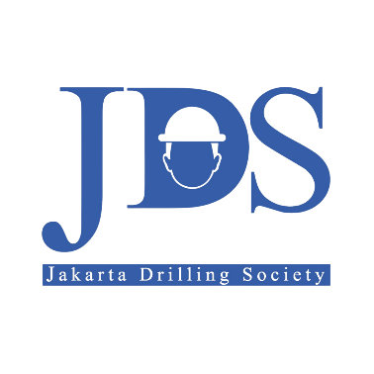
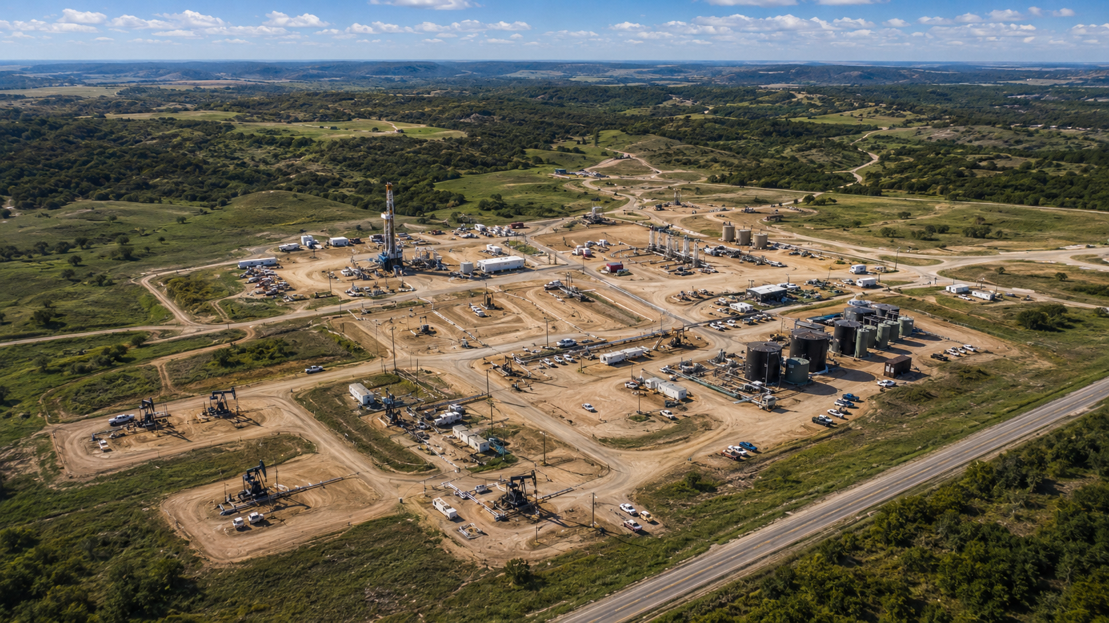

JDS 2026 DRILLING CAMPAIGN
SW (Single Well) DPM (Drilling Project Management) Phase-1: ALPHA-07
CORE ENERGY SOLUTION
GROUP 6 ONLINE

Slide 2
EXECUTIVE SUMMARY

Slide 3
LOCATION, GEOGRAPHY, & SURFACE RECONNAISSANCE

Slide 4
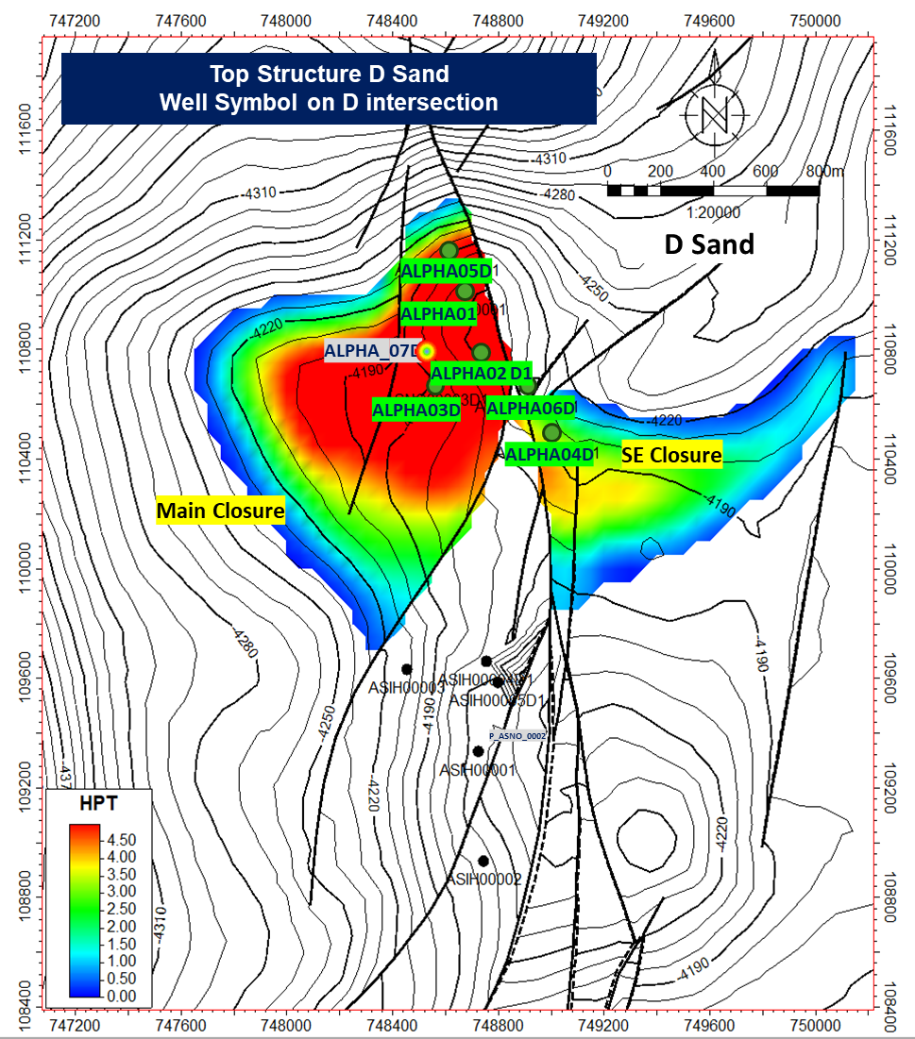
1. PROJECT MANDATE & JUSTIFICATION
Alpha Field Proposed Development Well Location Map
“Sanction Alpha-07 to unlock stranded reserves at low-risk USD 1.84M investment, delivering incremental recovery of 0.58 MMBO leveraging existing infrastructure.”
Description
Key highlights
Alpha Field is significantly under-developed. With OOIP of 21.66 MMSTB and cumulative production of only 6.48 MMSTB, the recovery factor stands at just 16.62%. The 5-well development program anchored by Alpha-07 provides a phased, capital-efficient pathway to improve recovery using existing surface facilities, promotes the optimization of mature assets, minimizing new infrastructure requirements. Directional J-type design avoids land complications above target reservoirs.
located at Central Sumatra Basin
OOIP 21.66 MMSTB vs 6.48 MMSTB current| Recovery Factor only 16.62%
5-well program delivers ~0.58 MMBO incremental to 2041
Existing CES surface facilities — no major new infrastructure
Wellpad footprint minimized to 0.4–0.7 ha (J-type directional)
Aligns with SKK Migas production growth targets
21.66 MMSTB
Original Oil in Place (OOIP)
16.62% RF
Current Recovery Factor — significant upside
USD 1.84M
Total D&C Investment (AFE)

Slide 5
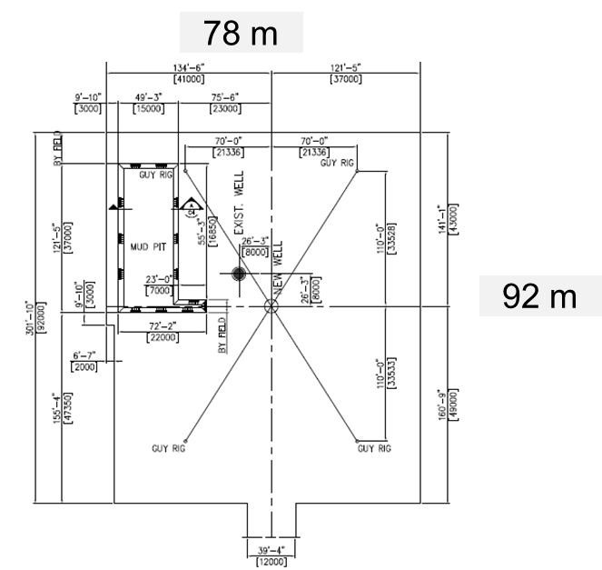
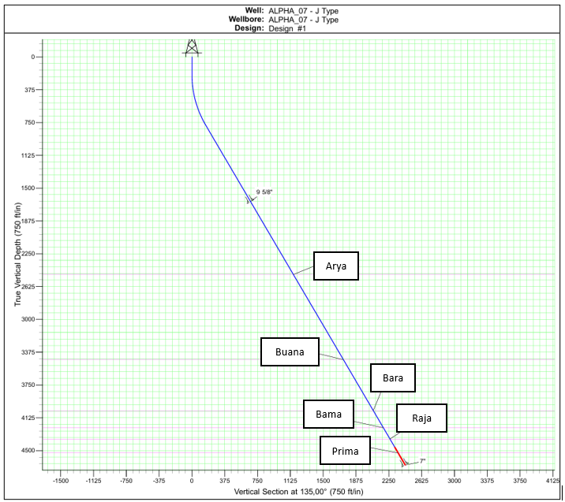
2. WELL CLASSIFICATION
Typical Design Wellpad Rig Layout 750 HP
Well Trajectory Profile Alpha-07
“Alpha-07 is a Development Well — directional J-type producer with cased-hole completion and ESP artificial lift — the lowest-risk execution path for Alpha Field.”
Description
Key highlights
The four target reservoirs (Bara, Bama, Raja, Prima sands) are fully delineated through 6 prior drilling campaigns (Alpha-01 to Alpha-06), removing subsurface definition risk. Classification as Development Well allows execution team to focus on operational variables: wellbore stability, loss circulation, and cementing quality. ESP is required to overcome field-wide ~99% water cut and sustain economic production rates. the primary objective of the well is hydrocarbon production.
• 6 offset wells (Alpha-01–06) provide direct analog data
• Bara, Bama, Raja, Prima sands: proven hydrocarbon productivity (adequately defined through previous development activities)
• Cased-hole completion enables selective zonal perforation
• ESP: custom-manufactured to well spec; 16–24 week lead time
• Target TD ~4,042–4,676 ft TVD; within 750 HP rig competency
750 HP Rig
Land rig | Directional J-type
~5,312 ft MD
Planned Total Depth
Cased-hole + ESP
Completion design | Artificial lift (Submersible Pump)

Slide 6
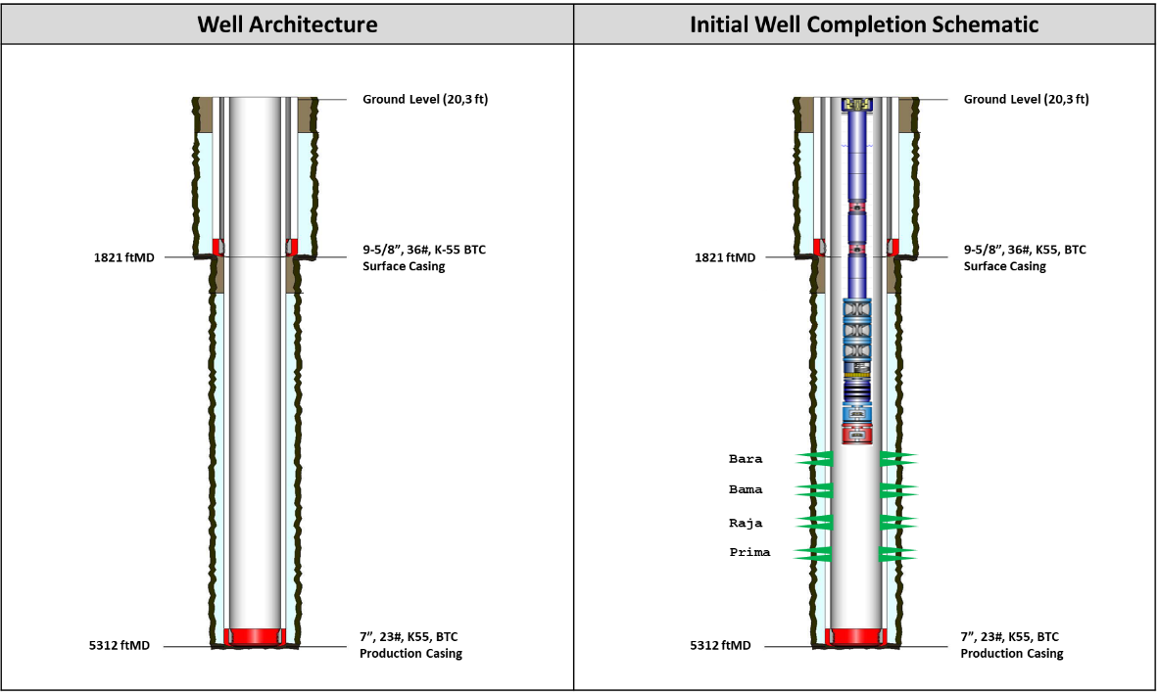
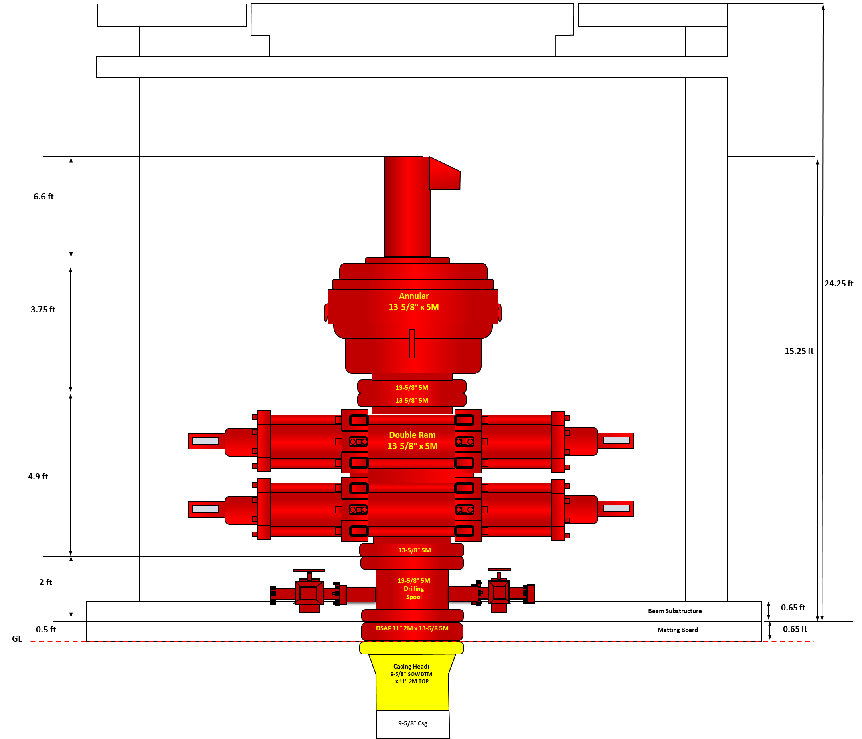
3. SUCCESS CRITERIA & KPIs
Conceptual casing
Conceptual wellhead
Success is defined by three mutually reinforcing criteria: subsurface data capture, production rate confirmation, and cost discipline — within a zero-LTI HSSE envelope.
~5,000 ft MD
Planned Total Depth | All 4 reservoirs penetrated
132 BOPD
IP P50 | P10–P90: 106–158 BOPD
156 MBO
EUR P50 / well | 5-well = 0.58 MMBO
21.3–29.3 days
Total Well Cycle Time | intra-field: 18%, inter field: 42%, drilling: 34%; completion: 6%
<5–10% NPT
Non-Productive Time Target
Zero LTI
HSSE | SKK Migas + CES compliance
Description:
Gate 1 requires confidence across three dimensions: geological data capture (to de-risk wells 2–5), production validation (DCA-based reserve), and cost control (to keep program investable). Failure on any single dimension impairs the USD ~7.4M 5-well business case.
Key Higlights:
acquiring complete subsurface data by triple combo logging + pressure test + Side Wall Coring required for full formation evaluation
AFE max overrun 10% (USD 177,961 contingency)
DCA-validated by Alpha-01, 02, 05 analogs
Logging program needed for Gate 2 sanction of wells 2–5.

Slide 7
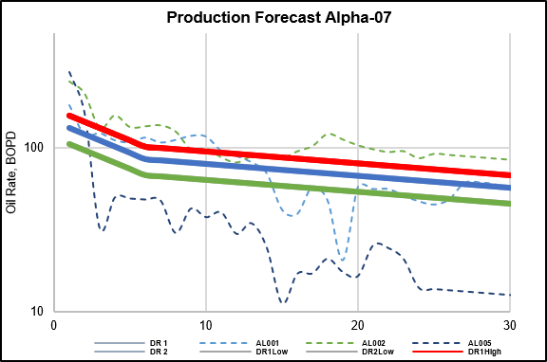
4. EXECUTIVE SANCTION REQUEST
Production forecast
“Management approval is requested for 3 specific actions:
Sanction Alpha-07 execution
Authorize USD 1.96M AFE + contingency
Formally accept the defined risk envelope to proceed to Gate 2.”
ACTION 1
Sanction Execution
Deploy 750 HP land rig | Alpha-07 directional drilling ops
ACTION 2
Authorize AFE Budget
USD 1,779,610 D&C + USD 177,961 contingency (10%)
ACTION 3
Accept Risk Envelope
0 Extreme | 7 High | 17 Medium | 5 Low risks
USD 422,090
Total Tangible Cost
USD 1,357,520
Total Intangible Cost
Description:
Gate 1 approval unlocks the critical path to Q4 2026 spud. LLI procurement (ESP: 16–24 wk, casing: 12+ wk) must begin immediately upon sanction. Delay cascades directly to spud date and first oil. The risk profile is well-understood — no Extreme risks — all High risks carry defined mitigation protocols. Gate 2 will cover detailed engineering, PPFG calibration, well design freeze, and PTD finalization.
EVIDENCE
LLI: ESP (16–24 wks), 7" Casingg ×140 jts, 9-5/8" Casing ×48 jts, 3½" Tbg ×161 jts
Drawdown authority: DSup (≤5%), PM (5–10%), MgtCom (>10%)
Target spud: 1 November 2026 (Gate 1 approval required Q2 2026)
June 2026
July 2026
Regulatory phase
PTD Submission
AMDAL/UKL-UPL
Land Clearance
Aug 2026 : Contracting
Sep – Oct 2026 : SPUD
VBWO submission
Gate 1 Sanction
AFE Authorization
Engineering phase
BOD finalization
Directional Plan
Rig confirmation
Tender launch
PTD Approval
Contract award
Site preparation
LLI delivery
Gate-2 sign off
Pre-Spud meeting
Rig mobilization
BOP testing
SPUD IN
Gate-1

