Slide 1
Virginia Parcels Workgroup
WebEx on Aug 27 started a group of stakeholders that will:
Inventory and compile existing digital parcel datasets
Recommend parcel data standards and best practices
Promote data sharing and incorporate parcel data in the existing clearinghouse
Investigate the potential for a seamless statewide parcel spatial database.

Slide 2
Stakeholders
Local governments
Assessment offices
GIS staff
Private geospatial services providers
Surveyors
State Agencies
Tax, DGS, DEM, DCR, DGIF, DEQ, DOF
Real Estate Industry

Slide 3
Next Steps
Improved inventory and data collection for 2013
Develop and adopt a standard for a core set of parcel attributes (2013-2014)
Create a statewide layer of parcels with attributes translated to the core set (2014)
Incomplete and un-reconciled geometry
Incomplete attributes
In out years move to
Reconciled geometry
Complete set of core attributes

Slide 4
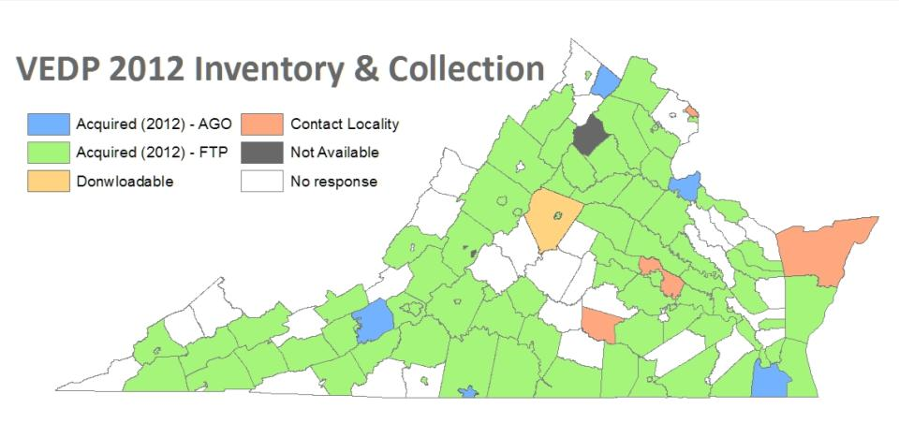
Parcels Inventory
5
4
81
3
1
40

